Slide 1
Report Guidelines
As this course will be using Gradescope to grade reports, the number of slides needs to match with the template that we provide. It is imperative that you provide the answers in the designated space. Please do not change the template or add additional slides. Assignments will not be graded if answers appear in the wrong location.
Each image should be 2MB or lesser before being pasted in the template. This is done to reduce file size and make grading easier.
Questions will be in blue. Please do not remove the questions from the slides.
We expect thoughtful answers that provide clear explanations. Short, one line answers will not receive the full score. Your answers should ideally fit in the space provided.
When you are done, convert your template report to a PDF and then check it to see if it looks okay! Students often end up with lines cut off on slide bottoms. We can only grade what appears in the report.
DELETE THIS SLIDE BEFORE YOU SUBMIT

Slide 2
Computer Vision
Spring 2021
Problem Set #1
Martin Mathew
martin.mathew.2k11@gatech.edu
Computer Vision @ GT

Slide 3
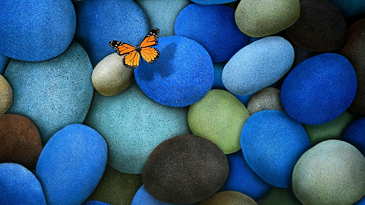
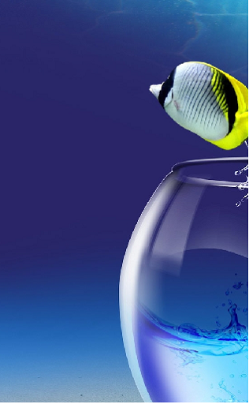
1a: Interesting Images
ps1-1-a-1
ps1-1-a-2
Computer Vision @ GT

Slide 4

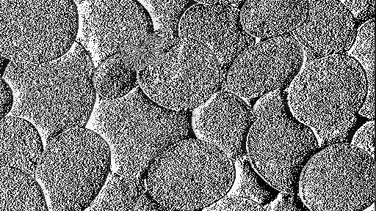
4d: Difference Image
ps1-4-d-1
Computer Vision @ GT

Slide 5
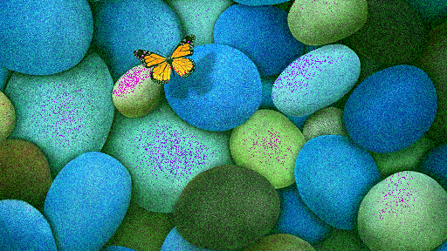
5a: Noisy Green Channel
ps1-5-a-1
Computer Vision @ GT

Slide 6
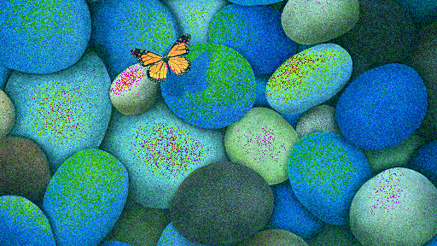
5b: Noisy Blue Channel
ps1-5-b-1
Computer Vision @ GT

Slide 7
6a: Discussion
Between all color channels, which channel, in your opinion, most resembles a grayscale conversion of the original.
Green
Why do you think this?
The formula used by OpenCV for grayscale conversion is
Y = 0.299 R + 0.587 G + 0.114 B
As you can see higher weightage has been given green channel because human eyes are more sensitive to Green color due to which grayscale closely resembles the green monochrome
Does it matter for each respective image? (For this problem, you will have to read a bit on how the eye works/cameras to discover which channel is more prevalent and widely used)
No , the same behaviour would be exhibited because gren channel is given higher weightage when calculating the luminosity for grayscale
Computer Vision @ GT

Slide 8
6b: Discussion
What does it mean when an image has negative pixel values stored?
Why is it important to maintain negative pixel values?
It means the range of intensity has transformed over to a range with
Computer Vision @ GT

Slide 9
6c: Discussion
In question 5, noise was added to the green channel and also to the blue channel. Which looks better to you?
Why?
What sigma was used to detect any discernible difference?
I think
my answer
is ...
Computer Vision @ GT

Slide 10
7a: Hybrid Images
ps1-7-a-1
Computer Vision @ GT

Slide 11
7b: Hybrid Images
Explain how the cut-off frequency impacts the final hybrid image
I think
my answer
is ...
Computer Vision @ GT

