Slide 1

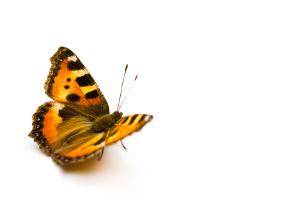
Vincent Blondeau
Test Sucker
How to Convert Real Production Objects to Automated Test Cases?

Slide 2
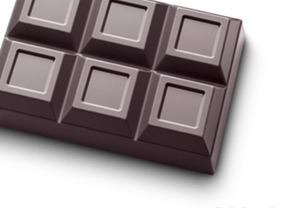
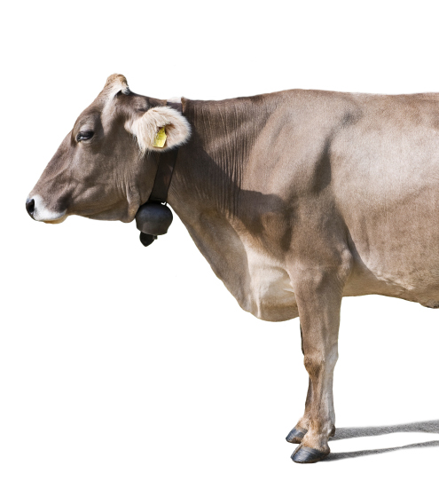
A SWISS COMPANY
21
5
60
4
Years old
Founders are top management
Employees with strong methodology
Redundant datacenters

Slide 3
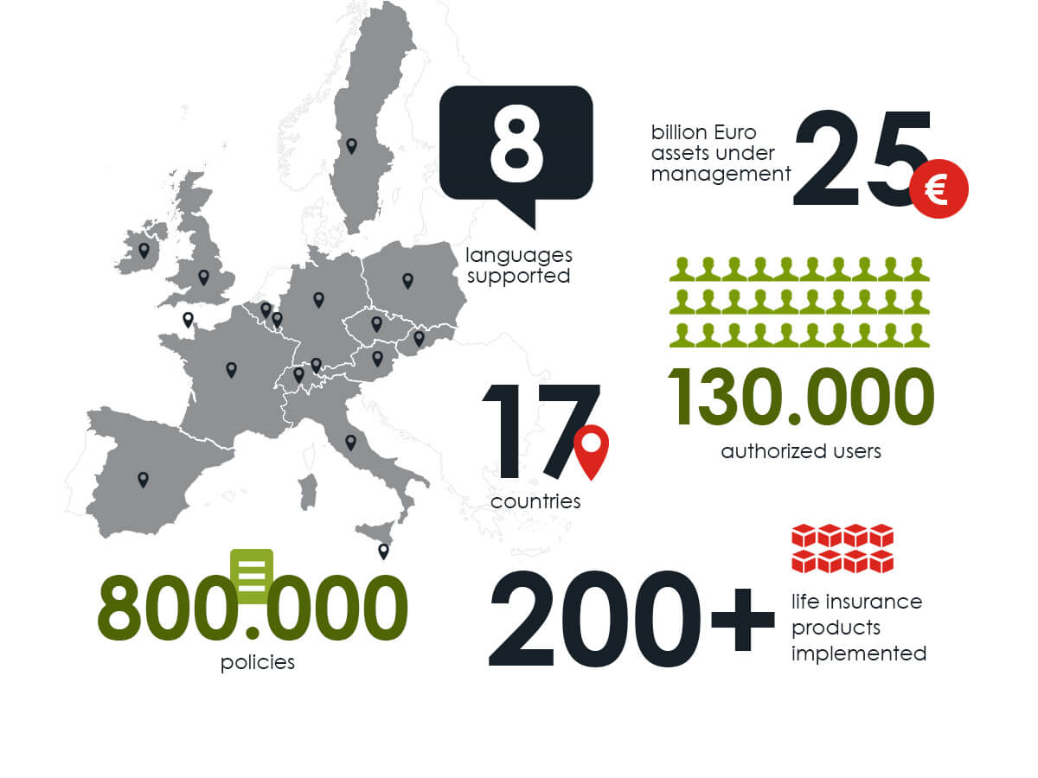

Slide 4




CORE TECHNOLOGY
Development
Production

Slide 5
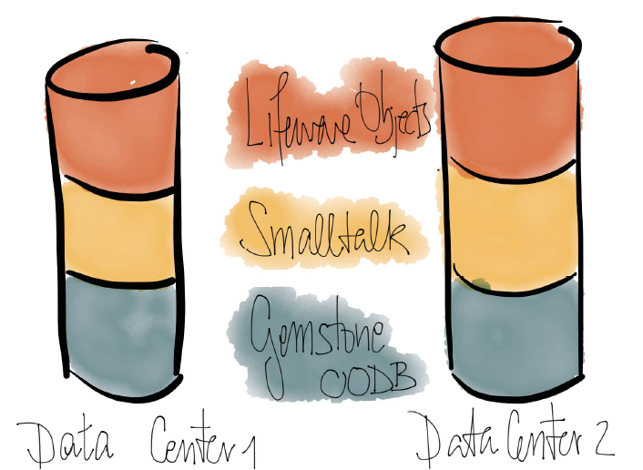
OBJECTS ALL OVER
70 000
Classes
1 500 000
Methods
3 TB
Persisted objects

Slide 6
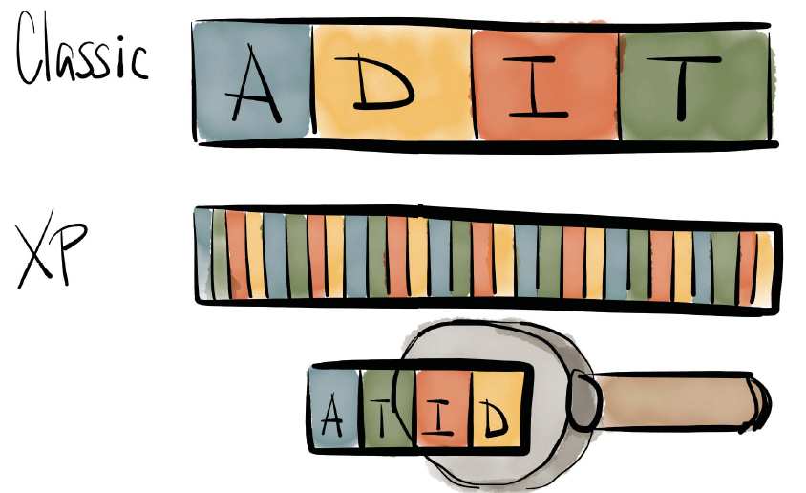
EXTREME EFFICIENCY
Notes:
Analyze testing implementation design

Slide 7

AUTOMATIC TESTING
Lifeware automated testing infrastructure
95 000
60
320
Σ
tests in the code base
times a day all tests run
processors sustain our test environment
coverage informs about untested code
Notes:
Continuous testing

Slide 8
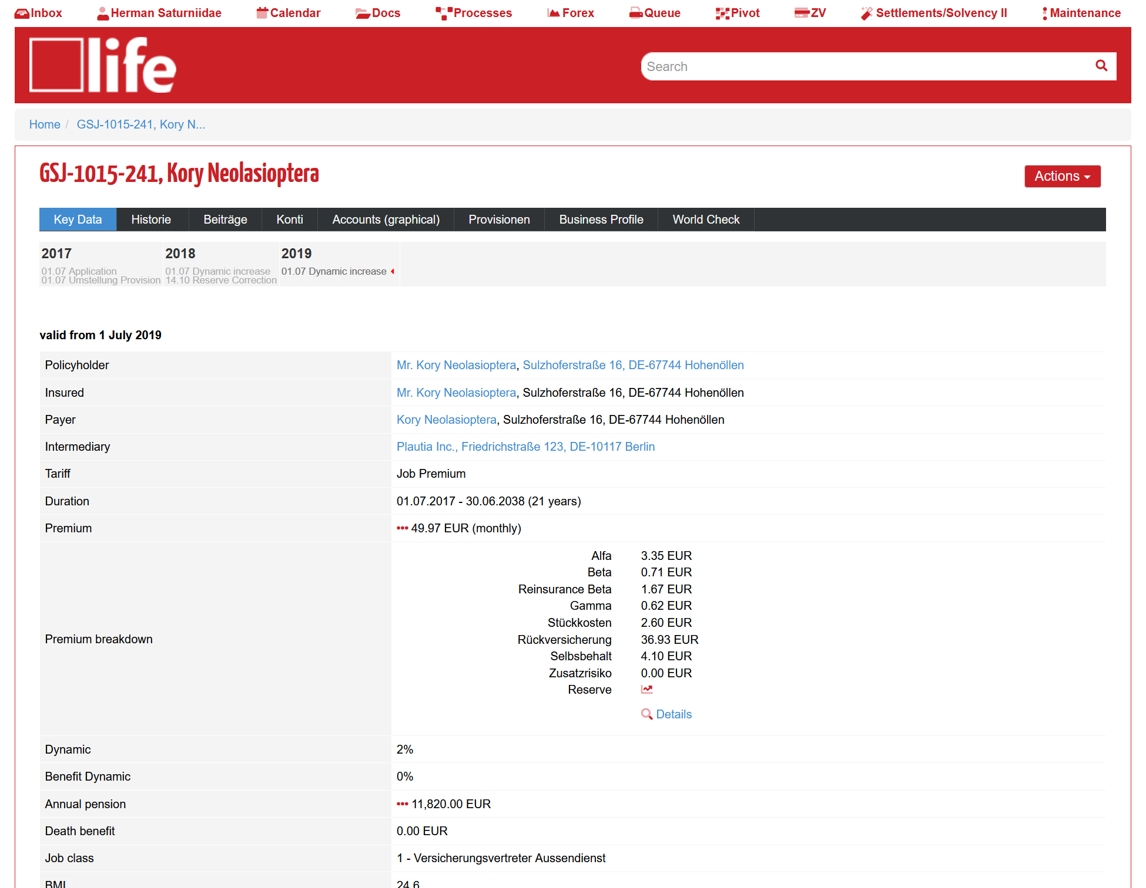
CONTRACT CENTRIC SYSTEM
Notes:
Our system can show:
Key Data
History
Investments
Accounts
Accounts relations
Commissions
Business Profile
Compliance Check

Slide 9
DEMO

Slide 10
OR BACKUP SLIDES…

Slide 11
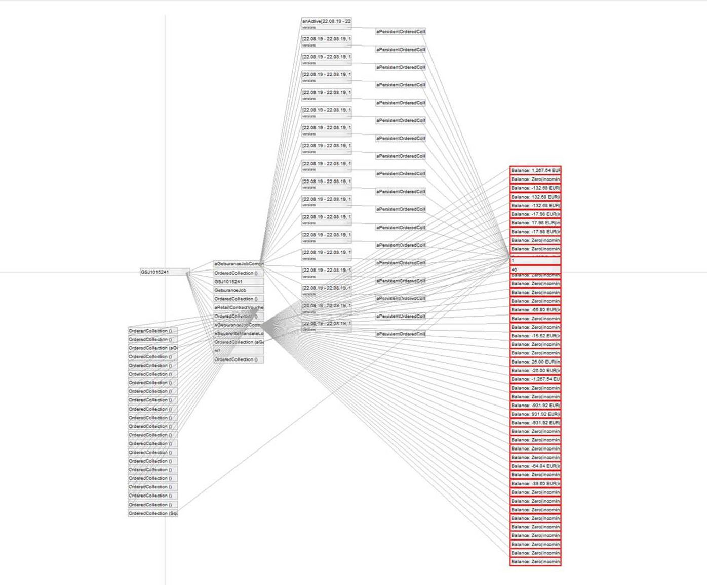
CONTRACT CENTRIC SYSTEM

Slide 12
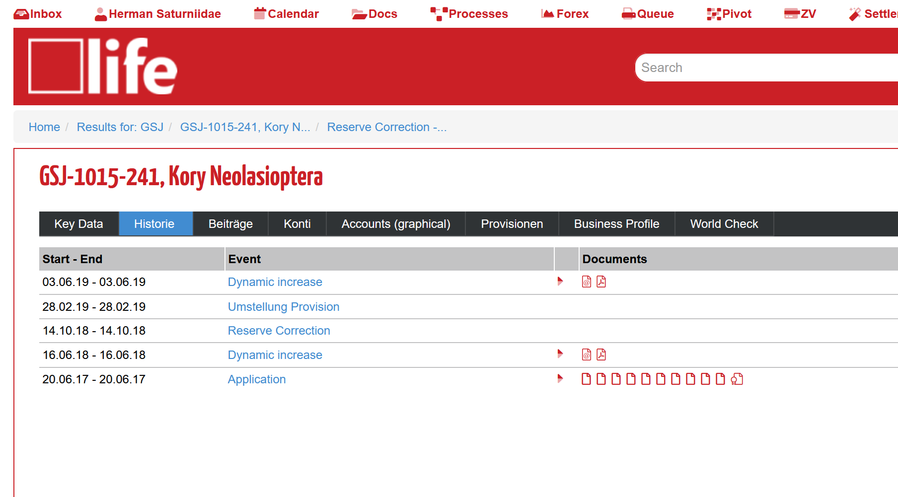
CONTRACT TOOLS

Slide 13
CONTRACT TOOLS

Slide 14
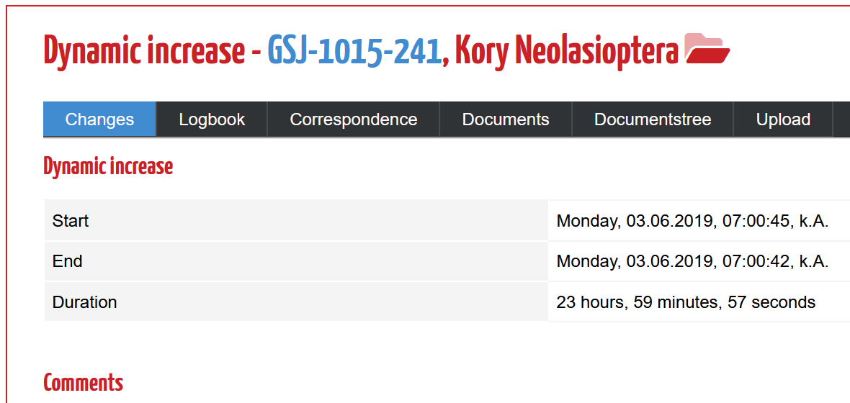
CONTRACT TOOL

Slide 15
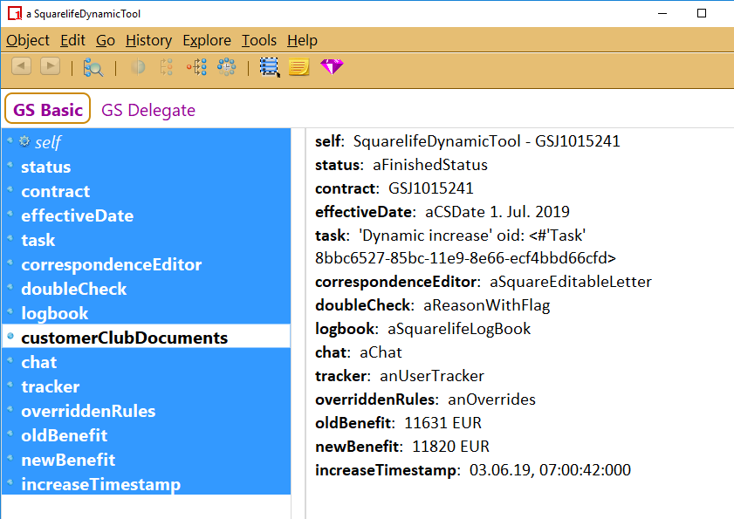
CONTRACT TOOL

Slide 16
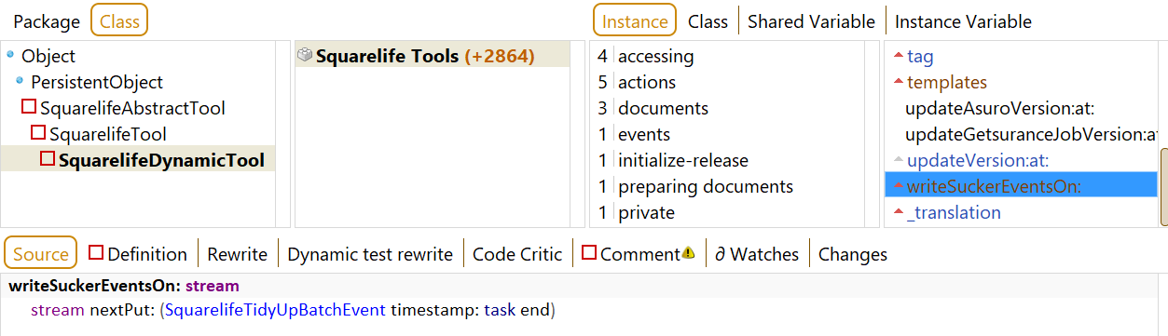
TEST SUCKER METHODS

Slide 17
TEST SUCKER METHODS

Slide 18
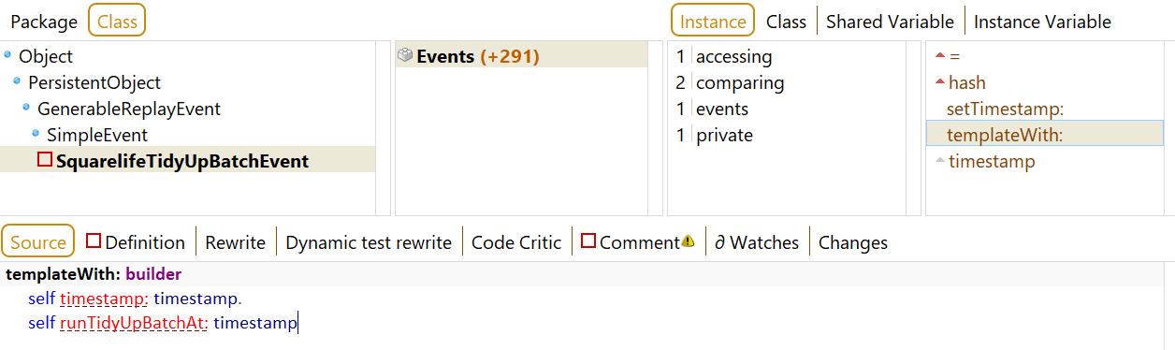
TEST SUCKER METHODS

Slide 19
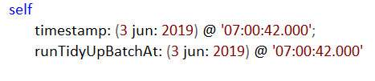
CONVERSION TO TEST
Inlining refactorings - Variables - Methods

Slide 20
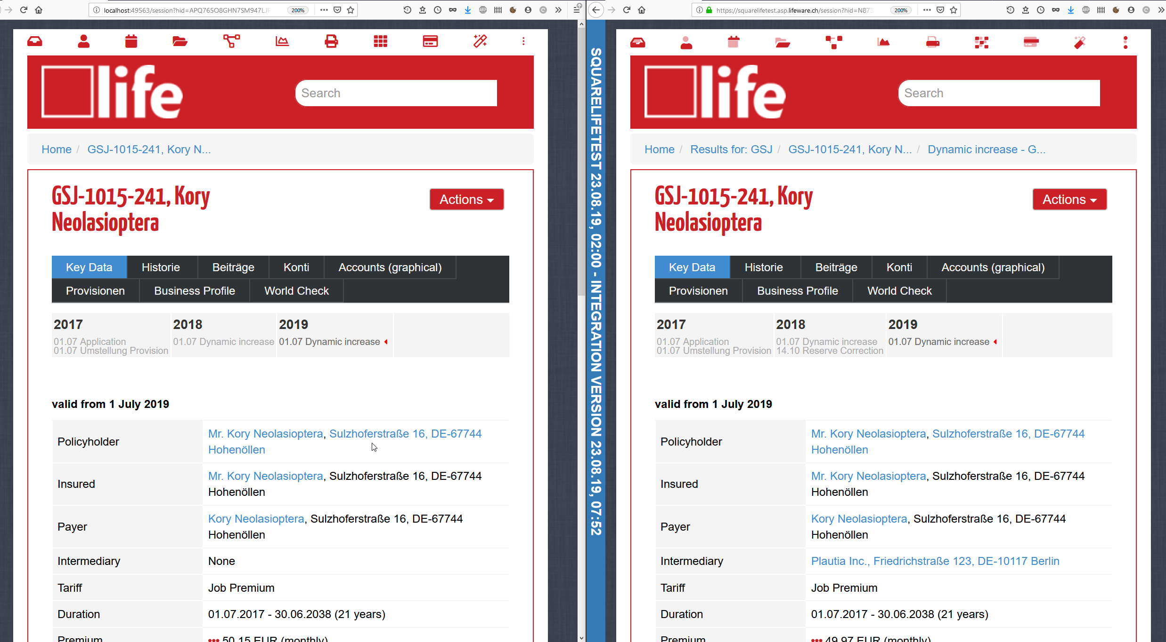
TEST SUCKED
Development
Production

Slide 21
END OF DEMO BACKUP SLIDES

Slide 22
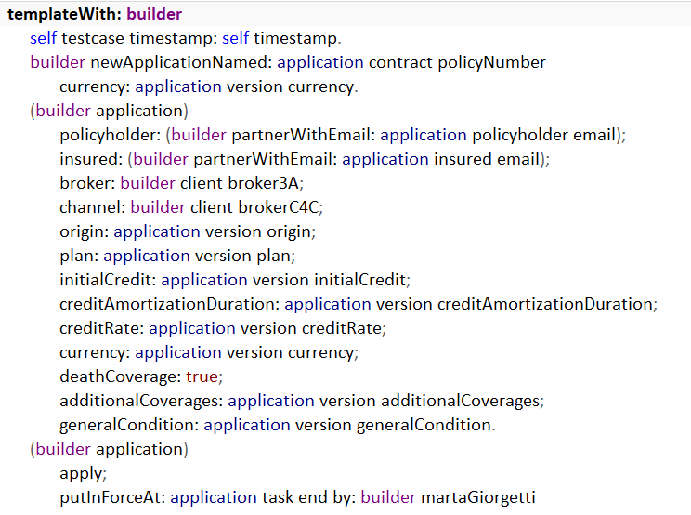
LIMITATIONS
Test sucker
does not handle manual changes
has to be implemented for each tool
may become tedious

Slide 23
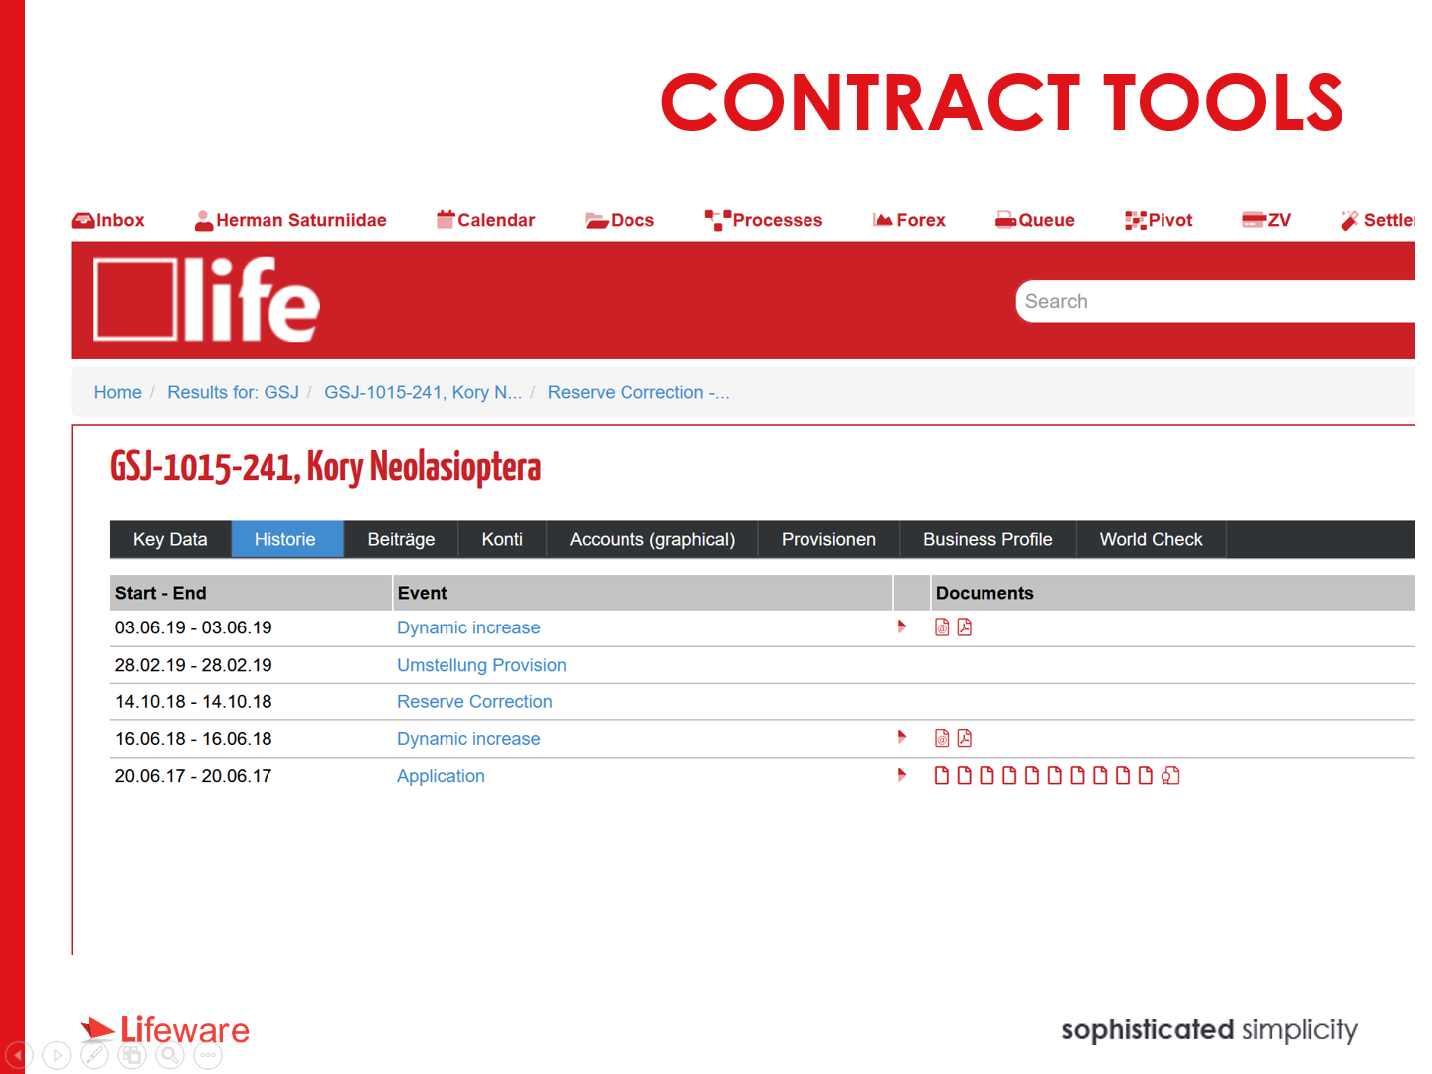
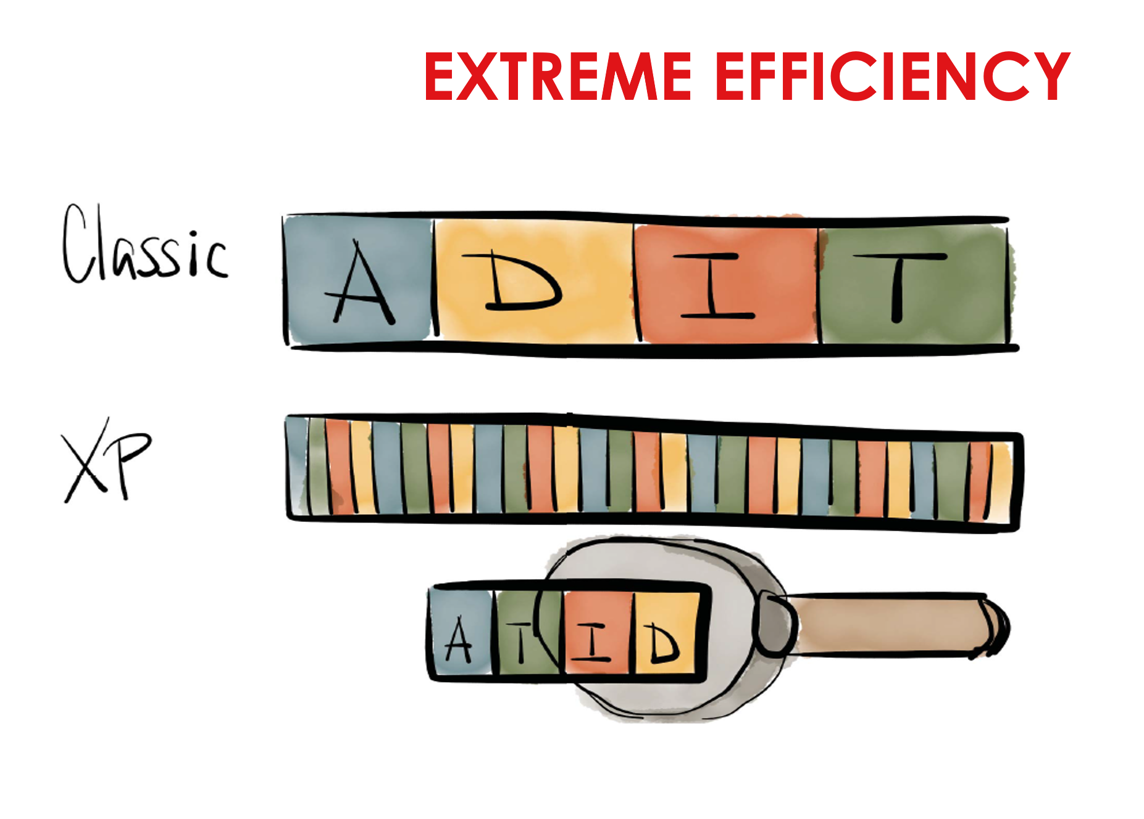
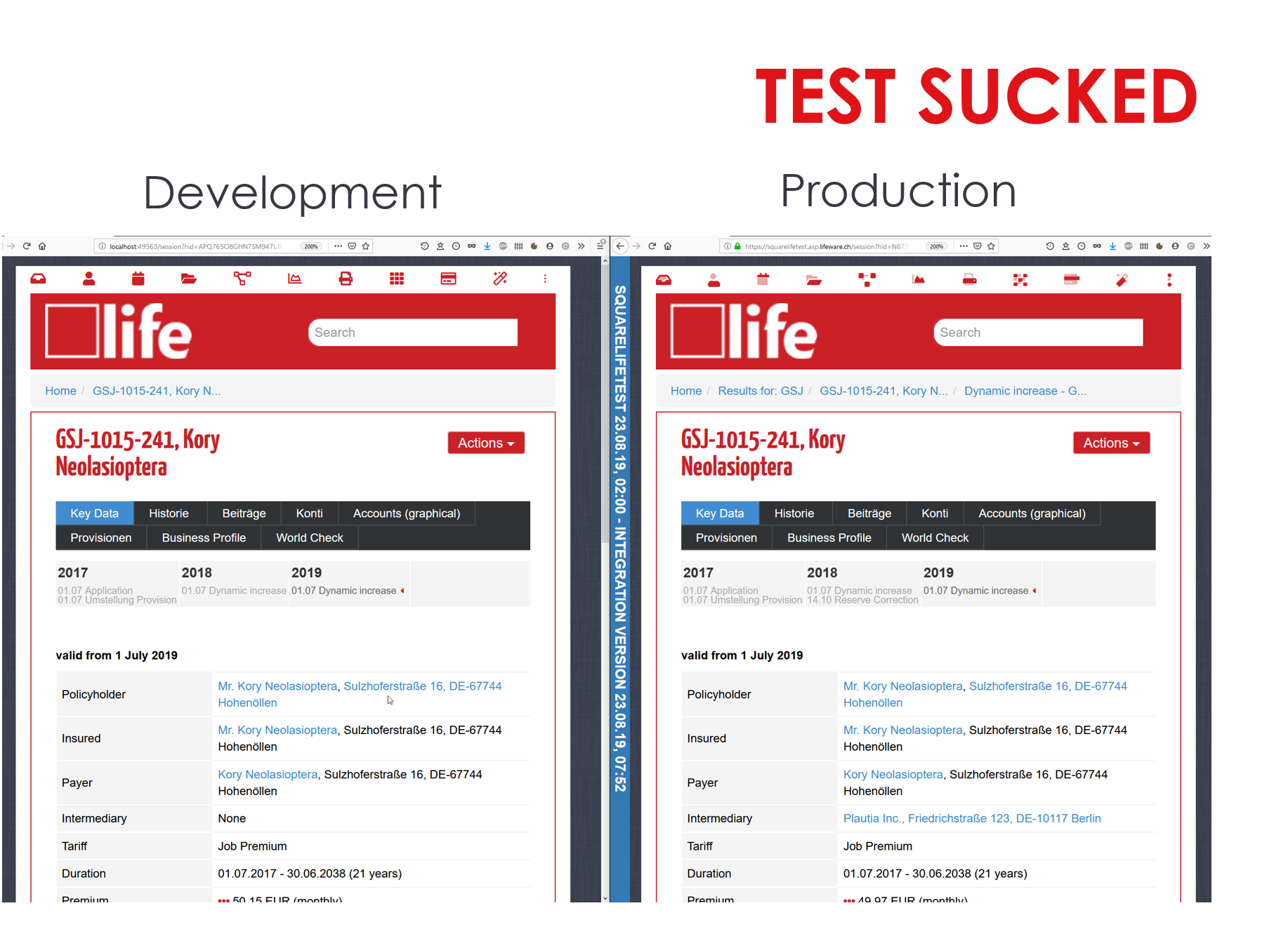
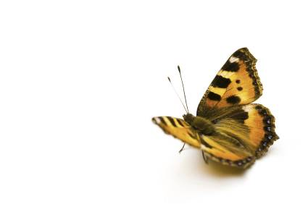
lifeware.ch
info@lifeware.ch

Slide 24



We are looking for innovative problem solvers!
Join us to
Solve real world problems
Design innovative solutions
Transition to Pharo
Luxembourg
Switzerland
hresource@lifeware.ch

