Slide 1


Live Typing Automatic Type Annotation that improves the Programming eXperience
Hernán A. Wilkinson - @hernanwilkinson
10Pines founder – Professor at UBA
agile software development & services

Slide 2
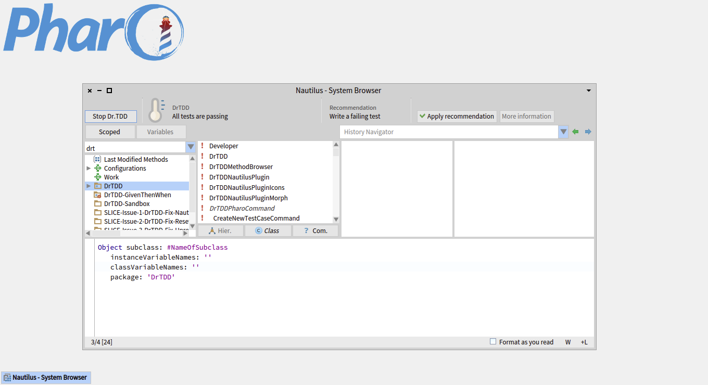
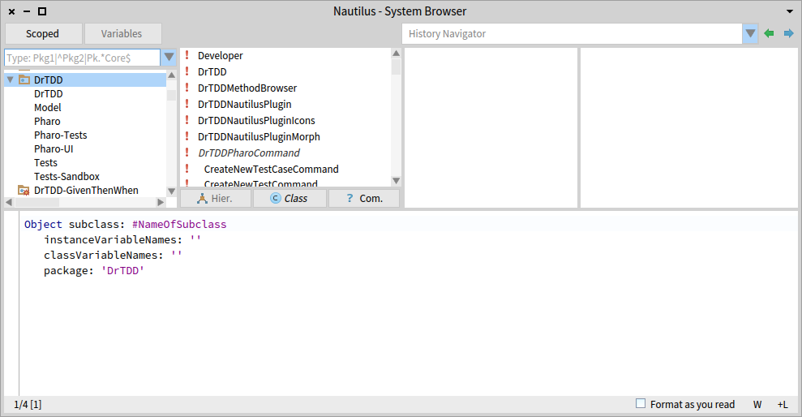
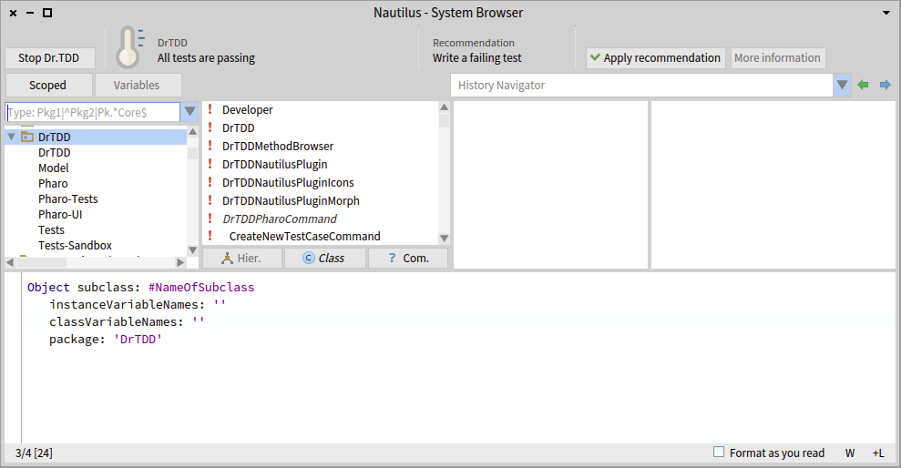

“Wilklippy”

Slide 3
Live Typing Automatic Type Annotation that improves the Programming eXperience
Hernán A. Wilkinson - @hernanwilkinson
10Pines founder – Professor at UBA
agile software development & services

Slide 4
Is Smalltalk Cool??

Slide 5
YEAH! Of Course!

Slide 6
Why?

Slide 7
Because it is Dynamically Typed

Slide 8
Because it is a Live Environment

Slide 9
But …

Slide 10
Looking for senders is done statically!!
we get more senders than the real ones we need to manually filter them

Slide 11
Looking for implementors is done statically!! we get more implementors than the real ones we need to manually filter them

Slide 12
Renaming a message is done statically!! we get more senders and implementors than the real ones we need to manually filter them

Slide 13
Autocomplete in the browser is done statically we get don’t get the real messages an object understands

Slide 14
and so on…

Slide 15
But Smalltalk is Cool!!

Slide 16
Because it is Dynamically Typed

Slide 17
Because it is a Live Environment

Slide 18
But …

Slide 19

But …
How can we get rid of this “but”?
Aren’t you tired of these problems?

Slide 20
I’m tired of all those problems It’s time to act!

Slide 21
What if we combine Dynamically Typed + Live Environment to get Automatic Type Annotation and improve the tools with that info?

Slide 22
What is Live Typing?

Slide 23
Live Typing
Automatic type annotation (done by the VM)
+
Tools to improve the development experience
(Annotation happens while the system runs)

Slide 24
It is not a new idea…

Slide 25
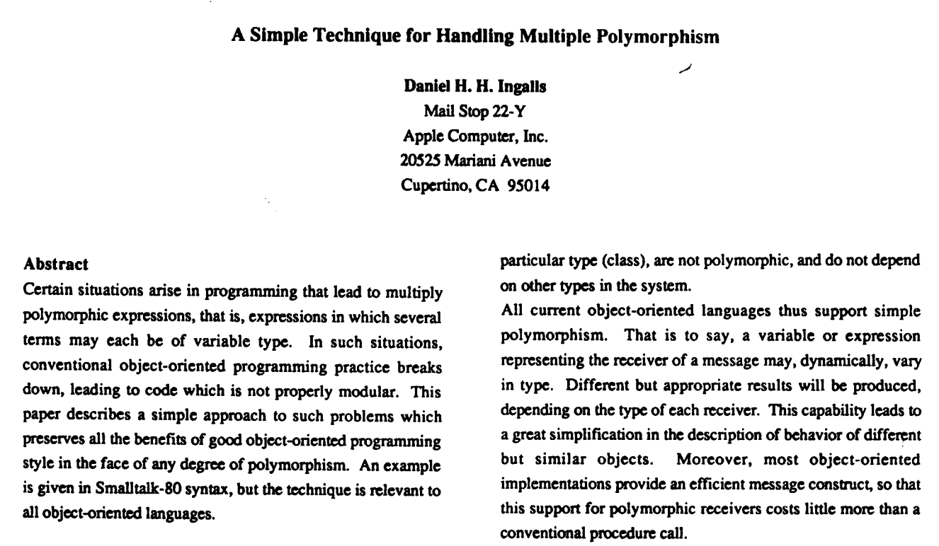
Since 1986!

Slide 26
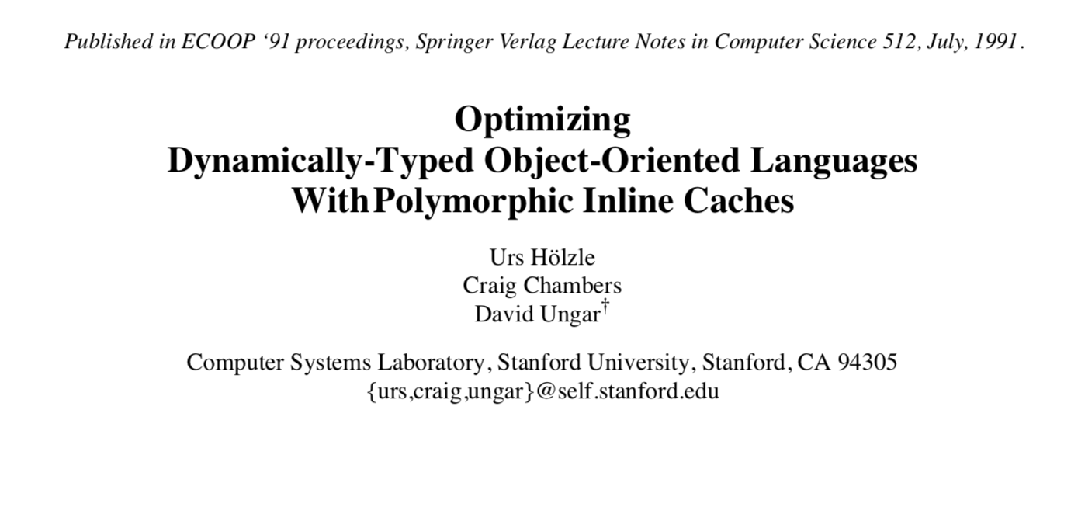

Slide 27
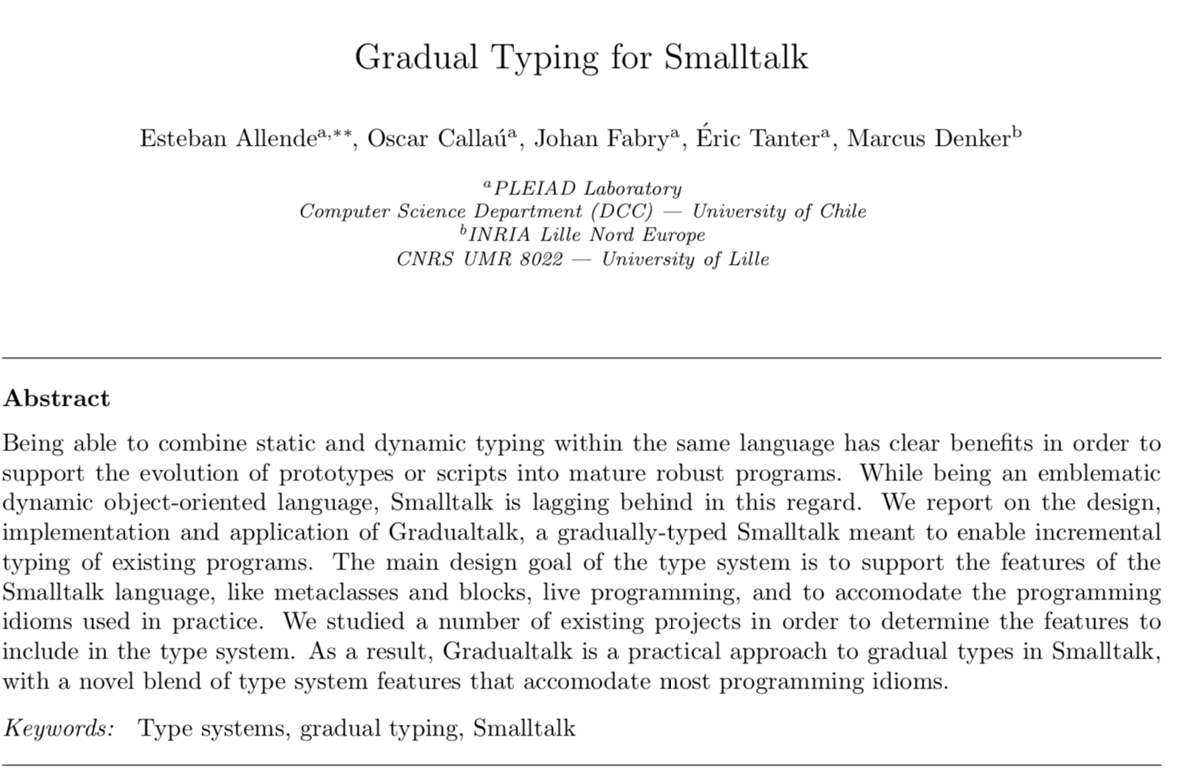

Slide 28
It is not a new idea but… It is a particular one with a working implementation

Slide 29
Live Typing is not about type checking in the “classic way”

Slide 30
Tools Examples

Slide 31
TicTacToe

Slide 32
Showing/Managing Types

Slide 33
Autocompletion

Slide 34
DynamicType (SelfType, ClassType, InstanceType) Thank you Jan Vrany & Marcus Denker

Slide 35
Actual Implementors (“a much better use of the human brain”-Tudor et al ☺)

Slide 36
Actual Senders Sure and Possible (Per Message Send analysis)

Slide 37
Refactorings with Actual Scope

Slide 38
Type Checker (we know for sure when nil is assigned!)

Slide 39
Conclusion

Slide 40
With no extra effort, we were able to get rid off of most of the disadvantages (you don’t have to maintain the types, it does not interfere when reading code, etc.)

Slide 41
Bret Victor: ‘we are used to play computers’ Unknow Smalltalker: ‘we are used to play memory type games’

Slide 42
Live Typing makes types explicit to you, you do not have to remember or infer them

Slide 43
It is a very simple technique that heavily improves the programming experience

Slide 44
feenk: When you start using it, you don’t want to loose it

Slide 45
It does not change the syntax It does not stop you from compiling It does not force you to use it Types are not in the source code

Slide 46
I humbly believe it respects and honors the Smalltalk spirit

Slide 47
My Goal?

Slide 48
To say that Smalltalk is not Dynamically Typed anymore, but Lively Typed (you func…. guys want types? You have types for free!)

Slide 49
The implementation has bigger challenges than in a Statically Typed Language

Slide 50
Statistics

Slide 51
Performance
 | Typed VM | Stack VM | Difference
Aconcagua Tests | 37 ms | 22 ms | 1.6 x
Chalten Tests | 2400 ms | 2204 ms | 1.08 x
Refactoring Tests | 56382 ms | 39650 ms | 1.42 x
TicTacToe Tests | 3 ms | 2 ms | 1.5 x
Some Kernel Tests | 220 ms | 151 ms | 1.45 x
Average |  |  | 1.41 x
The important thing is that you do not notice it when you are programming

Slide 52
Memory
Live Typing Image* | Common Image | Difference
22 MB | 10 MB | 2.2 x
(*) Default configuration
All type arrays size equals 10
Instance Variables Usage: 8.8%
Method Variables Usage: 8.4%
Method Return Usage: 8.02%

Slide 53
Future Work

Slide 54
In the VM side
Annotate types in closure parameters and variables (under development)
Support for Parameterized types (Generics) is needed for collections, association, etc. (Collection<T>, Association<K,V>, etc.) (under development)
Implement it on the JIT VM (Currently it is implemented on the Stack VM) (under development – need a lot of help!!)
To think about:
Change the COMPILER (not the VM) to generate and initialize the PIC at compile time!!

Slide 55
In the Image side
Support for Parameterized types (on development)
Add more type cast cases in the Type Checker
Check for parameter types (Freeze annotated types before)
Use Type Checker infrastructure to improve even more the autocomplete
Import type info from production images to development images
Things to try/think about:
Improve Type Checker to warn about dead code
Check for soundness in parameters and method returns
Delete method with transitive closure of actual sends in that method

Slide 56
Thanks! @HernanWilkinson – hernan.wilkinson@10pines.com – www.10pines.com

