Slide 1
Chitter Prototype Presentation
By
Martin Micunda & Chris Laughlin

Slide 2
Overview
Client Side & Server Side
System Architecture Overview
Task Manager
Testing
Continuous Integration
Browser Support
Hosting
Demo
Conclusion
Questions

Slide 3




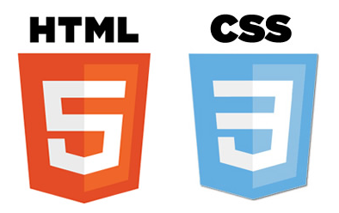







Slide 4
Client Side
MVW (Model-View-Whatever)
Data Binding and Dependency Injection
Declarative user interface
REST Easy
Enterprise-level Testing (Unit & E2E)
It’s developed and supported by Google

Slide 5
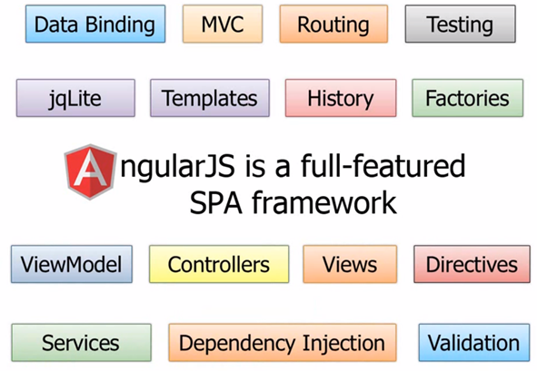
Client Side
The AngularJS stack

Slide 6
Client Side
JS library aimed to manage data in rich client application
Rich queries (query the server and client cache with filters, ordering, paging, and projections)
Execute query asynchronously with promise
Well documented + has roadmap

Slide 7
Client Side
Query example:
var query = breeze.EntityQuery
.from("Customers")
.where("CompanyName", "startsWith", "A")
.orderBy("CompanyName");
BMEAN stack app example:
http://www.breezejs.com/samples/zza

Slide 8
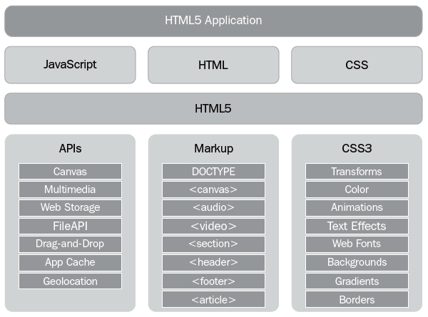
Client Side

Slide 9
Client Side
Responsive design
Rapid web development
Well documented (easy to work with for developers without the CSS skills)

Slide 10
Client Side
CSS preprocessors contain variables, functions, "mixins", and other features
DRY as in “Don't repeat yourself”
Less vs Sass vs Stylus http://www.slideshare.net/patricka1/css-preprocessors-sass-less-and-stylus

Slide 11

Server Side
Server-side document-oriented database
Flexible database schema
Speed and durability (scaling)
JSON format
Replication
Secondary indexes
Sharding

Slide 12
Server Side
Server-side platform for web applications
Web development in a dynamic language (JavaScript) on a VM that is incredibly fast (V8)
Ability to handle thousands of concurrent connections with minimal overhead on a single process.
Client and Server side use same language

Slide 13
Server Side
Server-side web application framework for node
It help organize web app into MVC architecture on the server side.

Slide 14
Server Side
MongoDB object modeling for Node.js

Slide 15
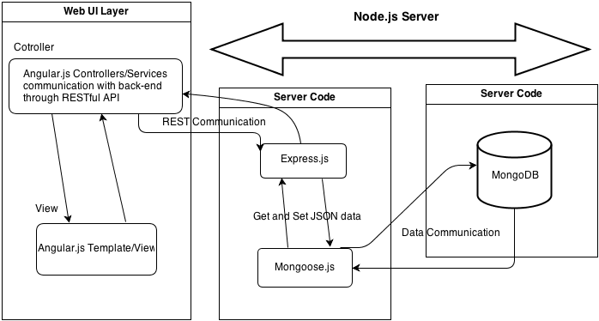
System Architecture Overview

Slide 16
Task Manager
Grunt:
The JavaScript Task Runner that is used to build, preview and test project.
Bower:
Package manager for the web. Is used for dependency management, so that you no longer have to manually download and manage your scripts.

Slide 17
Testing (BDD and TDD)
AngularJS
Unit testing and E2E testing (Karma runner)
NodeJS
Jasmine or Mocha
Selenium (+ PhantomJS)
Automation testing

Slide 18
Continuous Integration
TeamCity has a lot of powerful features
Our prototype use Travis CI (not that powerful as TeamCity but well integrated with GitHub)

Slide 19
Browser Support
Main latest browser (Chrome, Firefox, IE10+)

Slide 20
Hosting
Chitter and Teamcity should be hosting on our servers to give us practical experience with deployments and maintenance of chitter app

Slide 21

Socket.io
Socket.IO aims to make realtime apps possible in every browser and mobile device, blurring the differences between the different transport mechanisms. It's care-free realtime 100% in JavaScript.
We can consider this

Slide 22
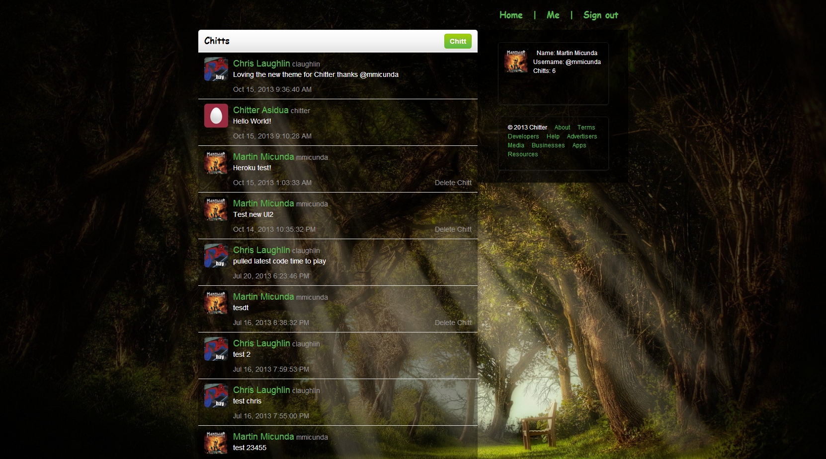
Demo

Slide 23
Conclusion
Our prototype follow all project and development principles
We suggest all technologies as package because these technologies working very well together
Presentation can be found here “https://github.com/martinmicunda/chitter-prototype/tree/master/resources/presentation”

Slide 24

Questions

