Slide 1
Adolescent mental health and food insecurity as relative deprivation
- Evidence from PISA 2022
Eszter Timár
eszter.timar@stud.uni-corvinus.hu
Corvinus University of Budapest

Slide 2
Outline
Background and theory
Data and methodology
Results
Discussion and implications

Slide 3
Background
Food insecurity = lack of consistent access to sufficient, safe, and nutritious food to meet their dietary needs and preferences
Persists globally, affects 8-20% of the population in HICS (Pollard & Booth, 2019)
Much evidence on food and physical health
Some emerging evidence on food and mental well-being
Food insecurity affects mental health independently of poverty and hunger through psychological and social stressors (Jessiman-Perrealt & McIntyre, 2017)
Gap: single countries and narrow groups (with HIV/AIDS (Ayano et al., 2020), pregnant women (Mokona et al., 2020) or only adults (Frongillo et al., 2017; Elgar et al., 2021)

Slide 4
Background: relative deprivation theory
Absolute deprivation
The inability to afford one’s basic physical needs, such as sufficient food
Relative deprivation
A social phenomenon - the inability to afford goods and services and participate in social activities deemed adequate in one’s reference group
(Townsend, 1971; Bourgignon, 1999; Sen, 1983; Ravallion, 1992)
Elgar et al. (2021) argues that food fulfils an important social role and finds empirical evidence that the effects of food security on mental health are more pronounced where it is less common
But only looking at country-level prevalence of food insecurity among adults
Notes:
Absolute deprivation refers to the inability to meet one’s basic needs – relative deprivation is a social phenomenon

Slide 5
Background
Over USD 35.3 billion spent on school meals in 2021 globally¹
Positive ROR achieved through physical health, improved learning, and local economy multipliers (Verguet et al., 2020)
Returns underestimated?
1: own calculations based on the Global Survey of School Meals Programs

Slide 6
Contributions
Contribute to the scarce evidence base on food insecurity and mental health (children and adolescents)
Pursue the theory of food insecurity as relative deprivation by including immediate reference groups and two hypothetical pathways:
2.a. ‘Peer effects’ (association of mental health with prevalence of food insecurity in the reference groups)
2.b. ‘Relative deprivation effects’ (interaction between individual and contextual food insecurity)
Notes:
We know that people are more aware of the living standards of their immediate reference groups
If food insecurity has a relative dimension, thanks to the social and cultural role of food, then one should test its effects with narrower reference groups – with whom individuals are confronted daily

Slide 7
Data
OECD’s Programme for International Student Assessment (PISA)
Collected in 2022
12 countries (SWB Questionnaire): Brazil, Hong Kong, Hungary, Ireland, Macao, Mexico, Netherlands, New Zealand, Panama, Saudi Arabia, Slovenia, UAE
98,435 observations representing 5,295,666 15-year-old students
Hierarchical structure: students nested in schools

Slide 8
Key variables
Depression
Binary variable capturing whether the respondent has experienced depression in the past 6 months
Anxiety
Binary variable capturing whether the respondent has experienced anxiety in the past 6 months
Food insecurity (individual)
Binary variable capturing whether the respondent has gone hungry in the past 6 months due to a lack of food
Food insecurity (group)
% of students in the school who have experienced food insecurity
Cross-level interaction term
Individual food insecurity * group-level food insecurity
+ controls known to be associated with mental health and food insecurity (socio-demographics, SES etc.)

Slide 9
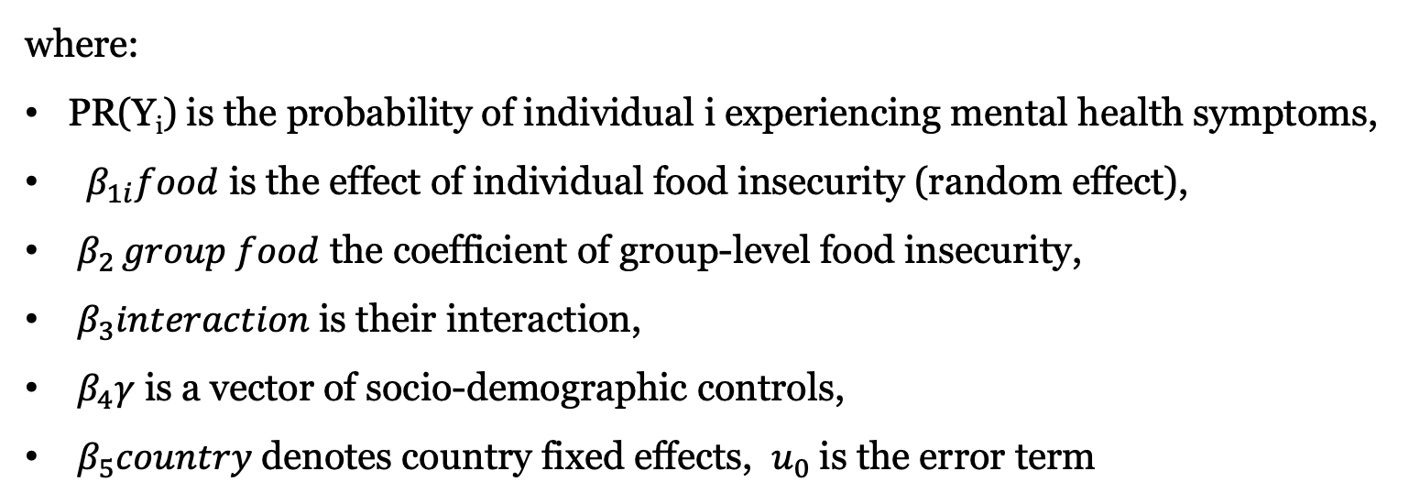
Analytical approach
Linear probability models (multilevel, using Stata’s xtmixed command)
$${PR( Y)}_{i}= α+ β_{1}{food}_{ij} + β_{2 }{group food}_{i}+β_{3}{interaction}_{i}+β_{4}γ_{i}+ β_{5}{country+u}_{0}$$
where:
PR(Y_{i}) is the probability of individual i experiencing mental health symptoms,
$β_{1i}food$ is the effect of individual food insecurity (random effect),
$β_{2 }group food$ the coefficient of group-level food insecurity,
$β_{3}interaction$is their interaction,
$β_{4}γ$ is a vector of socio-demographic controls,
$β_{5}country$denotes country fixed effects, $u_{0}$is the error term

Slide 10
Limitations
Food security variable does not capture intensity
Cannot construct a measure to capture the depth of relative deprivation (Elgar et al., 2021 construct a downward-looking Yitzhaki-index)
Low number of PISA countries administered the WBQ survey
Missing values: loss of 15% of observations
No data on policies that affect food insecurity and/or mental health (e.g., school meals, counselling)

Slide 11
Descriptive statistics
 | Experienced depression | Experienced anxiety
Food insecure | 64.9% (0.002) | 68.62% (0.048)
Not food insecure | 48.52% (0.005) | 62.17% (0.018)
Difference | -16.37% | -6.45%
t-statistic | -29.226*** | -12.194***
Source: own calculations using PISA 2022. *p<0.10; **p<0.05; ***p<0.001.
11.9% food insecure
Ranging from 2.7% in NL to 20.1% in Panama

Slide 12
Results: Depression
 |  | Depression
Model: | (1) | (2) | (3) | (4)
Food insecurity | 0.190*** (0.013) | 0.142*** (0.008) | 0.139*** (0.008) | 0.173*** (0.013)
School-level food insecurity |  |  | 0.090* (0.036) | 0.132*** (0.039)
Cross-level interaction |  |  |  | -0.213*** (0.061)
Medium SES |  | -0.043** | -0.043** | -0.043**
 |  | (0.13) | (0.13) | (0.13)
High SES |  | -0.083*** | -0.083*** | -0.083***
 |  | (0.12) | (0.12) | (0.12)
Country FE | No | Yes | Yes | Yes
Controls | No | Yes | Yes | Yes
ICC | 0.116 | 0.124 | 0.124 | 0.123
N (obs.) | 68,885 | 68,885 | 68,885 | 68,885
N (schools) | 2,997 | 2,997 | 2,997 | 2,997
Note: controls incl. sex, highest level of parental education, migration background of parents, number of siblings, subjective socioeconomic status, the location (village/town/city) and type (public/private) of the school. Full output reported in the annex.
*p<0.10; **p<0.05; ***p<0.001.
Notes:
Food insecurity is a significant predictor of depression (incl. when controlling for SES -- not poverty)
Limited evidence for peer effects
Cross-level interaction appears prominent:
Significant and negative
The higher the school-level prevalence, the lower the coefficient of individual food insecurity

Slide 13
Results: Anxiety
 |  | Anxiety
Model: | (5) | (6) | (7) | (8)
Food insecurity | 0.119*** (0.004) | 0.079*** (0.007) | 0.078*** (0.007) | 0.066*** (0.012)
School-level food insecurity |  |  | 0.023 (0.040) | 0.004 (0.043)
Cross-level interaction |  |  |  | 0.078 (0.058)
Medium SES |  | -0.018 | -0.018 | -0.018
 |  | (0.012) | (0.012) | (0.012)
High SES |  | -0.053*** | -0.053*** | -0.053***
 |  | (0.012) | (0.012) | (0.012)
Country FE | No | Yes | Yes | Yes
Controls | No | Yes | Yes | Yes
ICC | 0.144 | 0.156 | 0.156 | 0.156
N (obs.) | 71,005 | 71,005 | 71,005 | 71,005
N (schools) | 3,354 | 3,354 | 3,354 | 3,354
Note: controls incl. sex, highest level of parental education, migration background of parents, number of siblings, subjective socioeconomic status, the location (village/town/city) and type (public/private) of the school. Full output reported in the annex.
*p<0.10; **p<0.05; ***p<0.001.
Notes:
Food insecurity is a significant predictor of anxiety – but magnitude of association is smaller than for depression
Coefficient drops substantially when incorporating controls
No evidence for peer effects
No evidence for relative deprivation effects

Slide 14
Robustness tests
Marginal Effects at the Mean
Logistic regressions with clustered SE, sample split by group-level prevalence of food insecurity
 | Depression |  | Anxiety
 | Model (7) High prevalence | Model (8) Low prevalence | Model (9) High prevalence | Model (10) Low prevalence
Food insecurity (individual) | 0.122*** (0.003) | 0.226*** (0.029) | 0.123*** (0.028) | 0.140*** (0.022)
Controls | Yes | Yes | Yes | Yes
Country FE | Yes | Yes | Yes | Yes
N | 10,972 | 32,766 | 11,791 | 33,426

Slide 15
Discussion and conclusions
Among adolescents, food security is associated with poor mental health
Association runs independently from poverty → support Jessiman-Perreault and McIntyre’s (2017) proposition of psychological stressors
Evidence of significant peer effects of food insecurity on depression (but not anxiety)
Consistent with proposition by Elgar et al. (2021) on food insecurity as a form of relative deprivation

Slide 16
Implications for research and policy
Food insecurity remains a problem for adolescents in affluent nations
Deserves attention even in contexts where its overall prevalence is low
”Leaving no one behind”
Policies to combat food insecurity (e.g., school meals) are also policies that promote mental health
Check heterogeneity of peer- and relative deprivation effects across contexts

Slide 17
eszter.timar@stud.uni-corvinus.hu

Slide 18
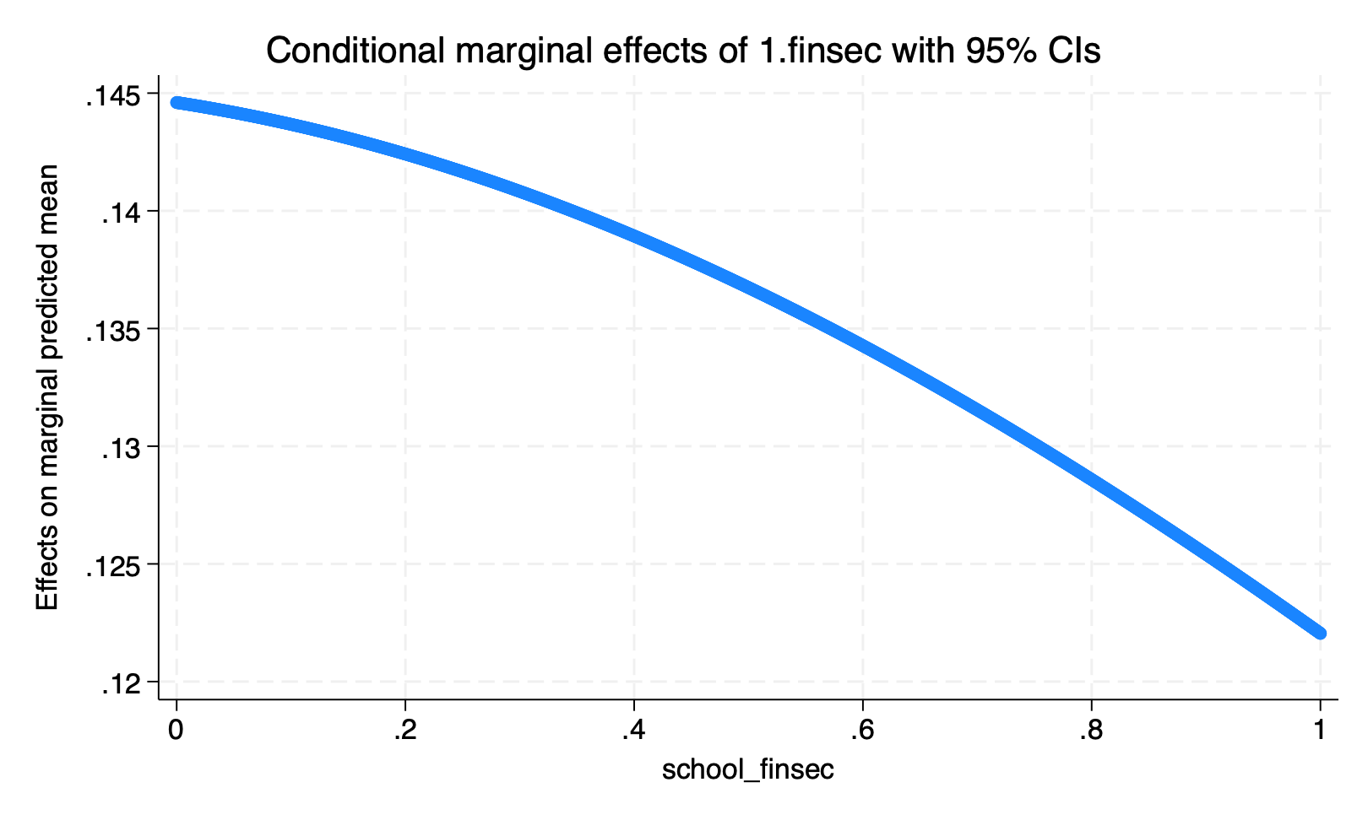
Robustness tests
Marginal effects of food insecurity on mental health, conditional on group-level prevalence of food insecurity (= ‘relative deprivation effects’)
Depression
Anxiety
Obtained using multi-level logistic regression models with socio—demographic controls, school-level random effects and country fixed effects
Notes:
Omitted SE because it took too long

