Slide 1
House price prediction (King County, Washington, USA)
Martino De Nardi, Damiano Clementel

Slide 2
Goals
Lineup
Data cleaning/filtering
EDA
Model(s)
Interpretation
Technical explanation
Find the most important features to determine house prices
Find the best model to predict new data

Slide 3
Dataset
House sale prices in King County, Washington (USA)
Houses sold between May, 2014 and May, 2015
21613 observations x 20 features (+ target price)
Feature description
id:
Date: date house was sold
price:
bedrooms:
bathrooms:
sqft_living:
Sqft_lot:
Floors:

Slide 4
waterfront:
view:
condition:
grade:
sqft_above:
sqft_basement:
yr_built:
yr_renovated:
zipcode:
lat:
long:
sqft_living15:
sqft_lot15:

Slide 5
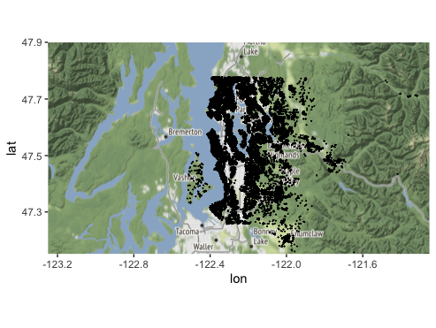
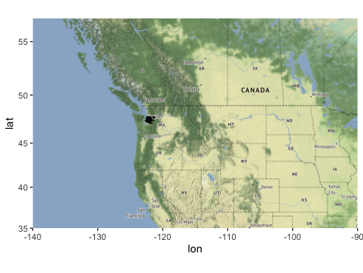
Geographic location

Slide 6
Data cleaning/filtering
After a couple of checks, some issues were found in the dataset:
sqft_basement
Problem: This feature turns out to be exactly the difference between sqft_living and sqft_above, so it makes no sense (and it would be an error) to keep it in the data.
Solution: we deleted the feature from the dataset.
INSERIRE SCREEN

Slide 7
Duplicated ID
Problem: an id is directly associated to a house and its features values; so, if a house has been sold twice, there can be two rows with identical values except for the price and the date. We are more interested in the latest value that was assigned to it. The duplicated rows are less than 1% w.r.t. the total number of observation.
Solution: we only keep the data related to most recent sale of that house. Moreover, we get rid of the id attribute since is not significant at all for the prediction.
INSERIRE SCREEN

Slide 8
Errors in the data
Problem: looking at the summary of the data, we found strange values for one row, that from what the data shows should be a single-story house with 33 bedrooms and only 2 bathrooms (less than 4,5 m² per room, which is almost impossible). There must be some errors in the reporting of the data.
Solution: we delete that instance from the dataset.
INSERIRE SCREEN

Slide 9
Semantic of yr_renovated feature
Problem: the feature yr_renovated is coded as 0 if no renovation has been done on the house, otherwise it keeps the last renovation year
Solution: To avoid this difference in the semantic of the feature, we transform it in the year of the last renovation of the house: if a house has never been renovated, we use the construction year.
Date semantic/format
Problem: the format of the column date is not really useful for the prediction. We want to have an integer value that can be exploit as an information to perform the prediction.
Solution: the value of date is transformed into an integer value, describing the number of days since the first sale in the analyzed period.

Slide 10
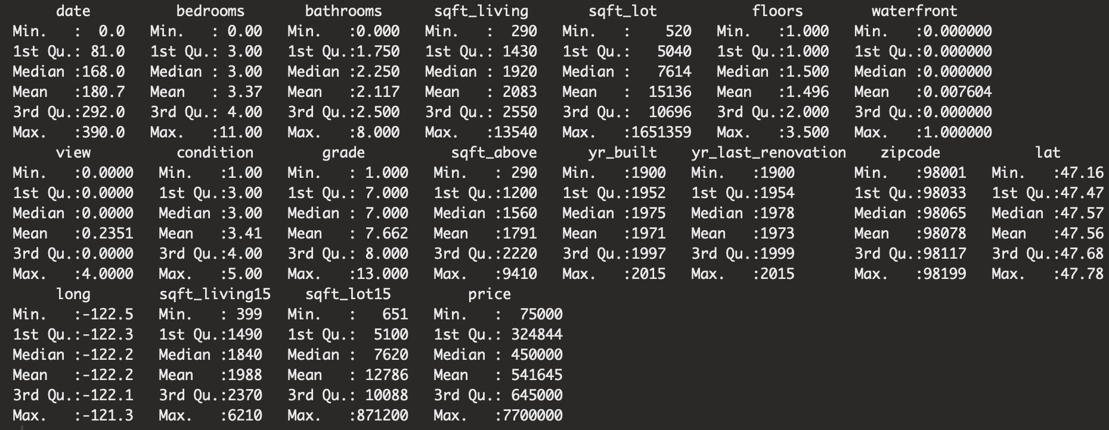
EDA
This part is aimed at exploring the data trying to summarize the main characteristics, also with visual methods. First of all, we ask for a summary of the data we have so far.

Slide 11
price
The values of price go from 75K $ to 7.7mln $, which is completely a different market with other components that determine the final price. We want to delete outliers (less than 5% of the data), working with instances belonging to the same market.
Then, from the plot we notice that price distribution is really right-skewed, so we apply a log transform to get a Normal distribution of the target value.
Hist prima → hist dopo

Slide 12
Sqft_lot / sqft_lot15

