Slide 1
House price prediction (King County, Washington, USA)
Martino De Nardi, Damiano Clementel

Slide 2
Goals
Lineup
Data cleaning/filtering
EDA
Model(s)
Interpretation
Technical explanation
Find the most important features to determine house prices
Find the best model to predict new data

Slide 3
Dataset
House sale prices in King County, Washington (USA)
Houses sold between May, 2014 and May, 2015
21613 observations x 20 features (+ target price)
Feature description
id:
Date: date house was sold
price:
bedrooms:
bathrooms:
sqft_living:
Sqft_lot:
Floors:

Slide 4
waterfront:
view:
condition:
grade:
sqft_above:
sqft_basement:
yr_built:
yr_renovated:
zipcode:
lat:
long:
sqft_living15:
sqft_lot15:

Slide 5
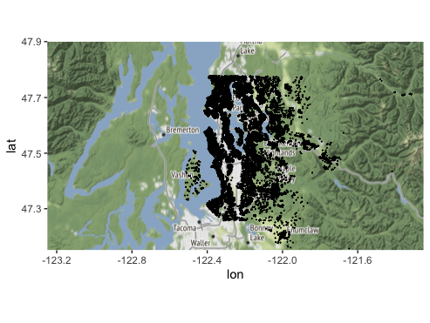
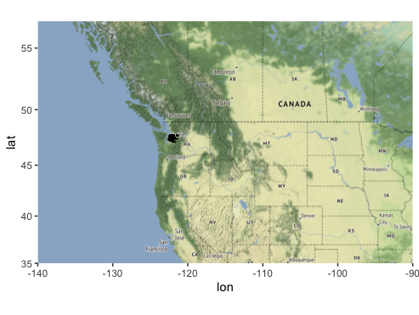
Geographic location

Slide 6
Data cleaning/filtering
Some issues were found in the dataset:
sqft_basement
Problem: This feature turns out to be exactly the difference between sqft_living and sqft_above, so it makes no sense (and it would be an error) to keep it in the data.
Solution: we deleted the feature from the dataset.
INSERIRE SCREEN

Slide 7
Duplicated ID
Problem: an id is directly associated to a house and its features values; so, if a house has been sold twice, there can be two rows with identical values except for the price and the date. We are more interested in the latest value that was assigned to it.
Solution:
INSERIRE SCREEN

Slide 8
Date format
Errors in the data

Slide 9
Semantic of yr_renovated feature

Slide 10
Mappa delle case

Slide 11
Mappa delle case

