Slide 1

CEMA HEALTH MANAGEMENT SYSTEM
A smart solution for efficient and seamless healthcare management.

Slide 2
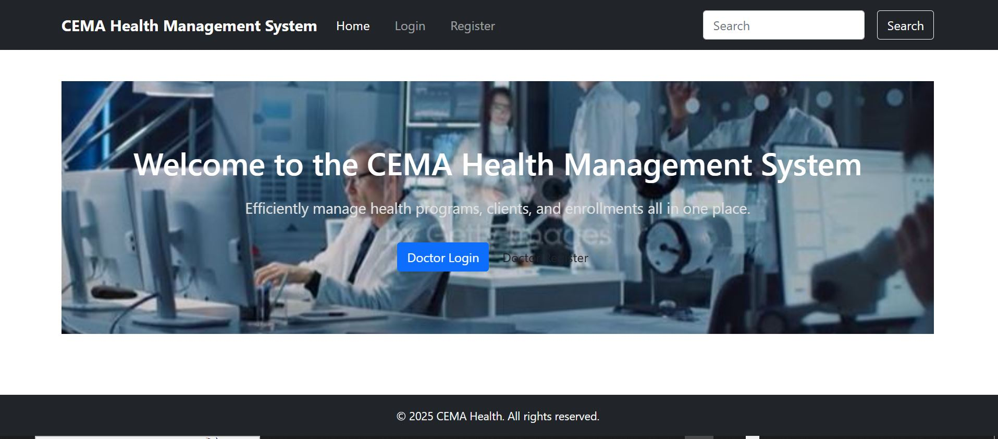
Home PAGE

Slide 3

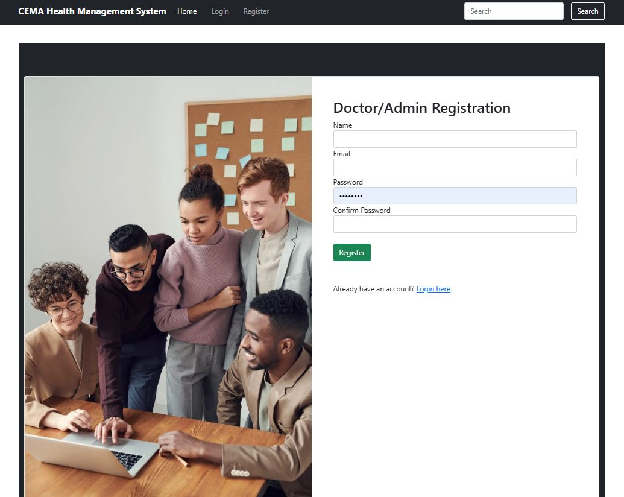
REGISTRATION PAGE

Slide 4
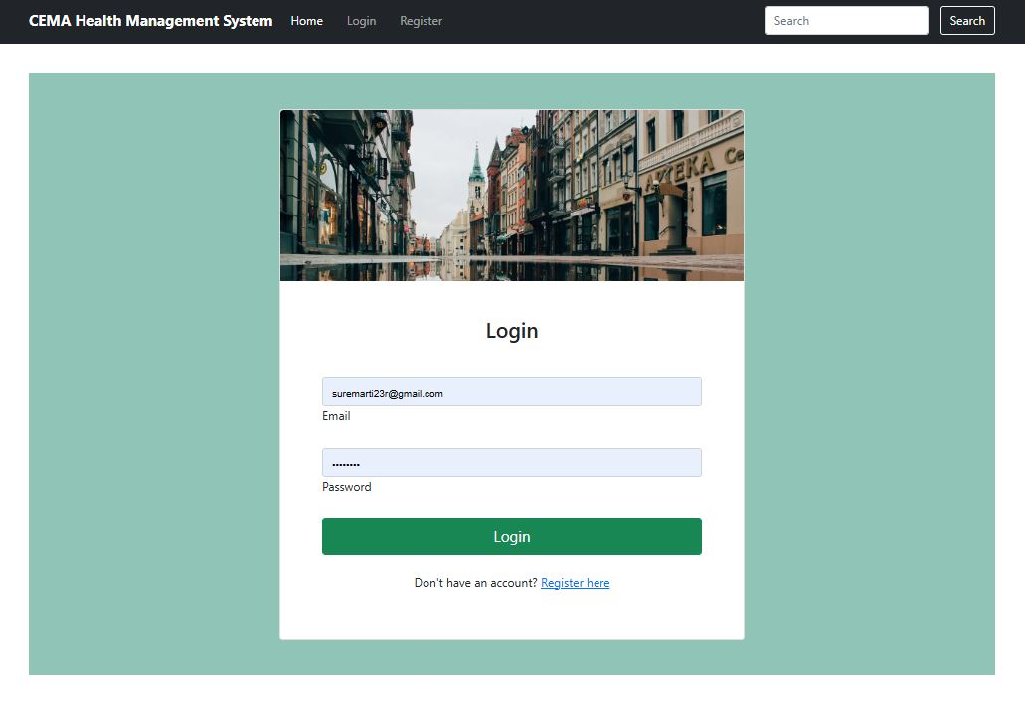
LOGIN

Slide 5
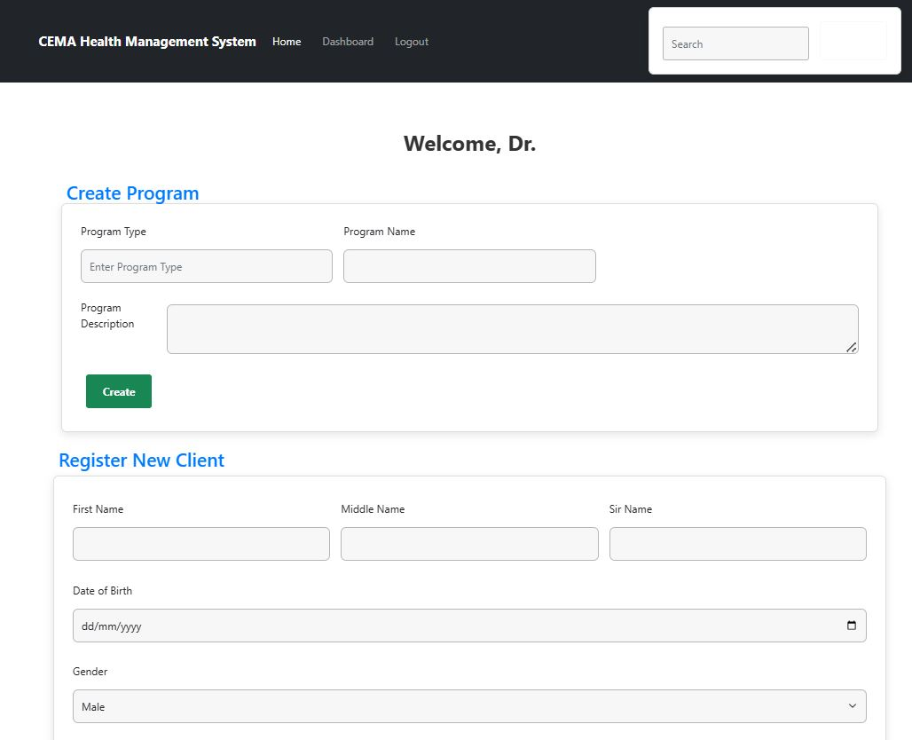
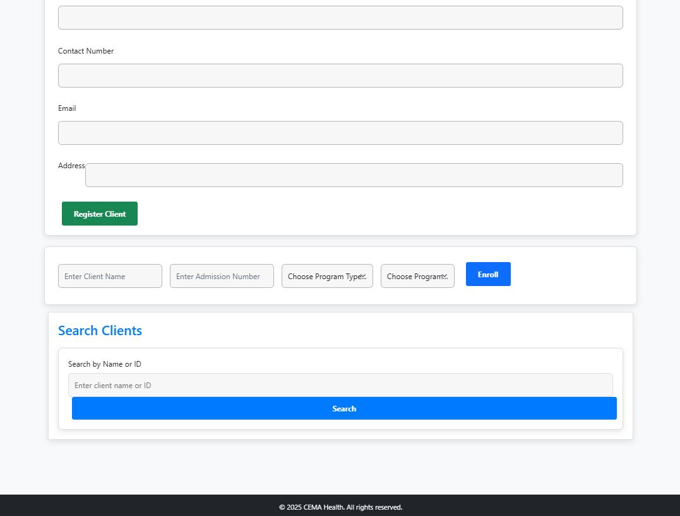
Doctor Dashboard

Slide 6
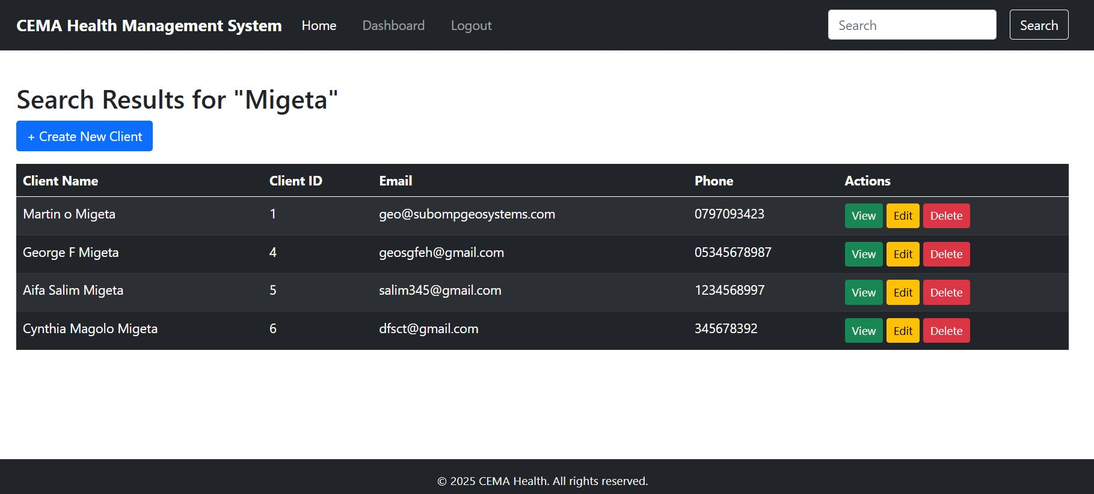
Search results

Slide 7
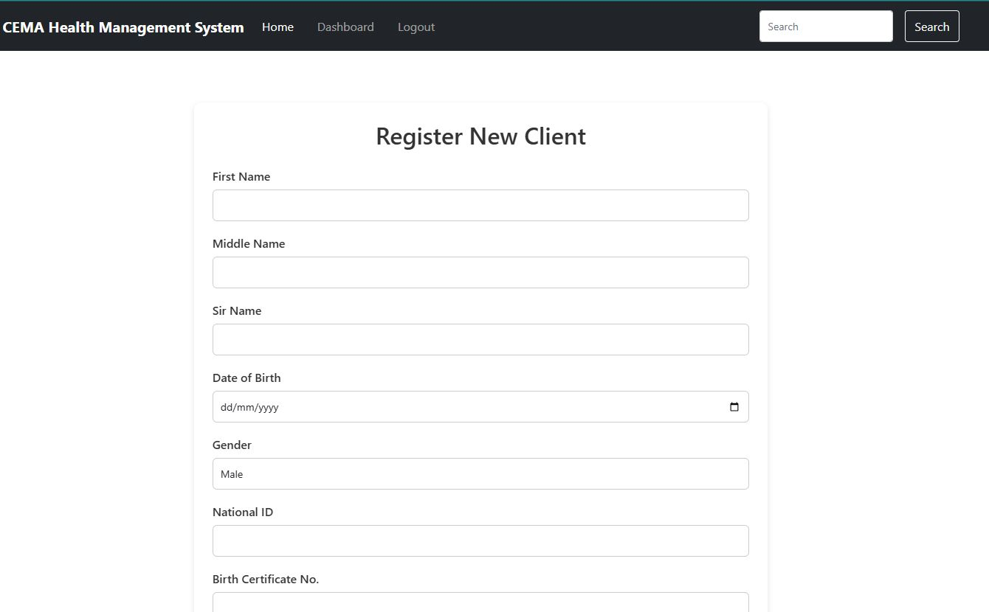
Add new client from search results page

Slide 8
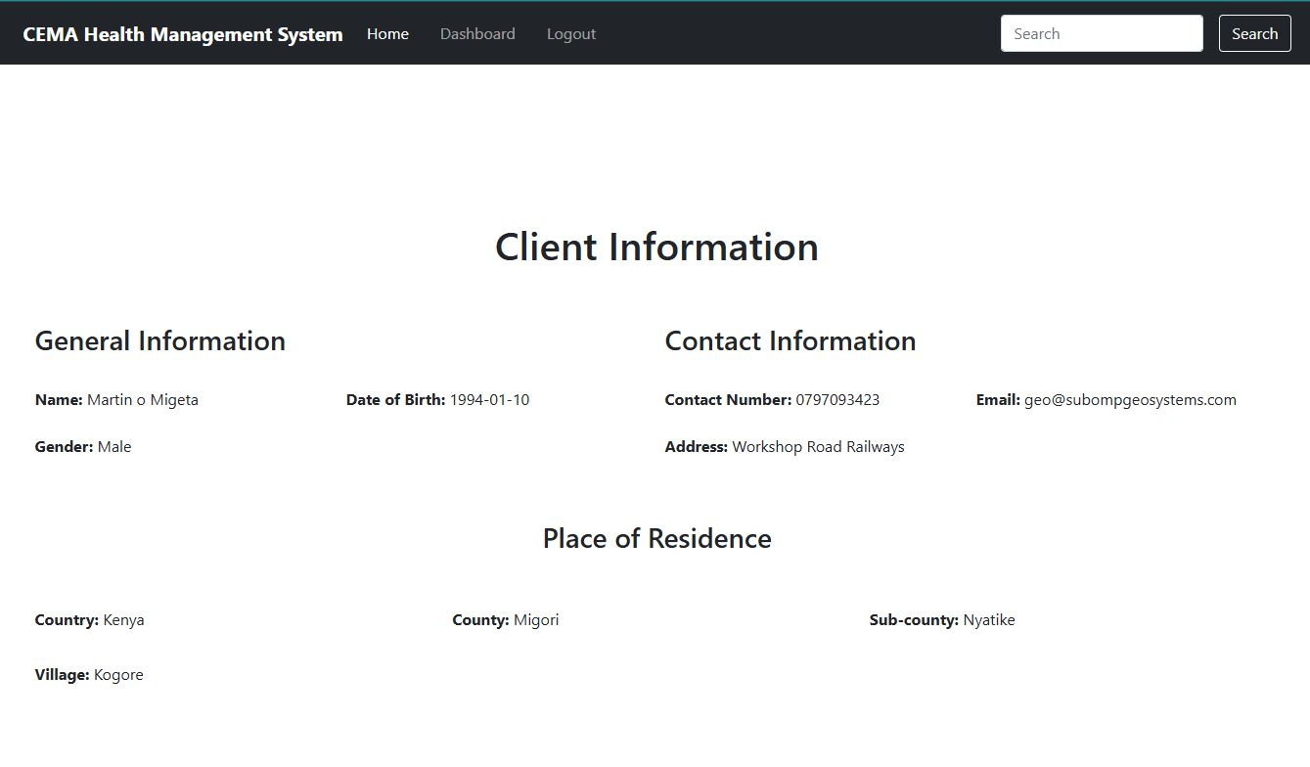
Client view page

Slide 9
KEY LANGUAGES USED
Python Flask
HTML, CSS, JavaScript
Shell, Mako

Slide 10

Thank You
suremartin653@gmail.com

