Slide 1
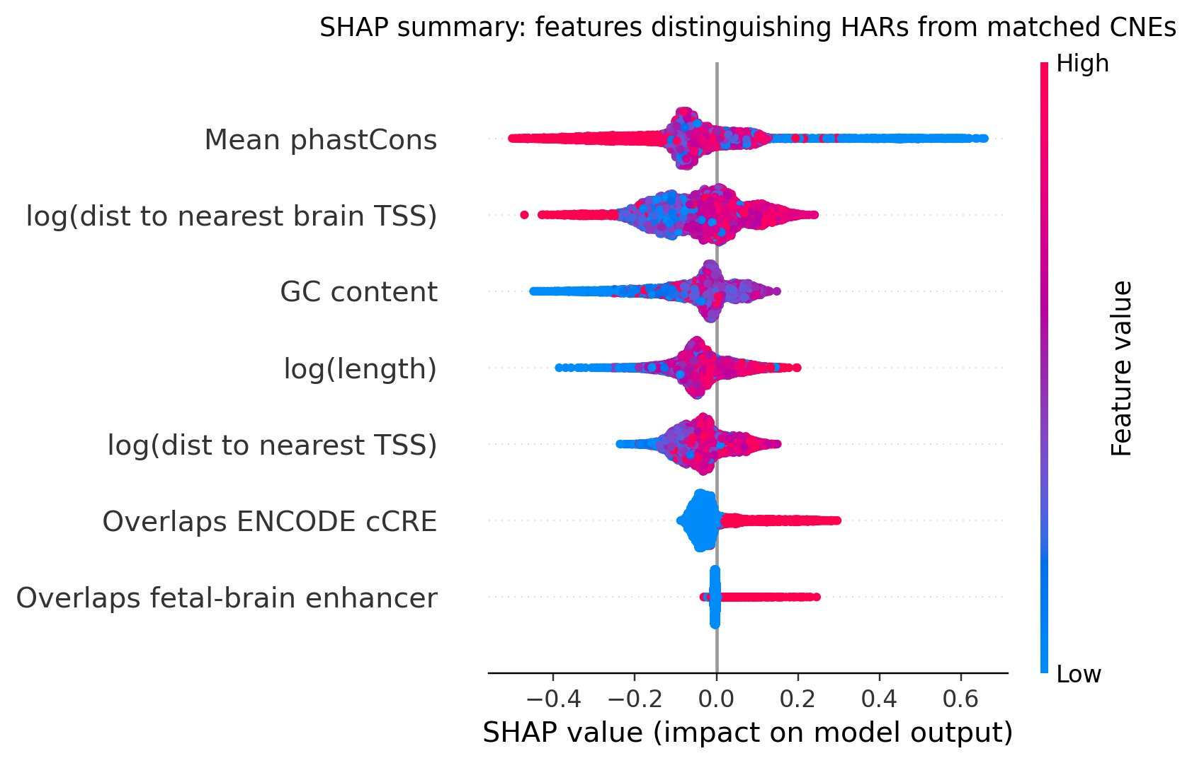
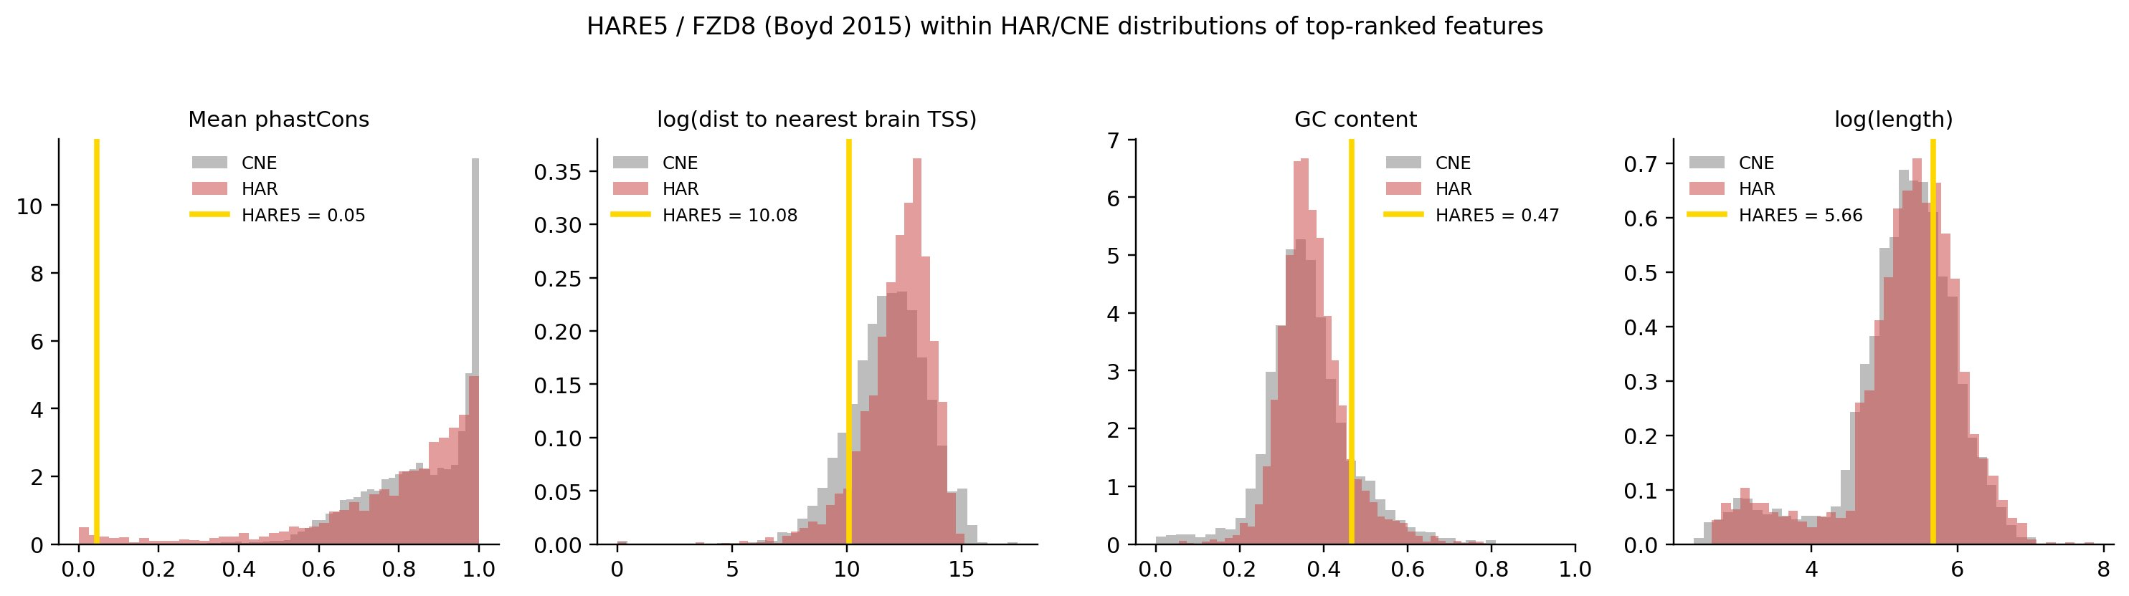
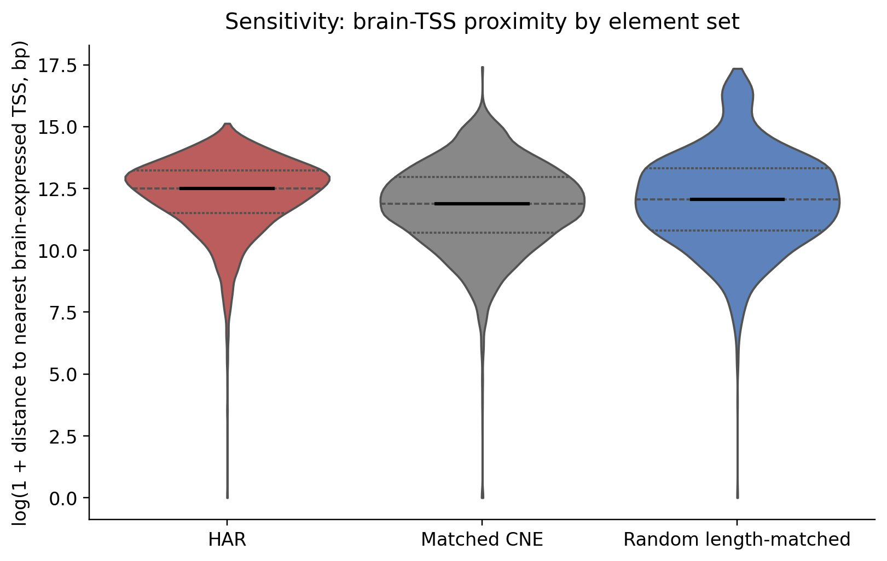
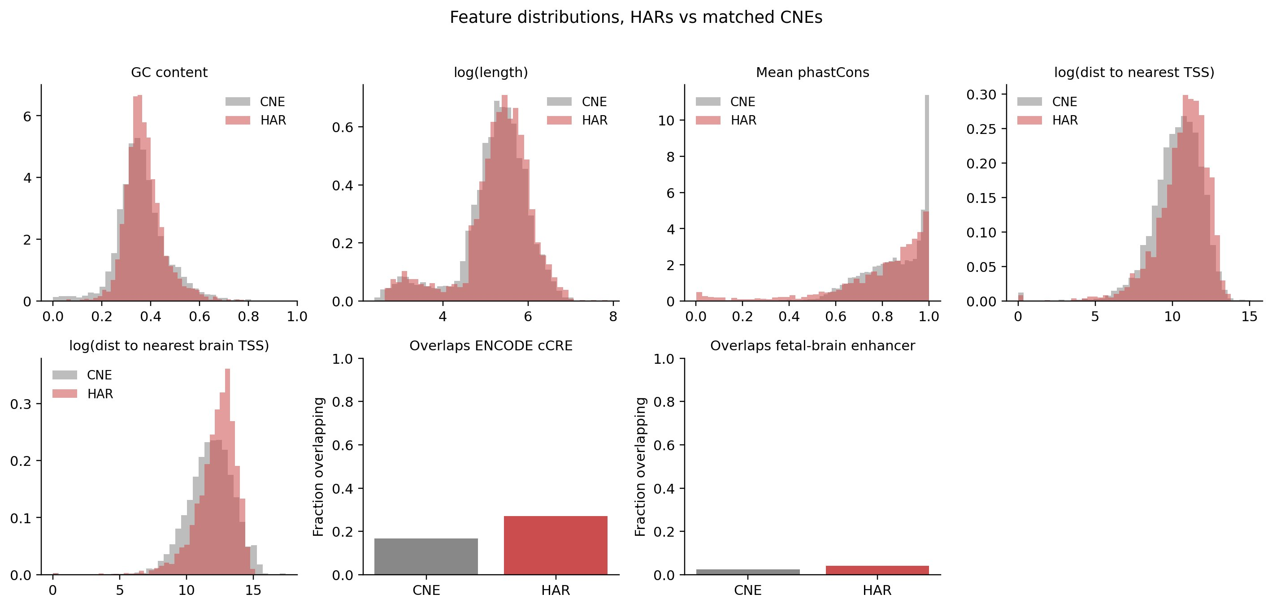
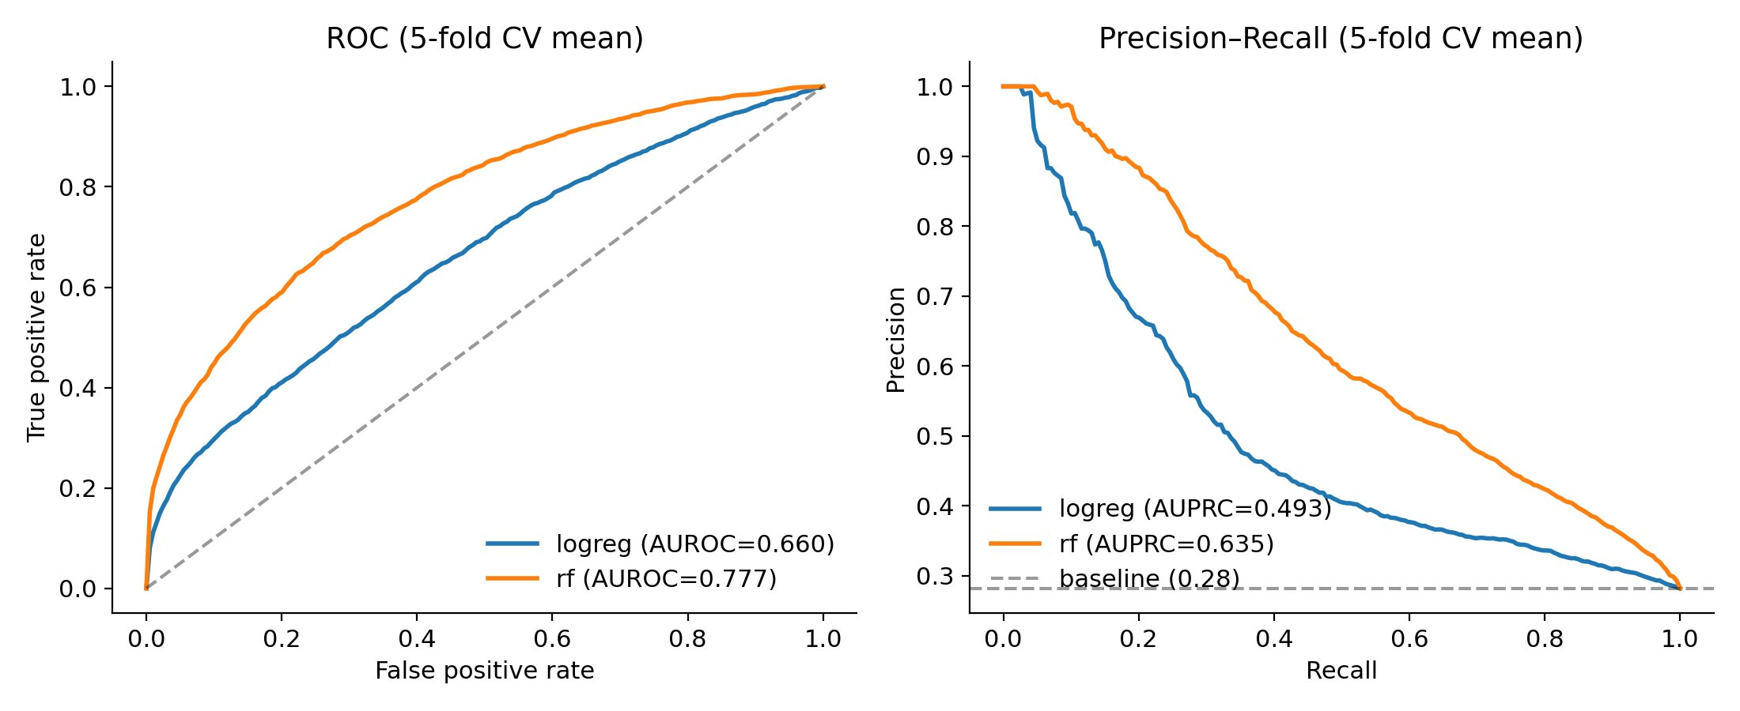
What makes a HAR a HAR? Interpretable ML on human-accelerated noncoding regions
Martin Orkuma · MCB 540 – Functional Genomics, Spring 2026 · Central question: Which genomic features distinguish HARs from matched conserved non-accelerated elements?
1. Background & question
3. Result 1: HARs are distinguished by conservation, GC content, and regulatory overlap
6. Case example: HARE5 / FZD8 shows acceleration
Human Accelerated Regions (HARs) are conserved noncoding sequences that changed rapidly on the human lineage after divergence from chimpanzees (Keough et al., 2023). Many have been linked to neurodevelopment and cognition.(Doan et al., 2016; Levchenko et al., 2018).
Hypothesis: HARs occupy distinctive regulatory contexts relative to matched conserved non-accelerated elements.
HARE5 / 2xHAR.238 (Boyd 2015; chr10:35,222,797–35,223,084, hg38) — phastCons 0.045, an extreme outlier consistent with strong human-lineage acceleration.
2. Approach
Top features: (1) lower phastCons → HAR; (2) farther from brain-expressed TSS → HAR; (3) higher GC; (4) cCRE overlap → HAR (HAR 27% vs CNE 17%).
7. Result 2: HARs are farther from brain-expressed TSSes
HAR set
(Doan 2016)
Matched
CNEs
7 features
→ LR + RF
SHAP
ranking
Median dist to brain TSS:
HAR: 269 kb
Random: 173 kb
CNE: 145 kb
4. Per-feature distributions (HAR vs matched CNE)
Dataset: 2,734 HARs vs 7,473 matched CNEs
Controls: length ±25%, mean phastCons ±0.05, ±10 kb buffer, coding exons excluded
Models: logistic regression baseline + random forest, 5-fold stratified CV
Category | Features
Sequence | GC content, length
Conservation | Mean phastCons
Gene context | Distance to nearest TSS, distance to nearest brain-expressed TSS.
Regulatory | ENCODE cCRE overlap, fetal-brain enhancer overlap
8. Conclusions
5. Result 3: Features moderately distinguish HARs
from matched CNEs
▸ HARs are regulatory-enriched: HARs overlap cCREs more often than matched CNEs: 27% vs 17%.
▸ HARs are not simply closer to brain-expressed genes: Matched and random-control comparisons show HARs are farther from brain TSSes.
▸ Conservation dominates the signal: Lower phastCons is the strongest distinguishing feature, but this is partly definitional.
▸ Caveat: Linear TSS distance does not prove regulatory targeting.
References
Boyd et al. 2015
Capra et al. 2013
Cui et al. 2025
Doan et al. 2016
Keough et al. 2023
Pollard et al. 2006
Random Forest
AUROC 0.777 ± 0.009
AUPRC 0.635 (baseline 0.27)
Logistic regression baseline: AUROC 0.660 · AUPRC 0.493 (blue line in ROC).

