Slide 1
What makes a HAR a HAR? Interpretable ML on human-accelerated noncoding regions
Central question: Which features distinguish HARs from matched conserved elements?
Martin Orkuma
MS, Biological Data Science
Arizona State University, Tempe, Arizona
April 26, 2026

Slide 2
Human Accelerated Regions
What is a HAR?
Human accelerated regions (HARs) are evolutionarily conserved nucleotide sequences in humans that have rapidly diverged since the separation from our common ancestor with chimpanzees (Keough et al., 2023).
Why people care?
Majority are noncoding; enriched near brain-expressed genes (Pollard 2006; Capra 2013)
Mutations in HARs implicated in cognition and social behavior (Doan 2016)
HARE5 / FZD8 enlarges cortex when humanized in mouse (Boyd 2015)
Open question: Most prior work compares HARs to genome background — which conflates "is conserved" with "is human-accelerated." Are HARs truly distinguished by their regulatory neighborhood, or just by sequence-level acceleration? Which features matter most?
Sequence conservation + human-lineage divergence
Chicken
A
C
G
T
A
C
G
C
A
T
G
C
A
C
G
T
A
C
Mouse
A
C
G
T
A
C
G
C
A
T
G
C
A
C
G
T
A
C
Dog
A
C
G
T
A
C
G
C
A
T
G
C
A
C
G
T
A
C
Chimp
A
C
G
T
A
C
G
C
A
T
G
C
A
C
G
T
A
C
Human
A
C
G
T
A
C
T
A
T
A
C
C
G
C
C
T
A
C
Conserved across non-humans (black) — diverged on the human lineage (red). That mid-window block is what we call a HAR.

Slide 3
Study Approach
INPUT
INPUT
FEATURES
MODELS
INTERPRETATION
INTERPRETATION
2,734 HARs
(Doan 2016)
+ 7,473 matched CNEs
(phastCons-derived)
7 per element
sequence · conservation
gene context
regulatory overlap
Logistic regression
Random forest
5-fold stratified CV
balanced class weight
SHAP
(TreeExplainer)
feature ranking
+ HARE5 case study
Why matched controls?
Random genome controls would let the model learn the trivial pattern "HARs are short conserved elements."
Instead, we sample CNEs from UCSC phastCons 100-way elements that match each HAR on length (±25%) and mean phastCons (±0.05), drawn at 3:1 with a ±10 kb buffer around HARs and coding exons excluded.
Now any signal the classifier finds must be beyond conservation alone.

Slide 4
Seven features, four categories Each feature corresponds to a specific biological hypothesis about what makes HARs distinctive.
Category | Features | What it tests
Sequence | GC content · element length | Are HARs unusual at the level of base composition or size?
Conservation | Mean phastCons (100-way) | Captures deep pre-acceleration conservation; included as a sanity check.
Gene context | Distance to nearest TSS · Distance to nearest brain-expressed TSS | Are HARs preferentially located near genes — and specifically near brain genes?
Regulatory | Overlaps ENCODE cCRE · Overlaps fetal-brain enhancer (Roadmap E081/E082) | Do HARs sit in annotated regulatory elements, especially developmental brain enhancers?
Brain-expressed = GTEx v8 median TPM > 5 in any of 13 brain tissues.
Annotations: GENCODE v45 · ENCODE cCRE combined.
Roadmap E081/E082 chromHMM (active enhancer states 13-15).

Slide 5
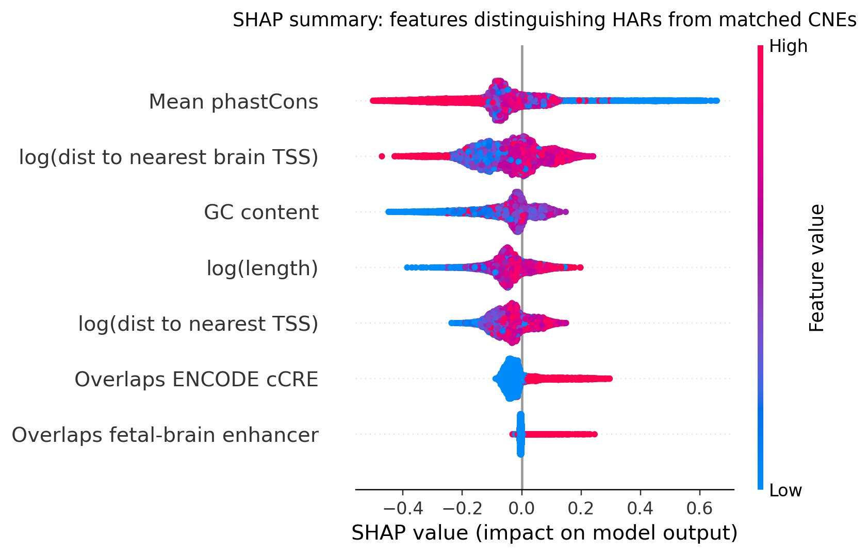
What the model learned: feature importance ranking
Mean |SHAP| from random forest, refit on all data. Each row = one feature; spread = per-element impact.
Top features · what they say
1
Mean phastCons
Lower → HAR
Expected: HARs are conserved elements that lost conservation on the human lineage.
2
Distance to brain TSS
Farther → HAR
Reverses the classic story. We test this on slide 7.
3
GC content
Higher → HAR
Modest sequence-composition shift.
4
Overlaps ENCODE cCRE
Yes → HAR
27% of HARs overlap a cCRE vs 17% of CNEs — the strongest regulatory signal.

Slide 6
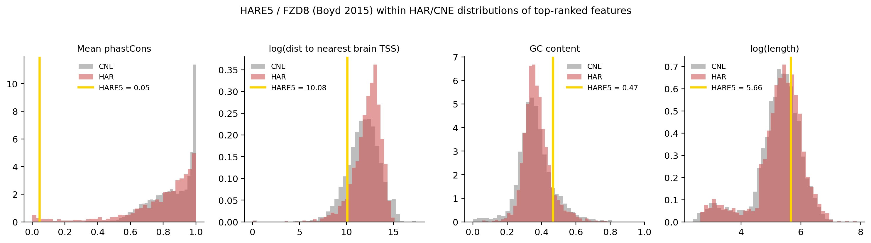
Anchoring the ranking: HARE5 / FZD8 (Boyd 2015)
Does the textbook "functional HAR" sit where the model says HARs should sit?
INTERVAL
PHASTCONS
REGULATORY
chr10:35,222,797–35,223,084
0.05
Overlaps an ENCODE cCRE
Boyd 2015 hg19 coords lifted to hg38. HARE5/2xHAR.238 is absent from the modeled HAR table, so we score it externally with the same feature pipeline.
An extreme outlier on the model's #1 feature — exactly where the SHAP ranking predicts a strongly human-accelerated locus should fall.
Consistent with the regulatory-context signal. Boyd's transgenic mouse shows HARE5 enlarges cortex via altered FZD8 expression.

Slide 7
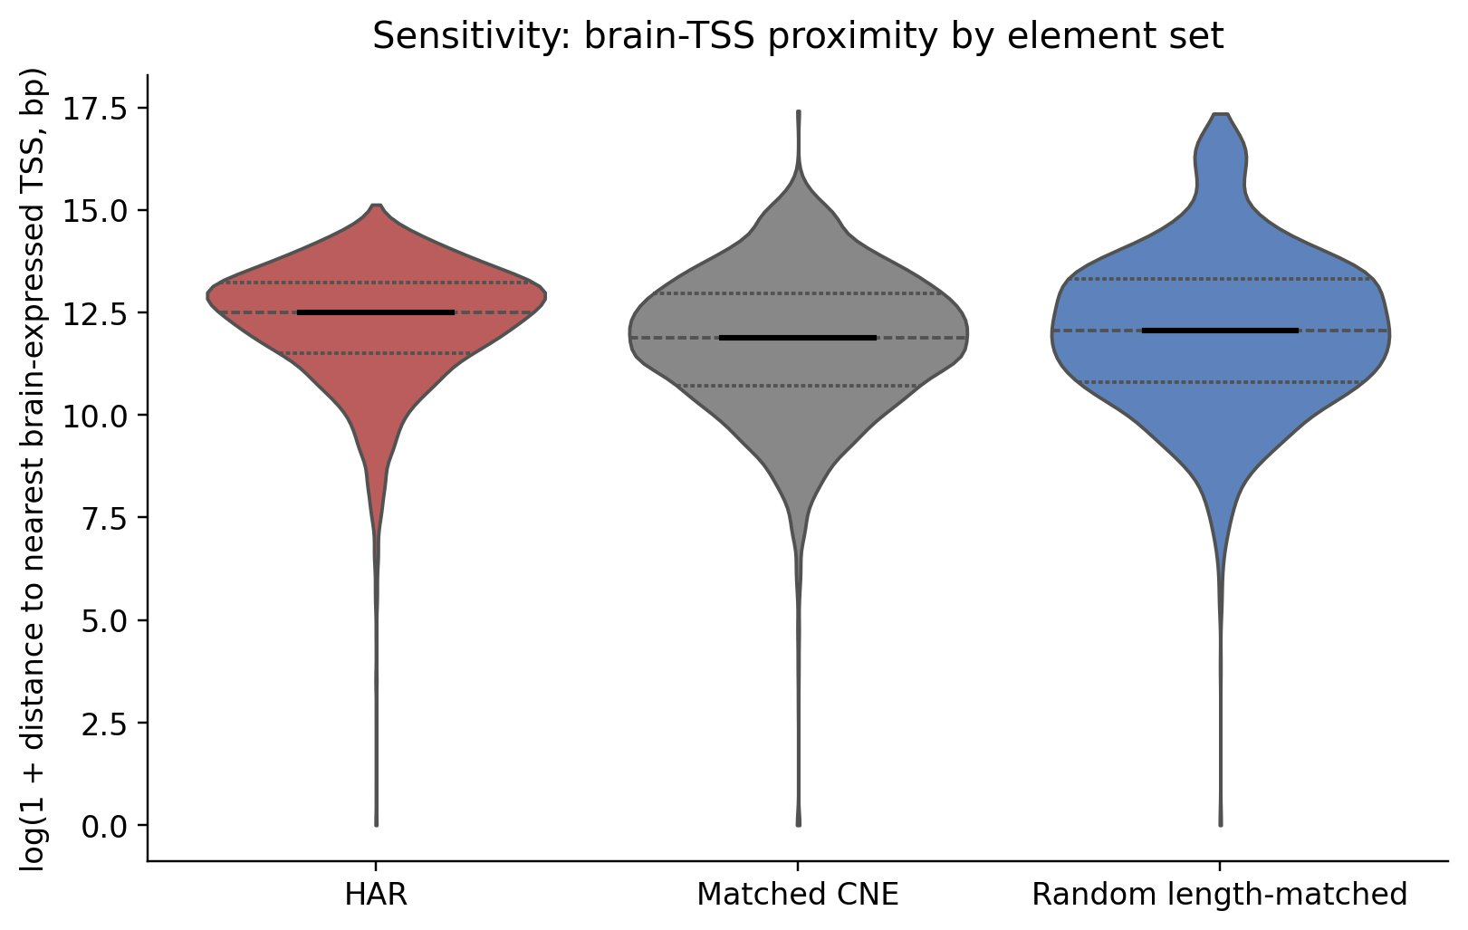
Caveats — and one finding that survives a stress test
Is the reversed brain-TSS proximity an artifact of matching CNEs on conservation? No.
Three honest caveats
phastCons is partly definitional
the 100-way track includes human, so residual signal reflects the acceleration we're trying to detect.
Annotation bias
ENCODE / Roadmap labels are biased toward studied cell types and developmental windows.
Linear distance ≠ regulatory targeting
enhancers can act over Mb-scale 3D contacts (Keough 2023).
BIOLOGICAL TAKEAWAY
Median distance to brain TSS: HAR 269 kb > Random 173 kb > Matched CNE 145 kb. Mann-Whitney p ≈ 1×10⁻⁹.
HARs are more regulatory-element-like than matched controls, but they sit farther from brain TSSes — even than random length-matched intervals. The simple "near brain genes" story doesn't survive matched-control design. Long-range 3D regulatory contacts become the natural next hypothesis.

Slide 8
Conclusion
I trained a small interpretable model to distinguish HARs from matched conserved elements, asked it which features mattered, and checked the answer at HARE5.
0.78
27% vs 17%
269 kb
Random forest AUROC
cCRE overlap, HAR vs CNE
Median HAR-to-brain-TSS distance
5-fold CV, modest but well above chance and consistent across folds.
The strongest directional regulatory signal — HARs preferentially overlap annotated cCREs.
Farther from brain TSSes than matched CNEs (145 kb) or random (173 kb). The textbook story doesn't survive.

Slide 9
Acknowledgement
Data Sources
This work relies entirely on publicly available datasets, and I thank the authors that produced and maintain them
HARs: Doan et al. (2016), Cell, Supplemental Table S1.
HARE5 / 2xHAR.238 reference coordinates. Boyd et al. (2015).
Reference genome and conservation tracks. UCSC Genome Browser: hg38 reference assembly.
Gene annotation. GENCODE v45
Regulatory annotation. ENCODE cCRE
Use of generative AI
Claude Opus 4.7 (Anthropic) was used as a coding assistant during development of the machine learning pipeline and trouble shooting the data analysis.
The idea for the project, the hypothesis, and evaluation strategy are all mine.

Slide 10
References
Boyd, J. L., Skove, S. L., Rouanet, J. P., Pilaz, L. J., Bepler, T., Gordân, R., ... & Silver, D. L. (2015). Human-chimpanzee differences in a FZD8 enhancer alter cell-cycle dynamics in the developing neocortex. Current Biology, 25(6), 772-779. https://www.cell.com/current-biology/fulltext/S0960-9822(15)00073-1?ref=binfind.com%2Fweb
Capra, J. A., Erwin, G. D., McKinsey, G., Rubenstein, J. L., & Pollard, K. S. (2013). Many human accelerated regions are developmental enhancers. Philosophical Transactions of the Royal Society B: Biological Sciences, 368(1632). https://royalsocietypublishing.org/rstb/article/368/1632/20130025/22332
Cui, X., Yang, H., Cai, C., Beaman, C., Yang, X., Liu, H., ... & Shen, Y. (2025). Comparative characterization of human accelerated regions in neurons. Nature, 640(8060), 991-999. https://www.nature.com/articles/s41586-025-08622-x
Doan, R. N., Bae, B. I., Cubelos, B., Chang, C., Hossain, A. A., Al-Saad, S., ... & Walsh, C. A. (2016). Mutations in human accelerated regions disrupt cognition and social behavior. Cell, 167(2), 341-354. https://www.cell.com/cell/fulltext/S0092-8674(16)31169-2
Keough, K. C., Whalen, S., Inoue, F., Przytycki, P. F., Fair, T., Deng, C., ... & Pollard, K. S. (2023). Three-dimensional genome rewiring in loci with human accelerated regions. Science, 380(6643), eabm1696. https://www.science.org/doi/abs/10.1126/science.abm1696
Levchenko, A., Kanapin, A., Samsonova, A., & Gainetdinov, R. R. (2018). Human accelerated regions and other human-specific sequence variations in the context of evolution and their relevance for brain development. Genome biology and evolution, 10(1), 166-188. https://doi.org/10.1093/gbe/evx240
Pollard, K. S., Salama, S. R., Lambert, N., Lambot, M. A., Coppens, S., Pedersen, J. S., ... & Haussler, D. (2006). An RNA gene expressed during cortical development evolved rapidly in humans. Nature, 443(7108), 167-172. https://www.nature.com/articles/nature05113

