Slide 1
Product Recommendations in Food-Retailer Online-Shops
Christoph Sieb – Solution Architect CI

Slide 2
Agenda
Business Goal
Analytical Method used
Software / Architecture to implement the recommender

Slide 3


Business Goal
Generate cross- and up-sell in the online-shop by recommending context specific products
Increase revenue by ~10%

Slide 4
Agenda
Business Goal
Analytical Method used
Software / Architecture to implement the recommender

Slide 5
Market Basket Analysis using Association Rule Mining
“Which products are bought frequently together?"
A
B
C
A
C
D
B
C
D
A
D
E
B
C
E
Which products and product groups are bought frequently together?
Also other properties can be added to the market basket
E.g. Gender, Age-Group, Season (Summer, Christmas, time of day,…)
Use (explicitly) NOT bought products to generate relations to them

Slide 6
Association Rule Mining
Summarize transactions into different hierarchy groups
Level „All customers“
All customers
Level „Customer segment“
Level „Market/Region“
Market/Region1
Market/Region2
Level „Customer“
Anne
Bob
Chris
A
B
C
A
C
D
B
C
D
A
D
E
B
C
E
Anne
Bob
Chris
Bob
Chris

Slide 7
Association Rule Mining
Product Hierarchy
…
…
Drugstore & Baby
Beverages
Body care
…
Not granular enough
Deo / Parfume
Oral care
Nivea Deo
Axe Bodyspray
Colgate tooth paste
Dr. Best tooth brush
…

Slide 8
Association Rule Mining
Result: Association Rules
Cheese => Dessert
Support: 9%
Confidence: 65%
Lift: 2,0
Cheese & Frozen Foods => Milk A
Support: 0,5%
Confidence: 70%
Cheese => Milk & Ice Cream
Lift: 2,1
Support: 1%
Confidence: 80%
Lift: 1,8

Slide 9
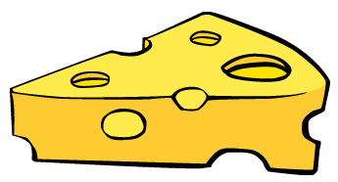
Scoring market baskets agains the rule base
Joghurt
Fisch-stäbchen
Kaufempfehlung:
Milk XY
Rule Base
Cheese => Dessert | Lift: 2,0
Cheese & Frozen Foods => Milk | Lift: 2,1
Bread => Butter | Lift: 3,0

Slide 10
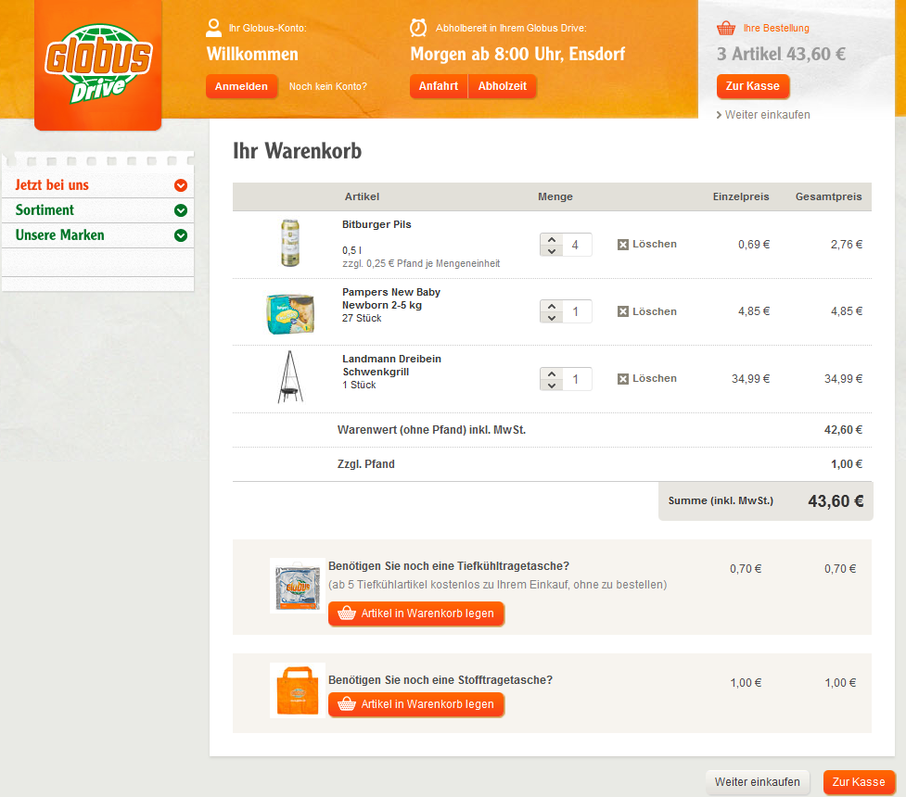

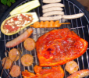
Up- / Cross-Sell in the Online-Shop
Benötigen Sie noch Nürnberger Rostbratwürste
Benötigen Sie noch Grillfleisch
Zur Warengruppe „Grillfleisch“

Slide 11
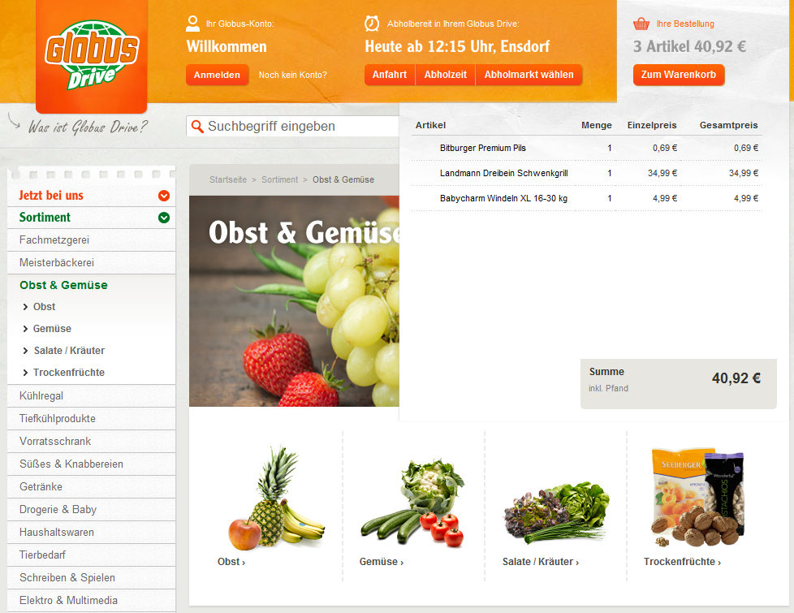
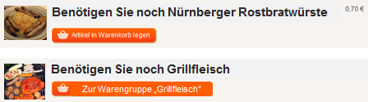
Up- / Cross-Sell in the Online-Shop
Variante

Slide 12
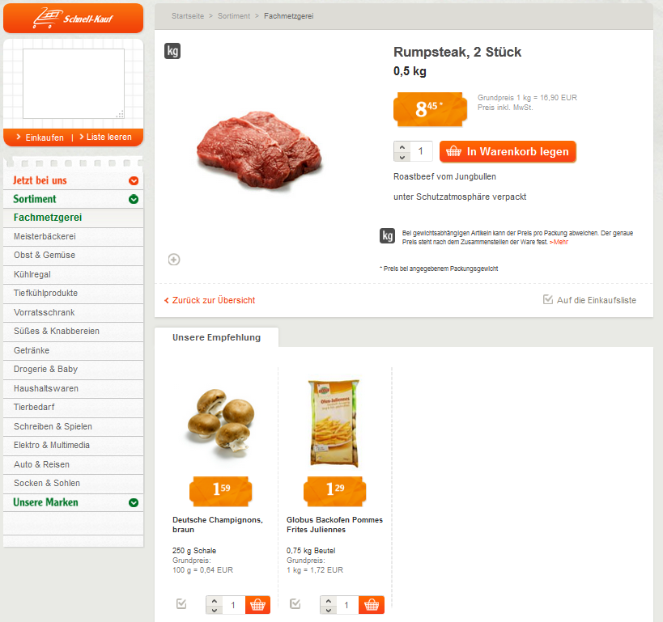
Up- / Cross-Sell in the Online-Shop
Variante

Slide 13
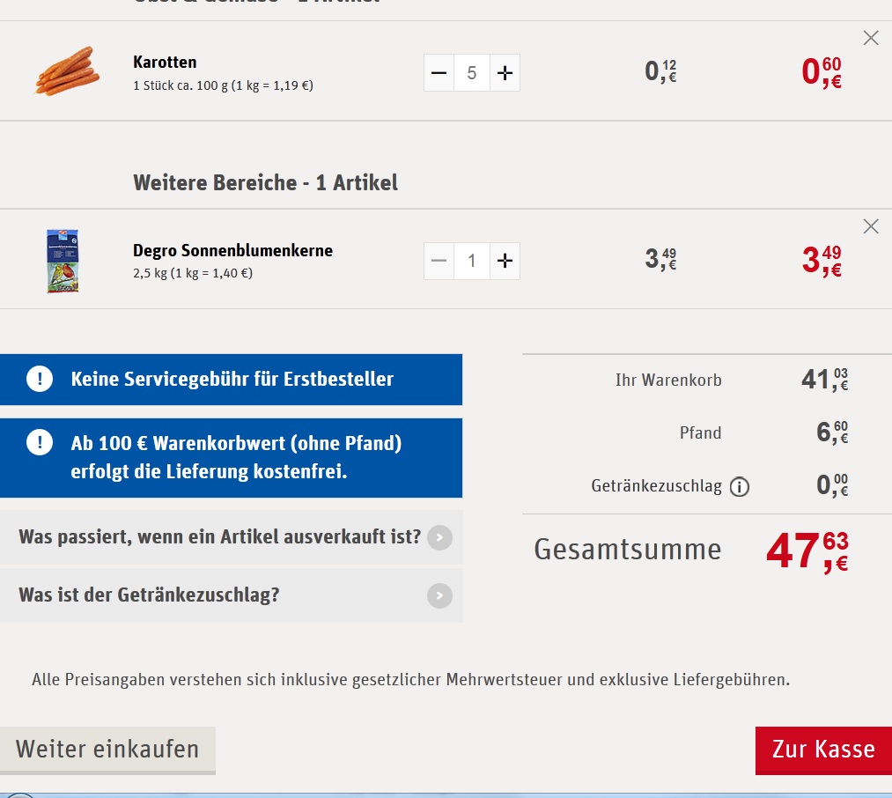

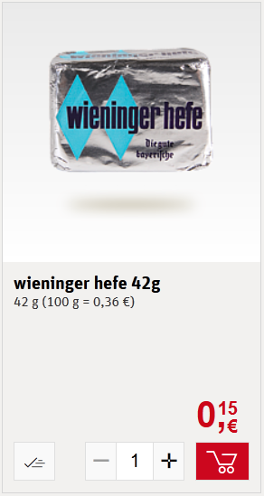
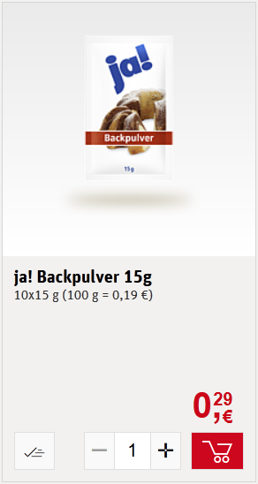
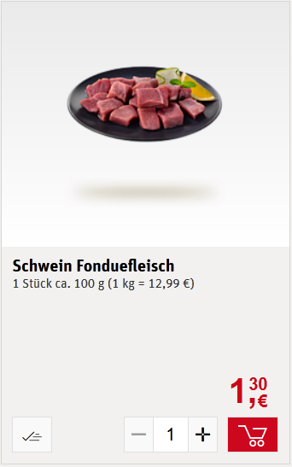
Up- / Cross-Sell in the Online-Shop
Benötigen Sie noch:
Fleisch
Zur Produktkategorie

Slide 14
Agenda
Business Goal
Analytical Method used
Software / Architecture to implement the recommender

Slide 15
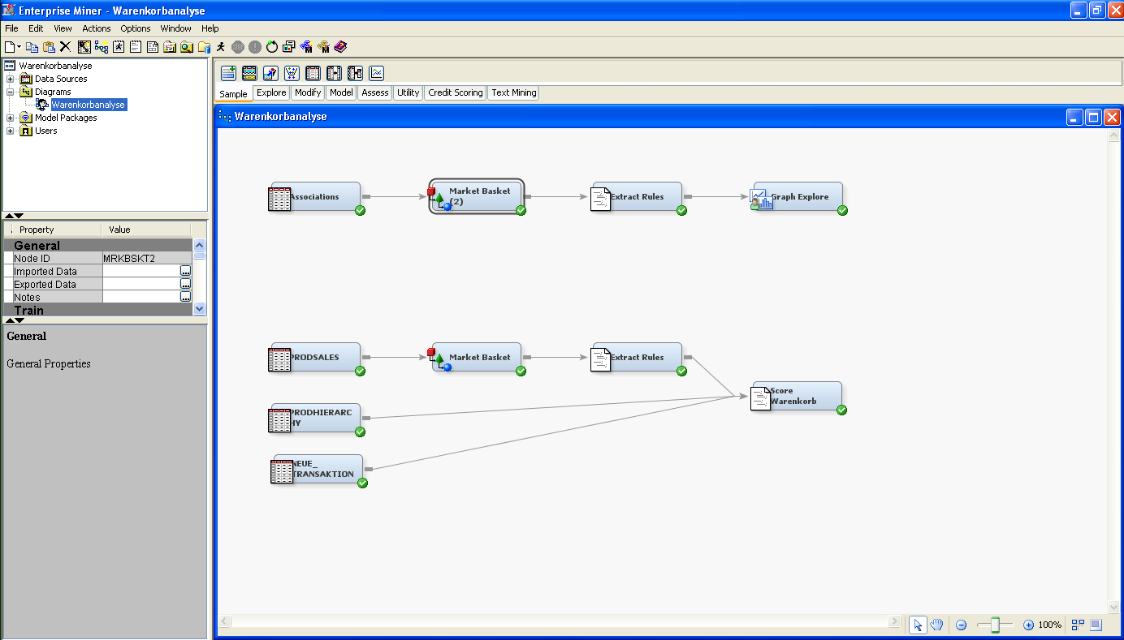
Enterprise Miner
Diagram with mining flow to extract association rules

Slide 16
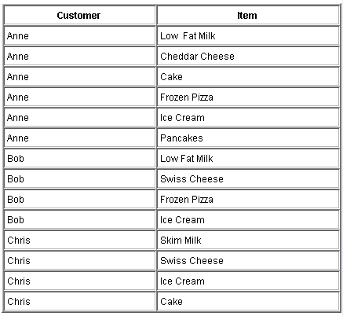
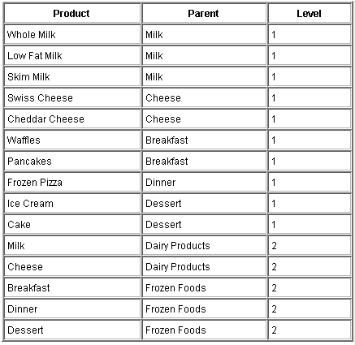
Association Rule Mining
Neccessary data structures
Transaction table
Product hierarchy table

Slide 17
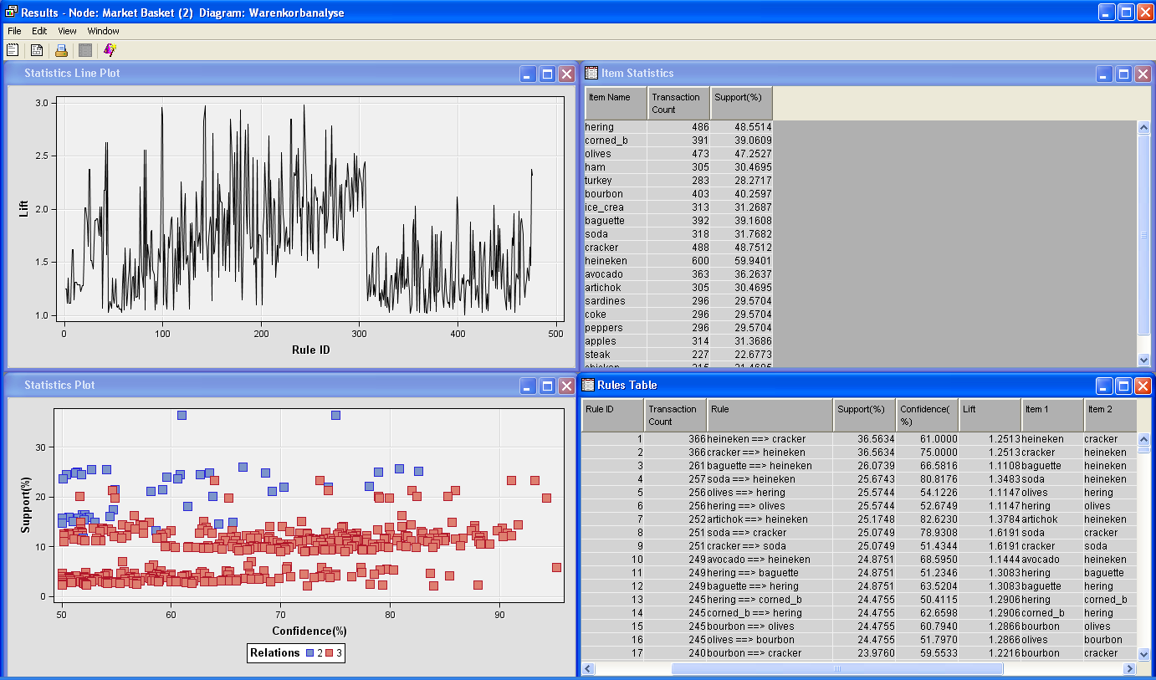
Enterprise Miner
Visualizing association rules and statistical reports

Slide 18
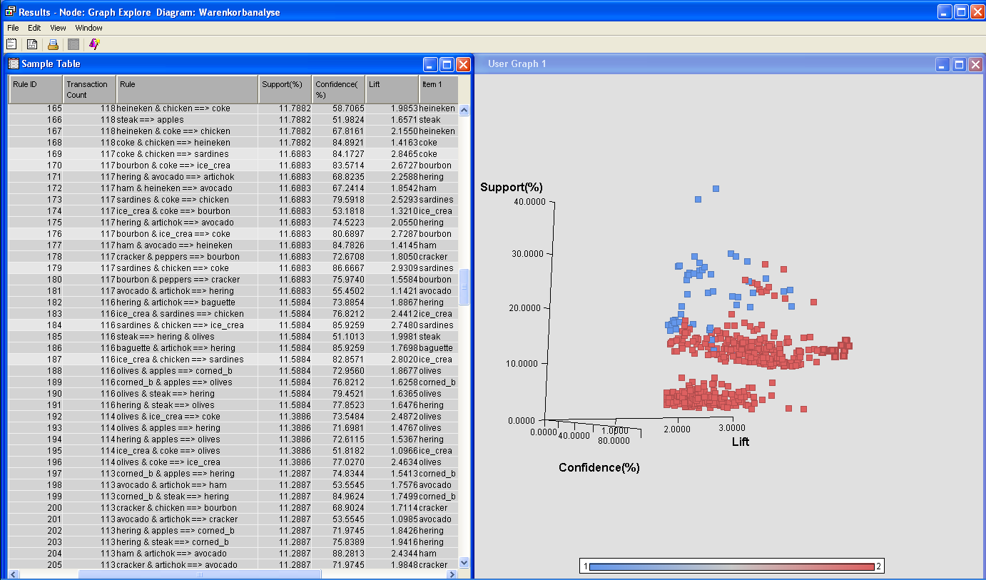
Enterprise Miner
Visualizing rules using Support, Confidence und Lift

Slide 19
Own Meta-Learning Logic
Just use the lower 3 – 4 product hierachy layers
Meta-Learn-Logic to create useful rule bases for different market basket groups (per customer, per market, …)
Number rules and runtime may have strong variances for fixed algorithm parameters (especially for support)
I.e. implemented dynamic parameter adaption to incrementally find balance between runtime and amount of rules
Rule Base is updated daily given priorities
E.g. a customer that did not buy since the last rule base update is not „re-trained“
Runtime bottle necks thus, are priority based reduced (important onse run today, less important onse run tomorrow
Rule Mining Scales with the number of market basket groups (per customer, per market,…)

Slide 20
Rule filtering
Algorithm generates self-recommendations within a hierarchy path that needs to be removed
Tomatos & Chees -> Vegetables
Filter out rules with consequences in higher hierarchy layers to get more specific recommendations
Mapping Table to recommend specific products if a product group is the consequence
During Scoring, sort the rules by e.g. lift or lift weighted by confidence, or other measure

Slide 21
Rule Base
Manage the rules as the „model“ of the association analysis
Rule Base
…
…
…
Regeln für Segment „Bestandskunden“:
Cheese => Dessert | Lift: 2,0
Cheese & Frozen Foods => Milk | Lift: 2,1
Bread => Butter | Lift: 3,0
…
…
Regeln für alle Transaktionen:
Cola => Dessert | Lift: 2,0
Crisps & Frozen Foods => Cola| Lift: 1,4
Bread => Jam| Lift: 1,9
…
Standardempfehlungen:
Dessert -> Danone Pudding …
Regeln für Kunde 111444:
Cheese => Dessert | Lift: 2,0
Cheese & Frozen Foods => Milk | Lift: 2,1
Bread => Butter | Lift: 3,0
…
…
Regeln für Segment „Bestandskunden“:
Cheese => Wine| Lift: 1,9
Cheese & Frozen Foods => Milk | Lift: 1,4
Milk => Butter | Lift: 2,9
…
Standardempfehlungen:
Cheese-> Kraft Gauda …
Regeln für Kunde 111333:
Cheese => Dessert | Lift: 2,0
Cheese & Frozen Foods => Milk | Lift: 2,1
Bread => Butter | Lift: 3,0
…
…
Regeln für Kunde 111222:
Cheese => Dessert | Lift: 2,0
Cheese & Frozen Foods => Milk | Lift: 2,1
Bread => Butter | Lift: 3,0
…
…
Regeln für Kunde 111111:
Cheese => Dessert | Lift: 2,0
Cheese & Frozen Foods => Milk | Lift: 2,1
Bread => Butter | Lift: 3,0
…
…
Regeln für Kunde 1104444:
Cheese => Dessert | Lift: 2,0
Cheese & Frozen Foods => Milk | Lift: 2,1
Bread => Butter | Lift: 3,0
…
…
Regeln für Kunde 1103333:
Cheese => Dessert | Lift: 2,0
Cheese & Frozen Foods => Milk | Lift: 2,1
Bread => Butter | Lift: 3,0
…
Standardempfehlungen:
Dessert -> Danone Pudding …
…
Regeln für Markt „XYZ“:
Cheese => Dessert | Lift: 2,0
Cheese & Frozen Foods => Milk | Lift: 2,1
Bread => Butter | Lift: 3,0
…
…
Black List
Manually created rules (White List)
Regeln für Markt„ABC“:
Cheese => Dessert | Lift: 2,0
Cheese & Frozen Foods => Milk | Lift: 2,1
Bread => Butter | Lift: 3,0
…
…
Regeln für Markt „123“:
Cheese => Dessert | Lift: 2,0
Cheese & Frozen Foods => Milk | Lift: 2,1
Bread => Butter | Lift: 3,0
…
Standardempfehlungen:
Dessert -> XYZ Pudding …
Rules valid from - to / Rule History
Detect changes in rules

Slide 22
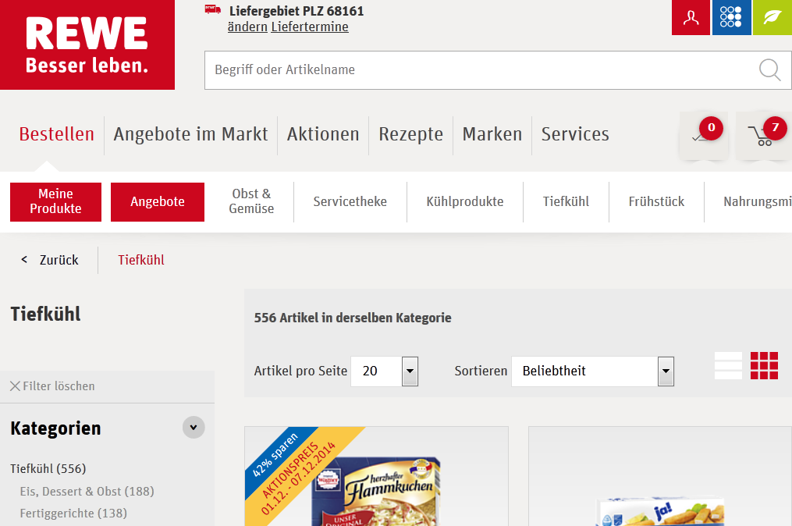
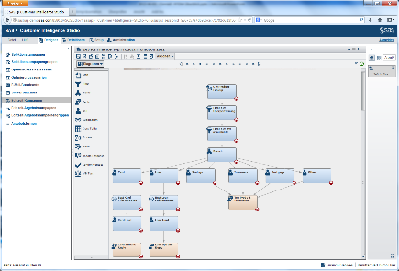
Integrated scoring und response tracking
Online-Shop
SAS Campagne Management
(Selection Diagram)
Call:
Recommendations
Chosen products
Track cancelations
SAS Realtime-Decision Manager
Regelbasis
…
…
…
Regeln für Segment „Bestandskunden“:
Cheese => Dessert | Lift: 2,0
Cheese & Frozen Foods => Milk | Lift: 2,1
Bread => Butter | Lift: 3,0
…
…
Regeln für Kunde 111444:
Cheese => Dessert | Lift: 2,0
Cheese & Frozen Foods => Milk | Lift: 2,1
Bread => Butter | Lift: 3,0
…
…
Regeln für Segment „Bestandskunden“:
Cheese => Wine| Lift: 1,9
Cheese & Frozen Foods => Milk | Lift: 1,4
Milk => Butter | Lift: 2,9
…
…
Regeln für Kunde 111333:
Cheese => Dessert | Lift: 2,0
Cheese & Frozen Foods => Milk | Lift: 2,1
Bread => Butter | Lift: 3,0
…
…
Regeln für Kunde 111222:
Cheese => Dessert | Lift: 2,0
Cheese & Frozen Foods => Milk | Lift: 2,1
Bread => Butter | Lift: 3,0
…
…
Regeln für Kunde 111111:
Cheese => Dessert | Lift: 2,0
Cheese & Frozen Foods => Milk | Lift: 2,1
Bread => Butter | Lift: 3,0
…
…
Regeln für alle Transaktionen:
Cola => Dessert | Lift: 2,0
Crisps & Frozen Foods => Cola| Lift: 1,4
Bread => Jam| Lift: 1,9
…
…
Regeln für Kunde 1104444:
Cheese => Dessert | Lift: 2,0
Cheese & Frozen Foods => Milk | Lift: 2,1
Bread => Butter | Lift: 3,0
…
…
Regeln für Kunde 1103333:
Cheese => Dessert | Lift: 2,0
Cheese & Frozen Foods => Milk | Lift: 2,1
Bread => Butter | Lift: 3,0
…
…
…
Regeln für Markt „XYZ“:
Cheese => Dessert | Lift: 2,0
Cheese & Frozen Foods => Milk | Lift: 2,1
Bread => Butter | Lift: 3,0
…
…
Regeln für Markt„ABC“:
Cheese => Dessert | Lift: 2,0
Cheese & Frozen Foods => Milk | Lift: 2,1
Bread => Butter | Lift: 3,0
…
…
Regeln für Markt„St. Wendel“:
Cheese => Dessert | Lift: 2,0
Cheese & Frozen Foods => Milk | Lift: 2,1
Bread => Butter | Lift: 3,0
…
…
Tracking:
Contact history
Response history of recommended products that have been bought
Track non-chosen recommendations (devaluation/ pre-filtering)
Campagn selection
Follow-up campgne
Cancelations
Non-chosen recommendations
Common Data Model

Slide 23
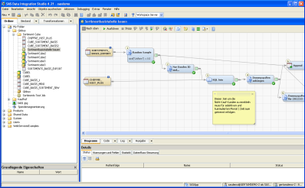
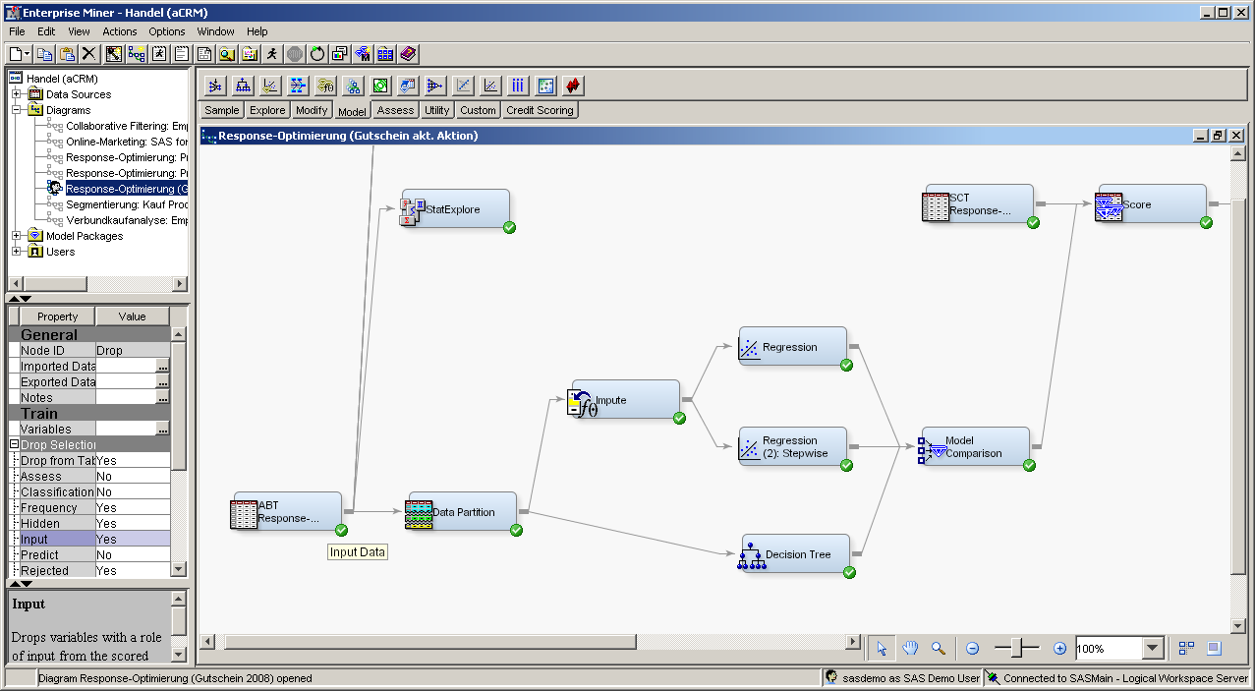
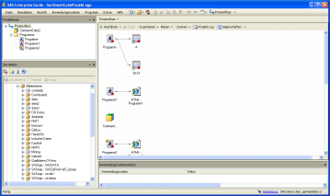
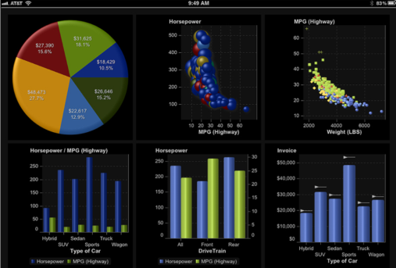
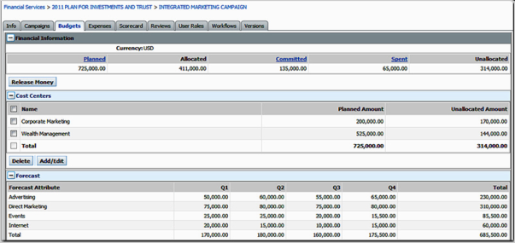
Integrated Scenario
Online-Shop
SAS Enterprise Miner
Socre market baskets against
Rule base/
(not) chosen recommendations
are put into history tables
(input for future rules)
Generate rules analytically,
Filter them and pre-process
Regelbasis
…
…
…
Regeln für Segment „Bestandskunden“:
Cheese => Dessert | Lift: 2,0
Cheese & Frozen Foods => Milk | Lift: 2,1
Bread => Butter | Lift: 3,0
…
…
Regeln für Kunde 111444:
Cheese => Dessert | Lift: 2,0
Cheese & Frozen Foods => Milk | Lift: 2,1
Bread => Butter | Lift: 3,0
…
…
Regeln für Segment „Bestandskunden“:
Cheese => Wine| Lift: 1,9
Cheese & Frozen Foods => Milk | Lift: 1,4
Milk => Butter | Lift: 2,9
…
…
Regeln für Kunde 111333:
Cheese => Dessert | Lift: 2,0
Cheese & Frozen Foods => Milk | Lift: 2,1
Bread => Butter | Lift: 3,0
…
…
Regeln für Kunde 111222:
Cheese => Dessert | Lift: 2,0
Cheese & Frozen Foods => Milk | Lift: 2,1
Bread => Butter | Lift: 3,0
…
…
Regeln für Kunde 111111:
Cheese => Dessert | Lift: 2,0
Cheese & Frozen Foods => Milk | Lift: 2,1
Bread => Butter | Lift: 3,0
…
…
Regeln für alle Transaktionen:
Cola => Dessert | Lift: 2,0
Crisps & Frozen Foods => Cola| Lift: 1,4
Bread => Jam| Lift: 1,9
…
…
Regeln für Kunde 1104444:
Cheese => Dessert | Lift: 2,0
Cheese & Frozen Foods => Milk | Lift: 2,1
Bread => Butter | Lift: 3,0
…
…
Regeln für Kunde 1103333:
Cheese => Dessert | Lift: 2,0
Cheese & Frozen Foods => Milk | Lift: 2,1
Bread => Butter | Lift: 3,0
…
…
…
SAS Reporting
Regeln für Markt „XYZ“:
Cheese => Dessert | Lift: 2,0
Cheese & Frozen Foods => Milk | Lift: 2,1
Bread => Butter | Lift: 3,0
…
…
Regeln für Markt„ABC“:
Cheese => Dessert | Lift: 2,0
Cheese & Frozen Foods => Milk | Lift: 2,1
Bread => Butter | Lift: 3,0
…
…
Regeln für Markt„St. Wendel“:
Cheese => Dessert | Lift: 2,0
Cheese & Frozen Foods => Milk | Lift: 2,1
Bread => Butter | Lift: 3,0
…
…
Rule Managment
Rule statistics,
Changes in Rules,
Rule comparison between
market basket groups
Create manual rules /
Filter rules / manage Black listing /
Etc.

Slide 24
Questions!

