Slide 1
In the morning

Slide 2
Getting up
Turn off alarm
Get out of bed

Slide 3
Breakfast
Eat eggs
Drink coffee

Slide 4
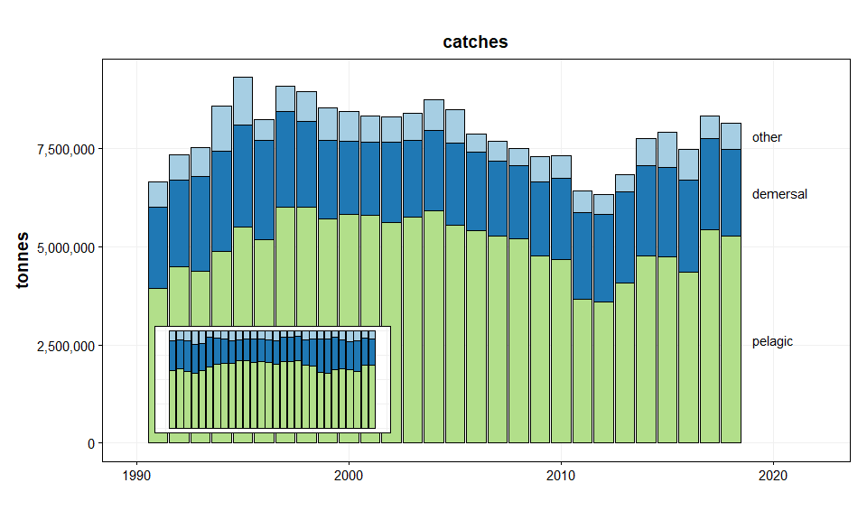
Catches by fisheries guild

Slide 5
More information
Please refer to the ICES website for an overview of all advice documents.

