Slide 2
PCPP1
Python

Slide 3
OOPS
OOPS foundation
OOPS Advanced
Exceptions
Object Persistence
MetaProgrammig
Assessment

Slide 4
Exception
__context__
__cause__
__traceback__
Type: Class traceback
Exception vars:
e.args
e.path
e.name
format_tb() print_tb()

Slide 5
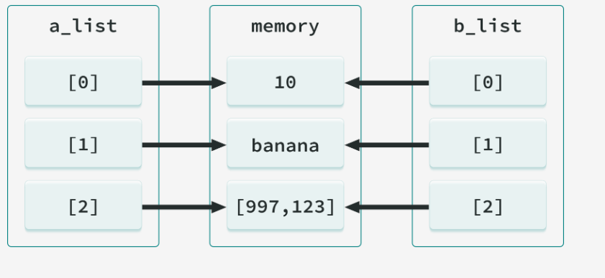
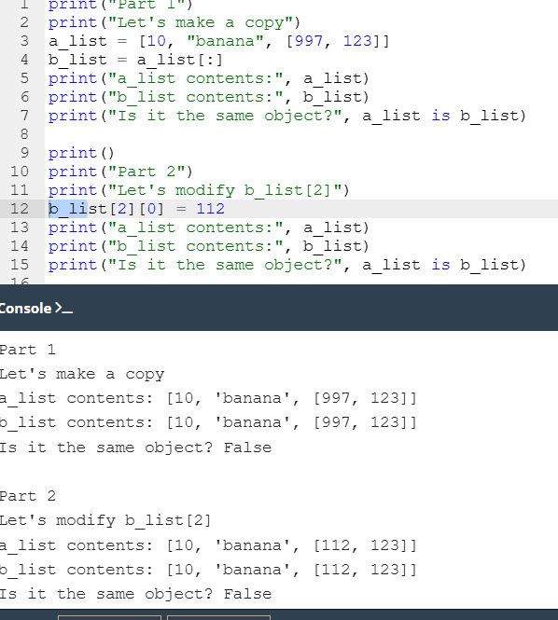
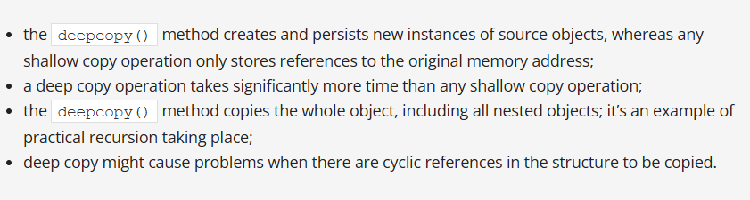
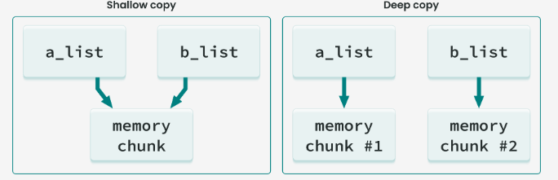
Object Persistence
Shallow Copy
[:]
function returns the 'identity' of an object
id()
compound object (list, dictionary, custom class instance)
Deep copy
integer
Str1 == str2
Value comparison
== & is: True
a_string = ['10', 'days', 'to', 'departure']
b_string = a_string
Str1 is str2
Object id comparison
== : True
Is: False
a_string = ['10', 'days', 'to', 'departure']
b_string = ['10', 'days', 'to', 'departure']
copy.deepcopy() - copy dictionaries or custom class objects
copy() - shallow copy

Slide 6
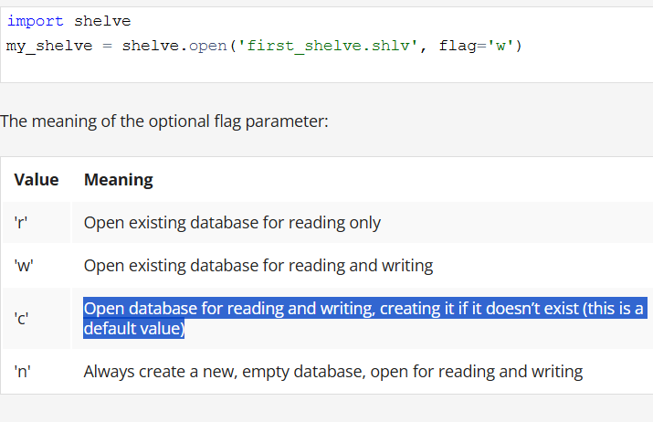
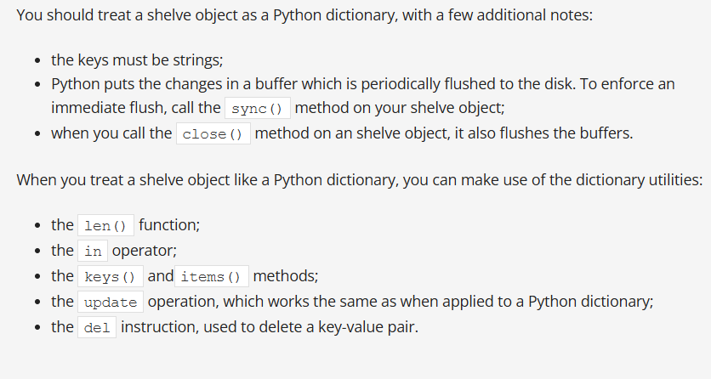
Serialization of Python objects using the pickle module
shelve
n Python, object serialization is the process of converting an object structure into a stream of bytes to store the object in a file or database, or to transmit it via a network. This byte stream contains all the information necessary to reconstruct the object in another Python script.
This reverse process is called deserialization.
Pickling is the process of preserving or extending the lifespan of food. The resulting food is called a pickle, and to prevent ambiguity, prefaced with the 'pickled' adjective.
pickle.dumps() and pickle.loads()
pickle.dumps(object_to_be_pickled) – expects an initial object, returns a byte object. This byte object should be passed to a database or network driver to persist the data;
pickle.loads(bytes_object) – expects the bytes object, returns the initial object.
The following types can be pickled:
  None, booleans;
  integers, floating-point numbers, complex numbers;
  strings, bytes, bytearrays;
  tuples, lists, sets, and dictionaries containing pickleable objects;
  objects, including objects with references to other objects (remember to avoid cycles!)
  references to functions and classes, but not their definitions.
PicklingError
RecursionErro
AtrributeErrorr
Trying to pickle a highly recursive data structure (mind the cycles) may exceed the maximum recursion depth
ensure that the environment where the class or function is unpickled is able to import the class or function definition.

Slide 7
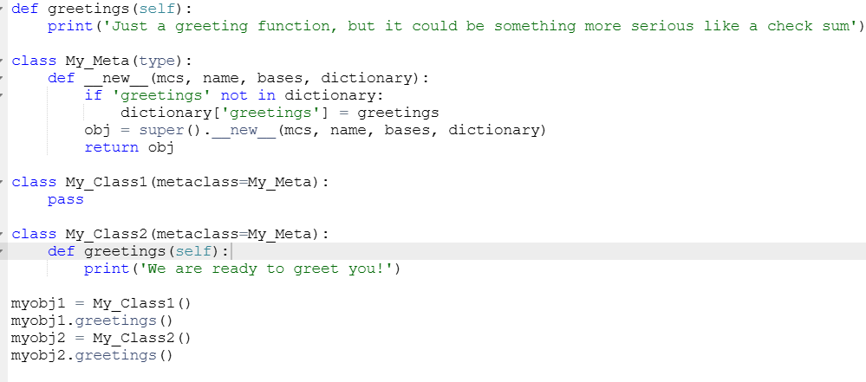
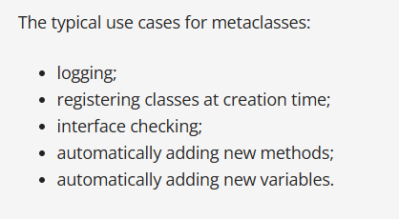
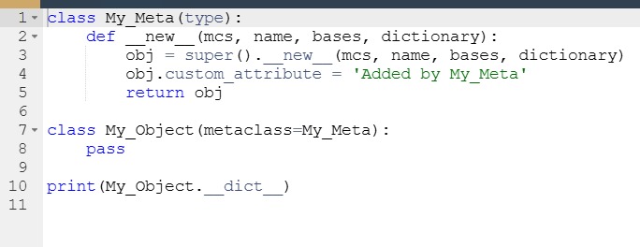
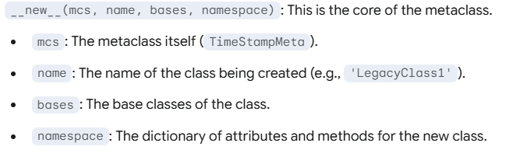
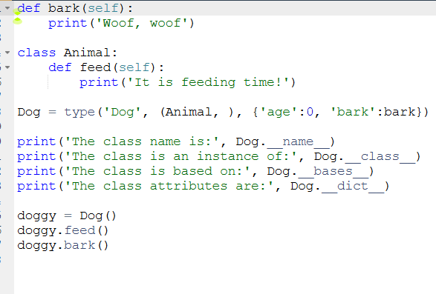
Metaprogramming
__dict__
type() function is called with three arguments, then it dynamically creates a new class.
For the invocation of type(, , )
inherent for both classes and instances
__class__ - type() return same
__name__
inherent for class
__bases__

Slide 8
Chain of responsibility
Iterator Pattern
Strategy Pattern
Interact with external.
Communication related
Behavior Pattern
Subscriber
Publisher
Observer
Command
Undo/Redo

Slide 9
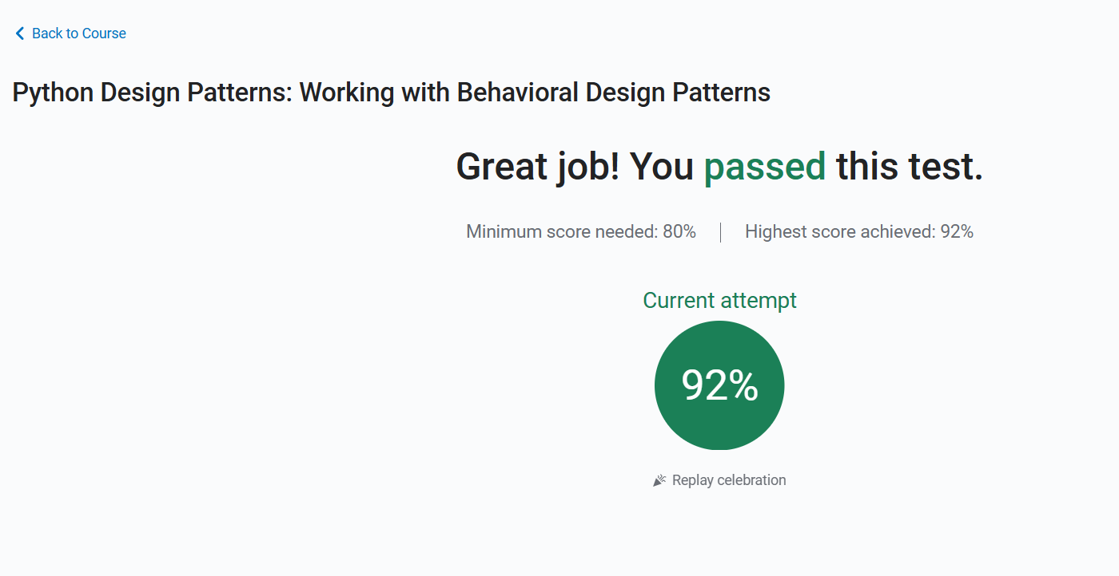

Slide 10
import logging
logging.basicConfig()
logger = logging.getLogger()
logger.setLevel(logging.DEBUG)
logger.critical('Your CRITICAL message')
Levels
Calling the basicConfig method (without specifying any arguments) creates a StreamHandler object that processes the logs and then displays them in the console.
Level Method
logging.setLevel()
Logging
The formatter is crated and mapped to the handler
Formatter
Logging method can be configured on basicConfig Also
import logging
FORMAT = '%(name)s:%(levelname)s:%(asctime)s:%(message)s'
logger = logging.getLogger(__name__)
handler = logging.FileHandler('prod.log', mode='w')
handler.setLevel(logging.CRITICAL)
formatter = logging.Formatter(FORMAT)
handler.setFormatter(formatter)
logger.addHandler(handler)
logger.critical('Your CRITICAL message')
logger.error('Your ERROR message')
logger.warning('Your WARNING message')
logger.info('Your INFO message')
logger.debug('Your DEBUG message')
Level
Handler
basicConfig
Filename FileHandler.
Format
FORMAT = '%(name)s:%(levelname)s:%(asctime)s:%(message)s'
FORMAT = '%(name)s:%(levelname)s:%(asctime)s:%(message)s'
logging.basicConfig(level=logging.CRITICAL, filename='prod.log', filemode='a', format=FORMAT)
logging.basicConfig(level=logging.DEBUG, filename='martin_logging.log', filemode='a')

Slide 11
[DEFAULT]
host = localhost # This is a comment.
[mariadb]
name = hello
user = user
password = password
[redis]
port = 6379
db = 0
import configparser
config = configparser.ConfigParser()
print(config.read('config.ini'))
print('Sections:', config.sections(),'\n')
print('mariadb section:')
print('Host:', config['mariadb']['host'])
print('Database:', config['mariadb']['name'])
print('Username:', config['mariadb']['user'])
[DEFAULT]
host = localhost
[mariadb]
name = hello
user = user
password = password
[redis]
port = 6379
db = 0
dsn = redis://%(host)s
ConfigParser
read_file
read_dict
Interpolating values
It allows you to create expressions consisting of a placeholder under which the appropriate value will be substituted
read_string

Slide 12
method overriding
Classses
static and class methods
inheritance
OOPS
metaclasses
special methods
polymorphism
methods
abstract classes
instances
encapsulation
attributes
shallow and deep operation
the pickle and shelve modules
advanced exception handling techniques
OOPS

Slide 13
An attribute is a capacious term that can refer to two major kinds of class traits:
variables, containing information about the class itself or a class instance; classes and class instances can own many variables;
methods, formulated as Python functions; they represent a behavior that could be applied to the object.
A class expresses an idea; it’s a blueprint or recipe for an instance. The class is something virtual, it can contain lots of different details, and there is always one class of any given type. Think of a class as a building blueprint that represents the architect’s ideas, and class instances as the actual buildings.
Type
it is the foremost type that any class can be inherited from;
as a result, if you’re looking for the type of class, then type is returned.
Information about an object’s class is contained in __class__.
attributes
Class Variable
Class variables are defined within the class construction, so these variables are available before any class instance is created
An instance is one particular physical instantiation of a class that occupies memory and has data elements. This is what 'self' refers to when we deal with class instances.
An object is everything in Python that you can operate on, like a class, instance, list, or dictionary.
The term instance is very often used interchangeably with the term object, because object refers to a particular instance of a class. It’s a bit of a simplification, because the term object is more general than instance.
The relation between instances and classes is quite simple: we have one class of a given type and an unlimited number of instances of a given class.
OOPS
getattr() and setattr()
Class
“dunder” for double underscores
Instance Variable
This kind of variable exists when and only when it is explicitly created and added to an object. This can be done during the object's initialization, performed by the __init__ method, or later at any moment of the object's life

