Slide 1
Virtual Commando 1.0

Slide 2
Idea
Build a 2d shooter
Do your own game engine, own collision detection, geometric primitives, etc
Add multiplayer using a TCP connection
Add bots which have some navigation and shooting capabilities
Add custom map rendering (TMX)
Add different possibilities and assets like animations (the fountain, soundm etc)

Slide 3
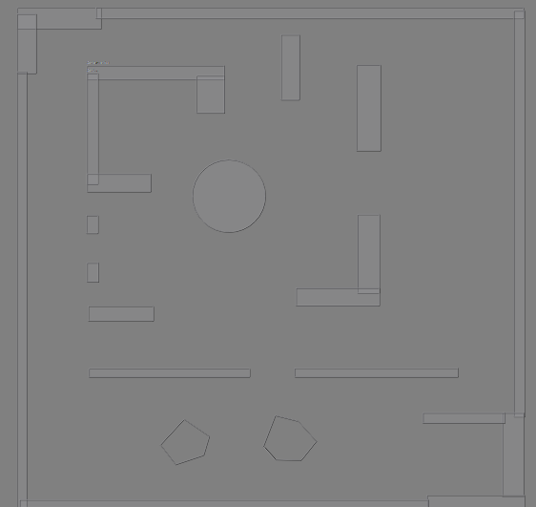
TMX Map example

Slide 4
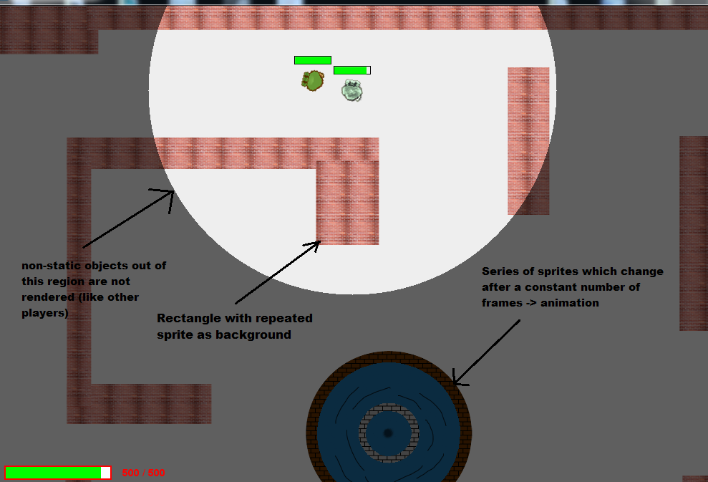
Some game explanations

Slide 5
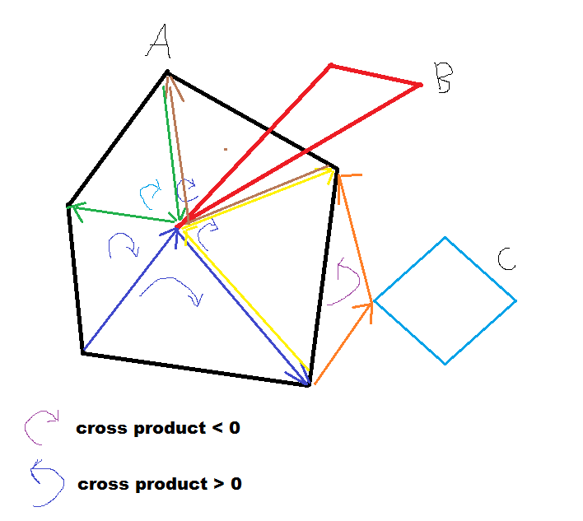
Collision detection #1 basic collision detection for convex polygons

Slide 6
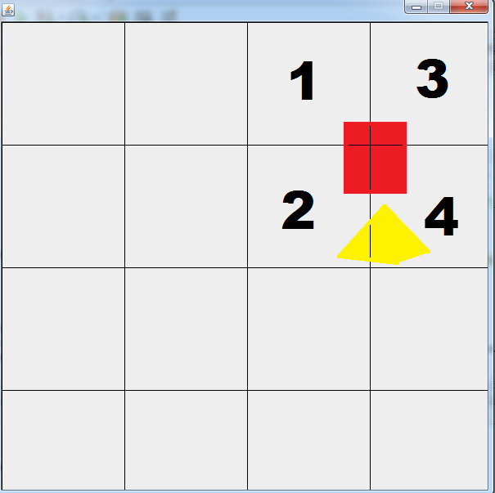
Collision detection #2 collision optimization using BSP

Slide 7
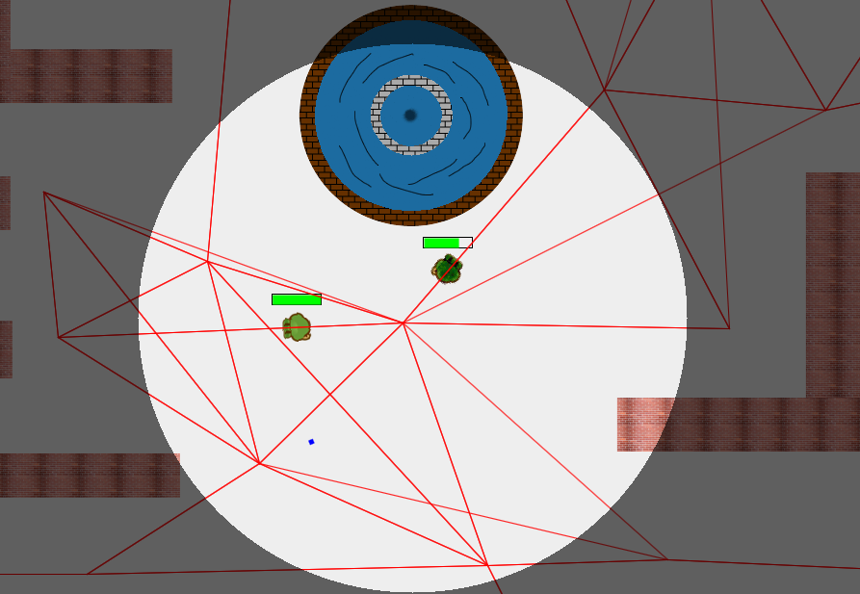
Bot navigation using way points

Slide 8
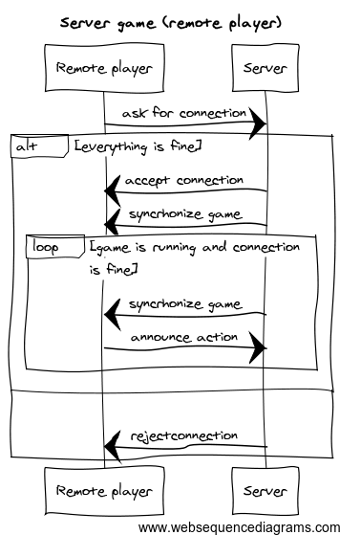
Server communication

Slide 9
Questions?
Github repo: http://github.com/martinradev/2dShooter/

