Slide 1
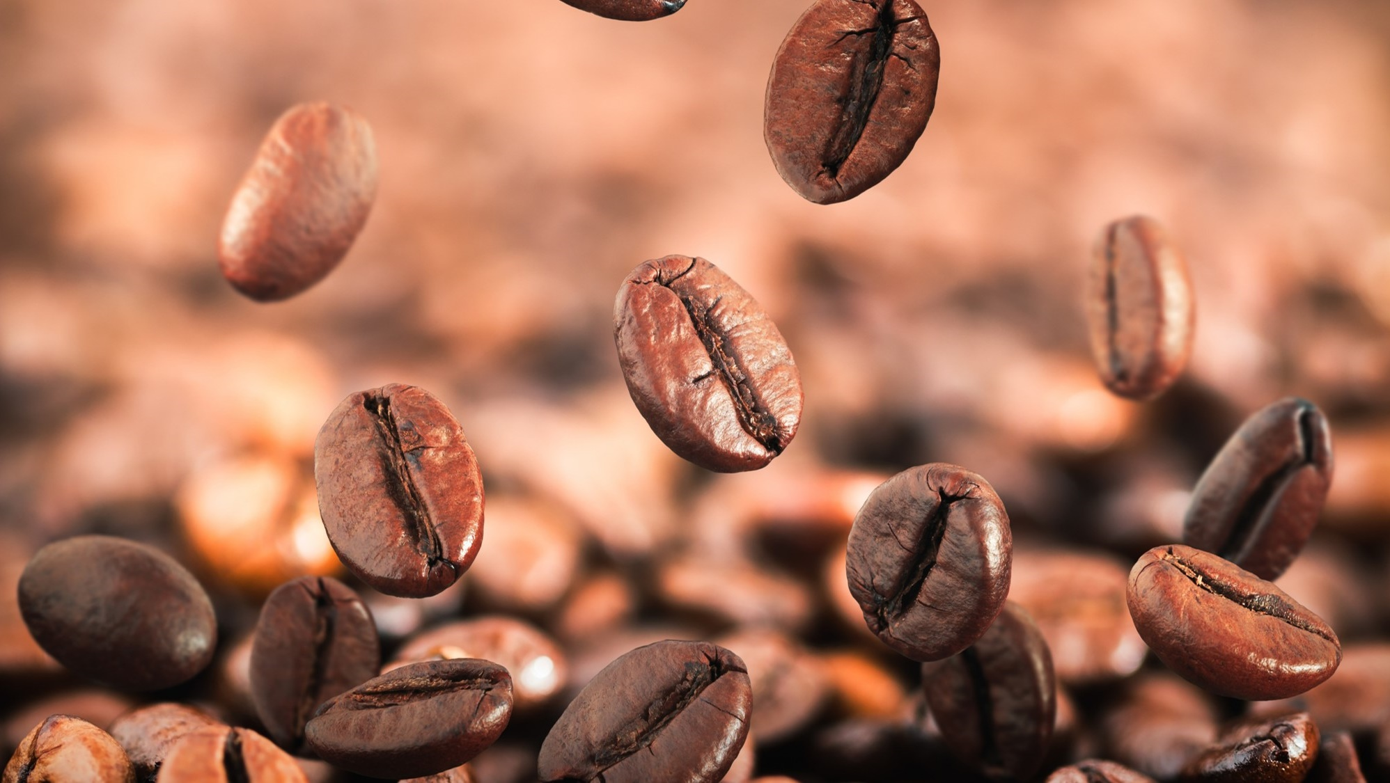
Coffee Hub: Potential suppliers
Martin Raubenheimer

Slide 2
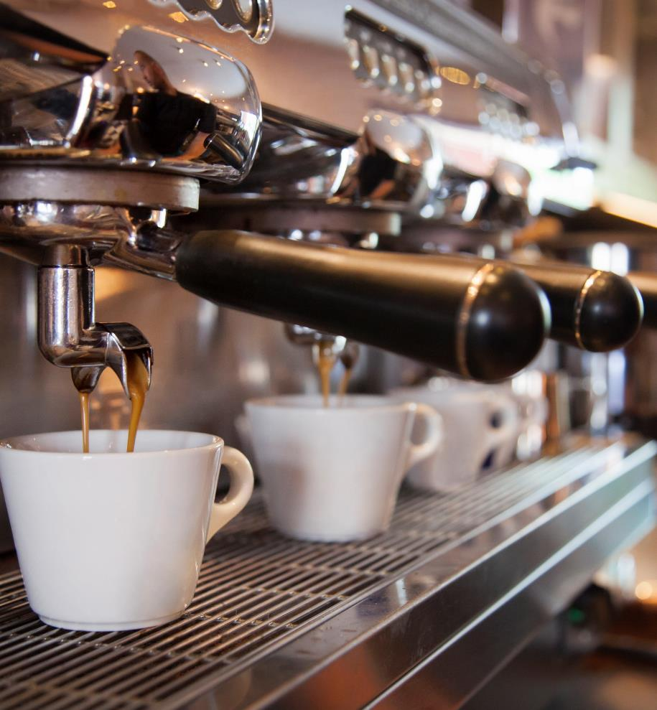
Agenda
Where is coffee sourced?
How is different coffees distinguished?
Recommendations

Slide 3
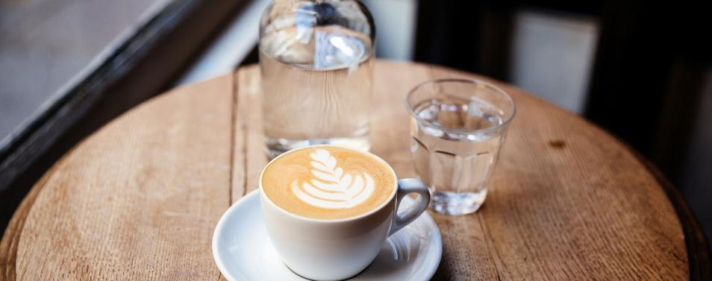
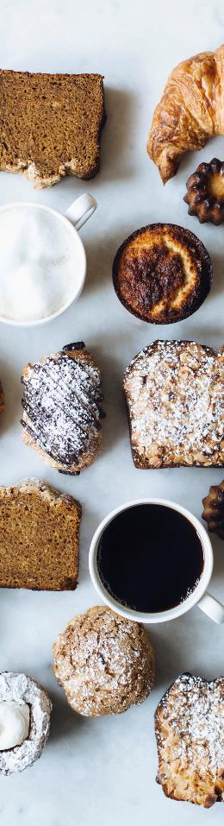
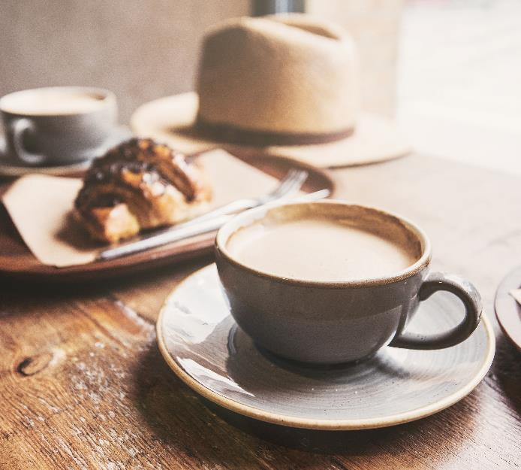
Introduction
The purpoe of this powerpoint is to give the owner of Coffee Hub a clear understanding of different the different characteristics of coffee, where coffea is sourced from and giving clear recommendations which coffee should be sourced.

Slide 4
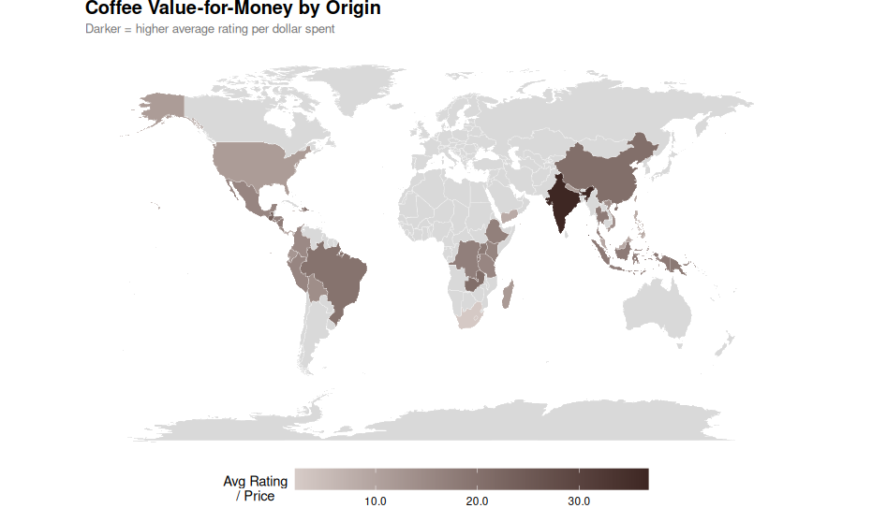
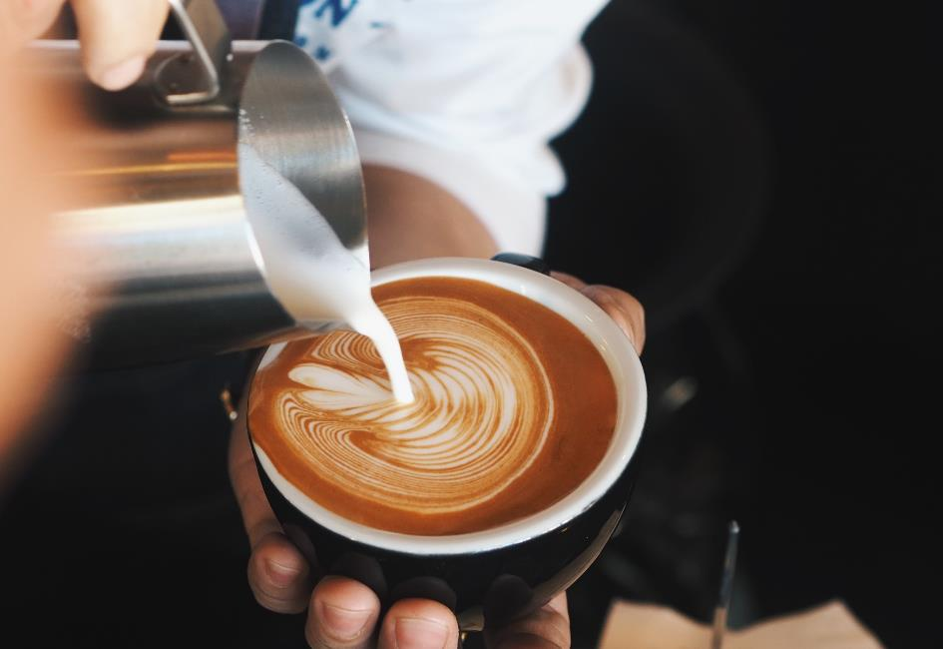
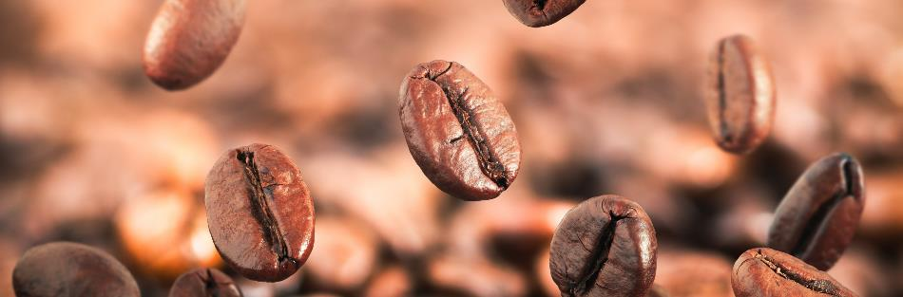
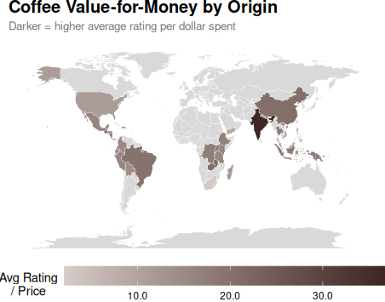
The way to get started is to quit talking and begin doing.
Notes:
This image is desinged just to illustrate where coffee is mostly sourced from. As can be seen coffee is mostly grown in tropical climates around equator. As a bonus we can see that it seems as if India gives the best value for money although the reason India is so dark is mainly because of its low price.

Slide 5
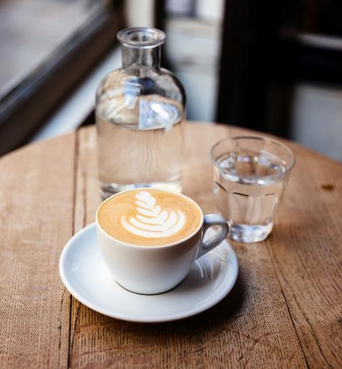
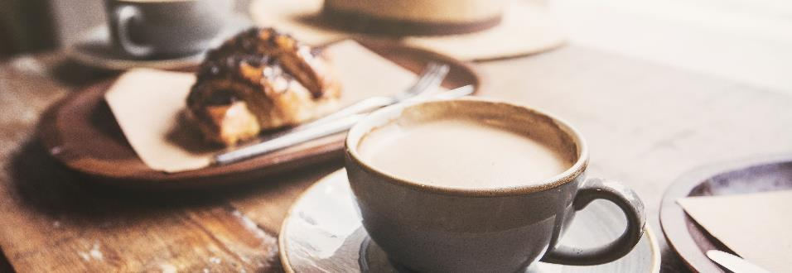
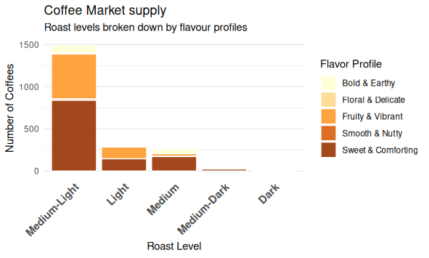
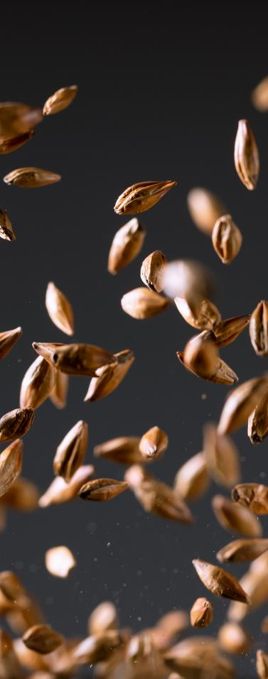
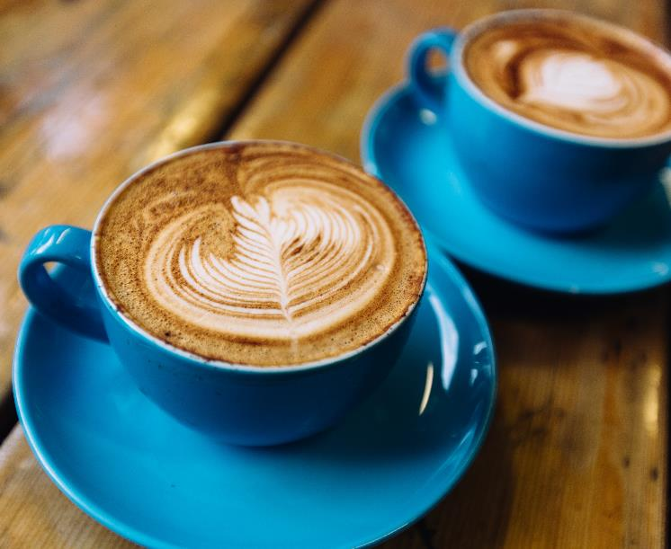
Subtitle
Notes:
This graph very clearly illustrates that there are very few medium dark and dark coffee supplied to the market. Medium light coffee clearly domiates all other roast levels. The flavor profiles were created from the word cloud of Maties student's preferences. Each coffee was then categorised into those profiles by using the reviewer's descriptions. We see most coffees are being described as either Fruity& Vibrant or Sweet and Comforting. If we had access to surveyed student's resposnes and not just a word cloud I could of generated this plot for coffee demand instead of supply.

Slide 6
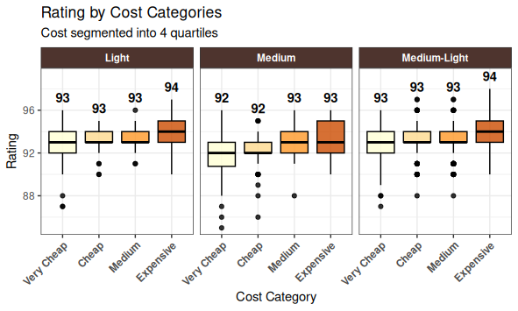
Timeline
Notes:
We saw previously that dark and medium dark roast is not that popular among suppliers and deduce that is a relatively niche market, so we focus on the other three roast levels. From this barplot we see that for Light, Medium-Light and Medium roast levels one can find highly rated coffees for various different prices.

Slide 7
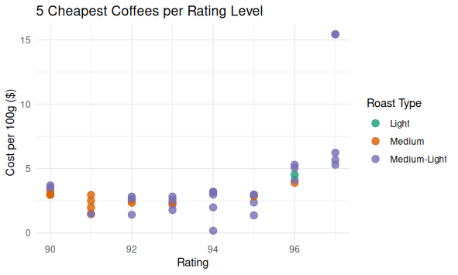
Notes:
This graph clearly shows us that if we buy coffee rated at below 95, we can buy could have bought better coffee at the same price. This illustrates that high quality coffee is available at decent prices.

Slide 8
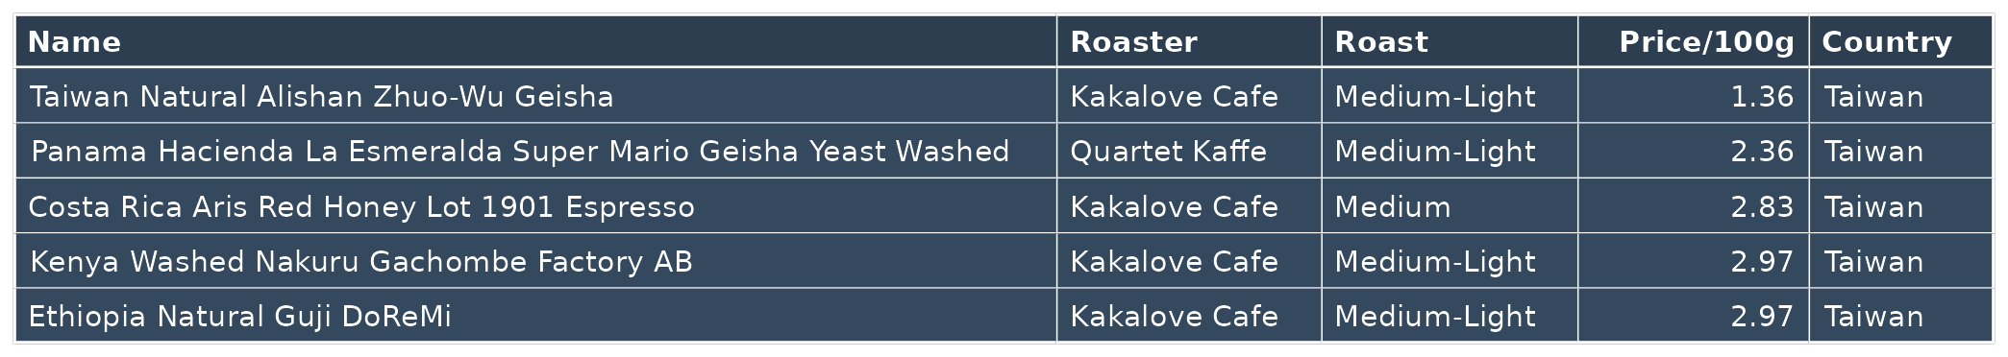
5 Cheapest Coffee rated at 95
Notes:
This is the first of two options I propose. These are the five cheapest coffees that are rated at 95. Since we have seen that there is a bit of a jump in price I would recommend one these options,especially since the target market is students.

Slide 9
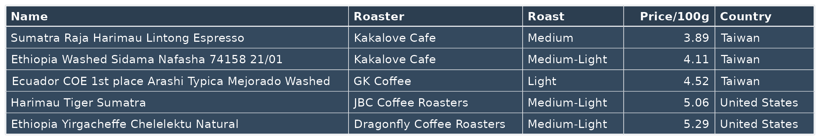
5 Cheapest Coffee rated at 96
Notes:
But I also provide this plot if the owner really wants to stand out above the other coffee shops in the Neelsie, she should consider one of these options.

Slide 10
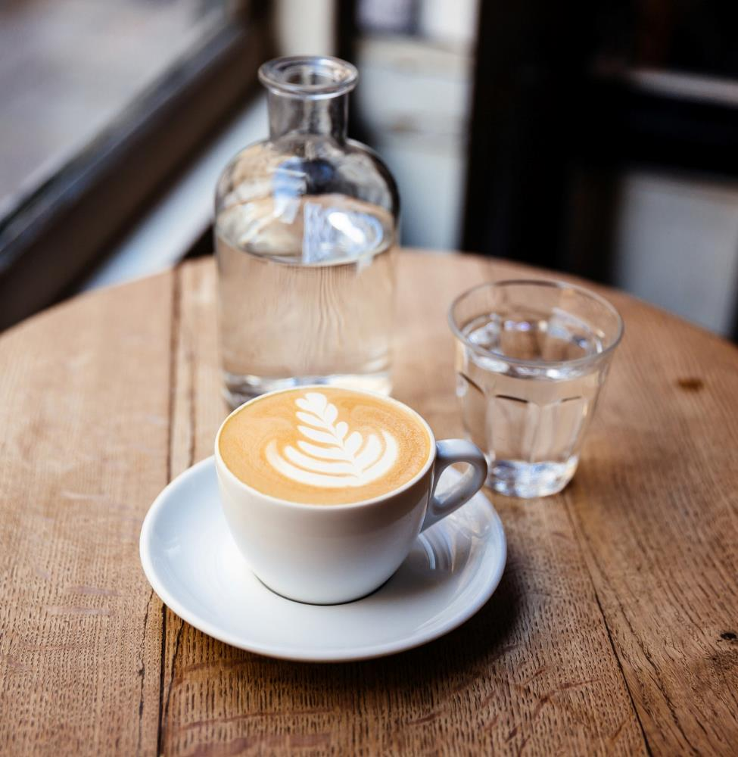
Thank You
Presenter Name
Email Address
Website Address

