Slide 1
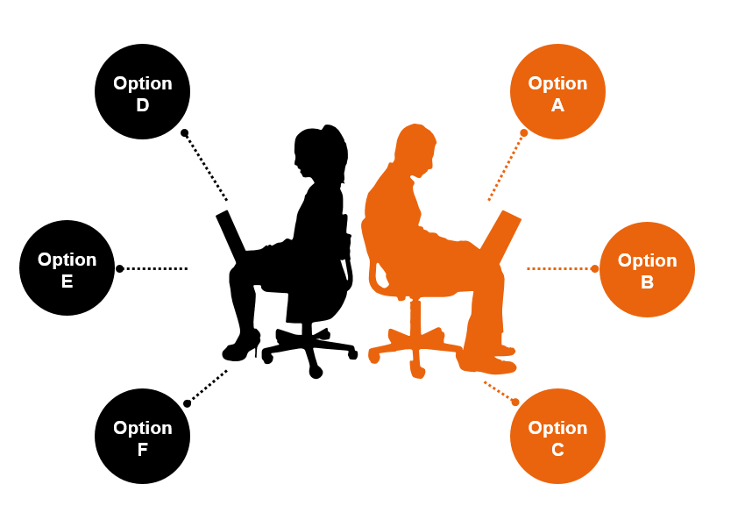
Kwizzle
Where Learning Meets Excitement!

Slide 2

Purpose and Goals
The mission is to make learning a delightful adventure by providing a fun platform for exploring various subjects, encouraging challenges, and fostering a sense of community through friendly competition.

Slide 3


Problem Solving and Value Proposition
Kwizzle solves the challenge of making learning engaging by turning education into an interactive game. It enhances knowledge, boosts confidence, and builds a community of learners through friendly competition.

Slide 4
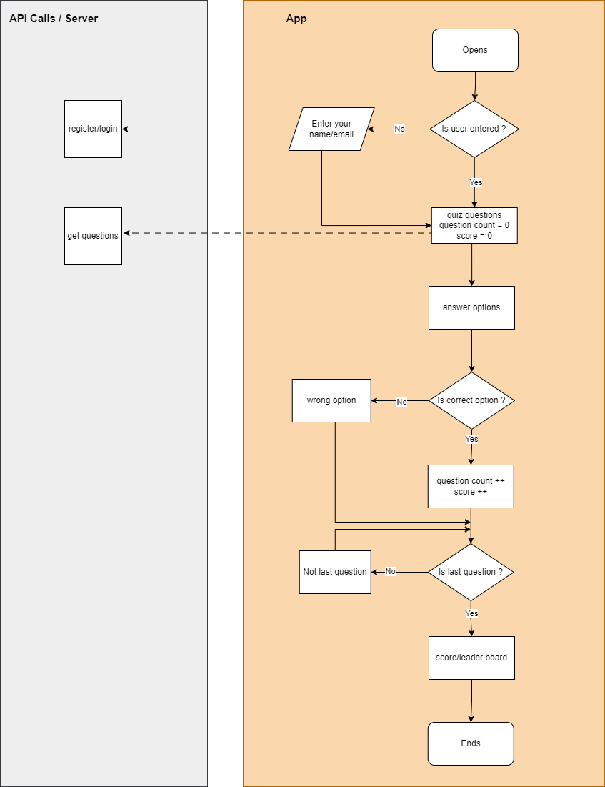
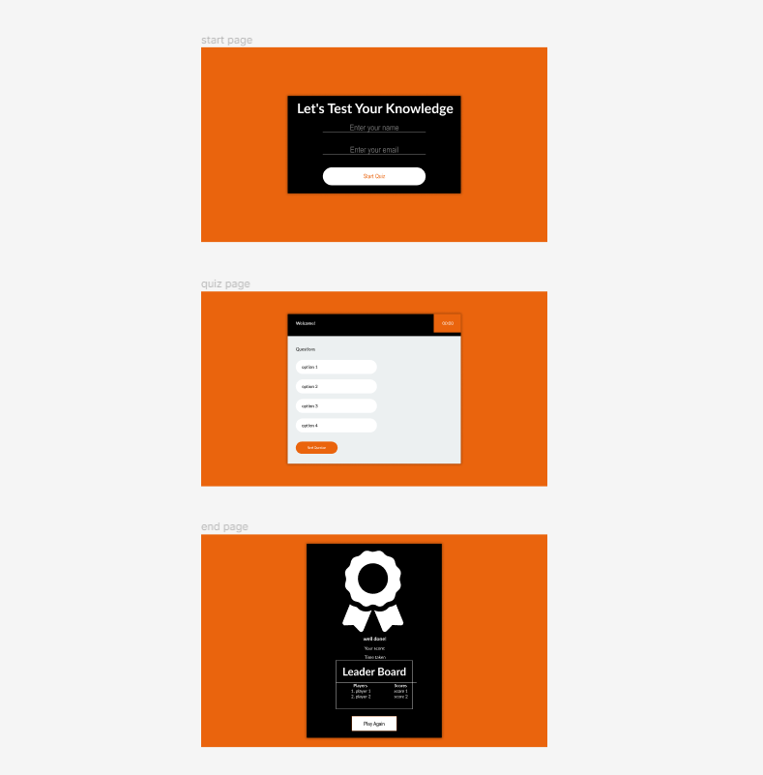

Features and Functionality
User verification: collects user details for result display and leaderboard.
Multiple-choice questions: engages users with diverse and informative questions spanning various subjects.
The leaderboard and challenges encourage community involvement through friendly competitions.

Slide 5

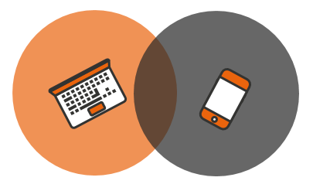
Technologies Used
- Frontend development: HTML, CSS, JavaScript
- Backend development (future upgrades): python and flask framework
- Database (future upgrades): SQLAchemy (SQL)
- Web services: API (future upgrade)
- Version control: git
- Development tools: visual studio code

Slide 6
Thank You

