Slide 1
Annotated Bibliography
Computing – Faculty of Business, Law and Digital
martin.reid@solent.ac.uk

Slide 2
Bibliography List
BLOG, N.T., 2016. Protecting Netflix Viewing Privacy at Scale. In: -08-08T07:00:00.000Z [viewed Nov 17, 2017]. Available from: https://medium.com/netflix-techblog/protecting-netflix-viewing-privacy-at-scale-39c675d88f45
CASTELLANOS, J. and D. AXELROD, 1990. Effect of habitual knuckle cracking on hand function. Annals of the rheumatic diseases, 49(5), 308-309
COPPOLA, R. and M. MORISIO, 2016. Connected Car: Technologies, Issues, Future Trends. ACM Computing Surveys (CSUR), 49(3), 1-36
DEANS, T., 2009. Managing the Freshman Year. Urbana: National Council of Teachers of English, pp.W496
GOODSTEIN, L.D.(. et al., 1986. Motivational Processes Affecting Learning. American Psychologist, 41(10), 1040-1048
HIGHER EDUCATION, P.I., MORI and UNITE, 2005. The student experience report 2005. Bristol: UNITE

Slide 3
Annotated Bibliography - Structure
KRUGER, JUSTIN & DUNNING, DAVID, 1999. Unskilled and Unaware of It: How Difficulties in Recognizing One's Own Incompetence Lead to Inflated Self-Assessments. (Statistical Data Included). Journal of Personality and Social Psychology, 77(6), pp.1121–34.
http://dx.doi.org/10.1037/0022-3514.77.6.1121
1
Harvard Reference
1
Harvard Reference
2
Overview
3
Summary
4
Evaluation
5
Usefulness

Slide 4
Before you start an Annotated Bibliography you will been to have found, read and understood a range of useful sources to support your project/reporting writing.
More information on evaluating sources can be found on succeed@solent

Slide 5
Annotated Bibliography - Introduction
The purpose of the Annotated Bibliography is to assess the standing, quality and usefulness of sources by summarising them in YOU OWN WORDS in preparation for completing a Literature Review/survey.

Slide 6
Annotated Bibliography - Introduction
An Annotated Bibliography simply means “Note about a book” but can relate to notes on any type of sources:
Annotated Bibliography is a “database” of information
It should be one of the first steps when undertaking research
See it as a “diary recording your reactions to information you have discovered.
It speeds up your research process – as you will already have gathered organised and evaluated your sources.
Each item is 150 words excluding the Harvard reference

Slide 7
Annotated Bibliography - workflow
Search for useful sources
Read and understand them
Record them in RefWorks (or similar)
Collect/record useful documents, diagrams/images & snippets of information
Write up an Annotated Bibliography for each of the most useful sources

Slide 8
Annotated Bibliography - Structure
KRUGER, JUSTIN & DUNNING, DAVID, 1999. Unskilled and Unaware of It: How Difficulties in Recognizing One's Own Incompetence Lead to Inflated Self-Assessments. (Statistical Data Included). Journal of Personality and Social Psychology, 77(6), pp.1121–34.
http://dx.doi.org/10.1037/0022-3514.77.6.1121
1
Harvard Reference
1
Harvard Reference
2
Overview
3
Summary
4
Evaluation
5
Usefulness

Slide 9
Annotated Bibliography – Harvard Reference
KRUGER, JUSTIN & DUNNING, DAVID, 1999. Unskilled and Unaware of It: How Difficulties in Recognizing One's Own Incompetence Lead to Inflated Self-Assessments. (Statistical Data Included). Journal of Personality and Social Psychology, 77(6), pp.1121–34.
http://dx.doi.org/10.1037/0022-3514.77.6.1121
Harvard Reference
1

Slide 10
Annotated Bibliography - Harvard Reference
This reference is in the correct Harvard structure: KRUGER, JUSTIN & DUNNING, DAVID, 1999. Unskilled and Unaware of It: How Difficulties in Recognizing One's Own Incompetence Lead to Inflated Self-Assessments. (Statistical Data Included). Journal of Personality and Social Psychology, 77(6), pp.1121–34.

Slide 11
Annotated Bibliography - DOI
…but it is a good idea to add (manually) the Digital Object Identifier: DOI to the bottom of the journal reference like this:
KRUGER, JUSTIN & DUNNING, DAVID, 1999. Unskilled and Unaware of It: How Difficulties in Recognizing One's Own Incompetence Lead to Inflated Self-Assessments. (Statistical Data Included). Journal of Personality and Social Psychology, 77(6), pp.1121–34.
http://dx.doi.org/10.1037/0022-3514.77.6.1121

Slide 12
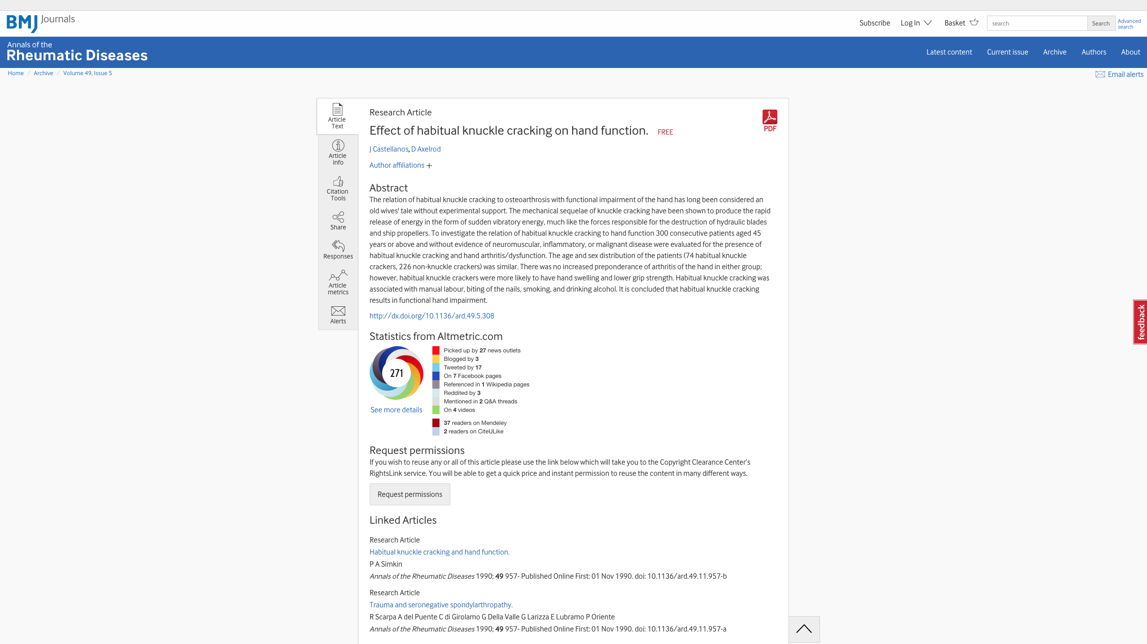

Slide 13
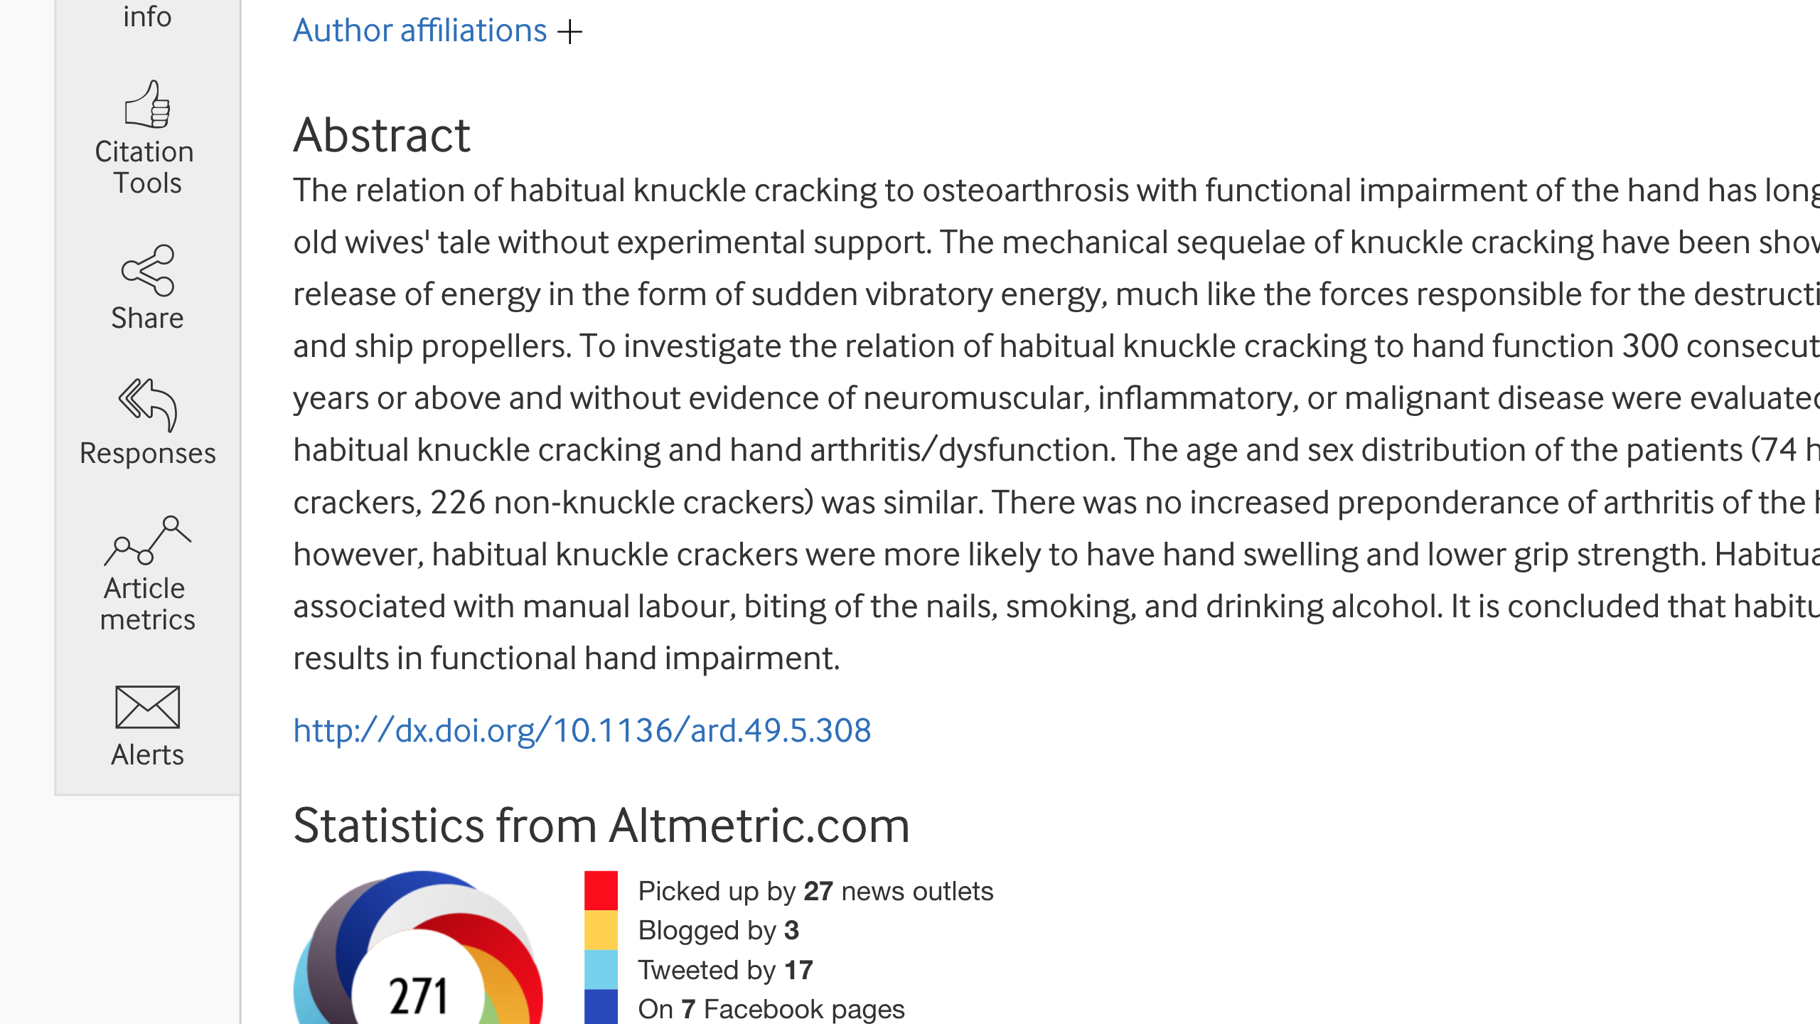

Slide 14
DOI link might be presented like this & will not work:
10.1136/ard.49.11.957-b
If this is the case just add http://dx.doi.org/:
http://dx.doi.org/10.1136/ard.49.11.957-b

Slide 15
Annotated Bibliography - Overview
KRUGER, JUSTIN & DUNNING, DAVID, 1999. Unskilled and Unaware of It: How Difficulties in Recognizing One's Own Incompetence Lead to Inflated Self-Assessments. (Statistical Data Included). Journal of Personality and Social Psychology, 77(6), pp.1121–34.
http://dx.doi.org/10.1037/0022-3514.77.6.1121
Harvard Reference
1
2
Overview

Slide 16
Annotated Bibliography - Overview
The overview includes:
Descriptive/summary of what you have found
The reference/citation to where you found it
What value it has – the information that is critical to your project

Slide 17
Annotated Bibliography
KRUGER, JUSTIN & DUNNING, DAVID, 1999. Unskilled and Unaware of It: How Difficulties in Recognizing One's Own Incompetence Lead to Inflated Self-Assessments. (Statistical Data Included). Journal of Personality and Social Psychology, 77(6), pp.1121–34.
http://dx.doi.org/10.1037/0022-3514.77.6.1121
Harvard Reference
1
2
Overview
Summary
3

Slide 18
Annotated Bibliography - Summary
The summary includes:
What the source is about IN YOU OWN words (do not copy & paste)
How methods were used & main statistics from analysis
REMEMBER to pay attention to the conclusions

Slide 19
Annotated Bibliography - Evaluation
KRUGER, JUSTIN & DUNNING, DAVID, 1999. Unskilled and Unaware of It: How Difficulties in Recognizing One's Own Incompetence Lead to Inflated Self-Assessments. (Statistical Data Included). Journal of Personality and Social Psychology, 77(6), pp.1121–34.
http://dx.doi.org/10.1037/0022-3514.77.6.1121
Harvard Reference
1
2
Overview
3
Summary
4
Evaluation

Slide 20
Annotated Bibliography - Evaluation
The Evaluation includes:
For what purpose was the source published
Determined the credibility and reliability of the source
Is it peer-reviewed?
Has it been widely cited?

Slide 21
Annotated Bibliography - Usefulness
KRUGER, JUSTIN & DUNNING, DAVID, 1999. Unskilled and Unaware of It: How Difficulties in Recognizing One's Own Incompetence Lead to Inflated Self-Assessments. (Statistical Data Included). Journal of Personality and Social Psychology, 77(6), pp.1121–34.
http://dx.doi.org/10.1037/0022-3514.77.6.1121
1
Harvard Reference
1
Harvard Reference
2
Overview
3
Summary
4
Evaluation
5
Usefulness

Slide 22
Annotated Bibliography - Usefulness
The Usefulness includes:
How useful is the source to you?
Focus on statistics, examples quotes and facts (if you do include any quotes make sure these are presented in “speech marks” to differentiate them from your own writing.

Slide 23
Thank you

