Slide 1
Systems Modelling
UML (Unified Modelling Language)

Slide 2
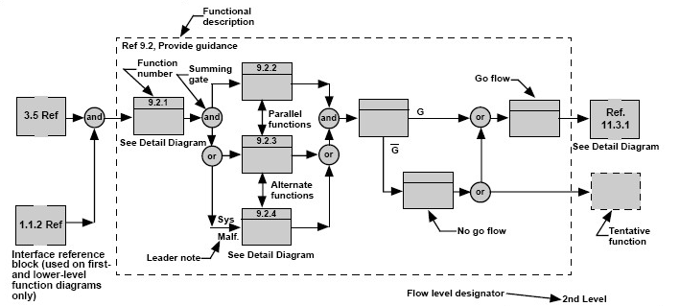
Systems modelling is a process of creating simplified representations or models of complex systems in order to understand their behaviour, analyse their dynamics, and make predictions or decisions based on those models.
Using mathematical and conceptual tools to describe and simulate the interactions and relationships among different components or elements within a system.

Slide 3
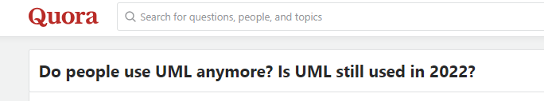

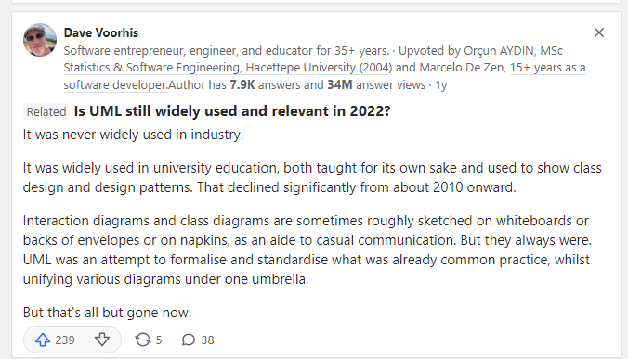
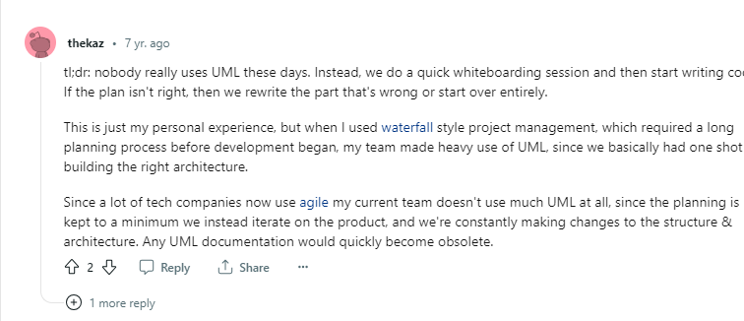
COBB, C., 2019. Agile Project Management Training [viewed 26 June 2023]. Available from: https://managedagile.com/is-uml-still-relevant-today/
https://www.quora.com/Do-people-use-UML-anymore-Is-UML-still-used-in-2022

Slide 4
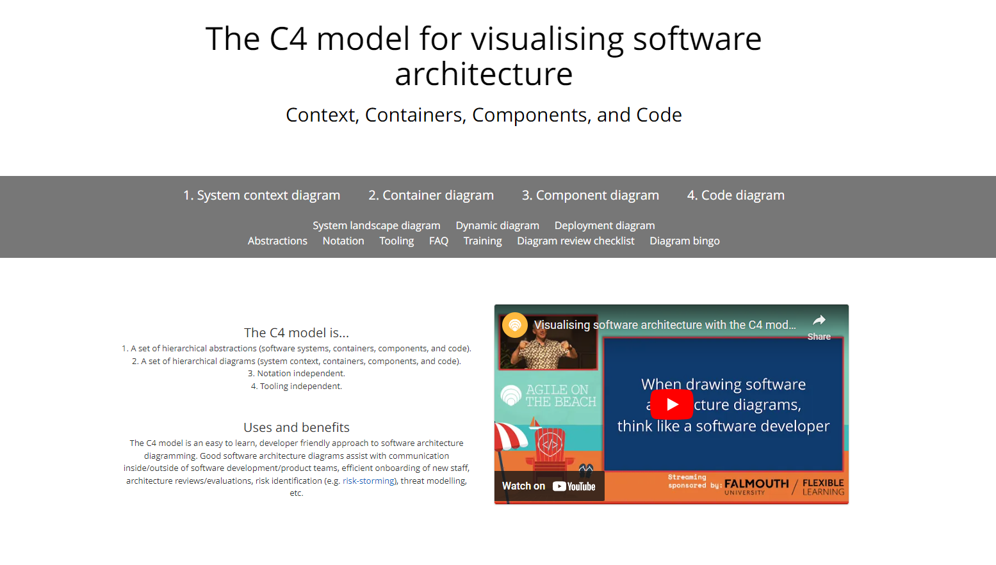
BROWN, S., 2011. The C4 model for visualising software architecture [viewed 26 June 2023]. Available from: https://c4model.com/

Slide 5
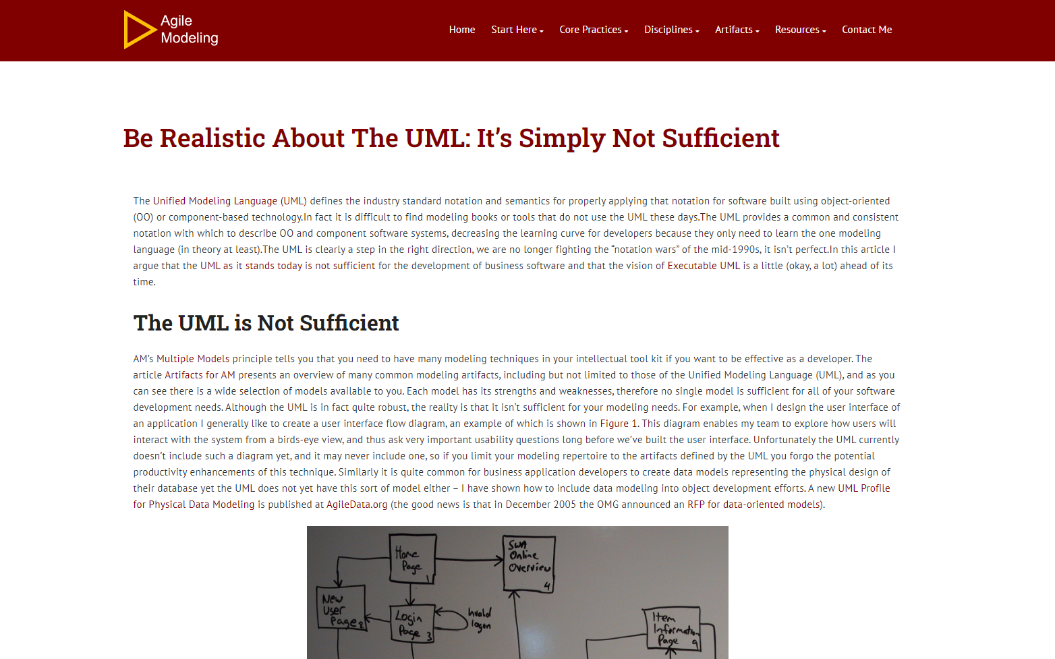
AGILE MODELING, 2023. Be Realistic About the UML: It’s Simply Not Sufficient – The Agile Modeling (AM) Method [viewed 26 June 2023]. Available from: https://agilemodeling.com/essays/realisticuml.htm

Slide 6
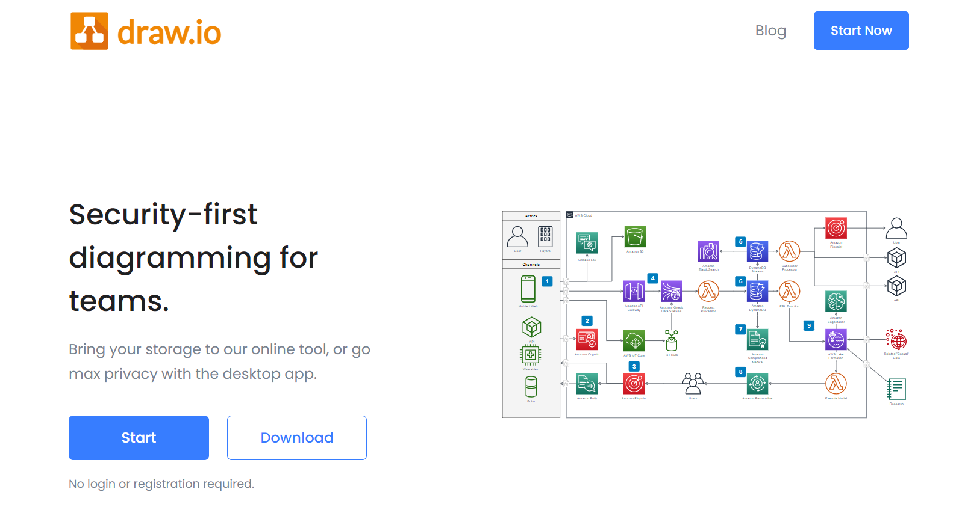

Slide 7
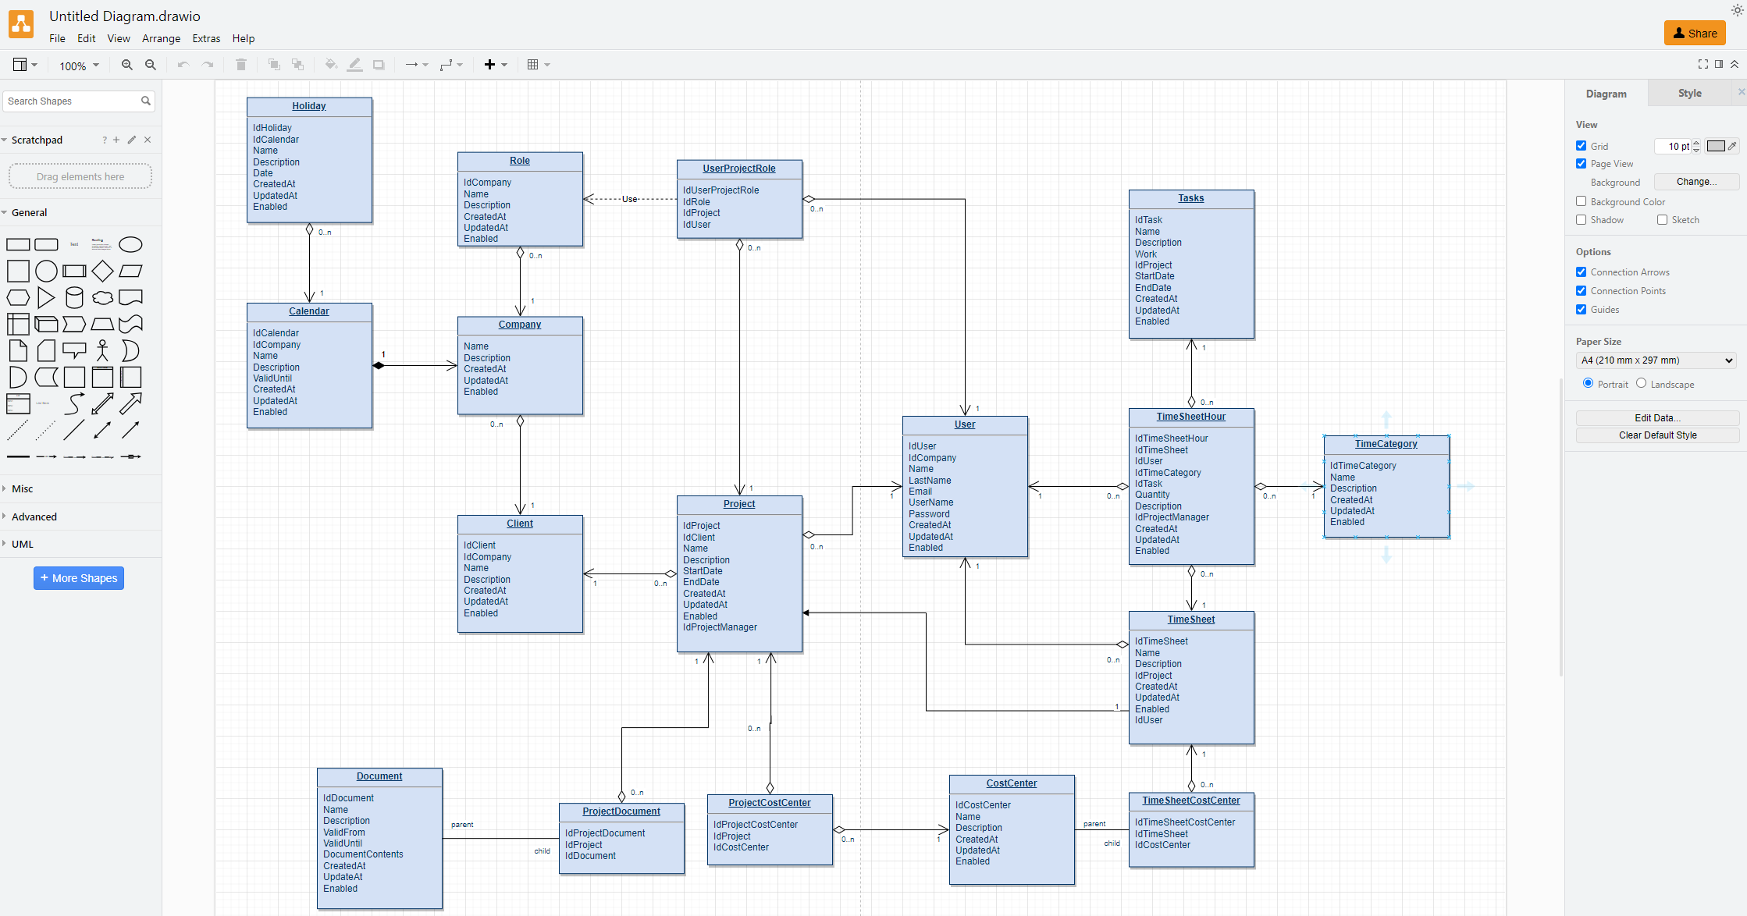

Slide 8
UML Types

Slide 9
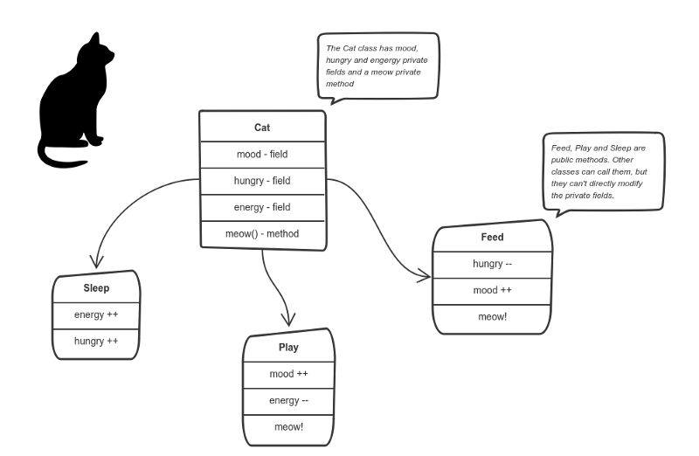
What is a Class? A Class serves as a design template for an object, and the relationship between objects and classes is closely intertwined.
Object-Oriented Design revolves around classes, rather than objects, we use classes to create objects. Classes describe the type of objects, while objects are usable instances of classes.
FREECODECAMP.ORG, 2018. How to explain object-oriented programming concepts to a 6-year-old [viewed 26 June 2023]. Available from: https://www.freecodecamp.org/news/object-oriented-programming-concepts-21bb035f7260/#:~:text=The%20four%20principles%20of%20object

Slide 10
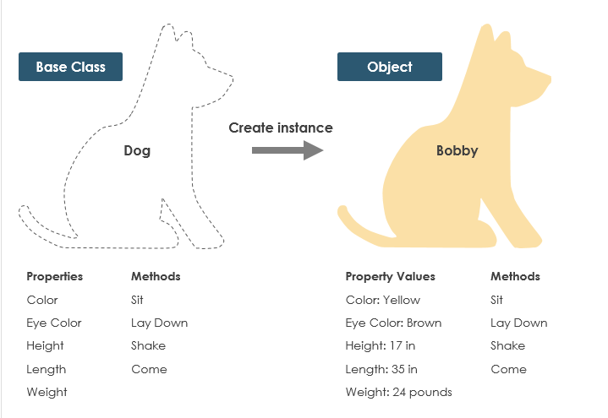
Example - A dog has states - colour, name, breed as well as behaviours -wagging, barking, eating. An object is an instance of a class.

Slide 11
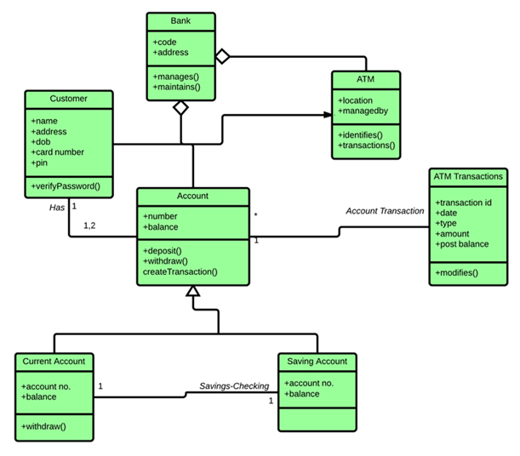
Class Diagram
Represents the static structure of a system by showing classes, attributes, operations, relationships, and their associations.
GLEEK, 2021. UML Class diagram example: Bank ATM system [viewed 26 June 2023]. Available from: https://youtu.be/iRiQMCAgWJc
VISUAL PARADIGM, 2019. UML Class Diagram Tutorial Available from: https://www.visual-paradigm.com/guide/uml-unified-modeling-language/uml-class-diagram-tutorial/

Slide 12
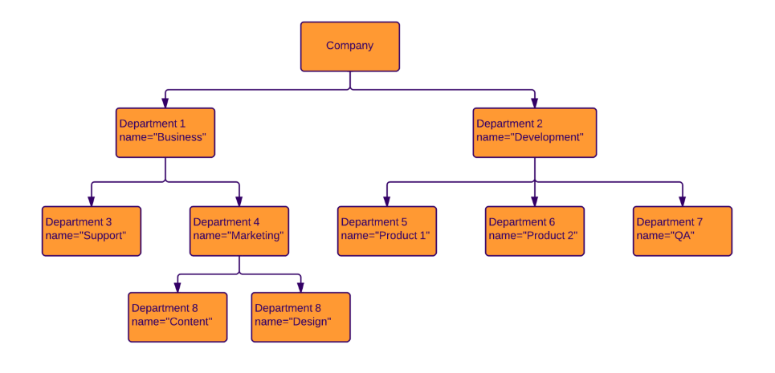
Object Diagram
Depicts instances of classes and their relationships at a specific point in time. It shows the objects and their attributes and associations.
LUCIDCHART, 2023. Object Diagram Tutorial [viewed 30 May 2023]. Available from: https://www.lucidchart.com/pages/uml-object-diagram

Slide 13
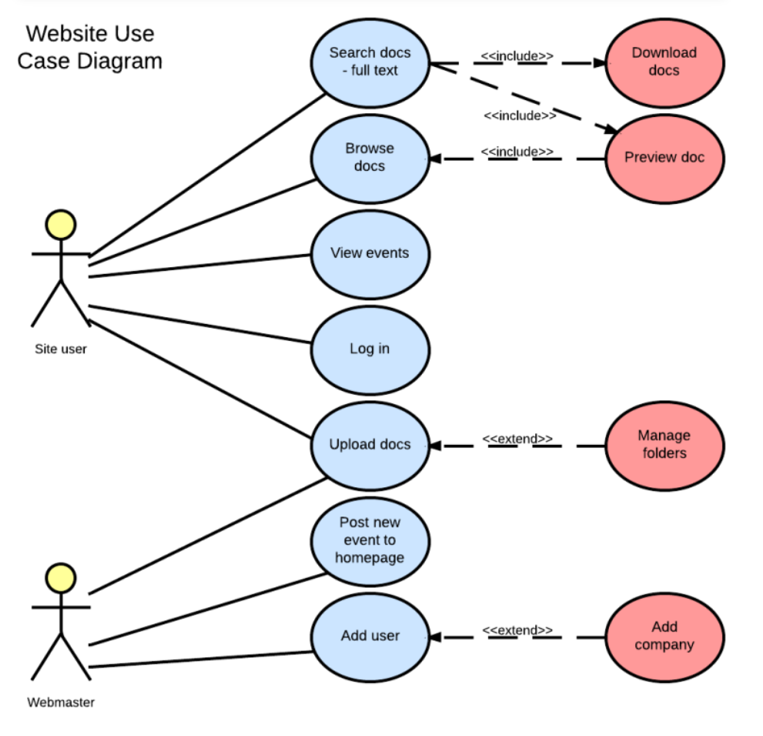
Use Case Diagram
Illustrates the functional requirements of a system by showing actors, use cases, and their relationships. It represents the interactions between the system and external entities.
LUCIDCHART, 2019. UML Use Case Diagram Tutorial Lucidchart [viewed 30 May 2023]. Available from: https://www.lucidchart.com/pages/uml-use-case-diagram

Slide 14
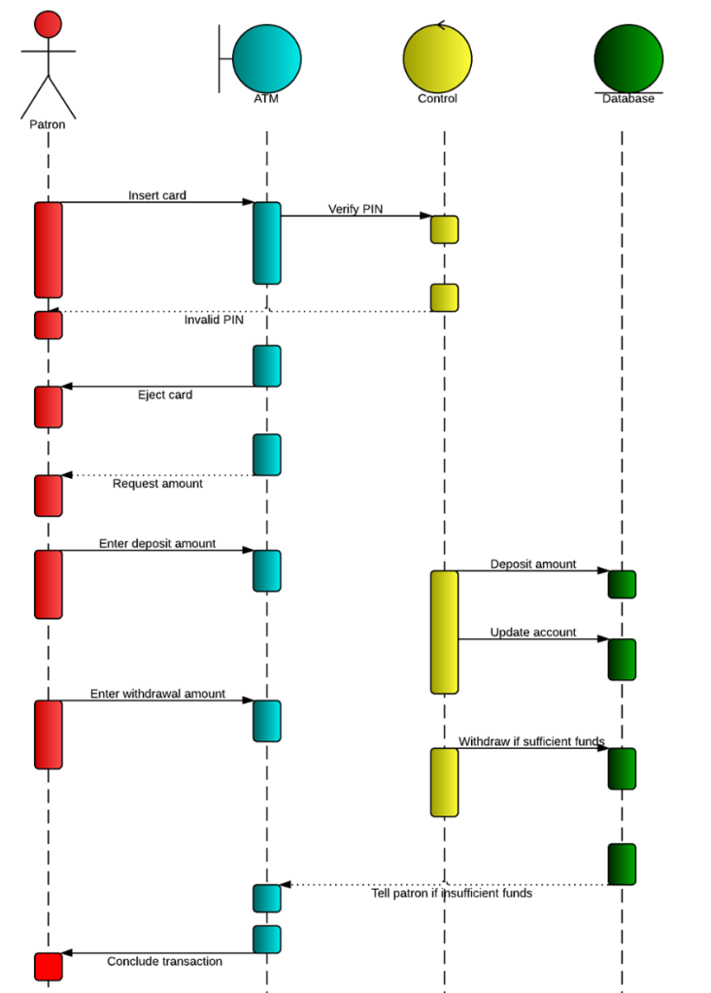
Sequence Diagram
Shows the interactions between objects in a sequential manner over time. It emphasizes the time ordering of messages exchanged between objects.
LUCIDCHART, 2019b. UML Sequence Diagram Tutorial [viewed 30 May 2023]. Available from: https://www.lucidchart.com/pages/uml-sequence-diagram

Slide 15
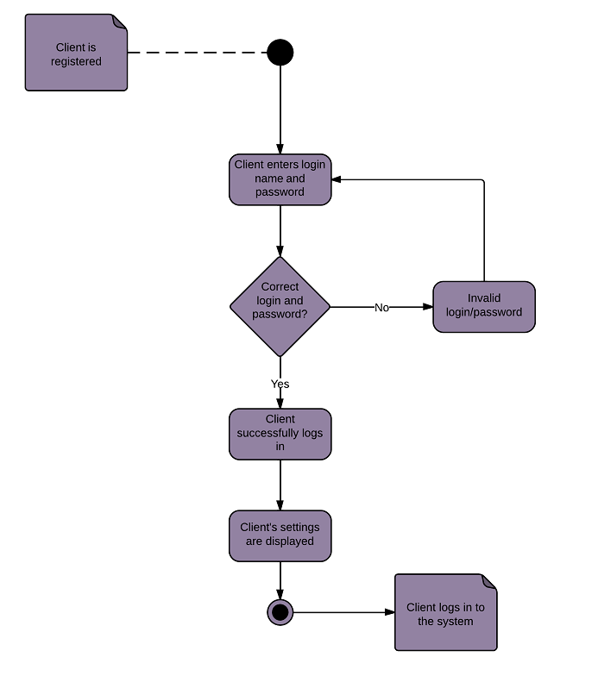
Activity Diagram
Represents the workflow or flow of activities in a system. It describes the dynamic behaviour of a system by showing the control flow, decisions, concurrency, and loops.
LUCIDCHART, 2023b. UML Activity Diagram Tutorial [viewed 30 May 2023]. Available from: https://www.lucidchart.com/pages/uml-activity-diagram

Slide 16
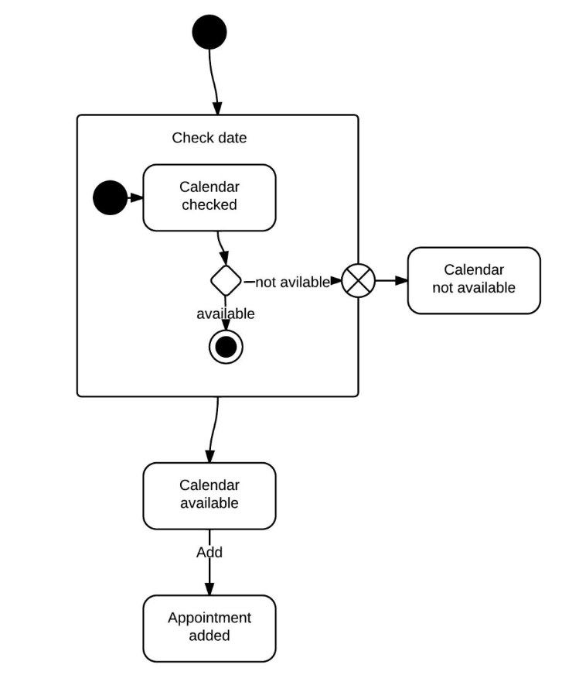
State Machine Diagram
Models the behaviour of an object or a system by representing the states, events, and transitions between states. It describes the possible sequences of states and their responses to events.
LUCIDCHART, 2023c. State Machine Diagram Tutorial [viewed 30 May 2023]. Available from: https://www.lucidchart.com/pages/uml-state-machine-diagram

Slide 17
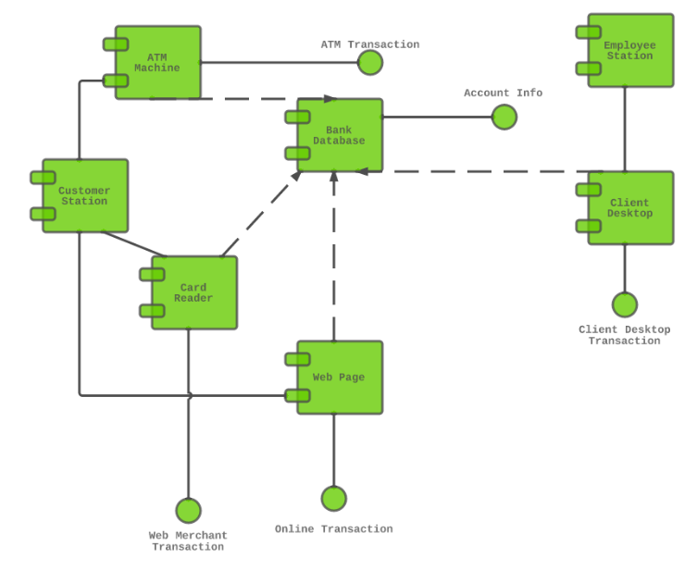
Component Diagram
Depicts the organization and dependencies of software components in a system. It shows the high-level structure of a system and the interfaces between components.
LUCIDCHART, 2019c. Component Diagram Tutorial [viewed 30 May 2023]. Available from: https://www.lucidchart.com/pages/uml-component-diagram

Slide 18
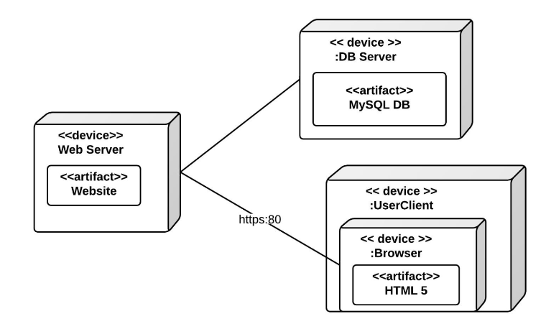
Deployment Diagram
Represents the physical deployment of software components on hardware nodes. It illustrates the hardware infrastructure and the distribution of components across nodes.
LUCIDCHART, 2023d. Deployment Diagram Tutorial [viewed 30 May 2023]. Available from: https://www.lucidchart.com/pages/uml-deployment-diagram

Slide 19
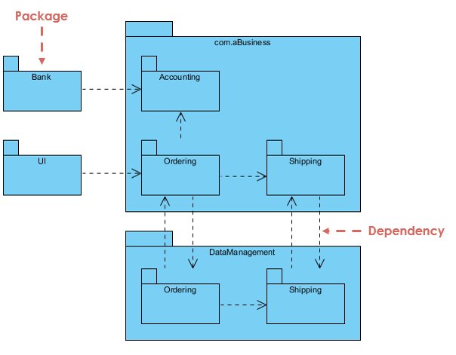
Package Diagram
Shows the organization and dependencies of packages or namespaces in a system. It provides a high-level view of the modular structure of a system.
The diagram show a business model in which the classes are grouped into packages:
Packages appear as rectangles with small tabs at the top.
The package name is on the tab or inside the rectangle.
The dotted arrows are dependencies.
One package depends on another if changes in the other could possibly force changes in the first.
LUCIDCHART, 2023e. Package Diagram Tutorial [viewed 30 May 2023]. Available from: https://www.lucidchart.com/pages/uml-package-diagram

Slide 20
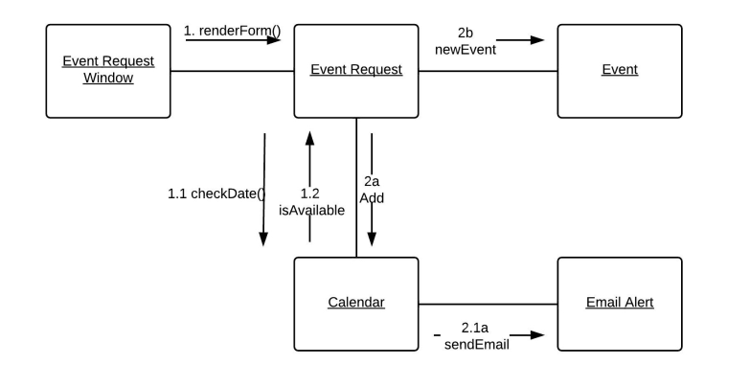
Communication Diagram
Like a sequence diagram, it focuses on the interactions between objects but emphasizes the relationships between objects rather than the time ordering of messages.
LUCIDCHART, 2023f. Communication Diagram Tutorial [viewed 30 May 2023]. Available from: https://www.lucidchart.com/pages/uml-communication-diagram

Slide 21
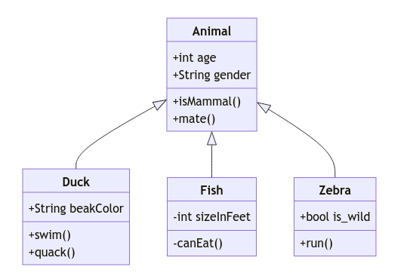
Composite Structure Diagram
Describes the internal structure and collaborations of a class or component. It shows the structure and relationships between parts, ports, connectors, and other internal elements.
LUCIDCHART, 2023g. Composite Structure Diagram Tutorial [viewed 30 May 2023]. Available from: https://www.lucidchart.com/pages/uml-composite-structure-diagram

Slide 22

mermaid.js.org/

Slide 23
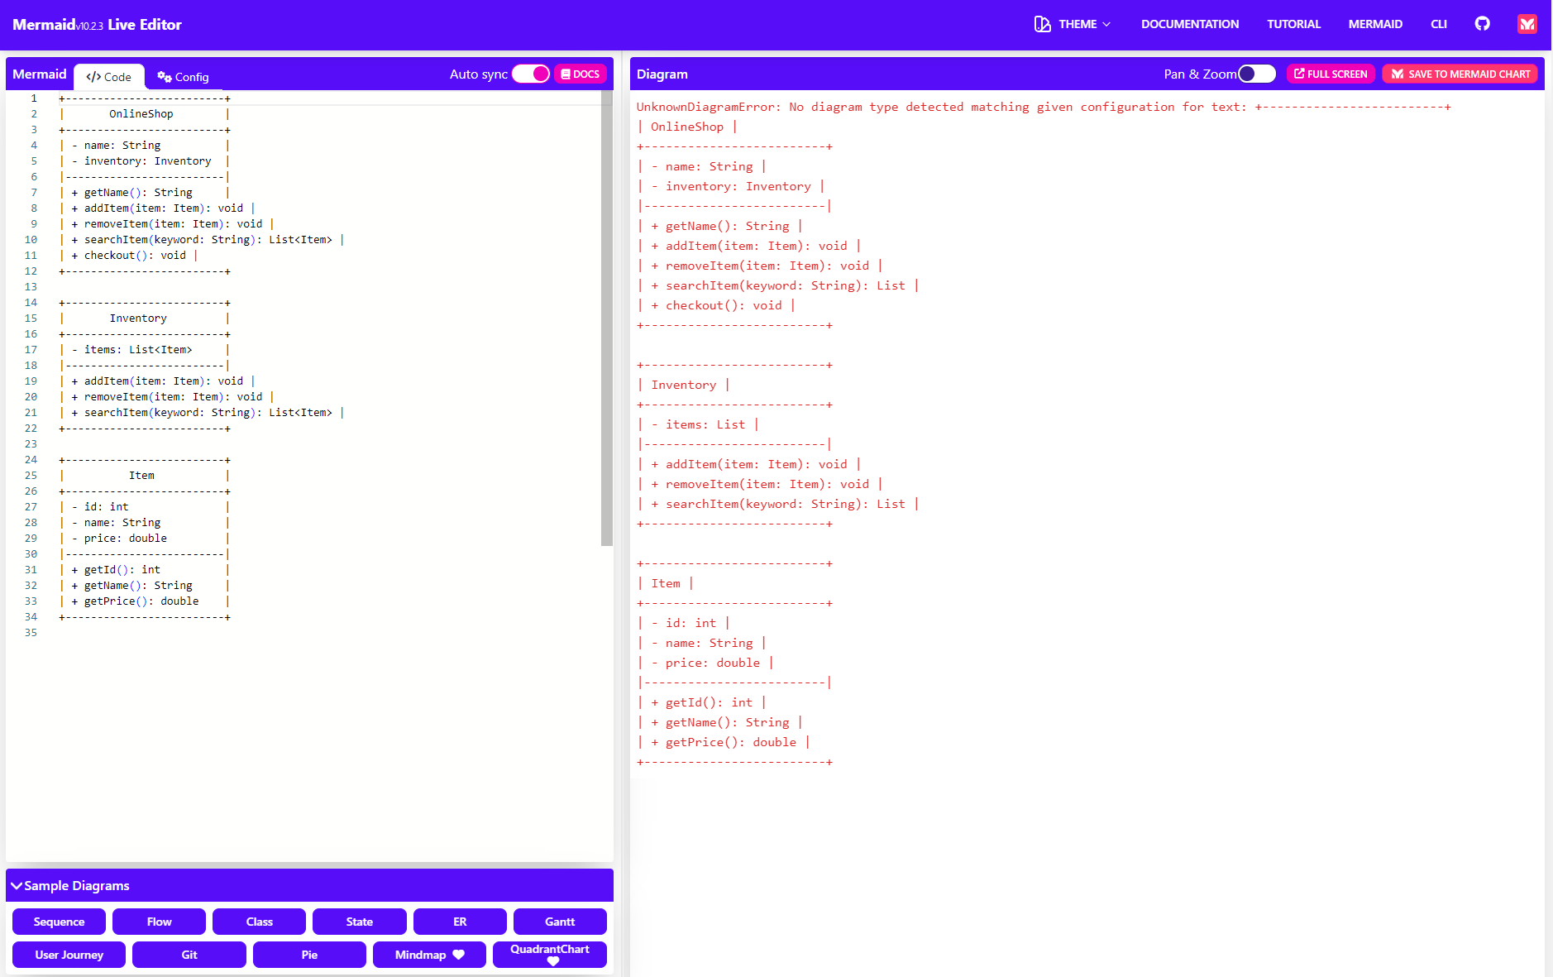
mermaid.js.org/

Slide 24
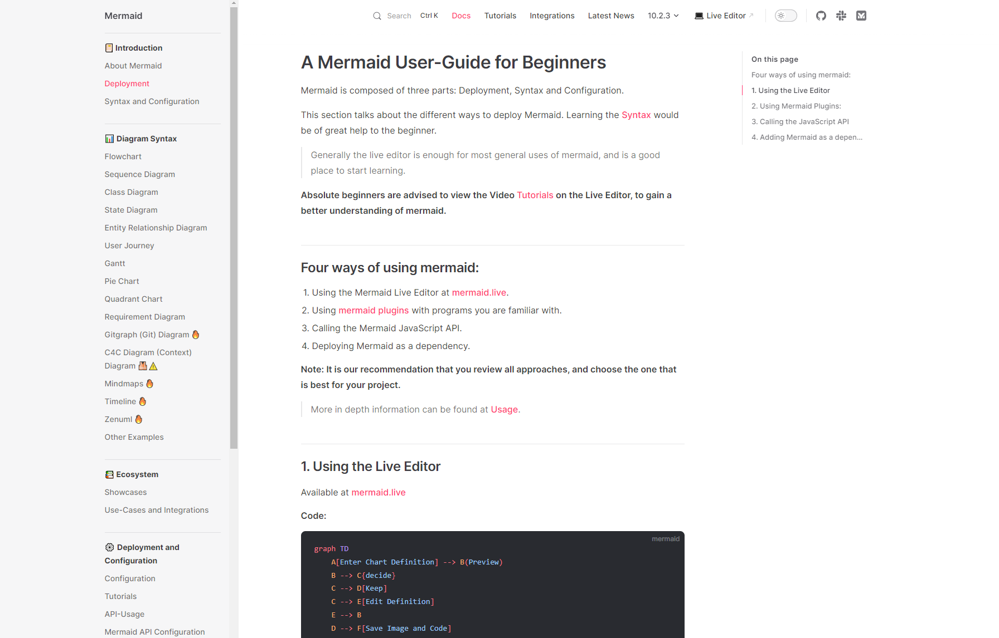
mermaid.js.org/intro/n00b-gettingStarted.html

Slide 25
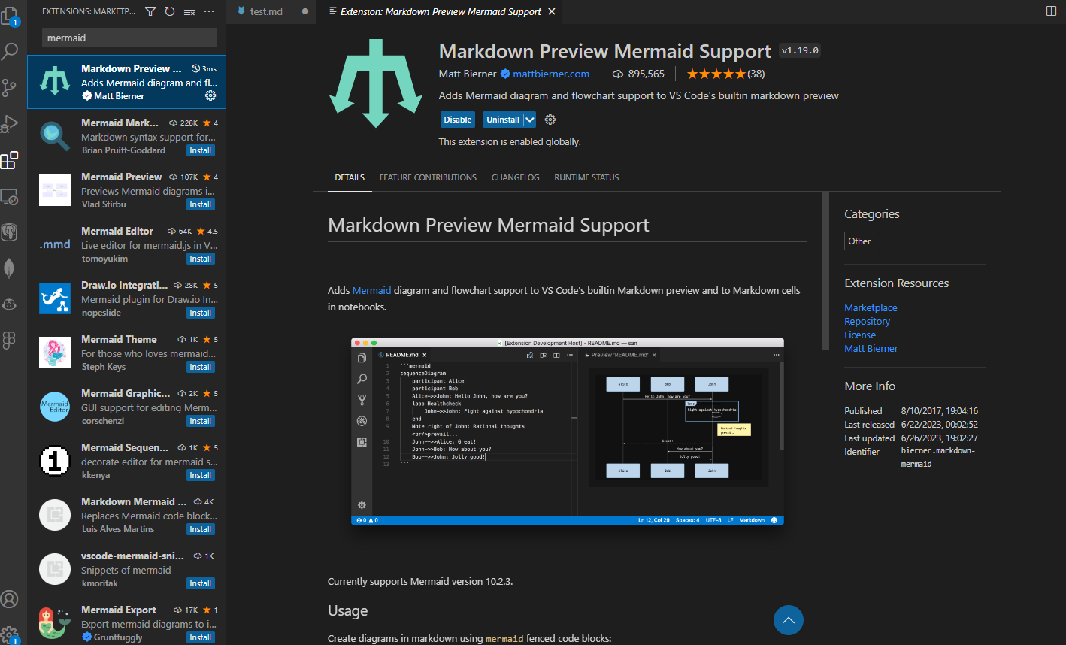

Slide 26

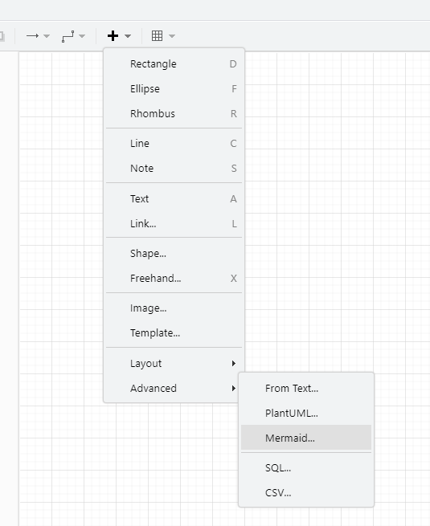
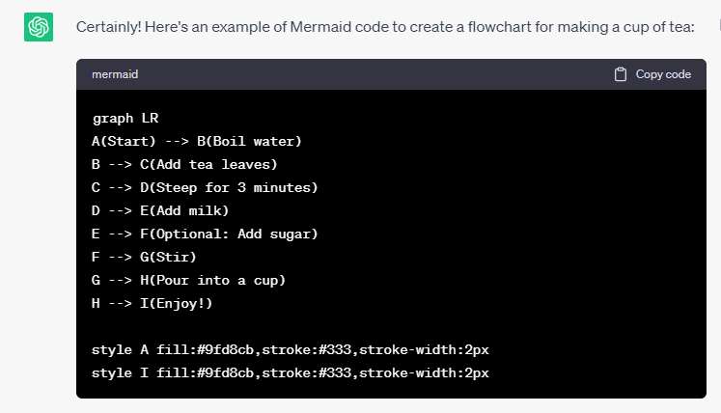
ChatGPT
Prompt: create mermaid code for flow chart to create a cup of tea
Notes:
graph TB
A(Start) --> B(Boil water)
B --> C(Add tea leaves)
C --> D(Steep for 3 minutes)
D --> E(Add milk)
E --> F(Optional: Add sugar)
F --> G(Stir)
G --> H(Pour into a cup)
H --> I(Enjoy!)
style A fill:#9fd8cb,stroke:#333,stroke-width:2px
style I fill:#9fd8cb,stroke:#333,stroke-width:2px

Slide 27
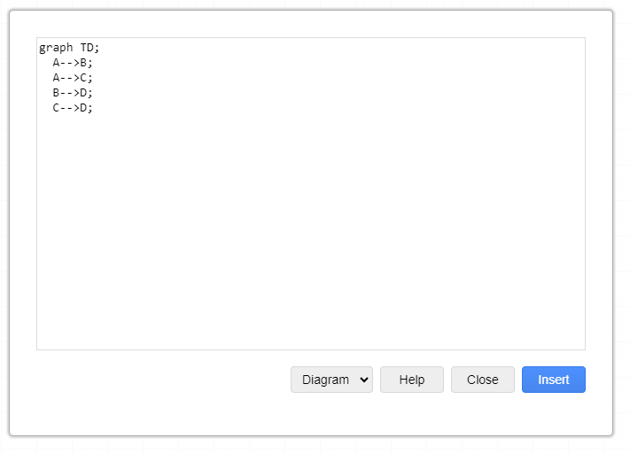
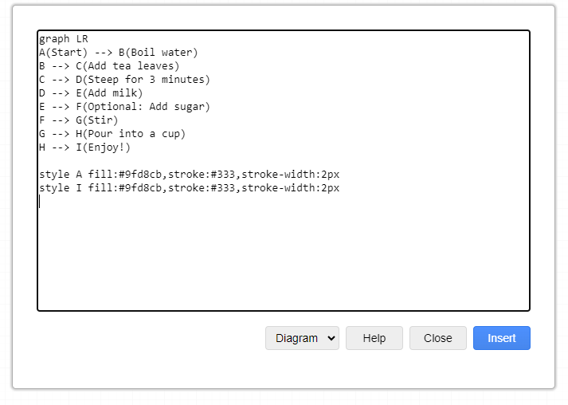
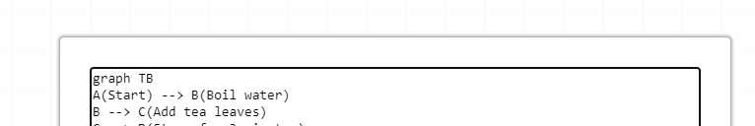
Change LR (Left-Right) to TB (Top-Bottom
Notes:
graph TB
A(Start) --> B(Boil water)
B --> C(Add tea leaves)
C --> D(Steep for 3 minutes)
D --> E(Add milk)
E --> F(Optional: Add sugar)
F --> G(Stir)
G --> H(Pour into a cup)
H --> I(Enjoy!)
style A fill:#9fd8cb,stroke:#333,stroke-width:2px
style I fill:#9fd8cb,stroke:#333,stroke-width:2px

Slide 28
