Slide 1
MENUS
Computing – Faculty of Business, Law and Digital
martin.reid@solent.ac.uk

Slide 2
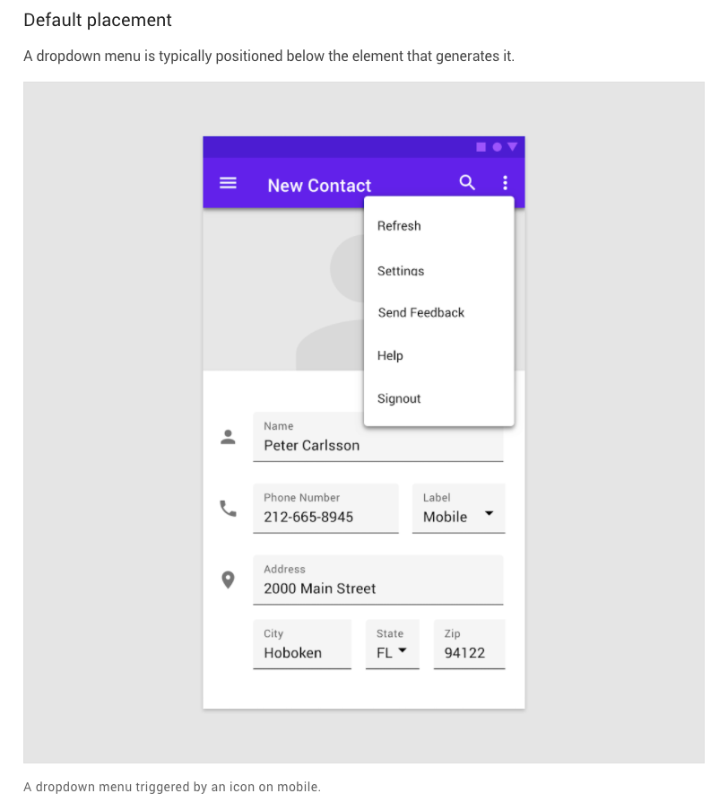
https://material.io/components/menus#specs

Slide 3
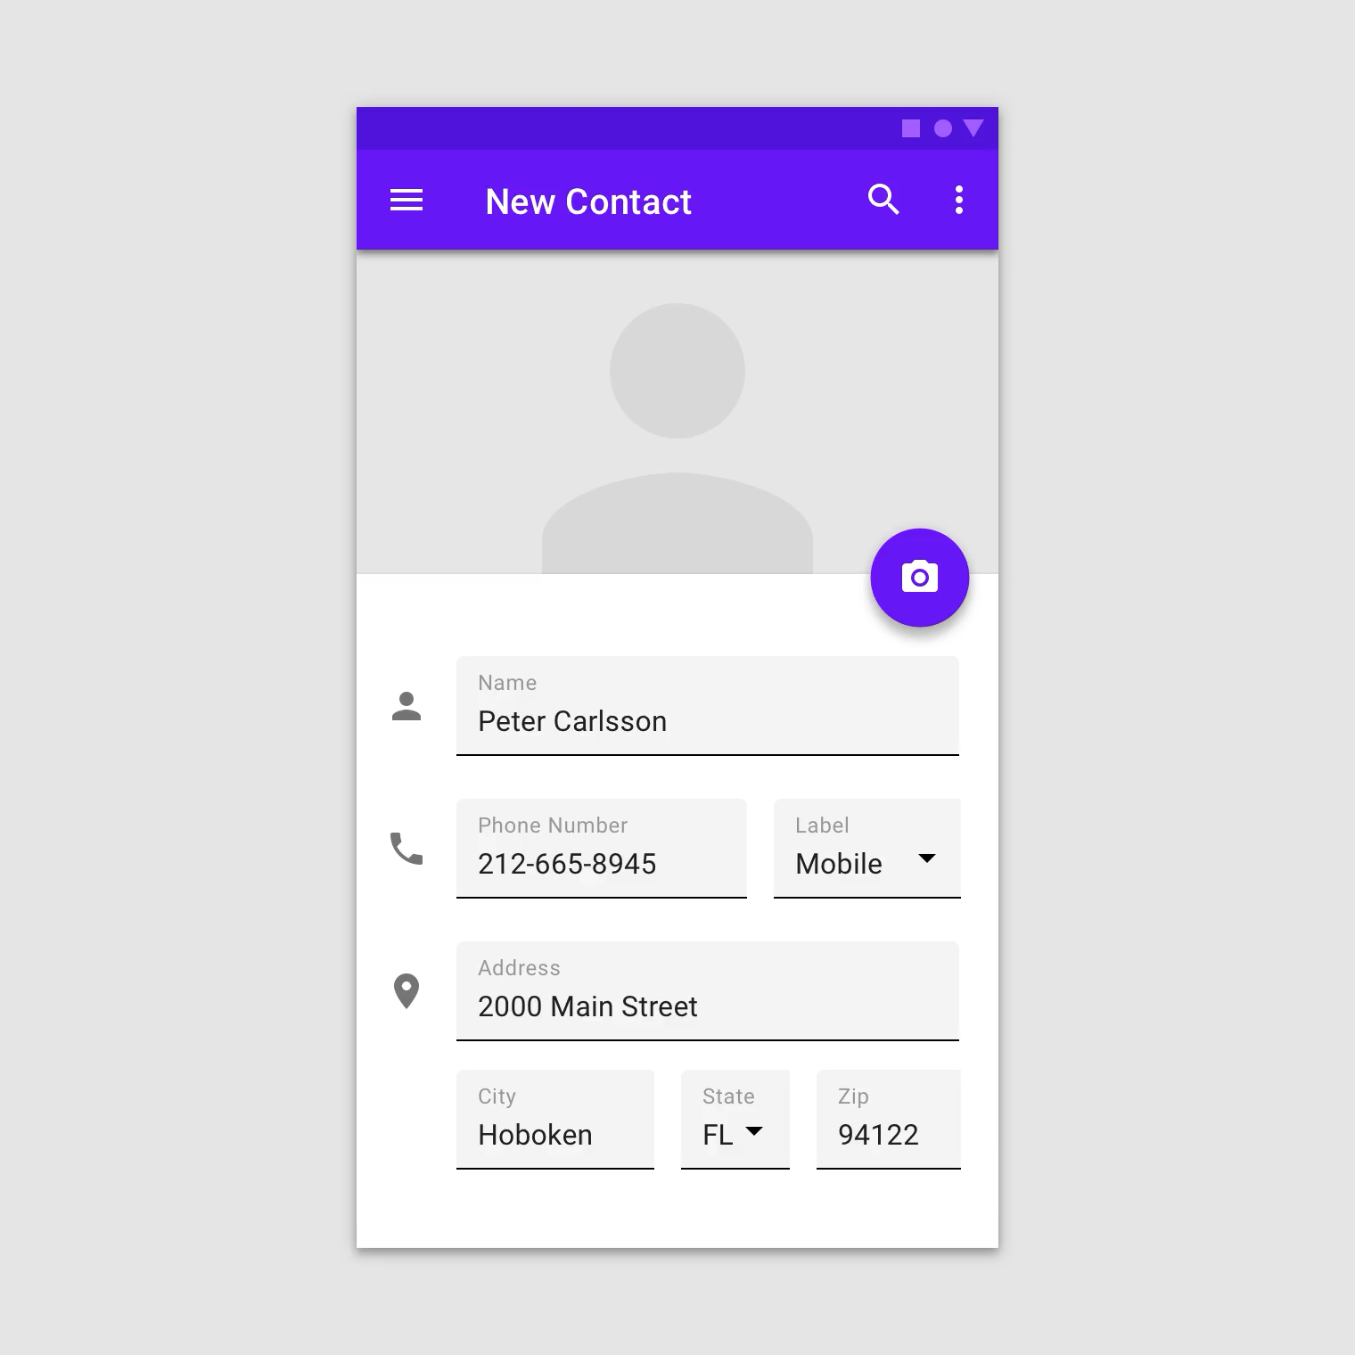
https://material.io/components/menus#specs

Slide 4
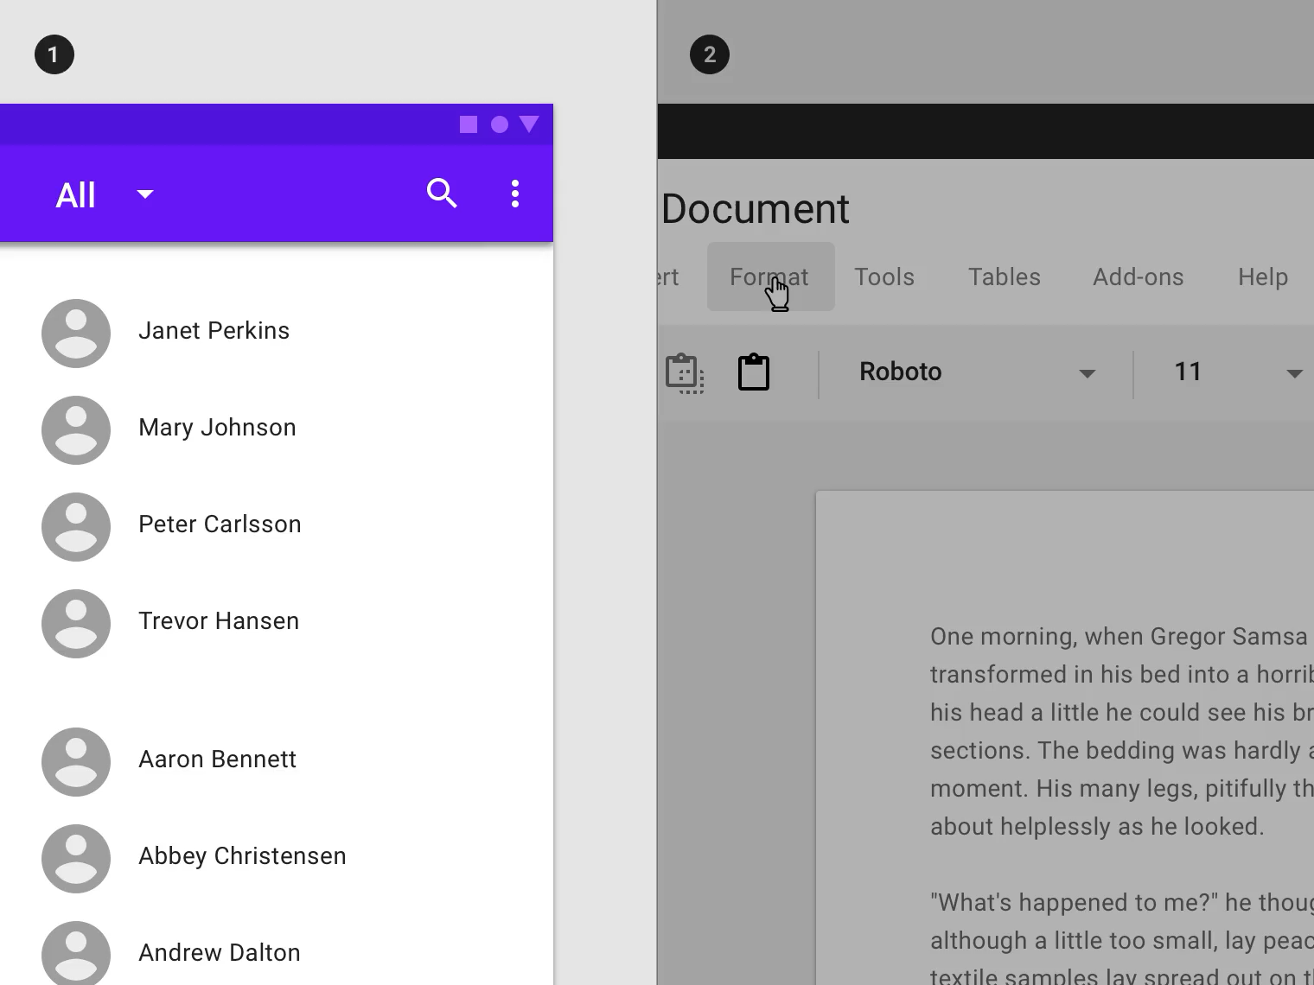
https://material.io/components/menus#specs

Slide 5
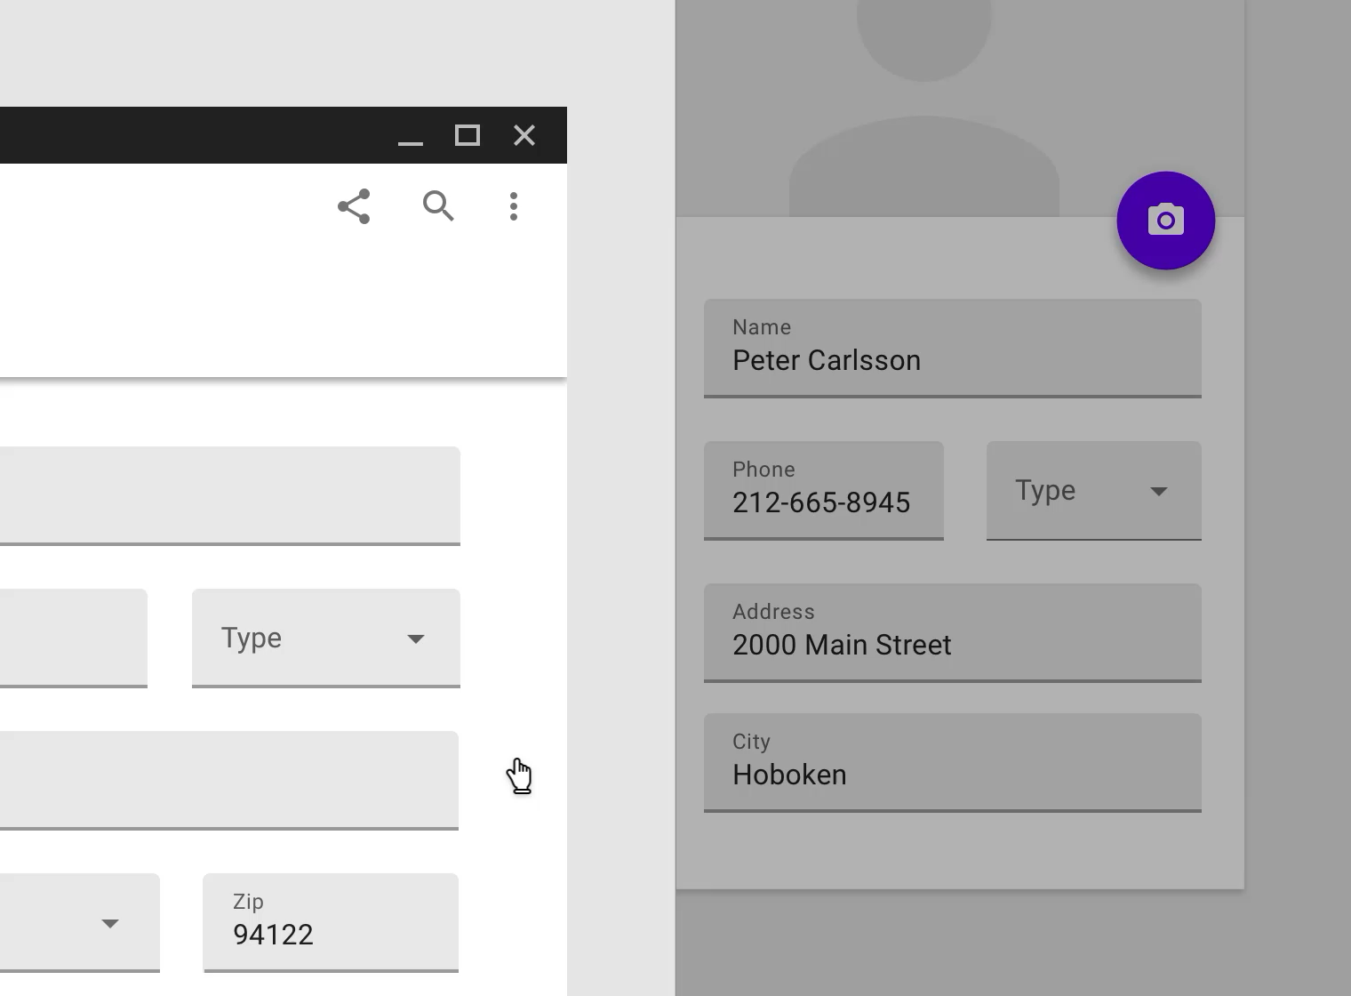
https://material.io/components/menus#specs

Slide 6
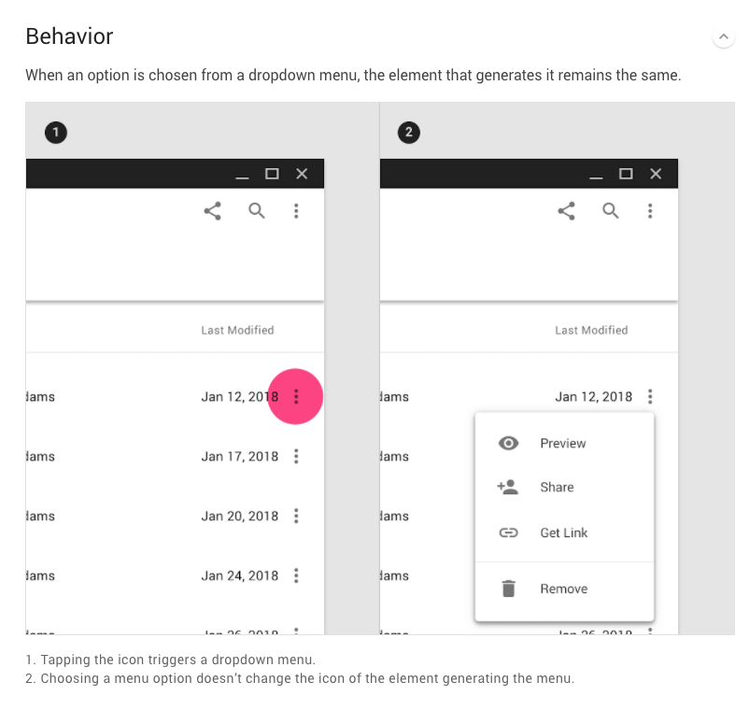
https://material.io/components/menus#specs

Slide 7
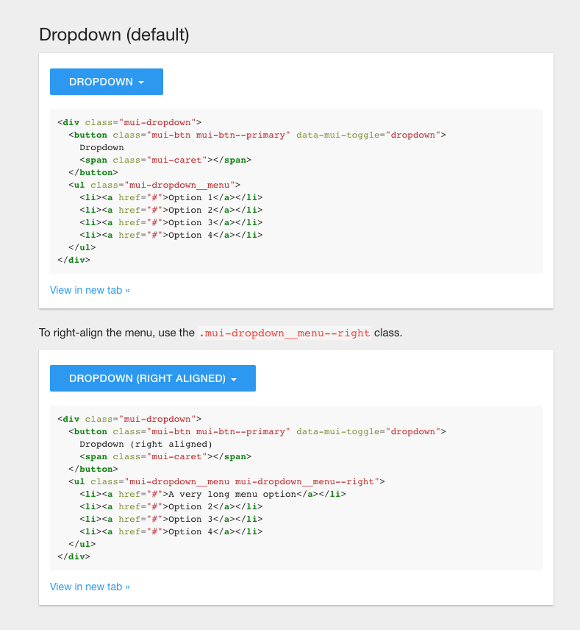
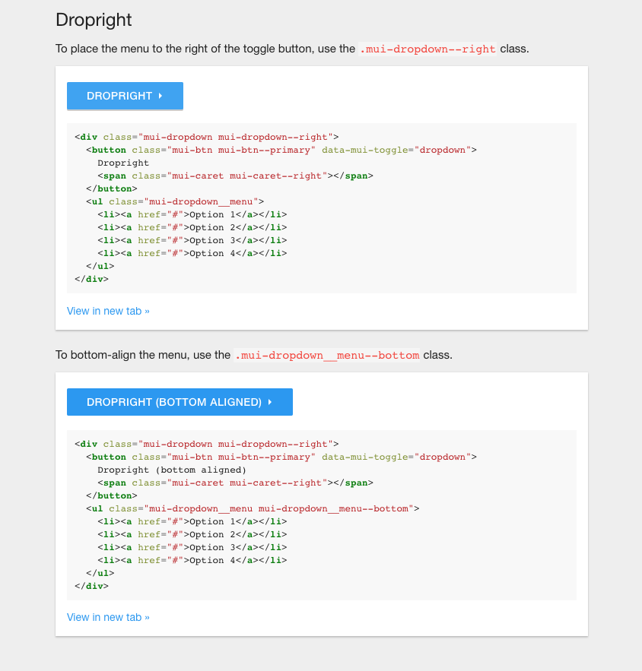
https://www.muicss.com/docs/v1/css-js/dropdowns#

Slide 8
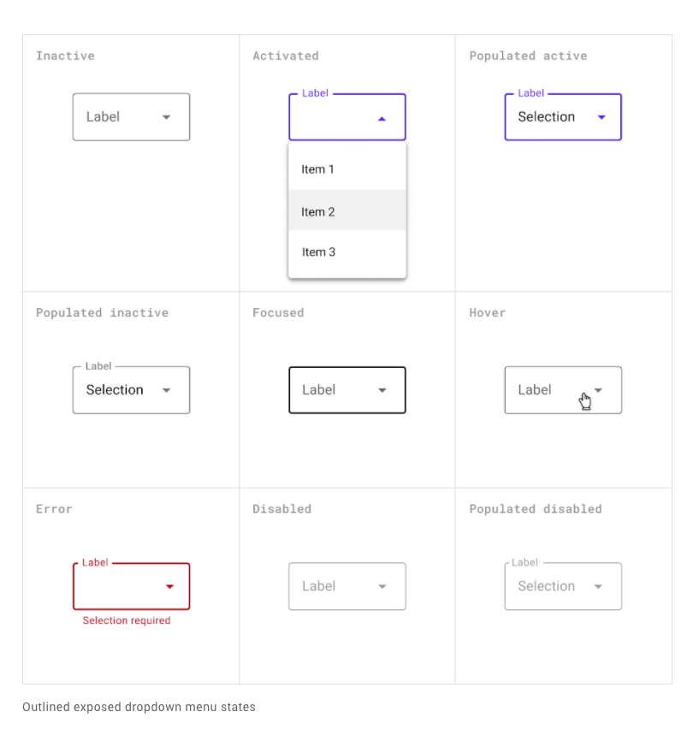
https://material.io/components/menus#specs

Slide 9
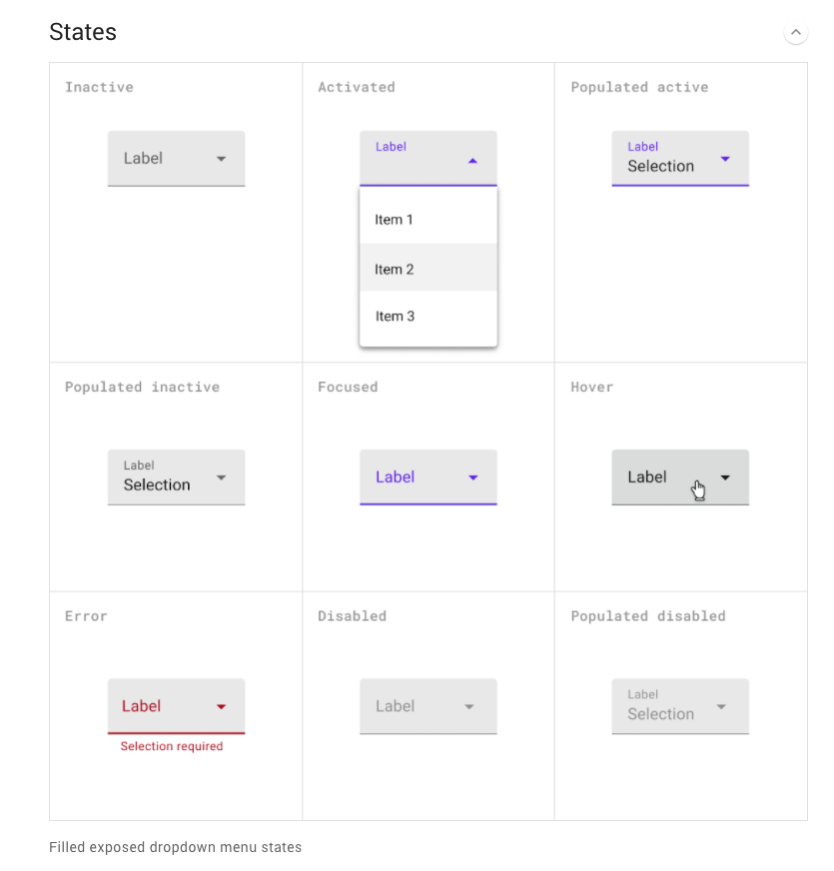
https://material.io/components/menus#specs

Slide 10
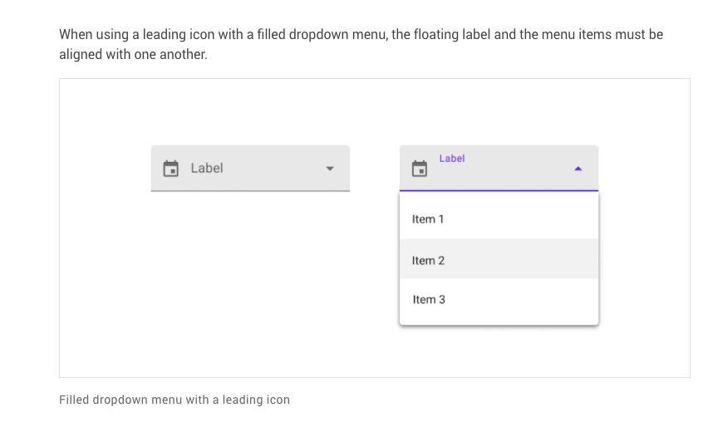
https://material.io/components/menus#specs

Slide 11
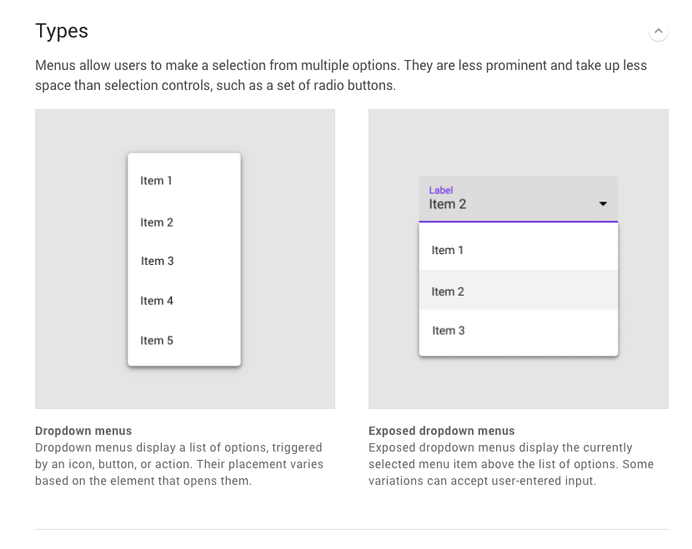
https://material.io/components/menus#specs

Slide 12
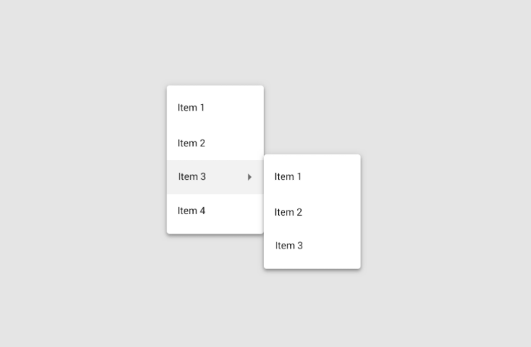
https://material.io/components/menus#specs

Slide 13
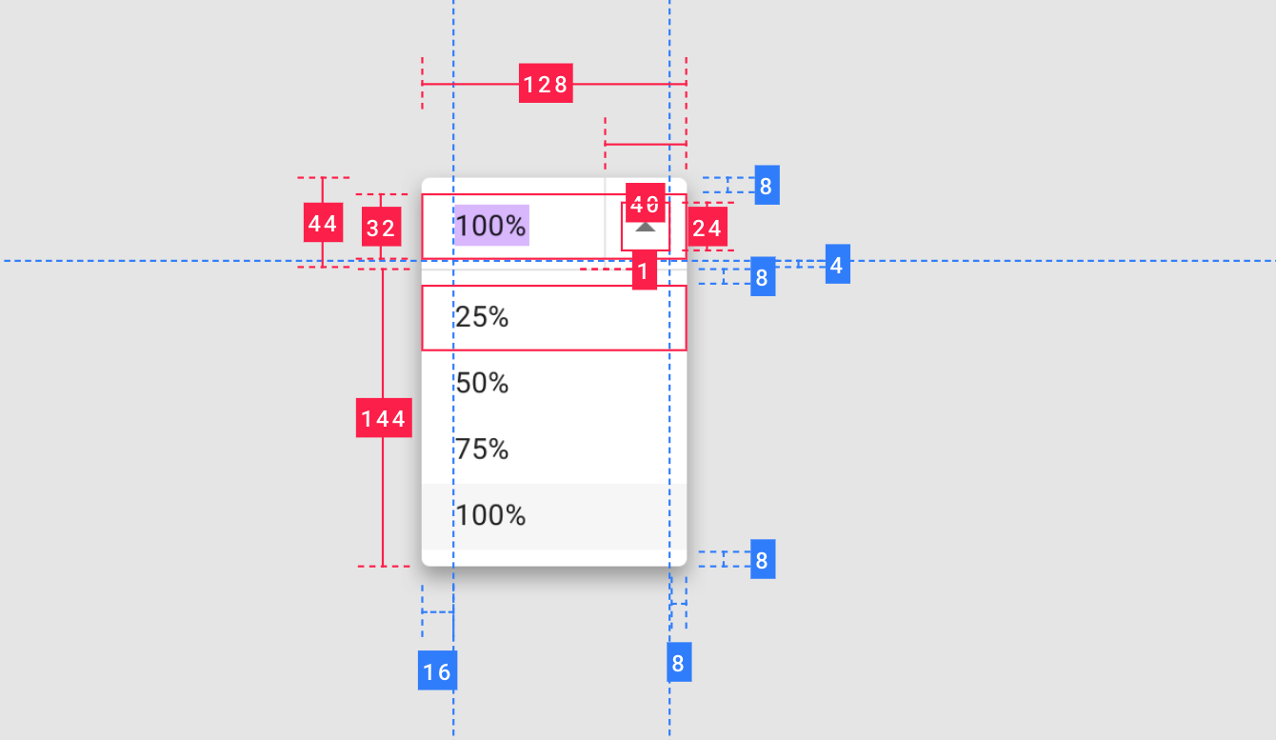
https://material.io/components/menus#specs

Slide 14
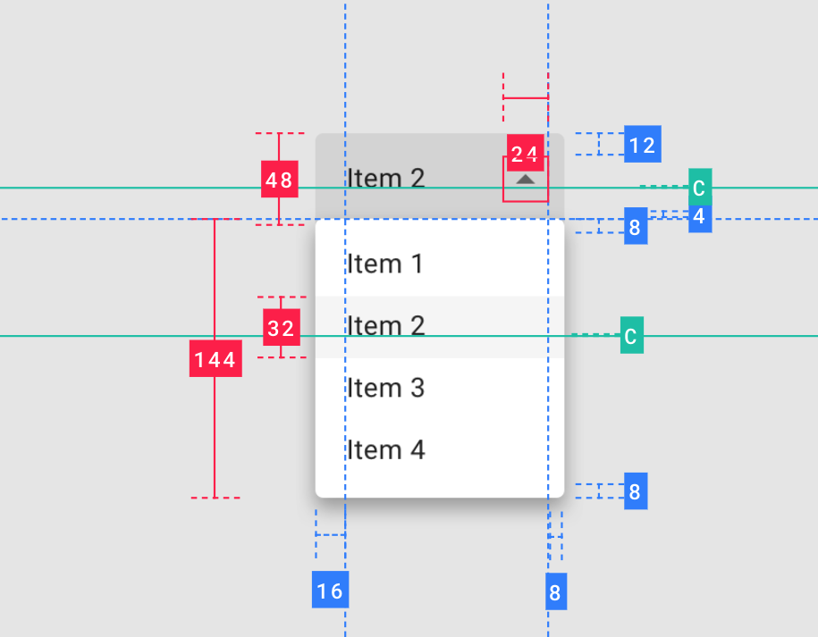
https://material.io/components/menus#specs

