Slide 1
LLM-Driven Ontology Learning
From Term Extraction to Upper-Level Categorization
for Building Information System Models
Martin Ströher · Mara Abel · Eduardo Roemers-Oliveira · Lucas Valadares Vieira
Fábio Herbert Jones · Luiz Fernando De Ros · Thaís Schäfer Luiz
UFRGS · UFRJ · Petrobras Research Center · Colorado State University
ICEIS 2026 — International Conference on Enterprise Information Systems

Slide 2
Context: The Knowledge Acquisition Bottleneck
From formal knowledge models to automated taxonomy learning
Ontologies: formal models of domain knowledge
Our context
Shared vocabulary with formal semantics
Enable reasoning, interoperability, consistency checking
Backbone for data models & retrieval systems
Domain: Brazilian Pre-Salt carbonate reservoirs
Upper ontologies: BFO → GeoCore → GeoReservoir
Goal: formal taxonomy of geological concepts for brazilian pre-salt carbonate reservoirs
Why building them is slow
Terminology acquisition + conceptualization
Requires dual expertise: domain + ontology engineering
Many working hours, inteviews, etc.
Our path
Apply a general-purpose LLM without any domain-specific fine-tuning.
ICEIS 2026

Slide 3
Context: The Knowledge Acquisition Bottleneck
Why building domain ontologies remains painfully slow
Ontologies power Knowledge-Intensive Information Systems
Existing approaches
Formal backbone for data models, software applications, retrieval systems
Enterprise ontology projects rely on specialized vocabulary
Vocabulary must be mapped to formal upper-level hierarchies
BFO → GeoCore → Domain ontology
Statistical (TF-IDF): fast but semantically weak
Embedding models (BERT): better, but require labeled data + fine-tuning
Fine-tuned LLMs: shifts the bottleneck, not removes it
NeOn Methodology identifies two bottleneck steps:
Non-Ontological Resource Reuse — selecting terminology sources
Conceptualization — clarifying and formalizing semantics
Both require highly specialized experts for extended sessions
Cannot keep pace with the exponential growth of unstructured data
Our path:
ICEIS 2026

Slide 4
Core Insight & Research Question
What is a Natural Language Definition (NLD)?
A concise, Aristotelian-style definition that clarifies a term's meaning: "X is a Y that Z" genus (Y) + differentia (Z) — easy to parse for both humans and LLMs
Term: Coquina
"Coquina is a sedimentary rock that is composed of cemented bioclastic fragments — mainly mollusk shells — deposited in high-energy shallow marine environments, and is a key Pre-Salt reservoir rock in Brazil."
Key Insights from Lopes Junior (2025)
Language models using NLDs to classify domain entities into top-level ontology concepts achieve >90% macro F1-score
NLDs are the most effective textual representation for ontological classification, even across multilingual settings
No prior work had leveraged this NLD insight for corpus-grounded extraction and formal hierarchy mapping
Can a non-specialist LLM produce semantically precise ontological artifacts — term extraction and taxonomic categorization into formal hierarchies — to bootstrap ontology construction, without fine-tuning by leveragind NLDs?
ICEIS 2026

Slide 5
Experiment Overview
4 phases — applied to 40 curated Brazilian Pre-Salt scientific articles
Phase 1
Phase 2
Phase 3
Phase 4
Corpus Preparation
Term Acquisition (4 distinct pipelines)
NLD-Centric Classification
(for each distinct pipeline)
Specialist Validation
40 peer-reviewed Pre-Salt articles Curated by senior domain specialist Automatic text extraction (pdftotext)
LLM + Corpus (extractive) LLM Generated (zero-shot) NER + Corpus (hybrid) TF-IDF (baseline)
LLM generates Aristotelian NLD Chain-of-Thought categorization BFO → GeoCore → GeoReservoir
5 domain experts (PhD + MSc) Term Relevance, NLD Accuracy, Category Accuracy
→
→
→
Model: Gemini 2.5 Pro · Temperature = 0 (deterministic) · Ontology stack: BFO → GeoCore → GeoReservoir
ICEIS 2026

Slide 6
Phase 2: The Four Term Extraction Pipelines
P1 — LLM + Corpus
P2 — LLM Generated
Extractive mode: LLM reads each of the 40 articles and extracts all relevant geological terms directly from the text. Stemming + normalization applied for aggregation of terms.
Zero-shot, corpus-agnostic: LLM generates the 500 most important domain terms from its pre-trained knowledge alone. Temperature = 0.2 for slight lexical variance.
P3 — NER + Corpus
P4 — TF-IDF
Hybrid / cross-lingual: XLM-RoBERTa Large fine-tuned on PetroGeoNER corpus extracts terms + NER labels.
Statistical baseline: Term Frequency–Inverse Document Frequency on the 40-article corpus. Replicates traditional frequency-based methodology (Garcia et al., 2020).
All 4 pipelines feed into the same unified NLD-centric classification module
ICEIS 2026

Slide 7
Phase 3: NLD-Centric Classification Workflow
Standardized across all pipelines — explicitly tests Lopes Junior (2025)
Step 1 — NLD Generation
Step 2 — CoT Categorization
Resulting Artifact
LLM role: "Senior geoscientist + ontology engineer" Aristotelian-style definition for each term: "X is a Y that Z" Concise, technically clear, canonical
Chain-of-Thought prompt: LLM analyzes term + NLD together Assigns most specific category possible Fallback hierarchy: GeoReservoir → GeoCore → BFO
Formally instantiated into multi-layered hierarchy: BFO → GeoCore → GeoReservoir Expert-validated taxonomy
→
→
Examples from the Pre-Salt corpus:
Term: Coquina
Term: Diagenesis
Term: Porosity
“Coquina is a carbonate rock that is predominantly composed of poorly cemented, sand- to gravel-sized skeletal fragments, primarily bivalve shells, formed in lacustrine environments during the rift phase of the Brazilian Pre-Salt petroleum system.”
“Diagenesis is the sum of all physical, chemical, and biological processes that alter a sediment after its initial deposition and throughout its burial history, exclusive of weathering and metamorphism. In the lacustrine carbonates of the Brazilian Pre-Salt, these processes are the primary control on reservoir quality, with burial-related dissolution by CO2-rich fluids being the dominant mechanism for generating the extensive secondary porosity that characterizes these prolific reservoirs.”
“Porosity is a fundamental petrophysical property of a reservoir rock that quantifies the fraction of the total rock volume occupied by void spaces, known as pores. In the context of Brazilian Pre-Salt carbonates, this pore system comprises a complex network of interparticle, intraparticle, vuggy, and moldic voids that provides the storage capacity for hydrocarbons. The effective porosity, which represents the interconnected pore volume, is a critical parameter for estimating reserves and predicting reservoir performance.”
→ GeoReservoir:SedimentaryRock
→ GeoCore:GeologicalProcess
→ BFO:Quality
ICEIS 2026

Slide 8
Phase 4: Blind Multi-Expert Validation Design
5 Domain Specialists
Sampling Strategy
PhD & MSc holders — up to 20 years experience Industry + Academia (Brazilian Pre-Salt) Provided 100 reference terms before extraction (20 each)
100 top-ranked terms/pipeline × 4 pipelines = 400 entries Combined, anonymized, and randomized into a single list Blind: evaluators did not know which pipeline produced each term
Proposed Term Relevance
Assigned NLD Accuracy
Assigned Category Accuracy
5 experts
3 experts
3 experts
Relevant / Irrelevant / Invalid / Unknown
Same specialists who provided reference terms
Correct / Partially Correct / Incorrect Ambiguous / Wrong Context / Unknown
Correct & Specific / Correct but Unspecific Incorrect / Unknown
Captures both accuracy and ontological depth
ICEIS 2026

Slide 9
Results — Term Coverage & Relevance
Pipeline
Recall (%)
Relevant (%)
Irrelevant (%)
Strictly Relevant (Consensus)
Highest recall AND precision
LLM + Corpus
60
97.8
2.0
91 / 100
LLM Generated
40
96.2
3.8
88 / 100
Corpus mitigates LLM "domain blindness"
NER + Corpus
32
86.6
11.8
66 / 100
TF-IDF
25
46.0
46.4
25 / 100
46% irrelevant noise — semantically blind
Decent recall, but 33 'Mixed Feelings'
Recall = % of expert-defined reference terms recovered by each pipeline
ICEIS 2026

Slide 10
Results — NLD Quality & Taxonomic Categorization
Natural Language Definition Accuracy (%)
Taxonomic Categorization — Final Majority Metrics (%)
Status
LLM+C
LLM-G
NER+C
TF-IDF
Metric
LLM+C
LLM-G
NER+C
TF-IDF
Correct
53.7
66.0
57.0
34.7
Majority Correct
71
66
68
36
Partially Correct
34.0
24.3
22.3
22.0
Majority Partial
11
9
10
5
Incorrect
9.7
6.7
15.3
9.0
Disputed / Rejected
18
25
22
59
Ambiguous/Unknown
2.0
2.6
4.0
30.4
Strict Consensus (Correct & Specific)
39
43
23
17
LLM-Generated leads on NLD accuracy — canonical terms have robust internal definitions.
LLM+Corpus: highest overall accuracy (71%) + lowest rejection (18%). Corpus acts as a decisive 'validity filter' for extracted terms.
ICEIS 2026

Slide 11
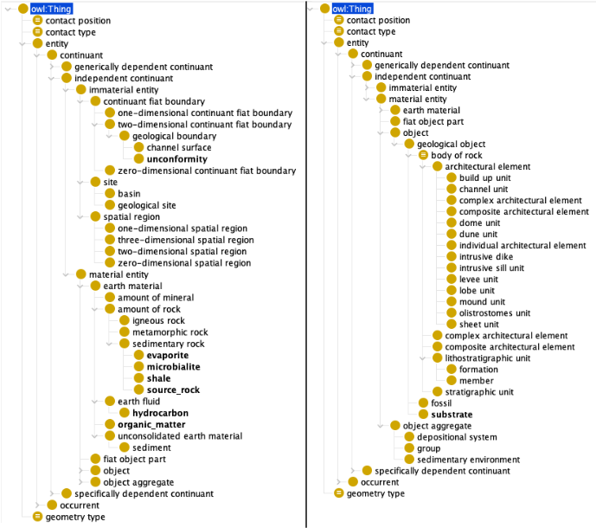
Resulting Conceptual Artifact
Expert-validated preliminary domain taxonomy
What was produced
Terms with unanimous expert consensus (Relevant + Correct & Specific)
Formally placed in BFO → GeoCore → GeoReservoir hierarchy
Not yet axiomatized, no relations
Example taxonomy paths
Shale
BFO:Entity → Continuant → Indep. Continuant → Material Entity → GeoCore:AmountOfRock → GeoReservoir:SedimentaryRock → Shale
Diagenesis
BFO:Entity → Occurrent → Process → GeoCore:GeologicalProcess → Diagenesis
Porosity
BFO:Entity → Continuant → Spec. Dep. Continuant → BFO:Quality → Porosity
ICEIS 2026

Slide 12
What the Experiment Revealed — Open Problems
These findings directly motivate our current, improved implementation
Context Blindness
Ambiguity — Not-Strict Consensus Gap
NLDs generated without source context → generic / outdated definitions
Expert disagreement on complex real-world terms reveals categorization limits
• LLM+Corpus: 34% 'Partially Correct' NLDs despite best term quality • Outdated paradigms propagated (e.g., homogeneous microbial origin of Pre-Salt carbonates); pointed by experts → Fix: provide relevant corpus passages at NLD generation time (RAG)
• LLM+Corpus: 39 Strict vs 32 Majority-only correct (categorization) • LLM's reasoning potential constrained by lack of domain grounding • Real terms extracted from reports are inherently more ambiguous → Fix: source context in NLD phase expected to elevate majority → strict consensus
Both problems point to the same architectural fix: Retrieval-Augmented Generation (RAG) in the NLD generation phase to improve results.
ICEIS 2026

Slide 13
Conclusion & Ongoing Work
Conclusions from this paper
Ongoing work
Term Relevance: LLM-based methods reached very high consensus relevance (over 96%), whereas statistical methods often failed to separate critical domain concepts from noise.
RAG implementation grounded on domain corpus for NLD step
NLD generation grounded in source corpus passages
Expanded corpus: 80 papers (2× the preliminary experiment)
Ablation study: 4 conditions — Full RAG / No RAG / No NLD / Raw RAG
Improved statistical analysis: category migration analysis, difference between conditions results (Cochran’s Q test), cross-condition agreement
OWL export: complete taxonomy → .owl generation
Relations?
The LLM-Generated pipeline (zero-shot) provided more accurate definitions, probably relying on "internal coherence" and canonical concepts the model already "knew“.
However, the LLM + Corpus pipeline extracted more relevant, real-world terms, even though its definitions were sometimes less precise due to "context blindness".
Context blindness is the principal remaining bottleneck
Future work should integrate RAG to provide necessary source grounding, resolve ambiguity, and ensure scientific currency.
Thank you! Questions welcome.
github.com/BDI-UFRGS/PreSaltOntology · Funded by CAPES, CNPq, Petrobras
ICEIS 2026

