Slide 1
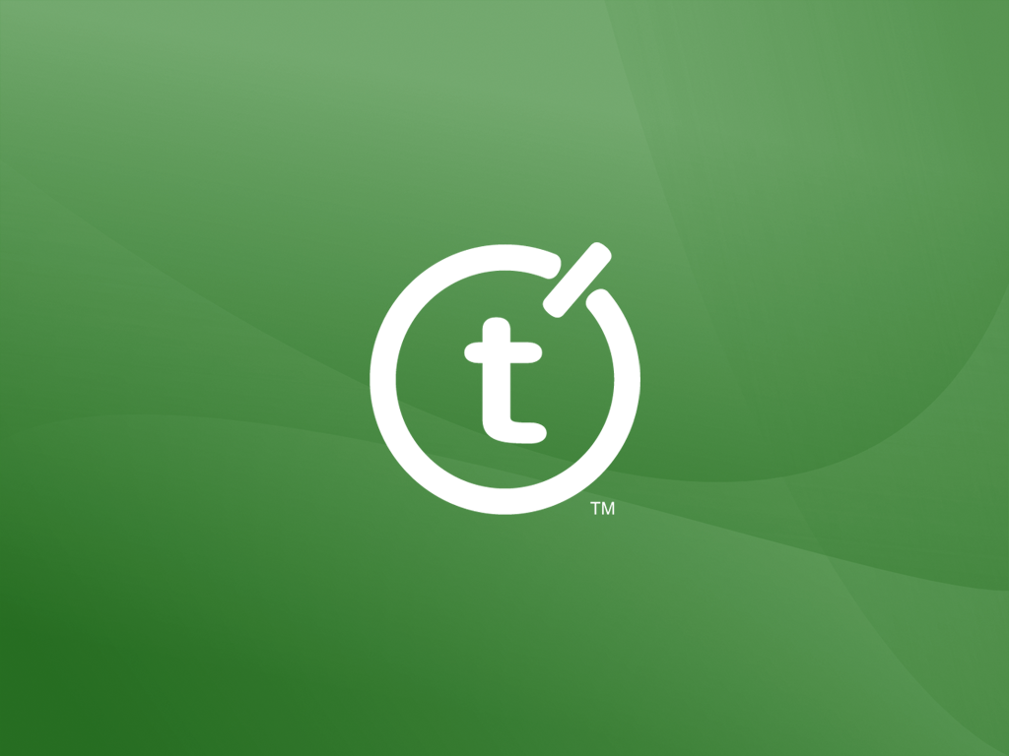

Slide 2

Top Ten Tips for
Team Foundation Server
Martin Woodward
Teamprise
Notes:
INDA Talk.
Source control is something that every professional developer uses yet is hardly ever taught to use. In this session, Martin explains source control using Microsoft Team Foundation Server, how this differs from other source control systems like VSS, CVS or Subversion and how to get the best out of it in your day to day development. He also talks about how to adopt the new Microsoft Team Foundation Server and manage all the source code of your company including Visual Studio 2003, Visual Basic 6 or Java projects.

Slide 3
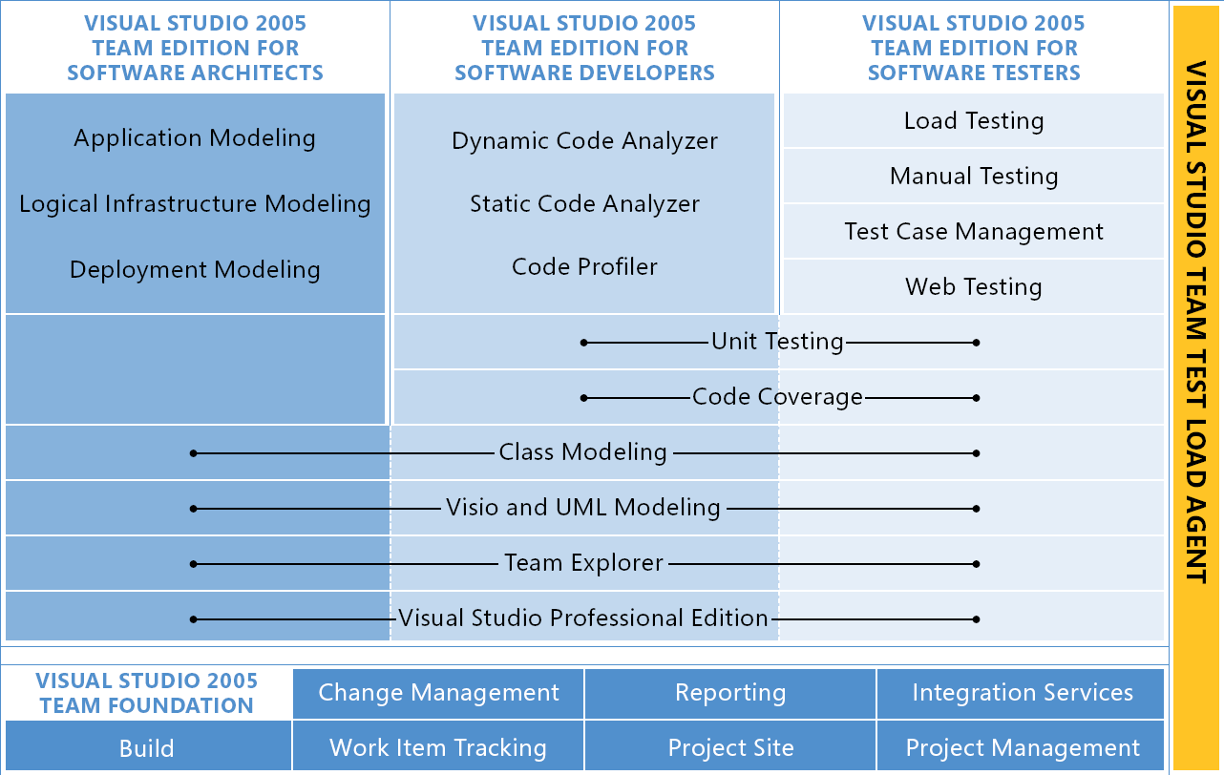
Visual Studio Team System
Notes:
What is Team System?
More than just Visual Studio. Talk about testing tools, code analyzer, Class Diagrams also Team Foundation Server.
Client side in VS 2005 (Team Explorer)
Team Foundation Server

Slide 4
Team Foundation Server
Change Management
Reporting
Version Control
Source Control
Work Item Tracking
Project Site
Notes:
Explain TFS and services it provides.
Work Item Tracking
Source Control
Reporting
Collaboration
TFS Services available to everyone
Mention other server components (build server, proxy server)
WIT – Flexible, configurable.
Source Control – NOT VSS.
Atomic Check in
Integrated with Visual Studio
Eclipse and Cross-platform support
(via partner)
Work Item Integration
Customizable Check in Behavior
WAN Support
Large File Support (>4GB)
Shelving

Slide 5
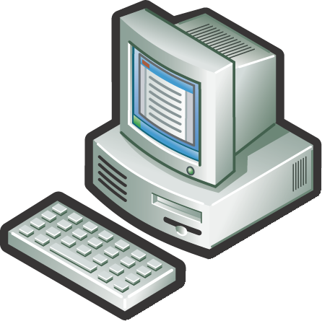
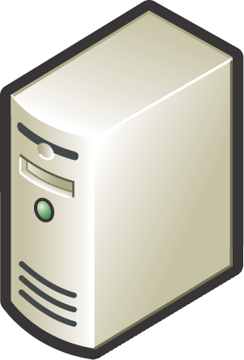

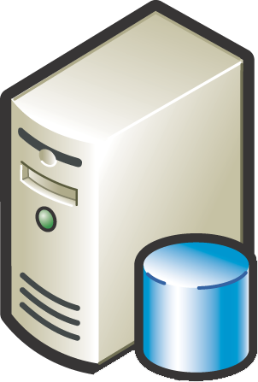

Team System Deployment
Business User
Dev Team (Local)
Dev Team (Remote)
Build Server
Win 2003 Server
SQL Server 2005
IIS 6.0
Version Control Proxy (Remote)
Active Directory
HTTP / S
TCP/IP
Team Foundation Server
Notes:
Give some stats on saleability and network requirements.
Caching Proxy Server
Downloading files is expensive in terms of bandwidth. Solution: cache them locally at your remote sites.
High level, clients get all meta data from server as to what is the latest version etc. When it wants to download a file, sends the request to the proxy server. If proxy has it sends it, otherwise gets it from the server. Keeps it stored in GZIP format (unless file format grows when GZIPED)
Also useful for reducing load on App tier. There is a file cache in app tier (stored in GZIP format)
Cache has fixed size limit or percentage space limit (of disk system) Files removed on a FIFO policy.
Cache counters available at
http://<proxy>:8081/VersionControlProxy/v1.0/ProxyStatistics.asmx
http://<at>:8080/VersionControl/v1.0/ProxyStatistics.asmx
Can also be output to server log file on a periodic basis.
Cache files located on separate disc to OS – configured for speed not reliability (files are stored in DB tier properly)
Can proxy multiple AT instances
Each proxy should have own user id?
In Microsoft, TFS Server in Redmond, TFS proxy in Raliegh (where the VC team are), TeamBuild in India and Beijing team.
Need to fit in with your WAN environment. Where are your main data centres. Where will your teams be? Cost low (cost of a Windows 2003 server) Configure disks for fast raid striping (RAID 0) (just a cache – don’t bother with redundancy for the cache partition)
Typical usage is 89% cache hit.

Slide 6
Top Ten TFS Tips

Slide 7
10

Slide 8
TF.exe is your Friend
The most powerful for Team Foundation Source Control is the command line.
Notes:
Demo
VS2005 command prompt
Tf get
Tf checkout HelloWorld.cs
Notepad2 HelloWorld.cs
Cntrl + mouse scroll to zoom in.
Tf checkin HelloWorld.cs – show dialog pops up. /noprompt option to not work this way.
Things you can only do from command line:-
Tf history $/ /recursive /user:*
Lock a file as Corey using Teamprise Explorer
Tf lock /lock:none $/AdventureWorks/release/1.0.0.0/DotNet2/HelloWorld/HelloWorld/HelloWorld.cs /workspace:Explorer;VSTSRC\Corey
Plus many others. Type tf to get help from MSDN Website.
TF.exe Performance tips:-
http://blogs.msdn.com/buckh/archive/2005/12/12/503015.aspx

Slide 9
9

Slide 10
Baby Come Back
Accessing Deleted Files
Notes:
Delete a file.
(AuthoringTests.txt in tests)
Tools, Options, Source Control, Show deleted items in Source Control Explorer.
Undelete file. Remember to add to solution…

Slide 11
8

Slide 12
Users are Painful
Manage TFS Security with Active Directory Groups.
Notes:
User configuration in TFS is a pain (V1)
Talk about 3 places to add users. Show them an easier way using groups. Show the gotdotnet tool from MS.

Slide 13
Team Foundation Server Users
Team Foundation
Application
Windows
Sharepoint
Services
SQL2005
Reporting
Services
TFS Server
Admin
Team Foundation Administrators
Site Administrator
Content Manager,
Site Administrator
Project
Admin
Project Administrators
Project site-level Administrator
Project site-level Content Manager
Project
Contributor
Project
Contributors
Project site-level Contributors
Project site-level Browser
Project
Reader
Project
Readers
Project site-level Readers
Projects site-level
Readers
Notes:
See http://msdn2.microsoft.com/en-us/library/ms252512(VS.80).aspx For more information.
Basically, create AD groups to manage security. For each project have:-
Project_Reader
Project_Contributor
Project_Admin
Where do you do this?
Right click on Team Project in VS2005. Select Group membership. See links at bottom for external config.
Show TFSUPM tool.

Slide 14
7

Slide 15
Make TFS Work Your Way
Customize your Work Items
Notes:
Demo
witexport /f bug.xml /t vstsrc /p SandboxWIT /n Bug
Edit some stuff based on audience suggestion, otherwise add company contact details for bug (company names in drop-down etc)
witimport /f bug.xml /t vstsrc /p SandboxWIT
Show Process Templat Editor GUI

Slide 16
6

Slide 17
Plan your Repository
Recommended file structure for Version Control.
Notes:
Demo: Do a branch.

Slide 18
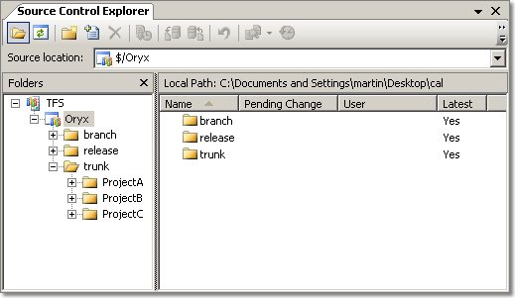
Recommended File Structure

Slide 19
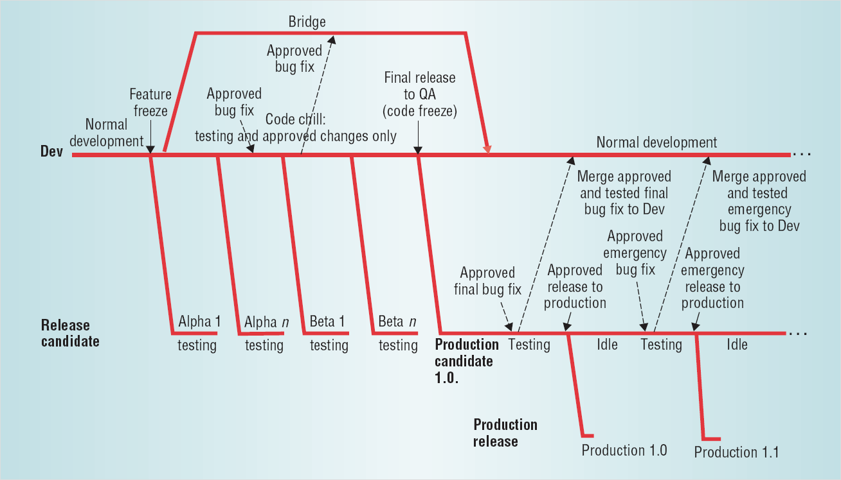
Branching and Merging
Source: http://downloads.seapine.com/pub/papers/SCMBranchingModels.pdf
Notes:
A lot of people are frightened of Branching. Up until I moved to an ISV that has it’s own SCM tool I’d only ever really used it in 2 major projects – and it was scary (mainly because the tools were not up to the job).
People ask if you can Share folders in TFS. The answer is no (sort of). In VSS world, shared folders are often used instead of branches.
Talk about terminology – truck and branches.
For a lot of internal IT projects – having one main branch and using CI is the way to go.
What is a branch
Why Branch
- Avoid source tree being polluted with experimental code.
- Allow work on different versions of product at same time
- Support maintenance releases etc
- Allow parallel Development (more later)
(Branch on label where label indicates a build) In CI environments, changeset may be just as good.
Merging.
- Difficulty in merging is directly proportional to the length of time that the branch existed.
In order to be successful, all the developers have got to understand branching and be disciplined. Also have to take care when merging to truck.
- Branch per Task
- Branch per Developer
- Branch per Feature

Slide 20

TFS Branching Features
Path-space branching
Support for merging changes
Branch from any point in history
Cherry Pick Changesets

Slide 21
5

Slide 22
TFS for Everyone Else
Accessing Team Foundation Server
Outside of Visual Studio 2005
Notes:
Talk about MSSCCI provider for VS2003.
Talk about Teamprise.

Slide 23
4

Slide 24
Extending TFS
Use the .NET object model to extend Team Foundation Server
Notes:
4: Team Foundation Server is Extendible.
VSTS and TFS are platforms. You can extend them yourselves. Easier to create a plug-in to Visual Studio now-a-days (using VSIP assemblies and managed code - that is how TFS client is written).
- Use the TeamFoundation object model to Extend (ex talk to CC.NET)
- Implementing and deploying a custom check-in policy

Slide 25
3

Slide 26
The Exception To The Rule
Hidden web services on your Team Foundation Server
Notes:
3: Hidden Web Services
- (TFS Admin) http://blogs.msdn.com/buckh/archive/2005/06/29/434099.aspx
- Proxy Statistics (http://alpo.teamprise.com:8080/VersionControl/v1.0/ProxyStatistics.asmx)

Slide 27
2

Slide 28
Change != Bad
TFS is new and different – you will need time to adjust.
Notes:
2: Change != Bad.
Remember TFS is new and different, you will need time to adjust.
Changesets for version numbering
Labels are (probably) not what you think.
http://blogs.msdn.com/bharry/archive/2005/11/18/494439.aspx
Talk a bit about Changesets etc
Check-in != Get Latest

Slide 29
The Changeset
The unit of atomic check-in
Files versioned by changeset in which they were modified

Slide 30
Check out != Get Latest
1
2
3
4
Edit Pending
on Version 3
Get Latest
Get Latest
Check in
1
3

Slide 31
Check out != Get Latest
1
2
3
4
Edit Pending
on Version 1
Attempted
Check in
Get Latest
Get Latest
Check in
1

Slide 32
Shelving
Put work on hold
Can be thought of as temporary developer branch.
Notes:
Some of the pro’s of branching – but you don’t have to know ahead of time.
Allows you to save your work on the server for long duration changes.
But like a branch, but you don’t have to know about it before hand.

Slide 33
1

Slide 34
Don’t Do That
The power of the TFS Security Model

Slide 35
Question and Answer
Martin Woodward
Senior Software Engineer
Teamprise
martin@teamprise.com
www.teamprise.com

