Slide 1
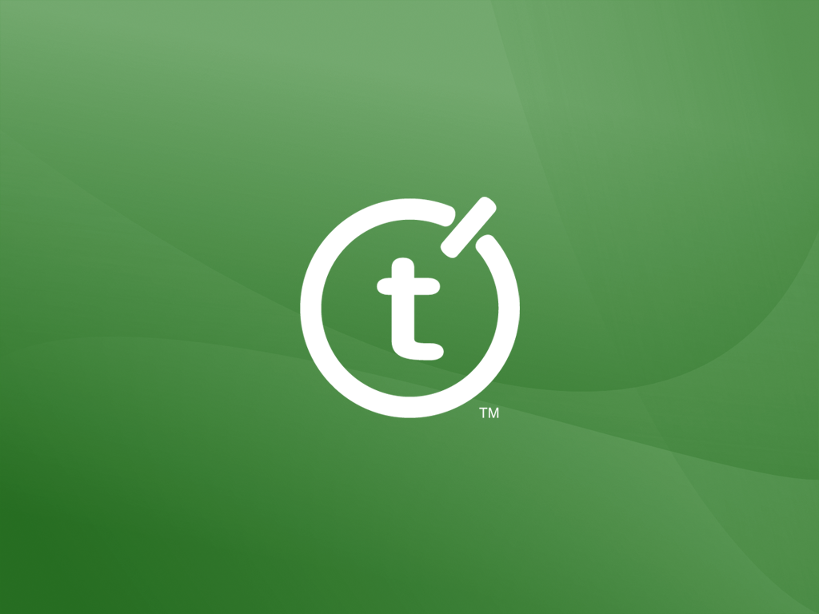

Slide 2

Source Control with Team Foundation Server
Martin Woodward
Teamprise
Notes:
INDA Talk.
Source control is something that every professional developer uses yet is hardly ever taught to use. In this session, Martin explains source control using Microsoft Team Foundation Server, how this differs from other source control systems like VSS, CVS or Subversion and how to get the best out of it in your day to day development. He also talks about how to adopt the new Microsoft Team Foundation Server and manage all the source code of your company including Visual Studio 2003, Visual Basic 6 or Java projects.

Slide 3
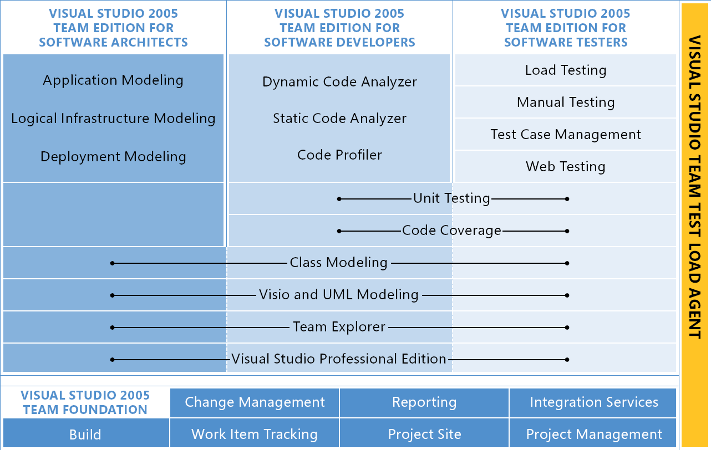
Visual Studio Team System
Notes:
What is Team System?
More than just Visual Studio. Talk about testing tools, code analyzer, Class Diagrams also Team Foundation Server.
Client side in VS 2005 (Team Explorer)
Team Foundation Server

Slide 4
Team Foundation Server
Change Management
Reporting
Version Control
Source Control
Work Item Tracking
Project Site
Notes:
Explain TFS and services it provides.
Work Item Tracking
Source Control
Reporting
Collaboration
TFS Services available to everyone
Mention other server components (build server, proxy server)

Slide 5
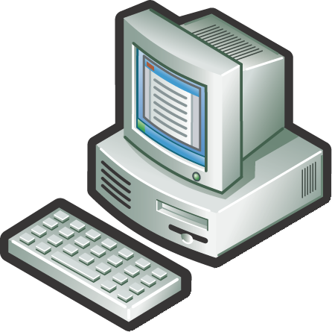
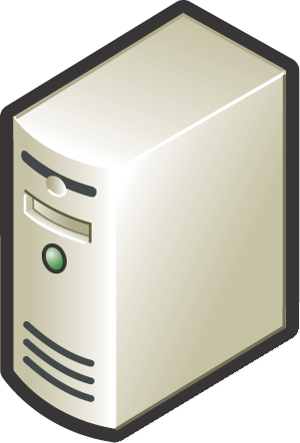
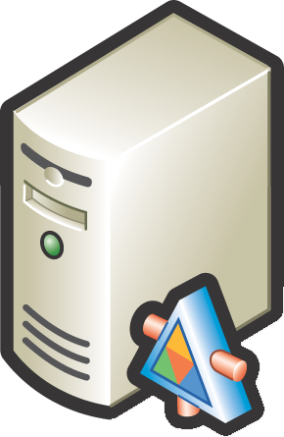
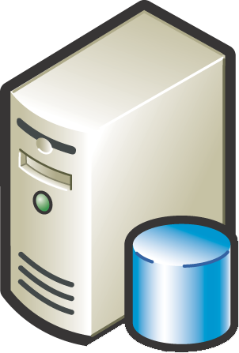

Team System Deployment
Business User
Dev Team (Local)
Dev Team (Remote)
Build Server
Win 2003 Server
SQL Server 2005
IIS 6.0
Version Control Proxy (Remote)
Active Directory
HTTP / S
TCP/IP
Team Foundation Server
Notes:
Give some stats on saleability and network requirements.
Caching Proxy Server
Downloading files is expensive in terms of bandwidth. Solution: cache them locally at your remote sites.
High level, clients get all meta data from server as to what is the latest version etc. When it wants to download a file, sends the request to the proxy server. If proxy has it sends it, otherwise gets it from the server. Keeps it stored in GZIP format (unless file format grows when GZIPED)
Also useful for reducing load on App tier. There is a file cache in app tier (stored in GZIP format)
Cache has fixed size limit or percentage space limit (of disk system) Files removed on a FIFO policy.
Cache counters available at
http://<proxy>:8081/VersionControlProxy/v1.0/ProxyStatistics.asmx
http://<at>:8080/VersionControl/v1.0/ProxyStatistics.asmx
Can also be output to server log file on a periodic basis.
Cache files located on separate disc to OS – configured for speed not reliability (files are stored in DB tier properly)
Can proxy multiple AT instances
Each proxy should have own user id?
In Microsoft, TFS Server in Redmond, TFS proxy in Raliegh (where the VC team are), TeamBuild in India and Beijing team.
Need to fit in with your WAN environment. Where are your main data centres. Where will your teams be? Cost low (cost of a Windows 2003 server) Configure disks for fast raid striping (RAID 0) (just a cache – don’t bother with redundancy for the cache partition)
Typical usage is 89% cache hit.

Slide 6

What is Source Control
A place to store stuff
Historical record of changes over time
Allows developers to work in parallel
Notes:
Sometimes known as Version Control as you can manage any files – not just source.
Do survey about who is using source control – what system are they currently using:-
TFS. The new kid on the block
Vault. Our parent companies product.
SourceSafe. Microsoft. Old. Loved. Hated.
Subversion. Open source. New. Neato.
CVS. Open source. Old. Reliable. Dusty.
PVCS Don’t see many folks using this any more.
ClearCase IBM Rationals powerful and complicated system.
BitKeeper. Commercial. Uses a distributed repository architecture, so I won't be talking about this one much.
Arch. Open source. Distributed repository architecture. Again, I spend most of my words here on tools with a centralized server.
Others?
I’ll be talking about source control, particularly in relation to single repository systems like TFS, CVS, Subversion and Vault.
Nobody ever seems to get taught to use source control.
Start programming working on own stuff.
Have to use source control when start in job, but just check-in and check-out.
The disciplines develop over time.
The pain of the Grad joining the team…
Some research has found that about 70% of all software development is done without source control – scary.

Slide 7
Source Control Basics
Notes:
You have a central store called the “repository”. This is the master copy of the files.
The workflow of a developer is an infinite loop which looks something like this:
Copy the contents of the repository into a working folder.
Make changes to the code in the working folder.
Update the repository to incorporate those changes.
Repeat.
Obviously missed out thinks like drink coffee, talk about last nights episode of Battlestar Gallatica, bitch about the management etc but that is about all we do at a high level.
If you think of a file system in 2 dimensions (files and folders), then a repository has a third dimension – time.
You are able to query the repository at any point in time and see what the state of the code base was then.
You can create labels in the code base to signify a milestone or point in time i.e. “Release V1.0”.
Consider the alternative.
Work on the code on your local machine and only have 1 working copy – you make a mistake and something stops working, very hard to see what has changed. So you take regular backups – only you have to remember to do this.
Throw in another developer into the equation, you start to use a network share to work on the code. You shout to him to make sure he isn’t in the file, edit it off you go.
The rise of Open Source Software means more and more folks are learning about source control soon after they start coding. This is a good thing.

Slide 8
The Problem of File-Sharing
Repository
A
A
A
Harry
Sally
Notes:
You have file A in the repository. Harry and Sally both read the file.

Slide 9
The Problem of File-Sharing
Repository
A
A’
A
Harry
Sally
Notes:
Harry makes a change

Slide 10
The Problem of File-Sharing
Repository
A
A’
A’’
Harry
Sally
Notes:
Sally makes a different change.

Slide 11
The Problem of File-Sharing
Repository
A
A’
A’
A’’
Harry
Sally
Notes:
You have file A in the repository. Harry and Sally both read the file.

Slide 12
The Problem of File-Sharing
Repository
A’
A’
A’’
A’’
Harry
Sally
Notes:
Sally saves her file back to the repository

Slide 13
The Problem of File-Sharing
Repository
A’’
A’
A’’
Harry
Sally
Notes:
Sally’s change overwrite Harry’s
Now Harry’s file is not lost because the repository retains a history of all changes to all files. However the changes Harry made are no longer in the latest version and Sally never saw them so the fix that Harry made is effectively lost unless somebody happens to notice that the fix has disappeared.

Slide 14

Lock, Modify, Unlock Model
Repository
A
Lock
Lock
Read
A
A
Harry
Sally
Notes:
Many version control systems use a lock-modify-unlock model to address this problem. In such a system, the repository allows only one person to change a file at a time. First Harry must “lock” the file before he can begin making changes to it. Locking a file is a lot like borrowing a book from the library; if Harry has locked a file, then Sally cannot make any changes to it. If she tries to lock the file, the repository will deny the request. All she can do is read the file, and wait for Harry to finish his changes and release his lock. The version control system will usually have the file as read-only on Sally’s machine until she can get a lock – that way she cannot edit it until she gets the lock. If Sally goes in and messes with the read/write status then she is on her own.

Slide 15
Lock, Modify, Unlock Model
Repository
A
’
Write
Lock
Read
Unlock
A’
A
’
’
Harry
Sally
Notes:
After Harry unlocks the file, his turn is over, and now Sally can take her turn by locking and editing.
This works well in lots of companies, but it can be quite restrictive.

Slide 16
Best Practice
Small frequent check-ins
Do get latest between check-ins
Communicate with the team
Consider continuous integration
Consider branching techniques
Notes:
The model can be restrictive. If a Harry leaves a file locked by mistake then Sally cannot continue until Harry unlocks it. If Harry and Sally are working on files that have dependencies on each other they can get stuck. Temptation is for Sally to set her file to writeable locally and then make changes she needs to progress. Finding these files later can be a problem – if she doesn’t manually merge the results she can accidentally overwrite Harry’s changes.
Can be a bit wasteful. What if Harry and Sally just want to add values to a property file. No need to take turns.
We’ll talk more about branching techniques later.

Slide 17
Copy, Modify, Merge Model
Repository
A
Read
A
A
Harry
Sally
Notes:
Many version control systems use a lock-modify-unlock model to address this problem. In such a system, the repository allows only one person to change a file at a time. First Harry must “lock” the file before he can begin making changes to it. Locking a file is a lot like borrowing a book from the library; if Harry has locked a file, then Sally cannot make any changes to it. If she tries to lock the file, the repository will deny the request. All she can do is read the file, and wait for Harry to finish his changes and release his lock. The version control system will usually have the file as read-only on Sally’s machine until she can get a lock – that way she cannot edit it until she gets the lock. If Sally goes in and messes with the read/write status then she is on her own.

Slide 18
Copy, Modify, Merge Model
Repository
A
’
’
Write
Write
A
A
’
’
’
Harry
Sally
Notes:
Many version control systems use a lock-modify-unlock model to address this problem. In such a system, the repository allows only one person to change a file at a time. First Harry must “lock” the file before he can begin making changes to it. Locking a file is a lot like borrowing a book from the library; if Harry has locked a file, then Sally cannot make any changes to it. If she tries to lock the file, the repository will deny the request. All she can do is read the file, and wait for Harry to finish his changes and release his lock. The version control system will usually have the file as read-only on Sally’s machine until she can get a lock – that way she cannot edit it until she gets the lock. If Sally goes in and messes with the read/write status then she is on her own.

Slide 19
Copy, Modify, Merge Model
Repository
A
’
’
*
Write
Read
Merge
A
A
A
’
*
’
*
’
’
’
Harry
Sally
Notes:
Many version control systems use a lock-modify-unlock model to address this problem. In such a system, the repository allows only one person to change a file at a time. First Harry must “lock” the file before he can begin making changes to it. Locking a file is a lot like borrowing a book from the library; if Harry has locked a file, then Sally cannot make any changes to it. If she tries to lock the file, the repository will deny the request. All she can do is read the file, and wait for Harry to finish his changes and release his lock. The version control system will usually have the file as read-only on Sally’s machine until she can get a lock – that way she cannot edit it until she gets the lock. If Sally goes in and messes with the read/write status then she is on her own.

Slide 20
Team Foundation Server Model
Lock types:-
  None
  Check – out
  Check – in
Notes:
TFS uses Copy Modify Merge but keeps files as read-only in your client machine. When you want to edit a file you must tell the server. At that point you can specify 1 of 3 lock types.
Lock "None". The file is not locked. A user may check out the file after you have, make changes and check those changes back in. At the point when you come to check in files you will be prompted to resolve any conflict that could occur. A really useful example when none is very useful is if editing a common config file, and interface containing constants or an enum where typically only additions are being made - your changes and another developers changes will usually always work in harmony. Typically, we default to lock of "none" in my organization and rely on communication between developers to ensure we do not adversely effect each others development.
Lock "Check-out". The file is locked on the server so that no user may check the file out after you have. This is useful is you are making a change to the file and you do not want anybody else to be able to start editing the file until you have released the lock by checking in the file or un-locking it. You cannot place a lock of "check-out" on a file if somebody already has checked out the file with a lock type of "none". Additionally, binary files are checked out with a check-out lock due to the problems of merging two binary files.
Lock "Check-in". This is also known as the "antisocial" lock in our company :-) A check-in lock prevents anyone else from committing their changes to that file until you have released the lock. This means that they will be responsible for performing any conflict resolution activities that result. You can place a check-in lock on a file even if somebody has a file checked out with a lock type of "none" i.e. I know you are working on this file but you are not allowed to check in your changes until I have made this important quick fix.
Depending on the culture in your organization, you may not be comfortable with two developers being able to work on the same file at the same time. In which case there is a Team Project Setting (Team, Team project Settings..., Source Control, Check-out settings) called "Enabled multiple check-out". This is typically enabled, however you can de-select this option if you have appropriate privileges and from then on all check-outs will be performed with lock "Check-out" - no other types of lock will be permitted by the server.

Slide 21
TFS Concepts: Team Project
“A collection of work items, code, tests, work products, metrics, etc that is used by a defined team to track a common set of related work.
Notes:
Local copy of stuff.
The server remembers which versions of the file you have.
Anything you do to these files the TFS client notifies the server to mark as “pending changes”.
Those changes (including delete, rename etc) are only comited to the server when you check
You update your workspace by doing a “Get Latest”.
Multiple workspaces per machine allowed.
If you don’t tell the server you are messing with the files you get into trouble.

Slide 22
TFS Concepts: Workspace
“Your client-side copy of the files and folders on the source control server.”
Notes:
Local copy of stuff.
The server remembers which versions of the file you have.
Anything you do to these files the TFS client notifies the server to mark as “pending changes”.
Those changes (including delete, rename etc) are only comited to the server when you check
You update your workspace by doing a “Get Latest”.
Multiple workspaces per machine allowed.
If you don’t tell the server you are messing with the files you get into trouble.

Slide 23
TFS Concepts: Changeset
“A logical container in which Team Foundation stores everything related to a single check-in operation”
Notes:
Changeset is a check-in transaction. All the changes done in one changeset.
Also associate work items with change set
Check-in notes
System generated changeset id that is generated sequentially by the server (i.e. #4 happened after #3).
A changeset number can represent a point in time on the TFS server.
Files are versions by the changeset that they appear in, not 1,2,3 for each file. (confusing at first)

Slide 24
Shelving
Put work on hold
Can be thought of as temporary developer branch.
Notes:
Some of the pro’s of branching – but you don’t have to know ahead of time.
Allows you to save your work on the server for long duration changes.
But like a branch, but you don’t have to know about it before hand.

Slide 25

Basic source control with
Team Foundation Server
Notes:
Create project in VS 2005 on XP. Check in. Make changes. Show history. Do Compares.
Have 2 (Harry and Sally) users, XP and Linux. Demo different lock types and how they would be used.
Show history. Do label and show that.
Associate check-ins with work items. Talk about check-in policies and check-in notes.
User Harry – Windows XP VS 2003.
Create a new “Hello World” solution.
Create “Hello World” and add tests.
Add to source control
Commit the add – discuss the fact that these changes are in one transaction called a changeset.
Checkout a file by right clicking and editing

Slide 26
Key Features
Atomic Check in
Integrated with Visual Studio
Eclipse and Cross-platform support
(via partner)
Work Item Integration
Customizable Check in Behavior
WAN Support
Large File Support (>4GB)
Shelving
Notes:
Checkin Policies, Checkin Notes. Allow non-exclusive edits.

Slide 27
Team System VC vs VSS
VSS
Team System
Full Get
1.5 hours
7.5 minutes
Get Latest
15 minutes
3 seconds
Right Click
3.5 seconds
0 Seconds
Navigate
4.5 Seconds
0 Seconds
X 6
X 25
X 28
Proxy
Notes:
Source Control over the WAN (Belfast - Chicago).
No source control proxy
~250 Mb of source
~6,000 individual files
VSTS Beta 2, Beta 3 had many performance improvements in it…
Full get on source tree:
VSS - 1 hour 26 mins 53 seconds
VSTS - 7 mins 32 Seconds (Expect to improve substantially with proxy server, should get to under a minute)
Get Latest when nothing changed (on full source tree):
VSS - 14 mins 23 seconds
VSTSB2 - 19 seconds
VSTSB3 – 3 seconds
Right click on a folder:
VSS - 3.5 seconds
VSTS - Instant
Navigate down a folder with no files in it:
VSS - 4.5 seconds.
VSTS - Instant
Show files checked out to me:
VSS - 3 mins
VSTS - Instant
When getting a cached result from a local proxy server, typically 6x faster for lots of small files. 25x faster for a set of large files (10, 10Mb files), 28x for 1 large (1.9GB) file. (Based on client and proxy on same lan. Proxy to AT via a T1 link). A typical development team can expect an 80-90% cache hit for files (depending on size).

Slide 28


Microsoft “Dogfooding”
Version Control
Version Control Users: 864
Number of Files/Folders: 1,507,247/178,953
Compressed File Size: 95.2 GB
Workspaces: 1,770
Workspace File Versions: 48.9 Million
Changesets: 32,573
Pending Changes: 57,278
Shelvesets: 2,458
Source: http://blogs.msdn.com/buckh/archive/2006/03/22/brownbag.aspx
Copenhagen, Denmark
6 Users
Fargo, ND
4 Users
Redmond, WA
368 Users
Research Triangle, NC
42 Users
Hyderabad, India
14 Users

Slide 29
Capacity Planning
Team Size | TFS Config | Model | CPU | Memory | Disk
100 | Single Server | Dell PowerEdge 1850 | 1 x 3.4Ghz | 1GB | 1 x 10k rpm SCSI
200 | Single Server | Dell PowerEdge 1850 | 1 x 3.4Ghz | 2GB | 1 x 10k rpm SCSI
400 | Single Server | Dell PowerEdge 1850 | 2 x 3.4Ghz | 2GB | 1 x 10k rpm SCSI
800 | Dual Server | HP Proliant DL580 G2 | AT: 1 x 2.8Ghz DT: 2 x 2.7Ghz | AT: 1GB DT: 4GB | 12 x 15k SCSI Raid 0
2000 | Dual Server | HP Proliant DL580 G2 | AT: 1 x 2.8Ghz DT: 4 x 2.7Ghz | AT: 1GB DT: 16GB | 12 x 15k SCSI Raid 0
3500 | Dual Server | Dell PowerEdge 1850 Unisys ES7000/600 | AT: 2 x 2.8Ghz DT: 8 x 2.8Ghz | AT: 4GB DT: 32GB | XIOTech SAN (2TB, RAID 10)
Source: http://blogs.msdn.com/bharry/archive/2006/01/04/509314.aspx
Notes:
Many variables that affect performance, but these are the results of internal testing inside Microsoft. Based on numbers from studying how TFS is used internally during dogfooding.
Request load averages about 0.1 peak requests per second per user.
From, http://blogs.msdn.com/buckh/archive/2006/02/22/tfs_size_estimation.aspx
Size of disk space needed = 1.25 * (# of files/folders * avg. content size + 520 * # of workspaces * avg. # of files in workspace + # of work items * average size of work item)

Slide 30
Terminology – CVS / Subversion
Check Out
Update

Slide 31
Terminology – VSS / TFS
Get Latest
Check Out
Check in

Slide 32
Check out != Get Latest
1
2
3
4
Edit Pending
on Version 3
Get Latest
Get Latest
Check in
1
3

Slide 33
Check out != Get Latest
1
2
3
4
Edit Pending
on Version 1
Attempted
Check in
Get Latest
Get Latest
Check in
1

Slide 34
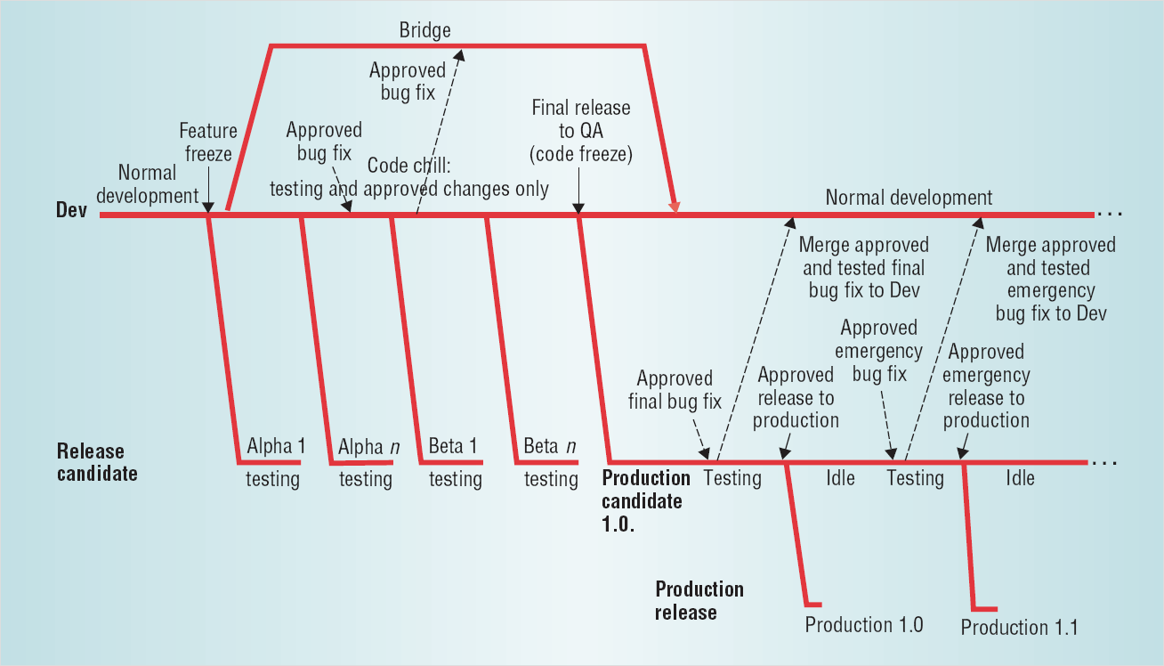
Branching and Merging
Source: http://downloads.seapine.com/pub/papers/SCMBranchingModels.pdf
Notes:
A lot of people are frightened of Branching. Up until I moved to an ISV that has it’s own SCM tool I’d only ever really used it in 2 major projects – and it was scary (mainly because the tools were not up to the job).
People ask if you can Share folders in TFS. The answer is no (sort of). In VSS world, shared folders are often used instead of branches.
Talk about terminology – truck and branches.
For a lot of internal IT projects – having one main branch and using CI is the way to go.
What is a branch
Why Branch
- Avoid source tree being polluted with experimental code.
- Allow work on different versions of product at same time
- Support maintenance releases etc
- Allow parallel Development (more later)
(Branch on label where label indicates a build) In CI environments, changeset may be just as good.
Merging.
- Difficulty in merging is directly proportional to the length of time that the branch existed.
In order to be successful, all the developers have got to understand branching and be disciplined. Also have to take care when merging to truck.
- Branch per Task
- Branch per Developer
- Branch per Feature

Slide 35
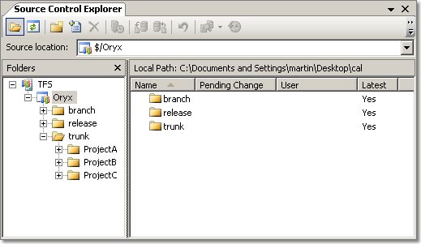
Recommended File Structure

Slide 36
TFS Branching Features
Path-space branching
Support for merging changes
Branch from any point in history
Cherry Pick Changesets

Slide 37
Branching and Shelving with
Team Foundation Server

Slide 38
Team Foundation Server Clients
Win 2003 Server
SQL Server 2005
IIS 6.0
Team Foundation Server
Notes:
Microsoft MSSCCI Provider - Visual Studio 2003 / Visual Studio 6 etc

Slide 39
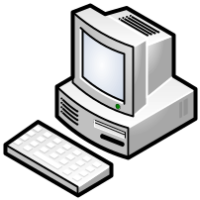
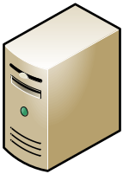

Team Foundation Server Clients
Teamprise
Eclipse Plugin
Teamprise
Explorer
Teamprise
Command Line Client
Visual Studio 2005
Team Explorer
Teamprise
On Linux
Microsoft Command
Line Client
Team Foundation
Server
Teamprise On
Sun / SPARC
Visual Studio 2003 /
Visual Studio 6
Teamprise
On Mac
Notes:
Microsoft MSSCCI Provider - Visual Studio 2003 / Visual Studio 6 etc

Slide 40
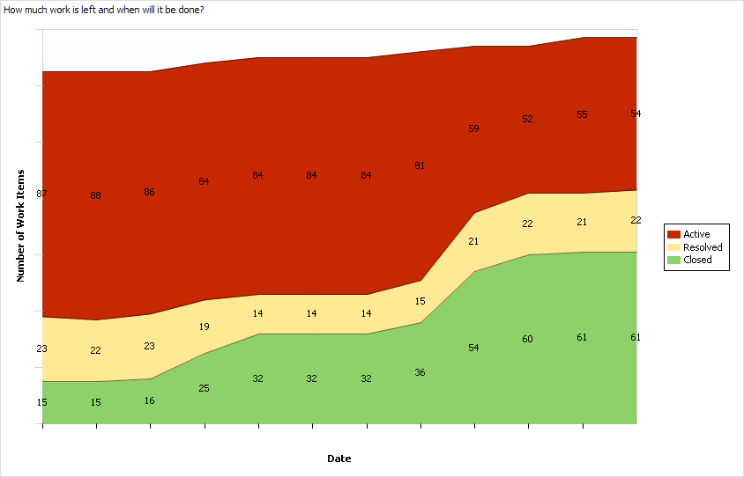
Example Report

Slide 41
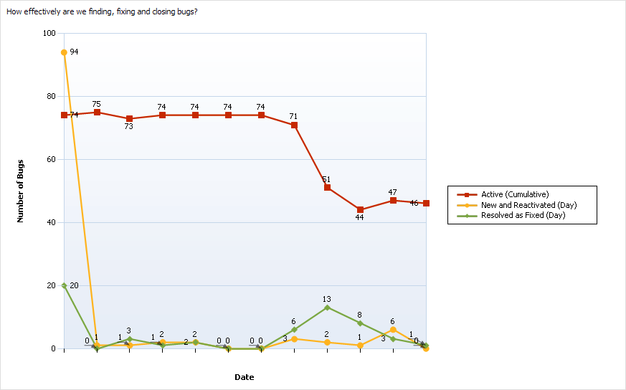
Example Report

Slide 42
Learning More
Eric Sink’s Source Control HOWTO
http://software.ericsink.com/scm/
Subversion Book
http://svnbook.red-bean.com
Rob Caron’s Blog:
http://blogs.msdn.com/robcaron
Team System Rocks:
http://www.teamsystemrocks.com
Microsoft
http://www.microsoft.com/teamsystem
VSTS Virtual Lab
http://shrinkster.com/emj

Slide 43
Question and Answer
Slides: http://www.woodwardweb.com
Martin Woodward
Senior Software Engineer
Teamprise
martin@teamprise.com
www.teamprise.com

Slide 44
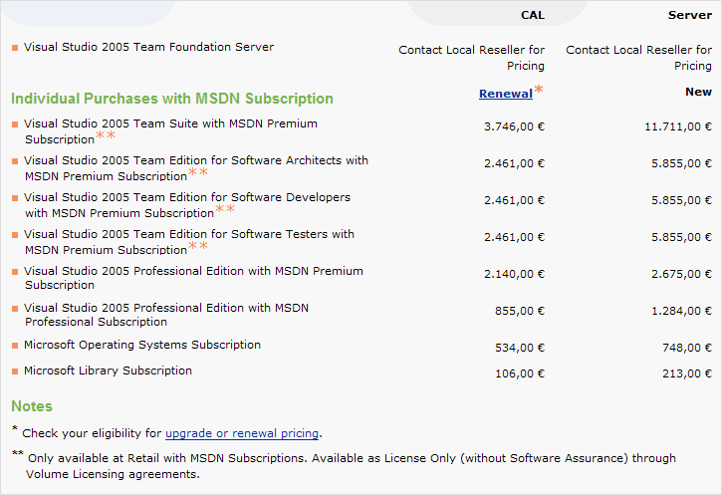
Team System Pricing
Source: http://msdn.microsoft.com/vstudio/howtobuy/ (April 2006)
Notes:
Would guess about 2,500 € for TFS Server & 500 € for a CAL – but don’t quote me on that.

