Slide 1
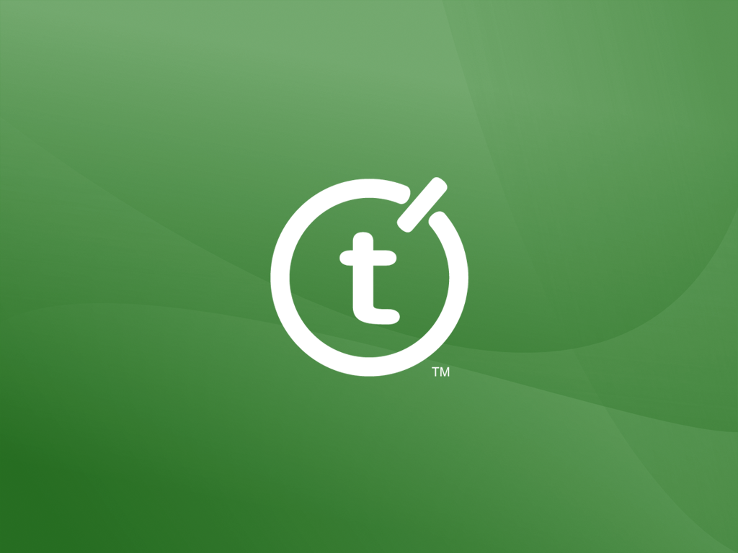

Slide 2


Connecting to Team System Across the Enterprise
Martin Woodward
Teamprise
Sponsored Partner Session
Notes:
SD West Technical Session
Connecting to Team System Across the Enterprise - Microsoft Sponsored Partner Session
Presented by Martin Woodward, Senior Software Engineer, Teamprise
Thursday, March 16, 8:30am - 10:00am
Drawing on real world scenarios, this session will explain how to deploy Visual Studio 2005 Team Foundation Server across your enterprise. It will focus in on a realistic adoption route and demonstrate the alternative methods available to connect into your Team System Environment. Particular focus will be given to the Teamprise suite of products which allows Team Foundation access from non-Windows platforms and from inside Eclipse, the leading Java IDE.

Slide 3

Teamprise the company
Division of SourceGear
Focused on creating products that extend Team Foundation Server to UNIX, Macintosh and Java developers

Slide 4
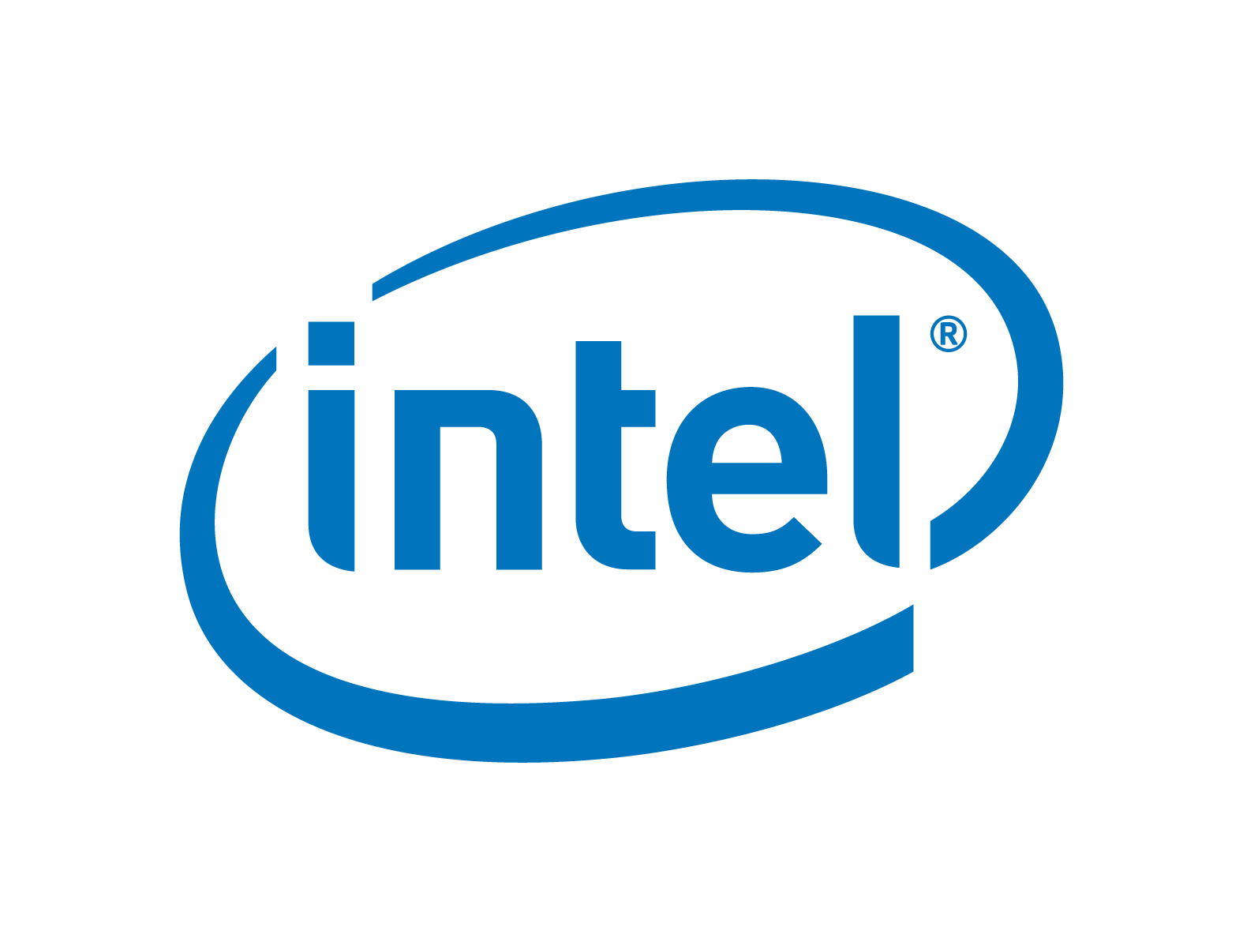

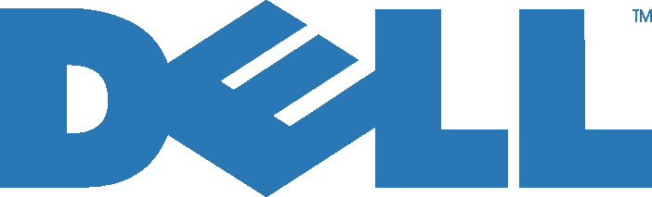


SourceGear company background
Founded 1997
Headquarters in Champaign, IL
SourceOffSite, SourceGear Vault
Customers include

Slide 5
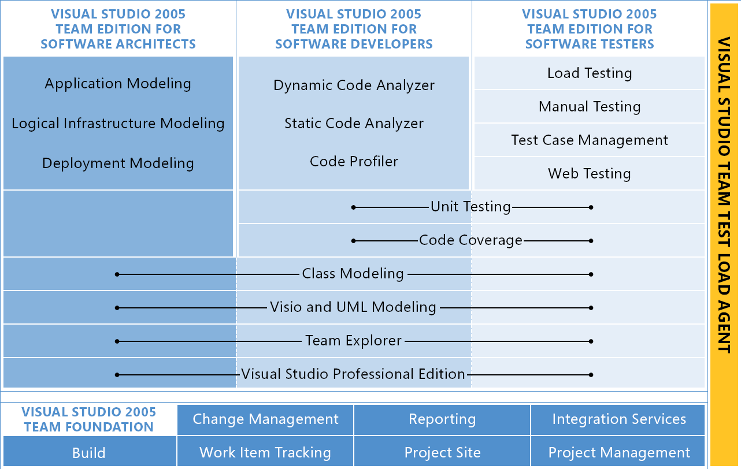
Visual Studio Team System
Notes:
What is Team System?
More than just Visual Studio. Talk about testing tools, code analyzer, Class Diagrams also Team Foundation Server.
Client side in VS 2005 (Team Explorer)
Team Foundation Server

Slide 6
Team Foundation Server
Change Management
Reporting
Work Item Tracking
Project Site
Notes:
Explain TFS and services it provides.
Work Item Tracking
Source Control
Reporting
Collaboration
TFS Services available to everyone
Mention other server components (build server, proxy server)

Slide 7
Challenges in IT
Main pain points
  Communication
    Tracking of work
    Traceability of requirements
  Distributed Version Control
All reduce time spent on development
Notes:
So, why do we need Team System and Team Foundation Server?
Most large enterprises face a common set of difficulties when developing IT solutions.
Communication
Version Control
Team Foundation Server provides tools to help address these. I’ll show you how in a second, but let’s look at how a TFS instance looks in a large company.

Slide 8
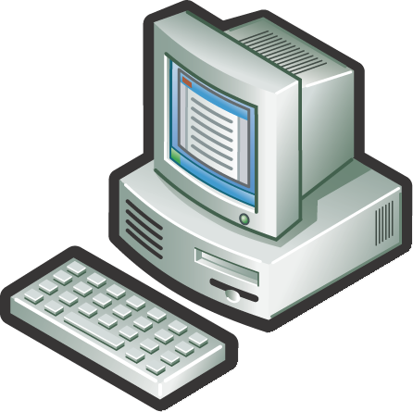
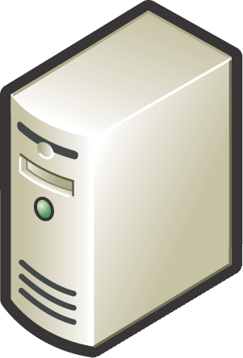
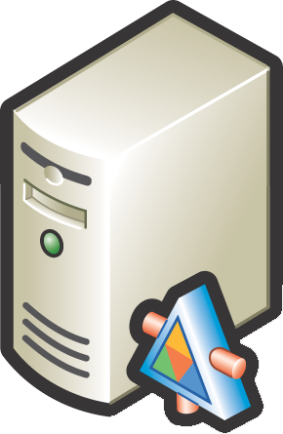
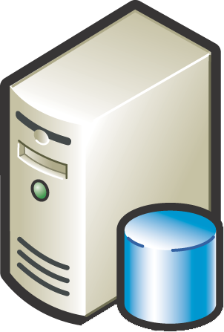

Team System Deployment
Business User
Dev Team (Local)
Dev Team (Remote)
Build Server
Win 2003 Server
SQL Server 2005
IIS 6.0
Version Control Proxy (Remote)
Active Directory
HTTP / S
TCP/IP
Team Foundation Server
Notes:
Give some stats on saleability and network requirements.
Caching Proxy Server
Downloading files is expensive in terms of bandwidth. Solution: cache them locally at your remote sites.
High level, clients get all meta data from server as to what is the latest version etc. When it wants to download a file, sends the request to the proxy server. If proxy has it sends it, otherwise gets it from the server. Keeps it stored in GZIP format (unless file format grows when GZIPED)
Also useful for reducing load on App tier. There is a file cache in app tier (stored in GZIP format)
Cache has fixed size limit or percentage space limit (of disk system) Files removed on a FIFO policy.
Cache counters available at
http://<proxy>:8081/VersionControlProxy/v1.0/ProxyStatistics.asmx
http://<at>:8080/VersionControl/v1.0/ProxyStatistics.asmx
Can also be output to server log file on a periodic basis.
Cache files located on separate disc to OS – configured for speed not reliability (files are stored in DB tier properly)
Can proxy multiple AT instances
Each proxy should have own user id?
In Microsoft, TFS Server in Redmond, TFS proxy in Raliegh (where the VC team are), TeamBuild in India and Beijing team.
Need to fit in with your WAN environment. Where are your main data centres. Where will your teams be? Cost low (cost of a Windows 2003 server) Configure disks for fast raid striping (RAID 0) (just a cache – don’t bother with redundancy for the cache partition)
Typical usage is 89% cache hit.

Slide 9
Team Foundation Server Clients
Win 2003 Server
SQL Server 2005
IIS 6.0
Team Foundation Server
Notes:
Microsoft MSSCCI Provider - Visual Studio 2003 / Visual Studio 6 etc

Slide 10
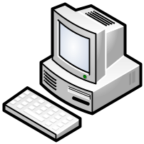
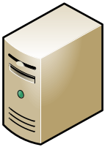

Team Foundation Server Clients
Teamprise
Eclipse Plugin
Teamprise
Explorer
Teamprise
Command Line Client
Visual Studio 2005
Team Explorer
Teamprise
On Linux
Microsoft Command
Line Client
Team Foundation
Server
Teamprise On
Sun / SPARC
Visual Studio 2003 /
Visual Studio 6
Teamprise
On Mac
Notes:
Microsoft MSSCCI Provider - Visual Studio 2003 / Visual Studio 6 etc

Slide 11
Capacity Planning
Team Size | TFS Config | Model | CPU | Memory | Disk
100 | Single Server | Dell PowerEdge 1850 | 1 x 3.4Ghz | 1GB | 1 x 10k rpm SCSI
200 | Single Server | Dell PowerEdge 1850 | 1 x 3.4Ghz | 2GB | 1 x 10k rpm SCSI
400 | Single Server | Dell PowerEdge 1850 | 2 x 3.4Ghz | 2GB | 1 x 10k rpm SCSI
800 | Dual Server | HP Proliant DL580 G2 | AT: 1 x 2.8Ghz DT: 2 x 2.7Ghz | AT: 1GB DT: 4GB | 12 x 15k SCSI Raid 0
2000 | Dual Server | HP Proliant DL580 G2 | AT: 1 x 2.8Ghz DT: 4 x 2.7Ghz | AT: 1GB DT: 16GB | 12 x 15k SCSI Raid 0
3500 | Dual Server | Dell PowerEdge 1850 Unisys ES7000/600 | AT: 2 x 2.8Ghz DT: 8 x 2.8Ghz | AT: 4GB DT: 32GB | XIOTech SAN (2TB, RAID 10)
Source: http://blogs.msdn.com/bharry/archive/2006/01/04/509314.aspx
Notes:
Many variables that affect performance, but these are the results of internal testing inside Microsoft. Based on numbers from studying how TFS is used internally during dogfooding.
Request load averages about 0.1 peak requests per second per user.
From, http://blogs.msdn.com/buckh/archive/2006/02/22/tfs_size_estimation.aspx
Size of disk space needed = 1.25 * (# of files/folders * avg. content size + 520 * # of workspaces * avg. # of files in workspace + # of work items * average size of work item)

Slide 12
Rising to the Challenge
Main Strengths
  Communication
    Tracking of work
    Traceability of requirements
  Distributed Version Control
All increase time spent on development
Notes:
Get value from having everyone using TFS
Team System is all about Communication.
Justify in terms of WIT,
reporting to give clarity
Talk about how good source control is. Compare with VSS and give stats.
By integrating work item tracking features into IDE, developer has less excuse not to keep them up to date. Managers have to spend less time collating information, real data is pased to automatic reports. Instead can manage, re-plan, talk with customers etc. Present the business with hard facts.
CIO Blogs (www.cio.com), March 8th - Chris Lindquist:- “Team Foundation looks like it will surround development efforts with a container the clarity of a fishbowl rather than a bowling ball. But you'll still need business analysts and the like standing outside where it's dry to translate business requirements into something Nemo can understand--and to keep overeager end users from dumping a whole box of food into the tank in an effort to make him code faster.”
It’s one of those solutions that feels so simple when it is in place, you cannot believe nobody has done it before (a sign of good software).

Slide 13
Team System VC vs VSS
VSS
Team System
Full Get
1.5 hours
7.5 minutes
Get Latest
15 minutes
3 seconds
Right Click
3.5 seconds
0 Seconds
Navigate
4.5 Seconds
0 Seconds
X 6
X 25
X 28
Proxy
Notes:
Source Control over the WAN (Belfast - Chicago).
No source control proxy
~250 Mb of source
~6,000 individual files
VSTS Beta 2, Beta 3 had many performance improvements in it…
Full get on source tree:
VSS - 1 hour 26 mins 53 seconds
VSTS - 7 mins 32 Seconds (Expect to improve substantially with proxy server, should get to under a minute)
Get Latest when nothing changed (on full source tree):
VSS - 14 mins 23 seconds
VSTSB2 - 19 seconds
VSTSB3 – 3 seconds
Right click on a folder:
VSS - 3.5 seconds
VSTS - Instant
Navigate down a folder with no files in it:
VSS - 4.5 seconds.
VSTS - Instant
Show files checked out to me:
VSS - 3 mins
VSTS - Instant
When getting a cached result from a local proxy server, typically 6x faster for lots of small files. 25x faster for a set of large files (10, 10Mb files), 28x for 1 large (1.9GB) file. (Based on client and proxy on same lan. Proxy to AT via a T1 link). A typical development team can expect an 80-90% cache hit for files (depending on size).

Slide 14
Team System Adoption
Project Portal
Load Testing
Static Code Analysis
Team Build
Work Item Tracking
Reporting
Class
Diagrams
.NET 2.0
Manual Testing
Source Control
Unit Testing

Slide 15

Accessing Team Foundation Server

Slide 16
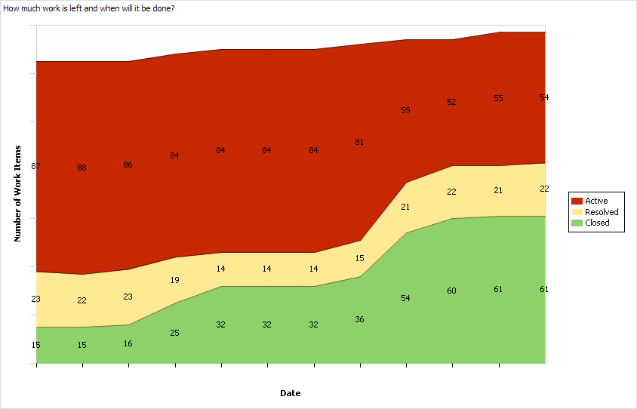
Example Report

Slide 17
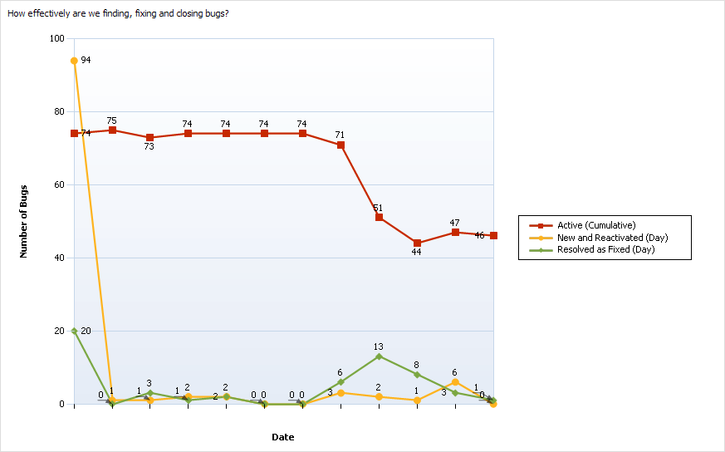
Example Report

Slide 18
Teamprise Client Suite
Client applications for accessing the source control and work item tracking features of Visual Studio 2005 Team Foundation Server from outside the Visual Studio IDE
100% Java (built on the Eclipse platform)
3 client interfaces
  Eclipse plug-in
  Explorer client
  Command-line client

Slide 19
Teamprise Plug-in for Eclipse
Perform source control and work item tracking operations to TFS from within the Eclipse IDE
Supported on Eclipse 3.0, 3.1, RAD 6.0, etc.
Standard Eclipse “Team Provider” Plug-in

Slide 20
Teamprise Explorer Client
Eclipse RCP application
Designed to look and feel like the Visual Studio 2005 Team System Source Control Explorer

Slide 21
Teamprise Command-line Client
Uses the same syntax as Microsoft’s CLC
Ideal for scripted use
Notes:
Few exceptions – same as using with /noprompt option because we have coded it for systems that run without a graphical interface.

Slide 22
Availability
Preview Program (www.teamprise.com)
Version 1.0
  Q1 2006
  Shortly after release of Team Foundation Server
Version 2.0
  Q3 2006
  Features will include
    Remaining source control features (Shelve, Branch... )
    Full work item tracking support

Slide 23
Learning More
Sam Guckenheimer, Room 201, 10.30am
Rick LaPlante Keynote, Theatre 12.30pm
Randy Miller, Room 201, 1.45pm
Rob Caron’s Blog:
http://blogs.msdn.com/robcaron
Team System Rocks:
http://www.teamsystemrocks.com
Notes:
Sam Guckenheimer talk up next. About using the reporting apects of TFS.
Rick LaPlante Keynote Theatre 12.30 – The vision behind Team System. Launch.
Randy Miller, Implementing CMMI and Agile process in real world.
Stop by the MS Stand at the front door of the expo.

Slide 24
Pricing and Licensing
Licensed on a per user basis
$499 with volume discounts
Upgrade from 1.0 to 2.0 at no additional cost
TFS CALs purchased separately from Microsoft

Slide 25
Question and Answer
Martin Woodward
Senior Software Engineer
Teamprise
martin@teamprise.com
www.teamprise.com

Slide 26
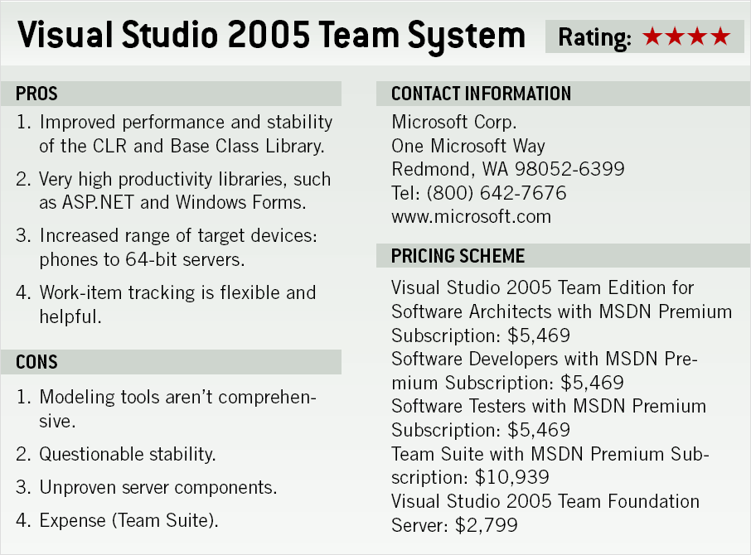
Team System Pricing
Source: SD Times, April 2006

