Slide 1
Team System Adoption
Martin Woodward
Teamprise
Notes:
© 2006 Teamprise. All rights reserved.
This presentation is for informational purposes only. Teamprise makes no warranties, express or implied, in this summary.
Teamprise

Slide 2
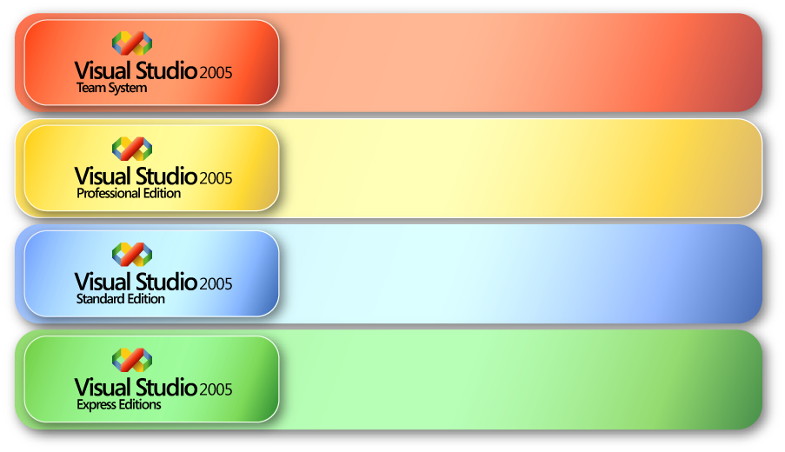
Visual Studio Editions
Lifecycle tools for better communication and collaboration among software teams
Comprehensive tool for professional developers
working alone or in small teams
Entry-point tool for professional developers
building rich Windows® and Web applications
Easy to use, easy to learn, easy to acquire tools for hobbyists, enthusiasts, and students
Notes:
Visual Studio® 2005 Team System expands the Visual Studio® product line to include new, productive, integrated software lifecycle tools for teams of operations managers, project managers, testers, enterprise developers, and architects in the enterprise market segment.
Visual Studio® 2005 Professional Edition is the professional developer tool for individual programmers, consultants, or those working in small teams who are building mission-critical, multi-tier smart client, Web, and mobile applications. Visual Studio® 2005 Tools for Office enables the Visual Studio developer to quickly build custom line-of-business solutions based on Microsoft Office. (Professional targets those developers on Visual Basic 6.0 – 50% of existing customer base has yet to migrate from 6.0. .Net took away critical functionality available in 6.0. “edit”, “continue” )
Visual Studio® 2005 Standard Edition is the entry-point professional development tool for existing Visual Basic® 6 and Web developers to rapidly construct dynamic Web sites and two-tier client/server applications. (2003 had five (5) language editions. 2005 has all five rolled into 1 edition.)
The Visual Studio® 2005 Express Editions offer new, lightweight, easy to use, easy to learn development tools for novices, enthusiasts, students, and hobbyists.
VS 2005 Subscription Comparison (see slide 17)
VS 2005 Pricing
VS 2005 Licensing
Teamprise
© 2006 Teamprise. All rights reserved.
This presentation is for informational purposes only. Teamprise makes no warranties, express or implied, in this summary.

Slide 3









Visual Studio Team System
Visual Studio Team Suite
Software
Architects
Software
Developers
Software
Testers
Database
Professionals
Visual
Studio
Team
Explorer
Application Modeling
Code Analysis
Performance Testing
Database Change Management
Visual
Studio
Industry
Partners
Infrastructure and Deployment Modeling
Performance Tuning
Manual Testing
Database Testing
Security Analysis
Test Case Management
Database
Deployment
Unit Testing
Code Coverage
MSF Process and Guidance
Class Modeling
Visio and UML Modeling
Visual Studio Professional Edition
Load Test Agent
Visual Studio Team Foundation Server
Change Management
Reporting
Integration Services
Work Item Tracking
Project Site
Project Management

Slide 4
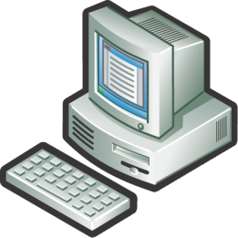





Team System Deployment
Business User
Dev Team (Local)
Dev Team (Remote)
Build Server
Win 2003 Server
SQL Server 2005
IIS 6.0
Version Control Proxy (Remote)
Active Directory
HTTP / S
TCP/IP
Team Foundation Server
Notes:
© 2006 Teamprise. All rights reserved.
This presentation is for informational purposes only. Teamprise makes no warranties, express or implied, in this summary.
Teamprise

Slide 5
Team Foundation Server Clients
Win 2003 Server
SQL Server 2005
IIS 6.0
Team Foundation Server
Notes:
Teamprise
© 2006 Teamprise. All rights reserved.
This presentation is for informational purposes only. Teamprise makes no warranties, express or implied, in this summary.
Microsoft MSSCCI Provider - Visual Studio 2003 / Visual Studio 6 etc

Slide 6





Team Foundation Server Clients
Teamprise
Eclipse Plugin
Teamprise
Explorer
Teamprise
Command Line Client
Visual Studio 2005
Team Explorer
Teamprise
On Linux
Microsoft Command
Line Client
Team Foundation
Server
Teamprise On
Sun / SPARC
Visual Studio 2003 /
Visual Studio 6
Teamprise
On Mac
Notes:
Teamprise
© 2006 Teamprise. All rights reserved.
This presentation is for informational purposes only. Teamprise makes no warranties, express or implied, in this summary.
Microsoft MSSCCI Provider - Visual Studio 2003 / Visual Studio 6 etc

Slide 7





Team Foundation Server
Work Item Tracking
Version Control
Reporting
Team Communications
Build Automation
Notes:
TFS provides the infrastructure for team members to collaborate successfully to deliver a software project. It’s built on Windows Server 2003 and SQL Server. It leverages core technologies like ASP.NET web services and SharePoint to provide services.
It’s composed of four cornerstones. The first is Work Item Tracking which is very fundamental to TFS. WI are our generic name for any piece of information related to a project that require further action or input. So it can be a Feature, Bug/Defect, Task, Requirement, etc. WIs are used by all parts of TFS.
Version Control is the name of our enterprise class source code Change Management feature that we’ll be talking about in depth shortly.
Build Automation makes it simple for teams to set up a regularly scheduled build. Performing regular builds will increase quality by catching defects when code is integrated. TFS makes it dead simple to set this up.
Team Communication is important to ensure the team is in sync. TFS supports this by aggregating all project related data in a single repository and making that easily accessible to anyone related to the project. Good communication increases the transparency of the project.
Finally, TFS’s extensive Reporting capabilities increase the predictability of a project by gathering and presenting important information. Out of the box we have over 20 predefined reports and it’s really simple to extend existing reports as well as create new reports.
Teamprise
© 2006 Teamprise. All rights reserved.
This presentation is for informational purposes only. Teamprise makes no warranties, express or implied, in this summary.

Slide 8

Migrating Data
Source Control
  VSS Converter
  CVS, Subversion
  ClearCase
Work Item Tracking

Slide 9
Team System Tools Adoption
Project Portal
Load Testing
Static Code Analysis
Team Build
Work Item Tracking
Reporting
Class
Diagrams
.NET 2.0
Manual Testing
Source Control
Unit Testing
Notes:
Teamprise
© 2006 Teamprise. All rights reserved.
This presentation is for informational purposes only. Teamprise makes no warranties, express or implied, in this summary.

Slide 10


Key Benefits for Other Stakeholders
Numerous reports graphically represent current status of project
Reporting is powerful, scalable and extensible
  Based on SQL Server 2005 Reporting Services
Fully populated Data Warehouse and Multidimensional Cube supports detailed custom queries and pivot tables
Team portal provides web based collaboration interface
Notes:
So we’ve seen how TS supports project managers, architects, developers and testers. What about people who are peripherally involved with the project, like business sponsors and executive stakeholders? How does TS help them?
TS exposes it’s data via the reporting site that’s created for each project. At any time, any person who has been given permission can view the data that’s on the sharepoint site. And remember that this portal site is customizable per user. So a stakeholder can see exactly the date she wants at any time. This is a great way to keep people in the loop.
© 2004 Microsoft Corporation. All rights reserved.
This presentation is for informational purposes only. Microsoft makes no warranties, express or implied, in this summary.

Slide 11
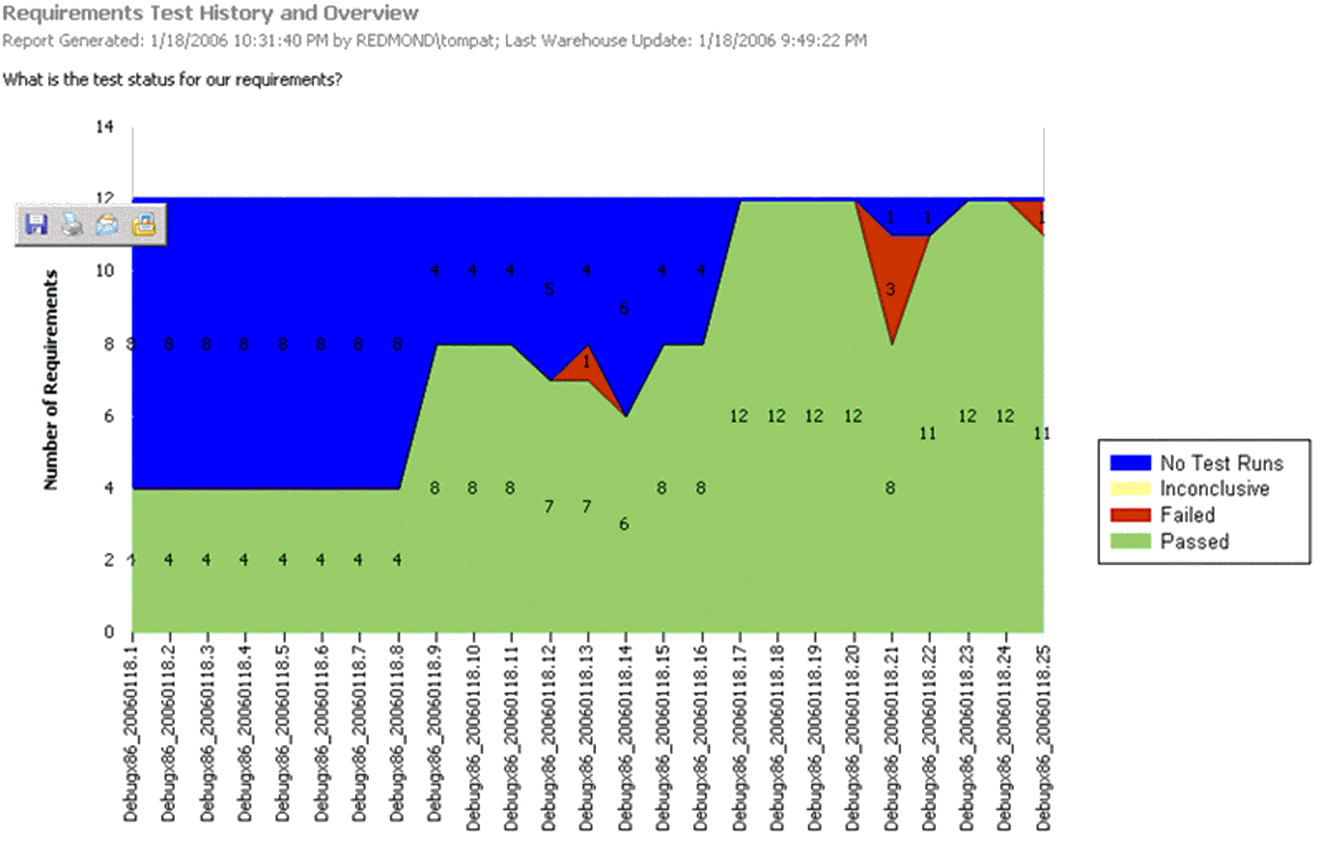

What Requirements Haven’t Been Tested?
Tracks progression of
requirements’ states from untested to passed by successive build

Slide 12
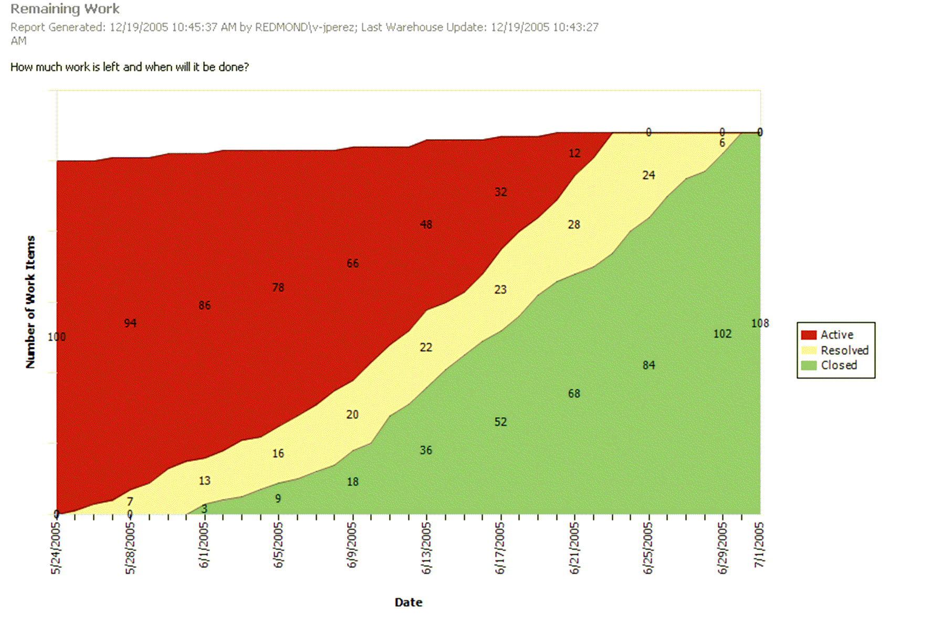


How Far Can We Get In The Available Time?
Work planned
Work
completed

Slide 13
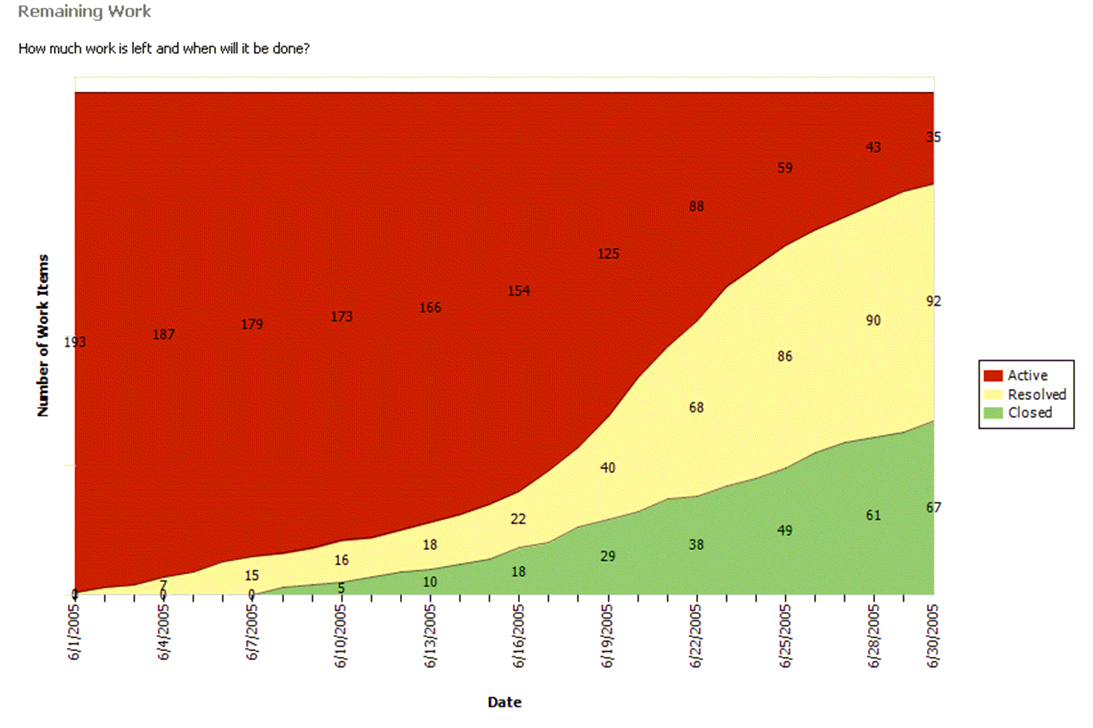

Where Do We Need To Shift Resources?
Bulge in work in process (i.e. in testing) indicates inadequate resources or inadequate incoming quality

Slide 14
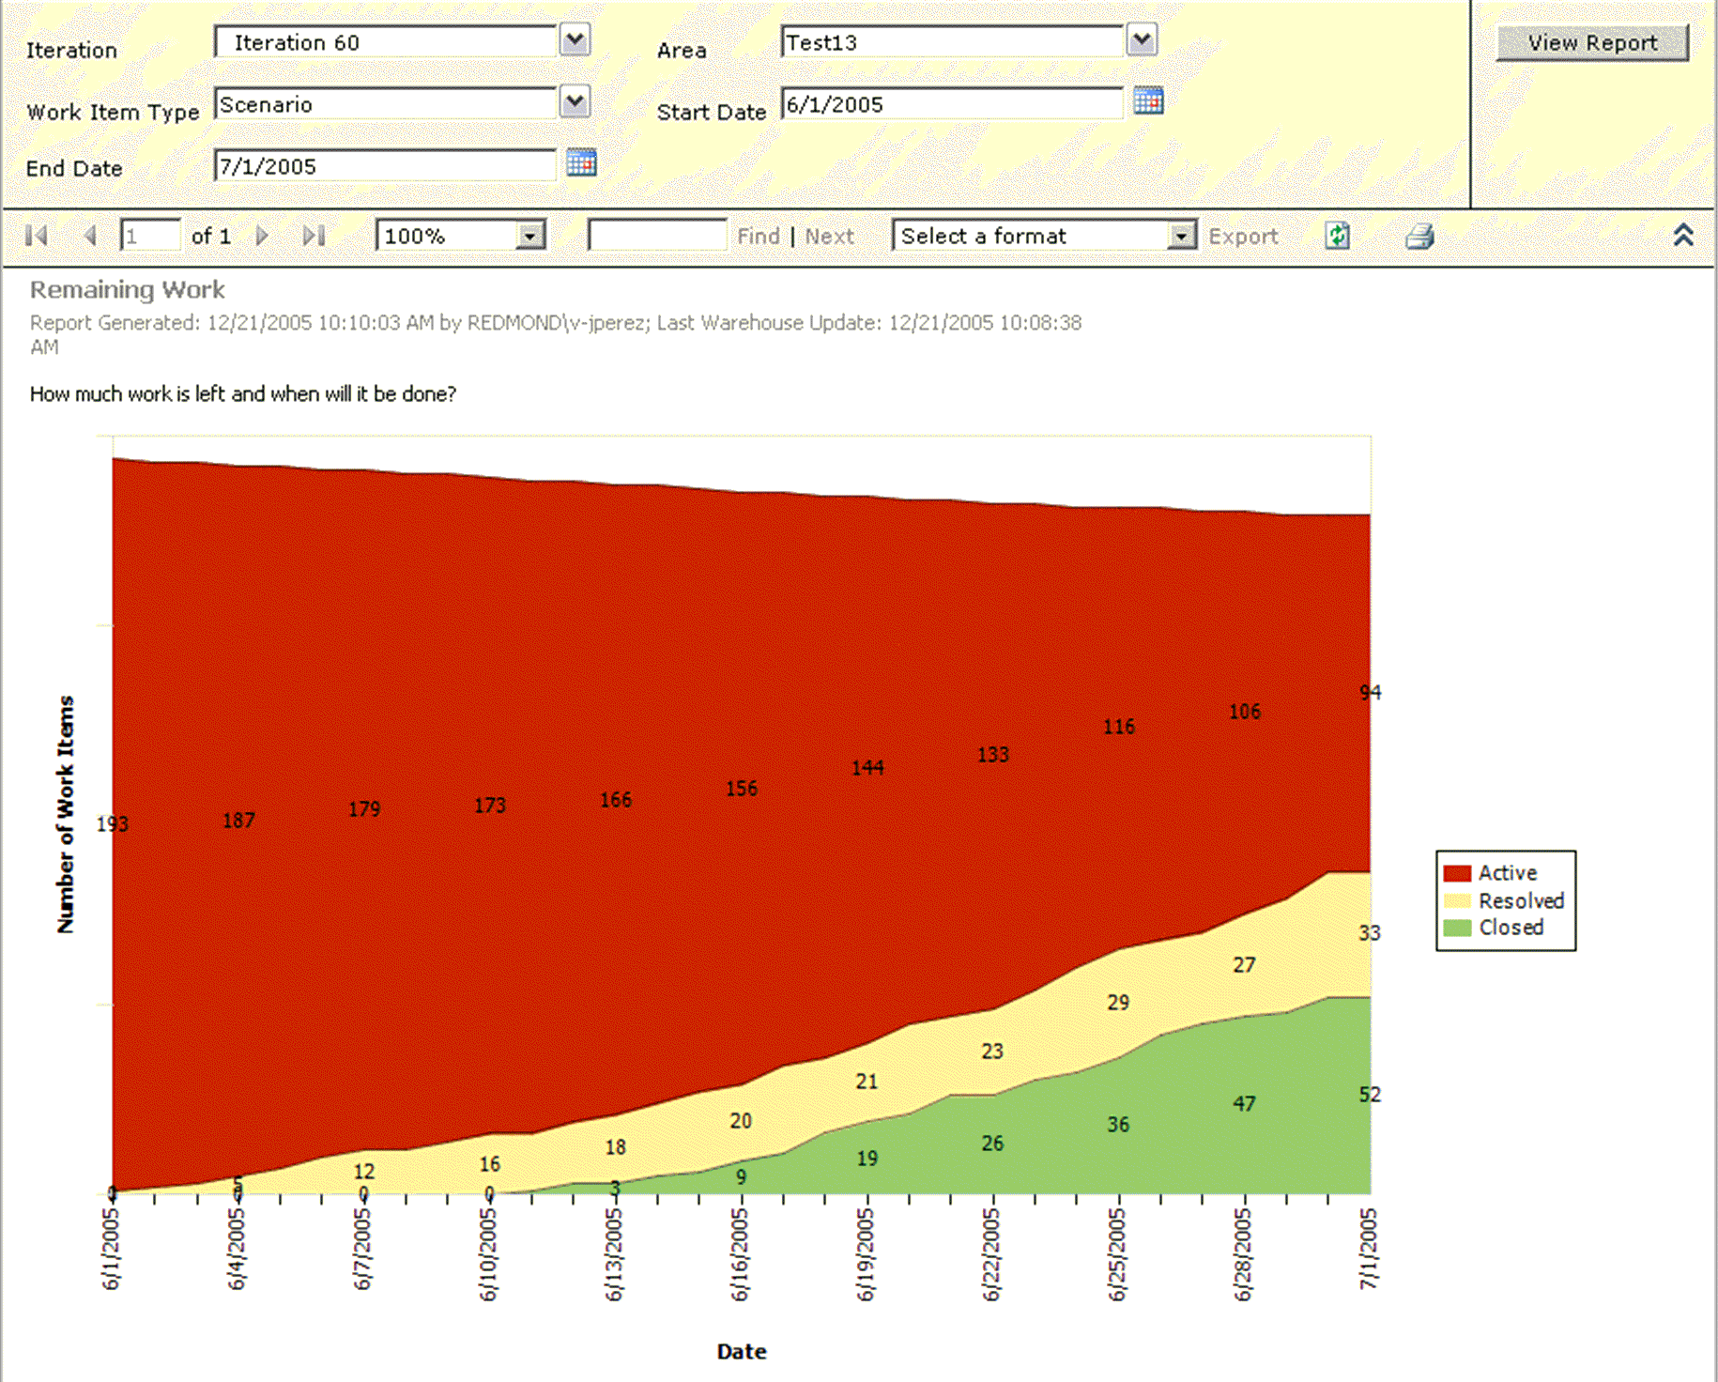


Underestimating
Slow progress leading
to cuts in planned work,
but not enough cuts
Steady rates of progress, but slope too shallow

Slide 15
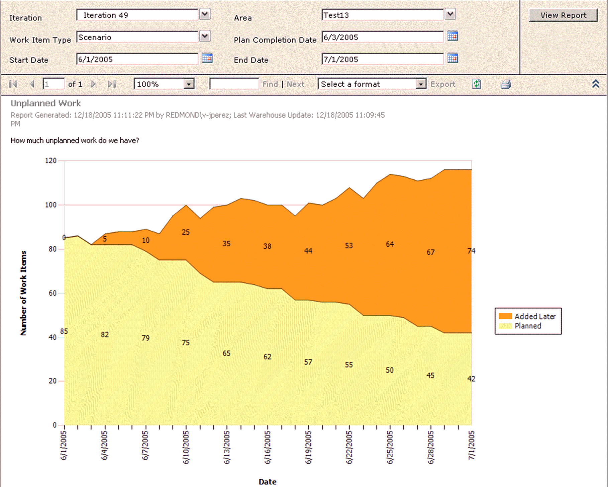


Scope Creep
“Dark matter” emerging during iteration
Planned work is squeezed out

Slide 16
Summary
VSTS can
  Improve your software development process.
  Build software with less defects
  Improve project transparency & predictability
Integrated, easy to use, cost effective.
Evaluate
  180-day trial editions available
  Virtual PC images available on MSDN
  Webcasts, demos and virtual labs will get you started quickly.

Slide 17
Learning More
Rob Caron’s Blog:
http://blogs.msdn.com/robcaron
Team System Rocks:
http://www.teamsystemrocks.com
Microsoft
http://www.microsoft.com/teamsystem
VSTS Virtual Lab
http://shrinkster.com/emj
Martin Woodward’s Blog
http://www.woodwardweb.com
Notes:
Teamprise
© 2006 Teamprise. All rights reserved.
This presentation is for informational purposes only. Teamprise makes no warranties, express or implied, in this summary.

Slide 18

Question and Answer
Slides: http://www.woodwardweb.com
Martin Woodward
Senior Software Engineer
Teamprise
martin@teamprise.com
www.teamprise.com
Notes:
© 2006 Teamprise. All rights reserved.
This presentation is for informational purposes only. Teamprise makes no warranties, express or implied, in this summary.
Teamprise

Slide 19
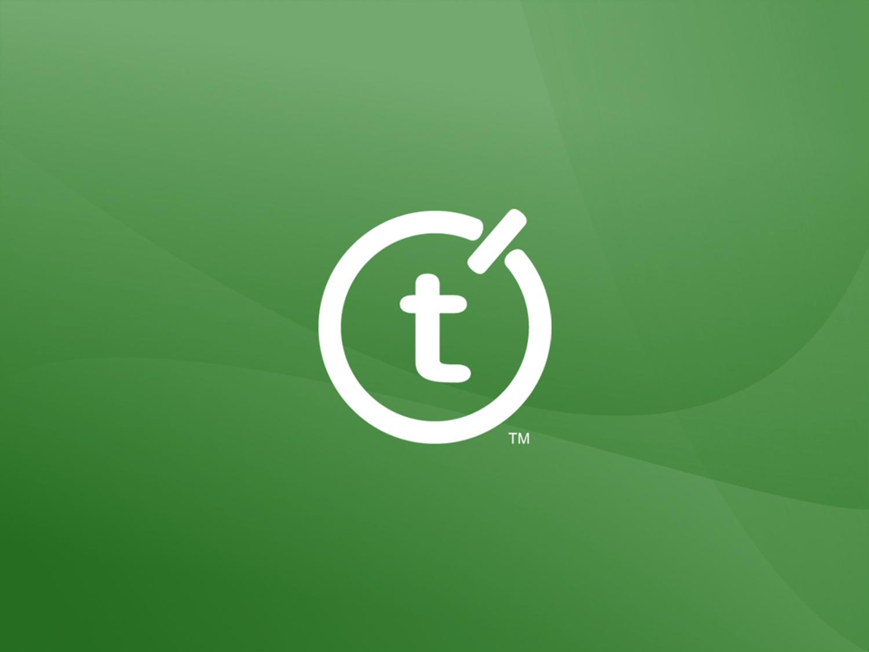
Notes:
© 2006 Teamprise. All rights reserved.
This presentation is for informational purposes only. Teamprise makes no warranties, express or implied, in this summary.
Teamprise

