Slide 1

Extending Python for Speed
2010-05-27
Martin Renold

Slide 2

MyPaint
Code
  80% Python, 20% C++
  12K lines of code
Project
  Started in 2004
  Developement slow but steady
  Popular since David Revoy's work on Durian

Slide 3
Why Python?
C++
for(std::vector<std::string>::const_iterator
i = items.begin(); i != items.end(); ++i) {
...
Python
for i in items:
...

Slide 4

Fast Enough?
Python:
  GUI
  „for each tile“
  „for each motion event“
C/C++:
  „for each pixel“
  low-level algorithms (eg. interpolation)

Slide 5
Tools to Extend Python
SWIG -- C/C++
Cython (Pyrex) -- Python-like language
h2defs.py -- C (GObject), PyGTK
SIP -- C++, PyQt
Boost.Python -- C++
ctypes -- Load .so/.dll in Python
...

Slide 6
SWIG: Code
hello.hpp
int answer() {
return 42;
}
hello.i
%module hello
%{
#include "hello.hpp"
%}
%include "hello.hpp"

Slide 7
SWIG: Compiling
setup.py
from distutils.core import setup, Extension
setup(ext_modules=[
Extension("_hello", ["hello.i"])
])
$ python setup.py build_ext -i
$ python
>> import hello
>> hello.answer()
42

Slide 8
SWIG: The End.
Do not learn more SWIG!
  People have died while trying to figure out SWIG Typemaps
Use the Python/C API
  SWIG supports this

Slide 9
Python/C API
Reference Counting
  Py_DECREF, Py_INCREF macros
PyObject * func(PyObject * arg);
New Reference
Borrowed Reference

Slide 10
Example
class Gradient {
public:
float parm1;
PyObject * get_color(float x, float y) {
int r, g, b;
// ...
return Py_BuildValue("ddd", r, g, b);
}
};
>> g = hello.Gradient()
>> g.parm1 = 2.8
>> r, g, b = g.get_color_at(0, 0)

Slide 11
Sharing Pixel Memory (without copy)
Cairo
Surface
GDK
PixBuf
PIL
Image
...
NumPy
Array
...
C
Pointer

Slide 12
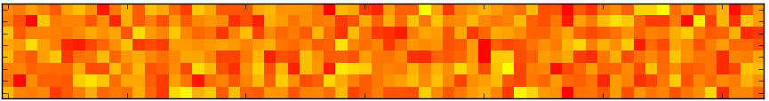
NumPy (and SciPy)
from pylab import *
pix = zeros((64, 8, 3), 'uint8')
pix[:,:,0] = 255
pix[:,:,1] = 128 + 60 * randn(64,8)
pix[:,:,2] = 0
imshow(pix)

Slide 13
Interfacing with NumPy
hello.hpp
void render(PyObject * arr, int radius) {
int h, w;
uint8_t * p;
h = PyArray_DIM(arr, 0);
w = PyArray_DIM(arr, 1);
p = (uint8_t*)((PyArrayObject*)arr)->data;

Slide 14
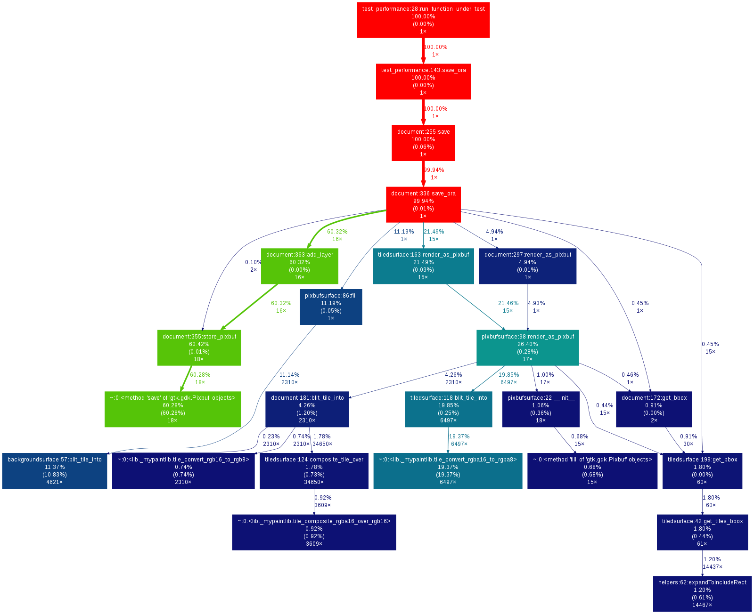
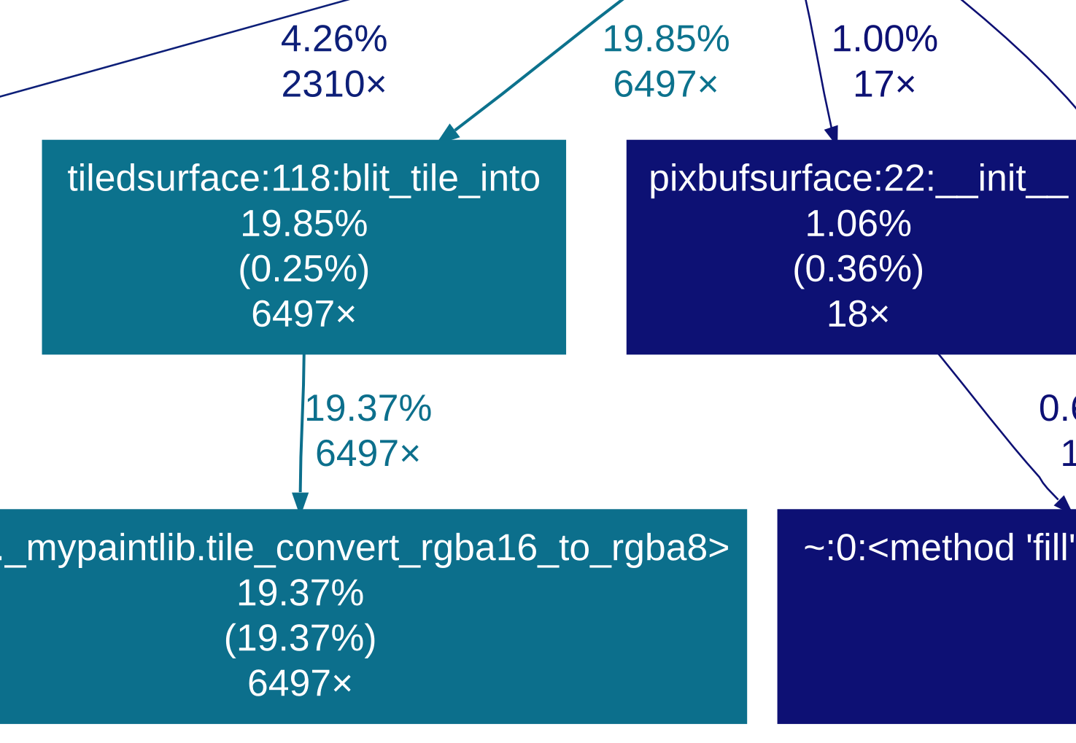
Profiling Python
cProfile, gprof2dot.py

Slide 15
OProfile: System Profiler
$ opreport
...
389232 57.0081 Xorg
------------------
360088 92.5124 libpixman-1.so.0.
15630 4.0156 libxaa.so
10684 2.7449 libc-2.10.2.so
...
146698 21.4858 python2.5
------------------
85310 58.1535 python2.5
31580 21.5272 _mypaintlib.so
15333 10.4521 libc-2.10.2.so

Slide 16
Debugging
Same as debugging any C/C++ library
$ gdb /usr/bin/python
(gdb) run program.py

Slide 17
Memory Leaks
Unused References (common)
  Hard to find, no tools (?)
Reference Cycles with __del__
  check gc.garbage
  SWIG generates empty __del__ (disable it)
Missing Py_DECREF (rare)

Slide 18
Thanks
Code Samples:
http://github.com/martinxyz/python

Slide 19
BACKUP

Slide 20
Why Not Python?
Personal taste
  Dislike syntax: self, __init__, whitespace
Invested into C/C++
  Existing codebase, expertise
Performance
  Not willing to use the Python/C API
Contributors
  C/C++ coders tend to be more experienced

Slide 21
Not Extending Python
Use libraries from Python
  eg. GDK-PixBuf, Cairo, NumPy
  for standard tasks (eg. compositing)
cr.set_line_width(3.0)
cr.set_line_join(cairo.LINE_JOIN_ROUND)
cr.rectangle(10, 10, 90, 90)
cr.stroke()

Slide 22
NumPy Array
PIL:
  fromarray
Cairo:
  create_for_data
GDK-PixBuf:
  new_from_array
  get_pixels_array

Slide 23
Interfacing with NumPy
hello.i
%module hello
%{
#include <numpy/arrayobject.h>
#include "hello.hpp"
%}
%include "hello.hpp"
%init %{
import_array();
%}

Slide 24
Interfacing with NumPy
hello.hpp
void render(PyObject * arr, int radius) {
int h, w;
uint8_t * p;
assert (PyArray_ISCARRAY(arr));
assert (PyArray_NDIM(arr) == 3);
assert (PyArray_DIM(arr, 2) == 3);
h = PyArray_DIM(arr, 0);
w = PyArray_DIM(arr, 1);
p = (uint8_t*)((PyArrayObject*)arr)->data;

Slide 25
OProfile: System Profiler
$ opreport -l /usr/bin/python2.5
37.8 libpng12.so
8.7 libz.so
7.8 _mypaintlib.so tile_convert_rgba16_to_
4.4 multiarray.so
4.1 python2.5 PyEval_EvalFrameEx
3.3 _mypaintlib.so tile_convert_rgba8_to_r
2.6 umath.so
2.3 libc-2.10.2.so random
2.3 libc-2.10.2.so memcpy

