Slide 1
SWIG
Scan existing C/C++ header files
Generate Python extension module
  (or Perl, Lua, Java, etc.)
No modification to existing C/C++ code
No need to wrap every function manually

Slide 2
SWIG: Code
hello.hpp
int answer() {
return 42;
}
hello.i
%module hello
%{
#include "hello.hpp"
%}
%include "hello.hpp"

Slide 3
SWIG: Compiling
setup.py
from distutils.core import setup, Extension
setup(ext_modules=[
Extension("_hello", ["hello.i"])
])
$ python setup.py build_ext -i
$ python
>> import hello
>> hello.answer()
42

Slide 4
SWIG: The End.
Do not learn more SWIG!
  People have died while trying to figure out SWIG Typemaps
Use the Python/C API
  SWIG supports this

Slide 5
Interfacing with NumPy
hello.hpp
void render(PyObject * arr, int radius) {
int height, width;
uint8_t * p;
height = PyArray_DIM(arr, 0);
width = PyArray_DIM(arr, 1);
p = (uint8_t*)PyArray_DATA(arr);

Slide 6


MyPaint
80% Python
  GUI (PyGTK)
  Tablet Motion
  Tile Management
20% C++
  Pixel blending
  Brush dynamics

Slide 7
Profiling
Your guess is wrong
  Scrolling is slow...
  Optimize compositing?
  ...only 2% spent compositing.
System Profiling
  perf (Linux)
Python
  cProfile

Slide 8
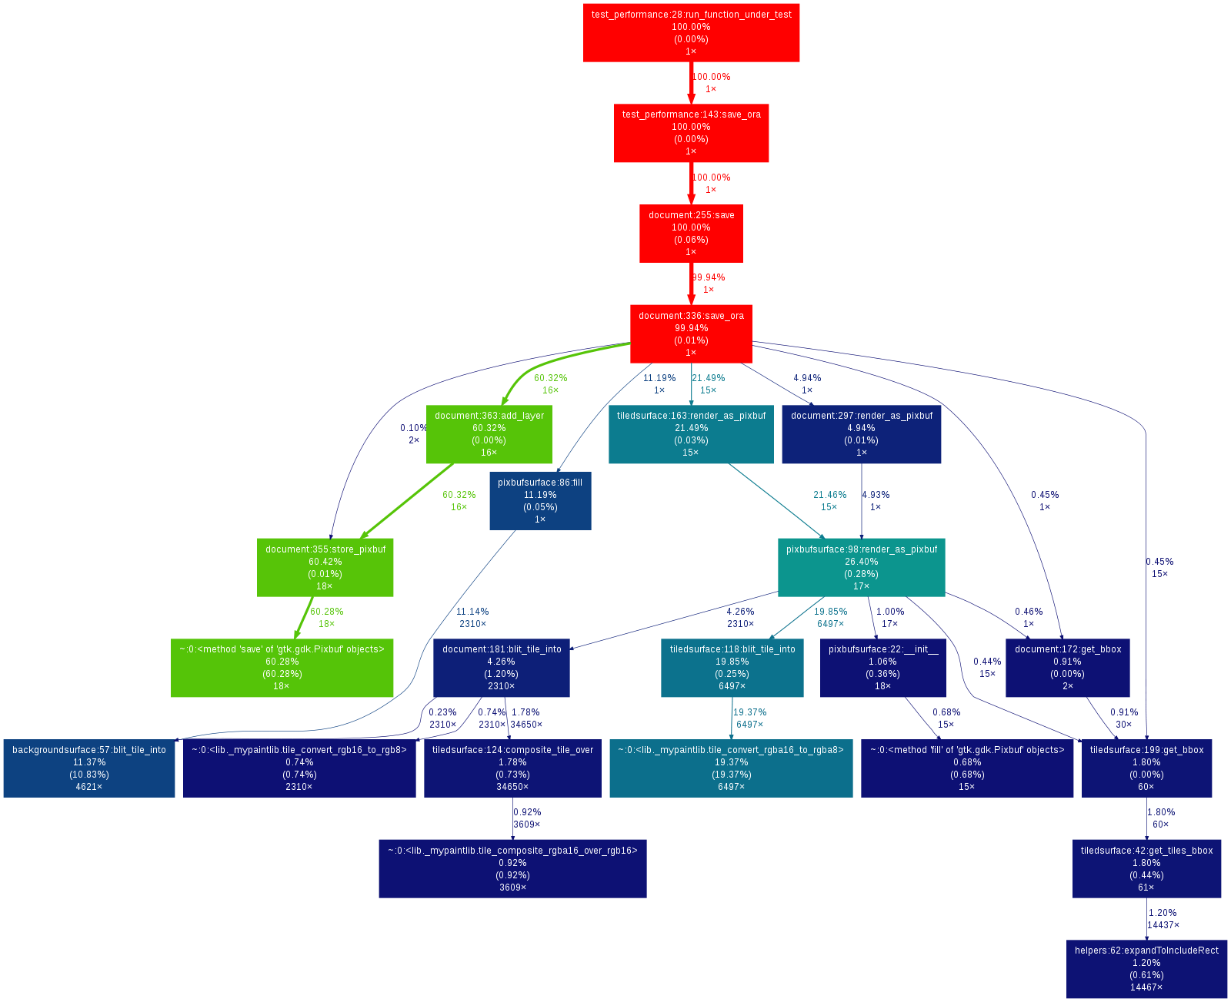
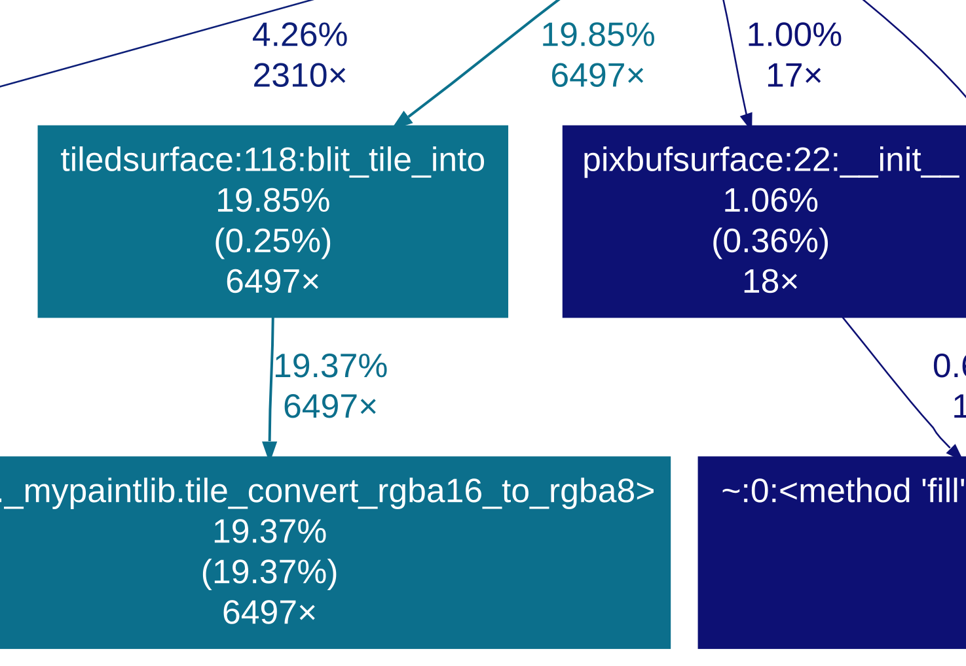
Profiling Python
gprof2dot.py

Slide 9
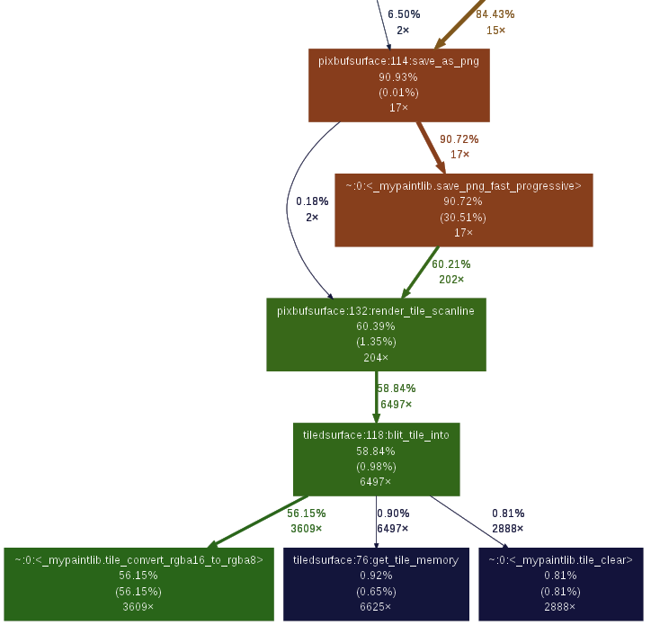
Function written in C...
...calling Python again...
...calling C code.

