Slide 1
Forecasting Inflation in a Big Data Setting Using Neural Networks
Yuhao Huo
yh620

Slide 2
Motivation & Literature
Motivation:
Forecasting inflation is essential for decision making by firms, investors, and central banks
Time-series econometrics often relies on linear models, which may suffer from over-fitting & fail to capture non-linearity
ML methods, such as neural networks, may provide robust predictions in high-dimensional, non-linear settings
Related Literature:
Univariate methods:
Lagged inflations as predictors, initially found difficult to beat (Stock & Watson, 2010)
ML methods:
With ML and large macro datasets, multivariate models began to achieve systematic gains
LASSO: outperforms AR in US CPI inflation forecasting (Medeiros & Mendes 2016)
Random forest: outperforms univariate benchmark, LASSO, and Bayesian VAR (Medeiros et al. 2021)
Non-linear & non-parametric methods appear to perform better: how about using neural networks?
Neural networks:
Both FNN and LSTM improve performance relative to AR (Andresen, 2023 and Paranhos, 2025)
LSTM usually achieves better performance than FNN
Multivariate FNN and LSTM also outperform their univariate counterparts
However, LSTM does not systematically outperform random forest

Slide 3
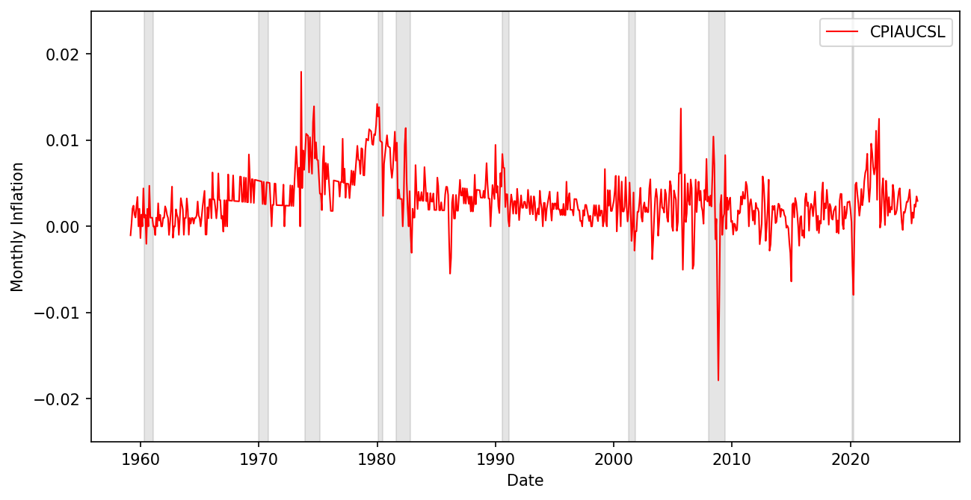
Data
FRED-MD Database:
A monthly macroeconomic database with 126 series
802 observations from Mar 1959 to Dec 2025
Target variable: log difference of CPI all-item series
The other series are transformed to achieve stationary
Series with > 10% missing values are dropped (4 series)
Train
Test
Train & Test Split:
Training sample: Mar 1959 to Jul 2012 (80% obs)
Test sample: Aug 2012 to Dec 2025
Feature Engineering:
Missing values (mostly around 0.05%) are imputed using Sciki-learn’s iterative imputer
Principal component analysis (PCA) is applied to all series to extract 10 principal components because:
Macro-economics series are usually correlated
The sample has too many dimensions relative to number of observations
The 10 PCs and the inflation rate are min-max scaled to [0, 1], as LSTM performs better at this range
All transformations are fitted on training set & applied to the full sample

Slide 4
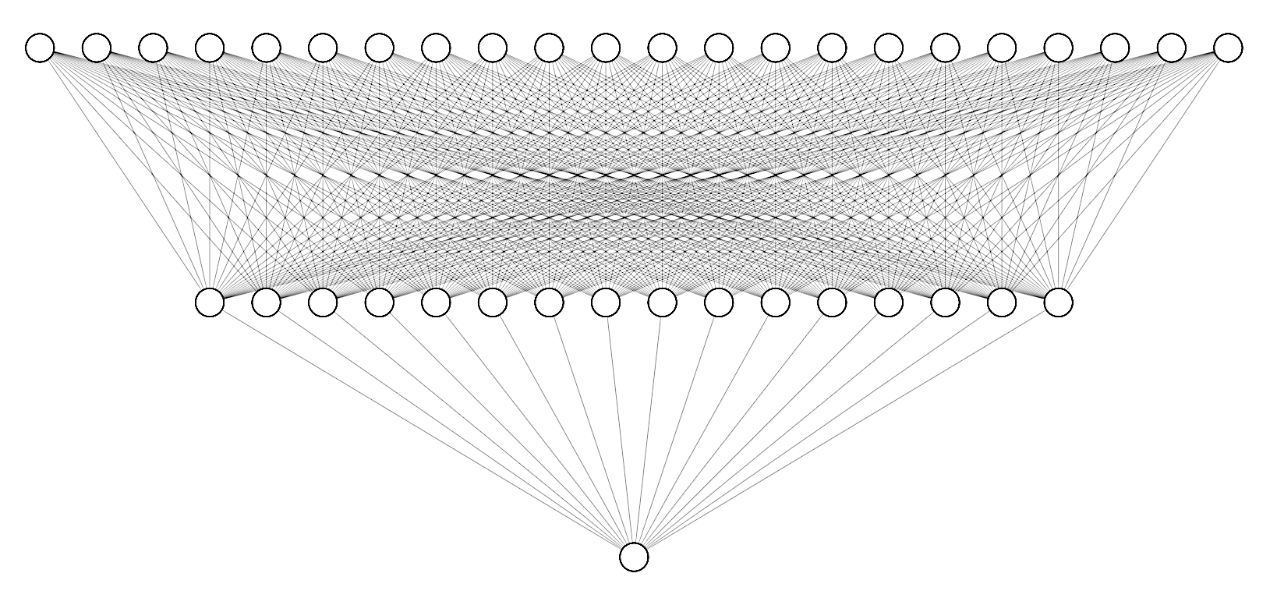
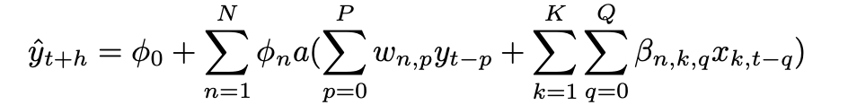
Methodology
Forecasting Methodology:
Indirect forecasting:
One-step-ahead forecasting,
Prediction result is then used as predictor for two-step-ahead forecasting
Iterates recursively to reach h-step-ahead forecast
Direct forecasting: estimates a separate model for each forecast horizon h
Indirect forecasting is more efficient under correct specification, but requires forecasting the covariates
Therefore, this research adopts direct forecasting and estimates a separate model for each horizon in [1, 3, 6, 12, 24]
Feedforward Neural Network:
A fully connected neural network with one hidden layer
y: inflation at period t
x: k-th principal component at period t
N: number of nodes
P: number of lags of inflation included
Q: number of lags of principal component included
P = 11, Q = 0 , Input Dim = 22
N = 16

Slide 5
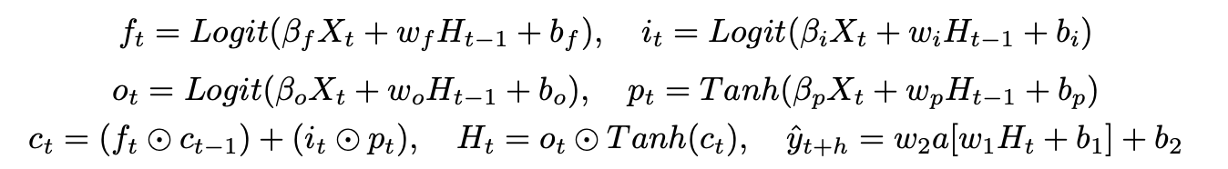
Methodology
Long Short-Term Memory:
A type of RNN: takes a sequence of observations as input, the length of the input sequence is window size
RNN encodes each observation in an input sequence into a hidden state
The hidden state of an observation depends on its features and the previous hidden state
RNN uses the last hidden state of an input sequence to predict the target (h-step-ahead inflation rate)
RNN suffers from the vanishing gradient problem when the input sequence is long
LSTM addresses this by introducing cell state + gate mechanisms
f: forget gate, outputs a proportion in [0, 1], controls how much of the previous cell state pass to current cell state
i: input gate, controls how much of the scaled combination of input is retained in current cell state
o: output gate, controls how much of current cell state is mapped to current hidden state
p: scaled combination of input features and previous hidden state
c: cell state
H: hidden state, passes through a one-layer FNN to form prediction
y: target variable, h-step-ahead inflation rate
X: vector of inflation and PCs at time t

Slide 6
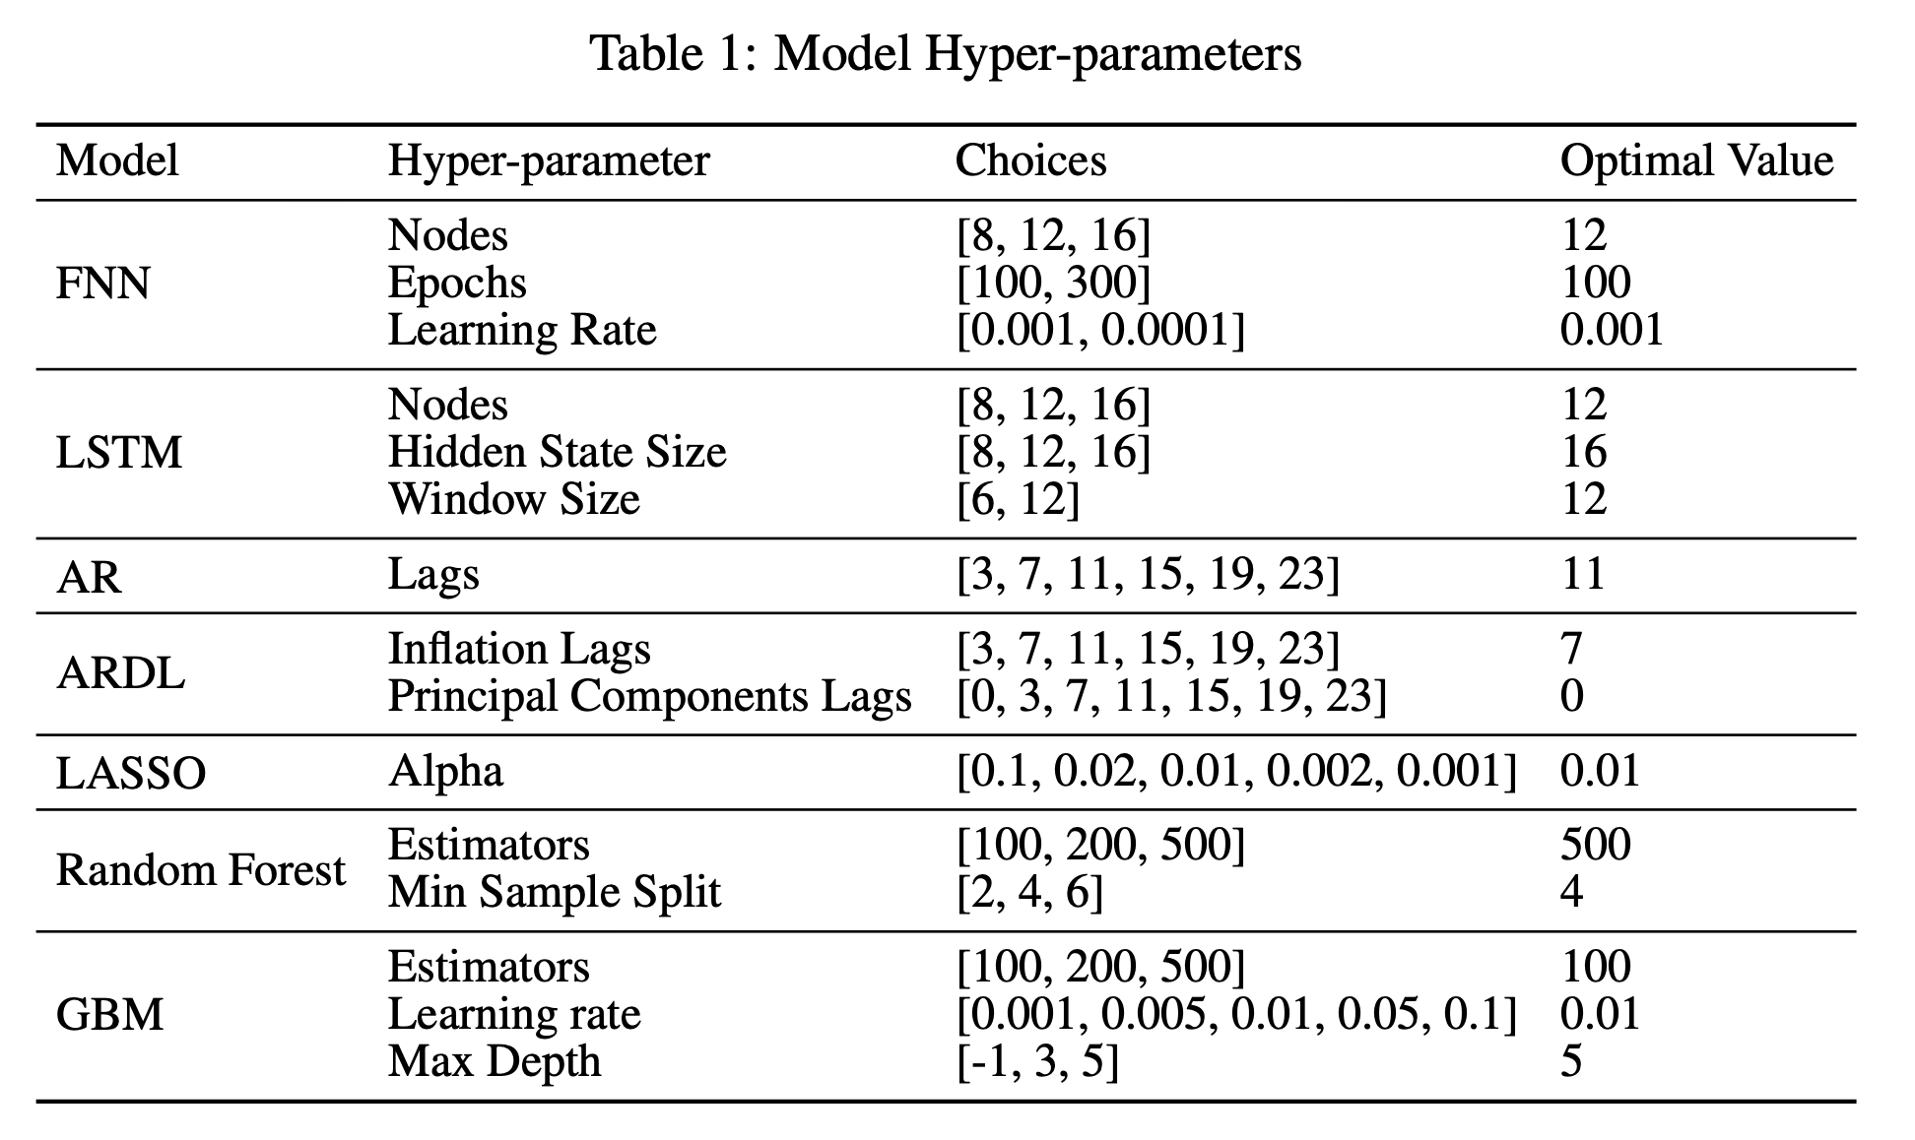
Training & Tuning
Other Benchmark Models:
AR, ARDL, LASSO, random forest, and LGBM
Training:
Loss function: mean squared error (MSE)
For neural networks:
Parameters updated by Adam optimization algorithm
Batch size = 128
Drop out rate = 0.2
Fine-tuning Hyper-parameters
Hyper-parameters are selected using grid-search
For each set of hyper-parameters, evaluate cross-validation loss, the set with lowest CV loss is optimal
CV in time series:
Split training sample into 5 chronological folds
For each fold, train model on observations up to that fold and evaluate on subsequent fold
Average MSE across folds to obtain CV loss

Slide 7
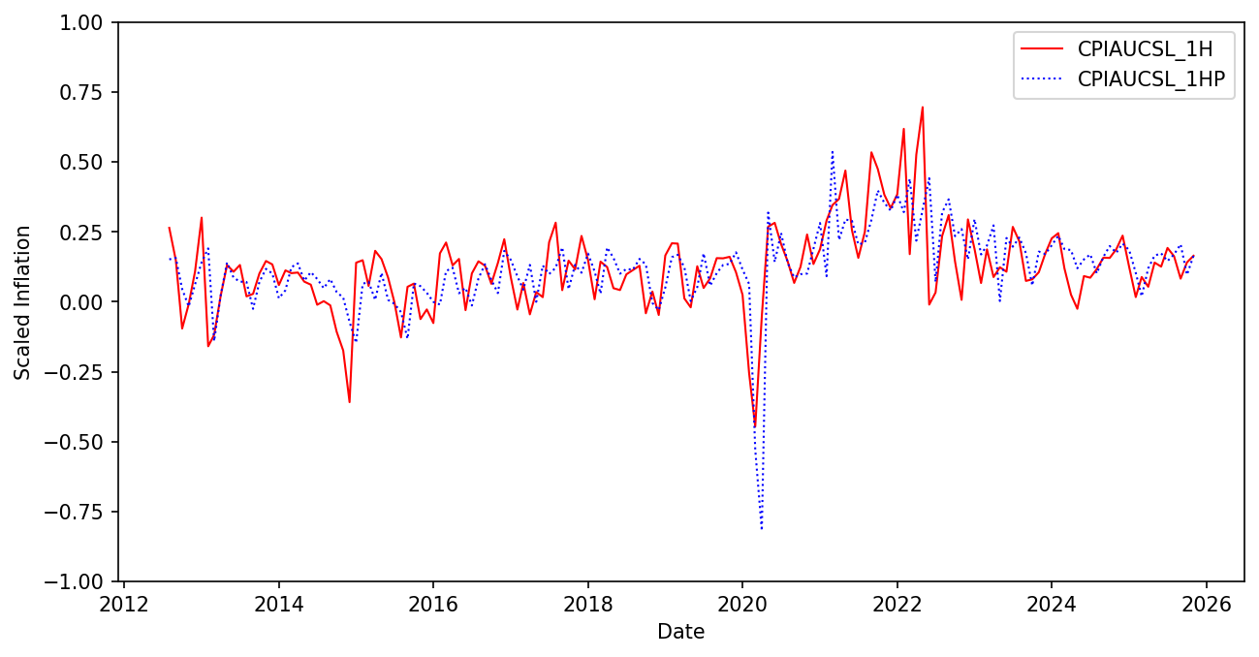
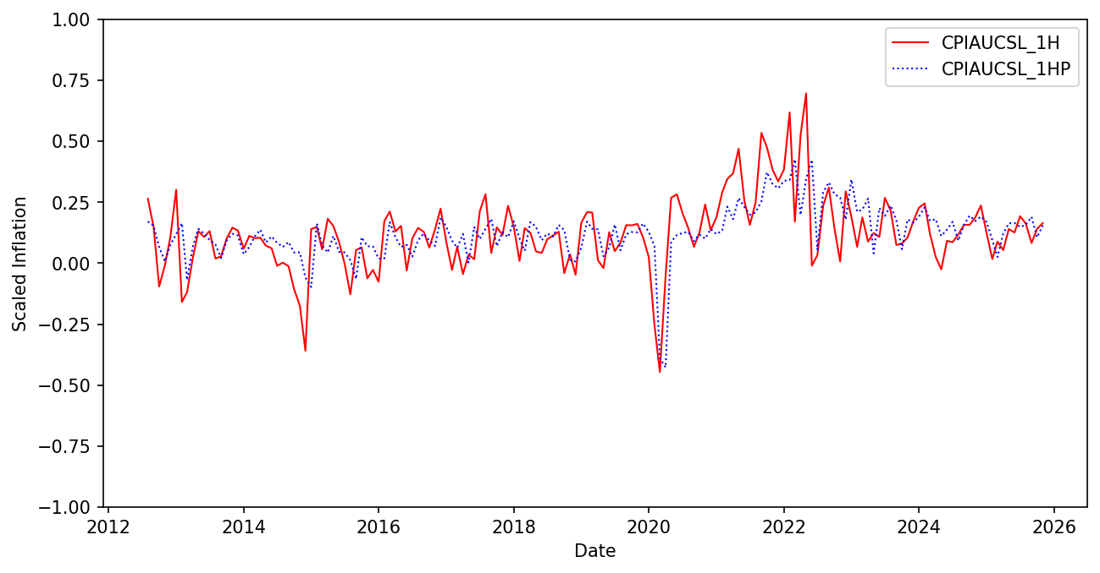
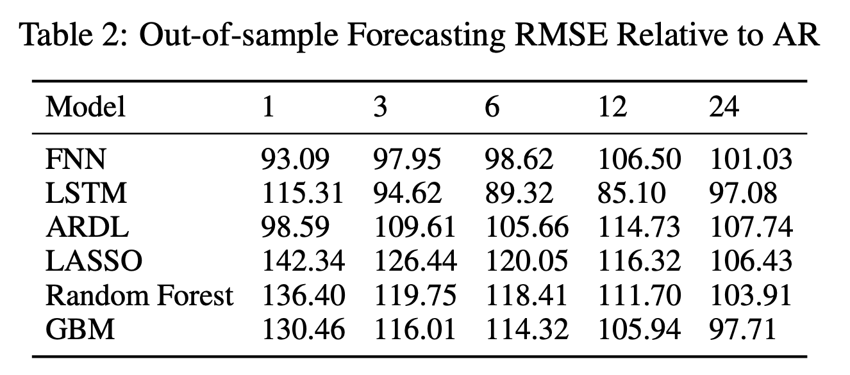
Forecasting Performance
Forecasting with Ensembles:
Neural networks are sensible to initial values (Paranhos, 2025)
Estimate 20 NNs with different initial values and ensemble them to form predictions for each horizon
Performance:
Evaluated using RMSE relative to AR
Univariate benchmark AR outperforms ARDL and ML methods
FNN outperforms AR at short forecasting horizons (1 to 6)
LSTM outperforms AR at longer horizons (3 to 24)
FNN outperforms LSTM at h=1, but performs worse at longer horizons

Slide 8
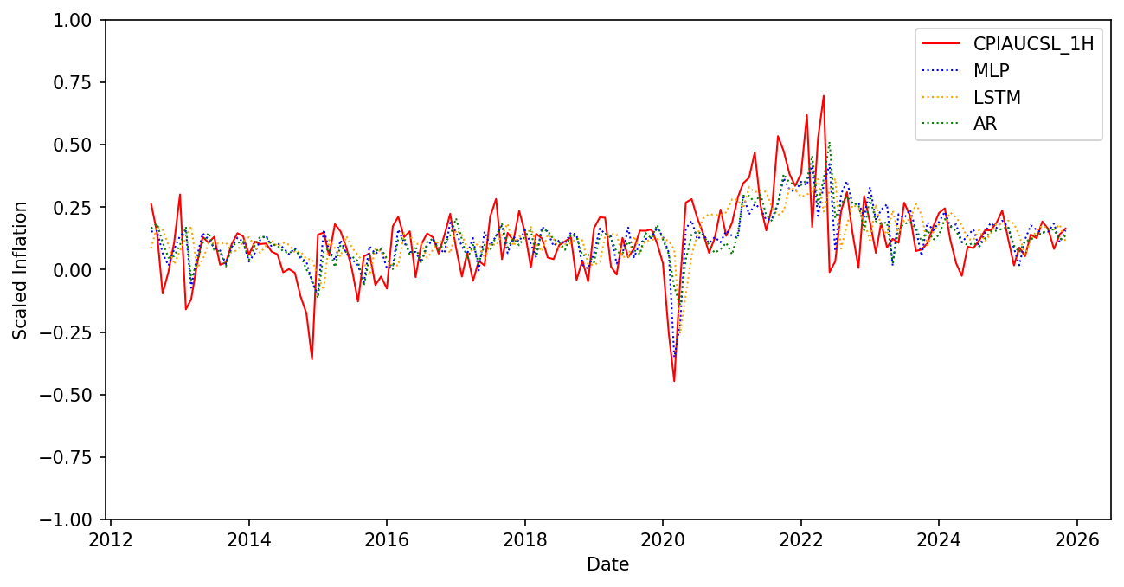
1 Period Ahead

Slide 9
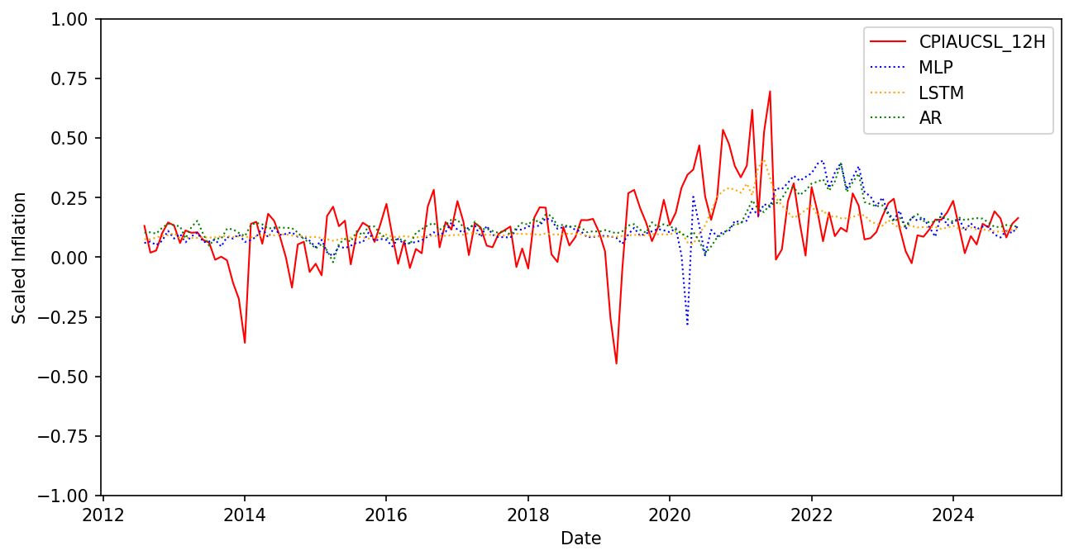
12 Periods Ahead

Slide 10
Discussion
Key Findings:
A simple FNN outperforms more complex neural network (LSTM) and univariate model in one-step-ahead forecasting
Fine-tuned LSTM perform especially well at longer horizons
FNN and LSTM can be combined to achieve superior forecasting performance across short and long horizons
Limitations:
Neural networks are not as interpretable as linear models (AR)
Due to time limitations, this research does not apply grid search to all hyper-parameters
Cross-validation losses are computed based on one NN initialization for each fold
Ideally, multiple initializations should be used for each fold to ensure stability

Slide 11
Reference
[1] Almosova, A., \& Andresen, N. (2023). Nonlinear inflation forecasting with recurrent neural networks. Journal of Forecasting, 42(2), 240–259.
[2] Bredahl Kock, A., \& Teräsvirta, T. (2016). Forecasting Macroeconomic Variables Using Neural Network Models and Three Automated Model Selection Techniques. Econometric Reviews, 35(8–10), 1753–1779.
[3] Marcellino, M. G., Stock, J. H., \& Watson, M. W. (2005). A Comparison of Direct and Iterated Multistep Ar Methods for Forecasting Macroeconomic Time Series (SSRN Scholarly Paper No. 771945). Social Science Research Network.
[4] Masini, R. P., Medeiros, M. C., \& Mendes, E. F. (2023). Machine learning advances for time series forecasting. Journal of Economic Surveys, 37(1), 76–111.
[5] McCracken, M. W., \& Ng, S. (2016). FRED-MD: A Monthly Database for Macroeconomic Research. Journal of Business \& Economic Statistics, 34(4), 574–589.
[6] Medeiros, M. C., \& Mendes, E. F. (2016). L1-regularization of high-dimensional time-series models with non-Gaussian and heteroskedastic errors. Journal of Econometrics, 191(1), 255–271.
[7] Medeiros, M. C., Vasconcelos, G. F. R., Veiga, Á., \& Zilberman, E. (2021). Forecasting Inflation in a Data-Rich Environment: The Benefits of Machine Learning Methods. Journal of Business \& Economic Statistics, 39(1), 98–119.

Slide 12
Reference
[8] Paranhos, L. (2025). Predicting inflation with recurrent neural networks. International Journal of Forecasting. https://doi.org/10.1016/j.ijforecast.2024.07.010
[9] Stock, J. H., \& Watson, M. W. (2007). Why Has U.S. Inflation Become Harder to Forecast? Journal of Money, Credit and Banking, 39(s1), 3–33. https://doi.org/10.1111/j.1538-4616.2007.00014.x
[10] Stock, J. H., \& Watson, M. W. (2010). Modeling Inflation After the Crisis (Working Paper No. 16488). National Bureau of Economic Research. https://doi.org/10.3386/w16488

