Slide 1
Hybrid mobile apps
Chao (Martin) Zhou
Instructor: Scott Pollack

Slide 2




Slide 3
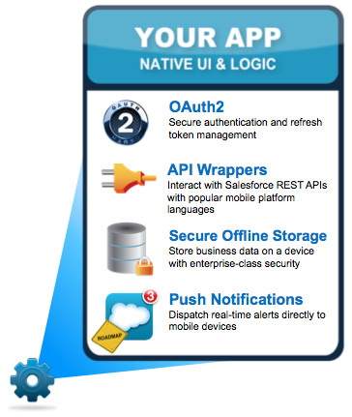
Native Mobile Application
Full capacity
Single platform
Fast performance
High learning curve

Slide 4
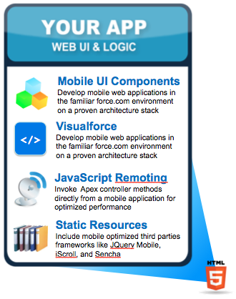
HTML5 Mobile applications
Limited capacity
Multiple platform
Quick development cycle
Very low learning curve

Slide 5
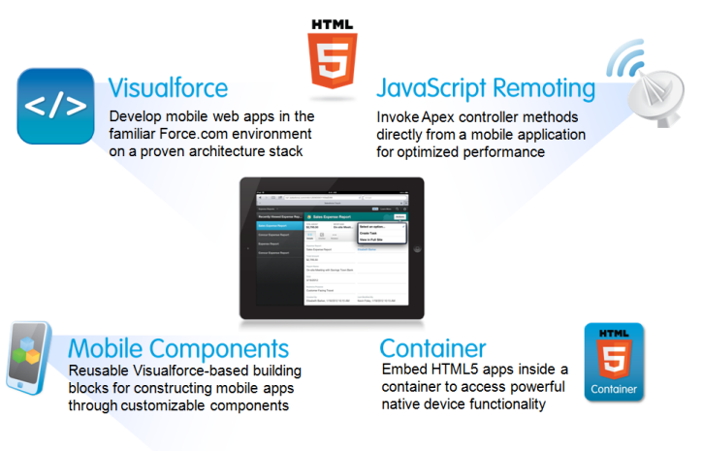
Hybrid mobile apps
Almost full capacity
Multiple platform
Quick development cycle
Low learning curve

Slide 6
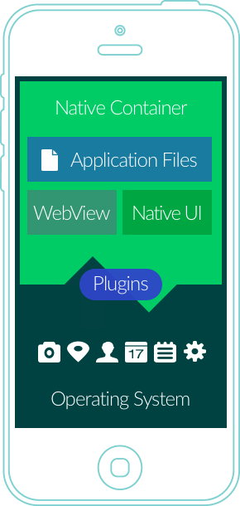
Architecture
Notes:
embeds an HTML5 app inside a native container

Slide 7
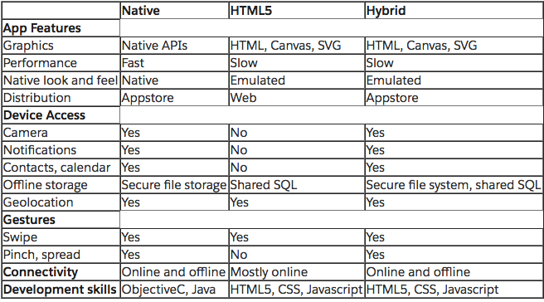

Slide 8
Popular frameworks
Cordova
Native Scripts
etc

Slide 9
create the app
$ cordova create hello com.example.hello HelloWorld
This creates the required directory structure for your cordova app. By default, the cordova create script generates a skeletal web-based application whose home page is the project's www/index.html file.

Slide 10
Add platforms
$ cordova platform add ios --save
$ cordova platform add android --save

Slide 11
Build and run
$ cordova build
$ cordova build ios
$ cordova emulate android
$ cordova run android

Slide 12
Add plugins
$ cordova plugin add cordova-plugin-camera
Fetching plugin "cordova-plugin-camera@~2.1.0" via npm
Installing "cordova-plugin-camera" for android
Installing "cordova-plugin-camera" for ios

Slide 13
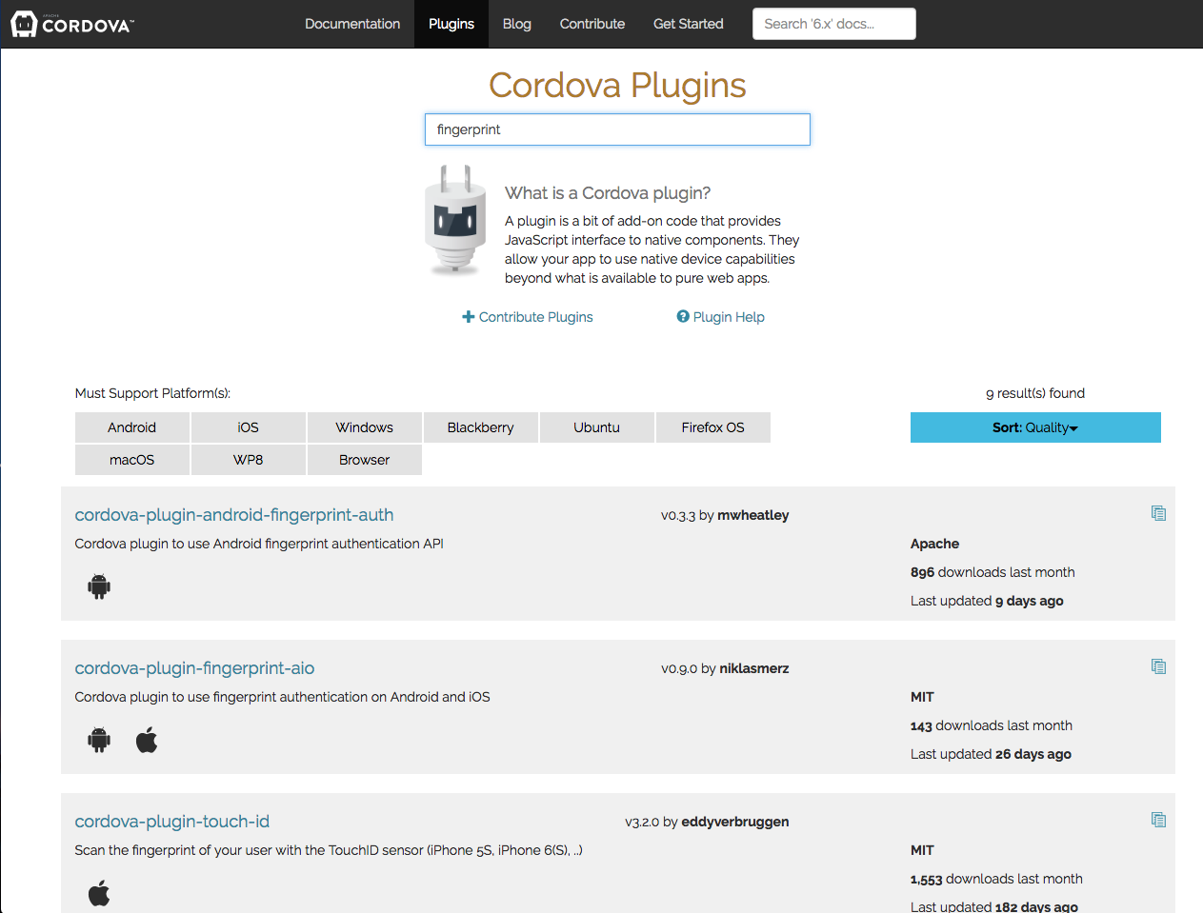

Slide 14
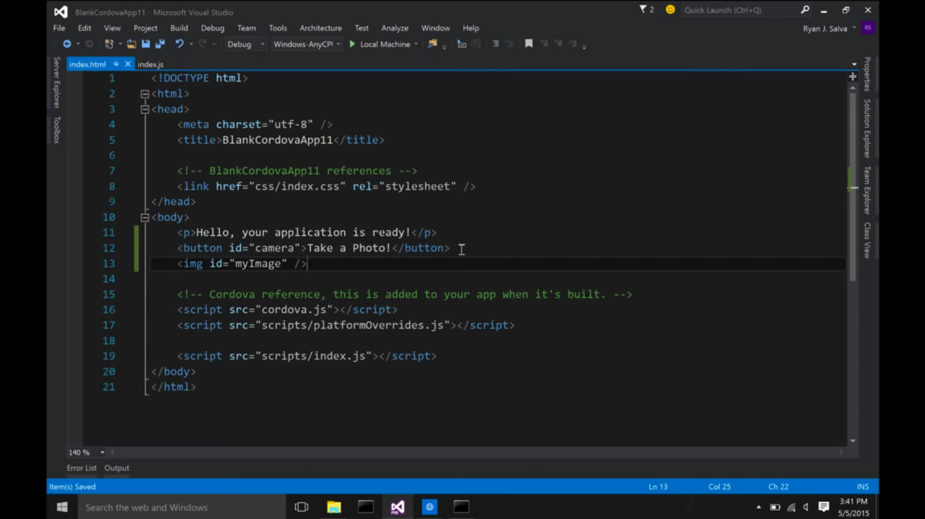

Slide 15
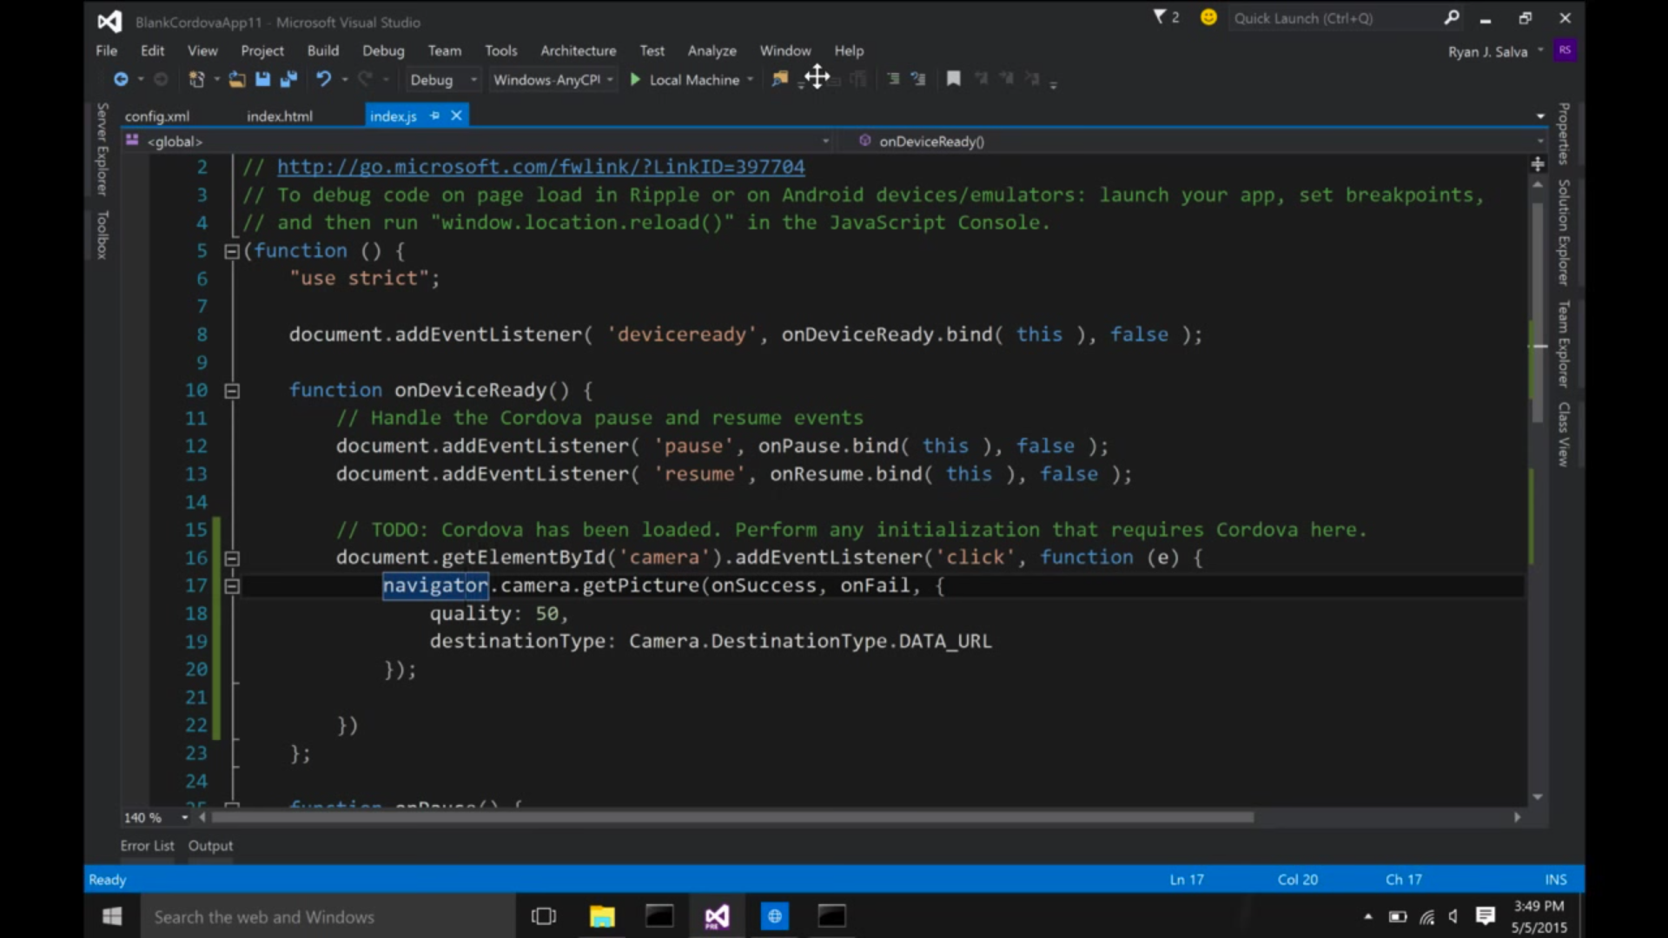

Slide 16


Slide 17
However…
Reliance on third party tools and code
Adds more complexity to the development architecture
Potential unexpected bugs

Slide 18
To use or not to use

Slide 19
Image and word citation
Mario Korf and Eugene Oksman. Native, HTML5, or Hybrid: Understanding Your Mobile Application Development Options. https://developer.salesforce.com/page/Native,_HTML5,_or_Hybrid:_Understanding_Your_Mobile_Application_Development_Options
John Bristowe. What is a Hybrid Mobile App? http://developer.telerik.com/featured/what-is-a-hybrid-mobile-app/

