Slide 1
Battle of Neighborhood Week2
Capstone Project

Slide 2
Principal Questions to answer
What is best location in New York City for Indian Cuisine ?
Which areas have potential Indian Resturant Market ?
Which all areas lack Indian Resturants?
Which is the best place to stay if I prefer Indian Cuisine ?

Slide 3
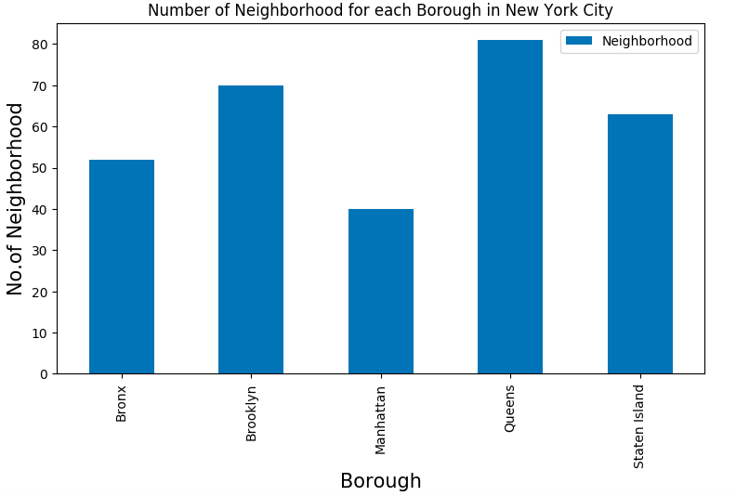
What is best location in New York City for Indian Cuisine ?
Conclusion:
We see that Queens has highest number of neighborhoods

Slide 4
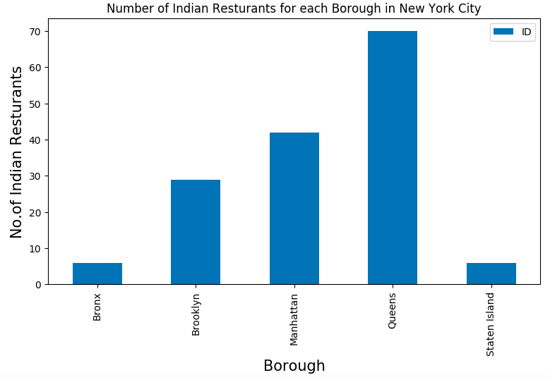
Which areas have potential Indian Resturant Market ?
Conclusion:
We see that Queens has the largest number of indian resturants

Slide 5
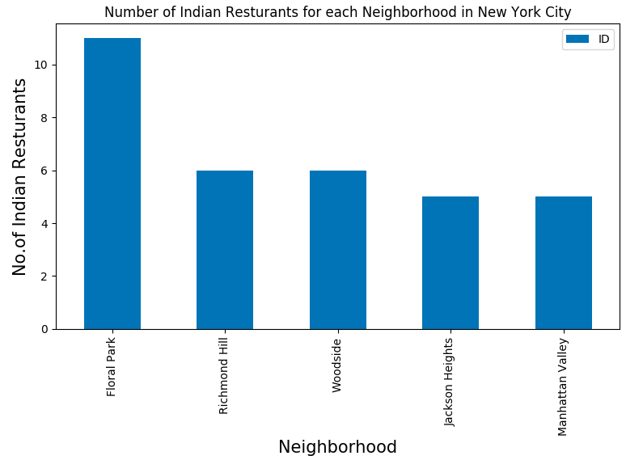
Which all areas lack Indian Resturants?
Conclusion:
The areas lack Indian restaurants are Jackson Heights, Richmond Hill & Manhattan Valley

Slide 6
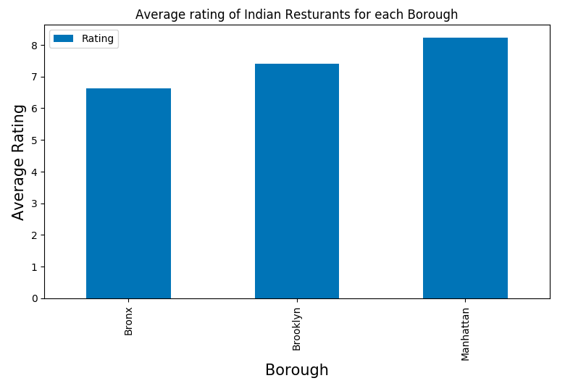
Which is the best place to stay if I prefer Indian Cuisine ?
Conclusion:
The areas lack Manhattan Valley will be the best place for Indian Cusine

Slide 7
Limitations
The ranking is purely on basis of rating of resturants
The accuracy of data depends purely depends on the data provided by FourSquare

