Slide 1
Introduction to HTML
Dr. Raj Singh

Slide 2
Introduction
The basic components of a web page are:
Content - information displayed or accepted from users
Static - content that doesn’t change for different user interactions
Dynamic - content that varies based on the user, user input, etc.
Instructions
Formatting - how the content is to be displayed
Navigation - path between web pages
Other Actions - Pop-up windows, field input and validation
Building a web page consists of creating the Content and Instructions

Slide 3
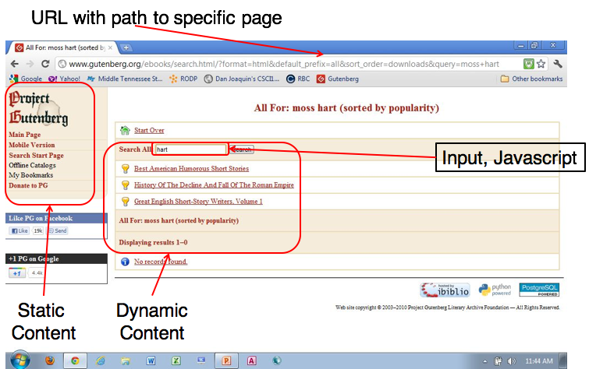
Web Page Example
3￼

Slide 4
What is a website?
Website is a collection of web pages and related content regarding a particular topic or entity.

Slide 5
HyperText
Text that enables non-sequential access within and between documents and web sites
Origin
1945 - Vannar Bush - a system for linking microfilm machines
1965 - Ted Nelson - coined the terms hypertext and hypermedia
1977 - First hypermedia use was a tour of Aspen
1983 – Hypermedia development tool for Apple II
1987 – Apple release Hypercards for the Macintosh

Slide 6
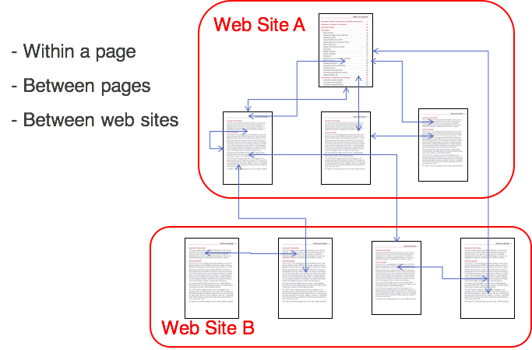

Slide 7
Computer Languages
Programming Language - set of rules that direct the actions of a computer
Markup Language - language for formatting “documents” where a document can be any stored file, not just text
Formatting is defined in the document with a series of tags

Slide 8
HyperText Markup Language (HTML)
The combinations of HyperText and Markup Languages.
Language that can be used to develop web pages.
The World Wide Web Consortium (http://w3c.org) sets the standards for HTML and its related languages.

Slide 9
What is XML?
XML – eXtensible Markup Language
A text-based language designed to describe, deliver, and exchange structured information.
It is not intended to replace HTML – it is intended to extend the power of HTML by separating data from presentation.
Mainly design for export and transport data.

Slide 10
The Difference Between XML and HTML
XML and HTML were designed with different goals:
XML was designed to carry data - with focus on what data is
HTML was designed to display data - with focus on how data looks
XML tags are not predefined like HTML tags are
http://www.w3schools.com/xml/xml_whatis.asp

Slide 11
What is XHTML?
XHTML – eXtensible Hypertext Markup Language
Developed by the W3C as the reformulation of HTML 4.0 as an application of XML.
It combines the formatting strengths of HTML 4.0 and the data structure and extensibility strengths of XML.

Slide 12

What is HTML5?
Newest draft version of HTML/XHTML
Supported by modern browsers
Safari, Google Chrome, Firefox, Internet Explorer 9
Intended to be backwards compatible
Adds new elements
Adds new functionality
Edit form data
Native video and audio
And more!

Slide 13
Document Type Definition
Document Type Definition (DTD)
doctype statement
identifies the version of HTML contained in your document.
placed at the top of a web page document

Slide 14
DTD Examples
XHTML 1.0 Transitional DTD
<!DOCTYPE html PUBLIC "-//W3C//DTD XHTML 1.0 Transitional//EN"
http://www.w3.org/TR/xhtml1/DTD/xhtml1-transitional.dtd>
HTML5 DTD
<!DOCTYPE html>

Slide 15
Example HTML5 Web Page
<!DOCTYPE html>
<html lang="en">
<head>
<title>Page Title Goes Here</title>
<meta charset="utf-8">
</head>
<body>
... body text and more HTML5 tags go here ...
</body>
</html>

Slide 16
Head and Body Sections:
Head Section Contains information that describes the Web page document
<head>
…head section info goes here
</head>
Body Section Contains text and elements that display in the Web page document <body>
…body section info goes here
</body>

Slide 17
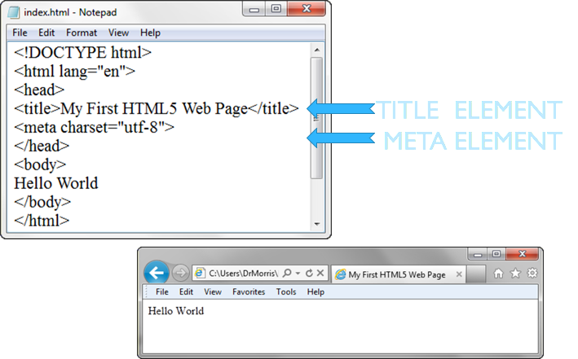

Slide 18
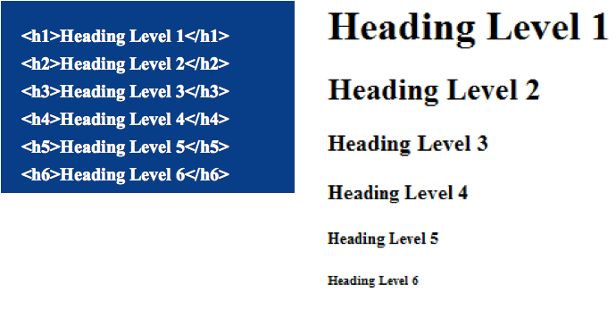
Heading Element

Slide 19
Paragraph Element
Paragraph element
<p> …paragraph goes here… </p>
Groups sentences and sections of text together.
Block Display – Configures empty space above and below

Slide 20
Line Break Element
Line Break element
Stand-alone, or void tag
…text goes here <br> This starts on a new line….
Causes the next element or text to display on a new line

Slide 21
Blockquote Element
Blockquote element
Indents a block of text for special emphasis
<blockquote>
…text goes here…
</blockquote>
Block Display – Configures empty space above and below

Slide 22
Phrase Elements
Element | Example | Usage
<b> | bold text | Text that has no extra importance but is styled in bold font by usage and convention
<em> | emphasized text | Causes text to be emphasized in relation to other text; usually displayed in italics
<i> | italicized text | Text that has no extra importance but is styled in italics by usage and convention
<mark> | mark text | Text that is highlighted in order to be easily referenced (HTML5 only)

Slide 23
Phrase Elements
Element | Example | Usage
<small> | text | Legal disclaimers and notices (“fine print”) displayed in small font-size
<strong> | strong text | Strong importance; causes text to stand out from surrounding text; usually displayed in bold
<sub> | sub text | Displays a subscript as small text below the baseline
<sup> | ^{sup} text | Displays a superscript as small text above the baseline

Slide 24
Proper Nesting
CODE:
<p><i>Call for a free quote for your web development needs: <strong>888.555.5555 </strong></i></p>
BROWSER DISPLAY:
Call for a free quote for your web development needs: 888.555.5555

Slide 25
HTML Lists
Unordered List
Ordered List
Description List formerly called a definition list

Slide 26
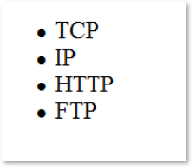
Unordered List
Displays a bullet, or list marker, before each entry in the list.
<ul> Contains the unordered list
<li> Contains an item in the list

Slide 27
Ordered List
Displays a numbering or lettering system to itemize the information contained in the list
<ol> Contains the ordered list
type attribute determines numbering scheme of list, default is numerals
<li> Contains an item in the list

Slide 28
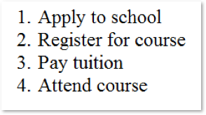
Ordered List Example
<ol>
<li>Apply to school</li>
<li>Register for course</li>
<li>Pay tuition</li>
<li>Attend course</li>
</ol>

Slide 29
Description List
Useful to display a list of terms and descriptions or a list of FAQ and answers
<dl> Contains the description list
<dt>
Contains a term/phrase/sentence
Configures empty space above and below the text
<dd> Contains a description of the term/phrase/sentence
Indents the text
Configures empty space above and below the text

Slide 30
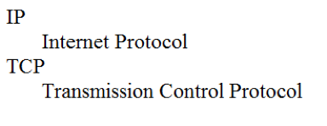
Description List Example
<dl>
<dt>IP</dt>
<dd>Internet Protocol</dd>
<dt>TCP</dt>
<dd>Transmission Control Protocol</dd>
</dl>

Slide 31
Special Characters
Display special characters such as quotes, copyright symbol, etc.
Character Code
© &copy;
< &lt;
> &gt;
& &amp;
&nbsp;

Slide 32
Div Element
Configures a structural block area or “division” on a web page with empty space above and below.
Can contain other block display elements, including other div elements
<div>Home Services Contact</div>

Slide 33
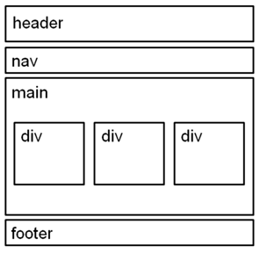
HTML5 Structural Elements
header Element
<header></header> Contains the web page document’s headings
nav Element
<nav></nav> Contains web page document’s main navigation
main Element <main></main> Contains the web page document’s main content
footer Element
<footer></footer> Contains the web page document’s footer

Slide 34
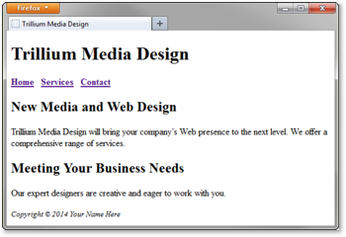
HTML5 Structural Element
<body>
<header> document headings go here </header>
<nav> main navigation goes here </nav>
<main> main content goes here </main>
<footer> document footer information goes here </footer>
</body>

Slide 35
Anchor Element
Specifies a hyperlink reference (href) to a file
Text between the <a> and </a> is displayed on the web page.
<a href="contact.html">Contact Us</a>
href Attribute
Indicates the file name or URL

Slide 36
Absolute and Relative Hyperlinks
Absolute link
Link to a different website
<a href="http://yahoo.com">Yahoo</a>
Relative link
Link to pages on your own site
<a href="index.htm">Home</a>

Slide 37
Email Hyperlinks
Automatically launch the default mail program configured for the browser
If no browser default is configured, a message is displayed
<a href=“mailto:me@gmail.com”>me@gmail.com</a>

Slide 38
External Resource
W3Schools HTML5 tutorial
http://www.w3schools.com/html/default.asp

