Slide 1
9.2 Explain the difference between internal and external fragmentation.

Slide 2
9.3 Describe the following allocation algorithms:
A. First fit
B. Best fit
C. Worst fit

Slide 3
9.4 When a process is rolled out of memory, it loses its ability to use the CPU (at least for a while). Describe another situation where a process loses its ability to use the CPU, but where the process does not get rolled out.

Slide 4
9.5 Given memory partitions of 100k, 500k, 200k, 300k, and 600k (in order), how would each of the First-fit, Best-fit, and Worst-fit algorithms place processes of 212k, 417k, 112k, and 426k (in order)? Which algorithm makes the most efficient use of memory?

Slide 5

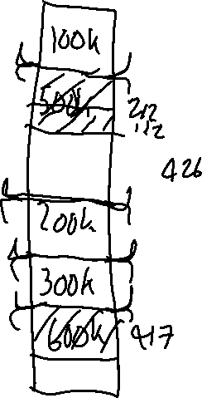


















9.5

Slide 6







Slide 7
9.6 Consider a system where a program can be separated into two parts: code and data. The CPU knows whether it wants an instruction (instruction fetch) or data (data fetch or store). Therefore, two base-limit register pairs are provided: one for instructions and one for data. The instruction base-limit register pair is automatically set to read only, so programs can be shared among different users. Discuss the advantages and disadvantages of this scheme.

Slide 8
9.7 Why are page sizes always powers of 2?

Slide 9
9.8 Consider a logical address space of eight pages of 1024 words each, mapped onto a physical memory of 32 frames.
A. How many bits are there in the logical address?
B. How many bits are there in the physical address?

Slide 10
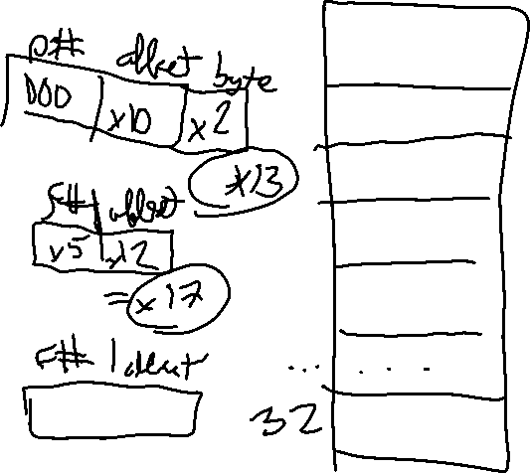
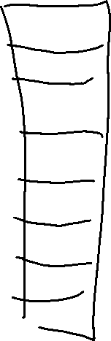
9.8

Slide 11
9.9 Why is it that, on a system with paging, a process cannot access memory that it does not own? How could the operating system allow access to other memory? What is the use of doing that?

Slide 12
9.10 Consider a paging system with the page table stored in memory.
A. If a memory reference takes 200 nanoseconds, how long does a paged memory reference take?
B. If we add associative registers, and 75 percent of all page-table references are found in the associative registers, what is the effective memory reference time? (Assume that finding a page-table entry in the associative registers takes zero time, if the entry is there.)

Slide 13

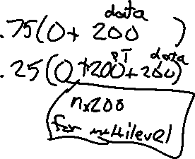
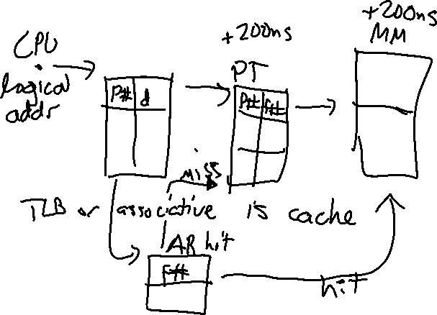
9.10

Slide 14
9.11 What is the effect of allowing two entries in a page table to point to the same page frame in memory? Explain how you could use this effect to decrease the amount of time needed to copy a large amount of memory from one place to another. What would the effect of updating some byte in the one page be on the other page?

Slide 15
9.13 Describe a mechanism by which one segment could belong to the address space of two different processes.

Slide 16
9.14 Explain why it is easier to share a reentrant module using segmentation than it is to do so when pure paging is used.

Slide 17
9.16 Consider the following segment table:
Segment Base Length
0 219 600
1 2300 14
2 90 100
3 1327 580
4 1952 96
Where are the physical addresses for the following logical addresses?
A. 0,430 B. 1,10 C. 2,500 D. 3,400 E. 4,112

Slide 18
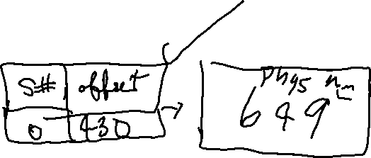
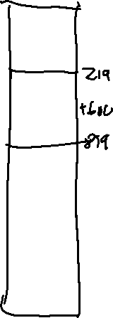
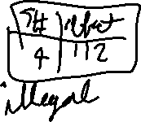

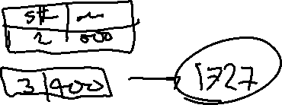

Slide 19
9.18 In the IBM/370, memory protection is provided through the use of keys. A key is a 4-bit quantity. Each 2k block of memory has a key (the storage key) associated with it. The CPU also has a key (the protection key) associated with it. A store operation is allowed only if both keys are equal, or if either is zero. Which of the following memory-management schemes could be used successfully with this hardware?
A. Bare machine
B. Single-user system

Slide 20
C. Multiprogramming with a fixed number of processes
D. Multiprogramming with a variable number of processes
E. Paging
F. Segmentation

Slide 21
10.1 Under what circumstances do page faults occur? Describe the actions taken by the operating system when a page fault occurs.

Slide 22
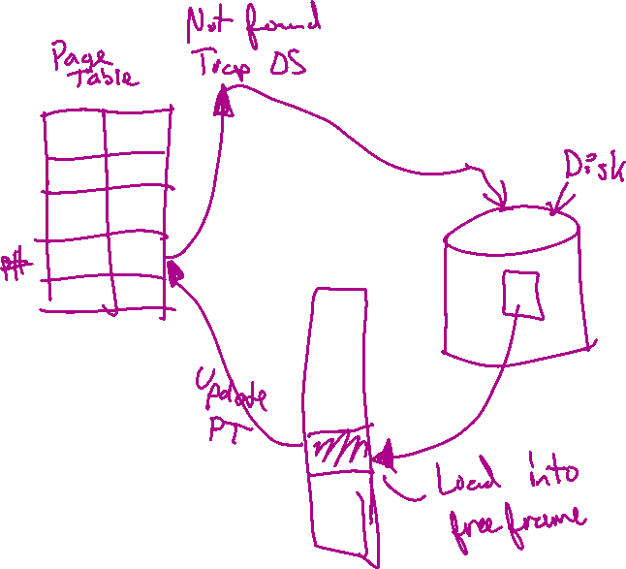

Slide 23
10.2 Assume that you have a page-reference string for a process with m frames (initially all empty). The page-reference string has length p; n distinct page numbers occur in it. Answer the question for any page-replacement algorithms:
What is a lower bound on the number of page faults? What is an upper bound?

Slide 24




10.2
2 1 3 2 4 5 1 2
M frames, n = 5 distinct pages
Lower bound = n
Upper bound = m

Slide 25
10.3 A certain computer provides its users with a virtual-memory space of 2³² bytes. The computer has 2¹⁸ bytes of physical memory. The virtual memory is implemented by paging, and the page size is 4096 bytes. A user process generates the virtual address 11123456. Explain how the system establishes the corresponding physical location.

Slide 26


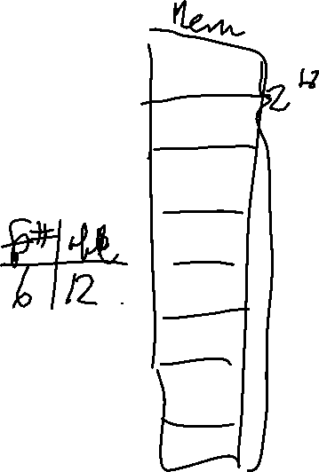
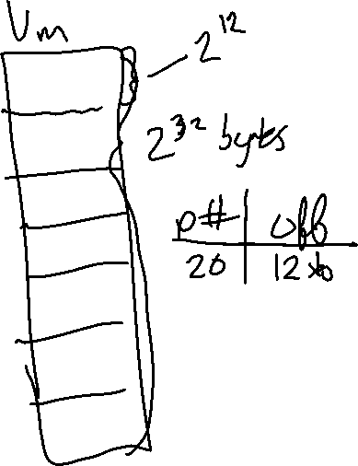
10.3

Slide 27





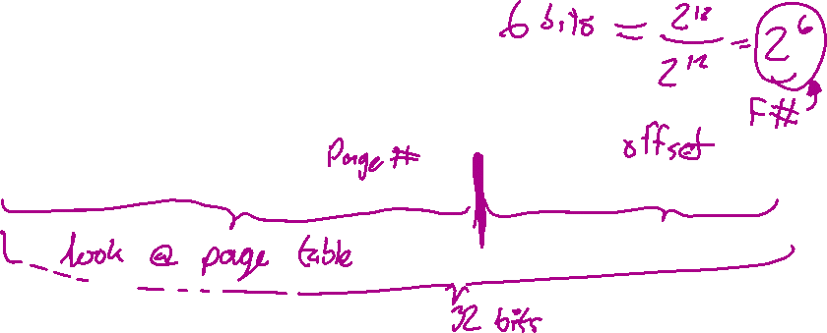
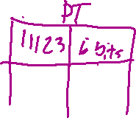
10.3
Logical addr : 11123456
Physical address? Offset s/b 12 bits
0001 0001 0001 0010 0011 0100 0101 0110
Physical
6 bits | 0100 0101 0110 < offset 12 bits

Slide 28
10.5 Assume we have a demand-paged memory. The page table is held in registers. It takes 8 milliseconds to service a page fault if an empty page is available or the replaced page is not modified, and 20 milliseconds if the replaced page is modified. Memory access time is 100 nanoseconds. Assume that the page to be replaced is modified 70 percent of the time. What is the maximum acceptable page-fault rate for an effective access time of no more than 200 nanoseconds?

Slide 29
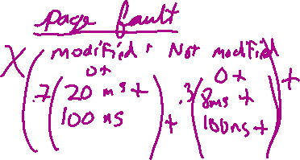

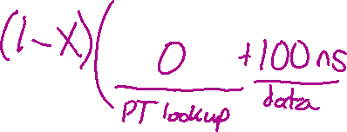
10.5
    EAT < 200ns

Slide 30
10.6 Consider the following page-replacement algorithms. Rank these algorithms on a five-point scale from “bad” to “perfect” according to their page-fault rate. Separate those algorithms that suffer from Belady’s anomaly from those that do not.

Slide 31
A. LRU replacement
B. FIFO replacement
C. Optimal replacement
D. Second-chance replacement

Slide 32
10.6
1. Optimal – Best, used as benchmark
2. FIFO – worst
3. LRU – 2nd place
4. SCR – 3rd place

Slide 33









10.6
Belady’s anomaly
1 2 3 4 1 2 5 1 2 3 4 5

Slide 34



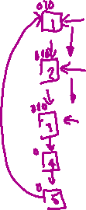







10.6
Belady’s anomaly
1 2 3 4 1 2 5 1 2 3 4 5

Slide 35
10.7 When virtual memory is implemented in a computing system, there are certain costs associated with the technique and certain benefits. List the costs and the benefits. Is it possible for the costs to exceed the benefits? If it is, what measures can be taken to ensure that this does not happen?

Slide 36
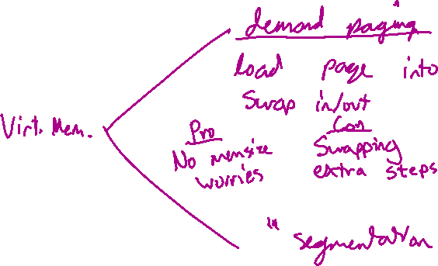


Slide 37


R
10.9 Consider a demand-paging system with the following time-measured utilizations: CPU utilization 20%, Paging disk 97.7%, Other I/O devices 5%. Which (if any) of the following will (probably) improve CPU utilization?

Slide 38










A. Install a faster CPU.
B. Install a bigger paging disk.
C. Increase the degree of multiprogramming.
D. Decrease the degree of multiprogramming.
E. Install more main memory.
F. Install a faster hard disk or multiple controllers with multiple hard disks.
G.Add prepaging to the page fetch algorithms.
H. Increase the page size.

Slide 39
10.11 Consider the following page-reference string:
1, 2, 3, 4, 2, 1, 5, 6, 2, 1, 2, 3, 7, 6, 3, 2, 1, 2, 3, 6.
How many page faults would occur for the following replacement algorithms, assuming 3 page frames?

Slide 40
LRU replacement
FIFO replacement
Optimal replacement

Slide 41
10.12 Suppose that you want to use a paging algorithm that requires a reference bit (such as second-chance replacement or working-set model), but the hardware does not provide one. Sketch how you could simulate a reference bit even if one were not provided by the hardware.

Slide 42






10.12

Slide 43
10.15 Segmentation is similar to paging, but uses variable-sized “pages.” Define two segment-replacement algorithm based on FIFO and LRU page-replacement schemes. Remember that, since segments are not the same size, the segment that is chosen to be replaced may not be big enough to leave enough consecutive locations for the needed segment. Consider strategies for systems where segments cannot be relocated, and those for systems where they can.

Slide 44
10.15
May need to swap 2 segments at once.
FIFO & Not relocatable –
  1. Check if it fits in 1.

Slide 45
10.18 Consider a demand-paged computer system where the degree of multi-programming is currently fixed at four. The system was recently measured to determine utilization of CPU and the paging disk. The results are one of the following alternatives. For each case, what is happening? Can you increase the degree of multiprogramming to increase CPU utilization?

Slide 46



A. CPU utilization, 13 percent; disk utilization, 97 percent
B. CPU utilization, 87 percent; disk utilization, 3 percent
C. CPU utilization, 13 percent; disk utilization, 3 percent

Slide 47
10.19 We have an operating system for a machine that uses based and limit registers, but we have modified the machine to provide a page table. Can we set up the page tables to simulate based and limit registers?

Slide 48
10.19
Base is frame #
Limit can be # of segments used per program

Slide 49
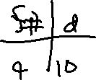


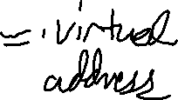




Slide 50
10.20 What is the cause of thrashing? How does the system detect thrashing? Once it detects thrashing, what can the system do to eliminate this problem?

Slide 51
10.20
High degree of multiprogramming.
Low CPU high Disk usage
Swap out some processes

