Slide 1
11.1 Consider a file system where a file can be deleted and its disk space reclaimed while links to that file still exist. What problems may occur if a new file is created in the same storage area or with the same absolute path name? How can these problems be avoided?

Slide 2
11.2
Old links will point to new file.
When deleting file, be sure to remove the links

Slide 3
11.2 Some systems automatically delete all user files when a user logs off or a job terminates, unless the user explicitly requests that they be kept; other systems keep all files unless the user explicitly deletes them. Discuss the relative merits of each approach.

Slide 4
11.2
Benefits of typical system – data still available after shutdown and restart
Benefits of deletion – save space, security/privace

Slide 5
11.3 Why do some systems keep track of the type of a file, while others leave it to the user or simply do not implement multiple file types? Which system is “better?”

Slide 6
11.3
Benefit of recognizing file type – Don’t have to think about which program to open.
You may use different programs to open a file.

Slide 7
11.6 Could you simulate a multilevel directory structure with a single-level directory structure in which arbitrarily long names could be used? If your answer is yes, explain how you can do so, and contrast this scheme with the multilevel directory scheme. If your answer is no, explain what prevents your simulation’s success. How would your answer change if file names were limited to seven characters?

Slide 8
11.6
* Yes, use an indexed structure to keep track of long file names.
If file names were limited to 7 characters, you would not have enough space to implement using this scheme.

Slide 9
11.8 Some systems automatically open a file when it is referenced for the first time, and close the file when the job terminates. Discuss the advantages and disadvantages of this scheme as compared to the more traditional one, where the user has to open and close the file explicitly.

Slide 10
11.8
Benefits of letting user open file – File access only done when user needs it.
Letting auto open/close – User has less control

Slide 11
11.9 Give an example of an application in which data in a file should be accessed in the following order:
a. Sequentially
b. Randomly

Slide 12
11.9
A) Music, videos
B) Database

Slide 13
11.10 Some systems provide file sharing by maintaining a single copy of a file; other systems maintain several copies, one for each of the users sharing the file. Discuss the relative merits of each approach.

Slide 14
11.10
Benefits of single copy – Save space, change can be seen by all users.
Benefits of dual copy – Updates are not up to date, uses more memory

Slide 15
11.12 Consider a system that supports 5000 users. Suppose that you want to allow 4990 of these users to be able to access one file.
a. How would you specify this protection scheme in UNIX?
b. Could you suggest another protection scheme that could be used more effectively for this purpose than the scheme provided by UNIX?

Slide 16
11.12
Owner – 7
Group – 5
Better way – Form a group of 10 people and disallow them access

Slide 17
11.13 Researchers have suggested that, instead of having an access list associated with each file (specifying which users can access the file, and how), we should have a user control list associated with each user (specifying which files a user can access, and how). Discuss the relative merits of these two schemes.

Slide 18
11.13
For many files,
Access list is better to change permissions of a file for a certain user.
User control list is better for changing a users permission for a certain file.

Slide 19
11.15 Consider a system where free space is kept in a free-space list.
a. Suppose that the pointer to the free-space list is lost. Can the system reconstruct the free-space list? Explain your answer.
b. Suggest a scheme to ensure that the pointer is never lost as a result of memory failure.

Slide 20
11.15
Yes, the process is called garbage collection. Look @ each block and check if it is available.
Store the pointer in a safe location. (stable storage)

Slide 21
11.17 Why must the bit map for file allocation be kept on mass storage rather than in main memory?

Slide 22
11.17
What is the bit vector(map)? Used in free space management. 0 if available, 1 if used space in blocks on disk.
Volatility of the two. Main memory is volatile and do not want to lose this data. Do not want to do garbage collection again.

Slide 23
11.18 Consider a system that supports the strategies of contiguous, linked, and indexed allocation. What criteria should be used in deciding which strategy is best utilized for a particular file?

Slide 24
11.18
Contiguous / indexed support direct access.
1. Need sequential or direct access?
  If need direct, avoid linked
2. Size of disk?
  If large file, avoid contiguous

Slide 25
11.22 How do caches help improve performance? Why do systems not use more or larger caches if they are so useful?

Slide 26
11.22
1. Provide faster data access
2. Expensive

Slide 27
12.8 How does DMA increase system concurrency? How does it complicate hardware design?

Slide 28
12.8
By allowing disk to work at the same time that CPU is performing other operations. IO @ same time that executing a process
Need DMA controller.

Slide 29
12.10 Why is it important to scale up system bus and device speeds as the CPU speed increases?

Slide 30
12.10
Bus will become bottleneck as device speeds and CPU speed increases.

Slide 31
13.1 None of the disk-scheduling disciplines, except FCFS, is truly fair (starvation may occur).
a. Explain why this assertion is true.
b. Describe a way to modify algorithms such as SCAN to ensure fairness.
c. Explain why fairness is an important goal in a time-sharing system.
d. Give three or more examples of circumstances in which it is important that the operating system be unfair in serving I/O requests.

Slide 32
13.1
a) SSTF is unfair and one can be starved
b) Add a timestamp
C) processes can be stopped if IO requests go unfulfilled
D) During priority or real-time processes.

Slide 33
13.2 Suppose that a disk drive has 5000 cylinders, numbered 0 to 4999. The drive is currently serving a request at cylinder 143, and the previous request was at cylinder 125. The queue of pending requests, in FIFO order, is 86, 1470, 913, 1774, 948, 1509, 1022, 1750, 130

Slide 34
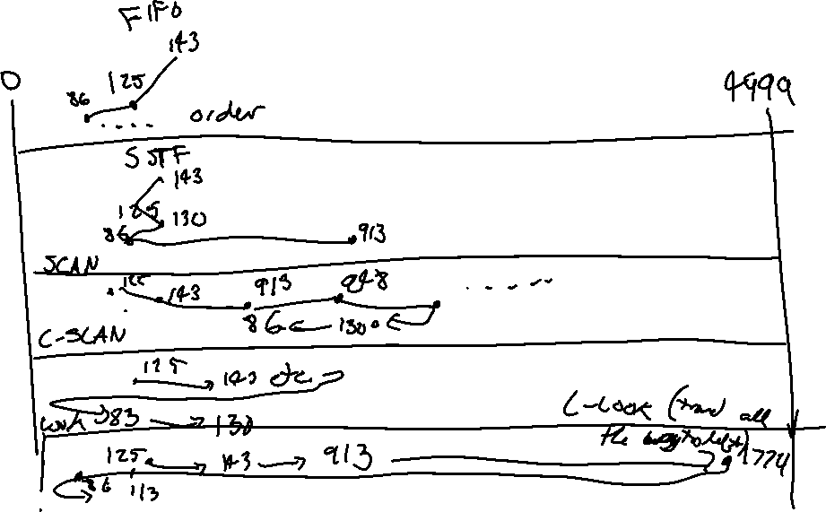
13.2

Slide 35
Starting from the current head position, what is the total distance (in cylinders) that the disk arm moves to satisfy all the pending requests, for each of the following diskscheduling
algorithms?
a. FCFS
b. SSTF
c. SCAN
d. C-SCAN
e. LOOK
f. C-LOOK

Slide 36


Slide 37
13.8 Is disk scheduling, other than FCFS scheduling, useful in a single-user environment? Explain your answer.

Slide 38
13.8
Not many IO requests, FIFO would work fine.

Slide 39
13.9 Explain why SSTF scheduling tends to favor middle cylinders over the innermost and outermost cylinders.

Slide 40
13.9
There is a tendency to stay in the middle. There is a higher probability for the next request to be near the middle.

Slide 41
13.10 Requests are not usually uniformly distributed. For example, a cylinder containing the file system FAT or inodes can be expected to be accessed more frequently than a cylinder that only contains files. Suppose you know that 50 percent of the requests are for a small, fixed number of cylinders.

Slide 42
13.10
a. Would any of the scheduling algorithms discussed in this chapter be particularly good for this case? Explain your answer.
b. Propose a disk-scheduling algorithm that gives even better performance by taking advantage of this “hot spot” on the disk.
c. File systems typically find data blocks via an indirection table, such as a FAT in DOS or inodes in UNIX. Describe one or more ways to take advantage of this indirection to improve the disk performance.

Slide 43
13.10
SSTF would benefit hot spots in disk.
Move hot spots close to eachother.

Slide 44
13.15 Is there any way to implement truly stable storage? Explain your answer.

Slide 45
13.15
No

