Slide 1
Questions to Chap. 8

Slide 2
8.1 List three examples of deadlocks that are not related to a computer-system environment.

Slide 3
Locked door, full classes in school, traffic, sharing silverware

Slide 4
8.2 Is it possible to have a deadlock involving only one single process? Explain your answer.

Slide 5
No, there is no hold and wait with only one process. There is also no circular wait possible with only one process.

Slide 6
8.9 Consider a system consisting of m resources of the same type, being shared by n processes. Resources can be requested and released by processes only one at a time. Show that the system is deadlock free if the following two conditions hold:
A. The maximum need of each process is between 1 and m resources
B. The sum of all maximum needs is less than m+n.

Slide 7


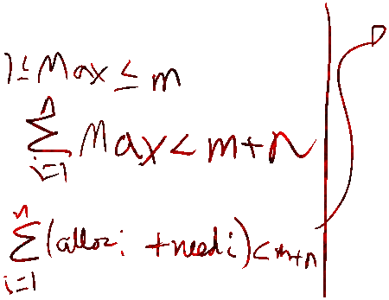
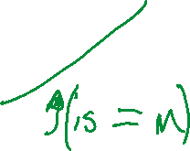











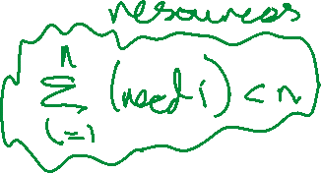
8.9
Two ways to prove this. Break one of the four lock conditions, Banker’s algorithm.
Banker’s algorithm is more relevant.

Slide 8
8.11 Consider the following resource-allocation policy. Requests and releases for resources are allowed at any time. If a request for resources cannot be satisfied because the resources are not available, then we check any processes that are blocked, waiting for resources. If they have the desired resources, then these resources are taken away from them and are given to the requesting process. The vector of resources for which the process is waiting is increased to include the resources that were taken away.

Slide 9
For example, consider a system with three resource types and the vector Available initialized to (4,2,2). If process P0 asks for (2,2,1), it gets them. If P1 asks for (1,0,1), it gets them. Then, if P0 asks for (0,0,1), it is blocked (resource not available). If P2 now asks for (2,0,0), it gets the available one (1,0,0) and one that was allocated to P0 (since P0 is blocked). P0’s Allocation vector goes down to (1,2,1), and its Need vector goes up to (1,0,1).

Slide 10
A. Can deadlock occur? If you answer “yes”, give an example. If you answer “no”, specify which necessary condition cannot occur.
B. Can indefinite blocking occur? Explain your answer.

Slide 11
8.11
No, no preemption condition is broken.
Yes, there can be a situation where other processes keep taking resources away from p0.

Slide 12

12. Consider the following snapshot of a system:
P0
 | Allocation | Max | Need | Available
 | A B C D | A B C D | A B C D | A B C D
P0 | 0 0 1 2 | 0 0 1 2 | 0 0 0 0 | 1 5 2 0
P1 | 1 0 0 0 1 4 2 0 | 1 7 5 0 | 0 7 5 0 0 3 3 0 | P0 > 1 5 3 2
P2 | 1 3 5 4 | 2 3 5 6 | 1 0 0 2 | P2 > 2 8 8 6
P3 | 0 6 3 2 | 0 6 5 2 | 0 0 2 0 | P1 > 3 8 8 6
P4 | 0 0 1 4 | 0 6 5 6 | 0 6 4 2 | P3 > 3 14 11 8 P4 > Good.

Slide 13
Answer the following questions using the banker’s algorithm:
A. What is the content of the matrix Need?
B. Is the system in a safe state?
C. If a request from process P1 arrives for (0, 4, 2, 0), can the request be granted immediately?

Slide 14
13. Consider a system consisting of four resources of the same type that are shared by three processes, each of which needs at most two resources. Show that the system is deadlock-free.

Slide 15




