Slide 1

Questions to Chap. 1

Slide 2


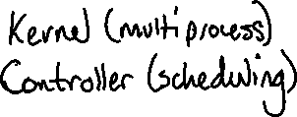
1.1 What are the three main purposes of an operating systems?

Slide 3
1.3 What is the main advantage of multiprogramming?
More efficient use of system resources

Slide 4
1.5 In a multiprogramming and time-sharing environment, several users share the system simultaneously. This situation can result in various security problems.
A. What are two such problems?
B. Can we ensure the same degree of security in a time-shared machine as we have in a dedicated machine? Explain your answer.

Slide 5
1.5a
Shared memory, one user may destroy, access or change part of another users memory. On dedicated machines, one cannot make changes to your memory. Does not happen on dedicated machines
1.5b
No, you can use algorithms but it will never grant the same security as a dedicated system.

Slide 6
1.6 Define the essential properties of the following types of operating systems:
A. Batch
B. Interactive
C. Time sharing
D. Real time
E. Network
F. Distributed

Slide 7
1.5a) Simple system which processes similar processes together.
1.5b) Lots of short transactions, interaction between user/system. eCommerce etc.
1.5c) System shared by multiple users where each user is given a slice of CPU time.
1.5d) System that must respond within deadline when stimulus is received
1.5e) System where resources are shared over a network. Hardware and software data communication system. Use network to transfer data.
1.6f) Multiple CPUs and Memory connected over a network.
(Parallel system) Shared memory and clock

Slide 8
1.7 We have stressed the need for an operating system to make efficient use of the computing hardware. When is it appropriate for the operating system to forsake this principle and to “waste” resources? Why is such a system not really wasteful?

Slide 9
1.7) A GUI/Interface is considered a waste of resources, but it’s better because system is more user-friendly.

Slide 10
1.8 Under what circumstances would a user be better off using a time-sharing system, rather than a personal computer or single-user workstation?

Slide 11
1.8) If the time-sharing computer is significantly more powerful.
If the time-sharing system has fewer users.

Slide 12
1.9 Describe the differences between symmetric and asymmetric multiprocessing. What are three advantages and one disadvantage of multiprocessor systems?

Slide 13
1.9) Parallel, shared memory & clock, tightly coupled
Distributed, Each system has mem and CPU, loosely coupled
Symmetric & Asymmetric refer to parallel system. Symmetric, all CPUs are =. Asymmetric has master/slave system.
Why distributed? More reliable, more efficient. Can share peripherals.
Disadvantage? Design is more complicated.

Slide 14
1.10 What is the main difficulty that a programmer must overcome in writing an operating system for a real-time environment?

Slide 15
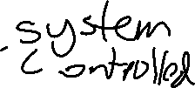



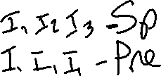
Spooling – Overlapping of input, processing and output of one job so that all parts of the CPU are working.
Prefetching – Overlapping Processing and Output.
I P O

