Slide 1
Questions in Chap. 6

Slide 2
6.1 A CPU scheduling algorithm determines an order for the execution of its scheduled processes. Given n processes to be scheduled on one processor, how many possible different schedules are there? Give a formula in terms of n.

Slide 3
n!

Slide 4
6.2 Define the difference between preemptive and nonpreemptive schduling. State why strict nonpreemptive scheduling is unlikely to be used in a computer center.

Slide 5
Preempt can take CPU
Non preemptive cannot take away CPU
User with infinite loop might starve other processes

Slide 6
6.3 Consider the following set of processes, with the length of the CPU-burst time given in milliseconds:
Process | Burst Time | Priority
P1 | 10 | 3
P2 | 1 | 1
P3 | 2 | 3
P4 | 1 | 4
P5 | 5 | 2

Slide 7
The processes are assumed to have arrived in the order P1, P2, P3, P4, P5, all at time 0.
A. Draw four Gantt charts illustrating the execution of these processes using FCFS, SJF, a nonpreemptive priority (a smaller priority number implies a higher priority), and RR (quantum = 1) scheduling.

Slide 8

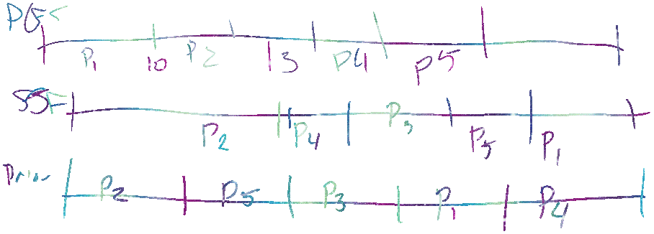




Slide 9


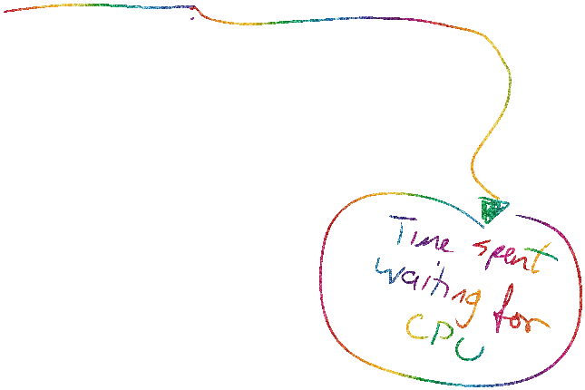
B. What is the turnaround time of each process for each of the scheduling algorithms in part a?
C. What is the waiting time of each process for each of the scheduling algorithms in part a?
D. Which of the schedules in part A results in the minimal average waiting time (over all processes)?

Slide 10
6.4 Suppose that the following processes arrive for execution at the times indicated. Each process will run the listed amount of time. In answering the questions, use nonpreemptive scheduling and base all decisions on the information you have at the time the decision must be made.

Slide 11
Process | Arrival Time | Burst Time
P1 | 0.0 | 8
P2 | 0.4 | 4
P3 | 1.0 | 1

Slide 12
A. What is the average turnaround time for these processes with the FCFS scheduling algorithm?
B. What is the average turnaround time for these processes with the SJF scheduling algorithm?

Slide 13
C. The SJF algorithm is supposed to improve performance, but notice that we chose to run process P1 at time 0 because we did not know that two shorter processes would arrive soon. Compute what the average turnaround time will be if the CPU is left idle for the first 1 unit and then SJF scheduling is used. Remember that processes P1 and P2 are waiting during this idle time, so their waiting time may increase. This algorithm could be known as future-knowledge scheduling.

Slide 14
6.5 Consider a variant of the RR scheduling algorithm where the entries in the ready queue are pointers to the PCBs.
A. What would be the effect of putting two pointers to the same process in the ready queue?
B. What would be the major advantages and disadvantages of this scheme?
C. How would you modify the basic RR algorithm to achieve the same effect without the duplicate pointers?

Slide 15
6.5)
A) Process gets double time (2 Quantums)
B) You can provide more time to particular processes. Disadvantage: Not fair to others, More context switches
C) Increase its time segment.

Slide 16
6.6 What advantage is there in having different time-quantum sizes on different levels of a multilevel queueing system?

Slide 17
6.6
Increases throughput. Shorter processes go in n out very quickly.

Slide 18
6.7 Consider the following preemptive priority-scheduling algorithm based on dynamically changing priorities. Larger priority numbers imply higher priority. When a process is waiting for the CPU (in the ready queue but not running), its priority changes at a rate α; when it is running, its priority changes at a rate β. All processes are given a priority of 0 when they enter the ready queue. The parameters α and β can be set to give many different scheduling algorithms.

Slide 19
A. What is the algorithm that results from
β > α > 0?
B. What is the algorithm that results from
α < β < 0?

Slide 20


6.7
A) Priority and preemptive. FCFS, the ones who are running have higher priority than the ones that come before it.
B) LIFO

Slide 21
6.8 Many CPU scheduling algorithms are parameterized. For example, the RR algorithm requires a parameter to indicate the time slice. Multilevel feedback queues require parameters to define the number of queues, the scheduling algorithms for each queue, the criteria used to move processes between queues, and so on.

Slide 22
These algorithms are thus really sets of algorithms (for example, the set of RR algorithms for all time slices, and so on). One set of algorithms may include another (for example, the FCFS algorithm is the RR algorithm with an infinite time quantum). What (if any) relation holds between the following pairs of sets of algorithms?

Slide 23
A. Priority and SJF
B. Multilevel feedback queues and FCFS
C. Priority and FCFS
D. RR and SJF

Slide 24
6.8
A) SJF is priority because priority is based on size.
B) Lowest level of multilevel feedback is fcfs
C) Priority is based on order process arrives
D) In RR, Shorter jobs end first.

Slide 25
6.9 Suppose that a scheduling algorithm (at the level of short-term CPU scheduling) favors those processes that have used the least processor time in the recent past. Why will this algorithm favor I/O-bound programs and yet not permanently starve CPU-bound programs?

Slide 26
6.10 Explain the differences in the degree to which the following scheduling algorithms discriminate in favor of short processes:
A. FCFS
B. RR
C. Multilevel feedback queues

