Slide 1
ERAU Faculty & Staff Climate Survey
Spring 2005
Results by Gender
Human Resources
Office of Institutional Research
April 2005

Slide 2
Background
Web-based instrument:
  28 “agreement” items, 7 “progress” items, 6 demographic items, 5 open-ended comment boxes after each section (Your Job, The ERAU Organization, The ERAU Environment, University Progress, Other)
    5-point agreement scale: Strongly Agree to Strongly Disagree
    5-point progress scale: Very Large Extent to None
Survey accessible from 02/22/05 – 03/08/05
  2 email announcements:
    Survey has begun, 02/22/05
    Reminder survey is about to end, 03/04/05
  All employees urged to participate (regardless of status, location, etc.)

Slide 3
Changes to this version:
  Some questions reworded/added/deleted (as noted on the charts that follow)
    Added 10 new questions
    Deleted 3 questions
    Reworded/expanded 11 questions
  Added new section on University Progress. “Indicate extent that progress has been made toward:”
    Effective marketing and promotion of ERAU
    Effective communication among campuses
    Improving overall appearance of facilities
    Making staff and students safer
    Hiring more women and members of underrepresented groups
    Improving pay
    Improving benefits

Slide 4
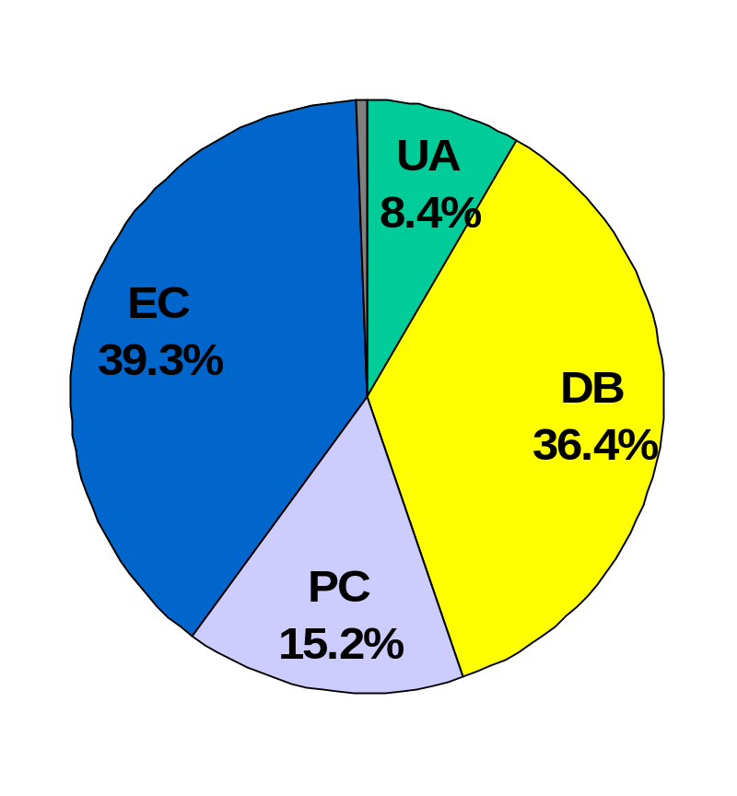
Who Responded?
Grand Total = 1021
  Highest number yet (this is the 4th administration).
By Division (with estimated response rates):
  University Administration:
    86 (26% response rate)
  Daytona Beach Campus:
    372 (44% response rate)
  Prescott Campus:
    155 (41% response rate)
  Extended Campus:
    401 (not available)
  Not Indicated: 7

Slide 5
Trend Results: By Gender
35 charts follow (all university divisions combined), one per question, with 20 charts displaying the side-by-side comparisons of Spring 2002, Fall 2002, Fall 2003 and Spring 2005 data (when available) and 15 charts only displaying data from Spring 2005 (new questions).
Each chart displays the percent response for each category to each of the 35 opinion questions
  5-point agreement scale: Strongly Agree to Strongly Disagree
  5-point progress scale: Very Large Extent to None
See data tables for breakouts within campus division

Slide 6
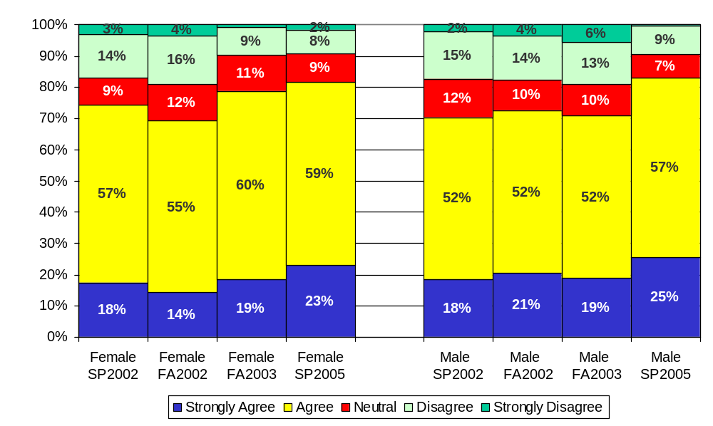
I have the materials and equipment to do my work effectively*
*Question was reworded in FA2003; FA2002 read as “to do my work right”.

Slide 7
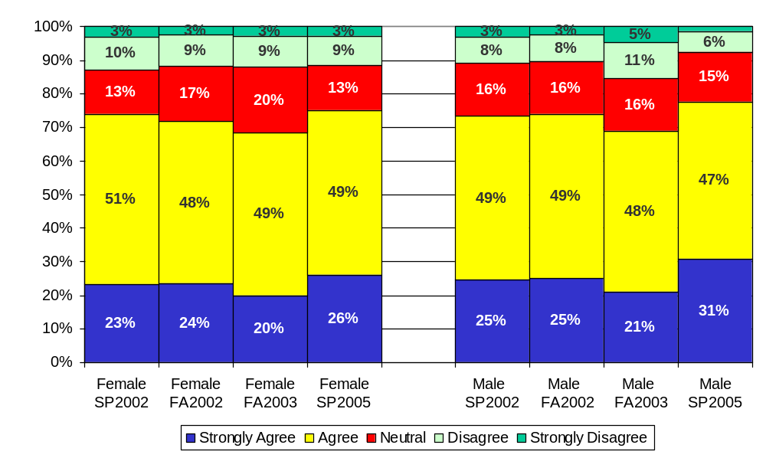
This last year, I have had opportunities to learn and grow either at work or through professional development activities

Slide 8
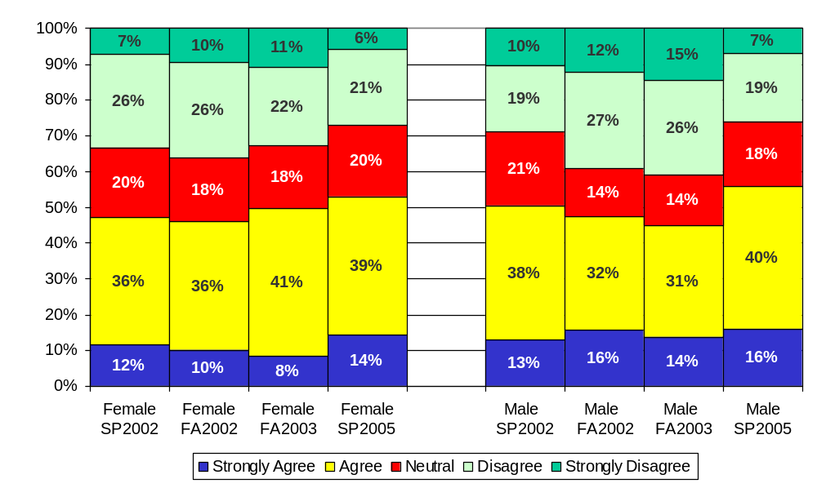
My current workload allows me to engage in a variety of activities, as appropriate to my position

Slide 9
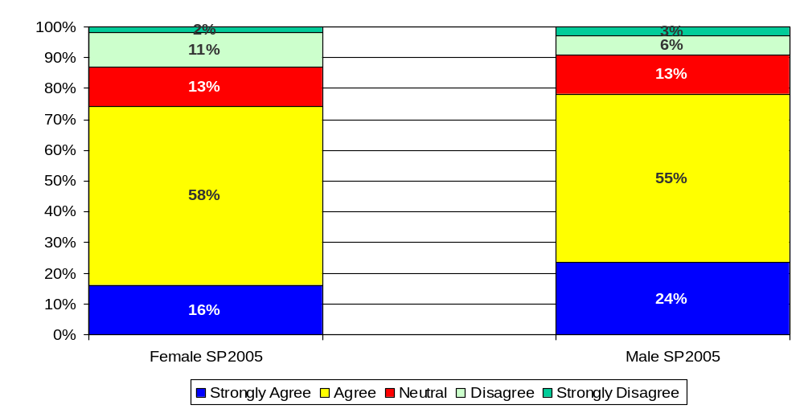
I have access to the information I need to make decisions for my work

Slide 10
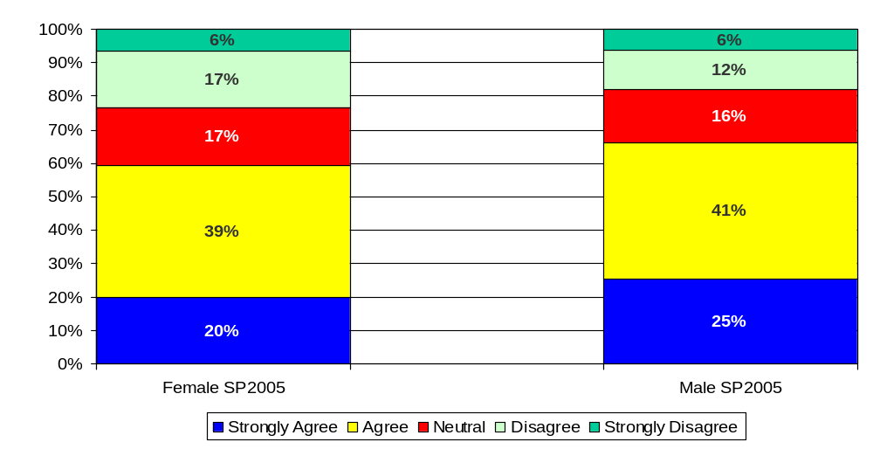
I am asked for my input on decisions that impact my work

Slide 11
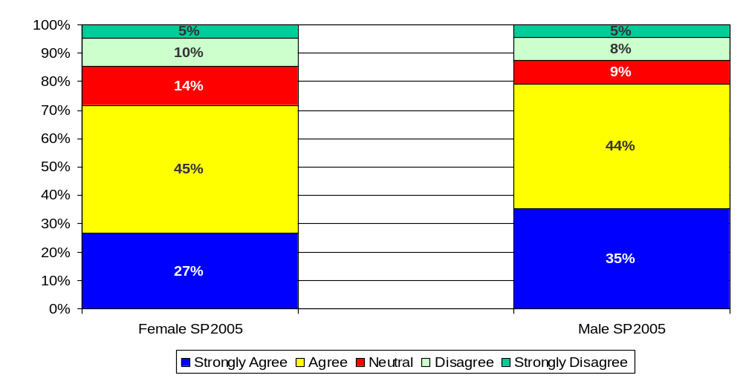
I feel safe in offering suggestions for improvement to the processes in my area

Slide 12
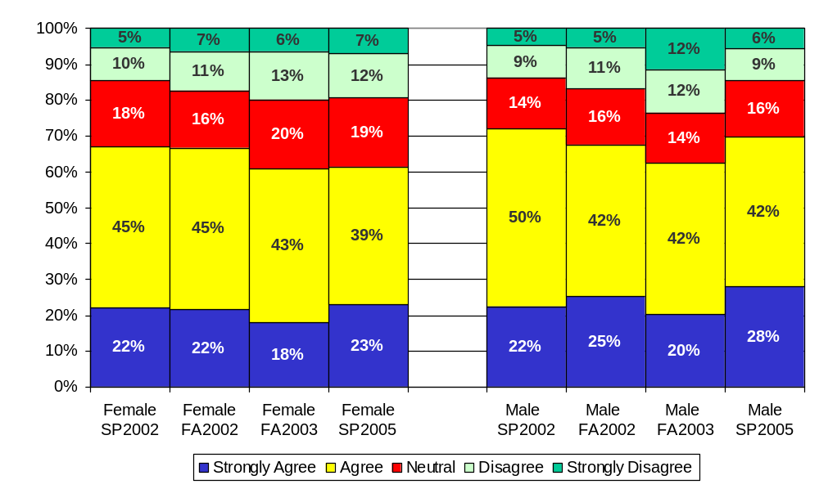
At work, my opinions seem to count

Slide 13
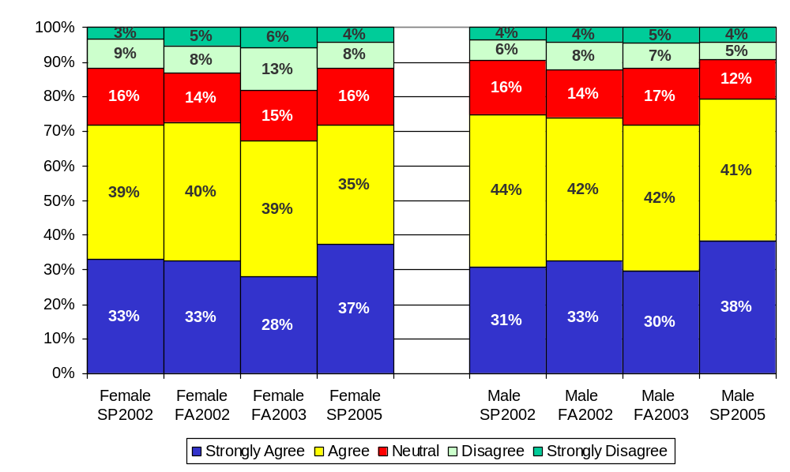
My direct supervisor lets me know when I have done a good job

Slide 14
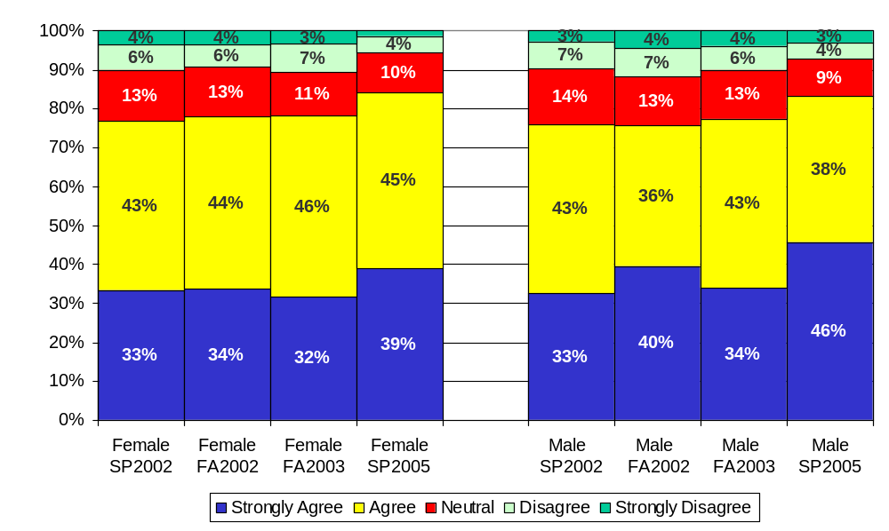
My direct supervisor talks with me at least once a year about my performance*
*Reworded. FA03 version = “My direct supervisor talks with me at least once a year about my performance objectives and progress.” SP02-F02 version = “My direct supervisor talks with me at least once a year about my objectives and progress.”

Slide 15
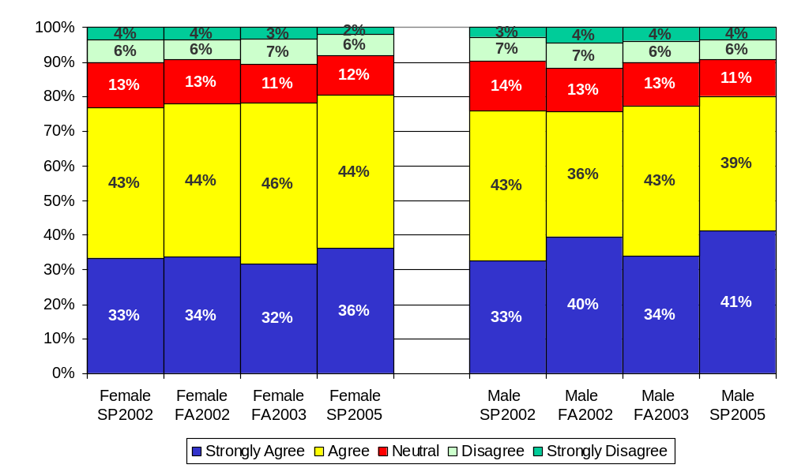
My direct supervisor talks with me at least once a year about my performance objectives/plan*
*Reworded. FA03 version = “My direct supervisor talks with me at least once a year about my performance objectives and progress.” SP02-F02 version = “My direct supervisor talks with me at least once a year about my objectives and progress.”

Slide 16
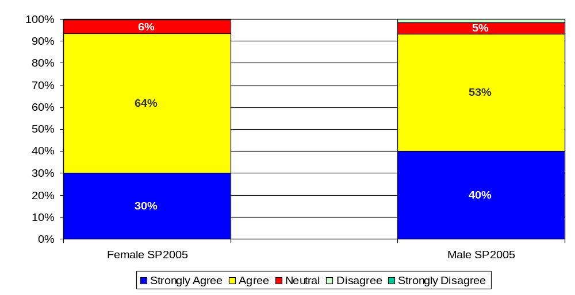
I am familiar with Embry-Riddle’s mission, goals, and vision

Slide 17
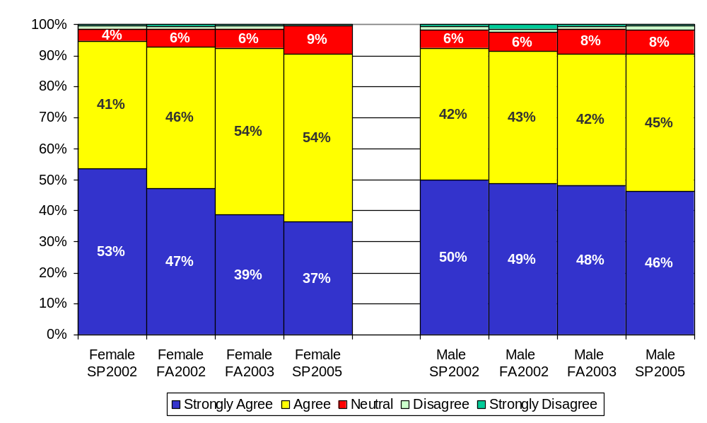
I support Embry-Riddle’s missions, goals, and vision

Slide 18
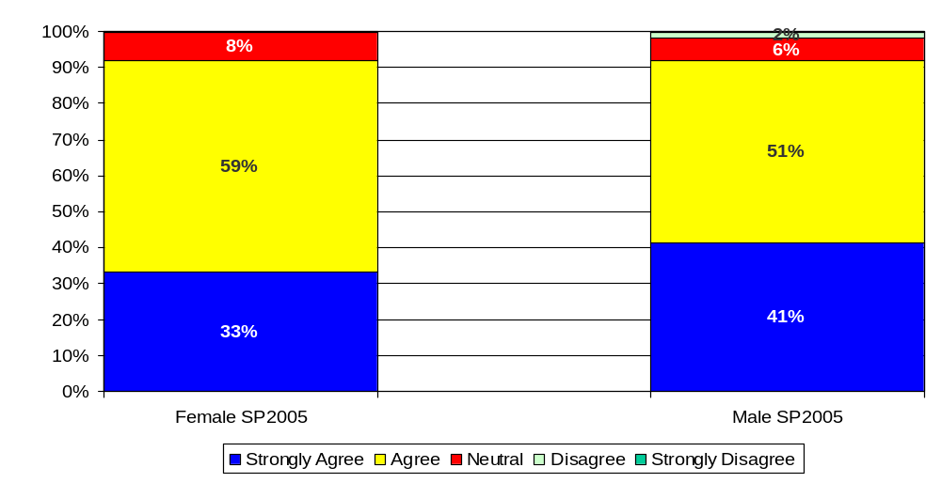
I am familiar with the values of Embry-Riddle

Slide 19
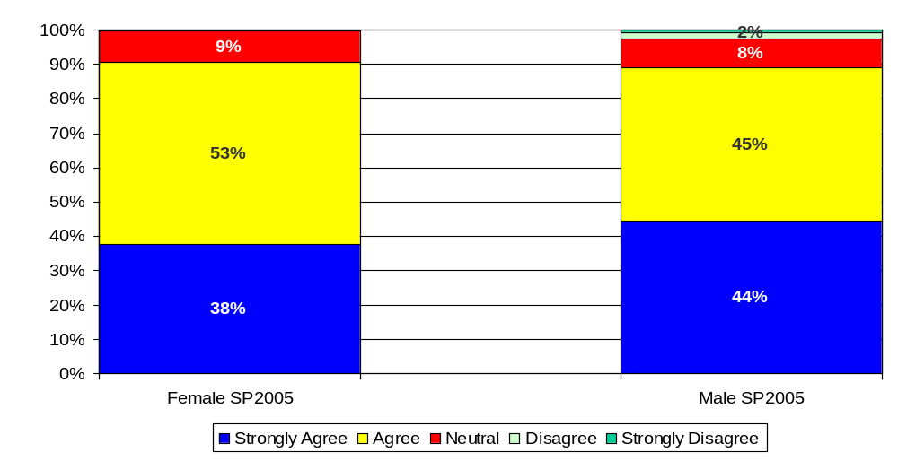
I support the values of Embry-Riddle

Slide 20
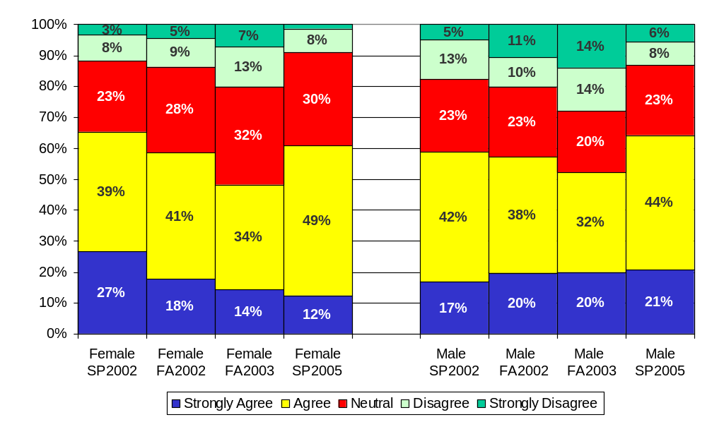
I believe University leadership is making progress toward University mission and goals
(President, Provost, Vice Presidents)*
*Reworded. FA02-FA03 version = “I have confidence in the University leadership (President, Vice Presidents).” SP02 version = “I have confidence in the University leadership (President, Vice Presidents, Chancellors).”

Slide 21
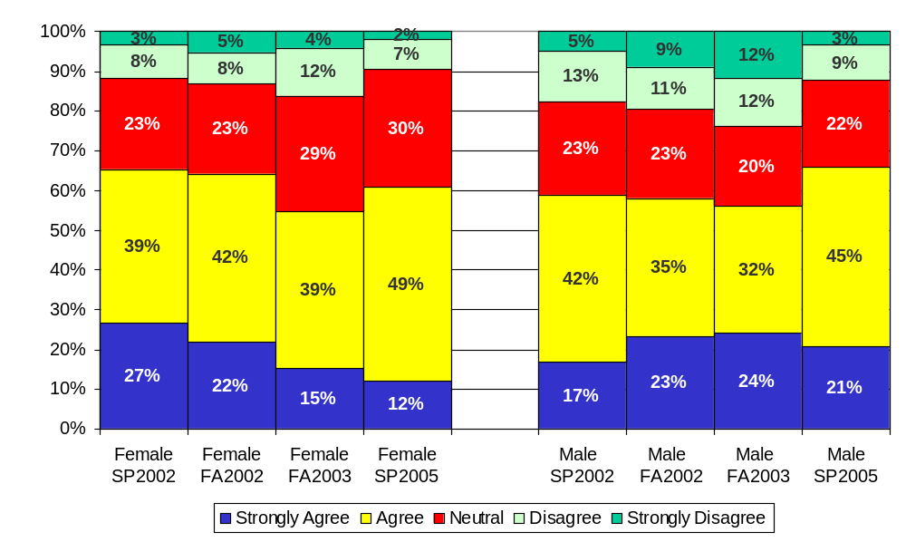
I believe campus leadership is making progress toward University mission and goals
(Chancellors, College Deans)*
*Reworded. FA02-FA03 version = “I have confidence in the campus leadership (Chancellors, College Deans).” SP02 version = “I have confidence in the University leadership (President, Vice Presidents, Chancellors).”

Slide 22
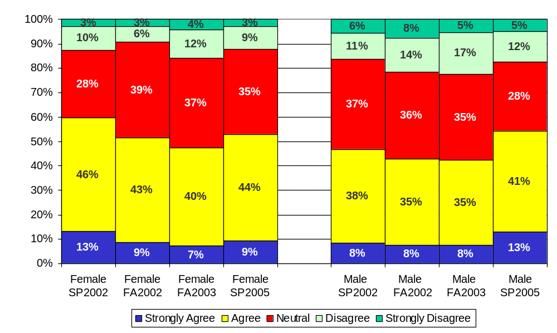
Strategic planning assists in setting my department/program’s direction and objectives

Slide 23
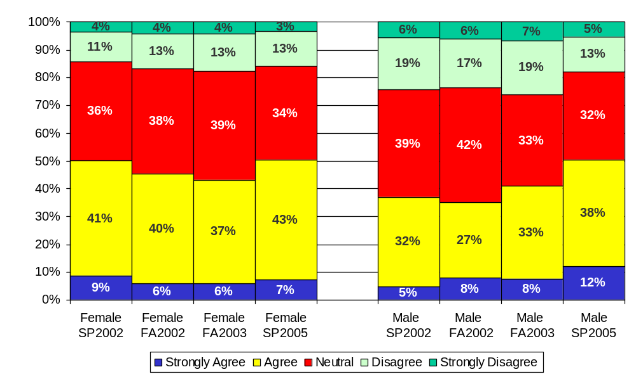
Assessment activities assist my department/program in measuring its success and identifying potential areas for improvement

Slide 24
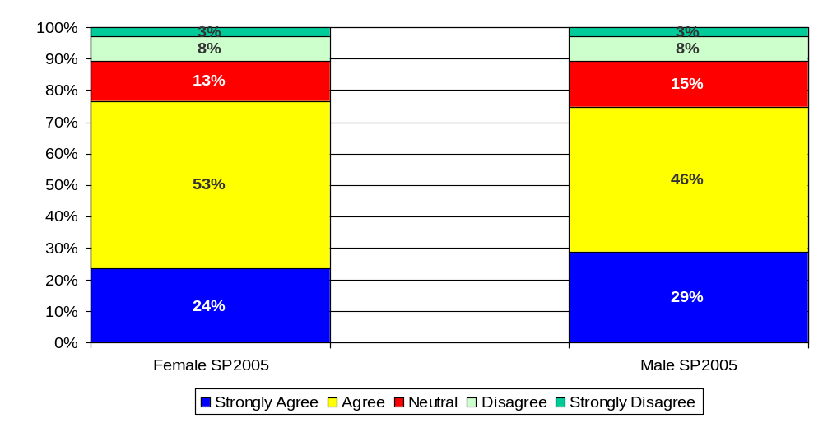
I am familiar with the “One University” concept

Slide 25
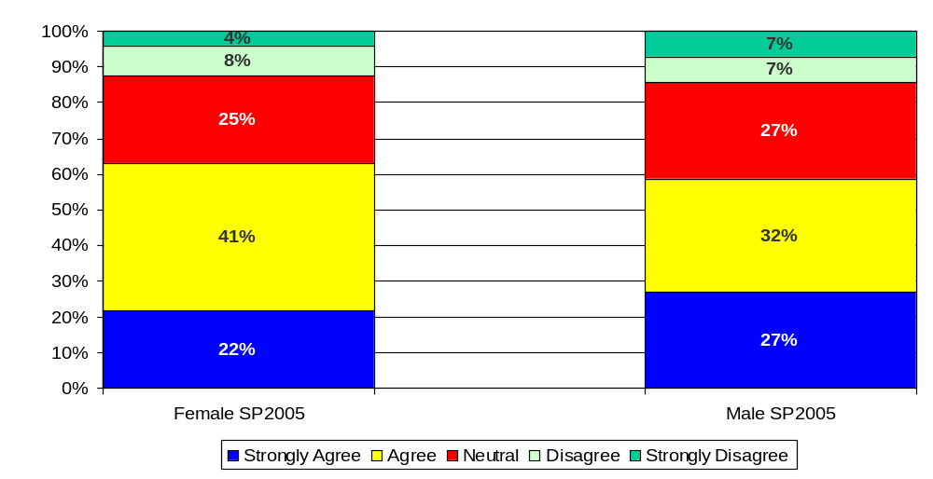
I support the “One University” concept

Slide 26
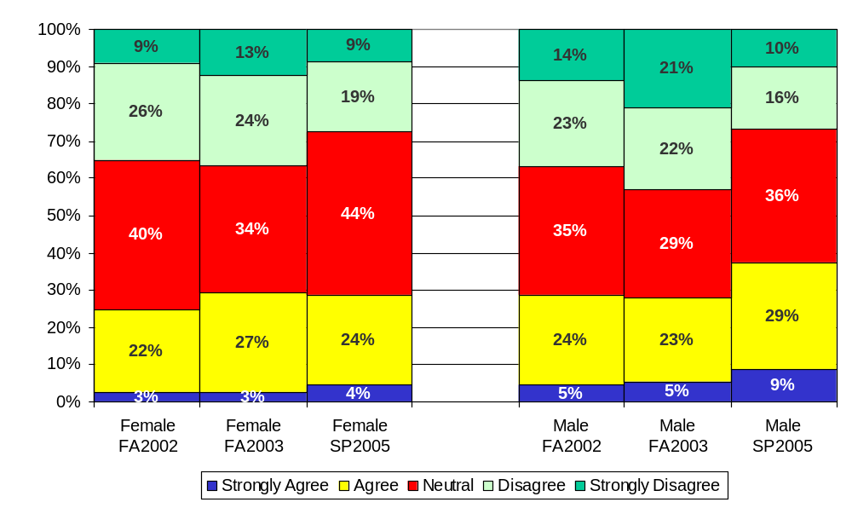
Budget allocations are based on the priorities of the University as a whole*
*Reworded. F02-FA03 version = “Budget allocations are based on a reasonable and understandable set of priorities.”

Slide 27
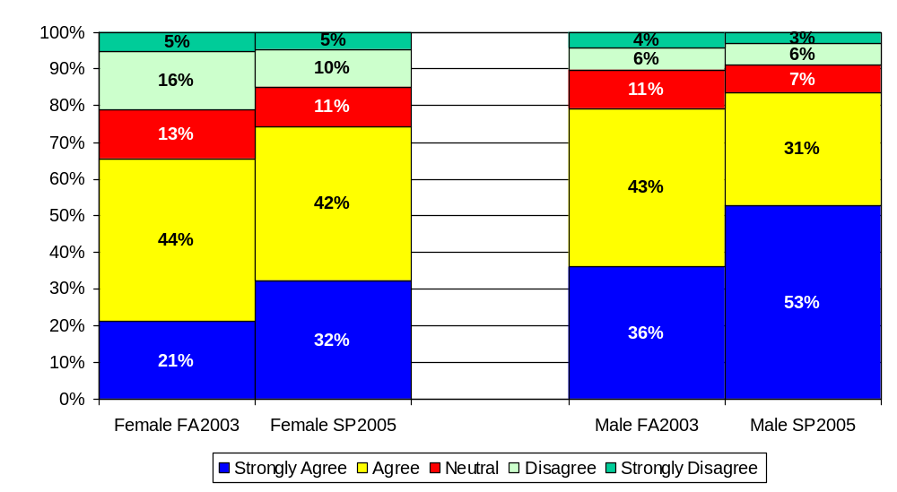
I have not been treated differently because of my race, ethnicity, national origin, age, physical disability, economic background, sexual orientation, or religious belief*
*Reworded. FA03 version = “I have not been treated differently because of my race, gender, sexual orientation, age, or religion.”

Slide 28
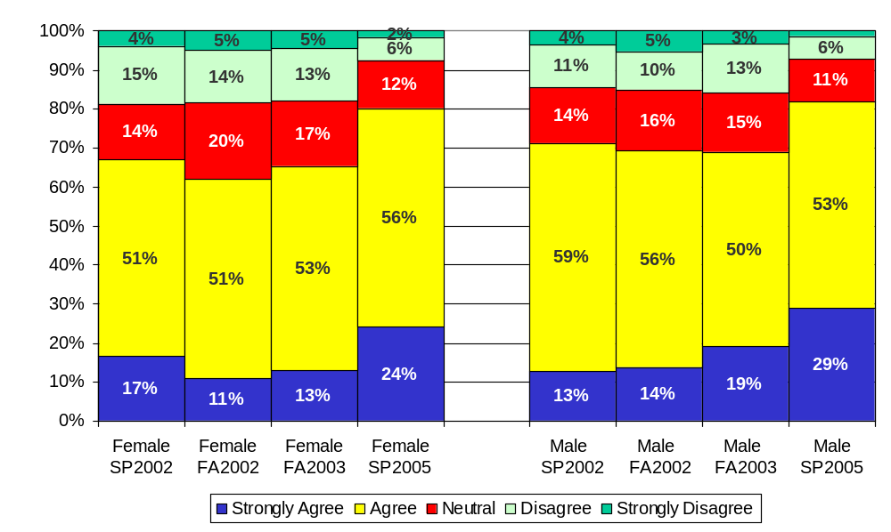
I am kept informed of University news and activities*
*Reworded. SP02-FA03 version = “I am kept informed of University, campus, and department level news and activities that are pertinent to my work.”

Slide 29
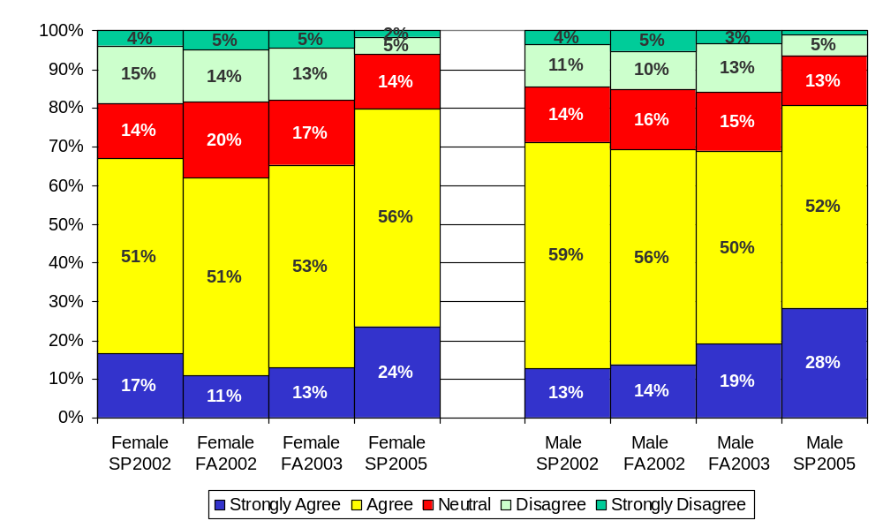
I am kept informed of campus news and activities*
*Reworded. SP02-FA03 version = “I am kept informed of University, campus, and department level news and activities that are pertinent to my work.”

Slide 30
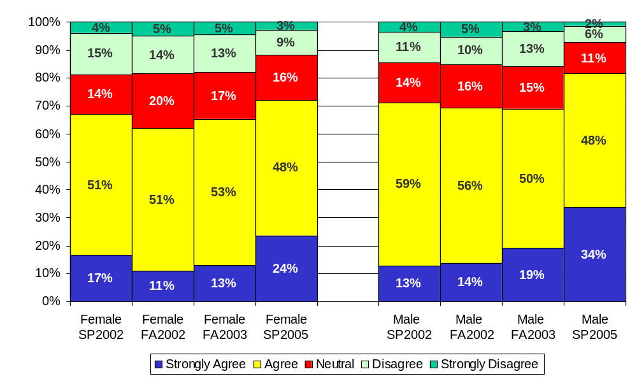
I am kept informed of department level news and activities*
*Reworded. SP02-FA03 version = “I am kept informed of University, campus, and department level news and activities that are pertinent to my work.”

Slide 31
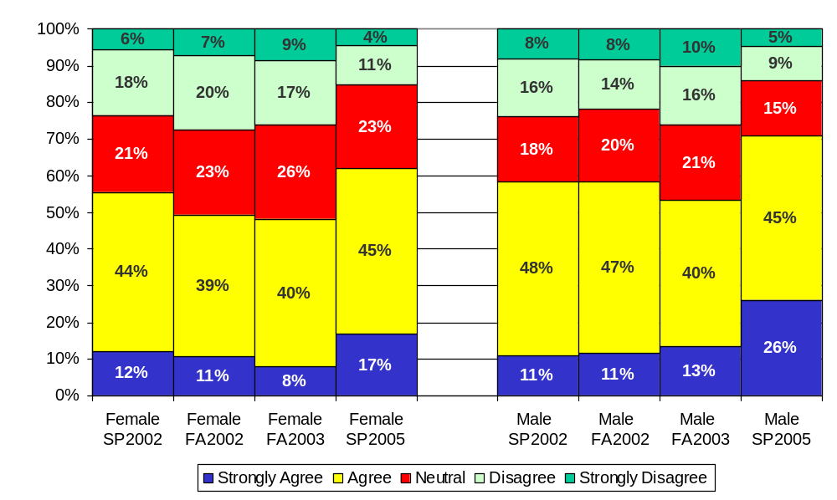
Embry-Riddle has a work environment of mutual respect and trust

Slide 32
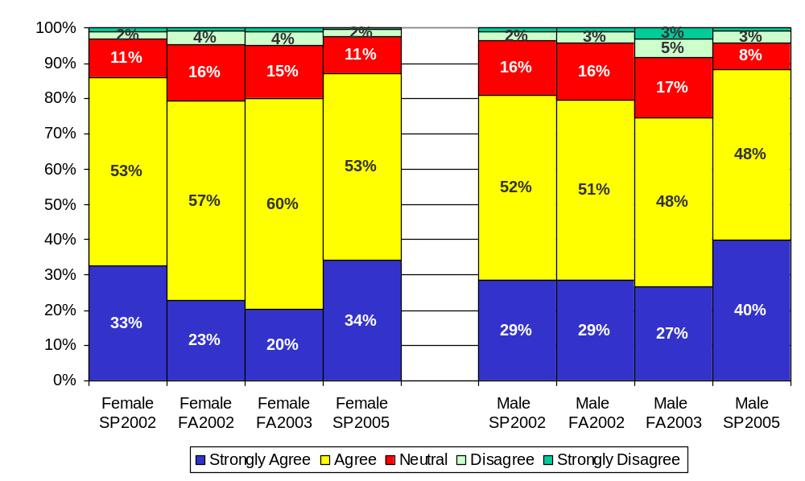
Overall, the University is a good place to work

Slide 33
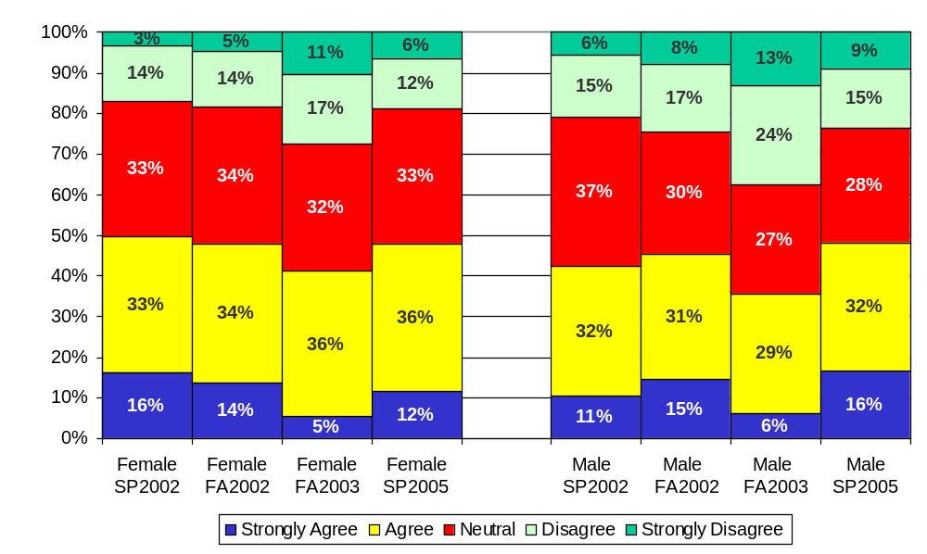
I believe that Climate Survey results will influence decisions to improve the University

Slide 34
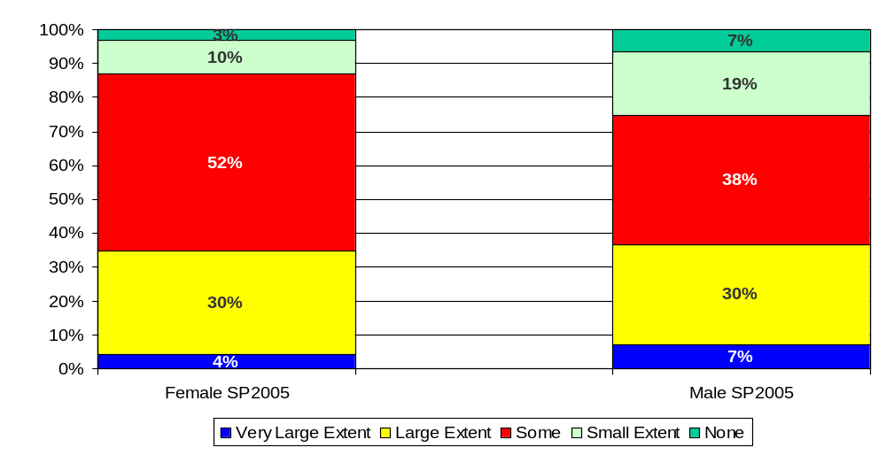
I feel progress has been made toward effective marketing and promotion of Embry-Riddle

Slide 35
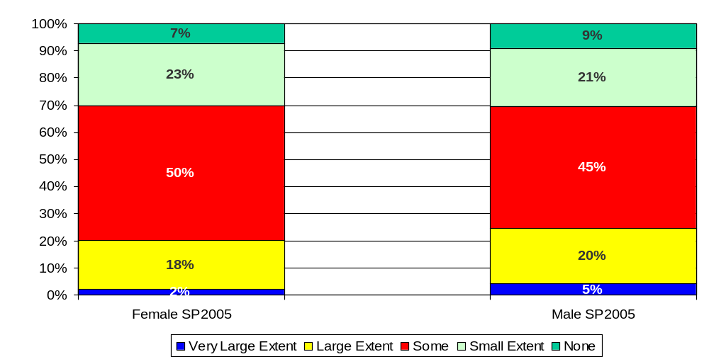
I feel progress has been made toward more effective communication among the campuses

Slide 36
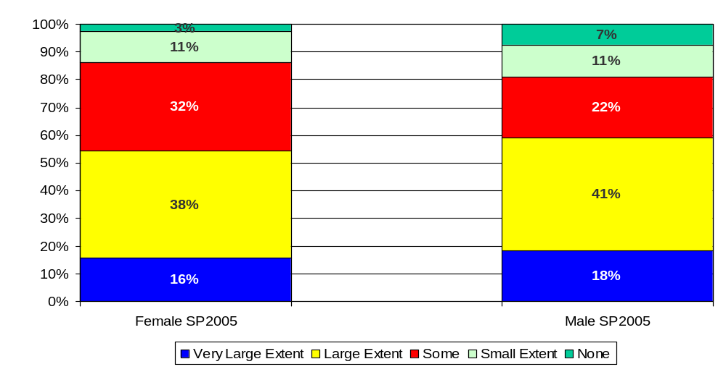
I feel progress has been made toward improving the overall appearance of the physical facilities of my campus/center

Slide 37
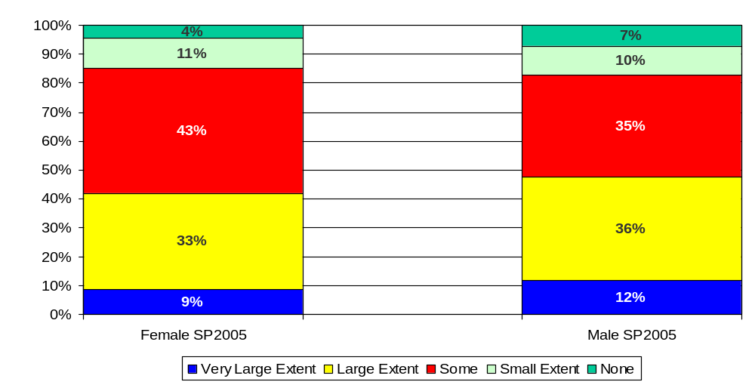
I feel progress has been made toward making the staff and students safer and more secure

Slide 38
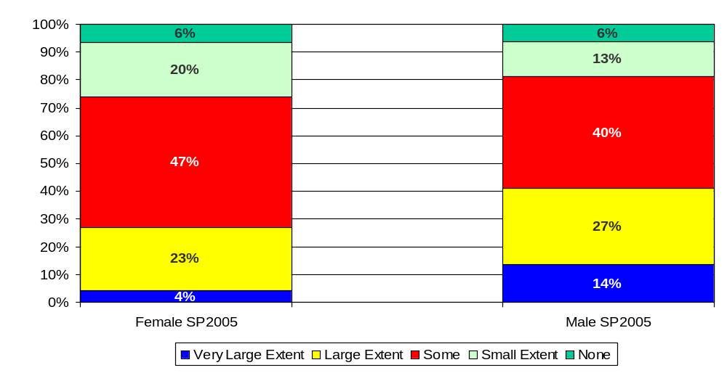
I feel progress has been made toward hiring more women and members of underrepresented groups into management and faculty positions

Slide 39
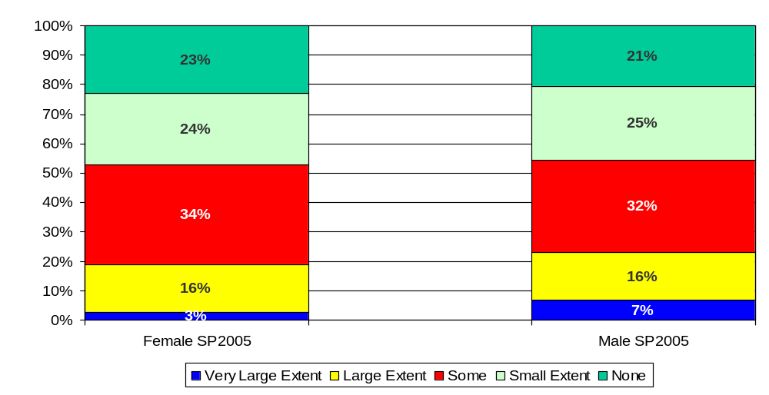
I feel progress has been made toward improving the pay afforded for my work

Slide 40
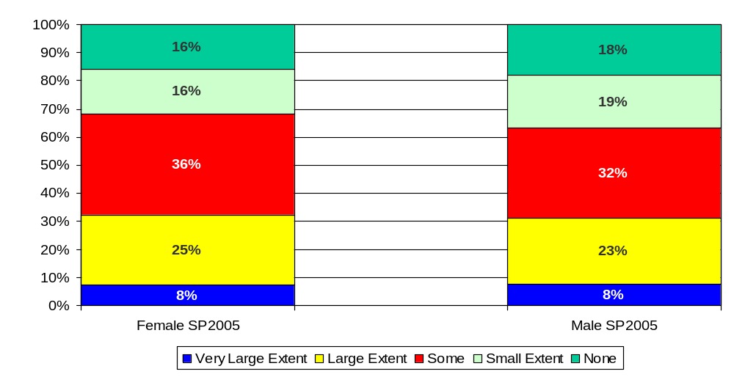
I feel progress has been made toward improving the benefits available for my needs and those of my family

