Slide 1
ERAU Faculty & Staff Climate Survey
Spring 2005
Overall Results
Human Resources
Office of Institutional Research
April 2005

Slide 2
Background
Web-based instrument:
  28 “agreement” items, 7 “progress” items, 6 demographic items, 5 open-ended comment boxes after each section (Your Job, The ERAU Organization, The ERAU Environment, University Progress, Other)
    5-point agreement scale: Strongly Agree to Strongly Disagree
    5-point progress scale: Very Large Extent to None
Survey accessible from 02/22/05 – 03/08/05
  2 email announcements:
    Survey has begun, 02/22/05
    Reminder survey is about to end, 03/04/05
  All employees urged to participate (regardless of status, location, etc.)

Slide 3
Changes to this version:
  Some questions reworded/added/deleted (as noted on the charts that follow)
    Added 10 new questions
    Deleted 3 questions
    Reworded/expanded 11 questions
  Added new section on University Progress. “Indicate extent that progress has been made toward:”
    Effective marketing and promotion of ERAU
    Effective communication among campuses
    Improving overall appearance of facilities
    Making staff and students safer
    Hiring more women and members of underrepresented groups
    Improving pay
    Improving benefits

Slide 4
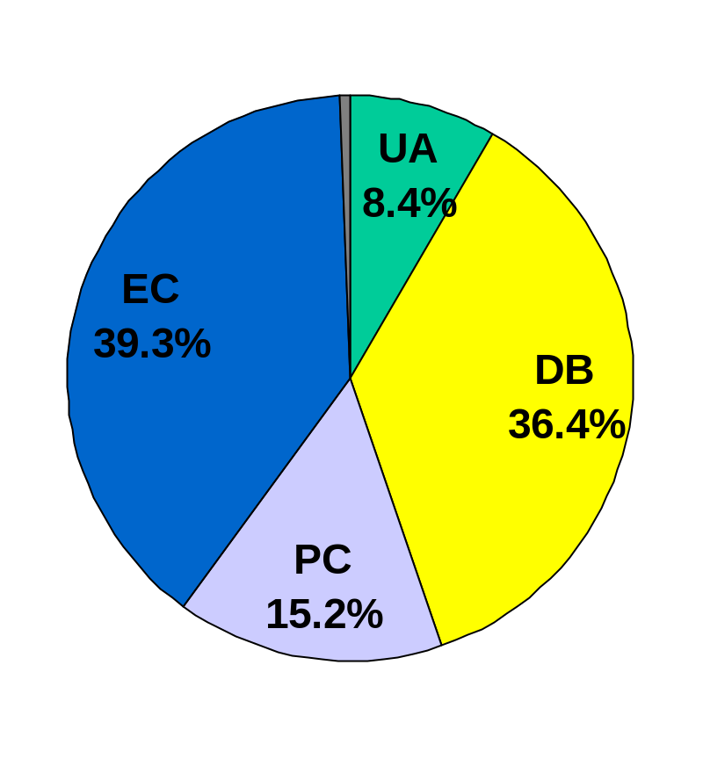
Who Responded?
Grand Total = 1021
  Highest number yet (this is the 4th administration).
By Division (with estimated response rates):
  University Administration:
    86 (26% response rate)
  Daytona Beach Campus:
    372 (44% response rate)
  Prescott Campus:
    155 (41% response rate)
  Extended Campus:
    401 (not available)
  Not Indicated: 7

Slide 5
Overall Observations
Participation increased:
  Increase in staff participation across all divisions
  Increase in faculty participation from EC
More positive responses in all comparable areas; fewer negative responses
Continued strong support for the University’s vision, mission, goals, and values

Slide 6
Results
Ten charts follow -- two for all divisions combined, plus two charts per division (UA, DB, PC, EC):
  Overall results for the 28 “agreement” items, sorted in order of those items which received the most agreement to the least.
  Overall results for the 7 “progress” items, sorted in order of those items viewed as making the most progress to the least.

Slide 7
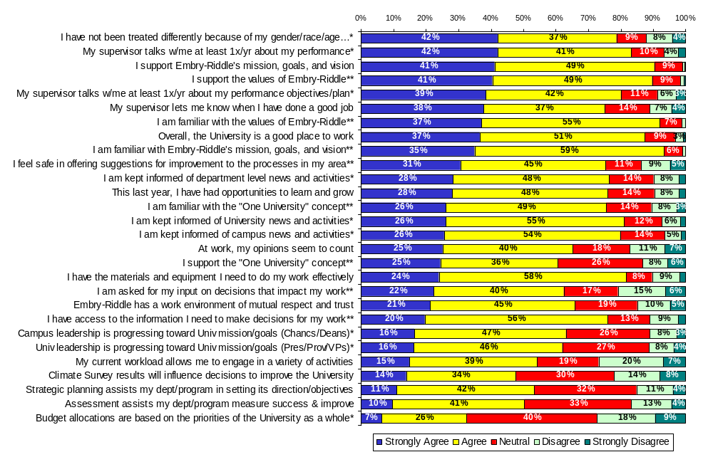
Chart 1: Spring 2005 Overall Results: “Agreement” Items
All Divisions Combined (n=1,021)
* Question was reworded in Spring 2005
** New Question in Spring 2005

Slide 8
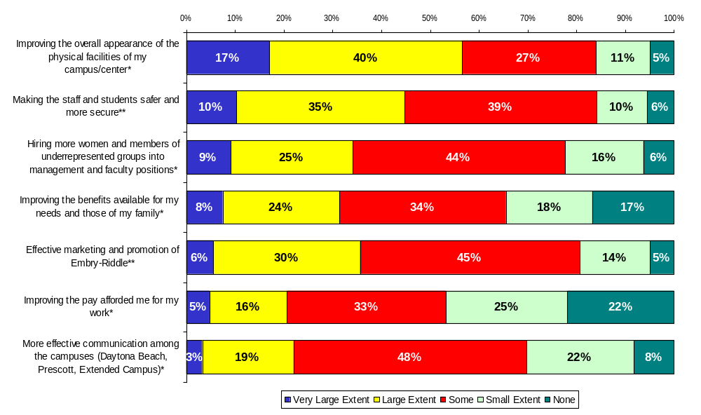
Chart 2: Spring 2005 Overall Results: “Progress” Items
All Divisions Combined (n=1,021)
“Indicate the Extent to Which You Feel Progress Has Been Made Toward…”
* Question and response options were reworded in Spring 2005
** New Question in Spring 2005

Slide 9
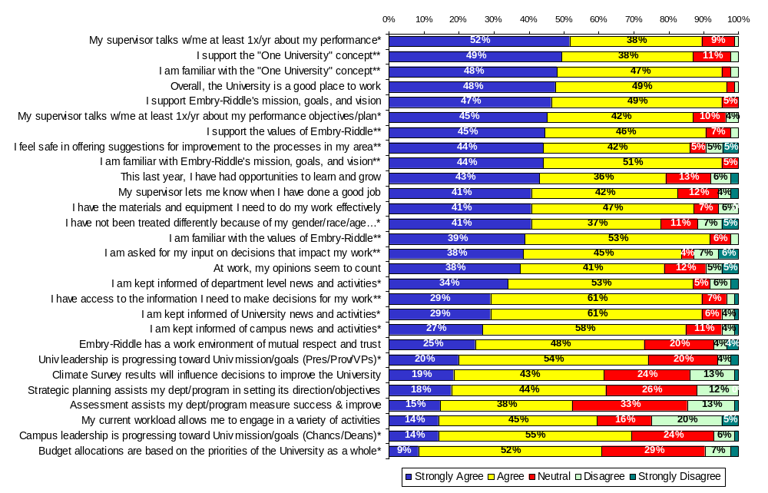
Chart 3: Spring 2005 Overall Results: “Agreement” Items
University Administration (n=86)
* Question was reworded in Spring 2005
** New Question in Spring 2005

Slide 10
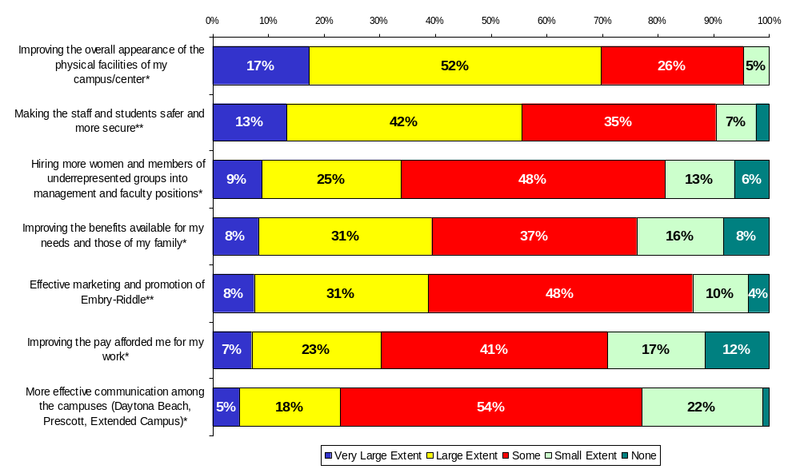
Chart 4: Spring 2005 Overall Results: “Progress” Items
University Administration (n=86)
“Indicate the Extent to Which You Feel Progress Has Been Made Toward…”
* Question and response options were reworded in Spring 2005
** New Question in Spring 2005

Slide 11
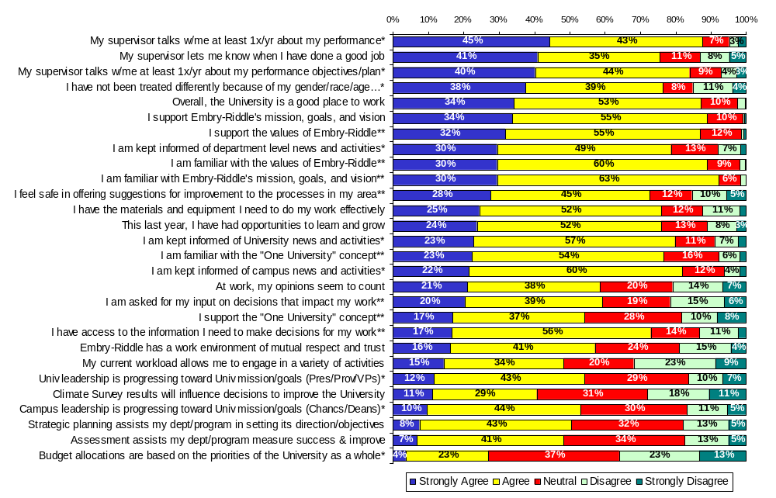
Chart 5: Spring 2005 Overall Results: “Agreement” Items
Daytona Beach Campus (n=372)
* Question was reworded in Spring 2005
** New Question in Spring 2005

Slide 12
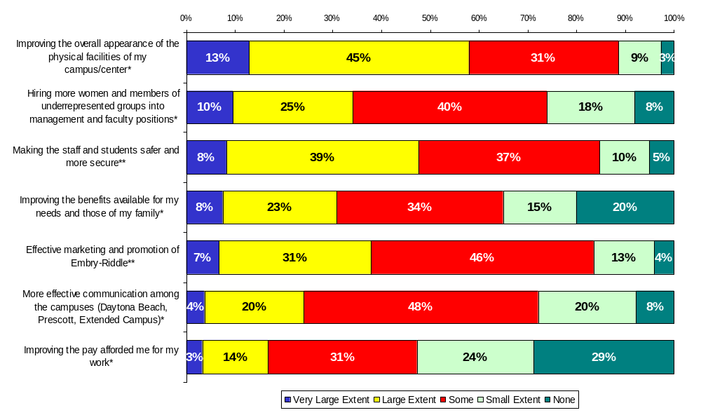
Chart 6: Spring 2005 Overall Results: “Progress” Items Daytona Beach Campus (n=372)
“Indicate the Extent to Which You Feel Progress Has Been Made Toward…”
* Question and response options were reworded in Spring 2005
** New Question in Spring 2005

Slide 13
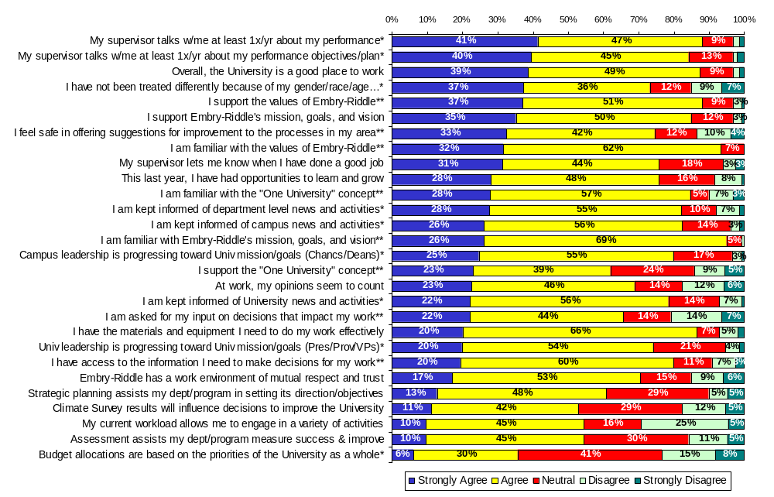
Chart 7: Spring 2005 Overall Results: “Agreement” Items Prescott Campus (n=155)
* Question was reworded in Spring 2005
** New Question in Spring 2005

Slide 14
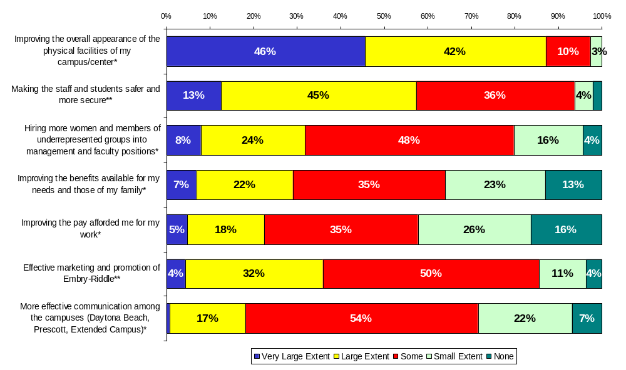
Chart 8: Spring 2005 Overall Results: “Progress” Items Prescott Campus (n=155)
“Indicate the Extent to Which You Feel Progress Has Been Made Toward…”
* Question and response options were reworded in Spring 2005
** New Question in Spring 2005

Slide 15
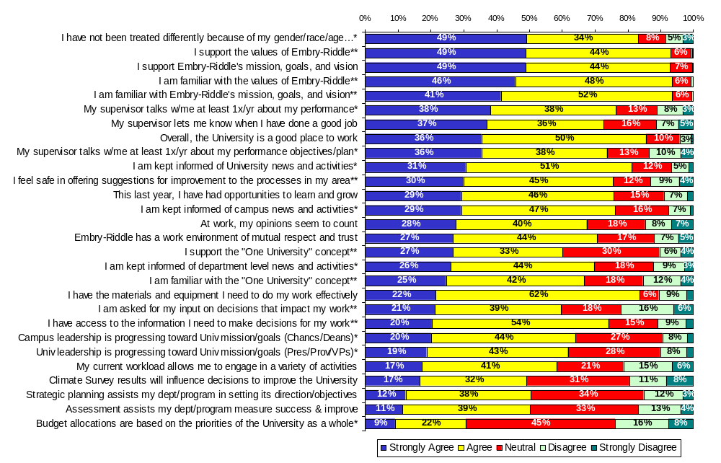
Chart 9: Spring 2005 Overall Results: “Agreement” Items Extended Campus (n=401)
* Question was reworded in Spring 2005
** New Question in Spring 2005

Slide 16
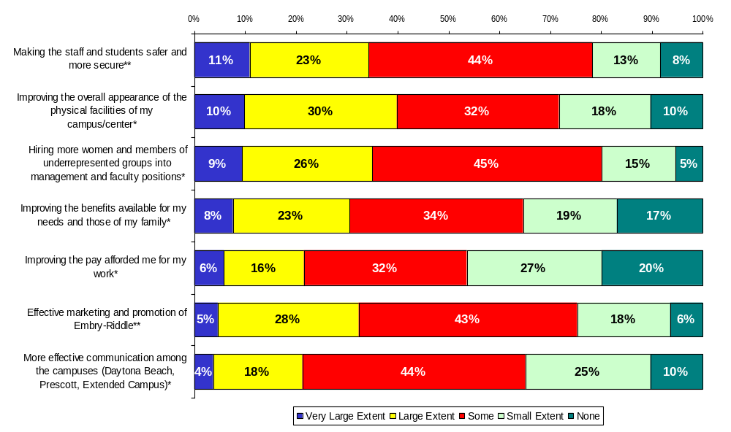
Chart 10: Spring 2005 Overall Results: “Progress” Items Extended Campus (n=401)
“Indicate the Extent to Which You Feel Progress Has Been Made Toward…”
* Question and response options were reworded in Spring 2005
** New Question in Spring 2005

Slide 17
Comparison to the Fall 2003 Survey
Ten charts follow -- two for all divisions combined, plus two charts per division (UA, DB, PC, EC):
  Only those questions that remained the same or were slightly reworded/expanded are shown.
  Sorted from “most improved” to “least improved” (based on the percent responding “strongly agree” or “agree”).
  Items for which a chi-square test of independence are significant (alpha=.05) are asterisked. This indicates that there is an association between the year of the survey administration and the response to that item (i.e. there is a significant difference in results between the two years).

Slide 18
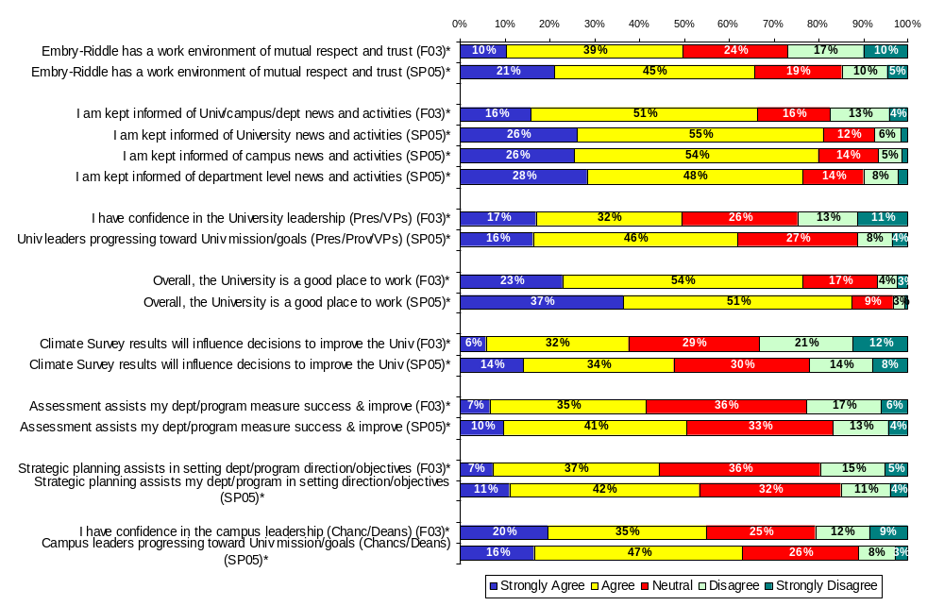
Chart 11: Fall 2003 vs. Spring 2005
All Divisions Combined (#1 of 2)
* Responses between F03 and SP05 are significantly different (alpha=.05).

Slide 19
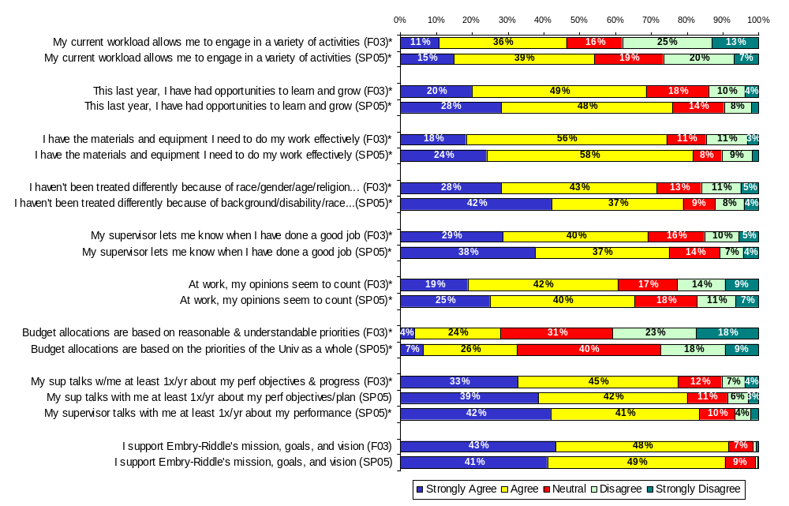
Chart 11 (cont’d): Fall 2003 vs. Spring 2005
All Divisions Combined (#2 of 2)
* Responses between F03 and SP05 are significantly different (alpha=.05).

Slide 20
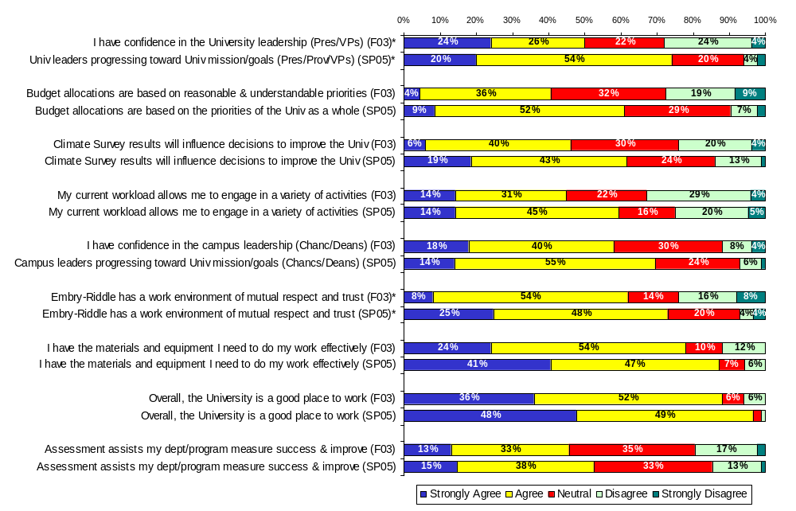
Chart 12: Fall 2003 vs. Spring 2005
University Administration (#1 of 2)
* Responses between F03 and SP05 are significantly different (alpha=.05).

Slide 21
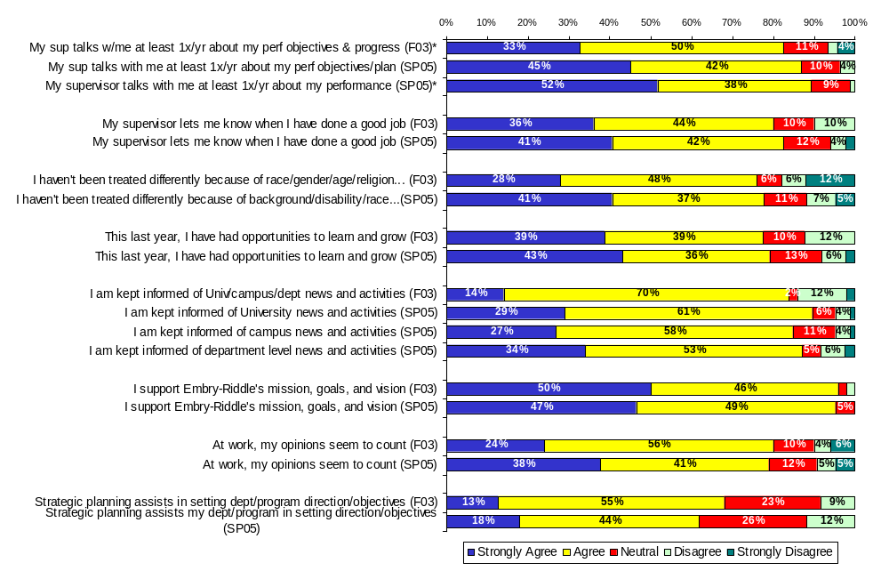
Chart 12 (cont’d): Fall 2003 vs. Spring 2005
University Administration (#2 of 2)
* Responses between F03 and SP05 are significantly different (alpha=.05).

Slide 22
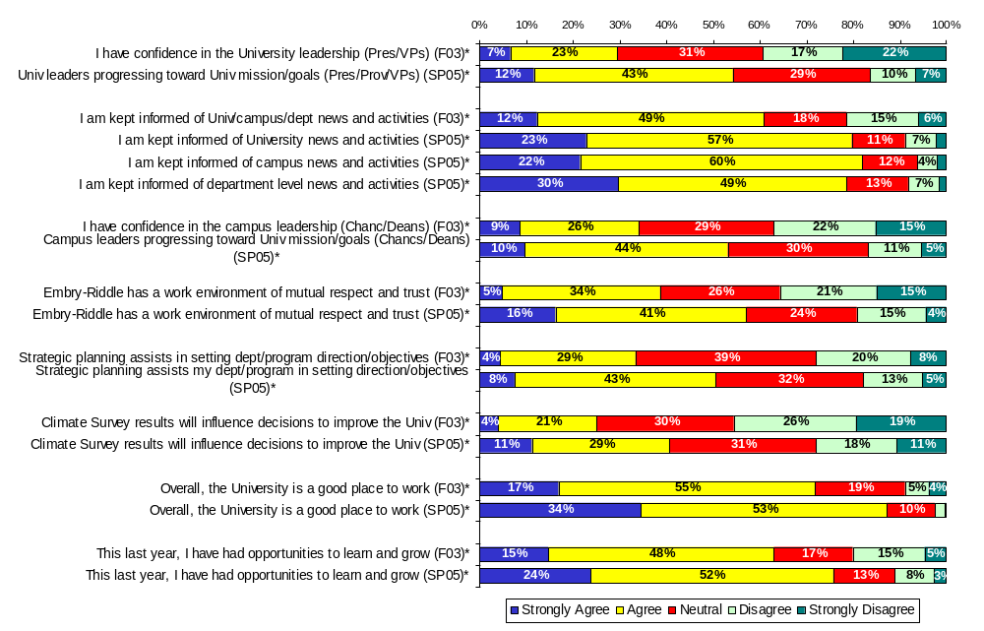
Chart 13: Fall 2003 vs. Spring 2005
Daytona Beach Campus (#1 of 2)
* Responses between F03 and SP05 are significantly different (alpha=.05).

Slide 23
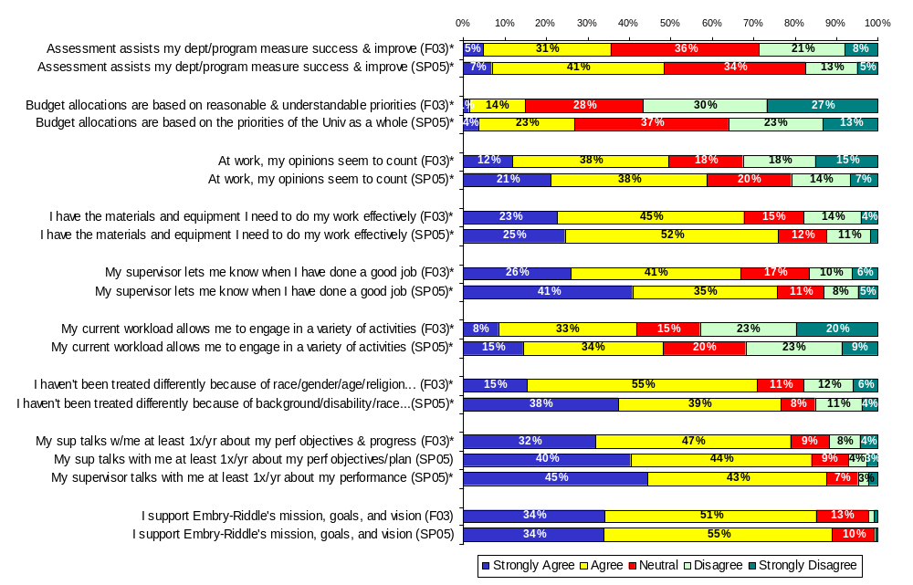
Chart 13 (cont’d): Fall 2003 vs. Spring 2005
Daytona Beach Campus (#2 of 2)
* Responses between F03 and SP05 are significantly different (alpha=.05).

Slide 24
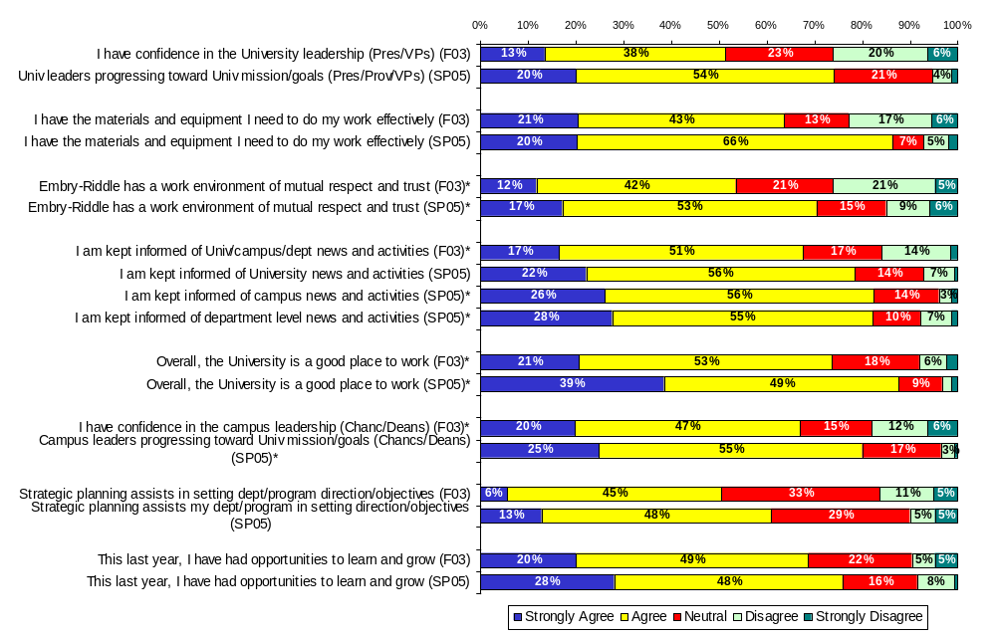
Chart 14: Fall 2003 vs. Spring 2005
Prescott Campus (#1 of 2)
* Responses between F03 and SP05 are significantly different (alpha=.05).

Slide 25
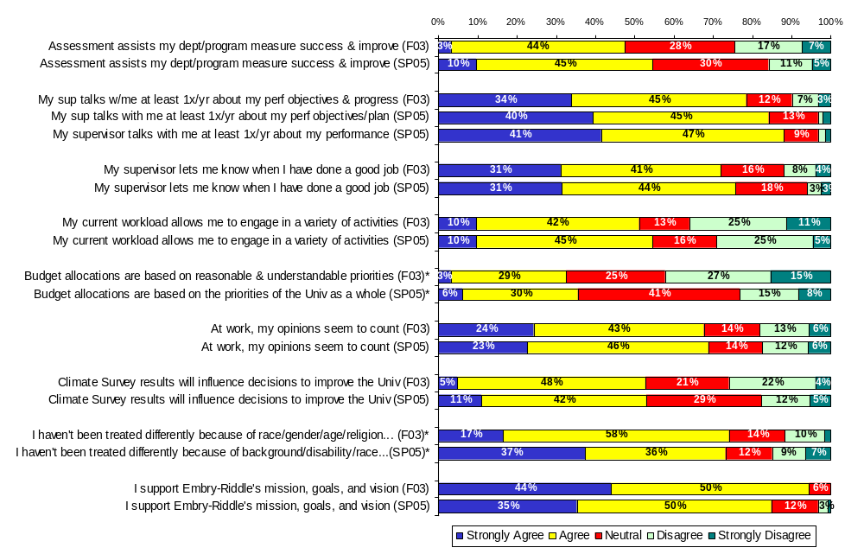
Chart 14 (cont’d): Fall 2003 vs. Spring 2005
Prescott Campus (#2 of 2)
* Responses between F03 and SP05 are significantly different (alpha=.05).

Slide 26
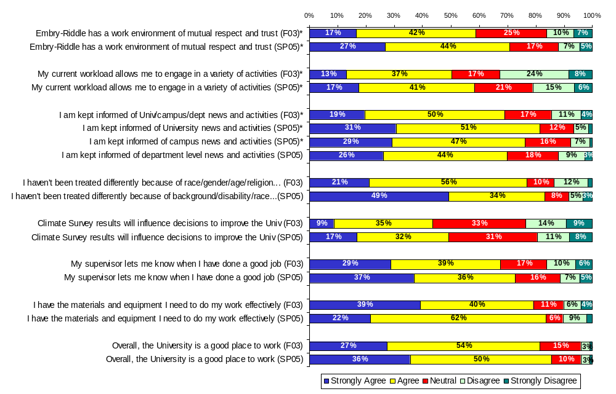
Chart 15: Fall 2003 vs. Spring 2005
Extended Campus (#1 of 2)
* Responses between F03 and SP05 are significantly different (alpha=.05).

Slide 27
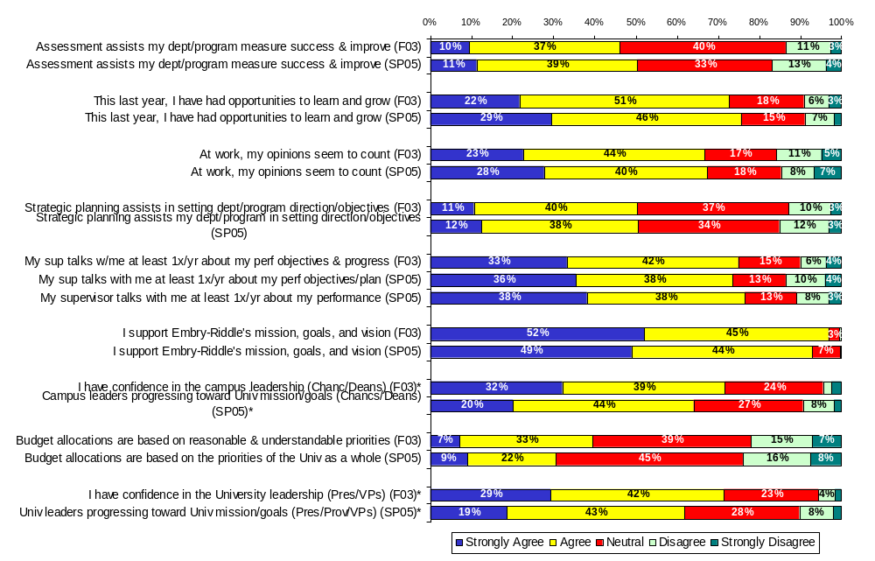
Chart 15 (cont’d): Fall 2003 vs. Spring 2005
Extended Campus (#2 of 2)
* Responses between F03 and SP05 are significantly different (alpha=.05).

Slide 28
Additional Breakouts Available in Separate Addenda
Charts displaying each question, broken out by respondent characteristics (division, location, gender, faculty vs. staff, f/t vs. p/t, and supervisory vs. non-supervisory). Includes comparisons to prior survey results.
Data Tables
Survey Instrument
Note: The comments section is not included in the posted report. Instead, individual feedback will be given as appropriate.

