Slide 1
ERAU Faculty & Staff Climate Survey
Spring 2006
Results by Gender
Human Resources
Office of Institutional Research
April 2006

Slide 2
Background
Web-based instrument:
  31 “agreement” items, 7 “progress” items, 6 demographic items, 5 open-ended comment boxes after each section (Your Job, The ERAU Organization, The ERAU Environment, University Progress, Other)
    5-point agreement scale: Strongly Agree to Strongly Disagree
    5-point progress scale: Very Good to Very Poor
Survey accessible from 02/21/06 – 03/07/06
  2 email announcements:
    Survey has begun, 02/21/06
    Reminder survey is about to end, 02/28/06
  All employees urged to participate (regardless of status, location, etc.)

Slide 3
Changes to this version:
  Some questions reworded/added/deleted (as noted on the charts that follow)
    Added 17 new questions
    Deleted 7 questions
    Reworded/expanded 2 questions

Slide 4
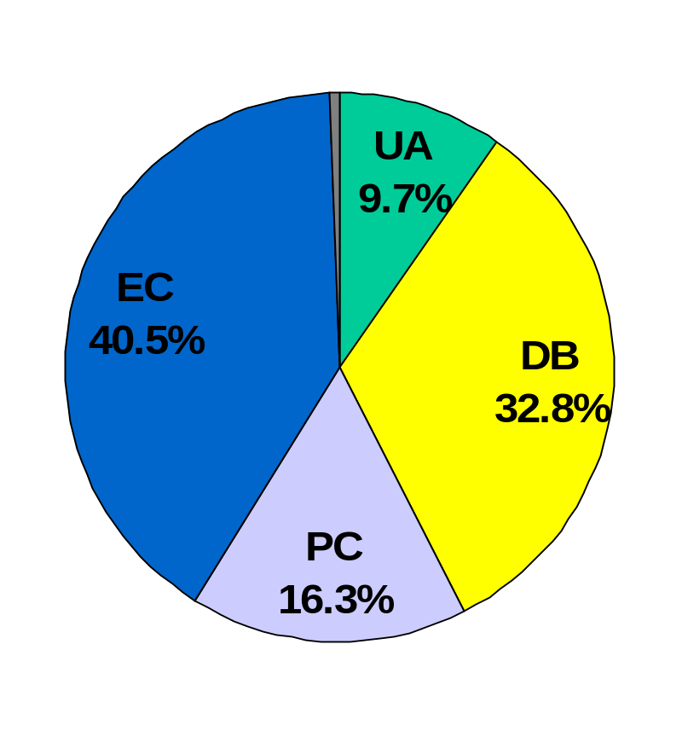
Who Responded?
Grand Total = 962
By Division (with estimated response rates):
  University Administration:
    93 (30% response rate)
  Daytona Beach Campus:
    316 (38% response rate)
  Prescott Campus:
    157 (44% response rate)
  Extended Campus:
    390 (31% response rate)
  Not Indicated: 6

Slide 5
Trend Results: By Gender
38 charts follow, one per question, with 21 charts displaying the side-by-side comparisons of Spring 2002, Fall 2002, Fall 2003, Spring 2005 and Spring 2006 data (when available) and 17 charts only displaying data from Spring 2006 (new questions).
Each chart displays the percent response for each category to each of the 38 opinion questions
  5-point agreement scale: Strongly Agree to Strongly Disagree
  5-point progress scale: Very Good to Very Poor
See data tables for breakouts within campus division
Spring 2002 survey did not include a breakout response choice for university administration. Shown on the following charts is UA/DB SP2002 as comparison for UA FA2002, UA FA2003, DB FA2002 and DB FA2003. UA/DB SP2002 is comprised mostly of DB.

Slide 6
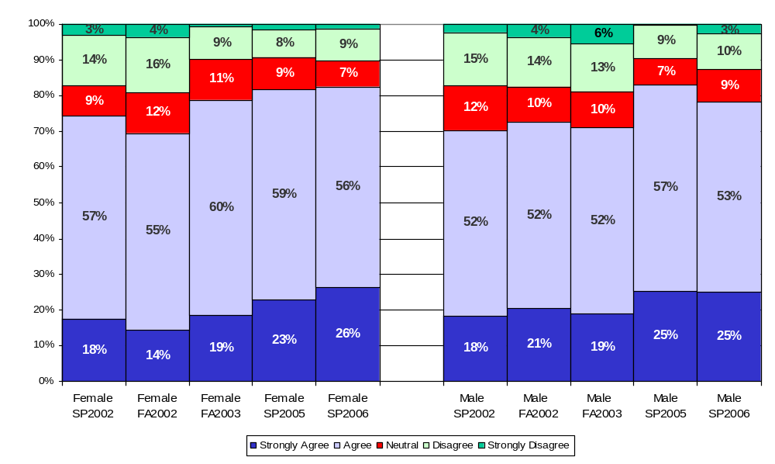
I have the materials and equipment to do my work effectively*
*Question was reworded in FA2003; FA2002 read as “to do my work right”.

Slide 7
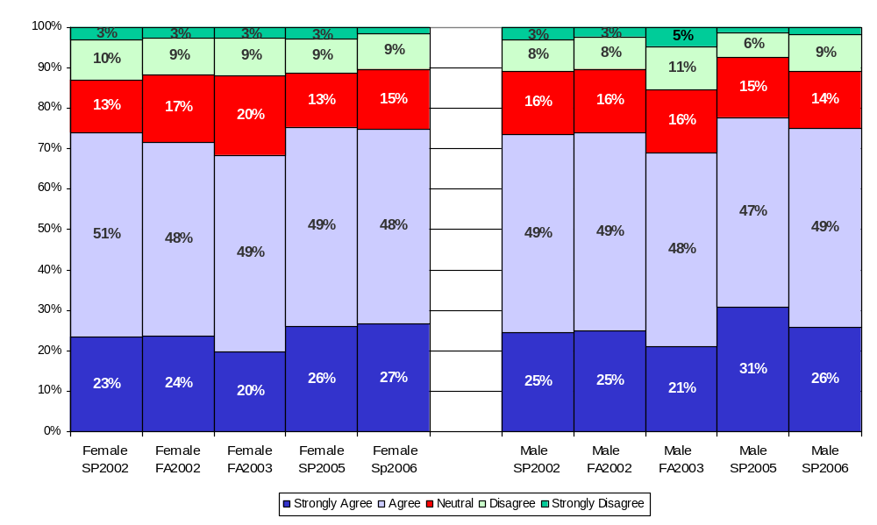
This last year, I have had opportunities to learn and grow either at work or through professional development activities

Slide 8
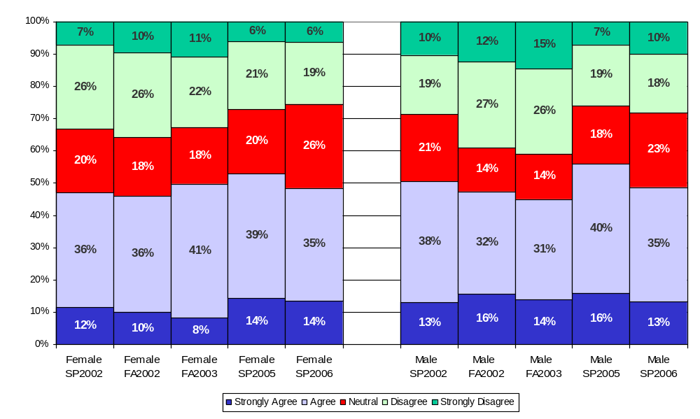
My current workload allows me to engage in a variety of activities*
*Question was reworded in SP2006; SP2005 read as “…activities, as appropriate to my position”.

Slide 9
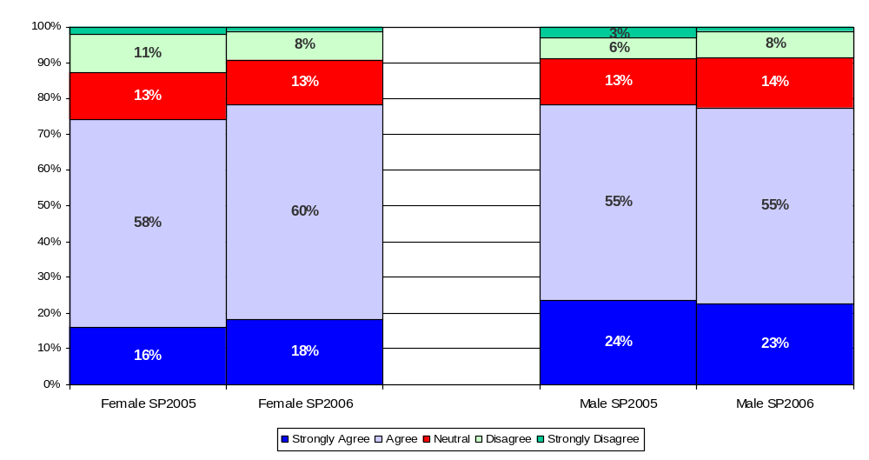
I have access to the information I need to make decisions for my work

Slide 10
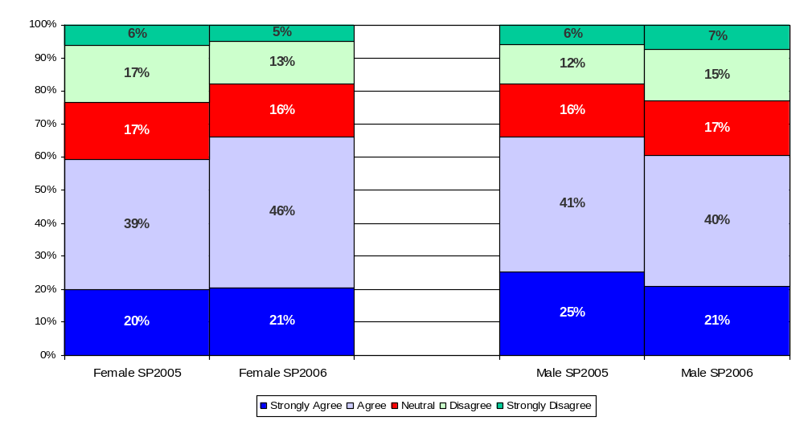
I am asked for my input on decisions that impact my work

Slide 11
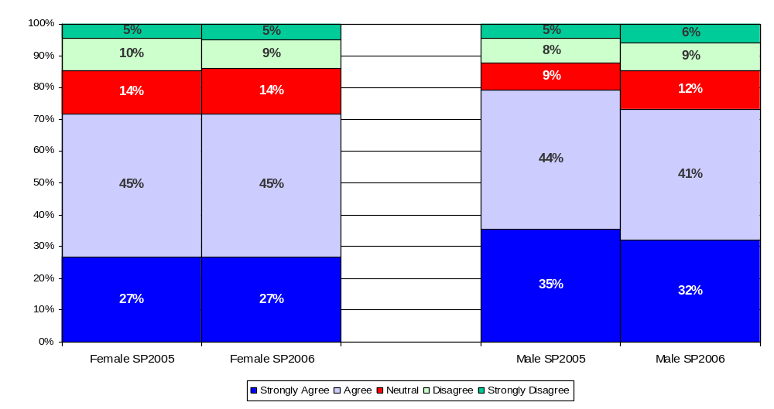
I feel safe in offering suggestions for improvement to the processes in my area

Slide 12
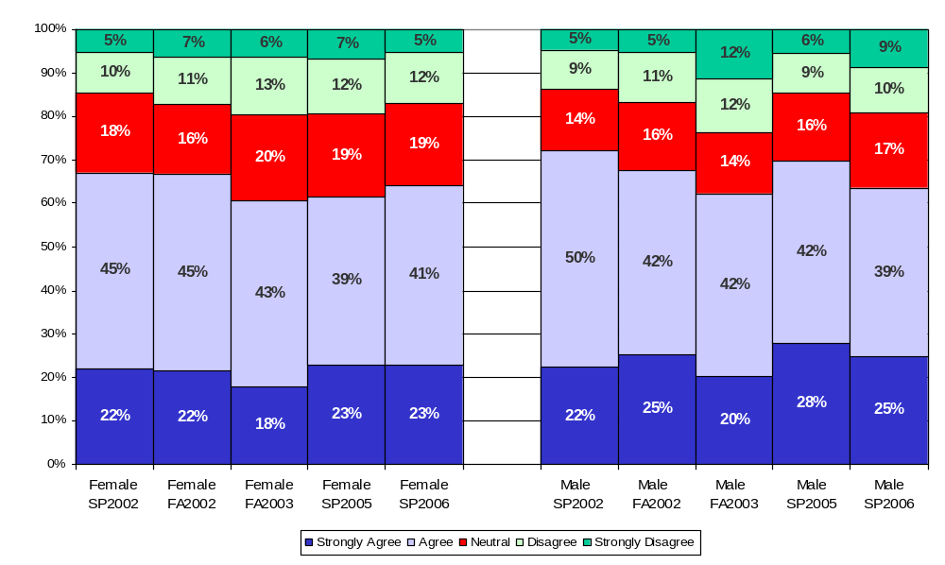
At work, my opinions seem to count

Slide 13
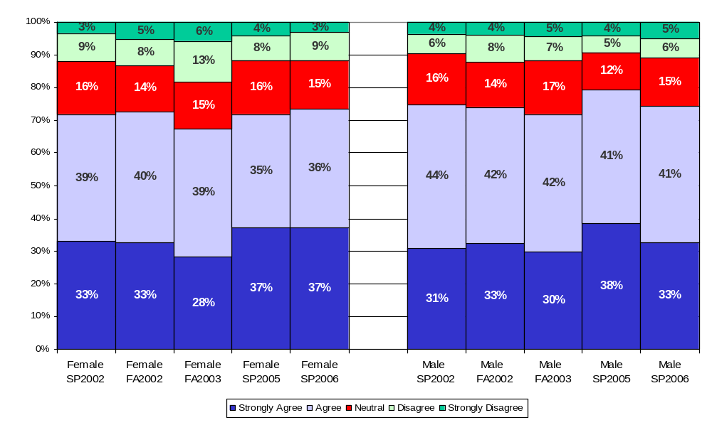
My direct supervisor lets me know when I have done a good job

Slide 14
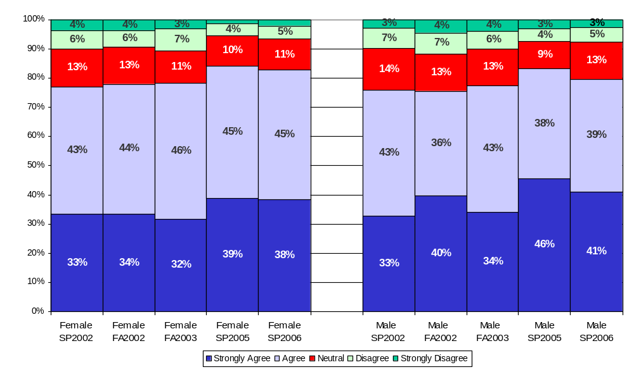
My direct supervisor talks with me at least once a year about my performance*
*Reworded. FA03 version = “…year about my performance objectives and progress”.
SP02-F02 version = “…year about my objectives and progress”.

Slide 15
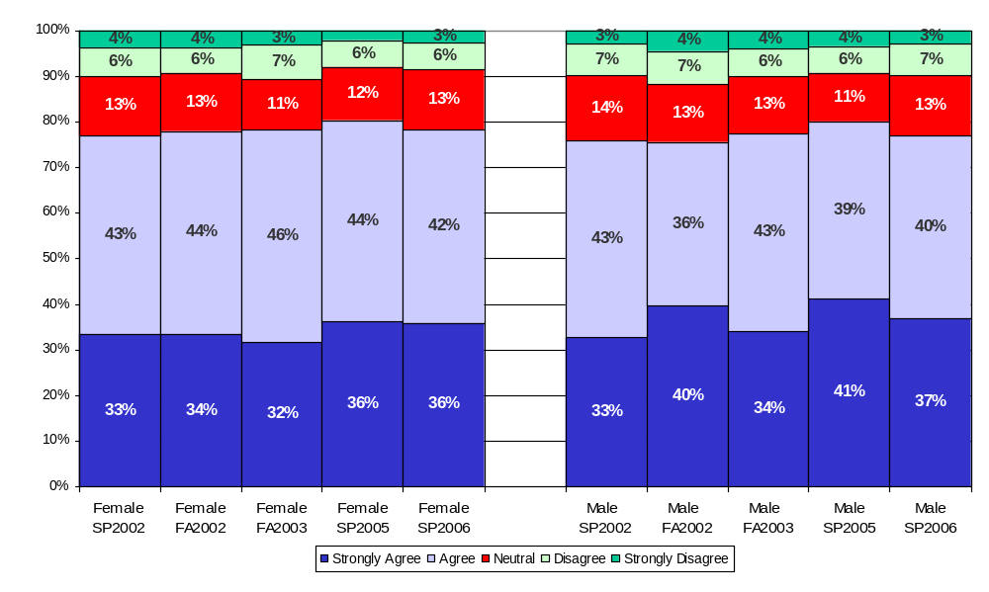
My direct supervisor talks with me at least once a year about my performance objectives/plan*
*Reworded. FA03 version = “…year about my performance objectives and progress”.
SP02-F02 version = “…year about my objectives and progress”.

Slide 16
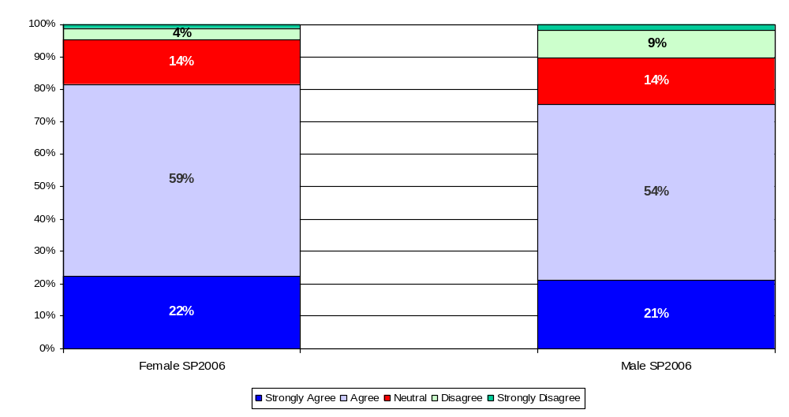
Embry-Riddle’s mission, goals, and vision have been clearly communicated to me

Slide 17
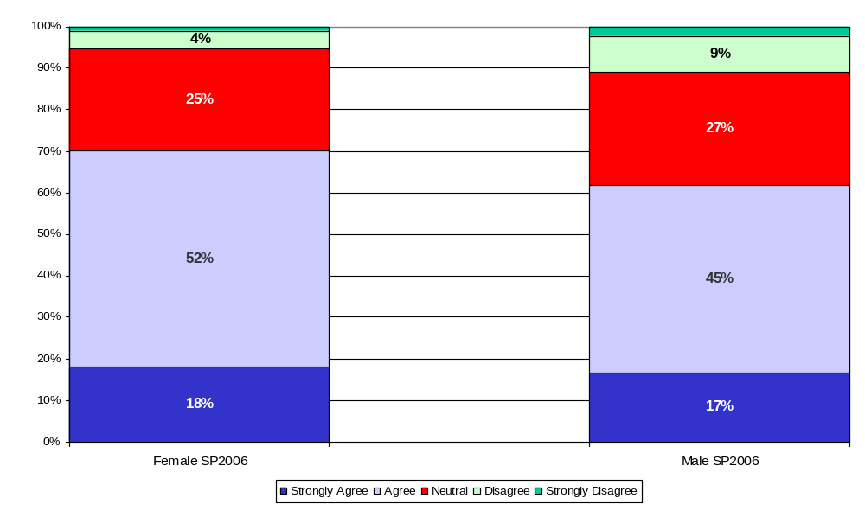
I believe Embry-Riddle’s missions, goals, and vision are the right ones for the organization at the current time

Slide 18
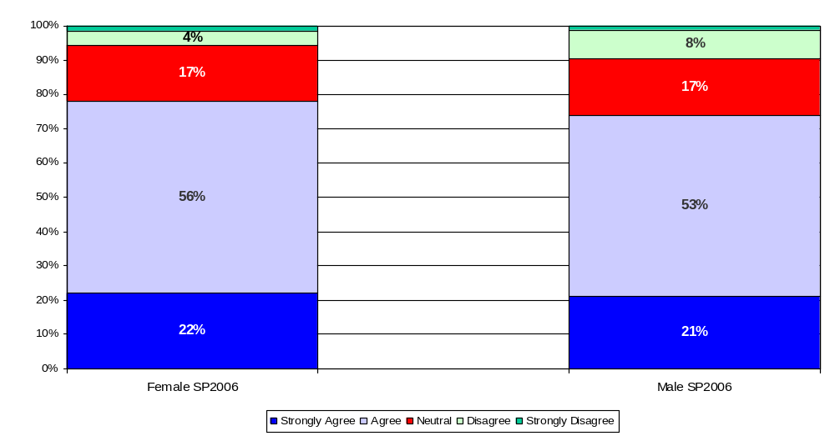
Embry-Riddle’s values have been clearly communicated to me

Slide 19
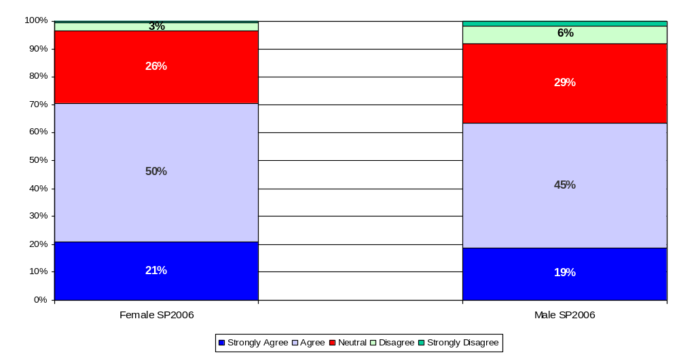
I believe Embry-Riddle’s values are the right ones for the organization at the current time

Slide 20
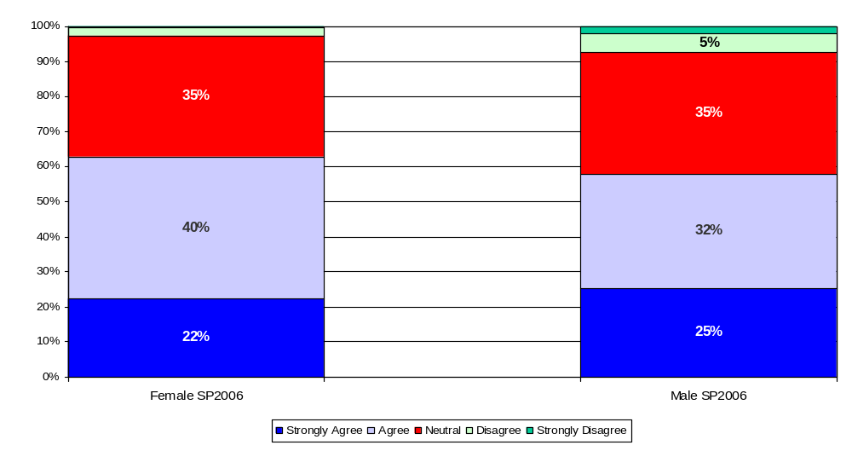
I believe the Interim President is making progress toward the University mission and goals

Slide 21
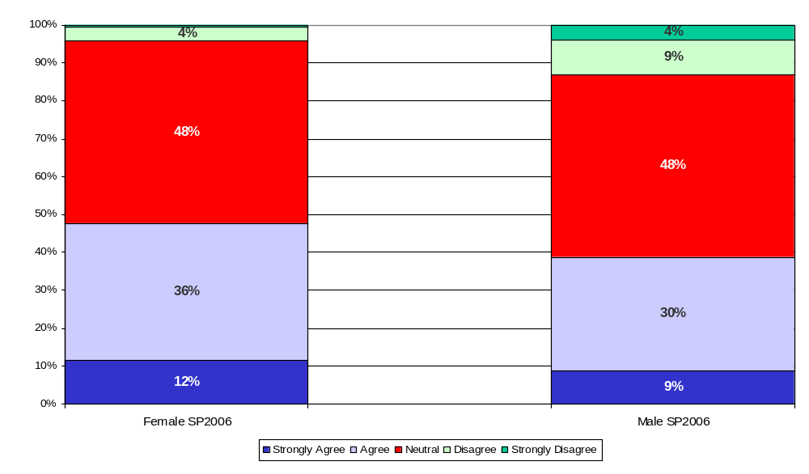
I believe the Vice Presidents are making progress toward the University mission and goals

Slide 22
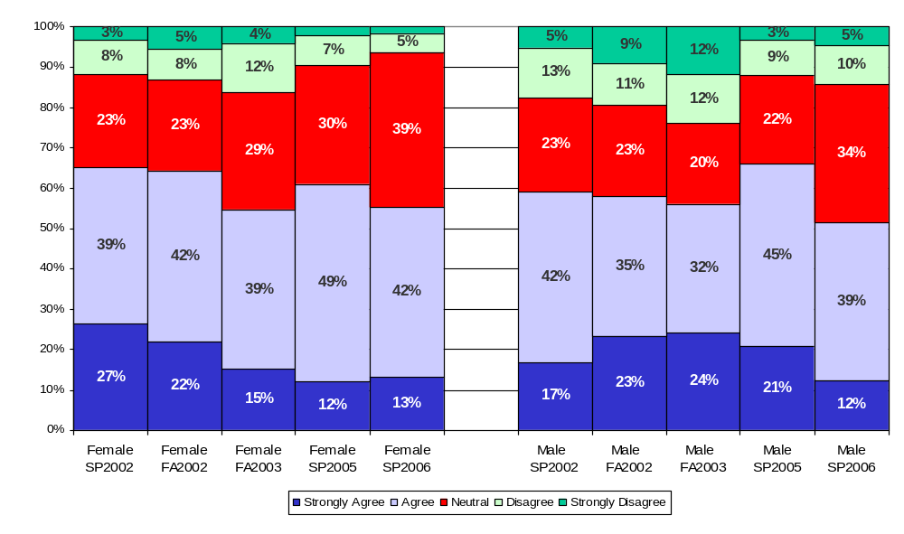
I believe campus leadership is making progress toward University mission and goals
(EC and PC: Chancellors, College Deans)* (DB: College Deans only)
*Reworded. SP05 version = “…University mission and goals (Chancellors, College Deans)”.
FA02-FA03 version = “I have confidence in the campus leadership (Chancellors, College Deans)”.
SP02 version = “I have confidence in the University leadership (President, Vice Presidents, Chancellors)”.

Slide 23
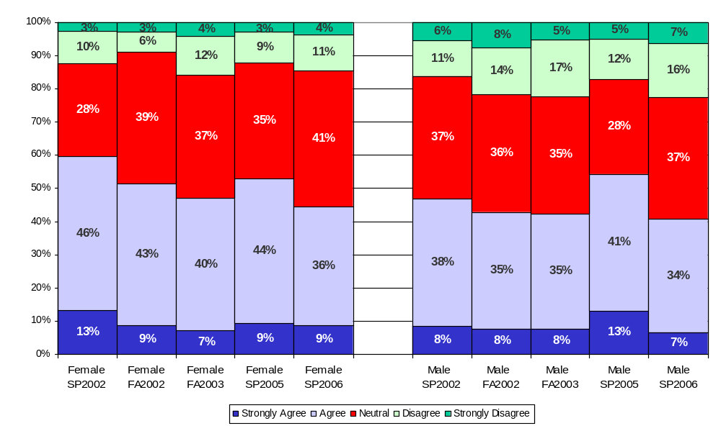
Strategic planning assists in setting my department/program’s direction and objectives

Slide 24
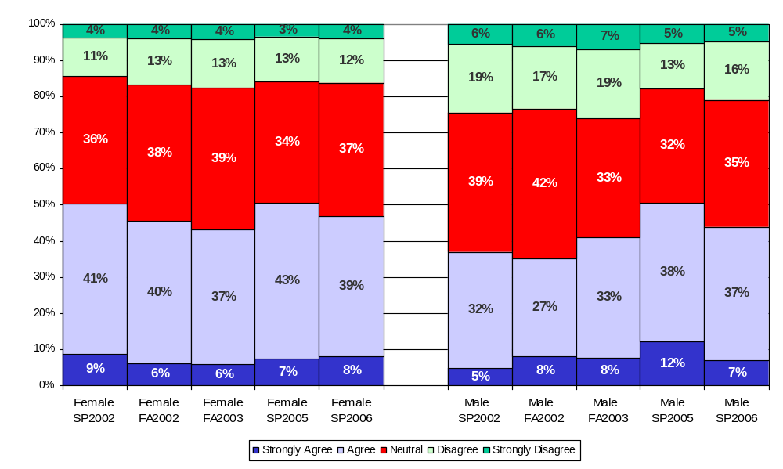
Assessment activities assist my department/program in measuring its success and identifying potential areas for improvement

Slide 25
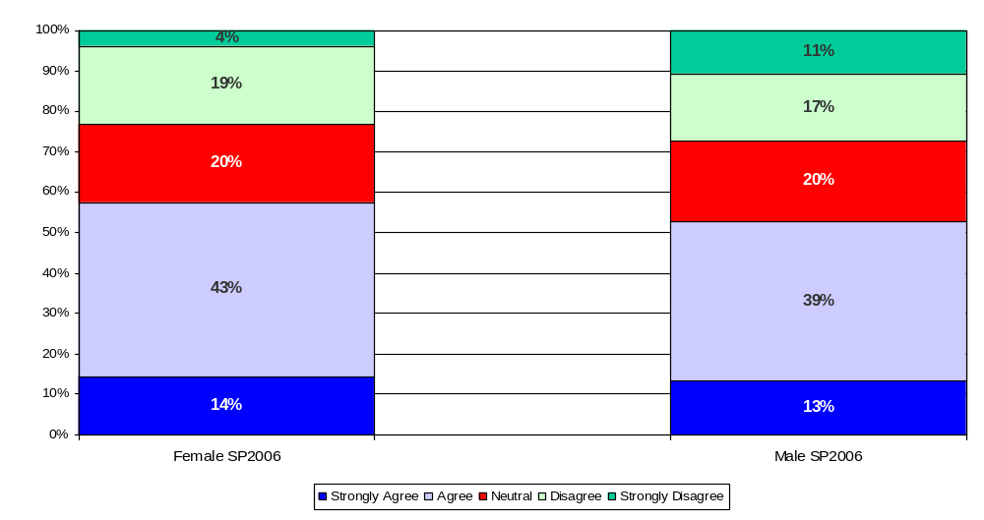
The “One University” concept has been clearly communicated to me

Slide 26
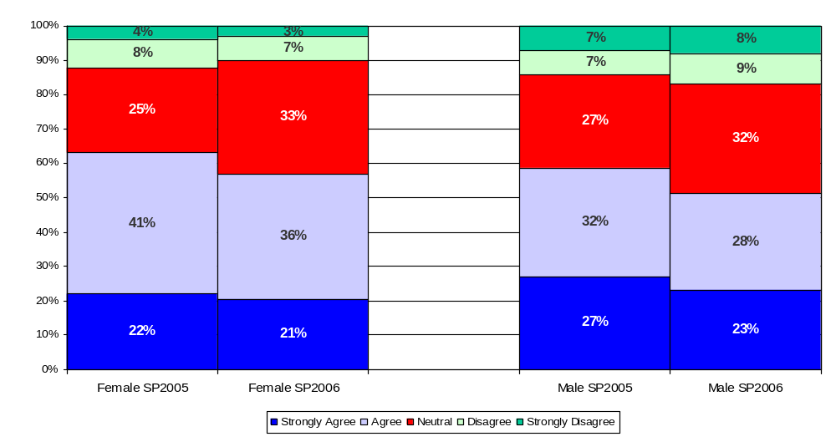
I support the “One University” concept

Slide 27
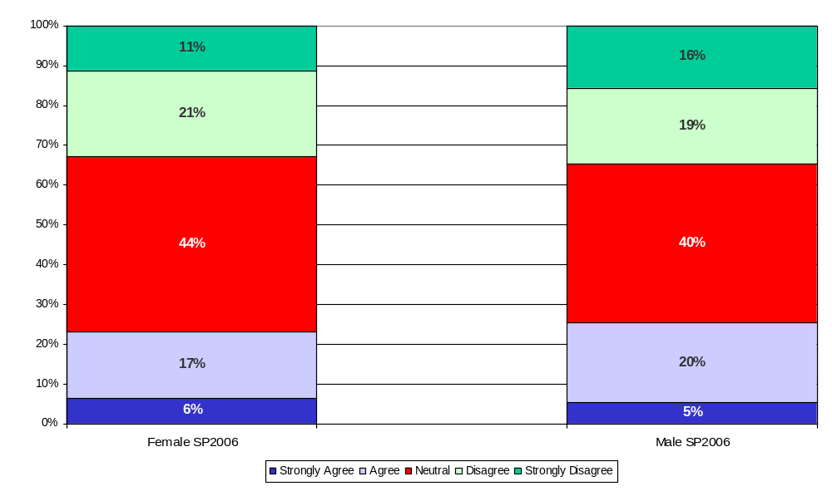
Appropriate consideration is given to all campuses when University budget allocations are made

Slide 28
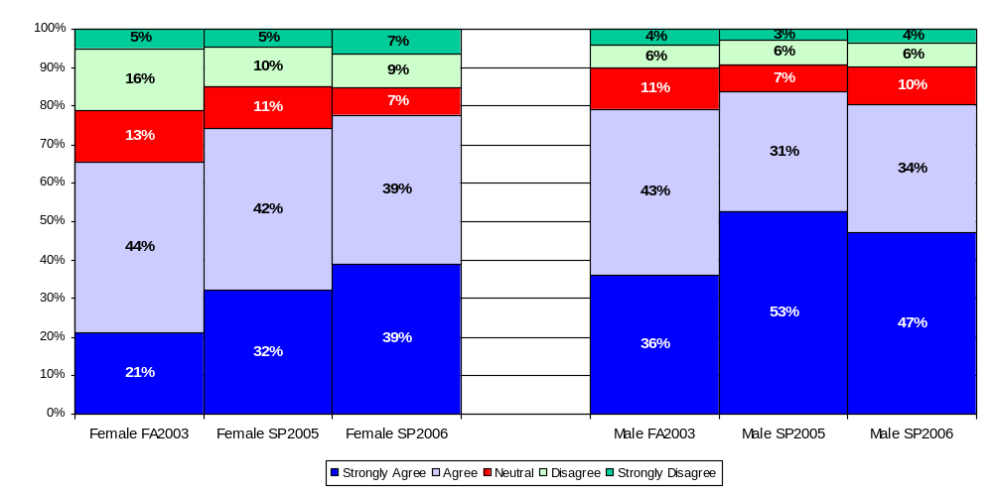
I have not been treated differently because of my race, ethnicity, national origin, age, physical disability, economic background, sexual orientation, or religious belief*
*Reworded. FA03 version = “I have not been treated differently because of my race, gender, sexual orientation, age, or religion”.

Slide 29
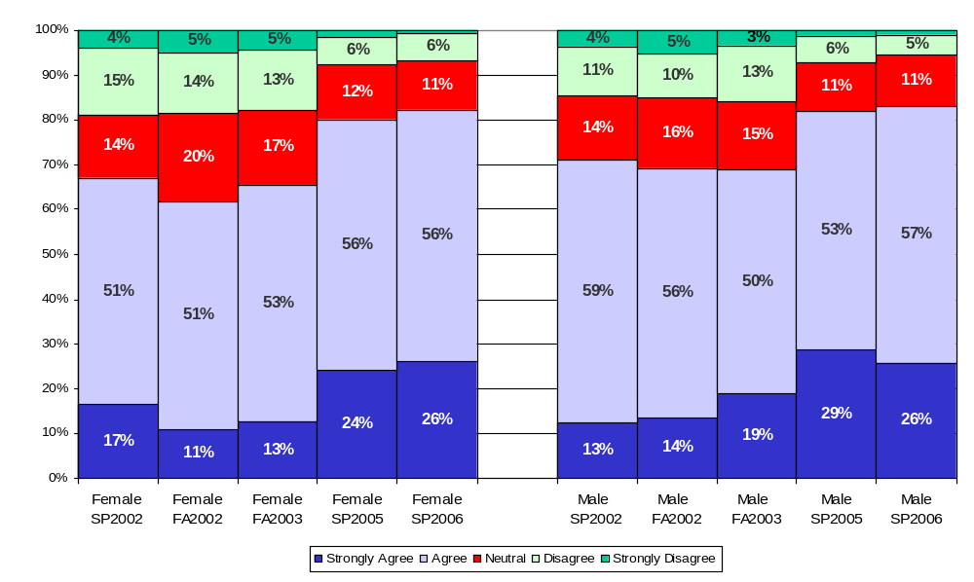
I am kept informed of University news and activities*
*Reworded. SP02-FA03 version = “I am kept informed of University, campus, and department level news and
activities that are pertinent to my work”.

Slide 30
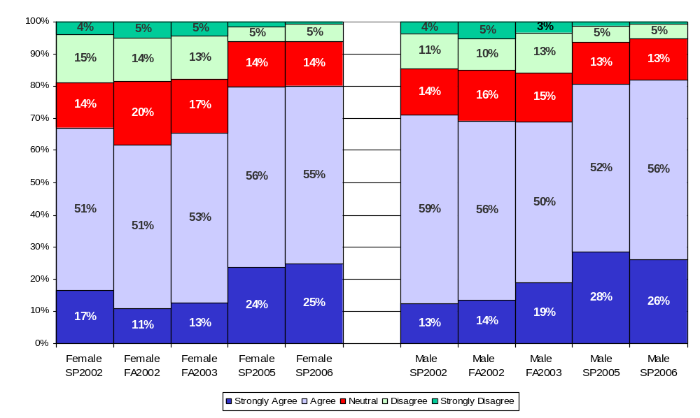
I am kept informed of campus news and activities*
*Reworded. SP02-FA03 version = “I am kept informed of University, campus, and department level news and
activities that are pertinent to my work”.

Slide 31
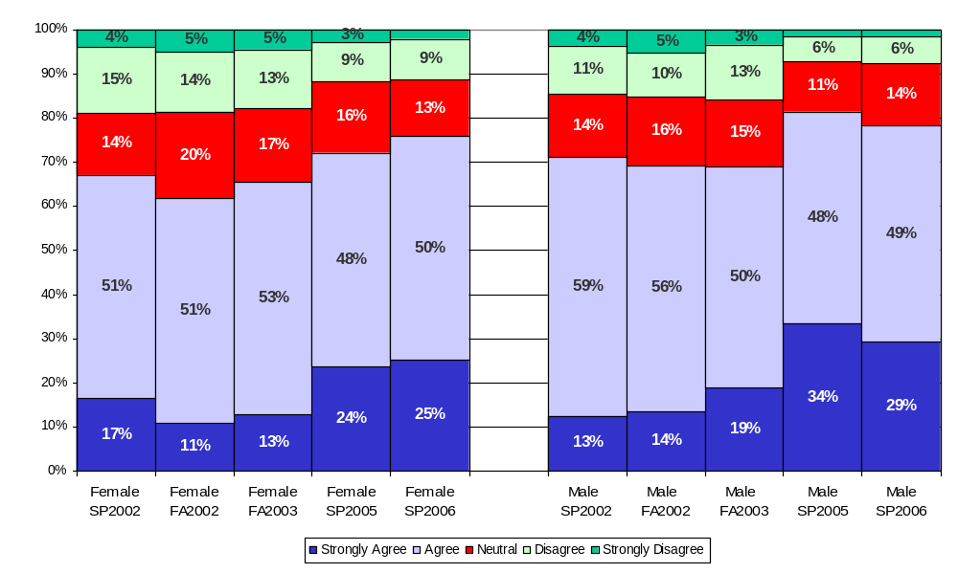
I am kept informed of department level news and activities*
*Reworded. SP02-FA03 version = “I am kept informed of University, campus, and department level news and
activities that are pertinent to my work”.

Slide 32
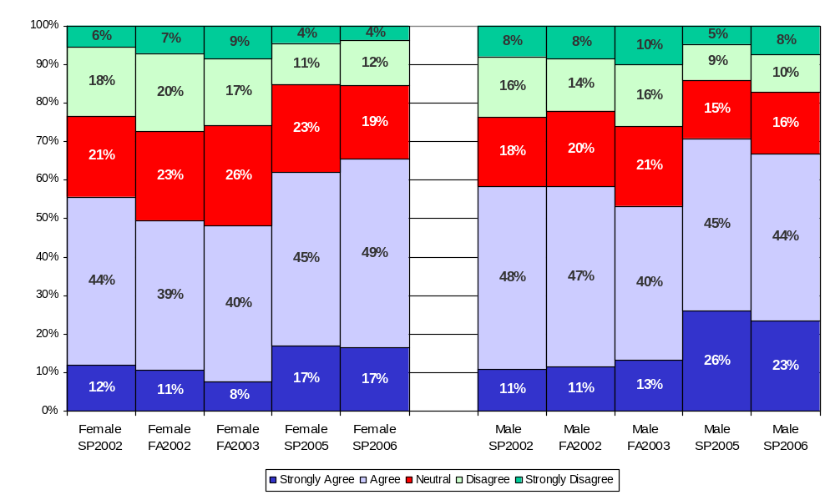
Embry-Riddle has a work environment of mutual respect and trust

Slide 33
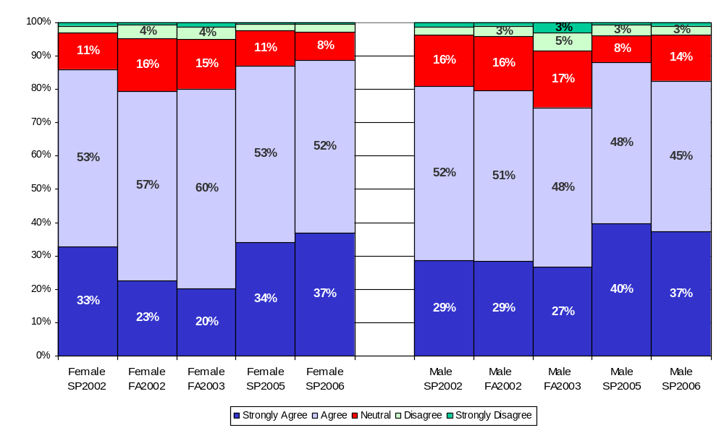
Overall, the University is a good place to work

Slide 34
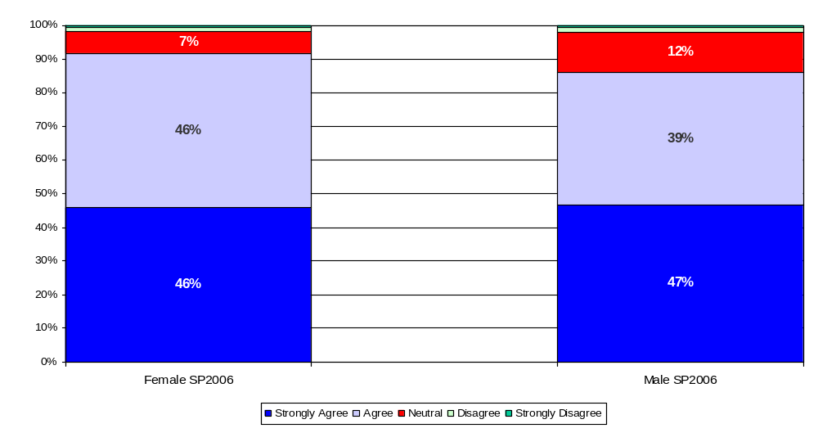
I am proud to be associated with the University

Slide 35
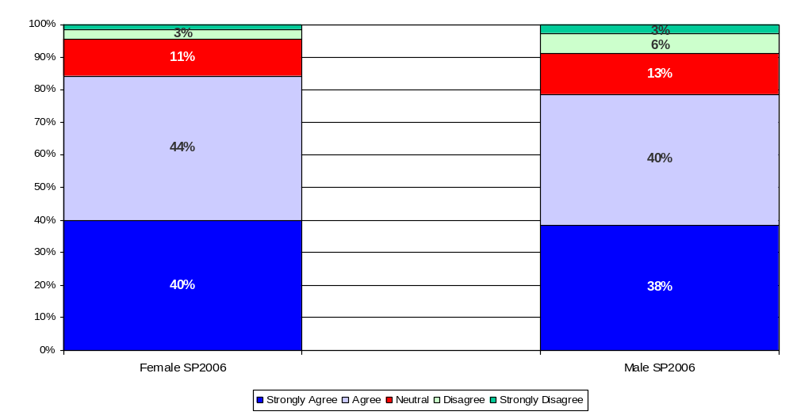
I would recommend the University to family and friends as a place to work

Slide 36
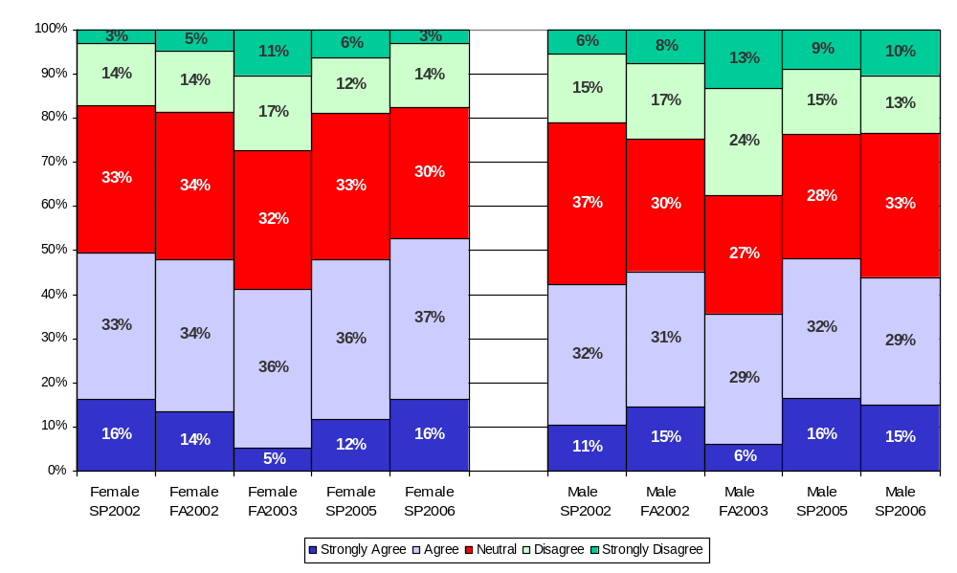
I believe that Climate Survey results will influence decisions to improve the University

Slide 37
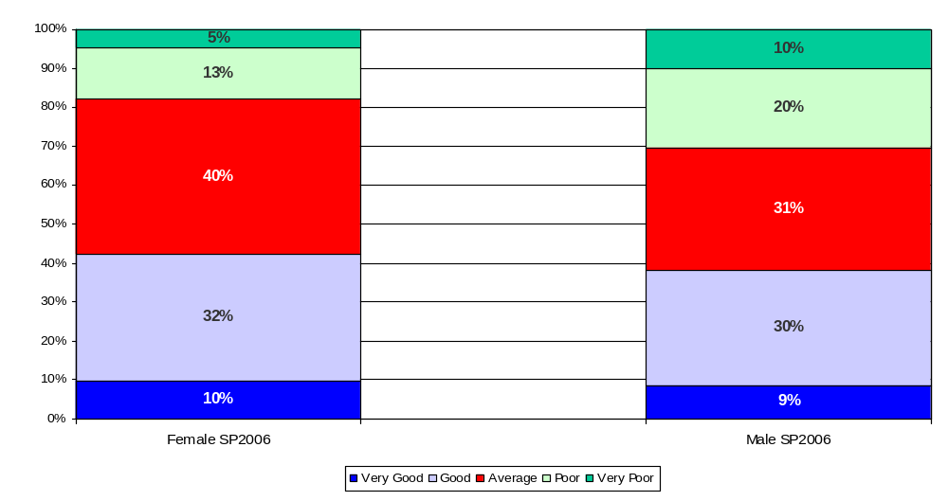
Marketing and promotion of Embry-Riddle

Slide 38
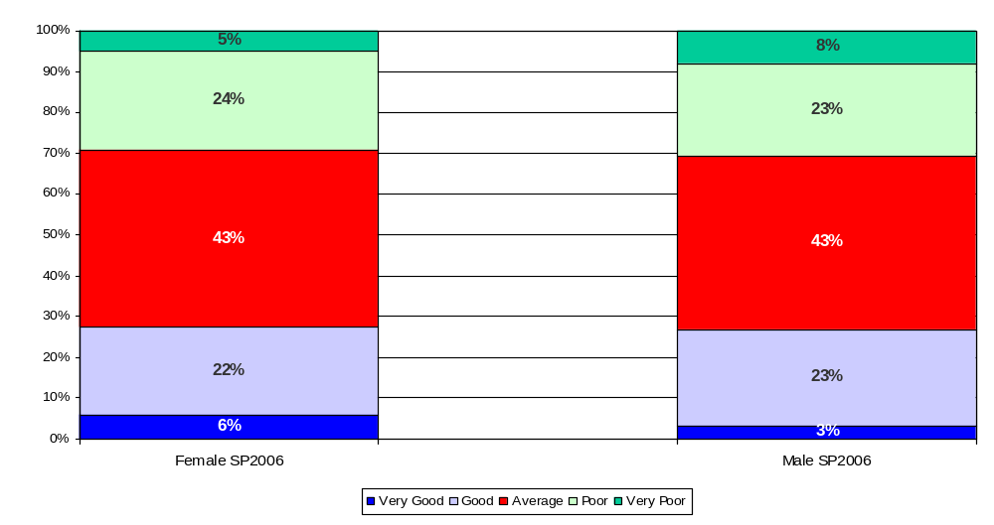
Communication among the campuses

Slide 39
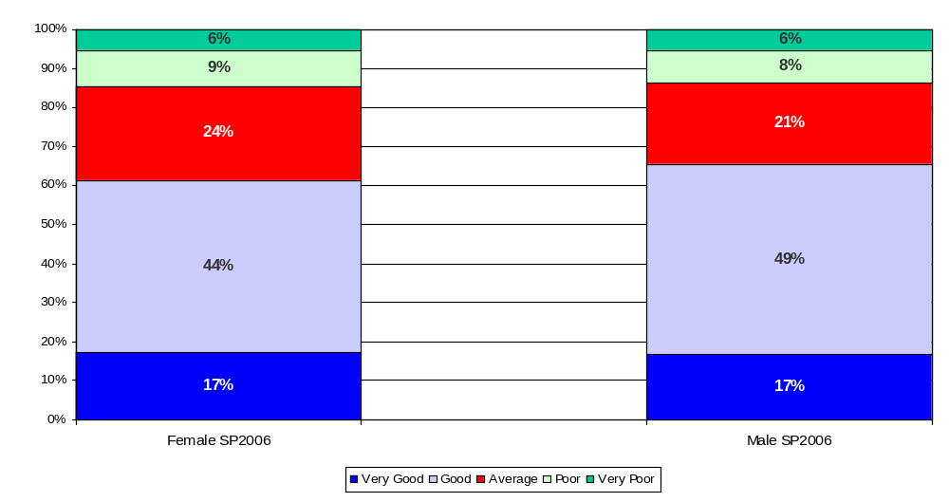
Overall appearance of the physical facilities of my campus/center

Slide 40
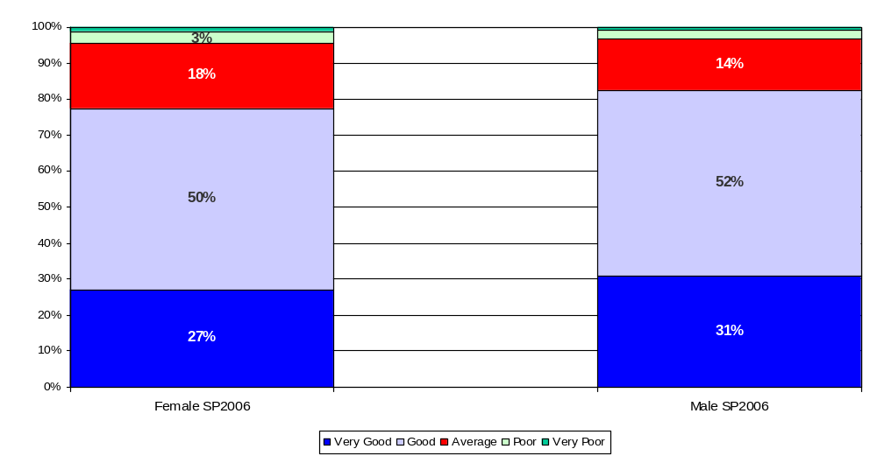
Providing a safe and secure environment for staff and students

Slide 41
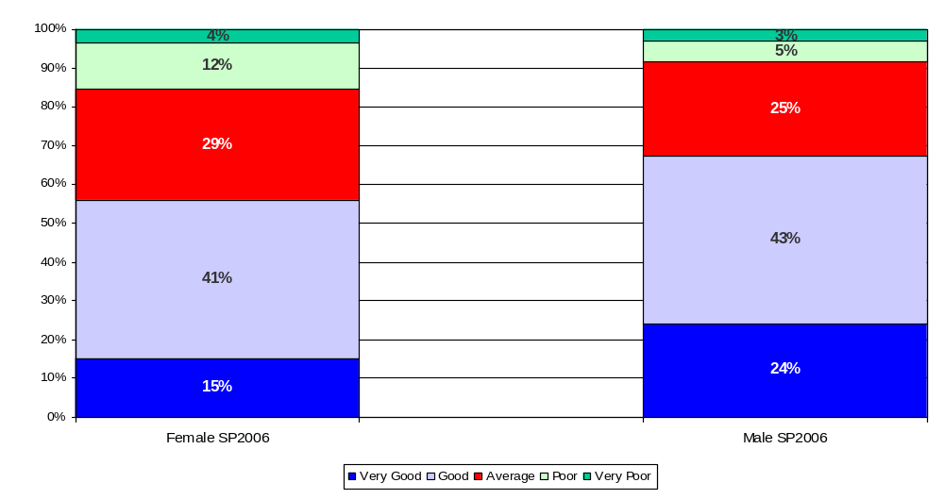
Hiring women and other members of underrepresented groups into management and faculty positions

Slide 42
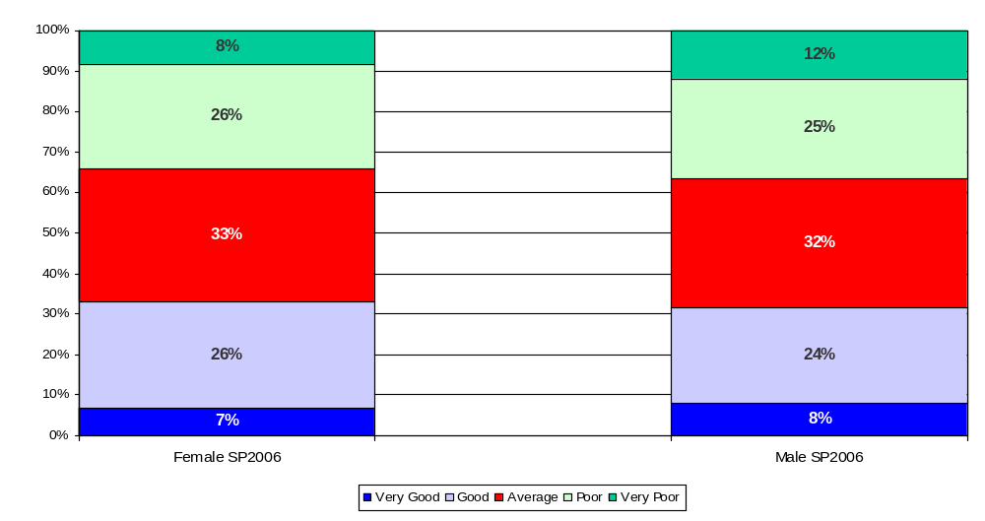
The pay afforded me for my work

Slide 43
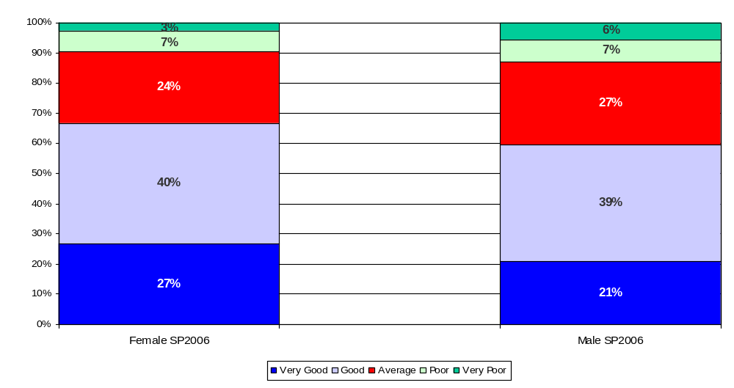
The benefits available for my needs and those of my family

