Slide 1
ERAU Faculty & Staff Climate Survey
Spring 2007
Results by Position
Human Resources
Office of Institutional Research
March 2007

Slide 2
Background
Web-based instrument:
  29 “agreement” items, 7 “rating” items, 6 demographic items, 1 open-ended comment box
    5-point agreement scale: Strongly Agree to Strongly Disagree
    5-point rating scale: Very Good to Very Poor
Survey accessible from 02/06/07 – 02/20/07
  2 email announcements:
    Survey has begun, 02/06/07
    Reminder survey is about to end, 02/13/07
  All employees urged to participate (regardless of status, location, etc.)

Slide 3
Changes to this version:
  Some questions reworded/added/deleted (as noted on the charts that follow)
    Added 1 new question
    Deleted 3 questions
    Reworded 2 questions

Slide 4
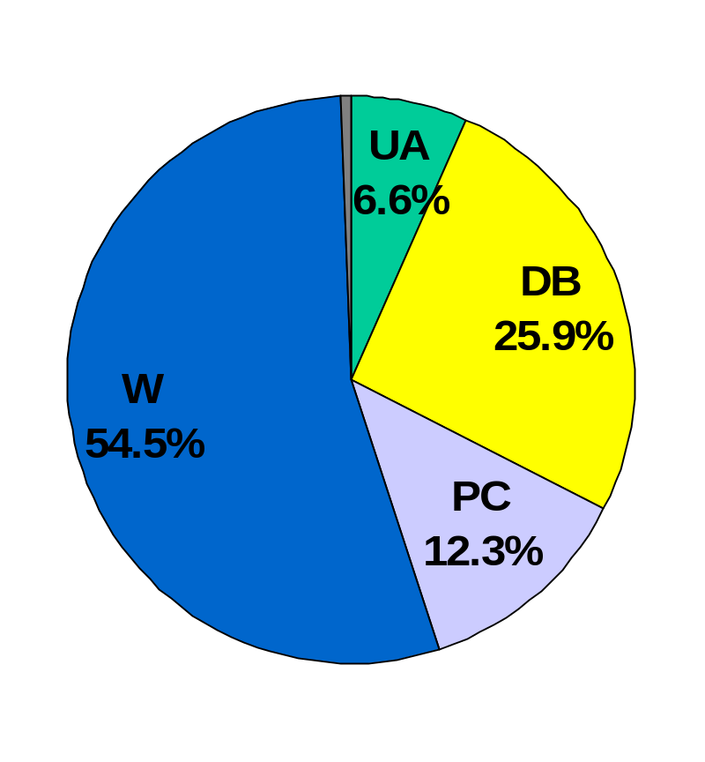
Who Responded?
Grand Total = 1176
By Division (with estimated response rates):
  University Administration:
    78 (28% response rate)
  Daytona Beach Campus:
    305 (34% response rate)
  Prescott Campus:
    145 (37% response rate)
  Worldwide Campus:
    641 (65% response rate)
  Not Indicated: 7

Slide 5
Trend Results: By Position
36 charts follow, one per question, with 35 charts displaying the side-by-side comparisons of Fall 2002, Fall 2003, Spring 2005, Spring 2006 and Spring 2007 data (when available) and 1 chart only displaying data from Spring 2007 (new question).
Each chart displays the percent response for each category to each of the 36 opinion questions
  5-point agreement scale: Strongly Agree to Strongly Disagree
  5-point rating scale: Very Good to Very Poor
See data tables for breakouts within campus division

Slide 6
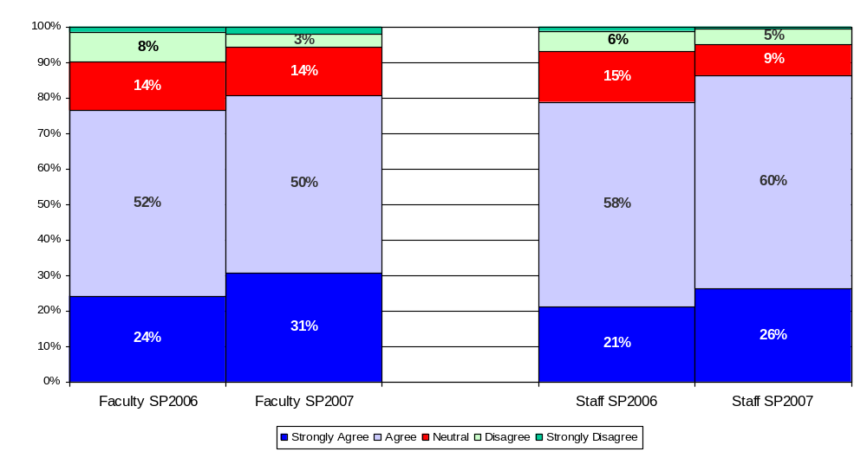
Embry-Riddle’s mission, goals, and vision have been clearly communicated to me

Slide 7
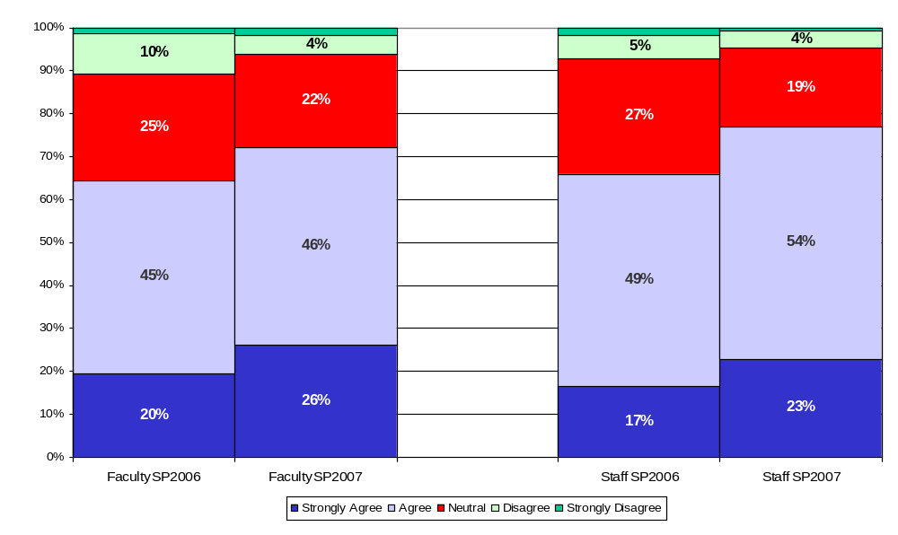
I believe Embry-Riddle’s mission, goals, and vision are the right ones for the organization at the current time

Slide 8
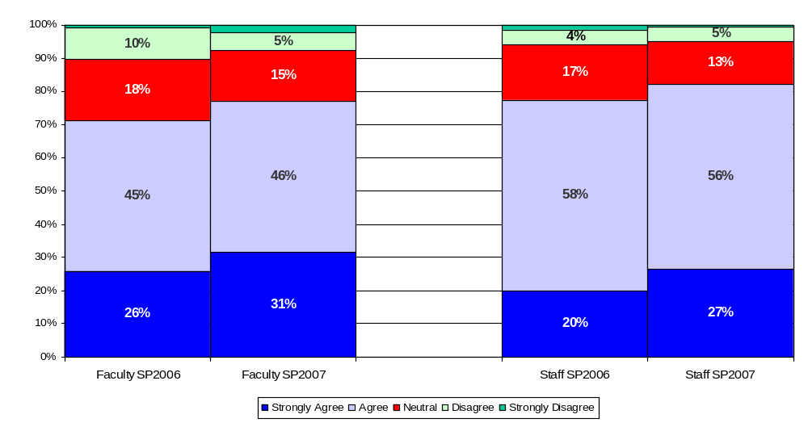
Embry-Riddle’s values have been clearly communicated to me

Slide 9
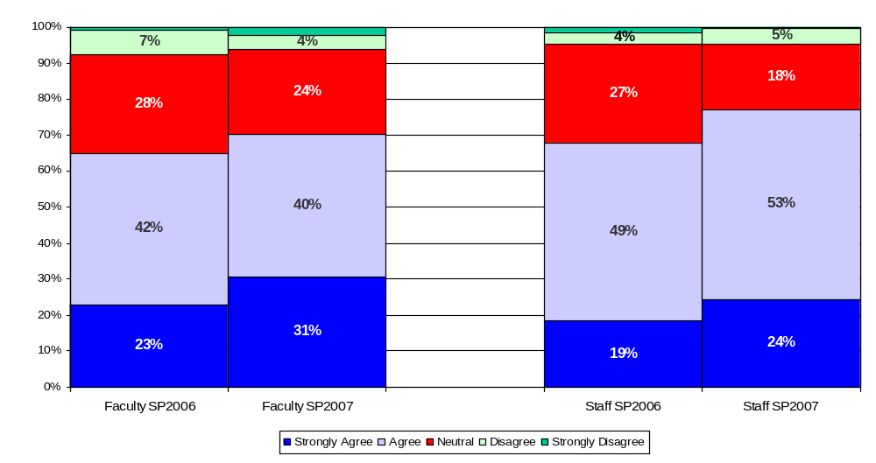
I believe Embry-Riddle’s values are the right ones for the organization at the current time

Slide 10
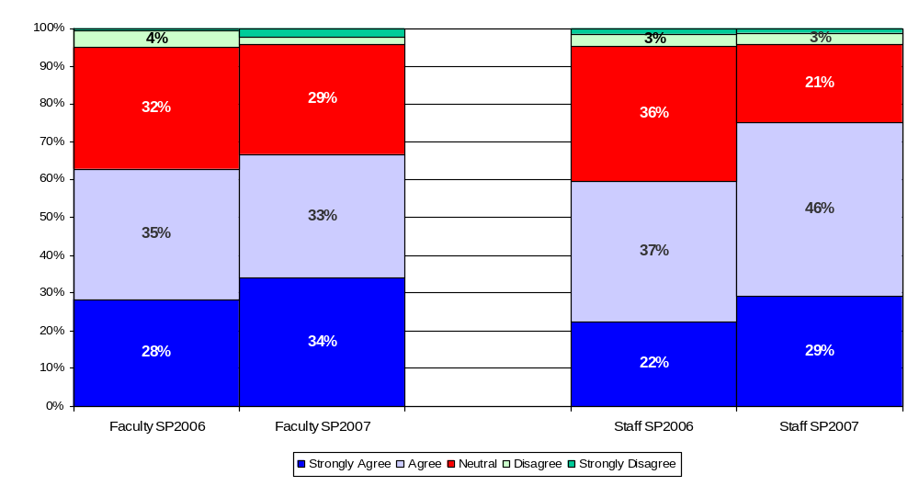
I believe the President is doing a good job.
*Reworded. SP06 version = “I believe the Interim President is making progress toward the University mission and goals”.

Slide 11
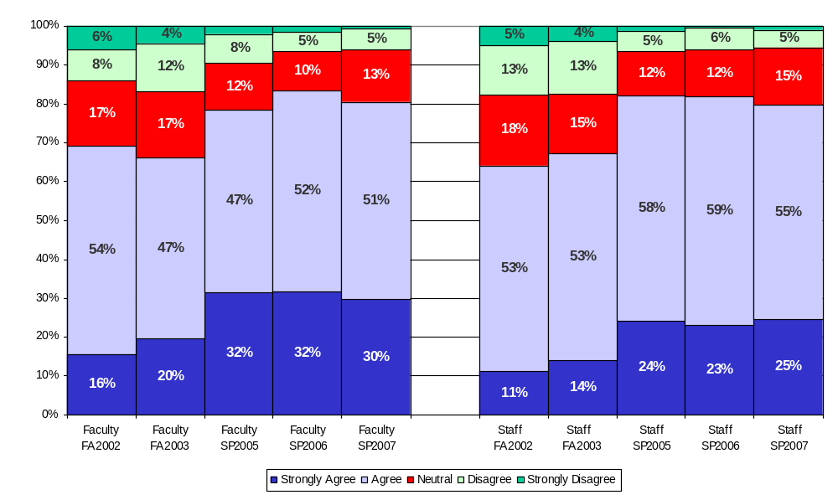
I am kept informed of University news and activities*
*Reworded. SP02-FA03 version = “I am kept informed of University, campus, and department level news and
activities that are pertinent to my work”.

Slide 12
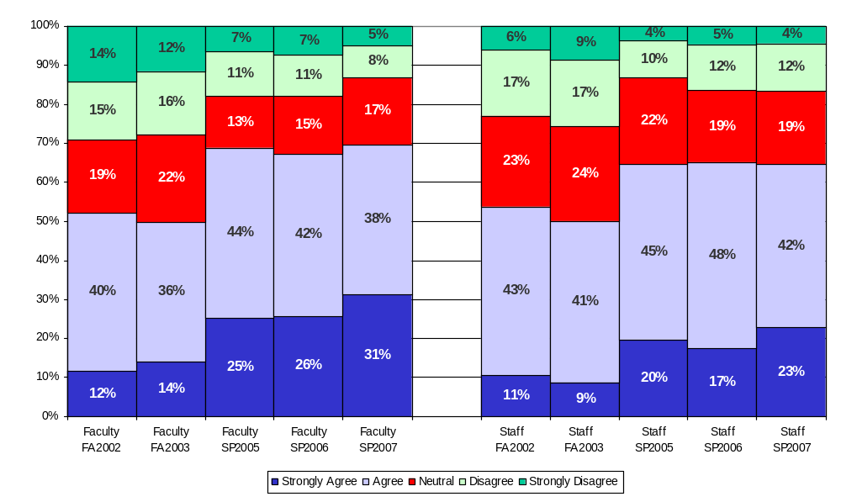
Embry-Riddle has a work environment of mutual respect and trust

Slide 13
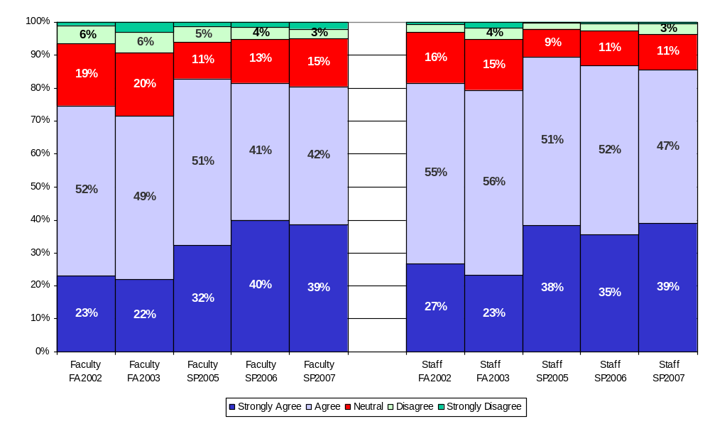
Overall, the University is a good place to work

Slide 14
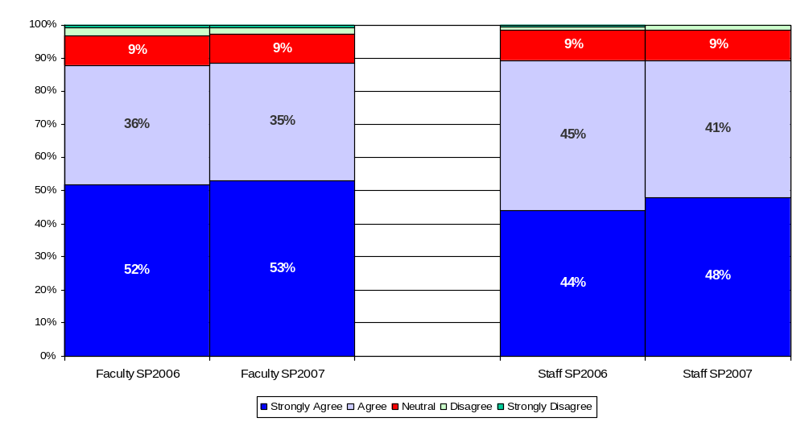
I am proud to be associated with the University

Slide 15
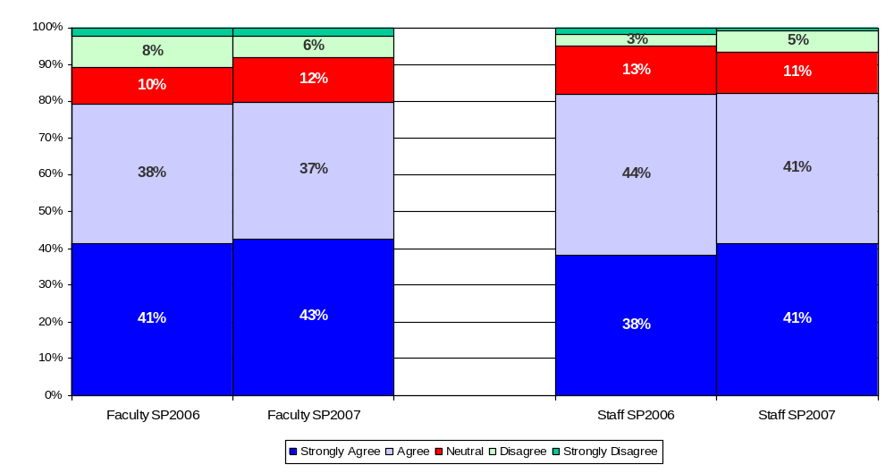
I would recommend the University to family and friends as a place to work

Slide 16
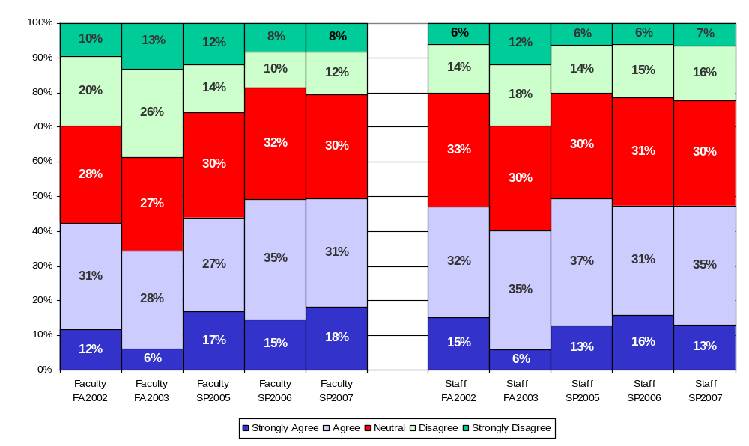
I believe that Climate Survey results will influence decisions to improve the University

Slide 17
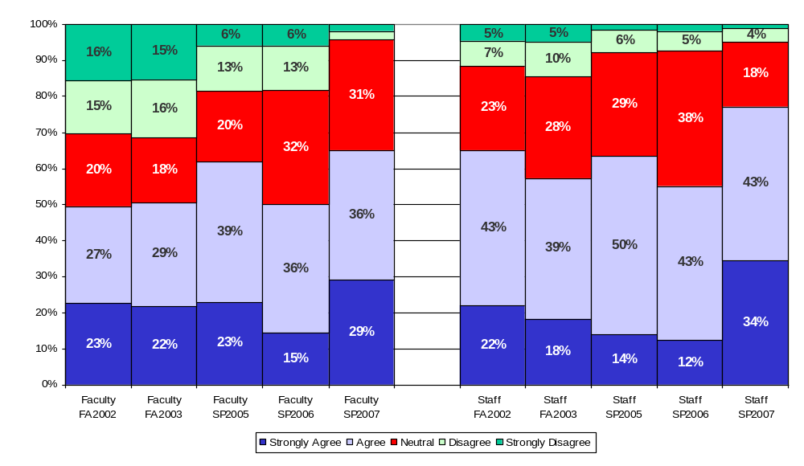
I believe my Chancellor is doing a good job
*Reworded. SP05 version = “I believe campus leadership is making progress toward University mission and goals (EC and PC: Chancellors, College Deans) (DB: College Deans only)”. * FA02-FA03 version = “I have confidence in the campus leadership (Chancellors, College Deans)”. SP02 version = “I have confidence in the University leadership (President, Vice Presidents, Chancellors)”.

Slide 18
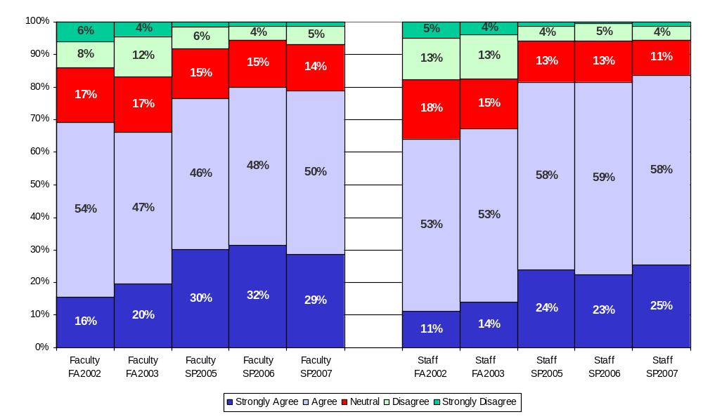
I am kept informed of campus news and activities*
*Reworded. SP02-FA03 version = “I am kept informed of University, campus, and department level news
and activities that are pertinent to my work”.

Slide 19
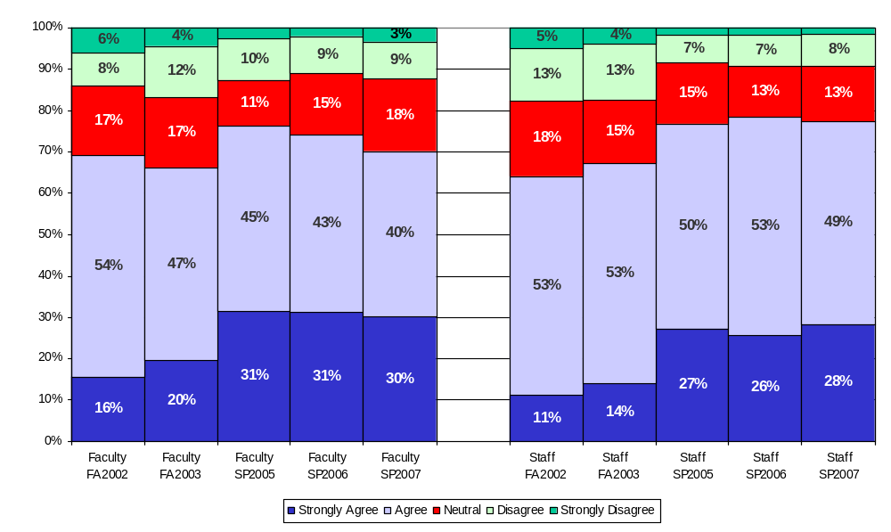
I am kept informed of department level news and activities*
*Reworded. SP02-FA03 version = “I am kept informed of University, campus, and department level news and
activities that are pertinent to my work”.

Slide 20
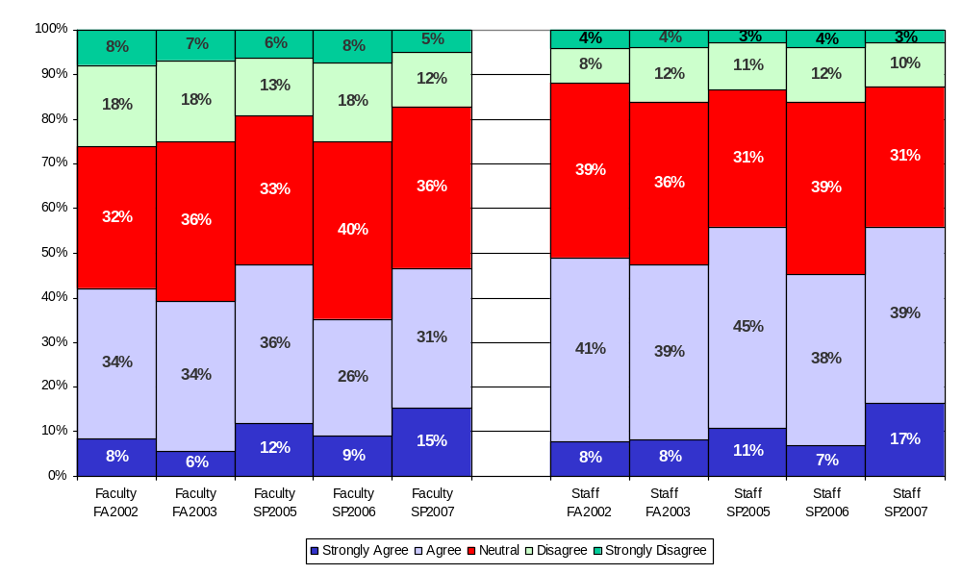
Strategic planning assists in setting my department/program’s direction and objectives

Slide 21
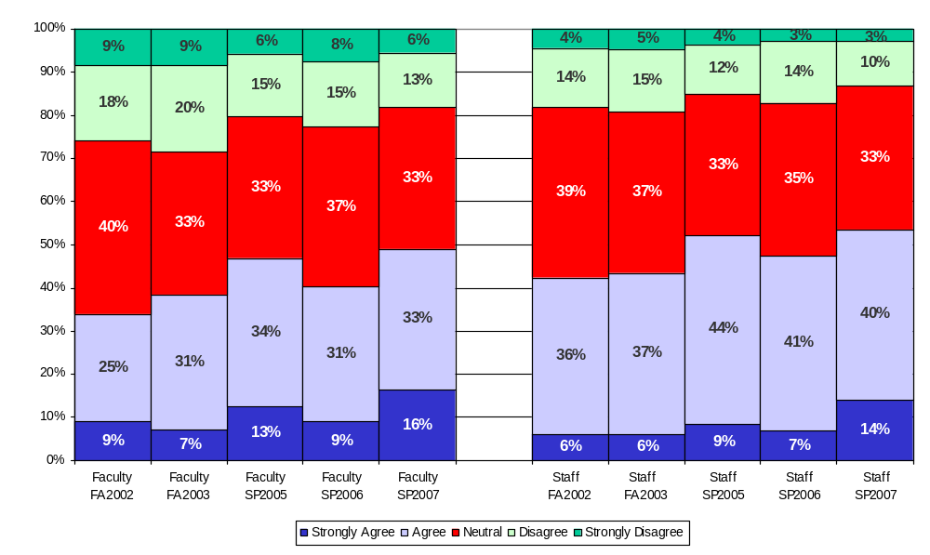
Assessment activities assist my department/program in measuring its success and identifying potential areas for improvement

Slide 22
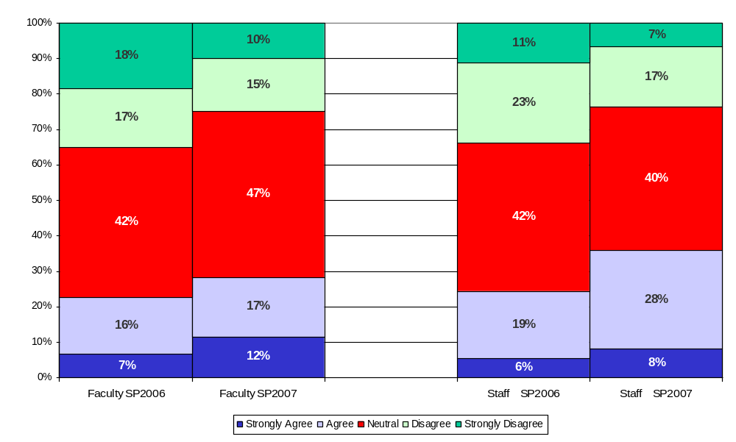
Appropriate consideration is given to all campuses when University budget allocations are made

Slide 23
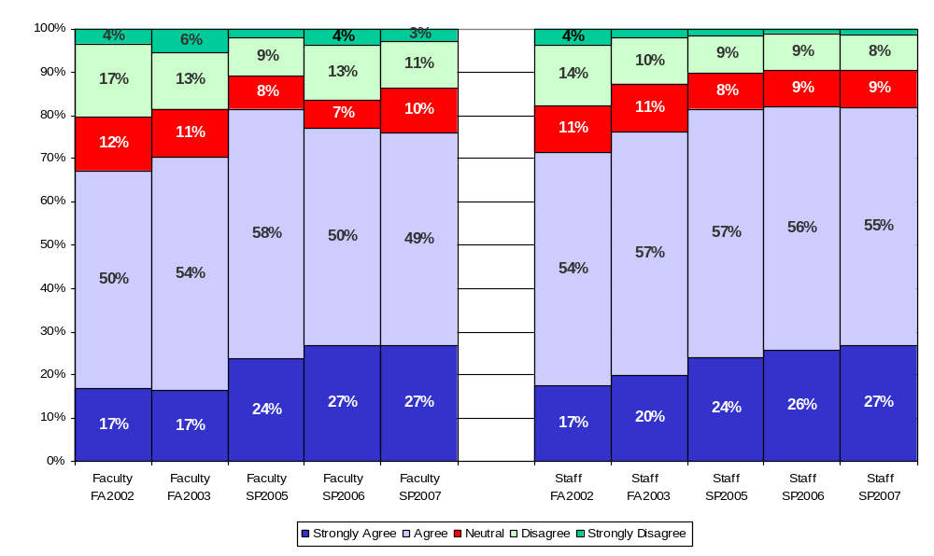
I have the materials and equipment to do my work effectively*
*Question was reworded in FA2003; FA2002 read as “…equipment to do my work right”.

Slide 24
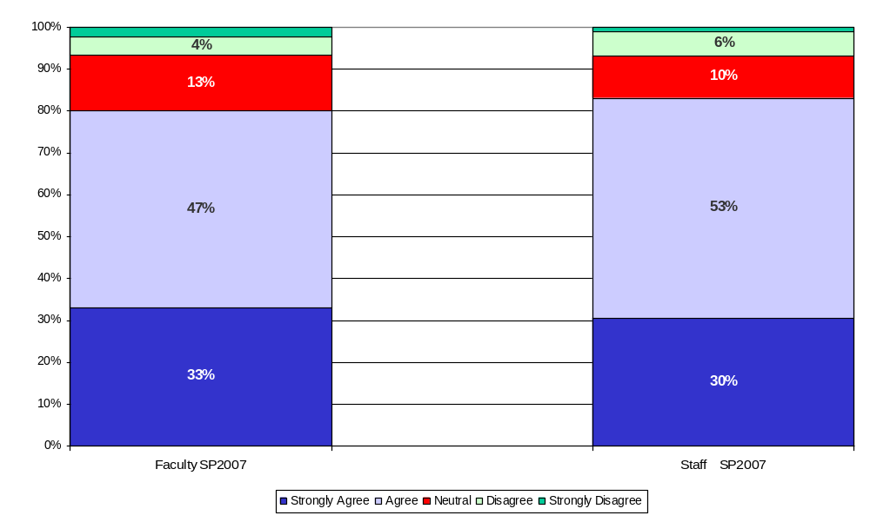
The Technology services provided by the University effectively assist me in the completion of my job

Slide 25
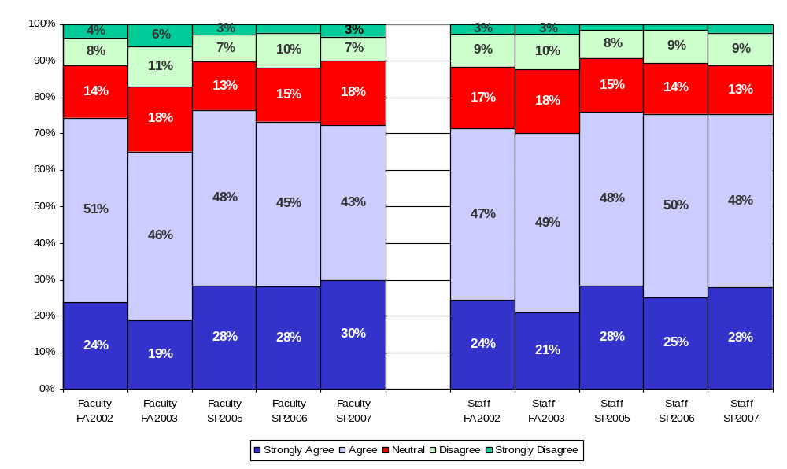
This last year, I have had opportunities to learn and grow either at work or through professional development activities

Slide 26
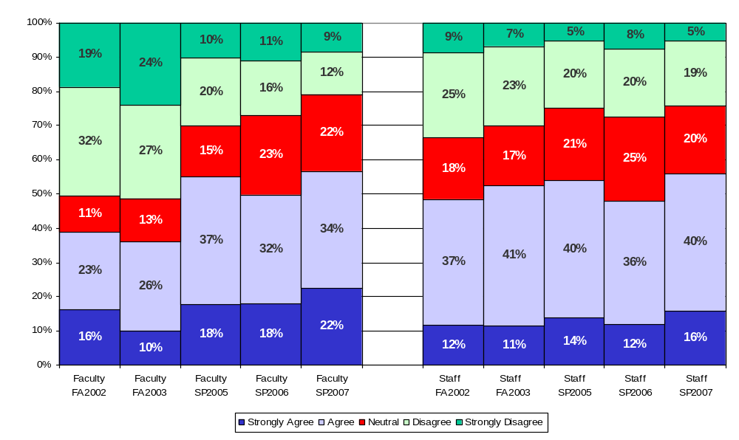
My current workload allows me to engage in a variety of activities*
*Question was reworded in SP2006; SP2005 read as “…activities, as appropriate to my position”.

Slide 27
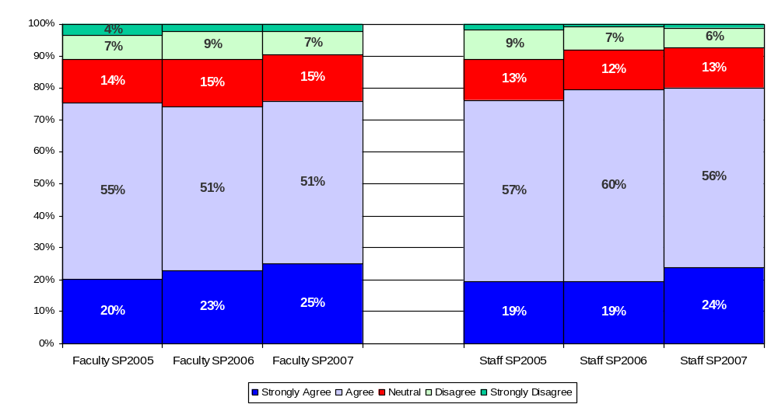
I have access to the information I need to make decisions for my work

Slide 28
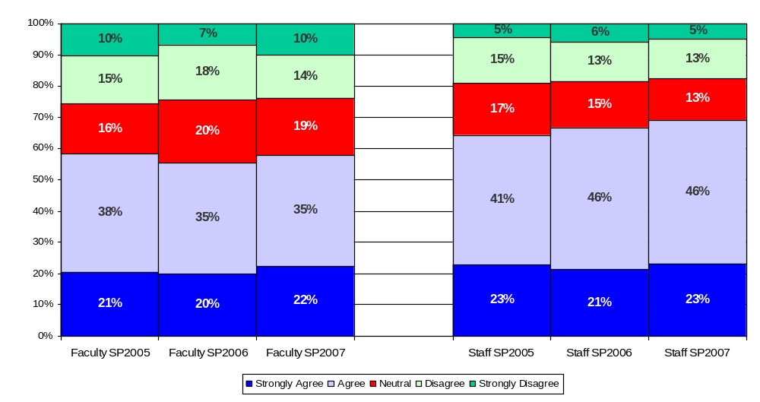
I am asked for my input on decisions that impact my work

Slide 29
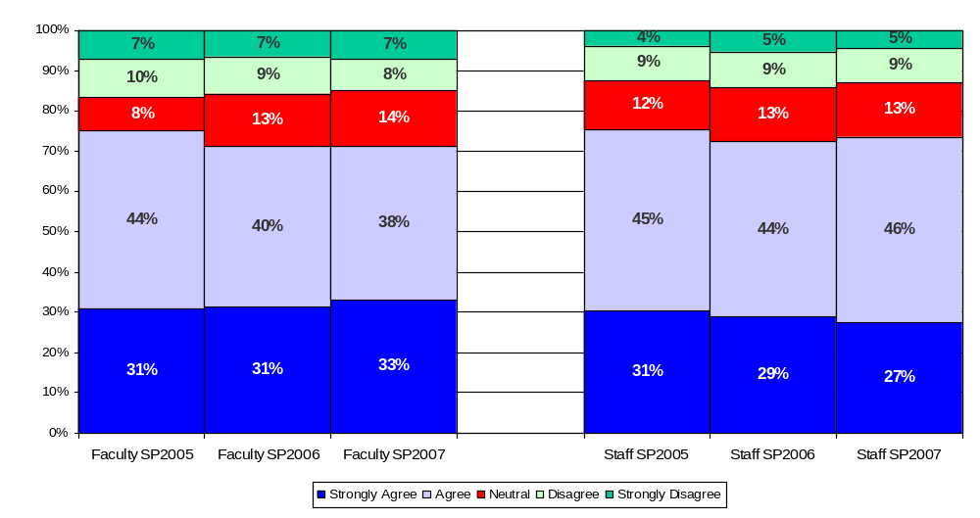
I feel safe in offering suggestions for improvement to the processes in my area

Slide 30
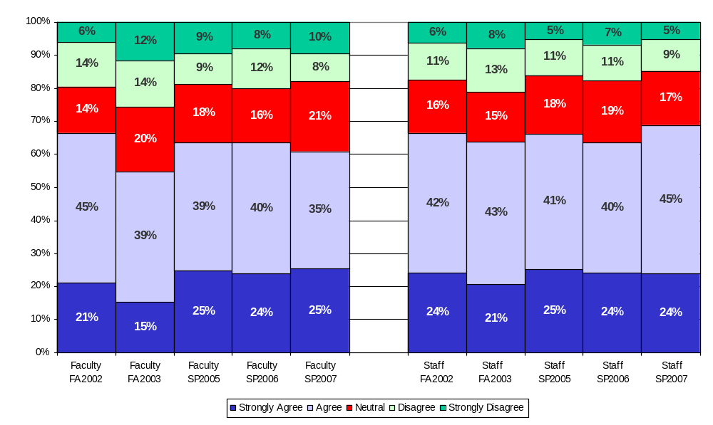
At work, my opinions seem to count

Slide 31
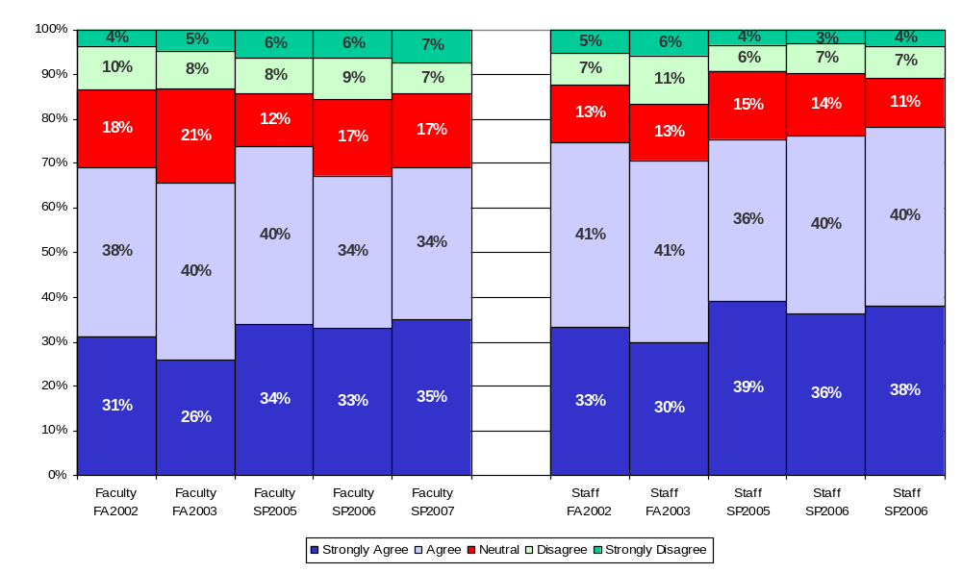
My direct supervisor lets me know when I have done a good job

Slide 32
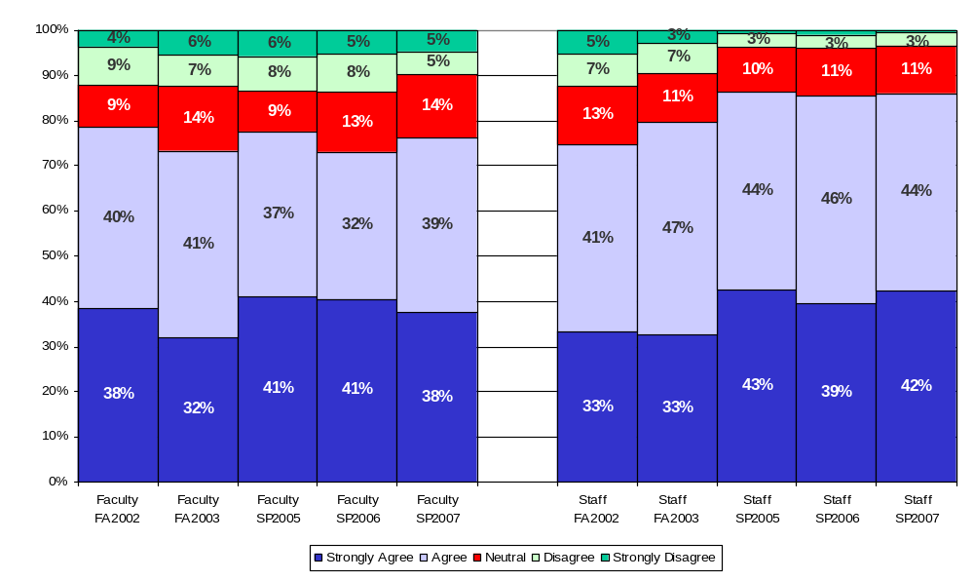
My direct supervisor talks with me at least once a year about my performance*
*Reworded. FA03 version = “…year about my performance objectives and progress”.
SP02-F02 version = “…year about my objectives and progress”.

Slide 33
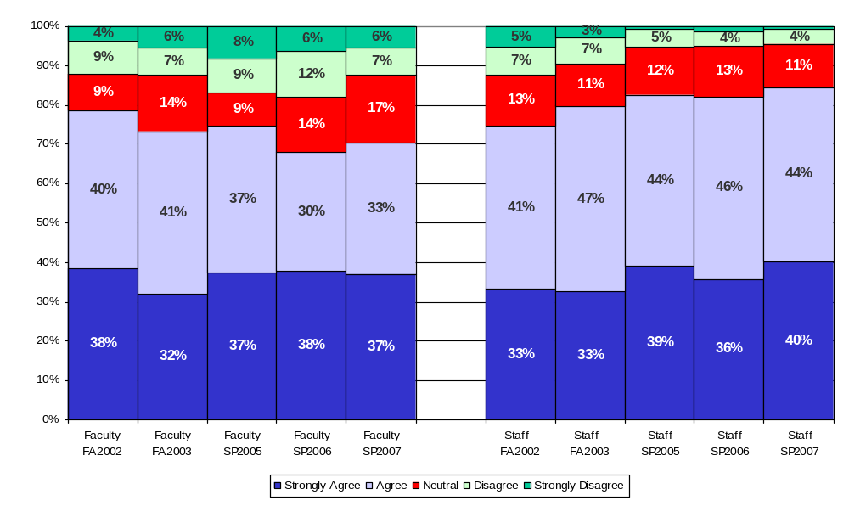
My direct supervisor talks with me at least once a year about my performance objectives/plan*
*Reworded. FA03 version = “…year about my performance objectives and progress”.
SP02-F02 version = “…year about my objectives and progress”.

Slide 34
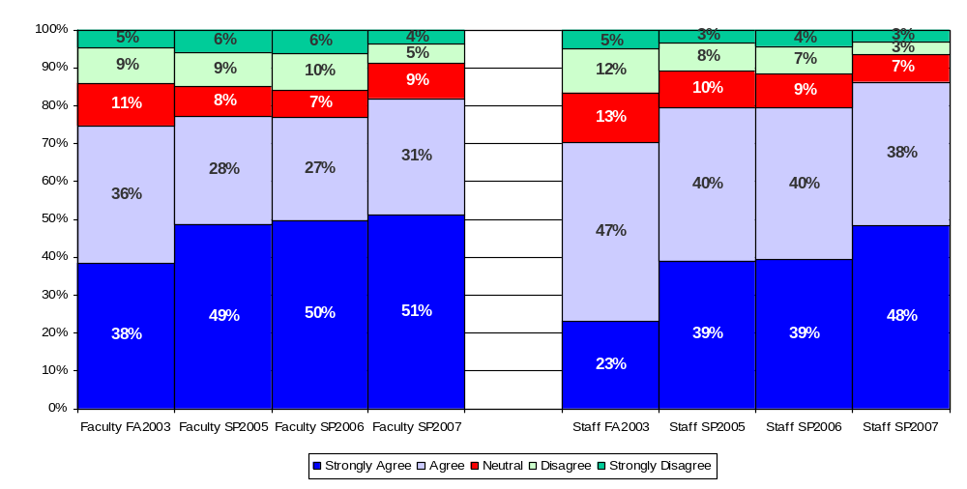
I have not been treated differently because of my race, ethnicity, national origin, age, physical disability, economic background, sexual orientation, or religious belief*
*Reworded. FA03 version = “I have not been treated differently because of my race, gender, sexual orientation, age, or religion”.

Slide 35
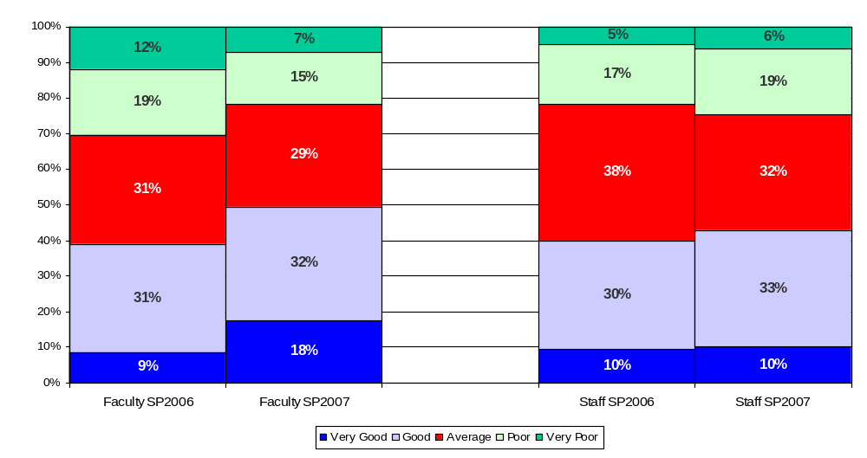
Marketing and promotion of Embry-Riddle

Slide 36
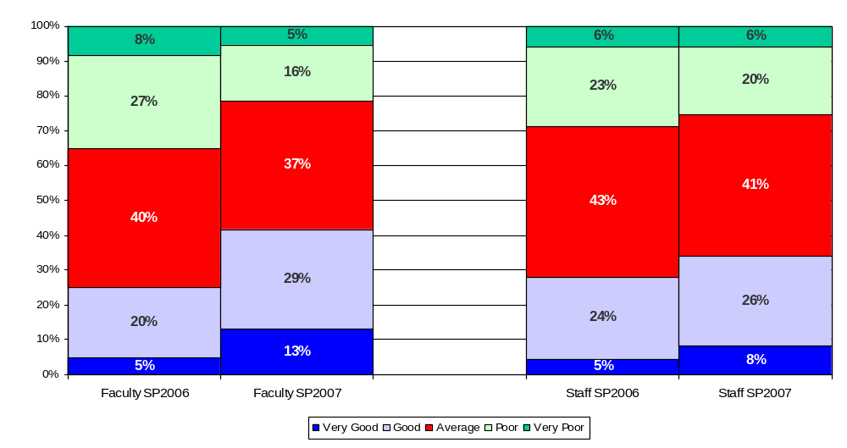
Communication among the campuses

Slide 37
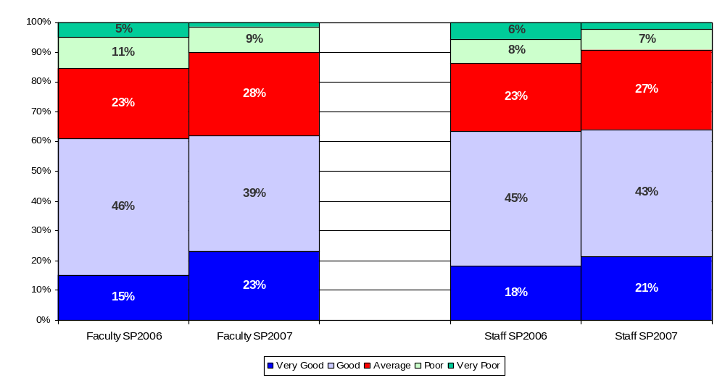
Overall appearance of the physical facilities of my campus/center

Slide 38
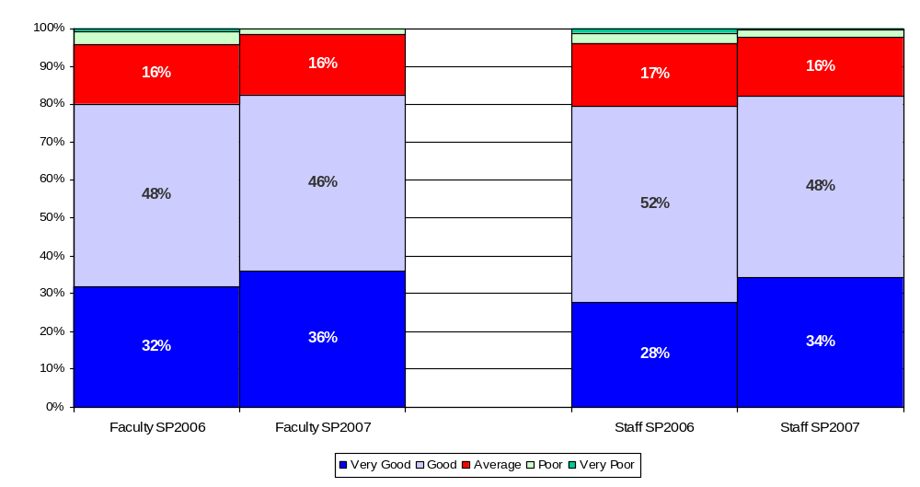
Providing a safe and secure environment for staff and students

Slide 39
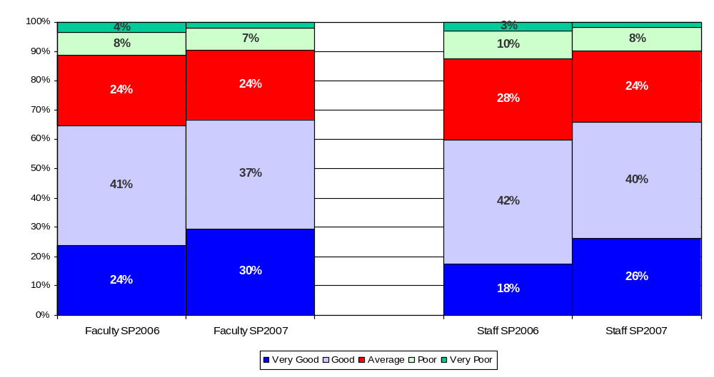
Hiring women and other members of underrepresented groups into management and faculty positions

Slide 40
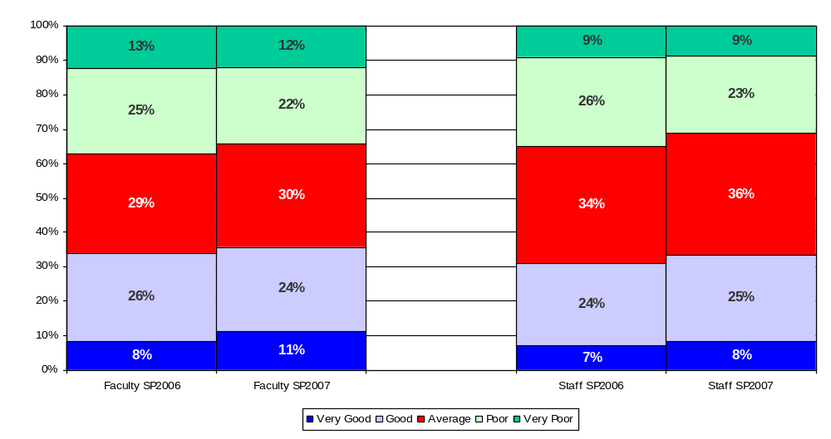
The pay afforded me for my work

Slide 41
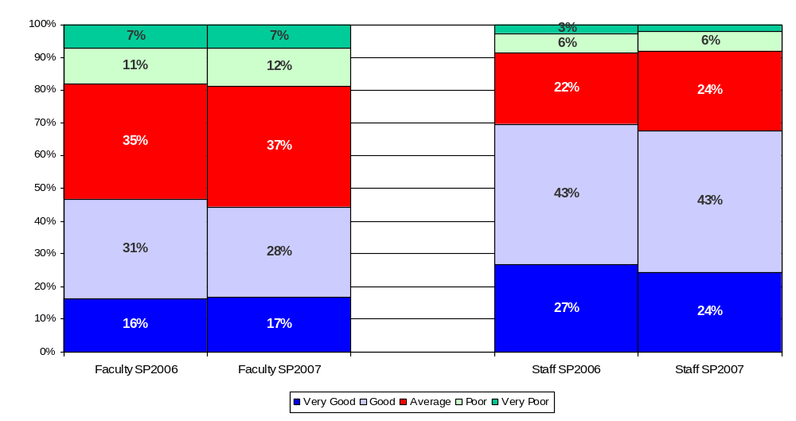
The benefits available for my needs and those of my family

