Slide 1
Profile of Alumni
(those whose employers responded to survey)
Employer Feedback Survey
Classes of 2001, 2002, 2003 & 2004: 1½ years after graduation
Alumni Profile
Slide #<number>
This section details the job characteristics of the ERAU graduates of the Classes of 2001, 2002, 2003, and 2004 whose employer responded to the Employer Feedback Survey including: length of employment, field of work, and relationship of job to field of study.
When results are presented by degree program, the number of respondents is included in parentheses next to the degree program. Only degree programs with three or more respondents are shown. See the degree program profiles for more information. Any numeric inconsistencies are due to the rounding of data.
A list of employers and job titles is also provided in a separate word document.
This data does not describe all ERAU graduates. It only describes the ERAU graduates whose employer responded to the Employer Feedback Survey. For complete Alumni statistics and trend information, please refer to the most recent Alumni Survey.
Source: Institutional Research, June 2007

Slide 2
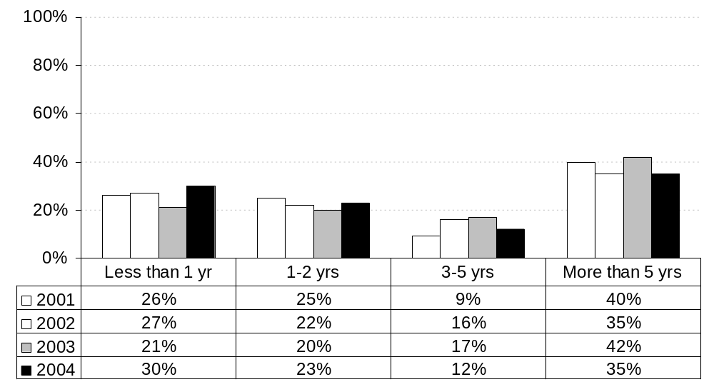
Graduate’s length of time at present position
By Graduation Year: All Campuses
Employer Feedback Survey
Classes of 2001, 2002, 2003 & 2004: 1½ years after graduation
Alumni Profile
Slide #<number>
Note: Includes all degree levels.
Source: Institutional Research, June 2007

Slide 3
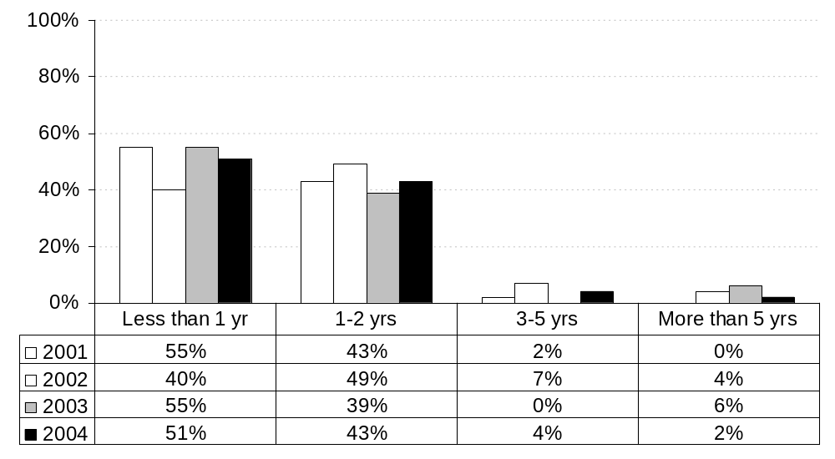
Graduate’s length of time at present position
By Graduation Year: Daytona Beach
Employer Feedback Survey
Classes of 2001, 2002, 2003 & 2004: 1½ years after graduation
Alumni Profile
Slide #<number>
Note: Includes all degree levels.
Source: Institutional Research, June 2007

Slide 4
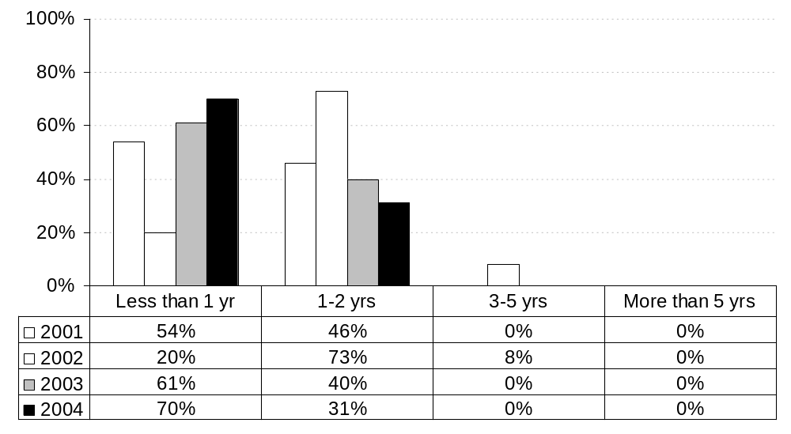
Graduate’s length of time at present position
By Graduation Year: Prescott
Employer Feedback Survey
Classes of 2001, 2002, 2003 & 2004: 1½ years after graduation
Alumni Profile
Slide #<number>
Note: Includes all degree levels.
Source: Institutional Research, June 2007

Slide 5
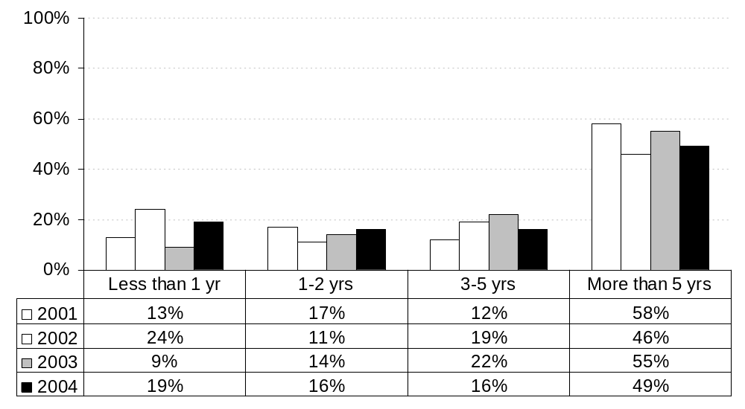
Graduate’s length of time at present position
By Graduation Year: Worldwide Campus
Employer Feedback Survey
Classes of 2001, 2002, 2003 & 2004: 1½ years after graduation
Alumni Profile
Slide #<number>
Note: Includes all degree levels.
Source: Institutional Research, June 2007

Slide 6
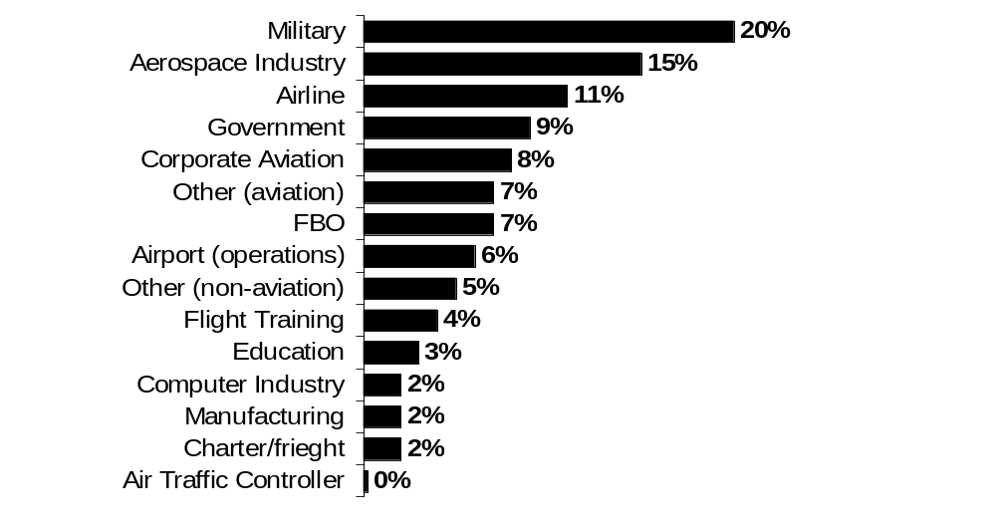
Best description of graduate’s field of work
(as reported by the graduate on the preceding Alumni Surveys)
All Campuses
All Years: Combined
Employer Feedback Survey
Classes of 2001, 2002, 2003 & 2004: 1½ years after graduation
Alumni Profile
Slide #<number>
Note: See data tables in this report for individual graduation year response rates
Source: Institutional Research, June 2007

Slide 7
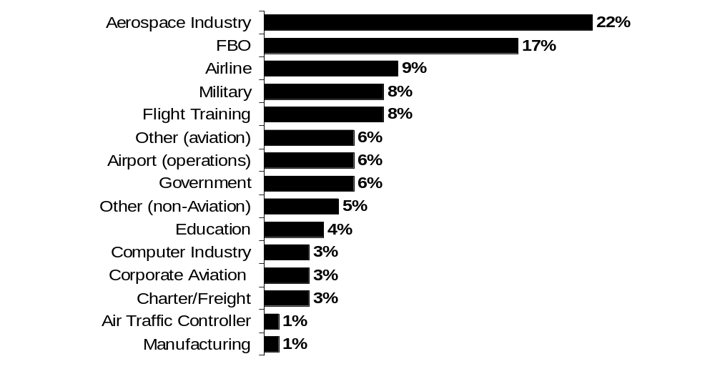
Best description of graduate’s field of work
(as reported by the graduate on the preceding Alumni Surveys)
Daytona Beach
All Years: Combined
Employer Feedback Survey
Classes of 2001, 2002, 2003 & 2004: 1½ years after graduation
Alumni Profile
Slide #<number>
Note: See data tables in this report for individual graduation year response rates
Source: Institutional Research, June 2007

Slide 8
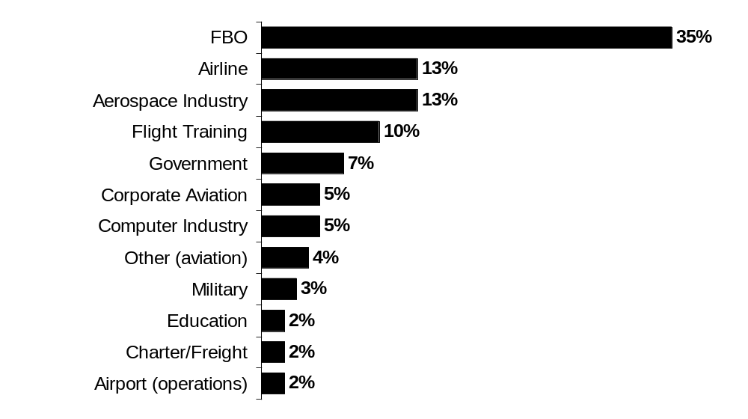
Best description of graduate’s field of work
(as reported by the graduate on the preceding Alumni Surveys)
Prescott
All Years: Combined
Employer Feedback Survey
Classes of 2001, 2002, 2003 & 2004: 1½ years after graduation
Alumni Profile
Slide #<number>
Note: See data tables in this report for individual graduation year response rates
Source: Institutional Research, June 2007

Slide 9
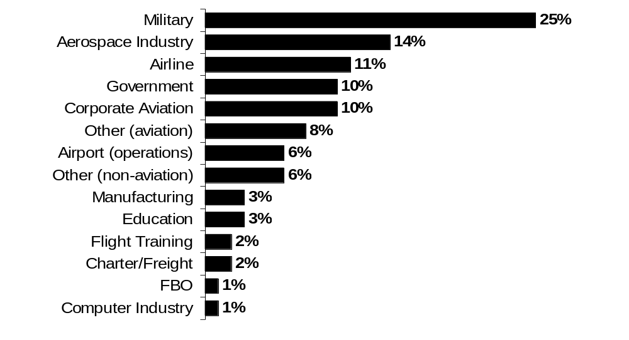
Best description of graduate’s field of work
(As reported by the graduate on the preceding Alumni Surveys)
Worldwide Campus
All Years: Combined
Employer Feedback Survey
Classes of 2001, 2002, 2003 & 2004: 1½ years after graduation
Alumni Profile
Slide #<number>
Note: See data tables in this report for individual graduation year response rates
.
Source: Institutional Research, June 2007

Slide 10
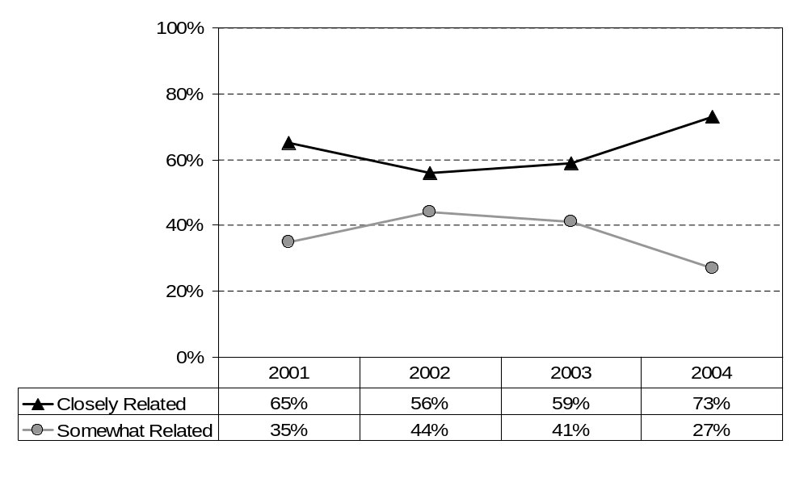
Relationship of graduate’s job to his/her field of study at ERAU
By Graduation Year: All Campuses
Employer Feedback Survey
Classes of 2001, 2002, 2003 & 2004: 1½ years after graduation
Alumni Profile
Slide #<number>
Note: Includes all degree levels.
Source: Institutional Research, June 2007

Slide 11
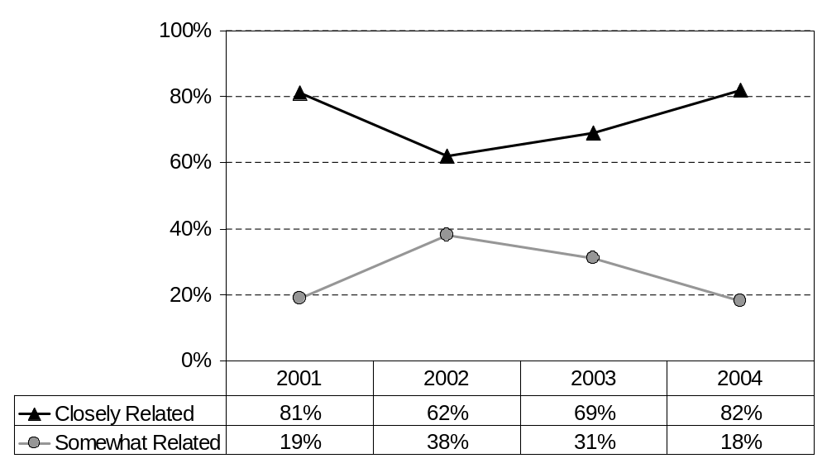
Relationship of graduate’s job to his/her field of study at ERAU
By Graduation Year: Daytona Beach
Employer Feedback Survey
Classes of 2001, 2002, 2003 & 2004: 1½ years after graduation
Alumni Profile
Slide #<number>
Note: Includes all degree levels.
Source: Institutional Research, June 2007

Slide 12
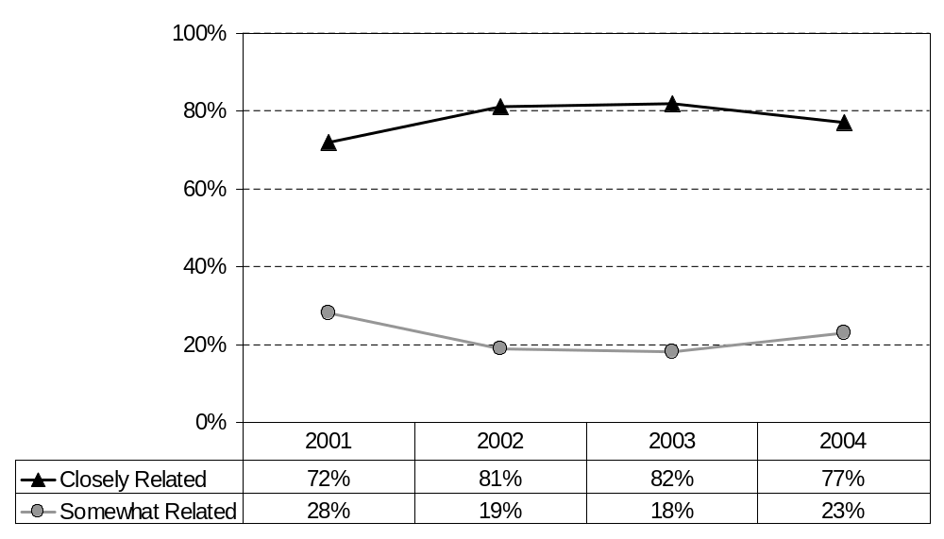
Relationship of graduate’s job to his/her field of study at ERAU
By Graduation Year: Prescott
Employer Feedback Survey
Classes of 2001, 2002, 2003 & 2004: 1½ years after graduation
Alumni Profile
Slide #<number>
Note: Includes all degree levels.
Source: Institutional Research, June 2007

Slide 13
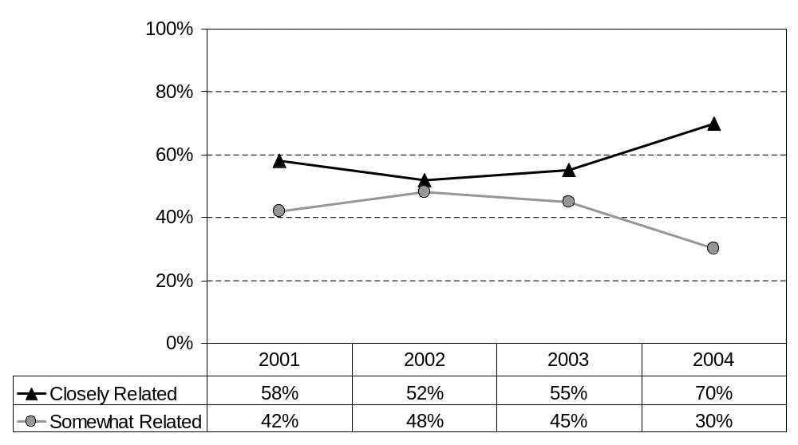
Relationship of graduate’s job to his/her field of study at ERAU
By Graduation Year: Worldwide Campus
Employer Feedback Survey
Classes of 2001, 2002, 2003 & 2004: 1½ years after graduation
Alumni Profile
Slide #<number>
Note: Includes all degree levels.
Source: Institutional Research, June 2007

Slide 14
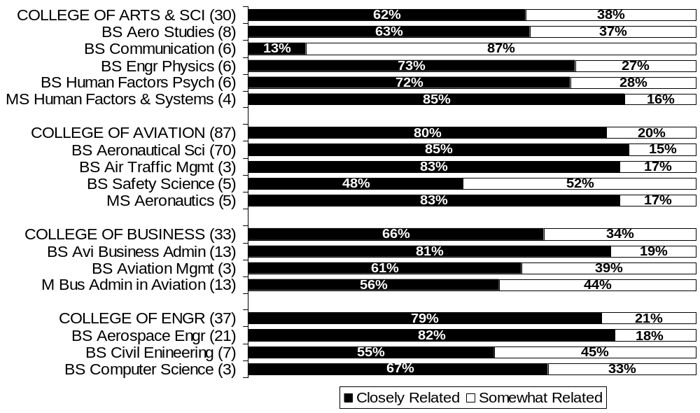
Relationship of graduate’s job to his/her field of study at ERAU
By College and Degree Program: Daytona Beach
All Years: Combined
Employer Feedback Survey
Classes of 2001, 2002, 2003 & 2004: 1½ years after graduation
Alumni Profile
Slide #<number>
Note: # of respondents is shown in ().
Source: Institutional Research, June 2007

Slide 15
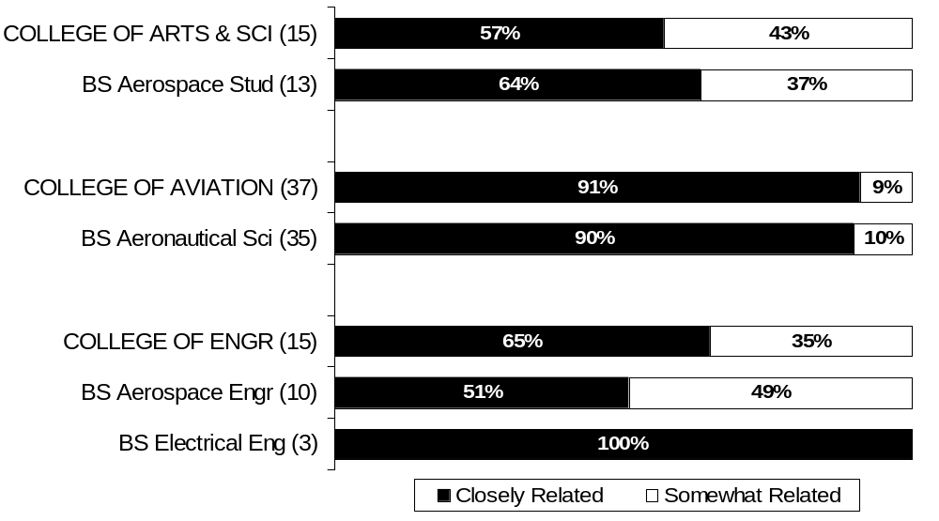
Relationship of graduate’s job to his/her field of study at ERAU
By College and Degree Program: Prescott
All Years: Combined
Employer Feedback Survey
Classes of 2001, 2002, 2003 & 2004: 1½ years after graduation
Alumni Profile
Slide #<number>
Note: # of respondents is shown in ().
Source: Institutional Research, June 2007

Slide 16
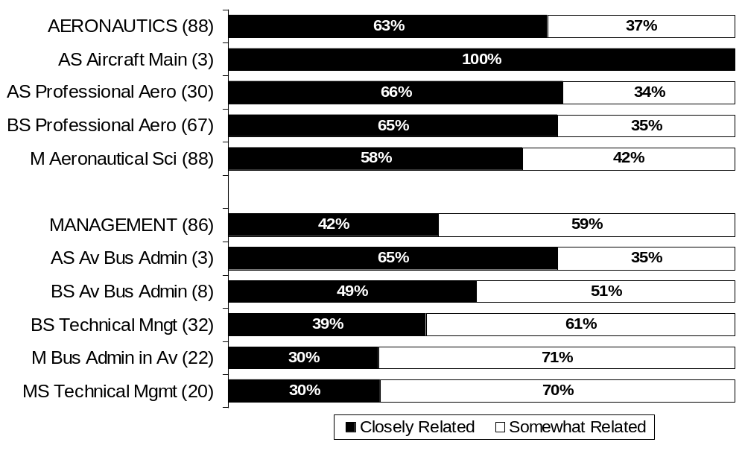
Relationship of graduate’s job to his/her field of study at ERAU
By Department and Degree Program: Worldwide Campus
All Years: Combined
Employer Feedback Survey
Classes of 2001, 2002, 2003 & 2004: 1½ years after graduation
Alumni Profile
Slide #<number>
Note: # of respondents is shown in ().
Source: Institutional Research, June 2007

