Slide 1
Employer Profile
Employer Feedback Survey
Classes of 2000, 2002, 2003 & 2004: 1½ years after graduation
Employer Profile
Slide # <number>
On the Employer Feedback Survey, employers were asked questions about themselves and their company regarding: the number of ERAU graduates they know or supervise, if they graduated from ERAU, their level of involvement in the hiring process, their preference for of ERAU graduates and multi-lingual employees, importance of global and international awareness and anticipated hiring needs.
When results are presented by degree program, the number of respondents is included in parentheses next to the degree program. Only degree programs with three or more respondents are shown. See the degree program profiles for more information. Any numeric inconsistencies are due to the rounding of data.

Slide 2
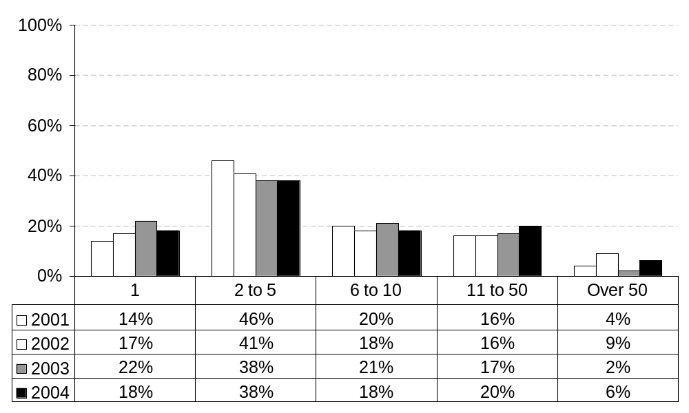
Approximately how many ERAU graduates do you know professionally?
By Graduation Year: All Campuses
Employer Feedback Survey
Classes of 2000, 2002, 2003 & 2004: 1½ years after graduation
Employer Profile
Slide # <number>

Slide 3
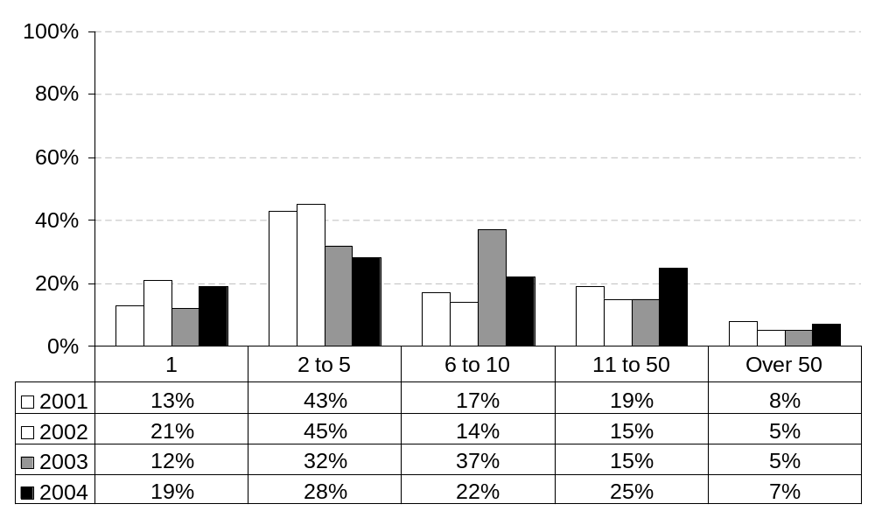
Approximately how many ERAU graduates do you know professionally?
By Graduation Year: Daytona Beach
Employer Feedback Survey
Classes of 2000, 2002, 2003 & 2004: 1½ years after graduation
Employer Profile
Slide # <number>

Slide 4
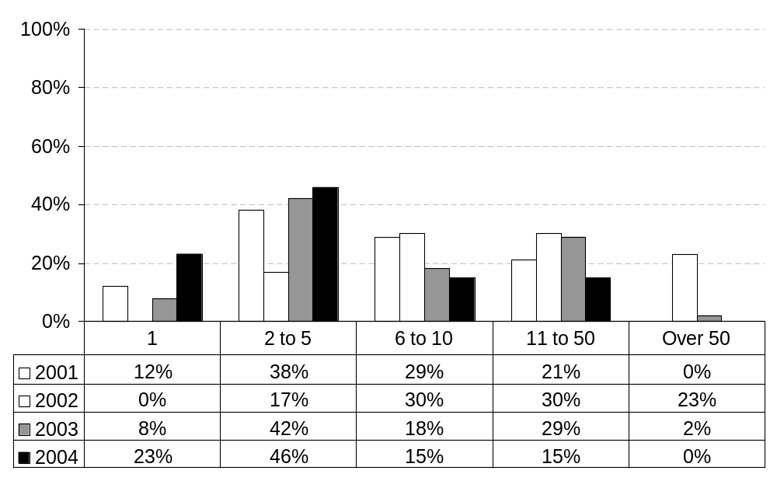
Approximately how many ERAU graduates do you know professionally?
By Graduation Year: Prescott
Employer Feedback Survey
Classes of 2000, 2002, 2003 & 2004: 1½ years after graduation
Employer Profile
Slide # <number>

Slide 5
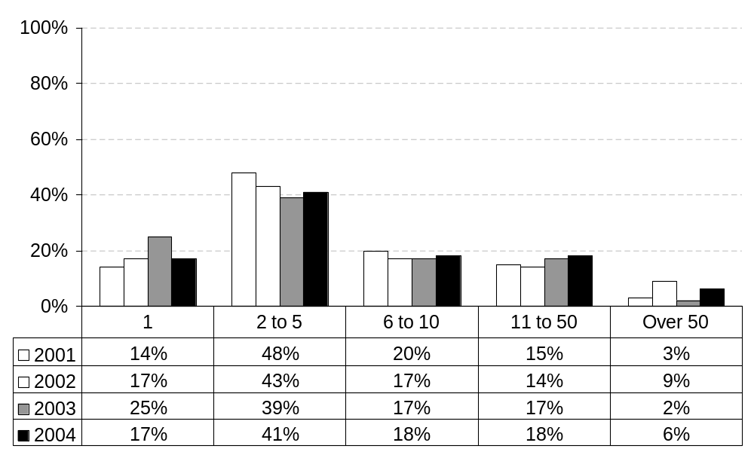
Approximately how many ERAU graduates do you know professionally?
By Graduation Year: Worldwide Campus
Employer Feedback Survey
Classes of 2000, 2002, 2003 & 2004: 1½ years after graduation
Employer Profile
Slide # <number>

Slide 6
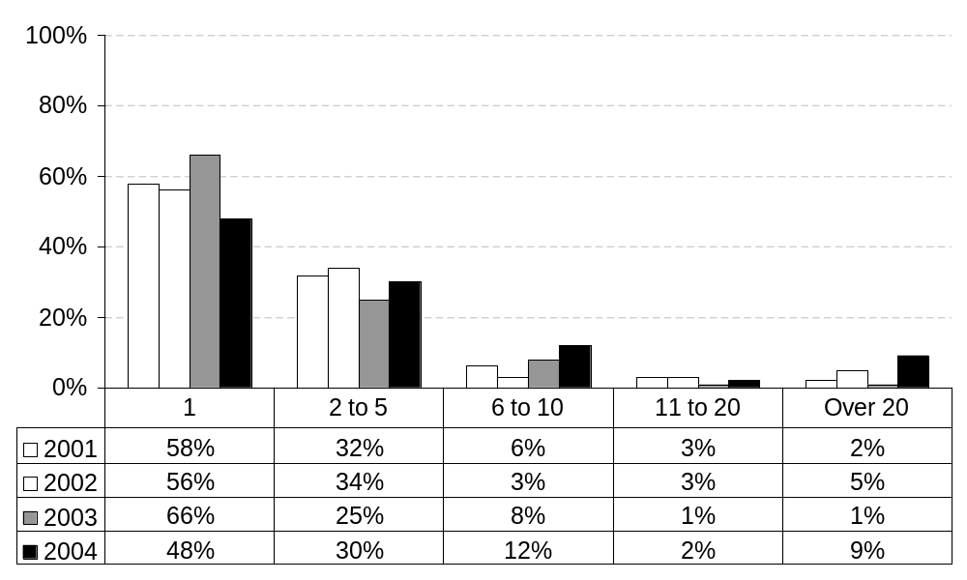
How many ERAU graduates do you currently supervise?
By Graduation Year: All Campuses
Employer Feedback Survey
Classes of 2000, 2002, 2003 & 2004: 1½ years after graduation
Employer Profile
Slide # <number>

Slide 7
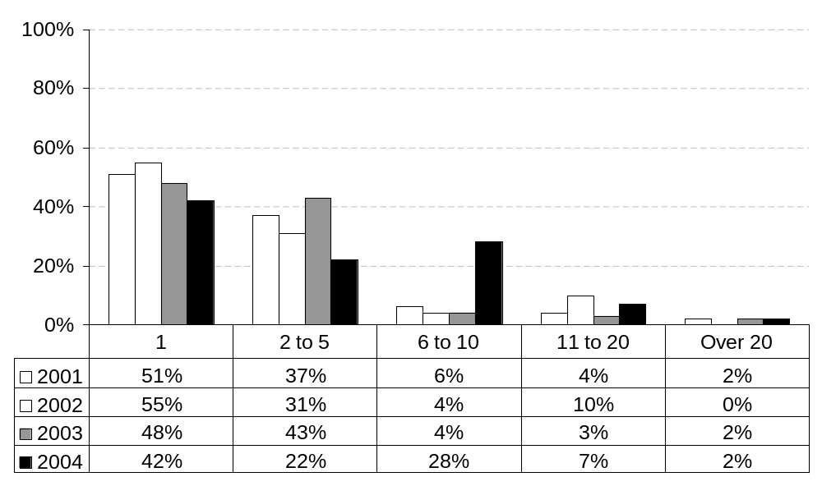
How many ERAU graduates do you currently supervise?
By Graduation Year: Daytona Beach
Employer Feedback Survey
Classes of 2000, 2002, 2003 & 2004: 1½ years after graduation
Employer Profile
Slide # <number>

Slide 8
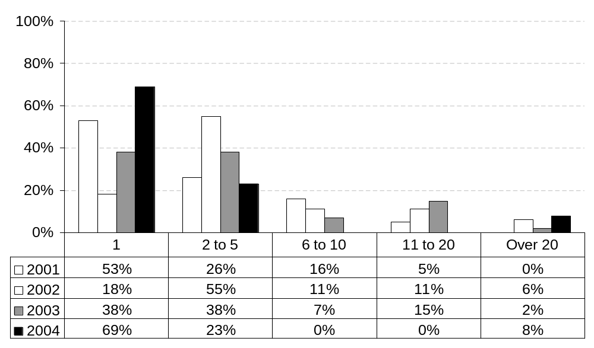
How many ERAU graduates do you currently supervise?
By Graduation Year: Prescott
Employer Feedback Survey
Classes of 2000, 2002, 2003 & 2004: 1½ years after graduation
Employer Profile
Slide # <number>

Slide 9
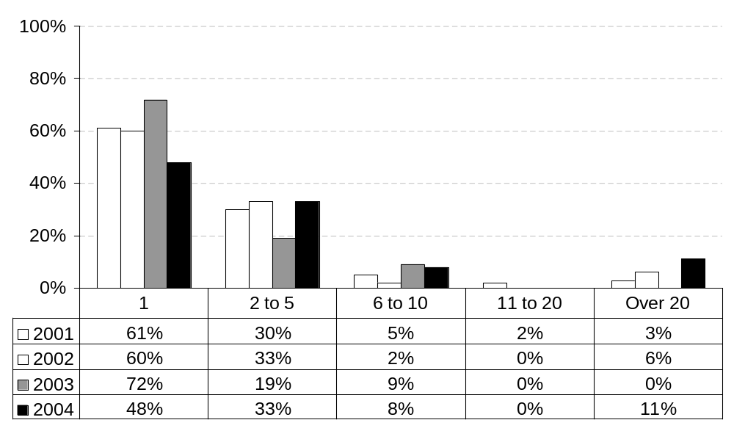
How many ERAU graduates do you currently supervise?
By Graduation Year: Worldwide Campus
Employer Feedback Survey
Classes of 2000, 2002, 2003 & 2004: 1½ years after graduation
Employer Profile
Slide # <number>

Slide 10
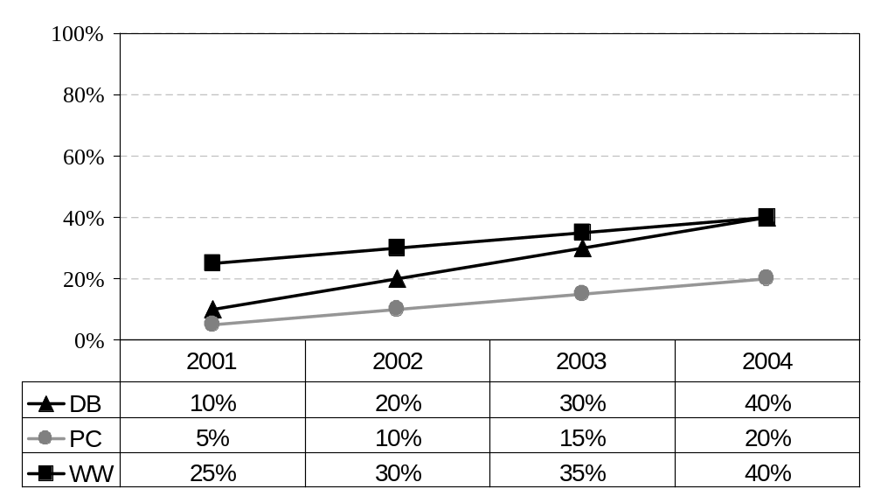
Did you graduate from ERAU?
(% responding ‘yes’)
By Campus and Graduation Year
Employer Feedback Survey
Classes of 2000, 2002, 2003 & 2004: 1½ years after graduation
Employer Profile
Slide # <number>

Slide 11
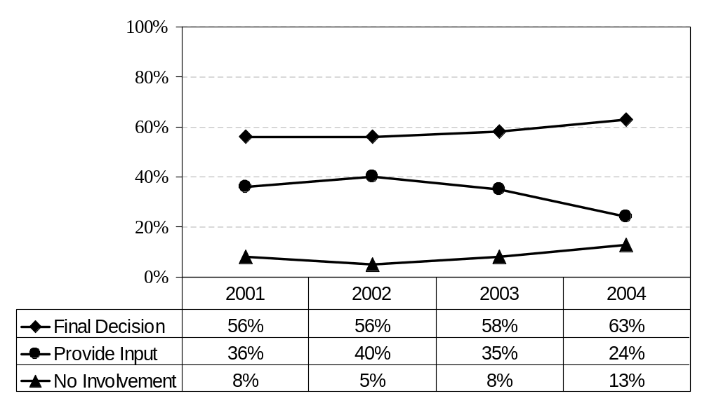
What is your level of involvement in the hiring of new workers?
By Graduation Year: All Campuses
Employer Feedback Survey
Classes of 2000, 2002, 2003 & 2004: 1½ years after graduation
Employer Profile
Slide # <number>

Slide 12
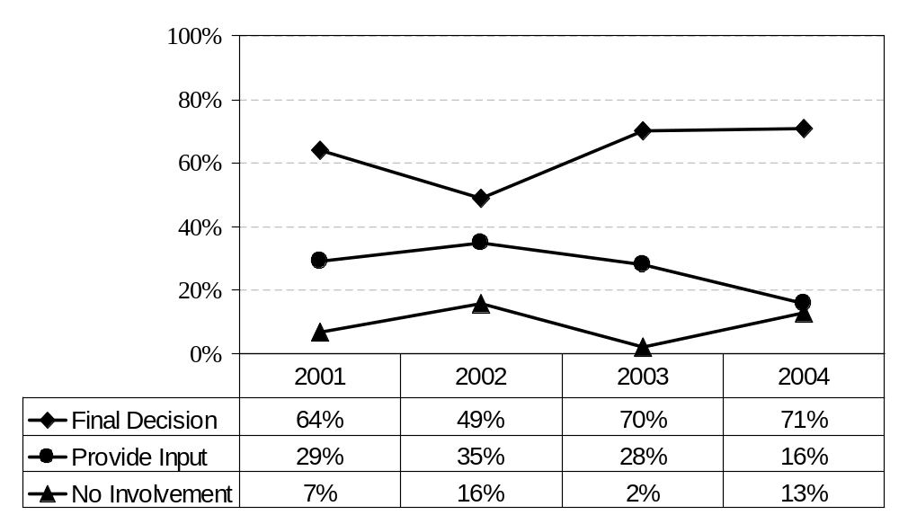
What is your level of involvement in the hiring of new workers?
By Graduation Year: Daytona Beach
Employer Feedback Survey
Classes of 2000, 2002, 2003 & 2004: 1½ years after graduation
Employer Profile
Slide # <number>

Slide 13
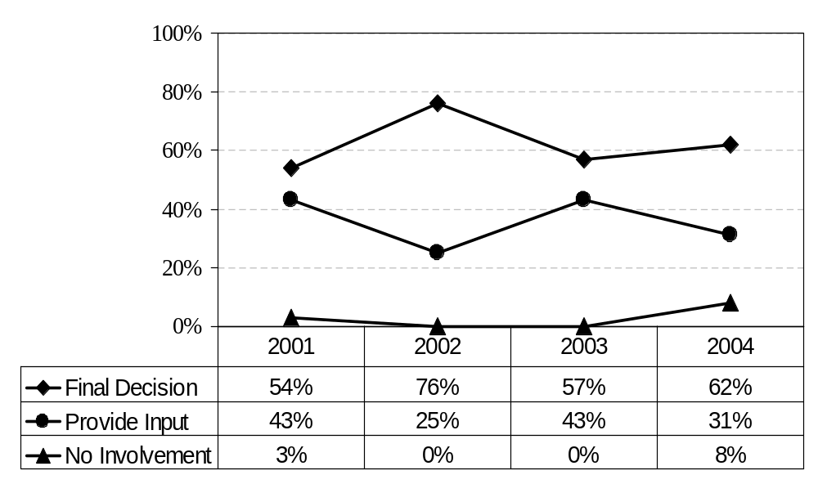
What is your level of involvement in the hiring of new workers?
By Graduation Year: Prescott
Employer Feedback Survey
Classes of 2000, 2002, 2003 & 2004: 1½ years after graduation
Employer Profile
Slide # <number>

Slide 14
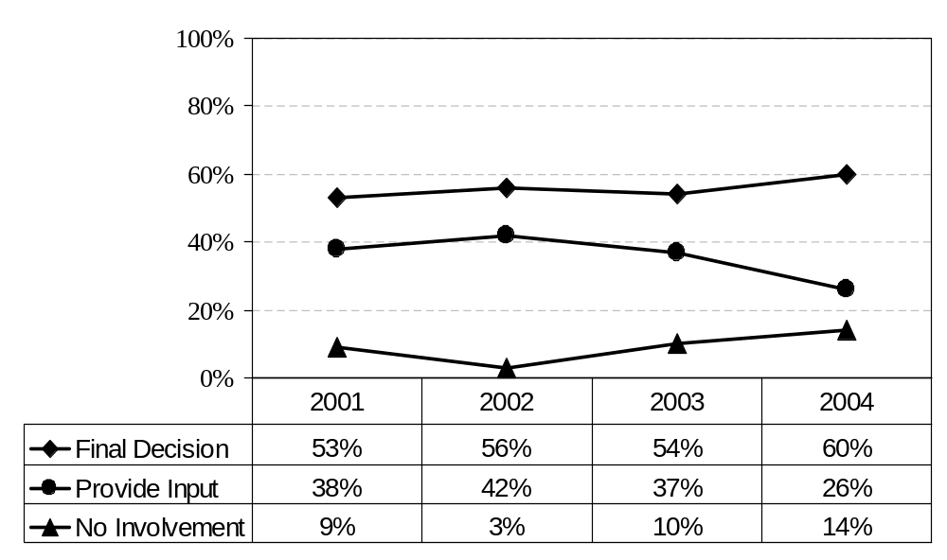
What is your level of involvement in the hiring of new workers?
By Graduation Year: Worldwide Campus
Employer Feedback Survey
Classes of 2000, 2002, 2003 & 2004: 1½ years after graduation
Employer Profile
Slide # <number>

Slide 15
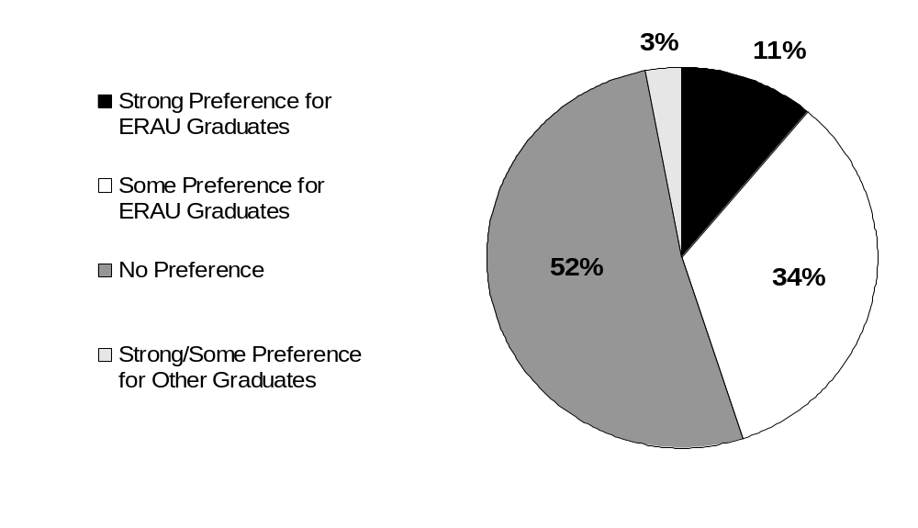
What is your preference for hiring graduates?
All Campuses
All Years: Combined
Employer Feedback Survey
Classes of 2000, 2002, 2003 & 2004: 1½ years after graduation
Employer Profile
Slide # <number>

Slide 16
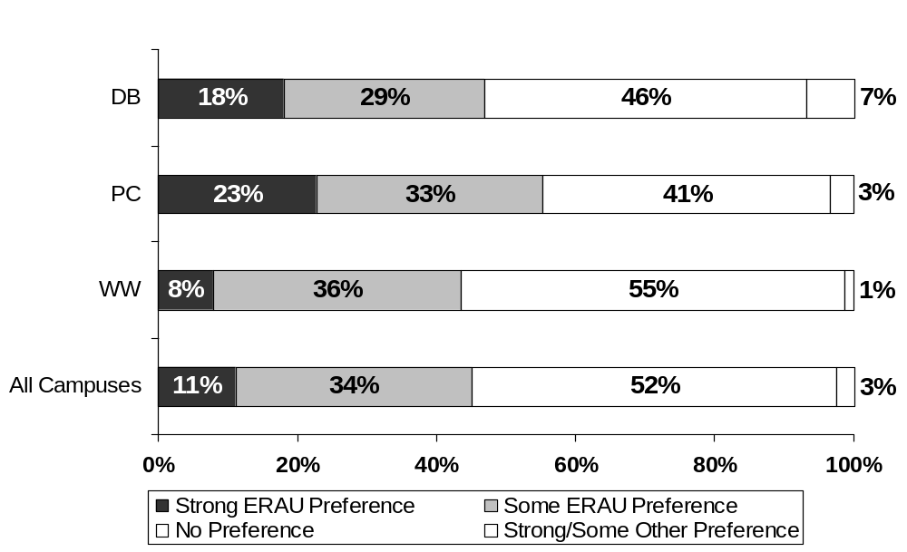
What is your preference for hiring graduates?
By Campus
All Years: Combined
Employer Feedback Survey
Classes of 2000, 2002, 2003 & 2004: 1½ years after graduation
Employer Profile
Slide # <number>

Slide 17
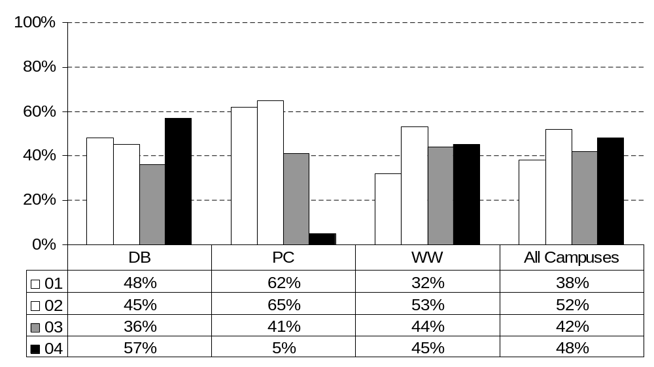
What is your preference for hiring graduates?
By Graduation Year and Campus
(percent responding "strong preference" or "some preference“ for ERAU Graduates)
Employer Feedback Survey
Classes of 2000, 2002, 2003 & 2004: 1½ years after graduation
Employer Profile
Slide # <number>

Slide 18
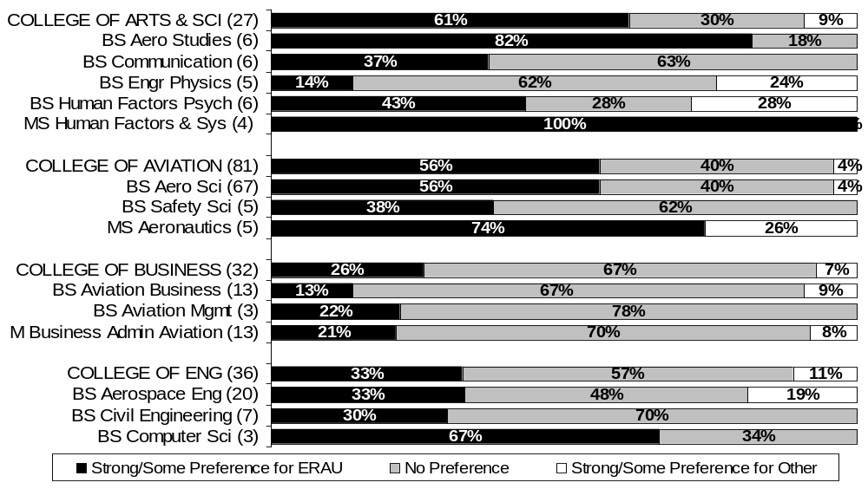
What is your preference for hiring graduates?
By College & Degree Program: Daytona Beach
All Years: Combined
Employer Feedback Survey
Classes of 2000, 2002, 2003 & 2004: 1½ years after graduation
Employer Profile
Slide # <number>

Slide 19
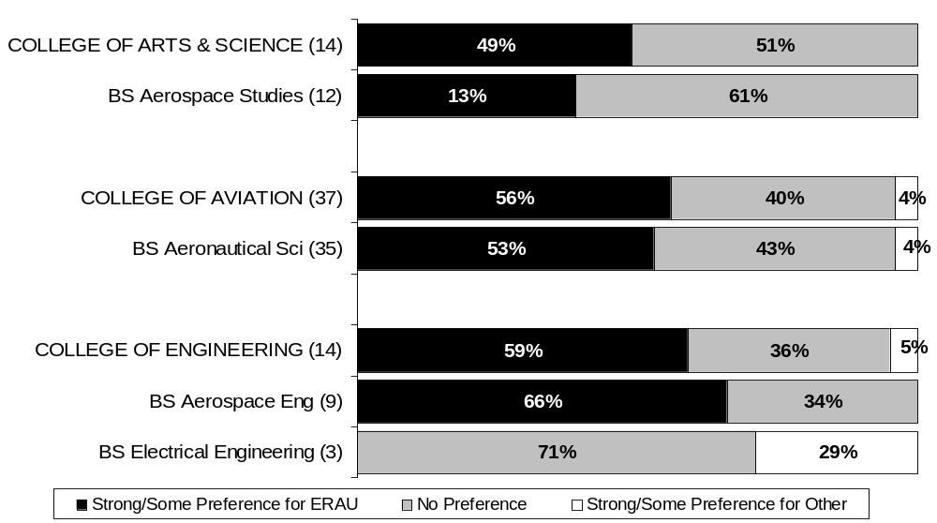
What is your preference for hiring graduates?
By College & Degree Program: Prescott
All Years: Combined
Employer Feedback Survey
Classes of 2000, 2002, 2003 & 2004: 1½ years after graduation
Employer Profile
Slide # <number>

Slide 20
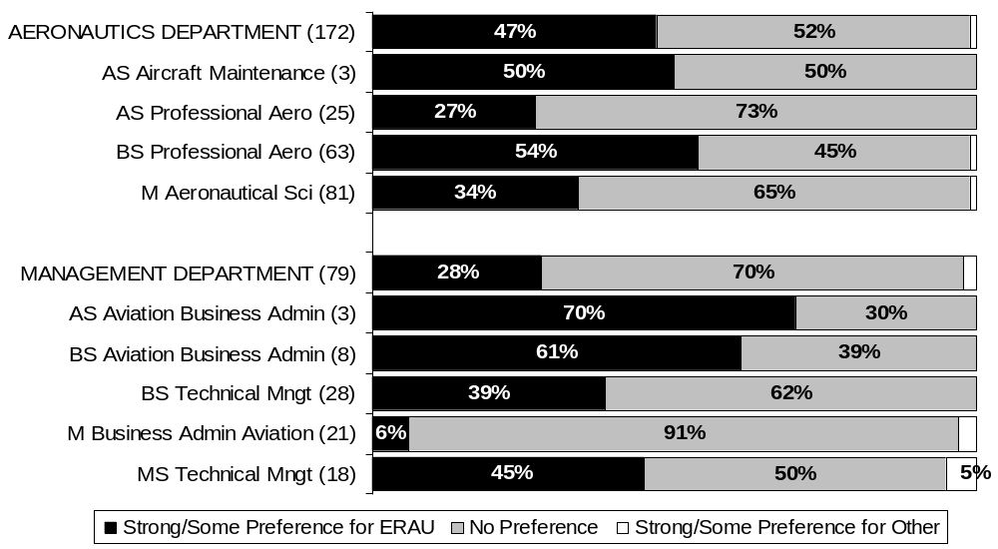
What is your preference for hiring graduates?
By Department & Degree Program: Worldwide Campus
All Years: Combined
Employer Feedback Survey
Classes of 2000, 2002, 2003 & 2004: 1½ years after graduation
Employer Profile
Slide # <number>

Slide 21
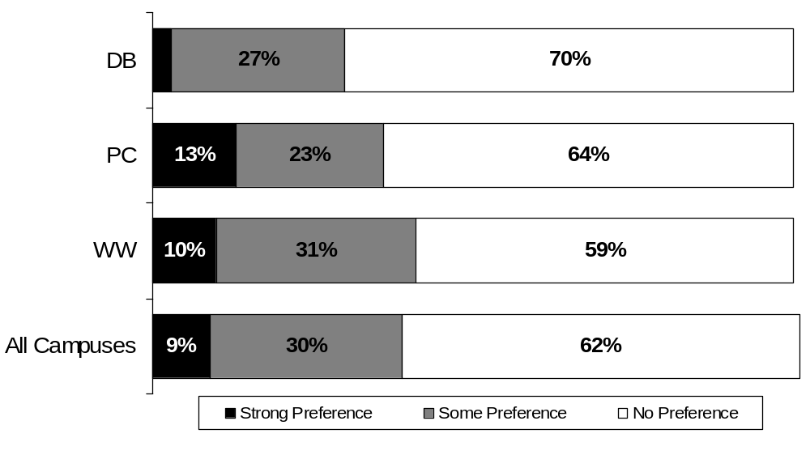
What preference do you have for multi-lingual candidates?
By Campus
All Years: Combined
Employer Feedback Survey
Classes of 2000, 2002, 2003 & 2004: 1½ years after graduation
Employer Profile
Slide # <number>
Note: New Question as of the class of 2003.

Slide 22
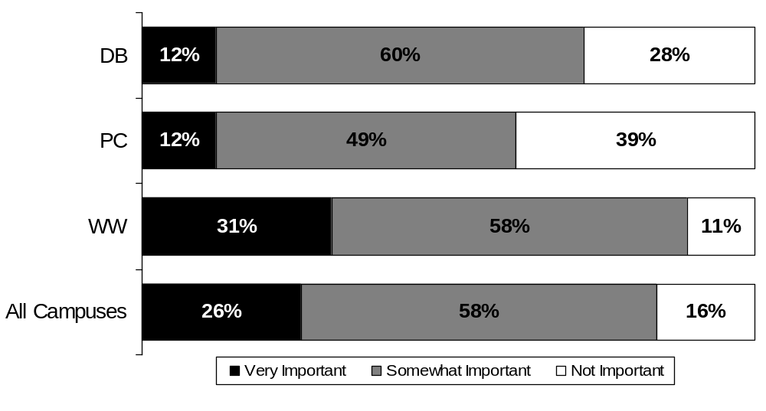
How important do you consider global awareness and international experience for new employees?
By Campus
All Years: Combined
Employer Feedback Survey
Classes of 2000, 2002, 2003 & 2004: 1½ years after graduation
Employer Profile
Slide # <number>
Note: New Question as of the class of 2003.

Slide 23
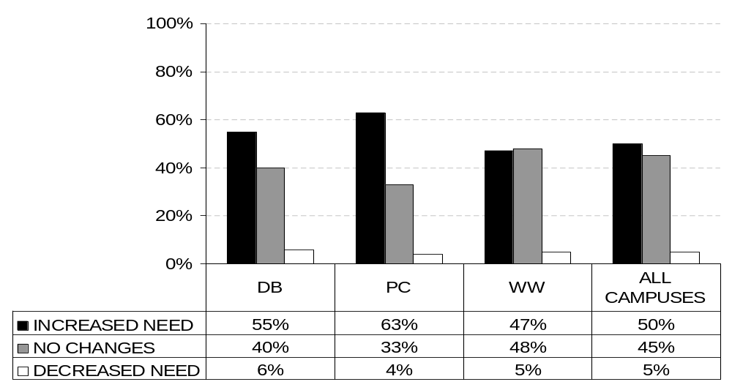
What changes do you anticipate in your organization’s need for aviation and aerospace professionals in the near future?
By Campuses
All Years: Combined
Employer Feedback Survey
Classes of 2000, 2002, 2003 & 2004: 1½ years after graduation
Employer Profile
Slide # <number>
Note: New Question as of the class of 2002.

Slide 24
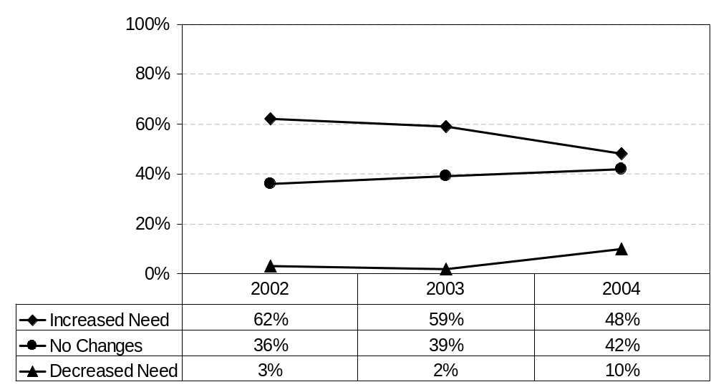
What changes do you anticipate in your organization’s need for aviation and aerospace professionals in the near future?
By Graduation Year: Daytona Beach
Employer Feedback Survey
Classes of 2000, 2002, 2003 & 2004: 1½ years after graduation
Employer Profile
Slide # <number>

Slide 25
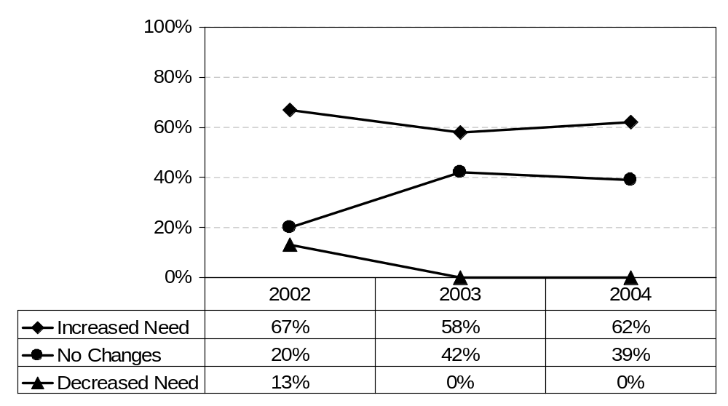
What changes do you anticipate in your organization’s need for aviation and aerospace professionals in the near future?
By Graduation Year: Prescott
Employer Feedback Survey
Classes of 2000, 2002, 2003 & 2004: 1½ years after graduation
Employer Profile
Slide # <number>

Slide 26
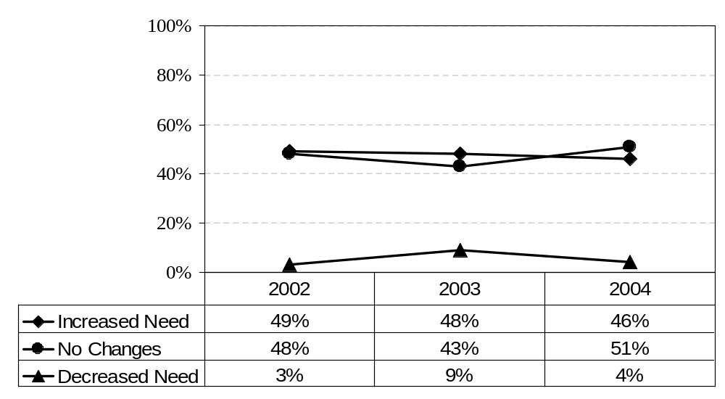
What changes do you anticipate in your organization’s need for aviation and aerospace professionals in the near future?
By Graduation Year: Worldwide Campus
Employer Feedback Survey
Classes of 2000, 2002, 2003 & 2004: 1½ years after graduation
Employer Profile
Slide # <number>

