Slide 1
The ERAU Graduate
Employer Feedback Survey
Classes of 2001, 2002, 2003 & 2004: 1½ years after graduation
The ERAU Graduate
Slide # <number>
The Employer Feedback Survey also measured the employer’s opinion of the ERAU graduate. Questions included an overall rating of the graduate’s education, their value as an employee and if they were a good candidate for promotion. Employers were also asked to compare the ERAU graduates’ knowledge and skill level to graduates from other institutions.
When results are presented by degree program, the number of respondents is included in parentheses next to the degree program. Only degree programs with three or more respondents are shown. See the degree program profiles for more information. Any numeric inconsistencies are due to the rounding of data.
Source: Institutional Research, June 2007

Slide 2
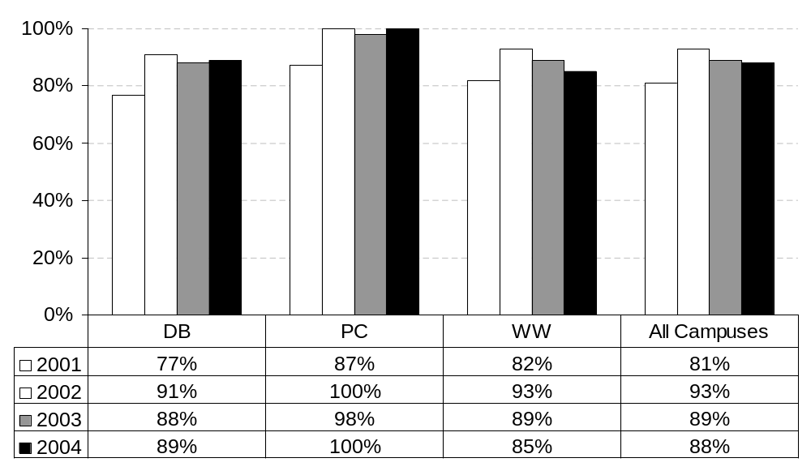
The education of the graduate meets our company’s need
(percent responding “strongly agree” or “agree”)
By Graduation Year: All Campuses
Employer Feedback Survey
Classes of 2001, 2002, 2003 & 2004: 1½ years after graduation
The ERAU Graduate
Slide # <number>
Source: Institutional Research, June 2007

Slide 3
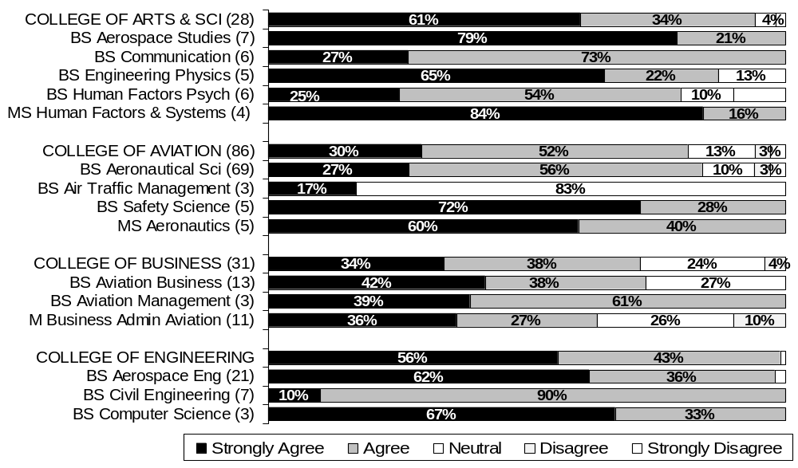
The education of the graduate meets our company’s needs
By College and Degree Program: Daytona Beach
All Years: Combined
Employer Feedback Survey
Classes of 2001, 2002, 2003 & 2004: 1½ years after graduation
The ERAU Graduate
Slide # <number>
Source: Institutional Research, June 2007

Slide 4
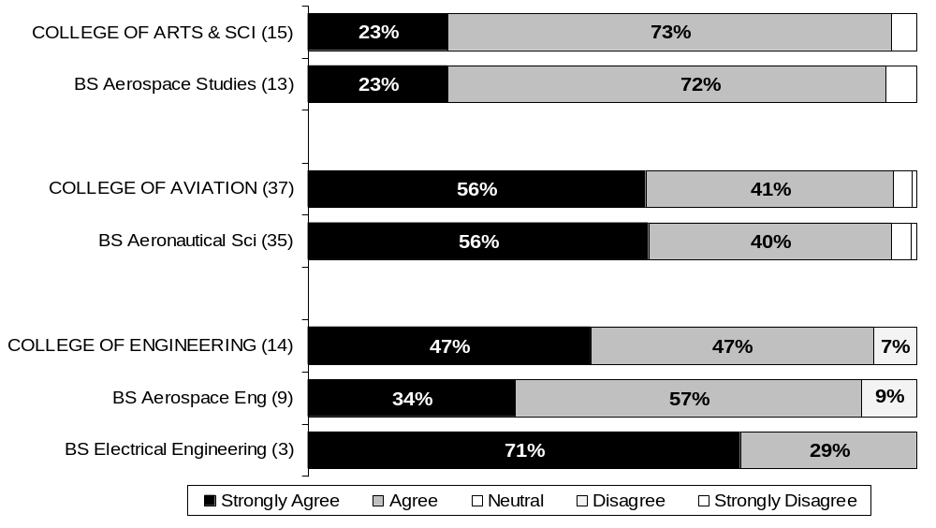
The education of the graduate meets our company’s needs
By College and Degree Program: Prescott
All Years: Combined
Employer Feedback Survey
Classes of 2001, 2002, 2003 & 2004: 1½ years after graduation
The ERAU Graduate
Slide # <number>
Source: Institutional Research, June 2007

Slide 5
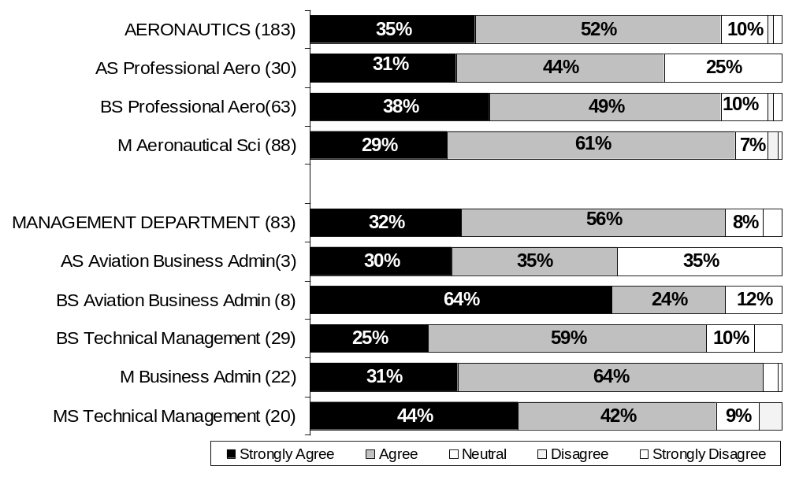
The education of the graduate meets our company’s needs
By Department and Degree Program: Worldwide Campus
All Years: Combined
Employer Feedback Survey
Classes of 2001, 2002, 2003 & 2004: 1½ years after graduation
The ERAU Graduate
Slide # <number>
Source: Institutional Research, June 2007

Slide 6
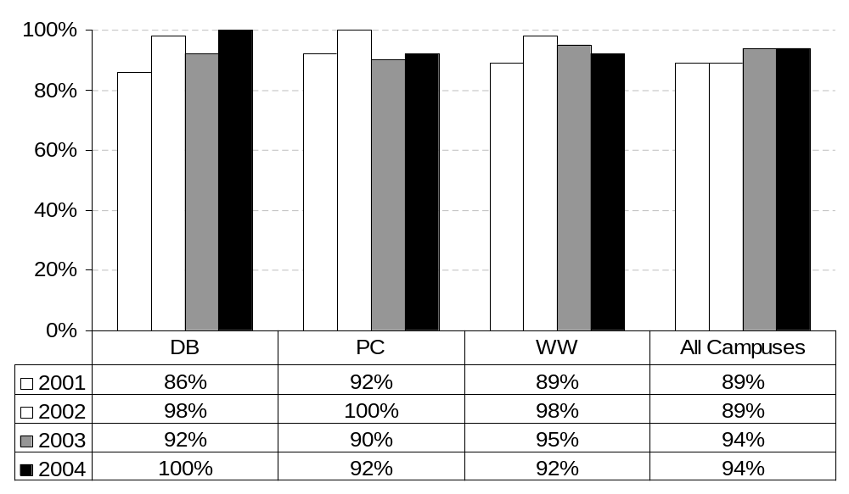
He/She is a valuable employee
(percent responding “strongly agree” or “agree”)
By Graduation Year: All Campuses
Employer Feedback Survey
Classes of 2001, 2002, 2003 & 2004: 1½ years after graduation
The ERAU Graduate
Slide # <number>
Source: Institutional Research, June 2007

Slide 7
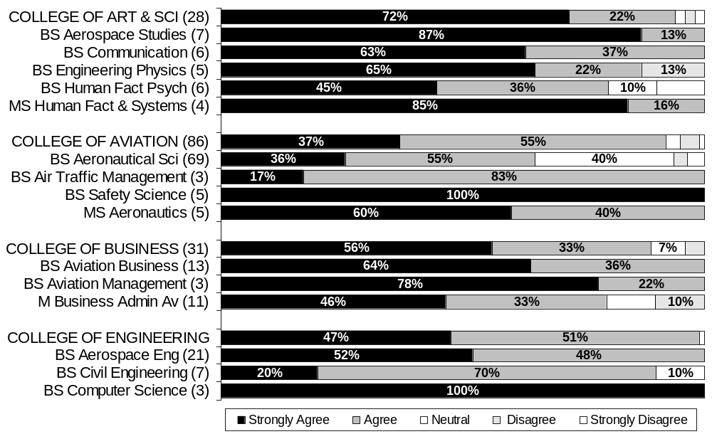
He/She is a valuable employee
By College and Degree Program: Daytona Beach
All Years: Combined
Employer Feedback Survey
Classes of 2001, 2002, 2003 & 2004: 1½ years after graduation
The ERAU Graduate
Slide # <number>
Source: Institutional Research, June 2007

Slide 8
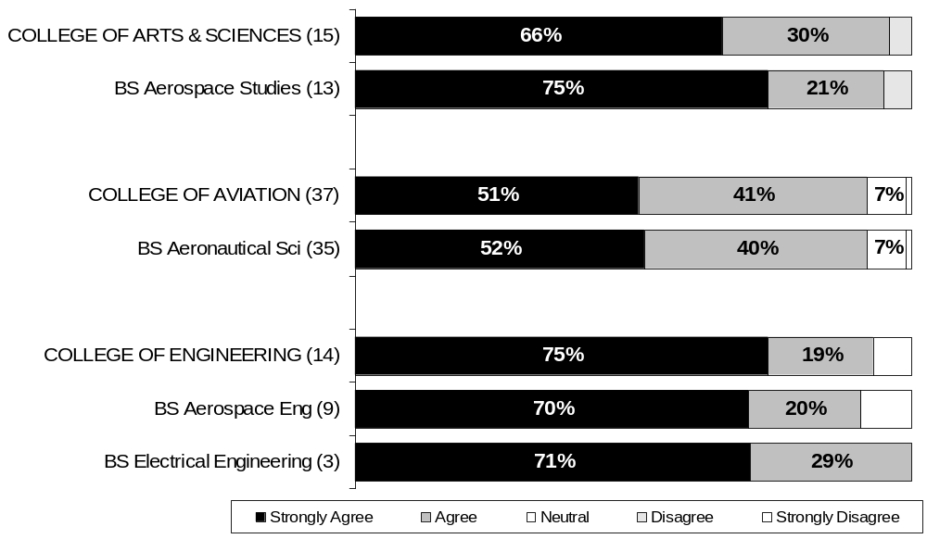
He/She is a valuable employee
By College and Degree Program: Prescott
All Years: Combined
Employer Feedback Survey
Classes of 2001, 2002, 2003 & 2004: 1½ years after graduation
The ERAU Graduate
Slide # <number>
Source: Institutional Research, June 2007

Slide 9
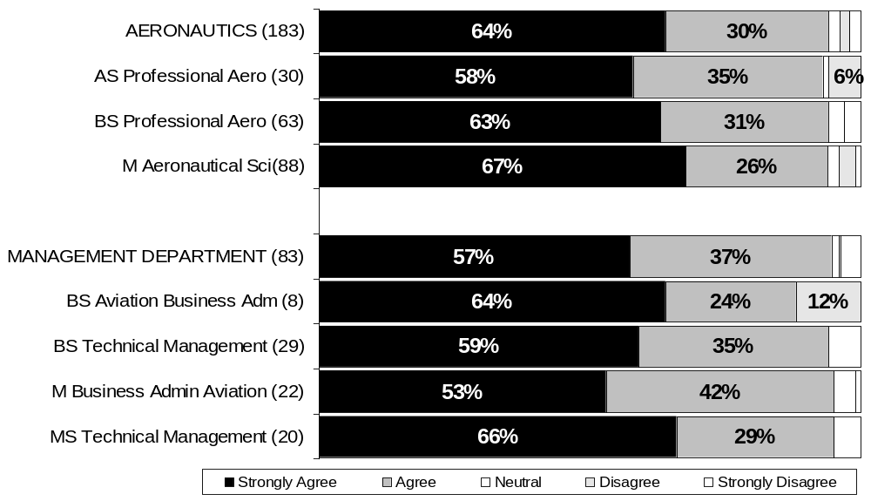
He/She is a valuable employee
By Department and Degree Program: Worldwide Campus
All Years: Combined
Employer Feedback Survey
Classes of 2001, 2002, 2003 & 2004: 1½ years after graduation
The ERAU Graduate
Slide # <number>
Source: Institutional Research, June 2007

Slide 10
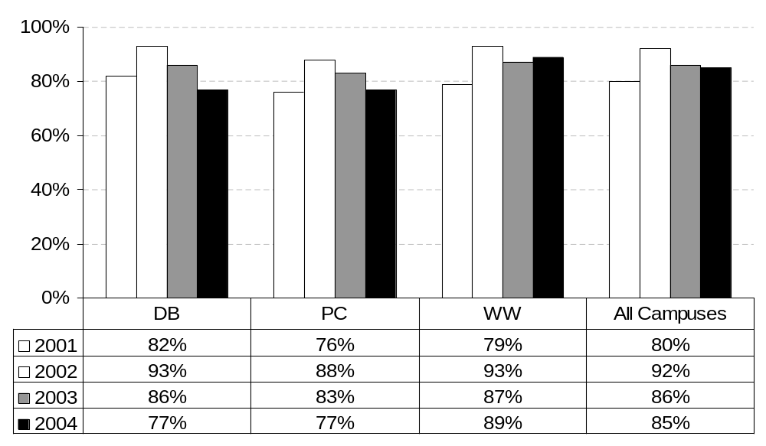
He/She is a good candidate for promotion
(percent responding “strongly agree” or “agree”)
By Graduation Year: All Campuses
Employer Feedback Survey
Classes of 2001, 2002, 2003 & 2004: 1½ years after graduation
The ERAU Graduate
Slide # <number>
Source: Institutional Research, June 2007

Slide 11
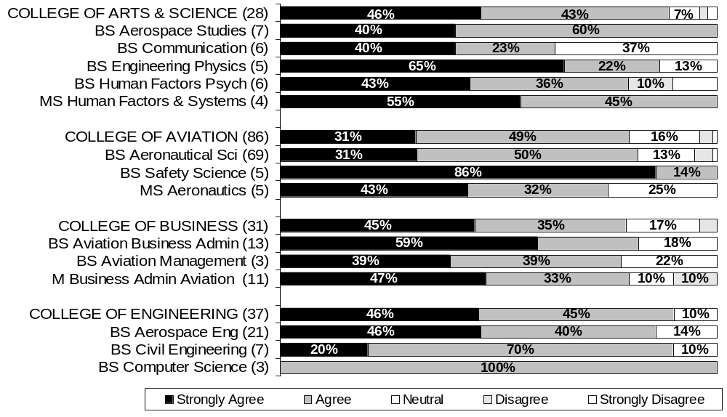
He/She is a good candidate for promotion
By College and Degree Program: Daytona Beach
All Years: Combined
Employer Feedback Survey
Classes of 2001, 2002, 2003 & 2004: 1½ years after graduation
The ERAU Graduate
Slide # <number>
Source: Institutional Research, June 2007

Slide 12
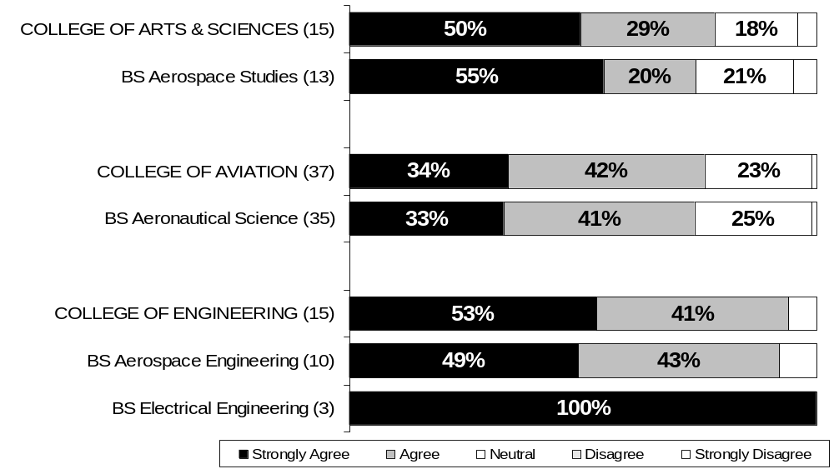
He/She is a good candidate for promotion
By College and Degree Program: Prescott
All Years: Combined
Employer Feedback Survey
Classes of 2001, 2002, 2003 & 2004: 1½ years after graduation
The ERAU Graduate
Slide # <number>
Source: Institutional Research, June 2007

Slide 13
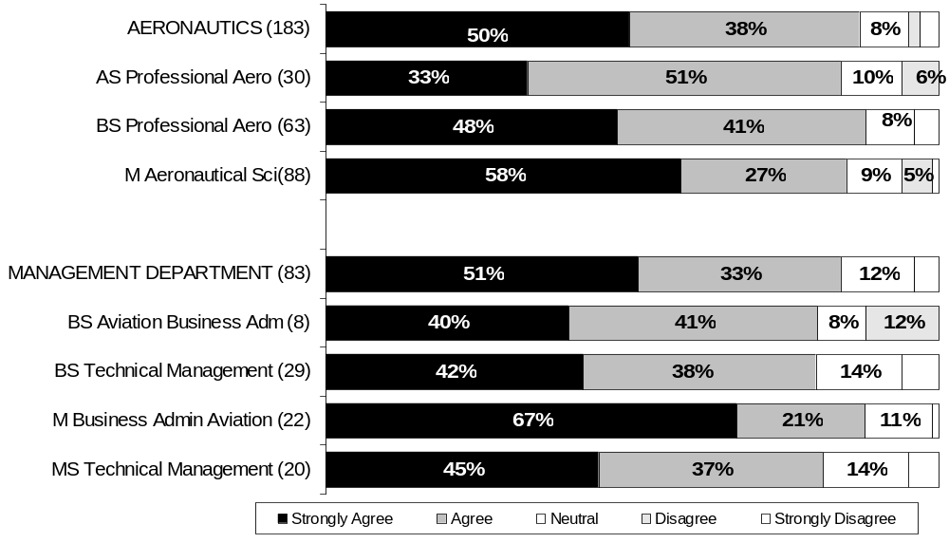
He/She is a good candidate for promotion
By Department and Degree Program: Worldwide Campus
All Years: Combined
Employer Feedback Survey
Classes of 2001, 2002, 2003 & 2004: 1½ years after graduation
The ERAU Graduate
Slide # <number>
Source: Institutional Research, June 2007

Slide 14
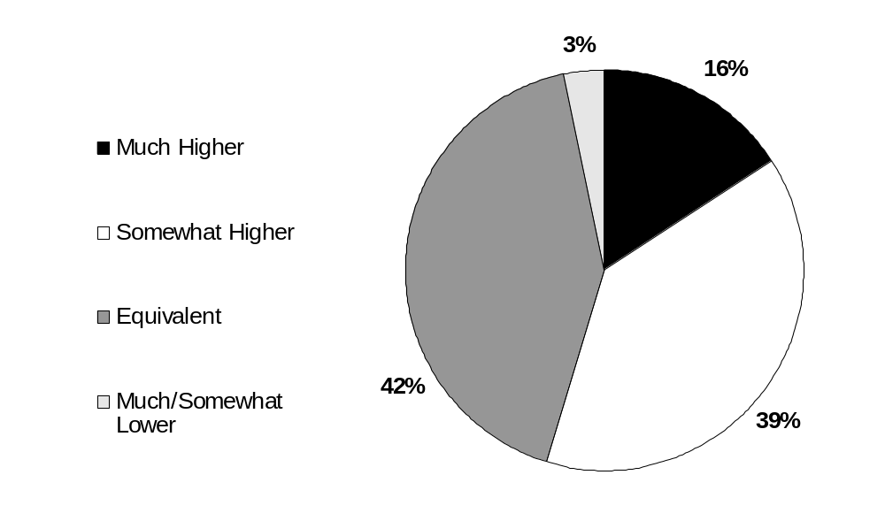
Compared to graduates from other institutions, his/her knowledge and skill level is:
All Campuses
All Years: Combined
Employer Feedback Survey
Classes of 2001, 2002, 2003 & 2004: 1½ years after graduation
The ERAU Graduate
Slide # <number>
Source: Institutional Research, June 2007

Slide 15
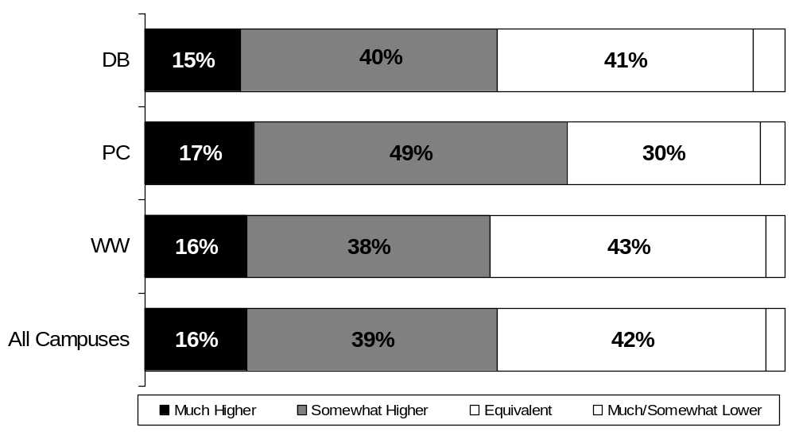
Compared to graduates from other institutions, his/her knowledge and skill level is:
All Campuses
All Years: Combined
Employer Feedback Survey
Classes of 2001, 2002, 2003 & 2004: 1½ years after graduation
The ERAU Graduate
Slide # <number>
Source: Institutional Research, June 2007

Slide 16
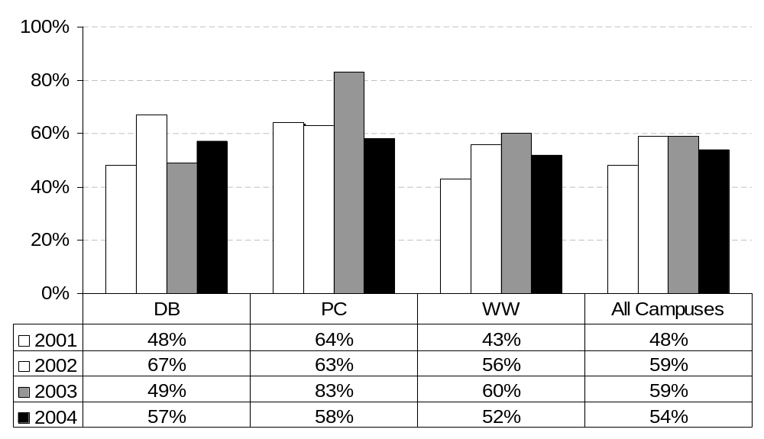
Compared to graduates from other institutions, his/her knowledge and skill level is:
By Graduation Year: All Campuses
(percent responding “ much higher” or “somewhat higher”)
Employer Feedback Survey
Classes of 2001, 2002, 2003 & 2004: 1½ years after graduation
The ERAU Graduate
Slide # <number>
Source: Institutional Research, June 2007

Slide 17
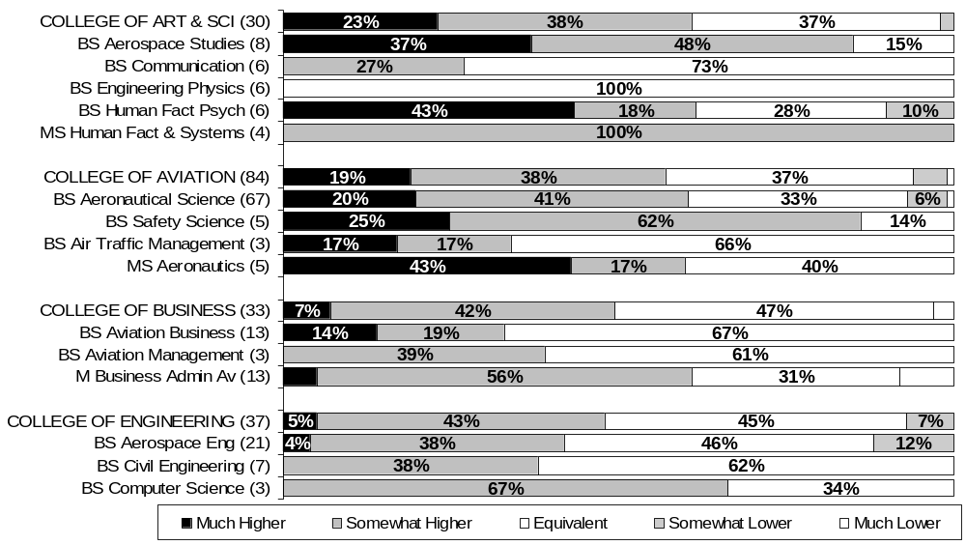
Compared to graduates from other institutions, his/her knowledge and skill level is:
By College and Degree Program: Daytona Beach
All years: Combined
Employer Feedback Survey
Classes of 2001, 2002, 2003 & 2004: 1½ years after graduation
The ERAU Graduate
Slide # <number>
Source: Institutional Research, June 2007

Slide 18
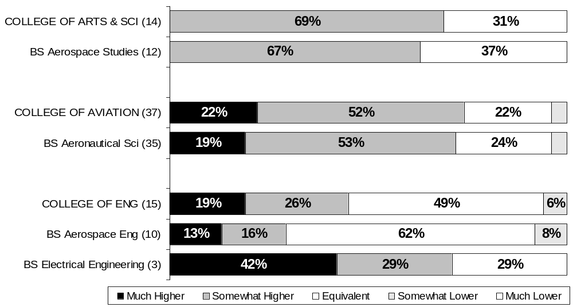
Compared to graduates from other institutions, his/her knowledge and skill level is:
By College and Degree Program: Prescott
All Years: Combined
Employer Feedback Survey
Classes of 2001, 2002, 2003 & 2004: 1½ years after graduation
The ERAU Graduate
Slide # <number>
Source: Institutional Research, June 2007

Slide 19
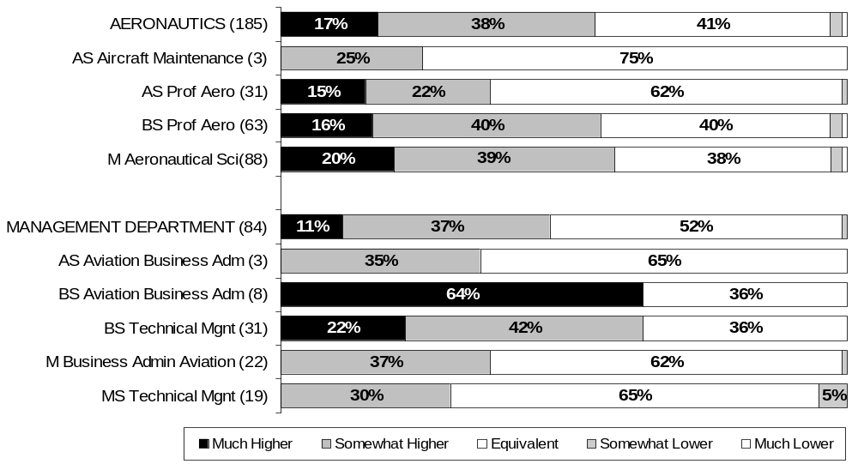
Compared to graduates from other institutions, his/her knowledge and skill level is:
By College & Degree Program: Worldwide Campus
All Years: Combined
Employer Feedback Survey
Classes of 2001, 2002, 2003 & 2004: 1½ years after graduation
The ERAU Graduate
Slide # <number>
Source: Institutional Research, June 2007

