Slide 1
Usefulness and Competence of General Skills
This section shows the employers’ rating of the usefulness of general skills on the job the graduates’ level of competence at these skills and a comparison of ERAU graduates’ level of competence in general skills to other graduates’ level of competence at the same skills.
The scatterplots display the means of x-axis (ERAU graduates’ competence of general skills on the job) and the y-axis (usefulness of general skills on the job). Plotting the level of competence on the x-axis and the usefulness on the y-axis creates a matrix which allows for analysis of the data taking competence and usefulness into consideration at the same time.
The grid lines on the graph represent the median competence and the median usefulness score. These gridlines create quadrants on the graph which designate areas of institutional strength (high ERAU competence and high usefulness) and also institutional challenges (low ERAU competence and high usefulness). The letter corresponding to a skill is in place of a point in the scatterplots. A skill legend is included for reference in slide 2.
When results are presented by degree program, the number of respondents is included in parentheses next to the degree program. Only degree programs with three or more respondents are shown. See the degree program profiles for more information. Any numeric inconsistencies are due to the rounding of data.

Slide 2
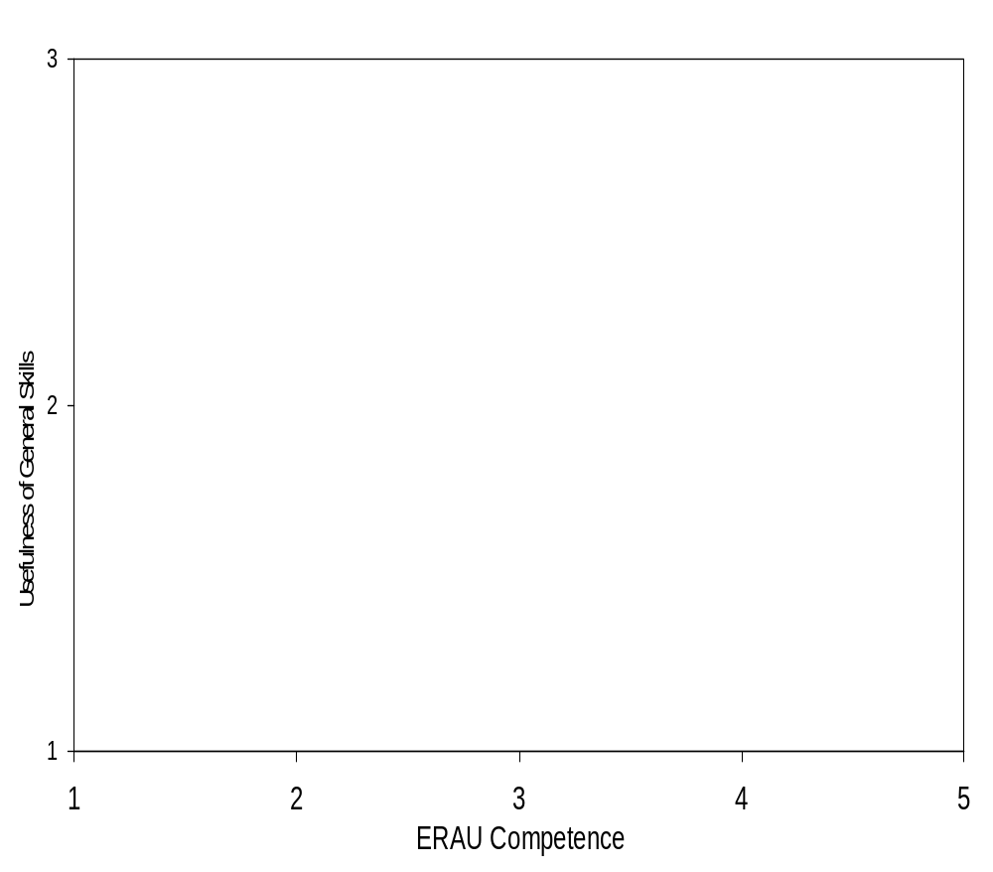
Sample Scatterplot
SKILL LEGEND
Quantitative/Mathematics | A
Basic PC Software (word processing, spreadsheets, etc.) | B
Writing Skills (non-technical) | C
Technical Writing | D
Speaking Before an Audience | E
Listening Skills | F
Applied Research (information gathering and analysis) | G
Critical Thinking | H
Independent Work | I
Planning, Scheduling, and Carrying Out Projects | J
Defining and Solving Problems | K
Working in Groups/Teams | L
Leading/Guiding Others | M
Responsible Actions and Decision Making | N
Ability to adapt to change | O
Understanding Other People and Other Points of View | P
Environmental Awareness | Q
Political and Economic Awareness | R
Knowledge of Political Importance | S
Quadrant IV
Institutional Challenges
High Usefulness
Low ERAU Competence
Quadrant I
Institutional Strengths
High Usefulness
High ERAU Competence
Quadrant III
Low Usefulness
Low ERAU Competence
Quadrant II
Institutional Strengths
Low Usefulness
High ERAU Competence

Slide 3
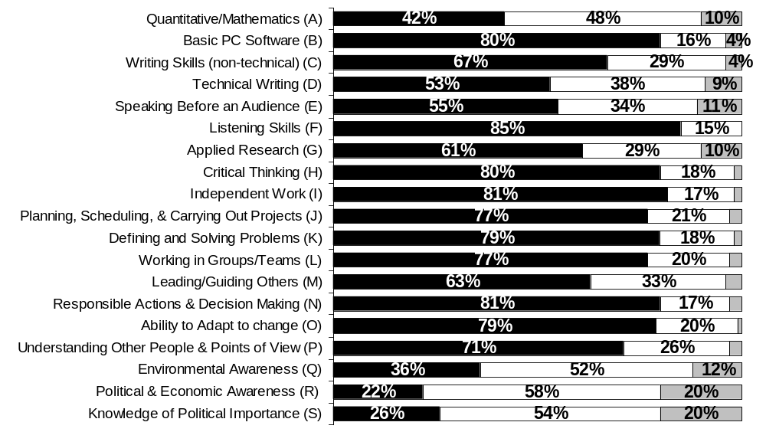
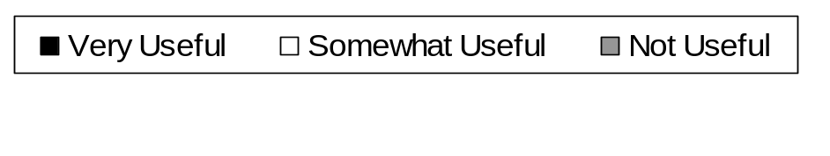
Usefulness of general skill on the job
All Campuses
All Years: Combined
Note: Includes all degree levels.

Slide 4
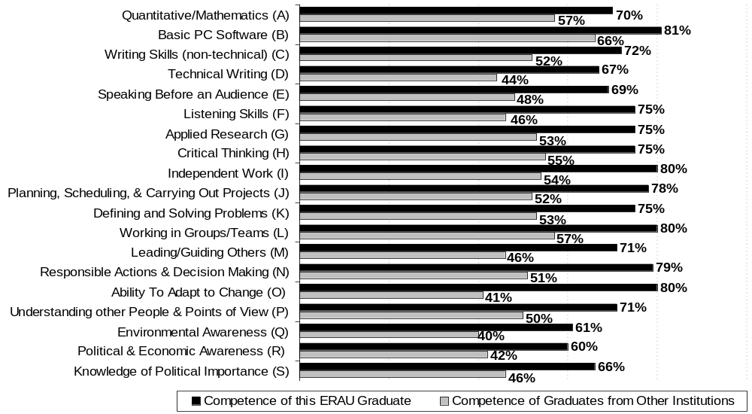
Competence of the ERAU graduate at general skills vs. other graduates
All Campuses
All Years: Combined
(percent responding ‘excellent’ or ‘good’)

Slide 5
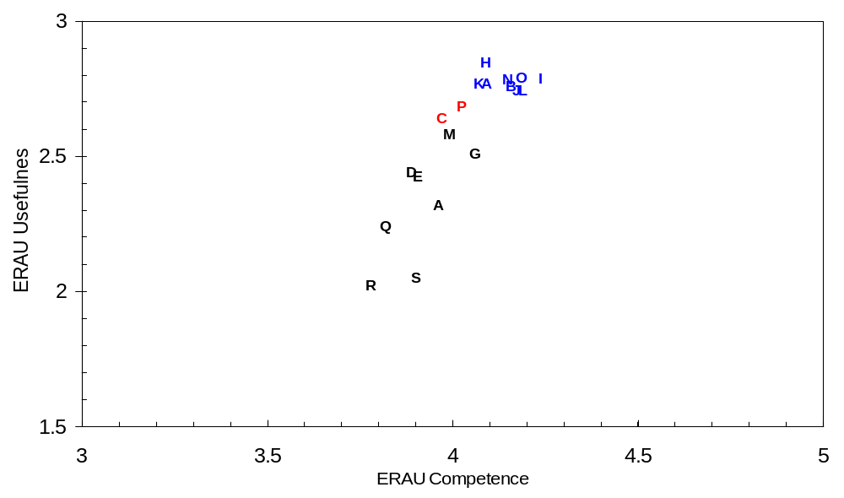
Usefulness of general skills vs. competence of ERAU graduate
All Campuses
All Years: Combined
High Usefulness
Low Competence
High Usefulness
High Competence
Low Usefulness
Low Competence
Low Usefulness
High Competence

Slide 6
Usefulness of general skills vs. competence of ERAU graduate
All Campuses
All Years: Combined
Scatter Plot Results
High Usefulness of General Skills and High Competence of ERAU Graduates
# A Quantitative Mathematics
# B Basic PC Software
# H Critical Thinking
# I Independent Work
# J Planning, Scheduling, and carrying out projects
# K Defining and Solving Problems
# L Working in Groups/Teams
# N Responsible Actions and Decision making
# O Environmental Awareness
High Usefulness of General Skills and Low Competence of ERAU Graduates
# C Writing Skills (non-technical)
# P Understanding Other People and Other Points of View

Slide 7
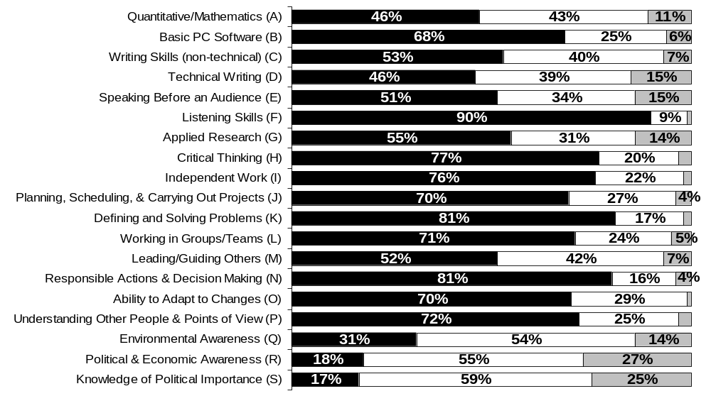

Usefulness of general skill on the job
Daytona Beach
All Years: Combined
Note: Includes all degree levels.

Slide 8
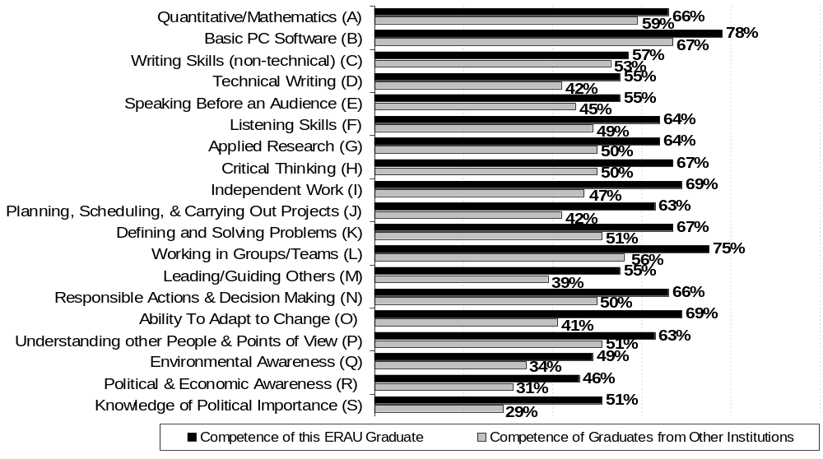
Competence of the ERAU graduate at general skills vs. other graduates
Daytona Beach
All Years: Combined
(Percent responding ‘Excellent’ or ‘Good’)

Slide 9
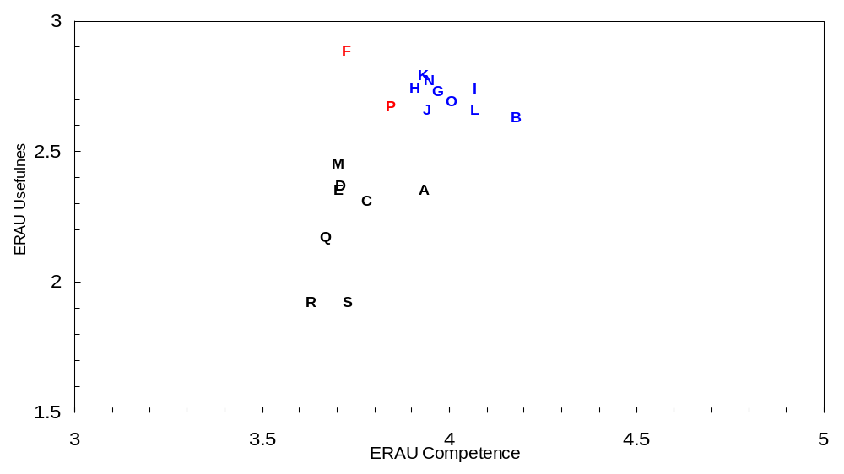
Usefulness of general skill vs. competence of ERAU graduate
Daytona Beach
All Years: Combined
High Usefulness
Low Competence
High Usefulness
High Competence
Low Usefulness
Low Competence
Low Usefulness
High Competence

Slide 10
Usefulness of general skills vs. competence of ERAU graduate
Daytona Beach
All Years: Combined
Scatter Plot Results
High Usefulness of General Skills and High Competence of ERAU Graduates
# B Basic PC Software
# G Applied Research
# H Critical Thinking
# I Independent Work
# J Planning, Scheduling, and Carrying out projects
# K Defining and solving problems
# L Working in groups/ teams
# N Responsible Actions and Decision Making
# O Environmental Awareness
High Usefulness of General Skills and Low Competence of ERAU Graduates
# F Listening Skills
# P Understanding Other People and Other Points of View

Slide 11
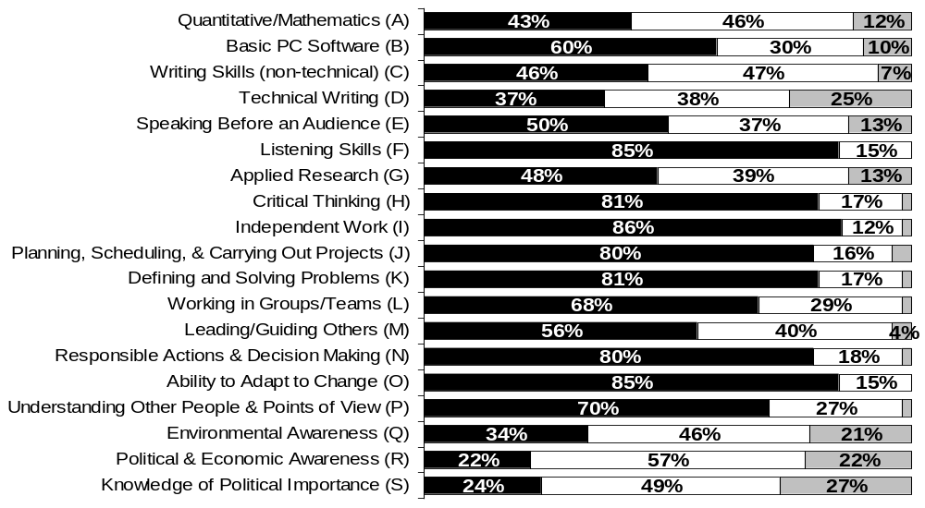

Usefulness of general skill on the job
Prescott
All Years: Combined
Note: Includes all degree levels.

Slide 12
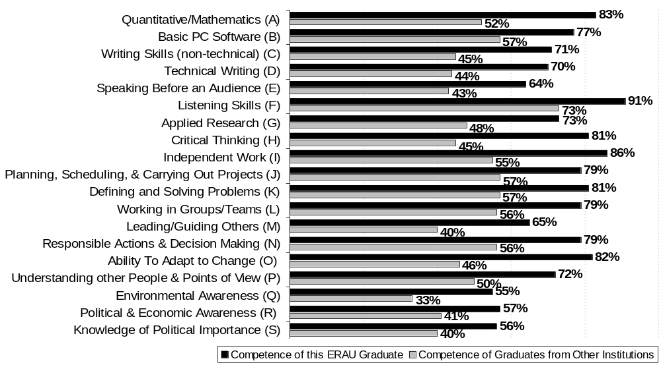
Competence of the ERAU graduate at general skills vs. other graduates
Prescott
All Years: Combined
(percent responding ‘excellent’ or ‘good’)

Slide 13
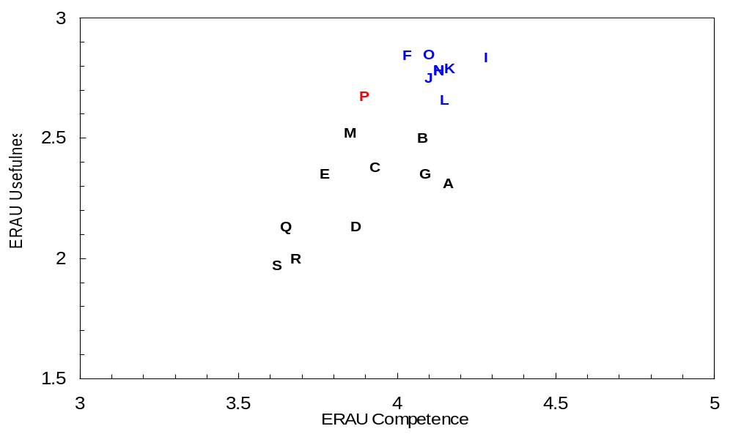
Usefulness of general skill vs. competence of ERAU graduate
Prescott
All Years: Combined
High Usefulness
Low Competence
High Usefulness
High Competence
Low Usefulness
Low Competence
Low Usefulness
High Competence

Slide 14
Usefulness of general skills vs. competence of ERAU graduate
Prescott Campus
All Years: Combined
Scatter Plot Results
High Usefulness of General Skills and High Competence of ERAU Graduates
# F Listening Skills
# H Critical Thinking
# I Independent Work
# J Planning, Scheduling, and carrying out projects
# K Defining and solving problems
# L Working in groups/teams
# N Responsible Actions and Decision making
# O Environmental Awareness
High Usefulness of General Skills and Low Competence of ERAU Graduates
# P Understanding other people and other points of view

Slide 15
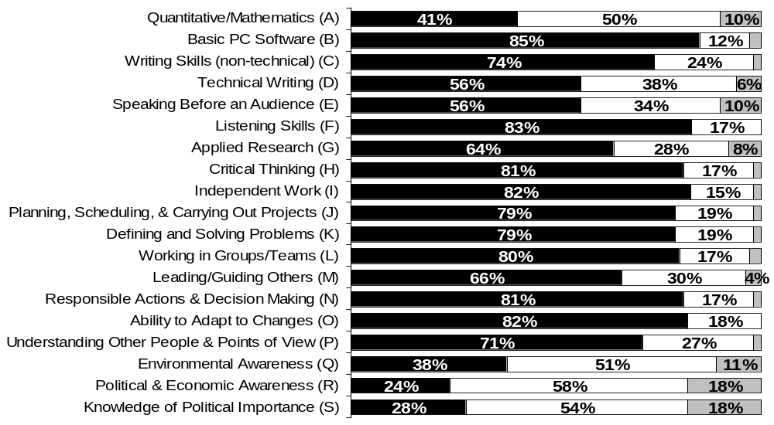
Usefulness of general skill on the job
Worldwide Campus
All Years: Combined
Note: Includes all degree levels.

Slide 16
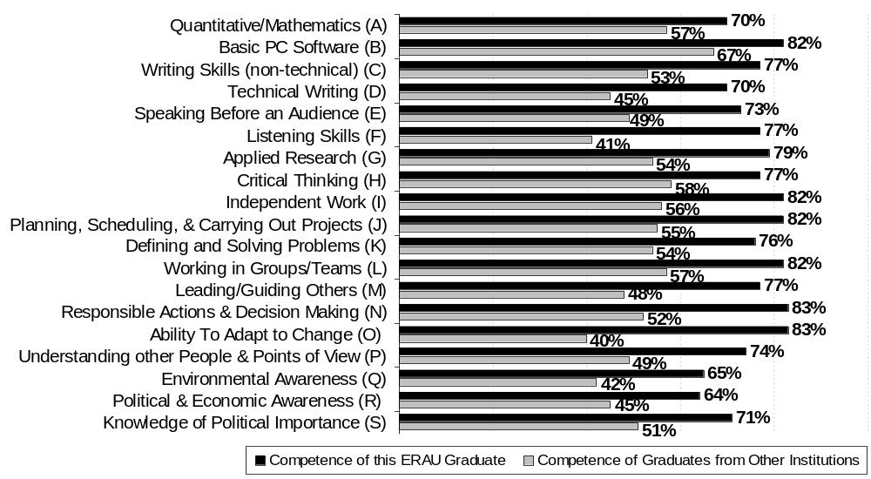
Competence of the ERAU graduate at general skills vs. other graduates
Worldwide Campus
All Years: Combined
(percent responding ‘excellent’ or ‘good’)

Slide 17
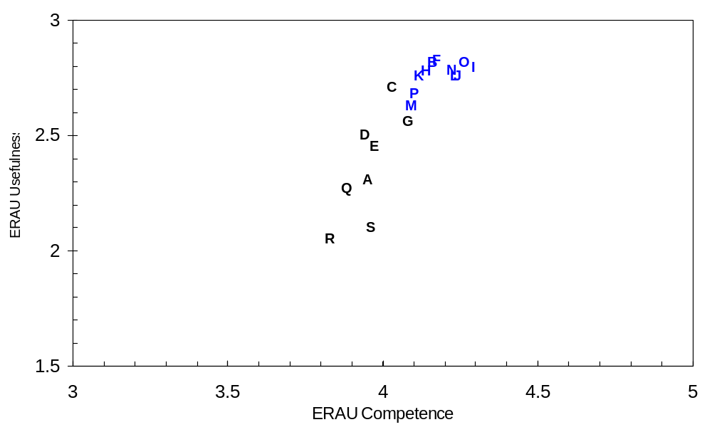
Usefulness of general skills vs. competence of ERAU graduate
Worldwide Campus
All Years: Combined
High Usefulness
Low Competence
High Usefulness
High Competence
Low Usefulness
Low Competence
Low Usefulness
High Competence

Slide 18
Usefulness of general skills vs. competence of ERAU graduate
Worldwide Campus
All Years: Combined
Scatter Plot Results
High Usefulness of General Skills and High Competence of ERAU Graduates
# B Basic PC Software
# F Listening Skills
# H Critical Thinking
# I Independent Work
# J Planning, Scheduling, and Carrying out projects
# K Defining and solving Problems
# L Working in groups/teams
#M Leading/Guiding Others
# N Responsible Actions and Decision Making
#O Environmental Awareness
#P Understanding Other People and Other Points of View
High Usefulness of General Skills and Low Competence of ERAU Graduates
None Noted

Slide 19
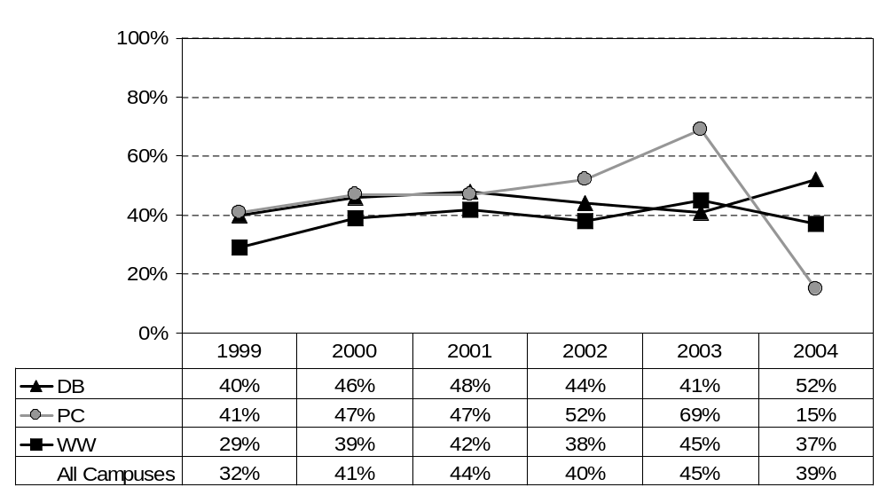
Usefulness of general skills on the job:
Quantitative/Mathematics
(percent responding "very useful")

Slide 20
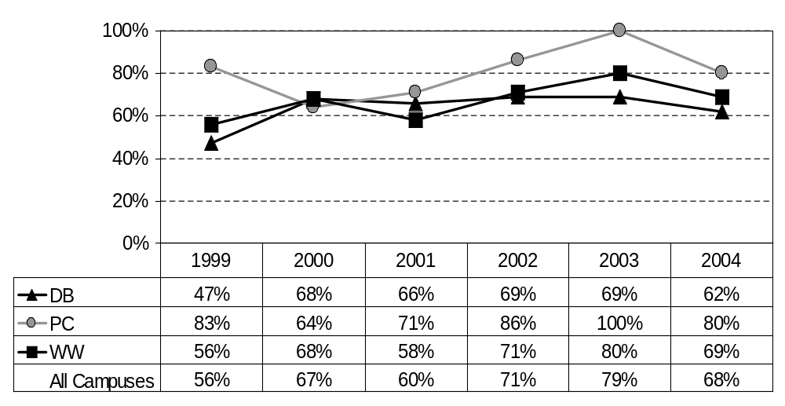
Competence of the ERAU graduate at general skills:
Quantitative/Mathematics
(percent responding "excellent" or "good")
Note: Response scale changed in ’03; “excellent” and “good” were the top two choices as of ’03, “very good” or “good” were the top two choices for ’01 and ’02, “excellent” & ”very good” were the two top choices prior to ’01. Includes all degree levels.

Slide 21
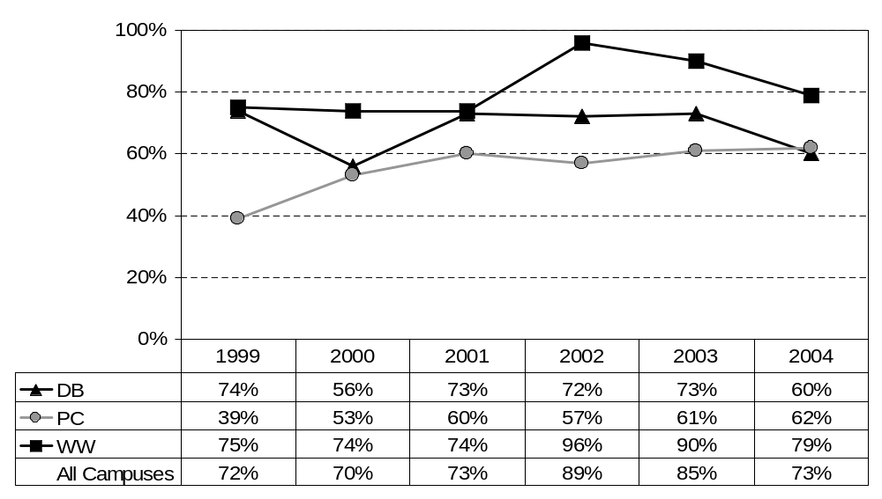
Usefulness of general skills on the job:
Basic PC Software
(percent responding "very useful")

Slide 22
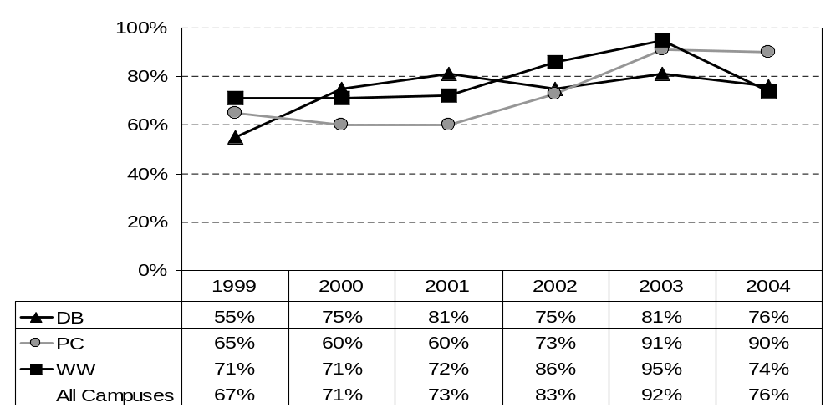
Competence of the ERAU graduate at general skills:
Basic PC Software
(percent responding "excellent" or "good")
Note: Response scale changed in ’03; “excellent” and “good” were the top two choices as of ’03, “very good” or “good” were the top two choices for ’01 and ’02, “excellent” & ”very good” were the two top choices prior to ’01. Includes all degree levels.

Slide 23
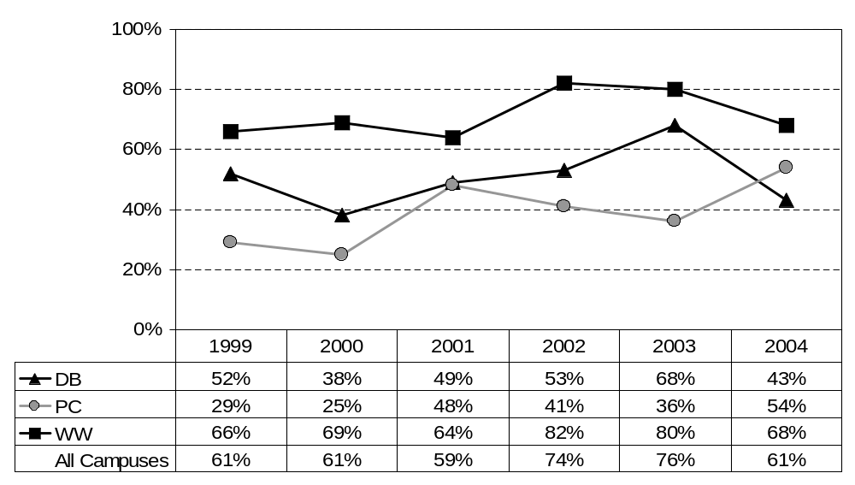
Usefulness of general skills on the job:
Writing Skills (non-technical)
(percent responding "very useful")

Slide 24
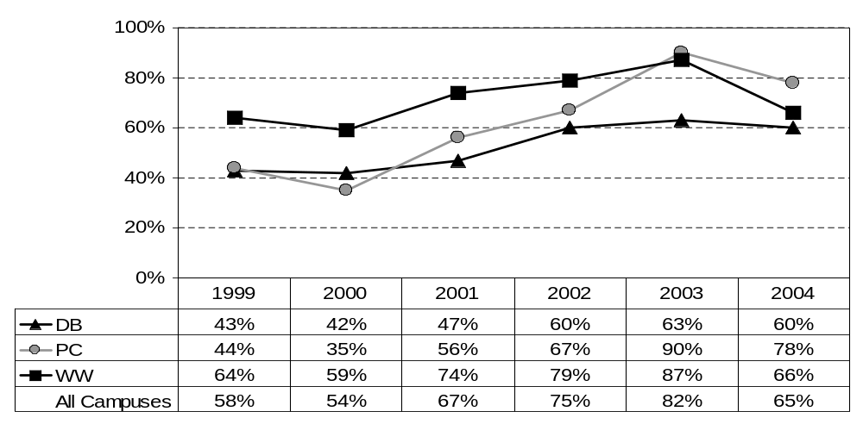
Competence of the ERAU graduate at general skills:
Writing Skills (non-technical)
(percent responding "excellent" or "good")
Note: Response scale changed in ’03; “excellent” and “good” were the top two choices as of ’03, “very good” or “good” were the top two choices for ’01 and ’02, “excellent” & ”very good” were the two top choices prior to ’01. Includes all degree levels.

Slide 25
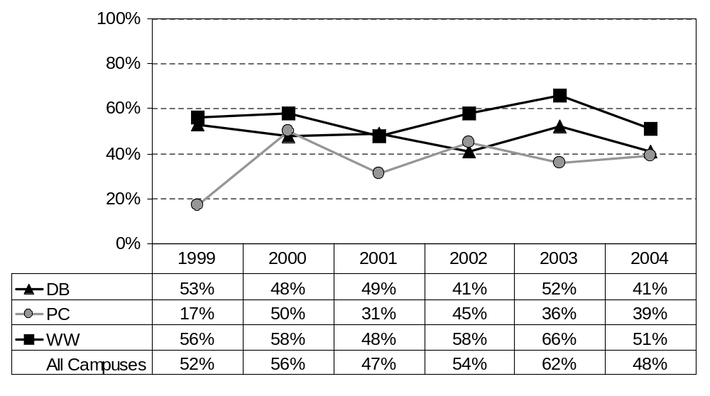
Usefulness of general skills on the job:
Technical Writing
(percent responding "very useful")

Slide 26
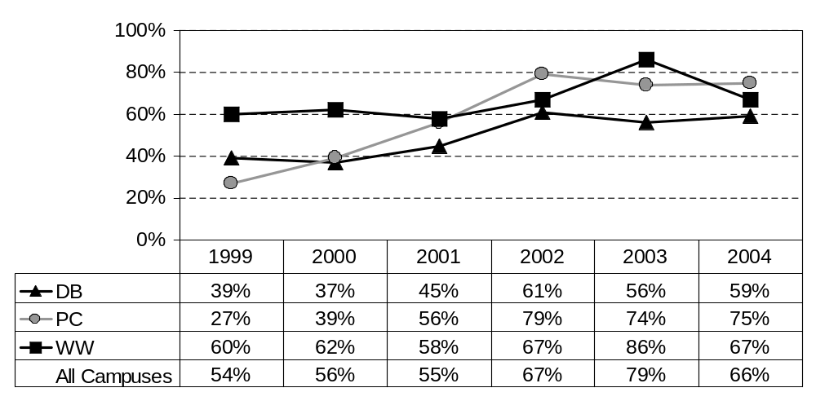
Competence of the ERAU graduate at general skills:
Technical Writing
(percent responding "excellent" or "good")
Note: Response scale changed in ’03; “excellent” and “good” were the top two choices as of ’03, “very good” or “good” were the top two choices for ’01 and ’02, “excellent” & ”very good” were the two top choices prior to ’01. Includes all degree levels.

Slide 27
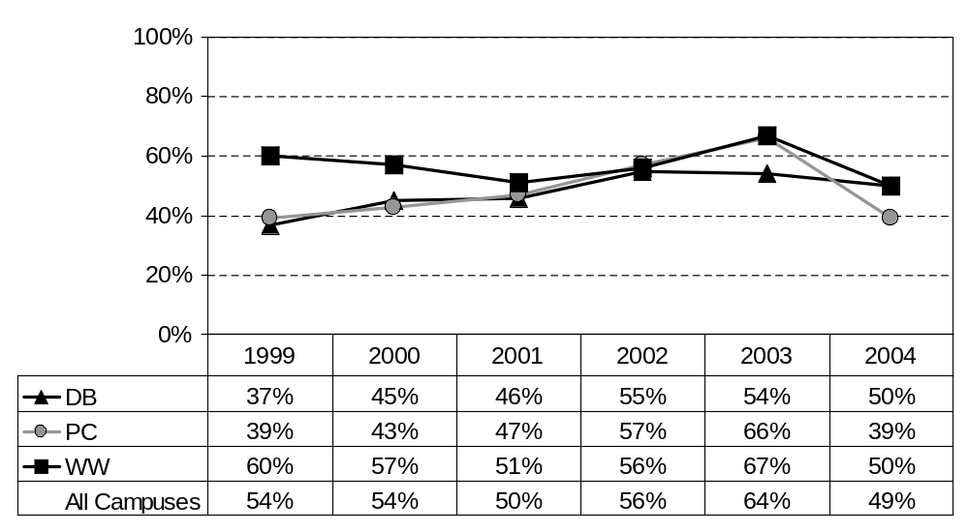
Usefulness of general skills on the job:
Speaking Before An Audience
(percent responding "very useful")

Slide 28
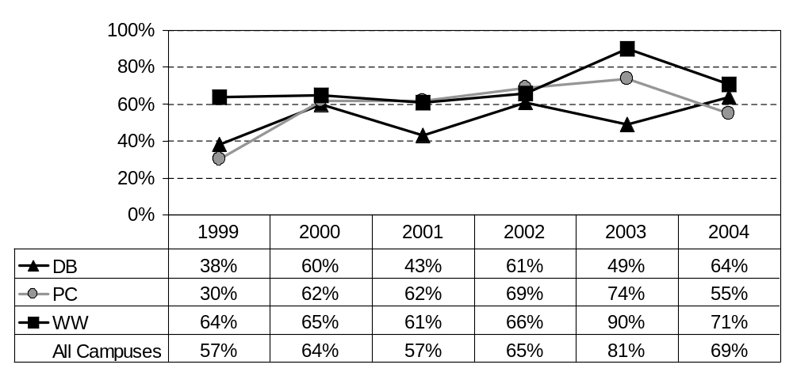
Competence of the ERAU graduate at general skills:
Speaking Before An Audience
(percent responding "excellent" or "good")
Note: Response scale changed in ’03; “excellent” and “good” were the top two choices as of ’03, “very good” or “good” were the top two choices for ’01 and ’02, “excellent” & ”very good” were the two top choices prior to ’01. Includes all degree levels.

Slide 29
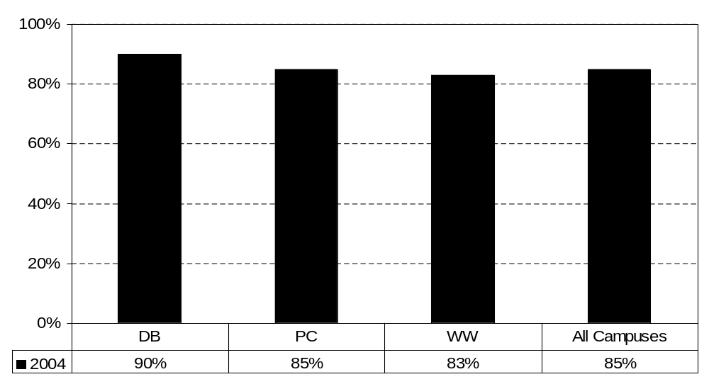
Usefulness of general skills on the job:
Listening Skills
(percent responding "very useful")

Slide 30
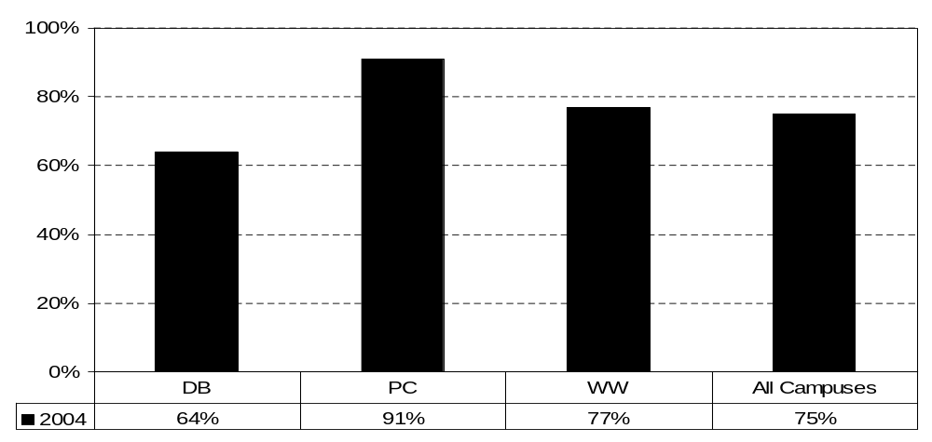
Competence of general skills on the job:
Listening Skills
(percent responding “excellent” or “good”)
Note: Response scale changed in ’03; “excellent” and “good” were the top two choices as of ’03, “very good” or “good” were the top two choices for ’01 and ’02, “excellent” & ”very good” were the two top choices prior to ’01. Includes all degree levels.

Slide 31
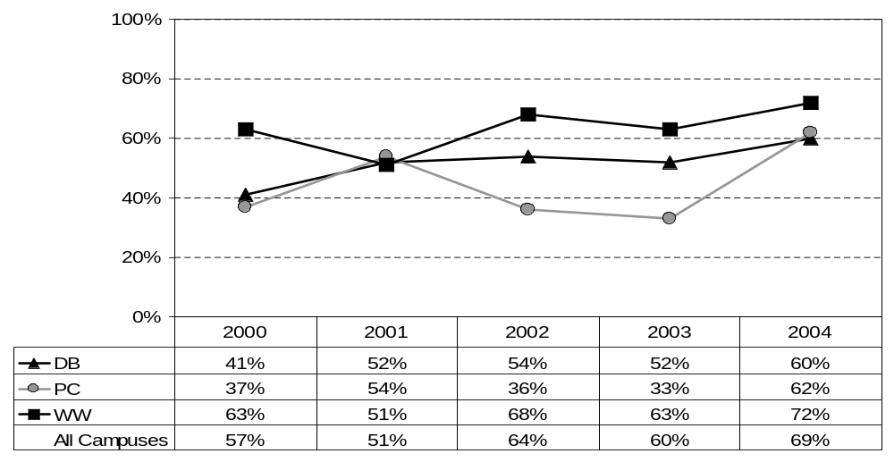
Usefulness of general skills on the job:
Applied Research
(percent responding "very useful")
Note: Applied Research replaced Library Research as of the Class of 2000 survey.

Slide 32
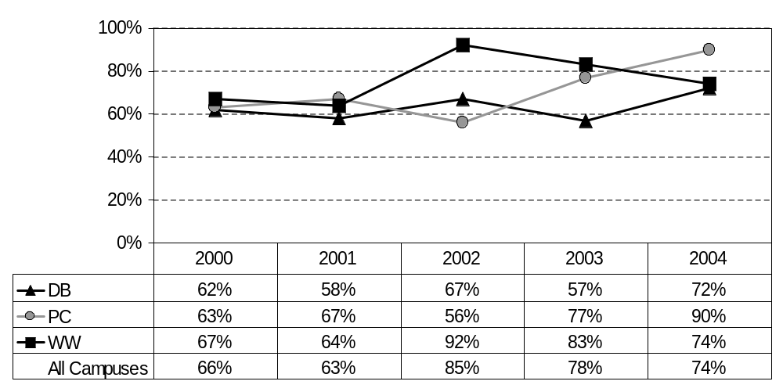
Competence of the ERAU graduate at general skills:
Applied Research
(percent responding "excellent" or "good")
Note: Applied Research replaced Library Research as of the Class of 2000. Response scale changed in ’03; “excellent” and “good” were the top two choices as of ’03, “very good” or “good” were the top two choices for ’01 and ’02, “excellent” & ”very good” were the two top choices prior to ’01. Includes all degree levels.

Slide 33
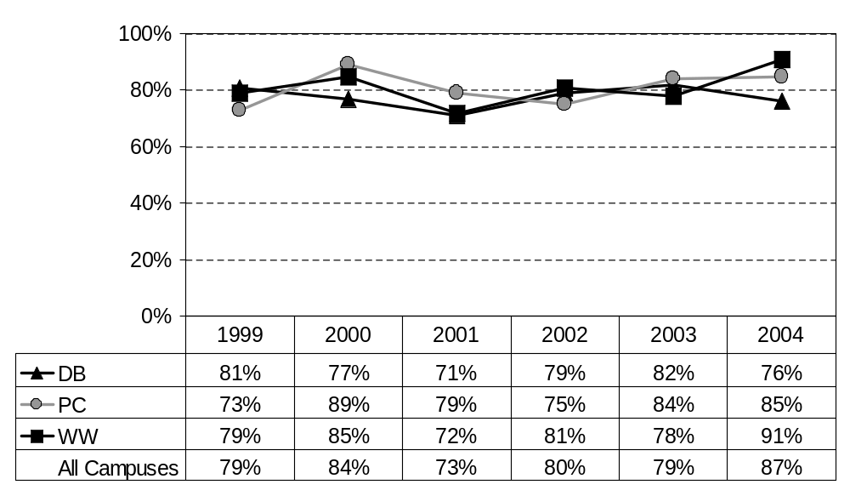
Usefulness of general skills on the job:
Critical Thinking
(percent responding "very useful")

Slide 34
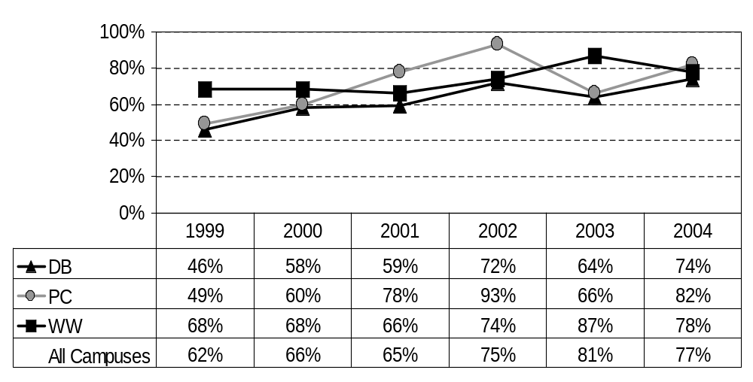
Competence of the ERAU graduate at general skills:
Critical Thinking
(percent responding "excellent" or "good")
Note: Response scale changed in ‘03; “excellent” and “good” were the top two choices as of ’03, “very good” or “good” were the top two choices for ’01 and ’02, “excellent” & ”very good” were the two top choices prior to ’01. Includes all degree levels.

Slide 35
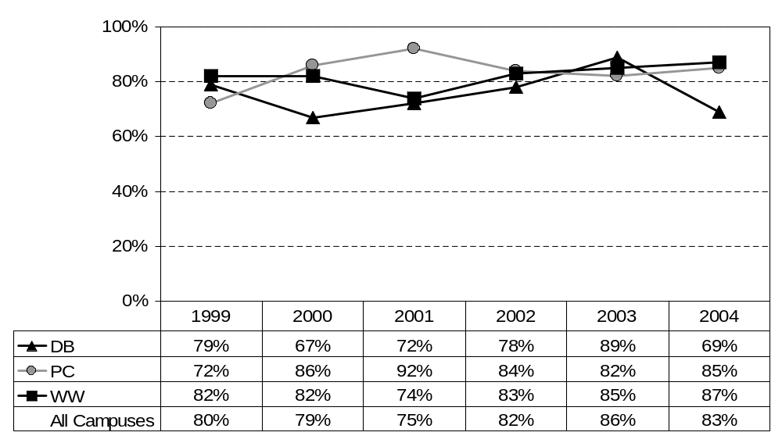
Usefulness of general skills on the job:
Independent Work
(percent responding "very useful")

Slide 36
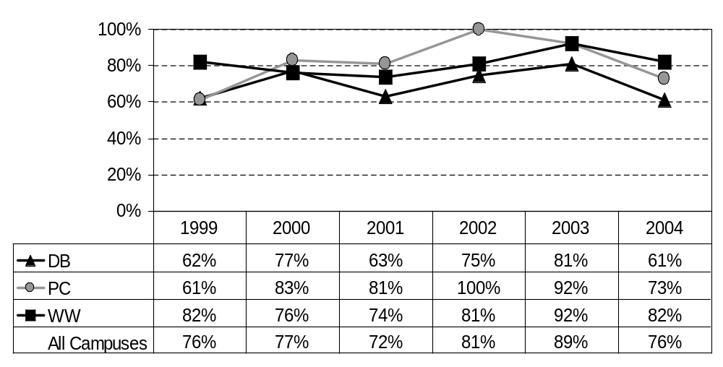
Competence of the ERAU graduate at general skills:
Independent Work
(percent responding "excellent" or "good")
Note: Response scale changed in ’03; “excellent” and “good” were the top two choices as of ’03, “very good” or “good” were the top two choices for ’01 and ’02, “excellent” & ”very good” were the two top choices prior to ’01. Includes all degree levels.

Slide 37
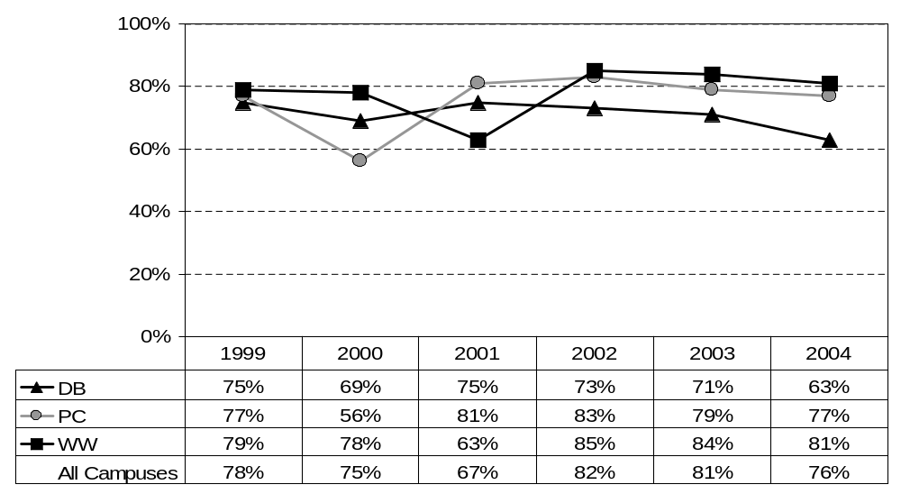
Usefulness of general skills on the job:
Planning, Scheduling, Carrying Out Projects
(percent responding "very useful")

Slide 38
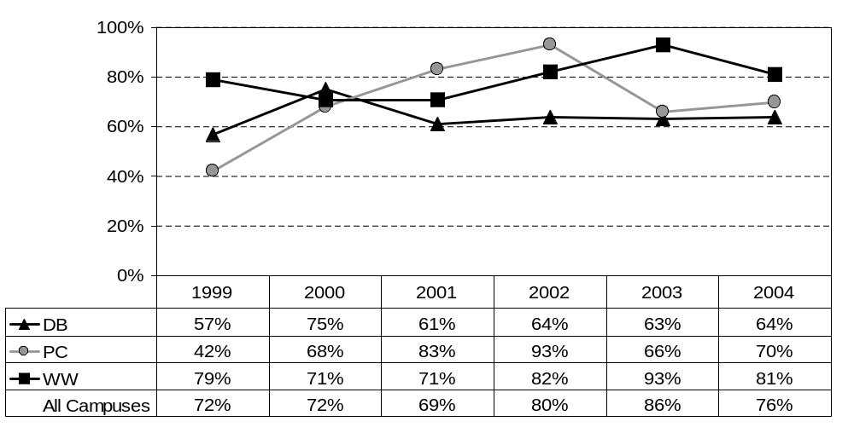
Competence of the ERAU graduate at general skills:
Planning, Scheduling, Carrying Out Projects
(percent responding "excellent" or "good")
Note: Response scale changed in ’03; “excellent” and “good” were the top two choices as of ’03, “very good” or “good” were the top two choices for ’01 and ’02, “excellent” & ”very good” were the two top choices prior to ’01. Includes all degree levels.

Slide 39
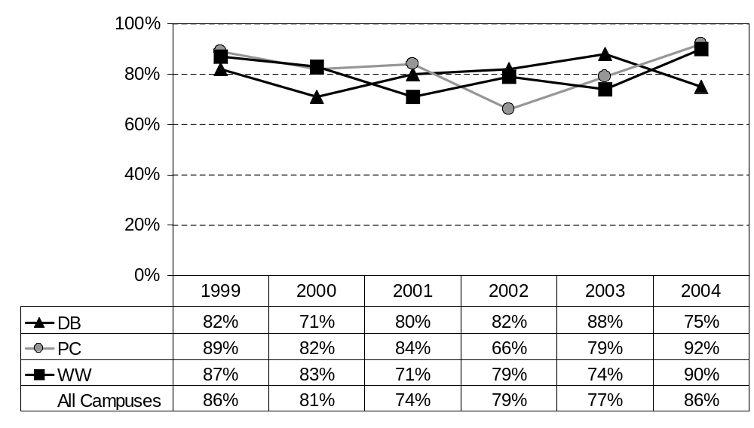
Usefulness of general skills on the job:
Defining and Solving Problems
(percent responding "very useful")

Slide 40
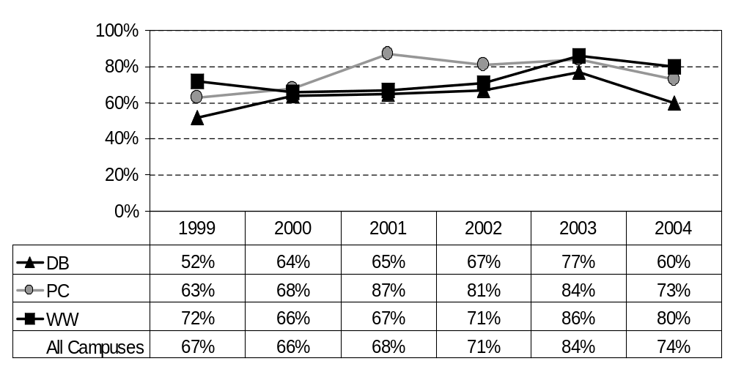
Competence of the ERAU graduate at general skills:
Defining and Solving Problems
(percent responding "excellent" or "good")
Note: Response scale changed in ’03; “excellent” and “good” were the top two choices as of ’03, “very good” or “good” were the top two choices for ’01 and ’02, “excellent” & ”very good” were the two top choices prior to ’01. Includes all degree levels.

Slide 41
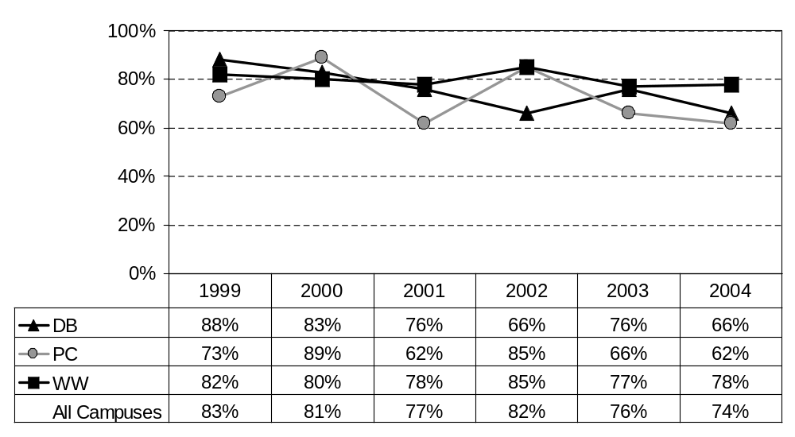
Usefulness of general skills on the job:
Working in Groups/Teams
(percent responding "very useful")

Slide 42
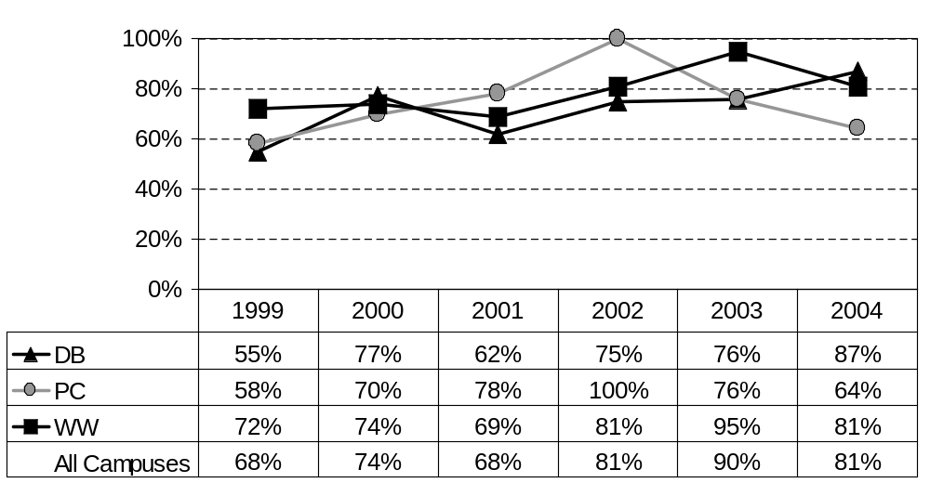
Competence of the ERAU graduate at general skills:
Working in Groups/Teams
(percent responding "excellent" or "good")
Note: Response scale changed in ’03; “excellent” and “good” were the top two choices as of ’03, “very good” or “good” were the top two choices for ’01 and ’02, “excellent” & ”very good” were the two top choices prior to ’01. Includes all degree levels.

Slide 43
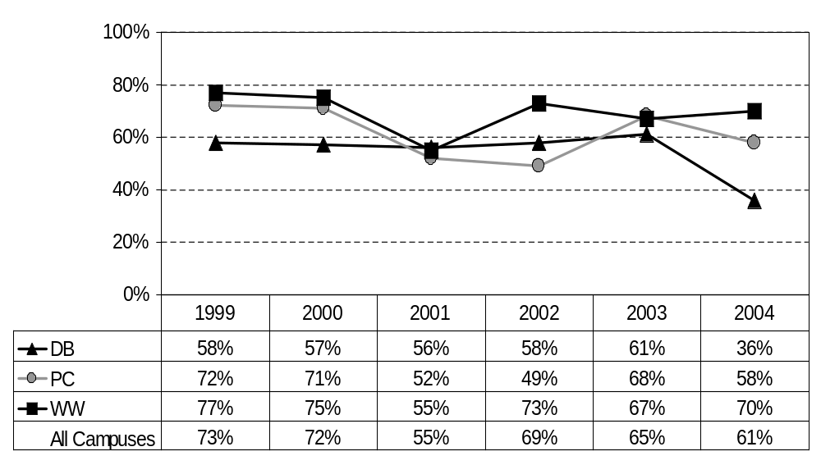
Usefulness of general skills on the job:
Leading/Guiding Others
(percent responding "very useful")

Slide 44
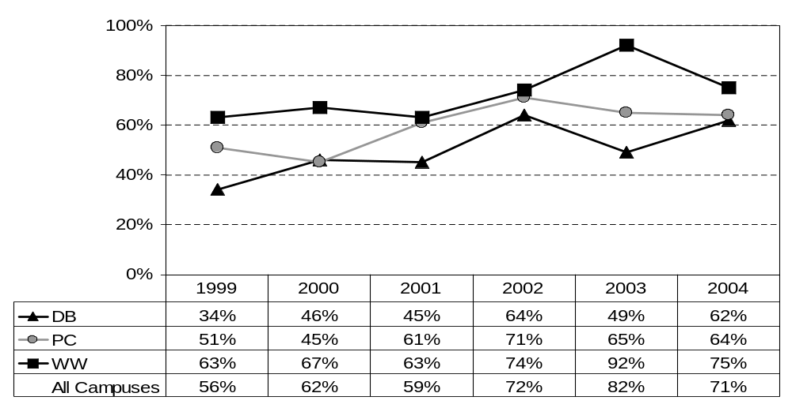
Competence of the ERAU graduate at general skills:
Leading/Guiding Others
(percent responding "excellent" or "good")
Note: Response scale changed in ’03; “excellent” and “good” were the top two choices as of ’03, “very good” or “good” were the top two choices for ’01 and ’02, “excellent” & ”very good” were the two top choices prior to ’01. Includes all degree levels.

Slide 45
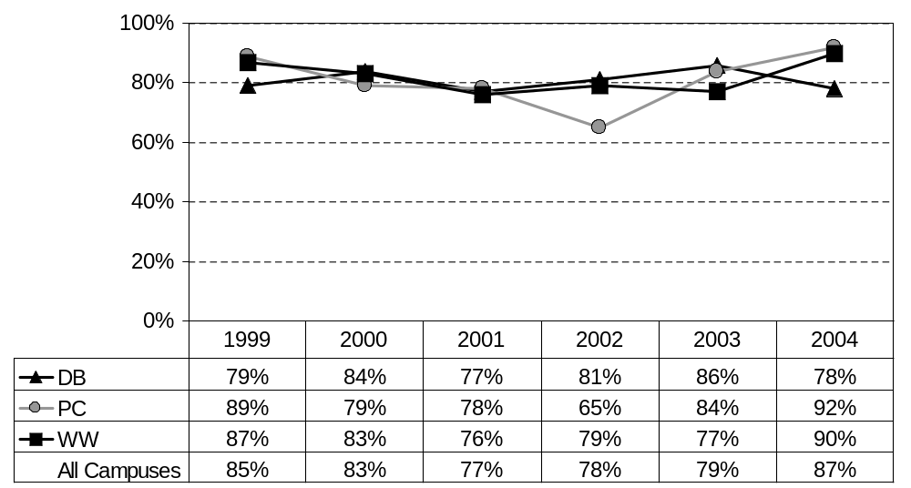
Usefulness of general skills on the job:
Responsible Actions and Decision Making
(percent responding "very useful")

Slide 46
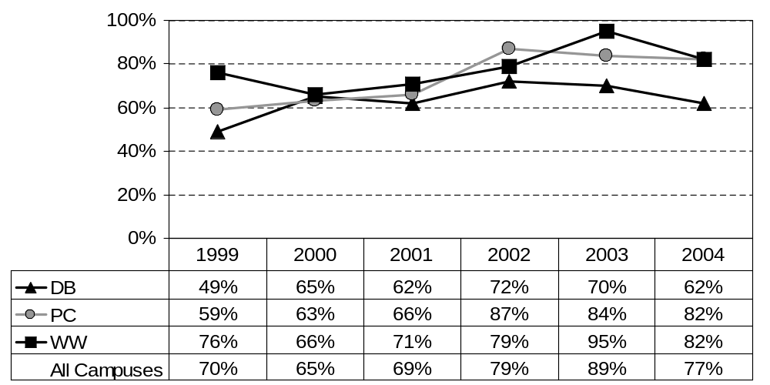
Competence of the ERAU graduate at general skills:
Responsible Actions and Decision Making
(percent responding "excellent" or "good")
Note: Response scale changed in ’03; “excellent” and “good” were the top two choices as of ’03, “very good” or “good” were the top two choices for ’01 and ’02, “excellent” & ”very good” were the two top choices prior to ’01. Includes all degree levels.

Slide 47
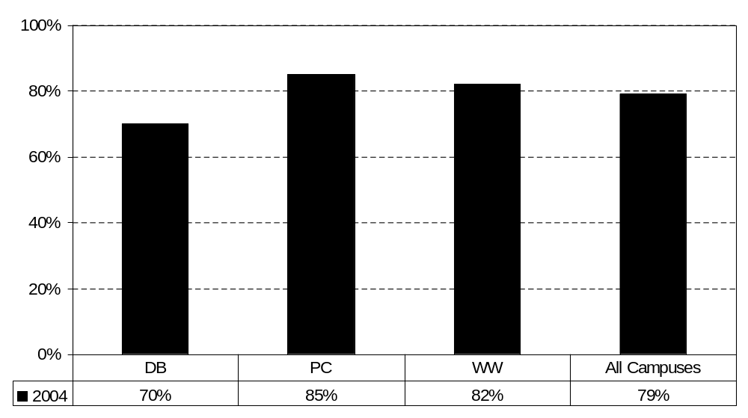
Usefulness of general skills on the job:
Ability to Adapt to change
(percent responding "very useful")

Slide 48
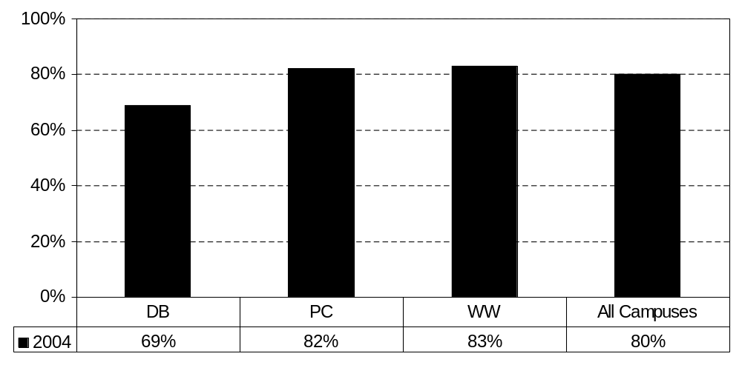
Competence of the ERAU graduate at general skills:
Ability to Adapt to change
(percent responding “excellent“ or “good”)
Note: Response scale changed in ’03; “excellent” and “good” were the top two choices as of ’03, “very good” or “good” were the top two choices for ’01 and ’02, “excellent” & ”very good” were the two top choices prior to ’01. Includes all degree levels.

Slide 49
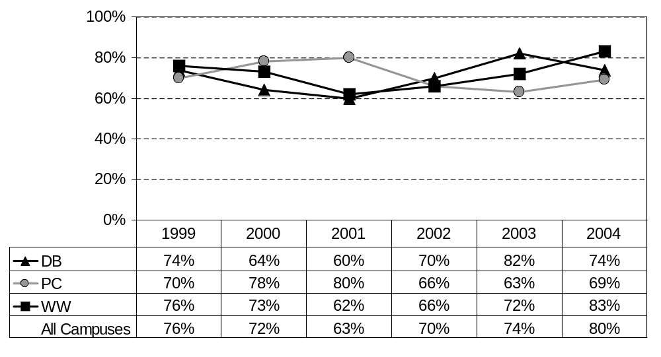
Usefulness of general skills on the job:
Understanding Other People and Other Points of View
(percent responding "very useful")

Slide 50
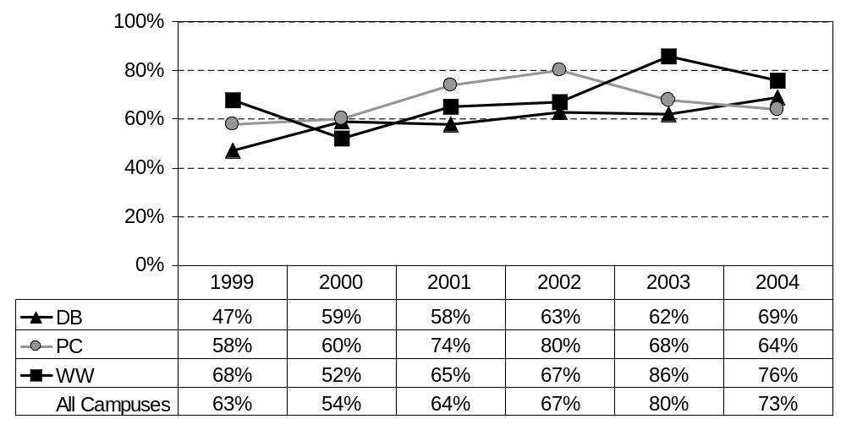
Competence of the ERAU graduate at general skills:
Understanding Other People and Other Points of View
(percent responding "excellent" or "good")
Note: Response scale changed in ’03; “excellent” and “good” were the top two choices as of ’03, “very good” or “good” were the top two choices for ’01 and ’02, “excellent” & ”very good” were the two top choices prior to ’01. Includes all degree levels.

Slide 51
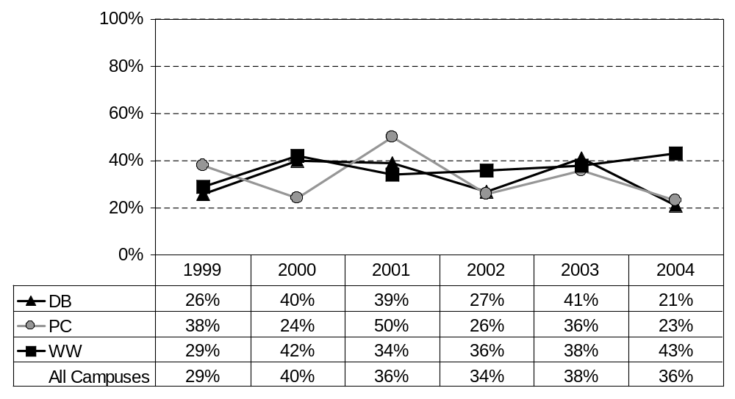
Usefulness of general skills on the job:
Environmental Awareness
(percent responding "very useful")

Slide 52
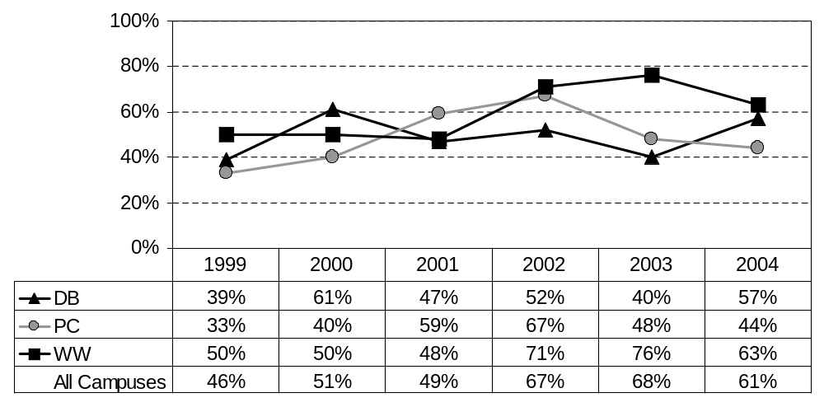
Competence of the ERAU graduate at general skills:
Environmental Awareness
(percent responding "excellent" or "good")
Note: Response scale changed in ’03; “excellent” and “good” were the top two choices as of ’03, “very good” or “good” were the top two choices for ’01 and ’02, “excellent” & ”very good” were the two top choices prior to ’01. Includes all degree levels.

Slide 53
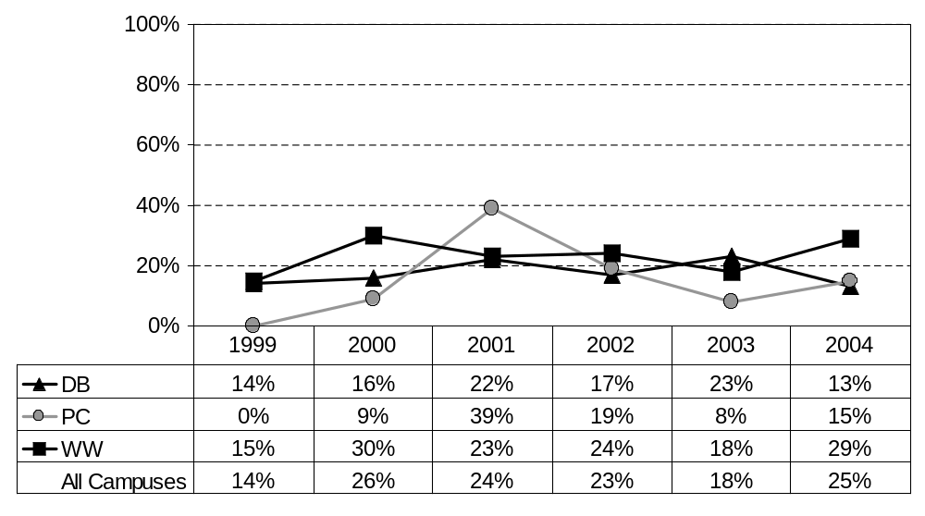
Usefulness of general skills on the job:
Political and Economic Awareness
(percent responding "very useful")

Slide 54
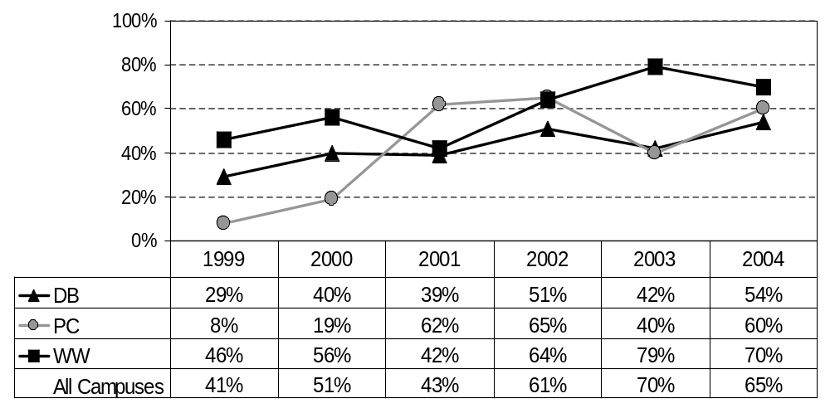
Competence of the ERAU graduate at general skills:
Political and Economic Awareness
(percent responding "excellent" or "good")
Note: Response scale changed in ’03; “excellent” and “good” were the top two choices as of ’03, “very good” or “good” were the top two choices for ’01 and ’02, “excellent” & ”very good” were the two top choices prior to ’01. Includes all degree levels.

Slide 55

Usefulness of general skills on the job:
Knowledge of Political & Physical Geography
(percent responding "very useful")

Slide 56

Usefulness of general skills on the job:
Knowledge of Political & Physical Geography
(percent responding “excellent“ and “good”)
Note: Response scale changed in ’03; “excellent” and “good” were the top two choices as of ’03, “very good” or “good” were the top two choices for ’01 and ’02, “excellent” & ”very good” were the two top choices prior to ’01. Includes all degree levels.

