Slide 1
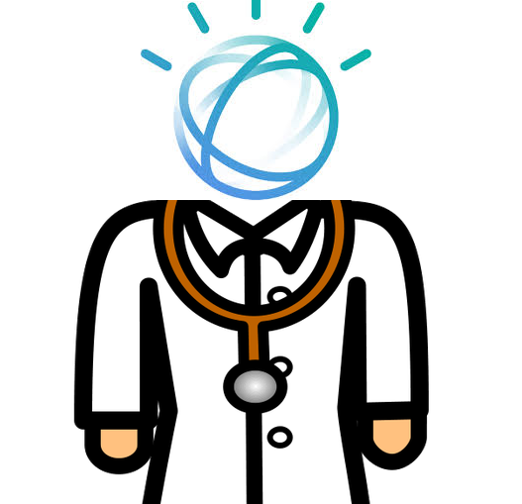
Team: goodfellas Challenge: TJBot, Smart IOT Project: DoctorWat
Xiaosheng Wu
Jin Tian
Mengting Yan

Slide 2
Challenge:
Public health data is important for both industry and research projects, but it is hard for doctors to collect accurate data from their patients when they are not in a hospital. Recording body condition at home involves searching information online, taking notes and getting medical help from doctors. Most applications require a laptop and only provides a few functions for patients.

Slide 3
Goal:
To create a desktop application that can collect user data to reduce the information gap between doctors and patients. The application interface should be simple for both doctors and patients to use, but it also need to provide enough functions for either patients or doctors.

Slide 4
User Interface:
Tone Analysis

Slide 5
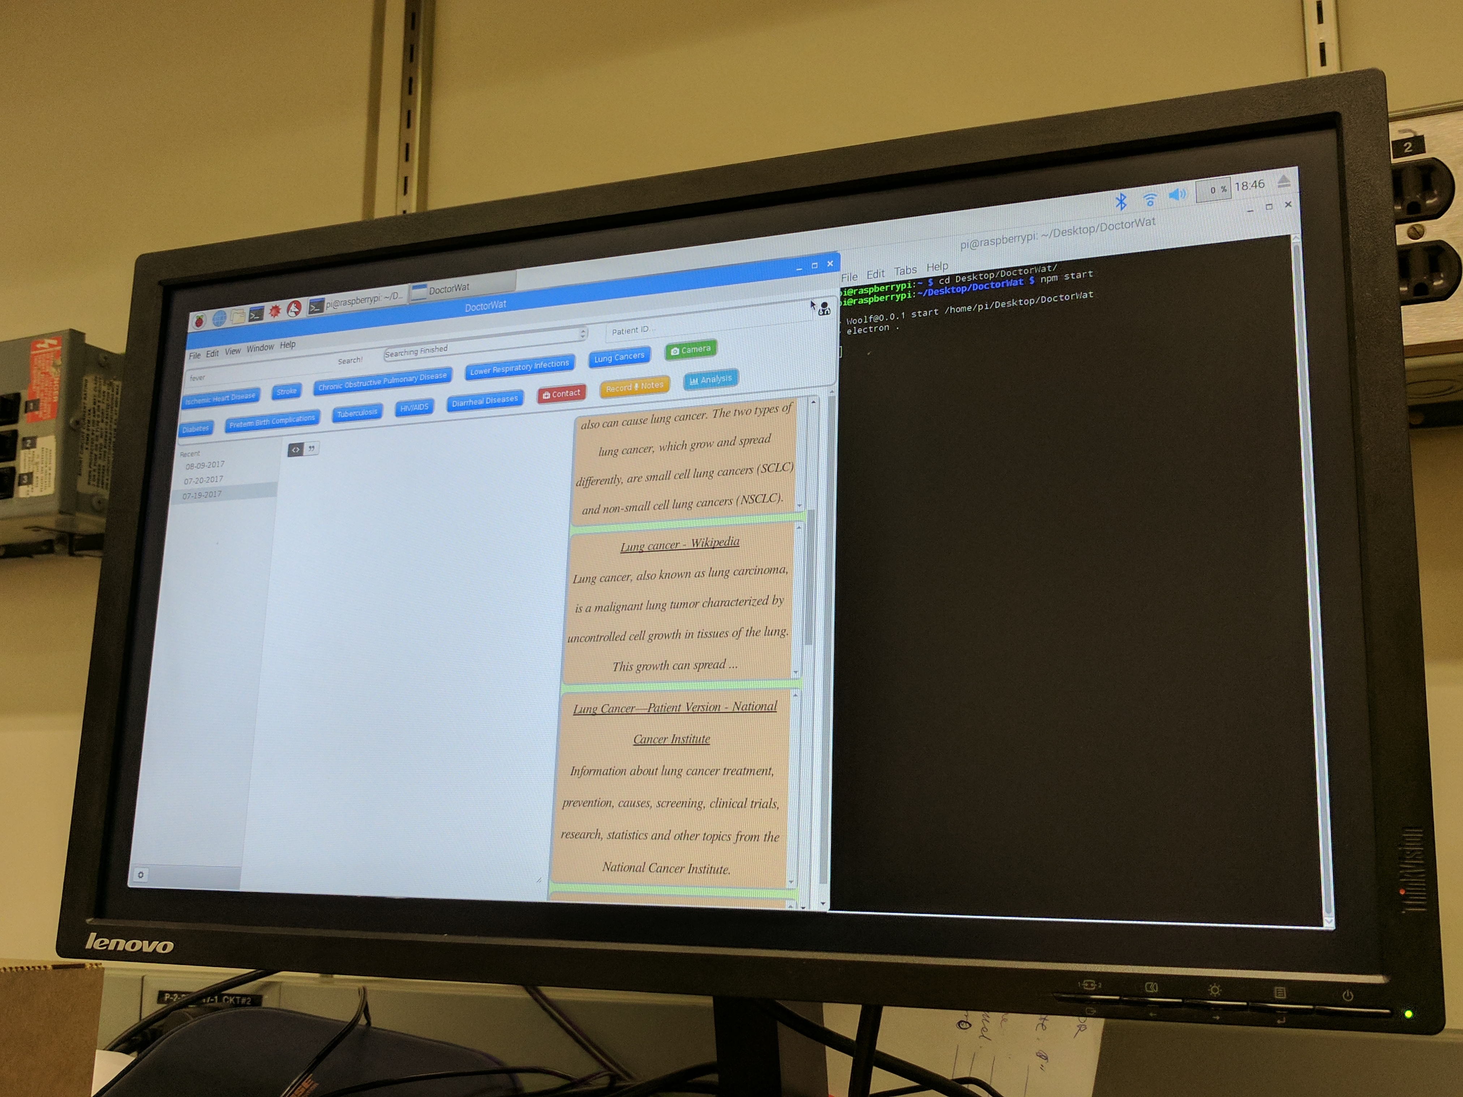
Design:
Input & Output
Speech to text
Tone Analysis

