Slide 1
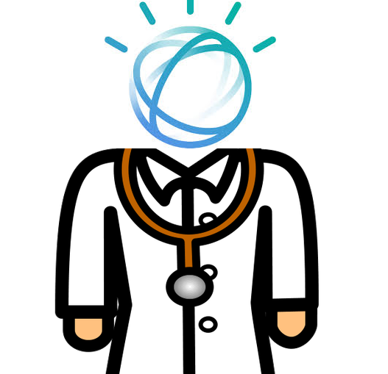
Team: goodfellas Challenge: TJBot, Smart IOT Project: DoctorWat
Xiaosheng Wu
Jin Tian
Mengting Yan

Slide 2
Challenge:
Public health data is important for both industry and research projects, but it is hard for doctors to collect accurate data from their patients when they are not in a hospital. Recording data at home involves searching information online, taking notes and getting medical help from doctors. Most applications require a laptop and only provides a few functions for patients.

Slide 3
Goal:
To create a desktop application that can collect user data to reduce the information gap between doctors and patients. The application interface should be simple for both doctors and patients to use, but it also need to provide enough functions for both patients and doctors.

Slide 4
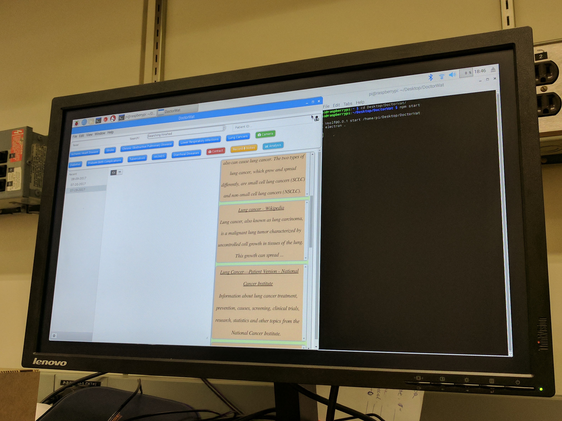
Design:
Input & Output
Speech to text
Tone Analysis

Slide 5
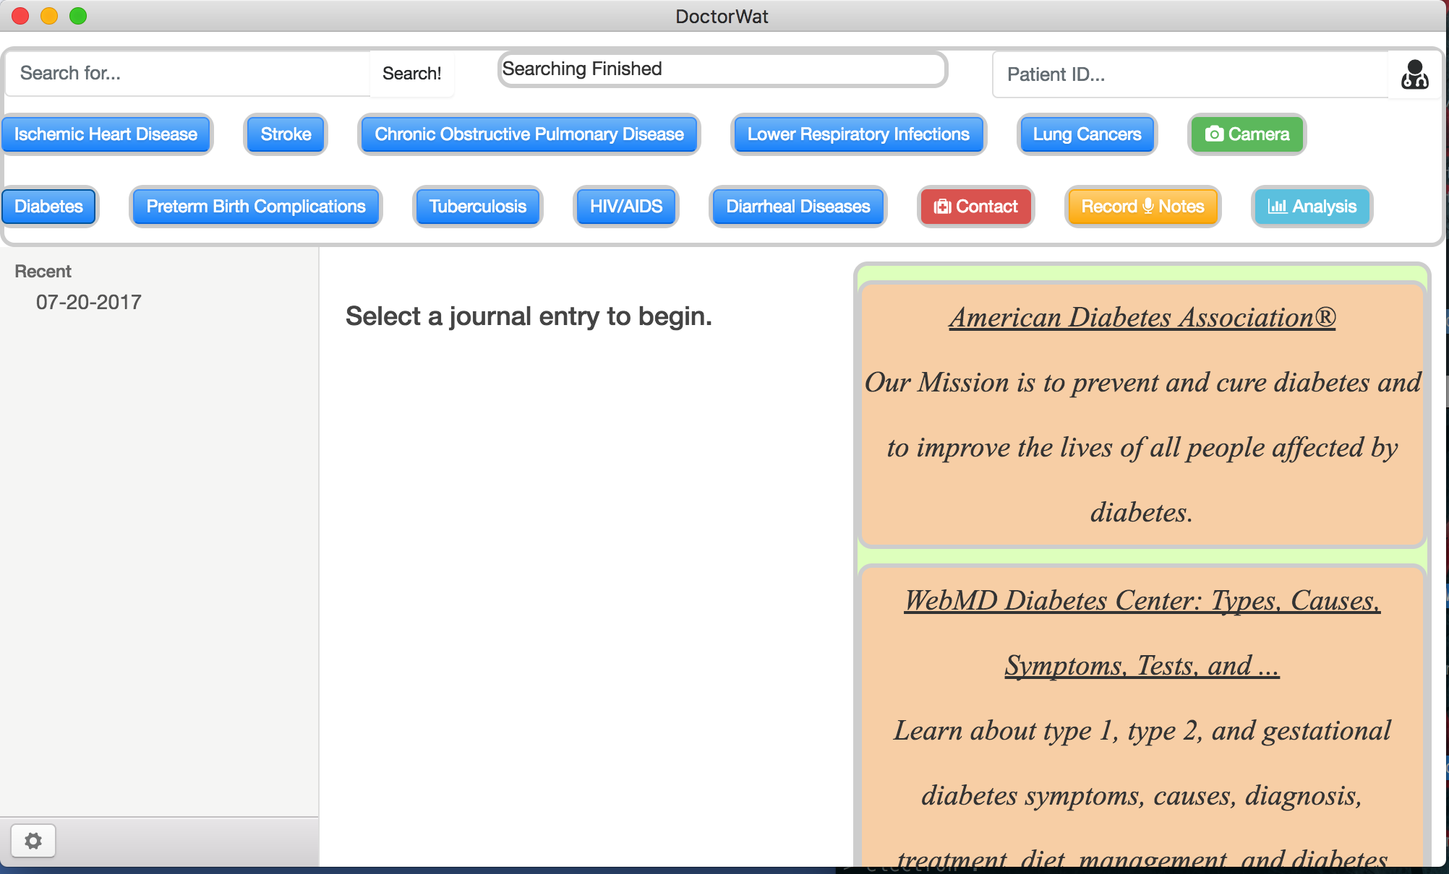
User Interface:

Slide 6
Functionalities:
Basic Functions:
Parse Online Information
Search for Patient Data
Take Notes & Save Notes
Send Email
Taking Photos
Bluemix Services:
Tone analysis on log files
Speech to text

Slide 7
Features :
Data Accuracy: The most accurate health information data comes from patient themselves, but many people ignore the importance of taking notes on a daily basis. DoctorWat encourages users to record data with a simple user interface and powerful IBM Bluemix service as its backbone.
Portability: TJ Bot is small, users can bring it to work.
Cost: Compared with phones or laptops, TJ Bots are cheap even with external devices such as keyboard and screen, but they are also powerful.
Functionality: DoctorWat provides a variety of functions for both doctors and patients to use. Since the project is open-source, contributions are welcome.
Platform Independent: Since DoctorWat is built with Electron, it runs on multiple platforms: MacOS, Windows, Linux, Raspbian.

Slide 8
Summary:
The project idea came from an article about how to collect reliable data sets from users for machine learning in medical research. We hope our project can help to reduce the information gap between doctors and patients.
Since the project is designed for both doctor and patients, one potential improvement is to add more Bluemix functions and database to update patient data in real time.

Slide 9
Thank You

