Slide 1
Deck Management
Summer Project Presentation
Vetle Chyba Norstad and Marte Aaberge
Notes:
Today we’re presenting how we have approached the task you have given us – Automatization of Deck Management

Slide 2
Disposition
The summer project task – Automatization of Deck Management
Problem decomposition
Results
Further improvements
Refinement of Deck Management COG
Notes:
We’re going to talk about how we have broken down the task and formulated a problem based on the criteria you have outlined, as well as how we have understood the problem while working in vCog and the Deck Management cog.
Then we are going to present how we have tried to solve the task, what approach we have used, why we think this is an efficient way of solving the problem.
We are then of course presenting the results we have obtained and going to show them in the Deck Management cog.
I am then addressing some further improvements, and how far in the process the program has come.
Vetle has outlines some refinements for vCog he will share with you.
We’re going to talk a bit about how we have used our time, our work process, working with each other, working alone, and asking for advice/have check-ins.

Slide 3
The task – Starting point
Base: Excel sheet containing information about Cargo
5-phase outline of the criteria for the program´ provided by Tore Kvam
Deck Management COG
Notes:
Vetle: Learning the basics in vCog was an important step. Our first week was spent going trough cogs, looking at manuals and playing around with different functions and options. Most of the time was spent in the Deck Management Cog since this was what we would work with the most.
Our stating point for the task was: the excel sheet containing cargo information, the outline of the 5 phases of progress as well as the Deck Management cog.
Because we have never been on a platform in real life, it was very helpful to receive the outline of the 5 phases which specified the important aspects to take in consideration when placing cargo. The 5 phases written together with the check-ins two times a week with feedback from Øystein and Tore in the end was very helpful to be on the right path.
A crucial part of the task definition was to define how the results should be formulated, or in other words what the output should look like. We will circle back to this, but in short – after some advice from Sasha, we ended up with an Excel sheet as the results as well.

Slide 4
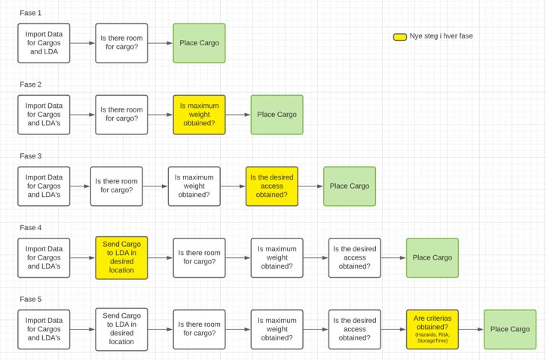
5 Phases
Placing
Weight
Access
Location
Hazards/Risk/Storage Time
Notes:
- Phase 1 to 3, One LDA
Phase 1: Laying out cargo on LDA
Phase 2: Setting a weight limit to LDA
Phase 3: Adding access to each cargo
Phase 4 and 5, Multiple LDAs
Phase 4: Adding Locations to Cargo and which LDAs belong to which Location
Phase 5: Adding Hazards and risk to cargos and which Location should accepth cargo with Hazards and/or risks. Include dates so it shows up at correct date in vCog

Slide 5
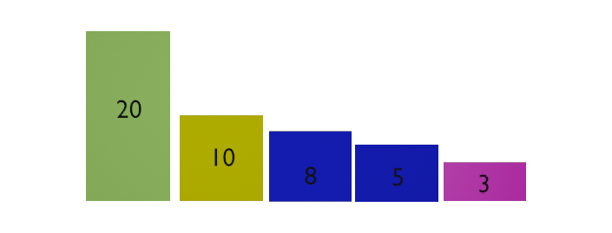
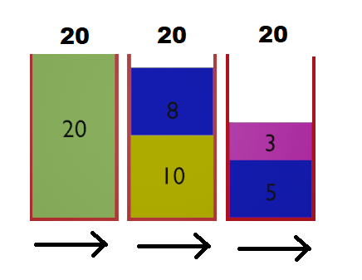
Research
Excel program
Bin Packaging Problem
First-Fit Decreasing
Notes:
When we had an overview of the problem, we started with research on how we could solve the task.
Vetle: Early on when doing research, we discovered a excel program, BPP Solver, created by a professor, Güneş Erdoğan, from University of Bath in UK. This program worked great for some scenarios, but it had one reguirement which made it difficult to use in our case. The program required that the boxes was square shaped. We contacted the Professor and asked if there was a way to change this in the excel file. He answerd that it would require changes in the macro code. Marte and Me did not know much about macro codes, so we quickly decided to look for other solutions.
Marte:
We quickly came across the problem called the “Bin Packing Problem” . The problem is described is such manner: “Given n items of different weights and bins each of capacity c, assign each item to a bin such that number of total used bins is minimized.” There are several different algorithms that solves this problem. Although our problem – place as many cargos as possible in the most desired location – is not solved directly by these algorithms, we used an algorithm called “First Fit Decreasing” as base.
“First Fit Decreasing” handles the problem where the item’s sizes differ a lot throughout the sequence. The algorithm’s solution is to sort the sequence – in our case the CargosList – by decreasing size and start by placing the largest cargos first. This makes it easier to place the smaller cargos when the space left on the LDAs have difficult shapes.
When we found this algorithm

Slide 6
Program
Input:
Excel sheet of LDA
Program:
Script calculating placement
Output:
Excel sheet with cargo placement
Excel sheet of Cargos

Slide 7
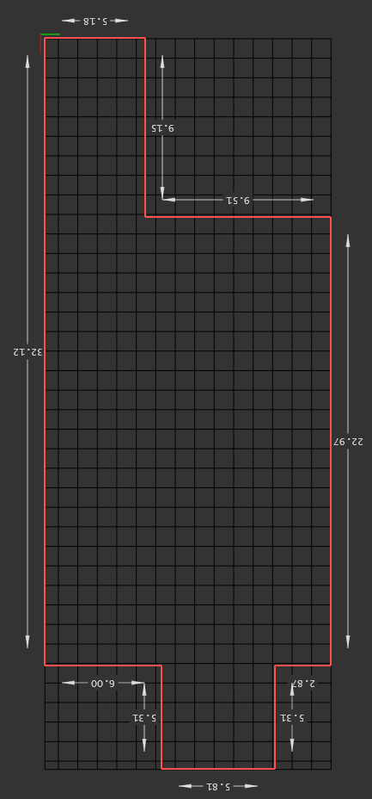
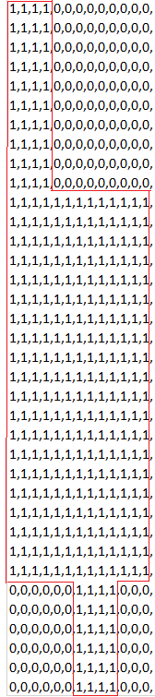
Data Handling / Phase 1
Defining LDA as matrices
First-Fit Decreasing
Placing cargo
Rotating cargo
Notes:
Vetle: LDA definering
- defining LDA with 1m pr unit: 1 is inside, 0 is outside. If scale is 1m, squares with sides 1X1.
- How scaling the LDA works
Benefits of scaling: Higher precision
Marte:
First-Fit Decreasing:
Sortere cargo listen basert på forskjellige ting, starter med vekt. Cargos plasseres ut så nært den forrige som mulig såfremt det er plass.
Plassering av cargo: sjekker om det er plass til cargo, hvis det er plass legges den ut, hvis ikke spares den til senere.

Slide 8
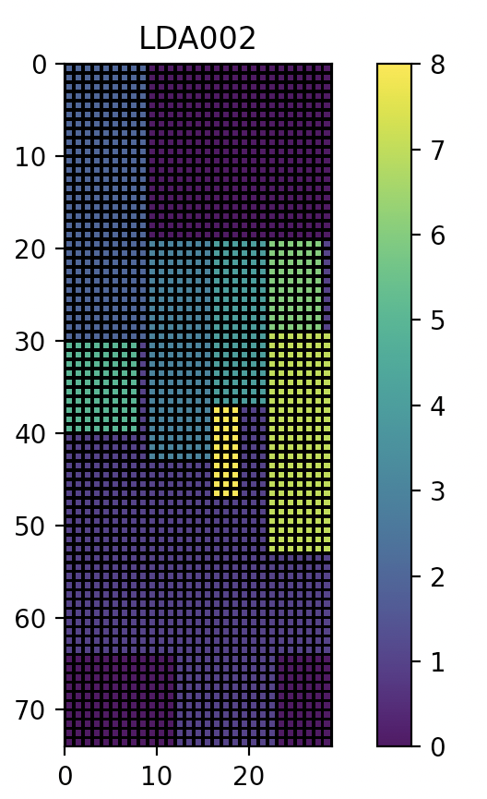
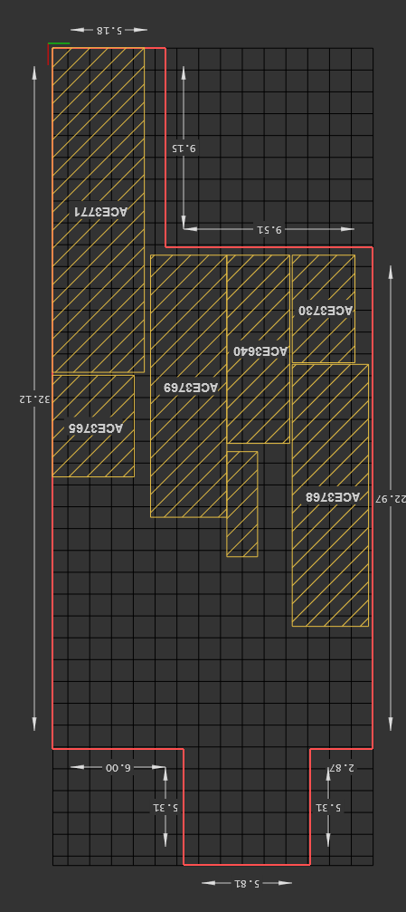
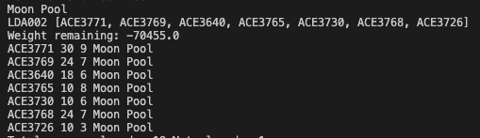
Notes:
Dårlig tilkomst til cargo, overstiger max vekt

Slide 9
Phase 2
Weight Limit
Notes:
Sortering basert på str og vekt. Plassering såfremt det er vekt tilgjengelig.

Slide 10
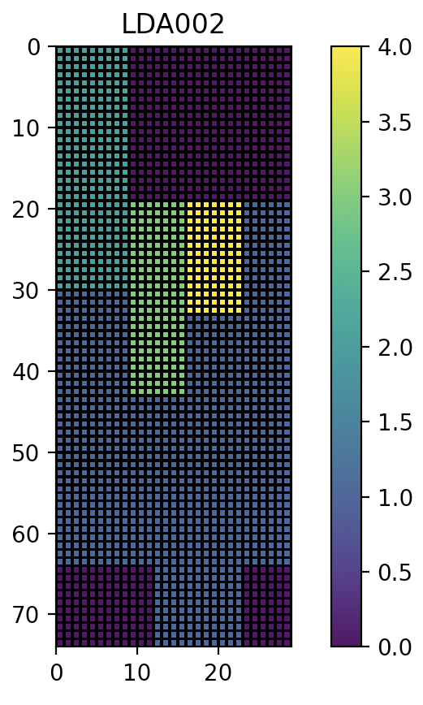
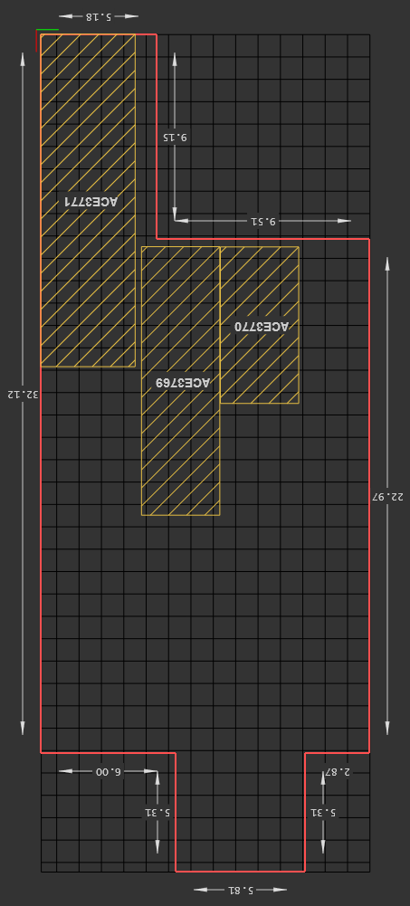
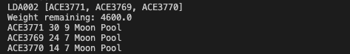
Notes:
Overstiger ikke max vekt, men fortsatt dårlig tillkomst

Slide 11
Phase 3
Access Space
Notes:
Legger inn plass rundt cargo for å få tilgang til alle dører. Her er det standard 1m på kortside og langside for å garantere tilkomst. Kan spesifisere senere for hver cargo.

Slide 12
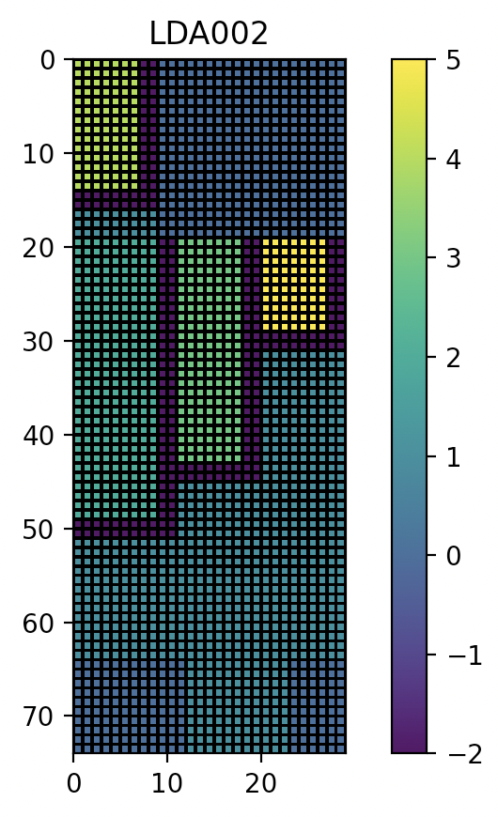
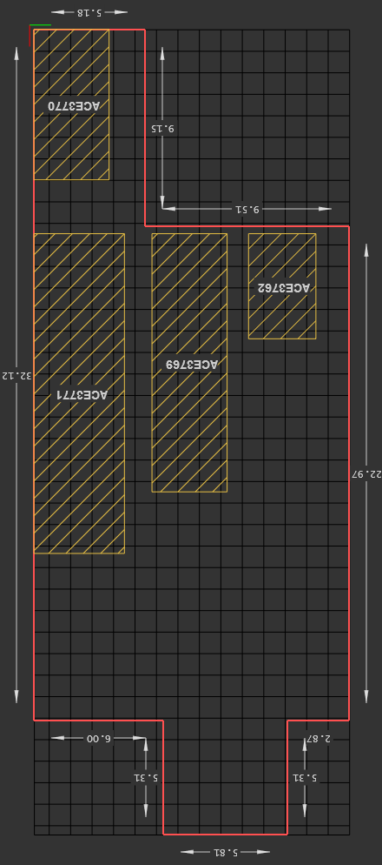
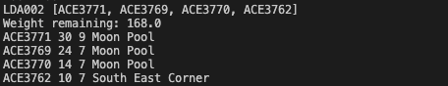
Notes:
Overstiger ikke max vekt. God tillgang til all cargo.

Slide 13
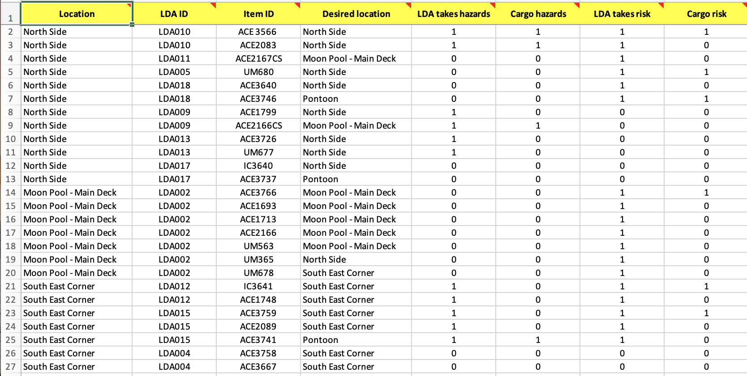
Phase 4 and 5
Locations and Risk & Hazards
Notes:
Sortere listen basert på risk and hazards. Plassere cargo kun på de LDAene som tillater cargoens «tilstand». Noen LDA tar i mot alle.

Slide 14
DEMO

Slide 15
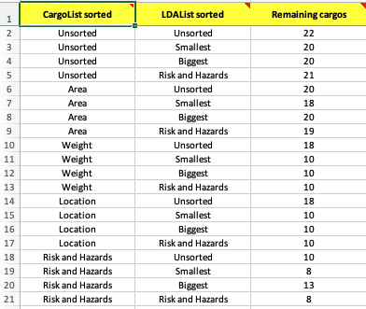
Result/achievements
Optimal result:
fewest remaining cargos
Output:
placement of optimal result

Slide 16
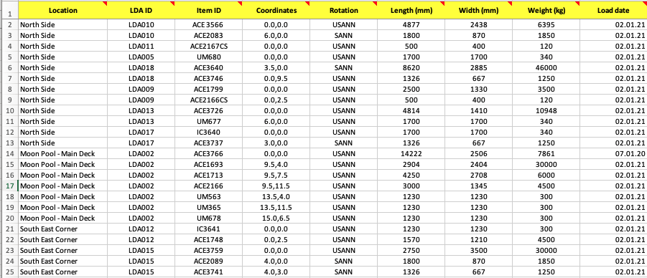

Slide 17
Further improvements
Prioritize location for cargo placement
Load and dispatch dates
Simulations
Change Access space to client’s preference
Notes:
Fase 5:
Vetle: Access,

Slide 18
Refinement of Deck Management COG
Search in Cargo List
Dates
Isolate Floor
Deck View
Orthographic Views

Slide 19
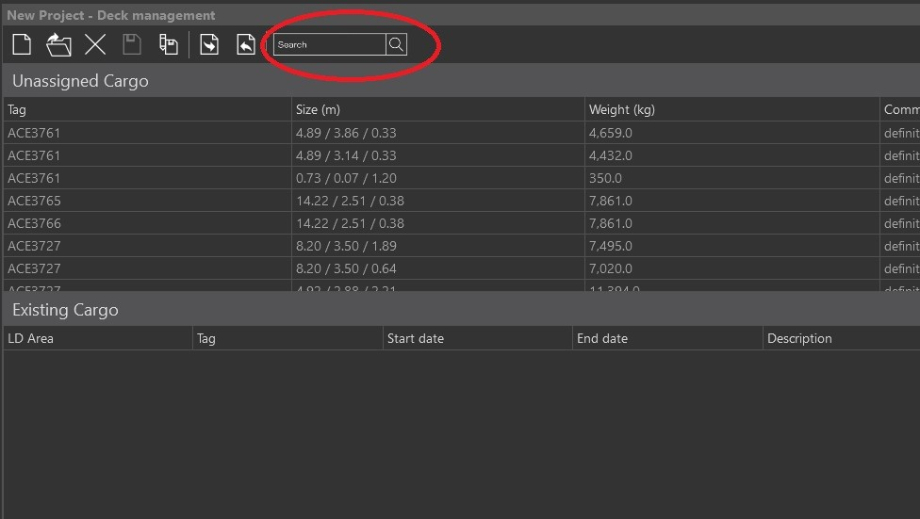
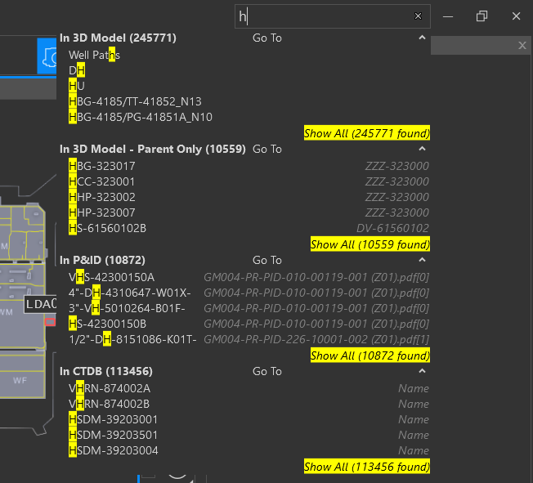
Search In Cargo List

Slide 20
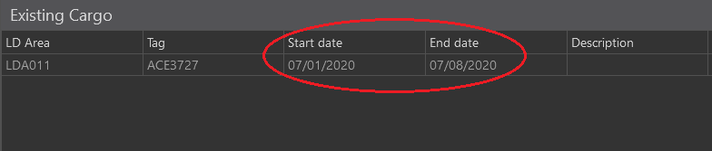
Changing Dates

Slide 21
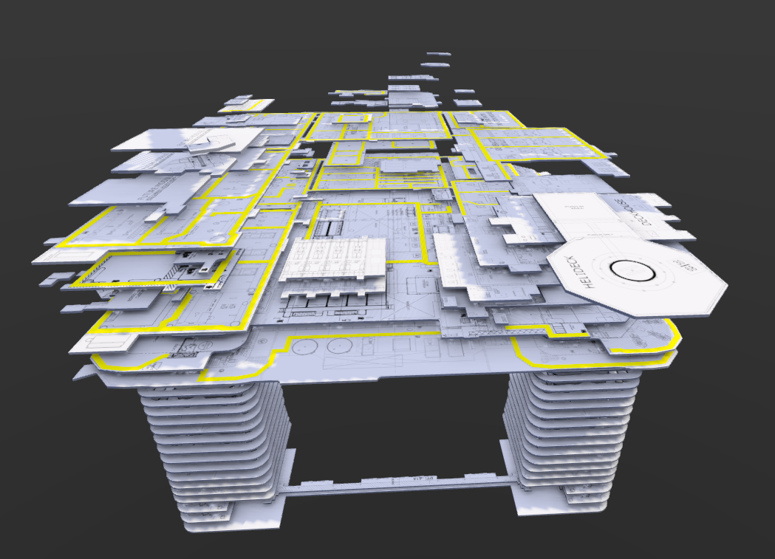
Isolate Floor

Slide 22
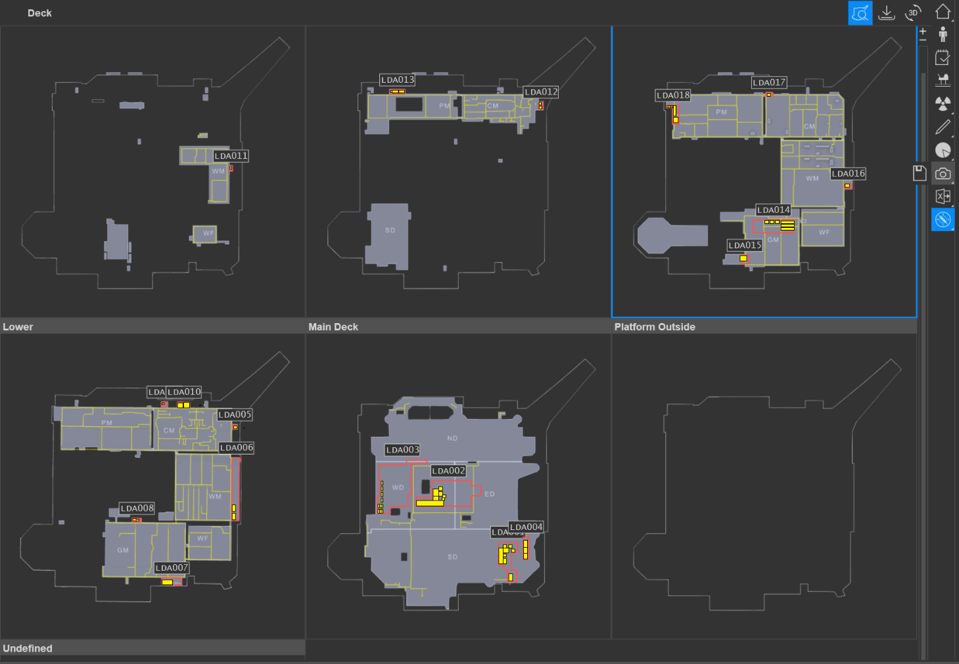
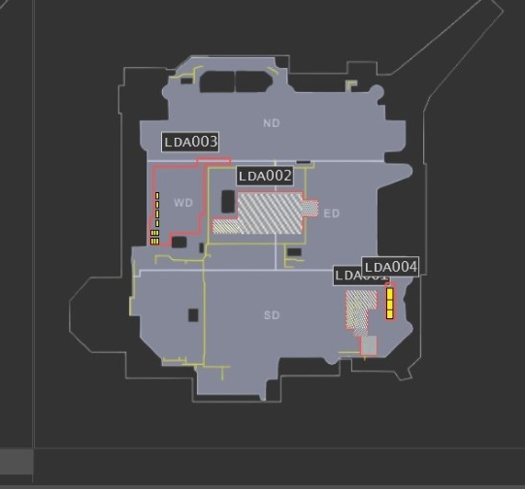
Cargo in Deck View

Slide 23
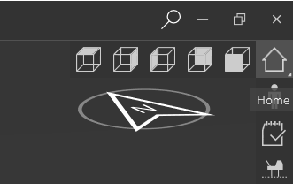
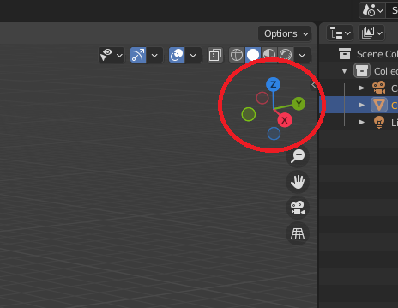
Orthographic Views

