Slide 1
GIT

Slide 2
What is Git?
Git is a free and open-source software.
Uses:
It is a version-control system for tracking changes in computer files.
Coordinating work on these computer files among multiple people.
Source-code management in software development.
Provides support for non-linear workflows.
It was created by Linus Torvalds in 2005.
Bitkeeper and Mercurial are examples of other version-control softwares.

Slide 3
What is version control?
Version control systems are a category of software tools that help a software team manage changes to source code over time.
Version control software keeps track of every modification to the code in a special kind of database.
If a mistake is made, developers can turn back the clock and compare earlier versions of the code to help fix the mistake while minimizing disruption to all team members.
Version control protects source code from both catastrophe and the casual degradation of human error and unintended consequences.

Slide 4
Basics of Git
Initialize repository
create a new directory
cd into that directory
git init
Set git user config
git config --global user.name “John Doe”
git config --global user.email “johnDoe@gmail.com”
First commit
touch new file
echo text in the file: echo “my first line” >> <myFileName>
git add <file name>
git commit -m “my first commit”

Slide 5
Branches
git branch -a: this will show all the branches.
A branch is a pointer to a commit. The default branch name in git is ‘master’.
git checkout -b “branchName”
echo append a new line in the already created text file. Hint: echo “my new line” >> <myFileName>
git status
git add <myFileName>
Git commit -m “my new branch commit”
Git log
git log
git checkout master
git log
Notes:
What is a branch

Slide 6
Git remote
Create a gitHub account
Create a new gitHub repository using the same directory name
Follow instructions written in the newly created gitHub repo

Slide 7
Some fun facts about repositories
You have access to all files in your local repository, whether you are working on one file or multiple files.
You can view public repositories without a GitHub account if you have the URL for that repository.
Each repository belongs to a user account or a team. In the case of a user account, that user owns the repository. + In the case of a team, that team owns it.
The repository owner is the only person who can delete the repository. If the repository belongs to a team, an admin can delete the repository.
A code project can consist of multiple repositories across multiple accounts but can also be a single repository from a single account.

Slide 8
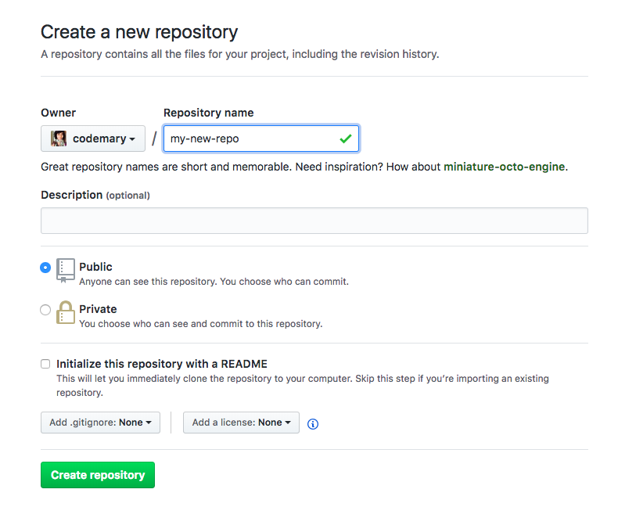

Slide 9
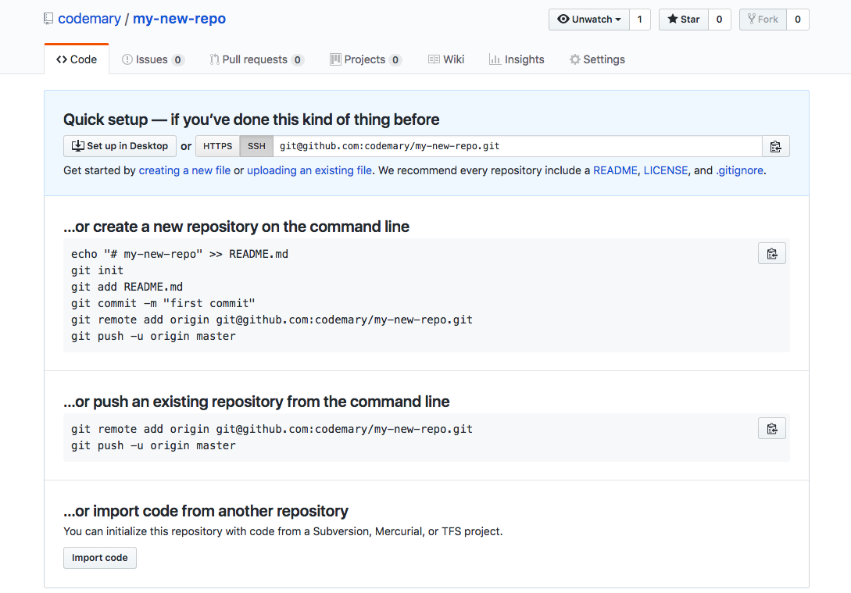

Slide 10
Create a pull request: a pull request is a request for change. This means that you request the owners of the repository to review your code and if everything is ok then they can approve it and merge to the master branch.
A master branch is the branch with the most recent approved changes.
Fork the repository
Git clone the forked repository
cd into that repository
Go to the master branch
Create a new working branch
Modify the text file
Commit the changes
Push the current working branch
Create pull request
Wait for approval

Slide 11
Exercise
PR Review Exercise
Create a new file and add some text to it. The file name should be your name. Then create a pull request to merge this file to the master of the repo my-new-repo.
Steps:
Fork the repository
Git clone the forked repository
cd into that repository
Create a new working branch using your name, eg.: “john-branch-1”
Create a new file using your name, eg.: “john-doe”
Add some content in the new file
Commit the new file
Push the current branch
Create the pull request
Wait for approval
If changes are requested, make the changes locally
Commit the new changes
Push the current branch again
Wait for approval

Slide 12
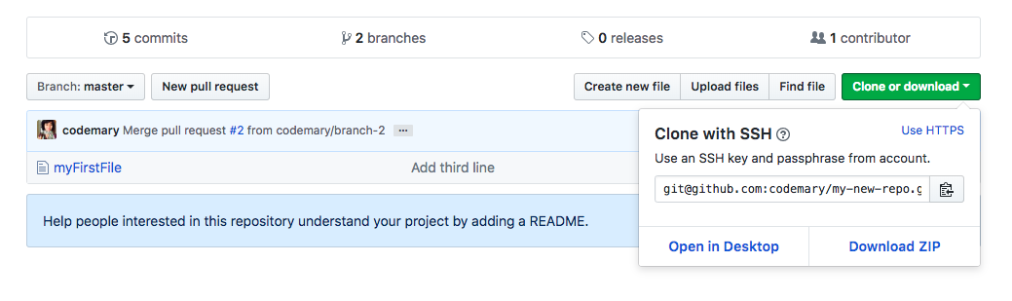

Slide 13
Exercise
2. PR Review Group Exercise
The Team Lead creates a new repo and creates a new file and add some text to it. The file name should be your name. Then create a pull request to merge this file to the master of the repo my-new-repo. The TL should review and approve PRs.
Member Steps:
Fork the repository
Git clone the forked repository
cd into that repository
Create a new working branch using your name, eg.: “john-branch-1”
Create a new file using your name, eg.: “john-doe”
Add some content in the new file
Commit the new file
Push the current branch
Create the pull request
Wait for approval
If changes are requested, make the changes locally
Commit the new changes
Push the current branch again
Wait for approval

Slide 14
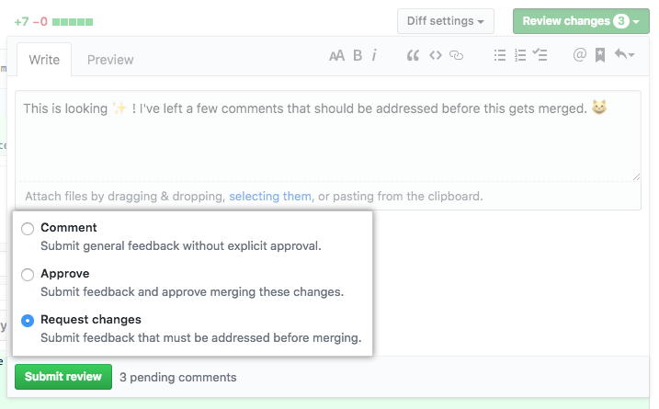

Slide 15
