Slide 1
LINUX CONTAINERS
Martin Petkov 38 group FKST 2019

Slide 2
What are linux containers and what benefits do they provide?
A Linux container is a set of one or more processes that are isolated from the rest of the system. All the files necessary to run them are provided from a distinct image, meaning that Linux containers are portable and consistent as they move from development, to testing, and finally to production. This makes them much quicker than development pipelines that rely on replicating traditional testing environments.

Slide 3
Difference between containers and virtualization
Virtualization lets your operating systems (Windows or Linux) run simultaneously on a single hardware system.
Containers share the same operating system kernel and isolate the application processes from the rest of the system. For example: ARM Linux systems run ARM Linux containers, x86 Linux systems run x86 Linux containers, x86 Windows systems run x86 Windows containers. Linux containers are extremely portable, but they must be compatible with the underlying system.

Slide 4
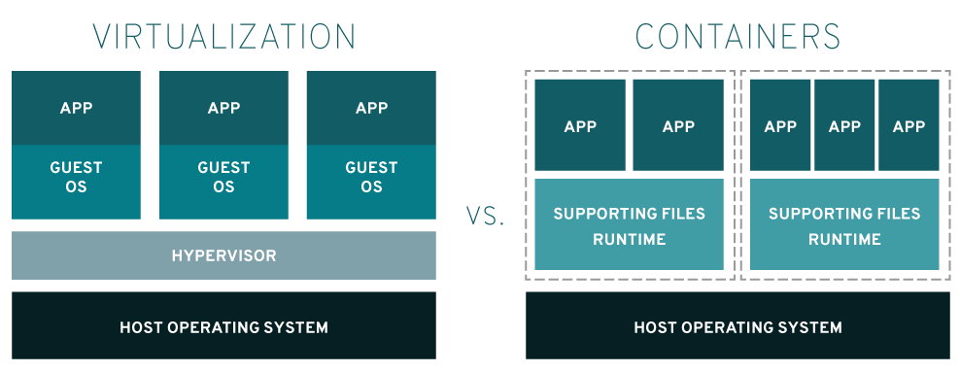

Slide 5
A brief history of containers
https://www.redhat.com/cms/managed-files/rh-history-of-containers-infographic-201609-en.pdf

Slide 6


Docker and kubernetes

Slide 7
Demo
https://github.com/martojdk/linux-containers-os-project

Slide 8
Sources
https://www.redhat.com/en/topics/containers/whats-a-linux-container

