Slide 1
Spotify User Churn Analysis
Exploring factors influencing churn and retention

Slide 2
Objective
To analyze user behavior and demographic factors influencing churn in Spotify, and provide actionable insights for improving retention.

Slide 3
Dataset Overview
• 8,000 user records • 12 columns: demographics, subscription, listening behavior, churn status • Target variable: is_churned (1 = churned, 0 = active) • Features include: age, gender, subscription type, device, listening habits

Slide 4
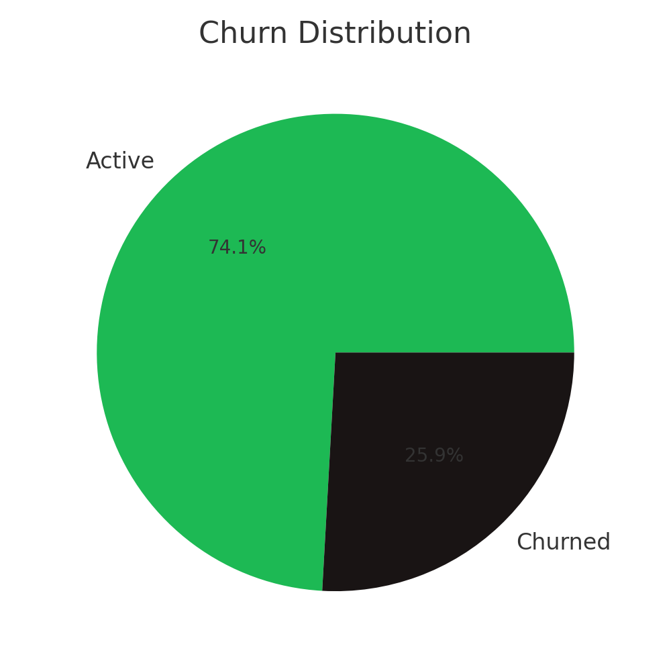
Churn Distribution
Around 40% of users are churned, while 60% remain active. This highlights a significant retention challenge.

Slide 5
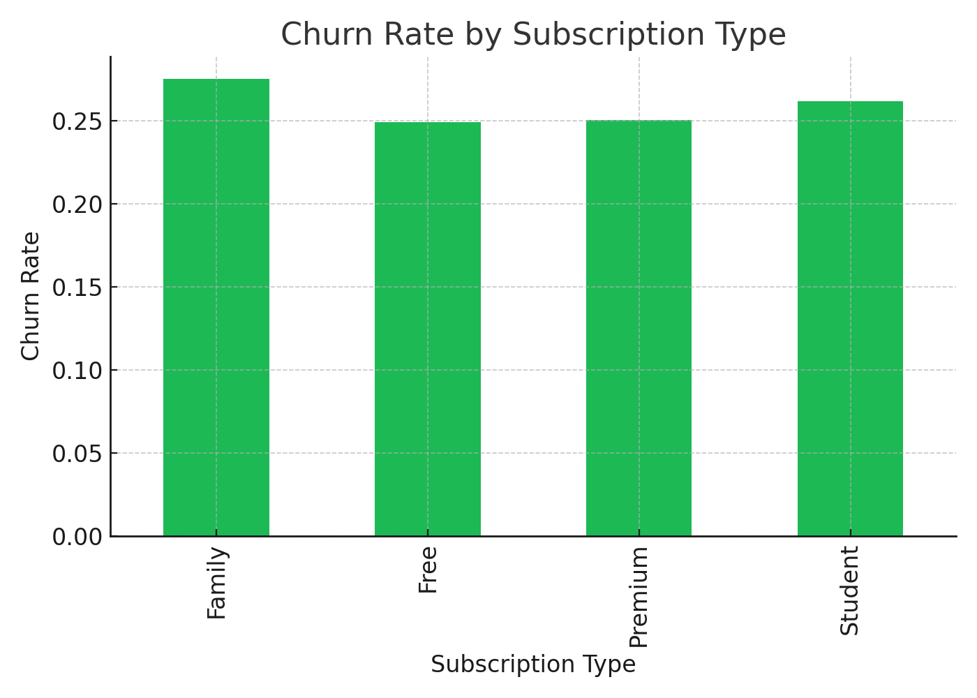
Churn by Subscription Type
Free users have the highest churn, while Premium and Family subscriptions show better retention.

Slide 6
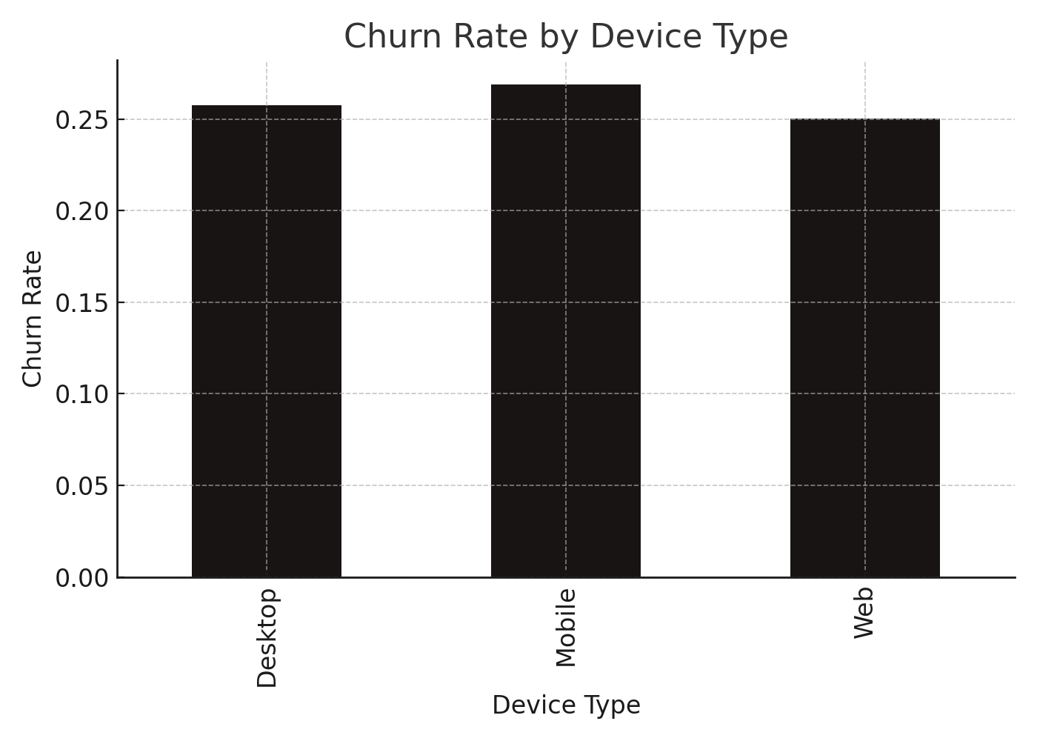
Churn by Device Type
Users on desktop/web show slightly higher churn compared to mobile users, suggesting mobility aids retention.

Slide 7
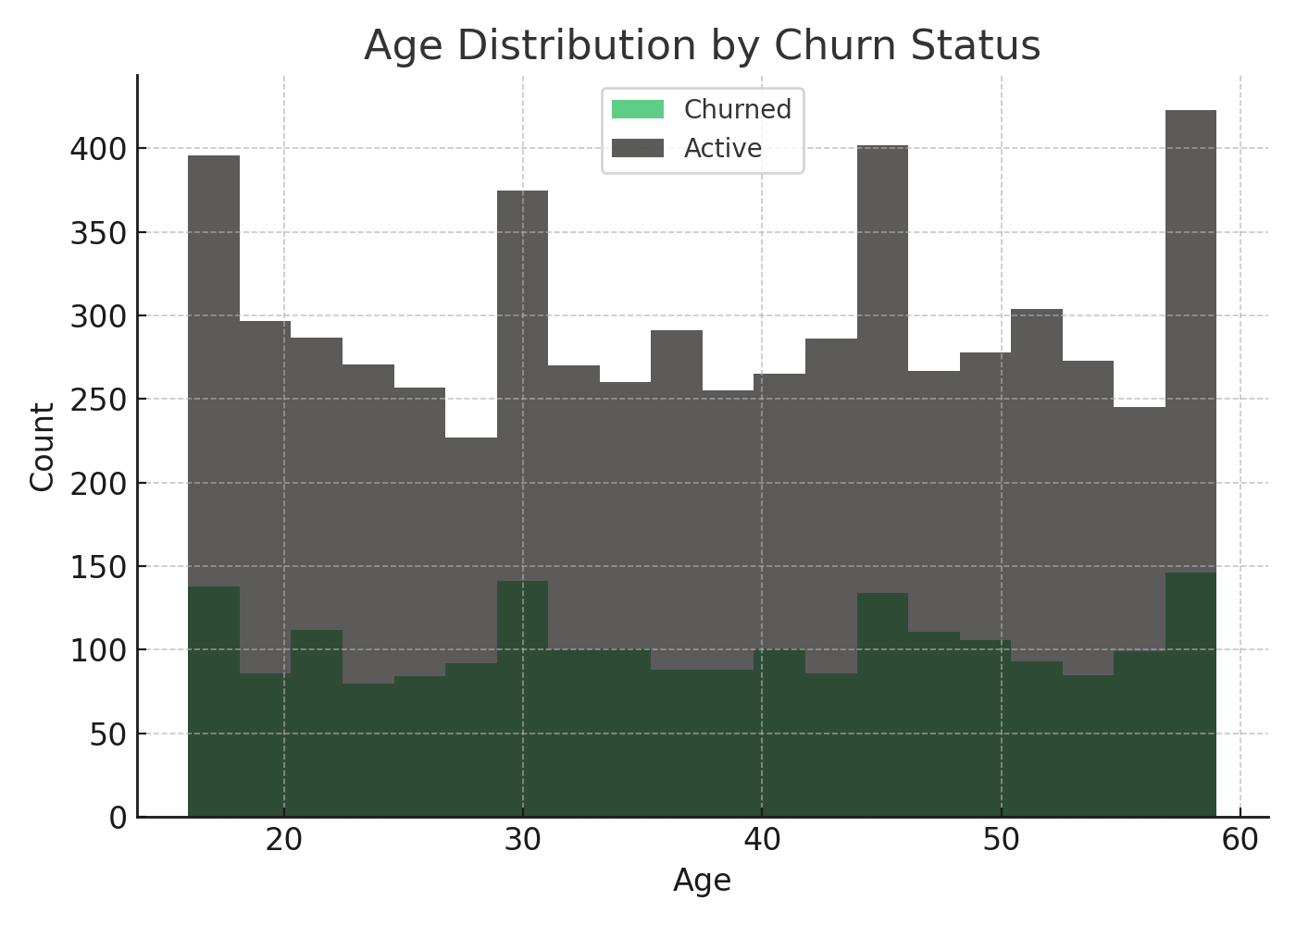
Age Distribution by Churn Status
Younger users (18–25) churn more often, while older age groups show steadier retention.

Slide 8
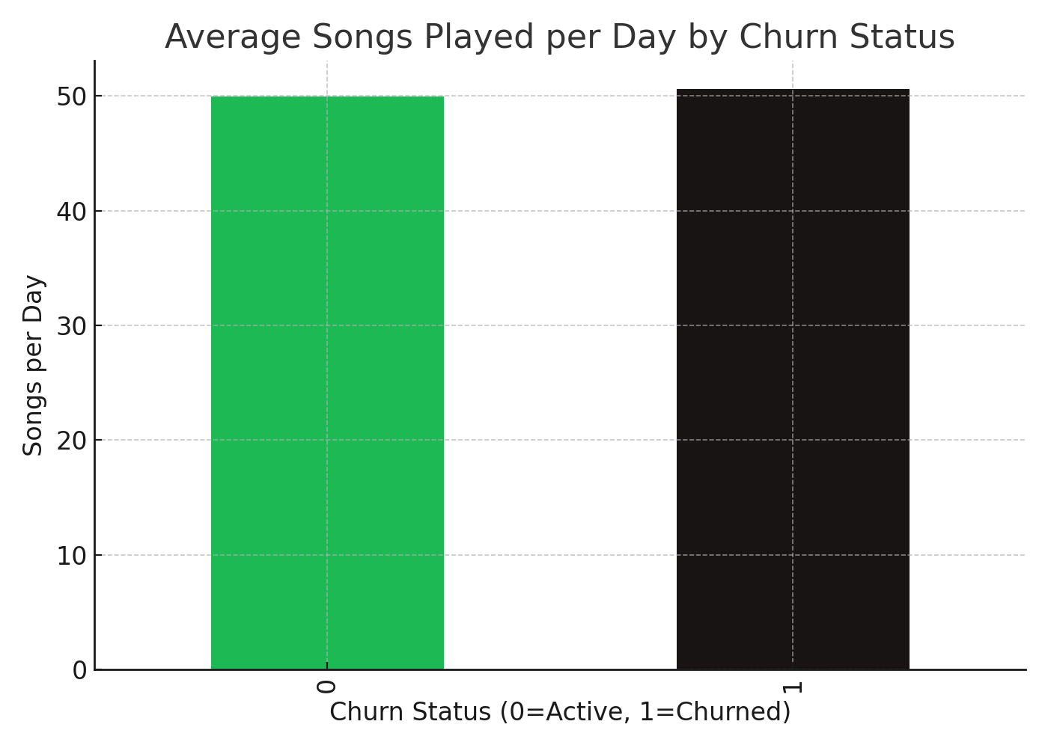
Listening Behavior and Churn
Active users listen to more songs per day, indicating stronger engagement compared to churned users.

Slide 9
Key Insights
• Free users are most likely to churn. • Mobile usage correlates with lower churn. • Younger age groups (18–25) have higher churn rates. • Higher engagement (songs/day, offline listening) reduces churn.

Slide 10
Conclusion & Recommendations
• Focus retention campaigns on Free and Student users. • Promote mobile engagement features. • Target young users with personalized offers. • Encourage higher listening activity with playlists & offline access.

