Slide 1
Spotify User Churn Analysis
Exploring factors influencing churn and retention

Slide 2
Objective
To analyze user behavior and demographic factors influencing churn in Spotify, and provide actionable insights for improving retention.

Slide 3
Dataset Overview
• 8,000 user records • 12 columns: demographics, subscription, listening behavior, churn status • Target variable: is_churned (1 = churned, 0 = active) • Features include: age, gender, subscription type, device, listening habits

Slide 4
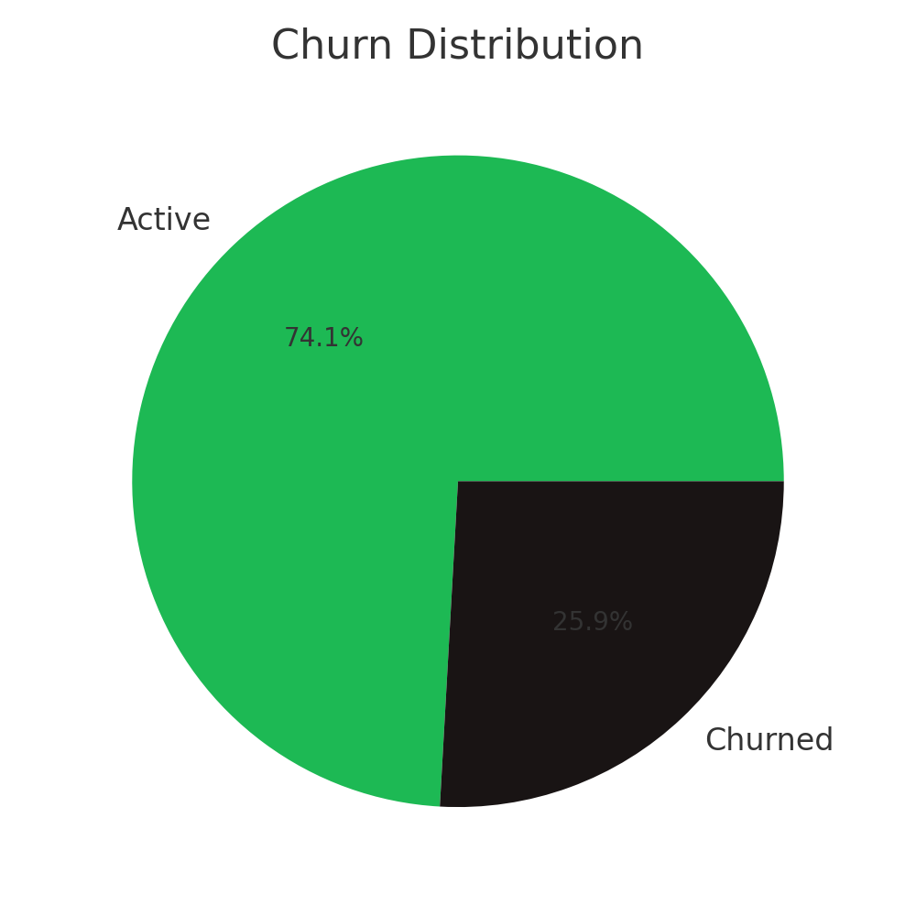
Churn Distribution
Around 40% of users are churned, while 60% remain active. This highlights a significant retention challenge.

Slide 5
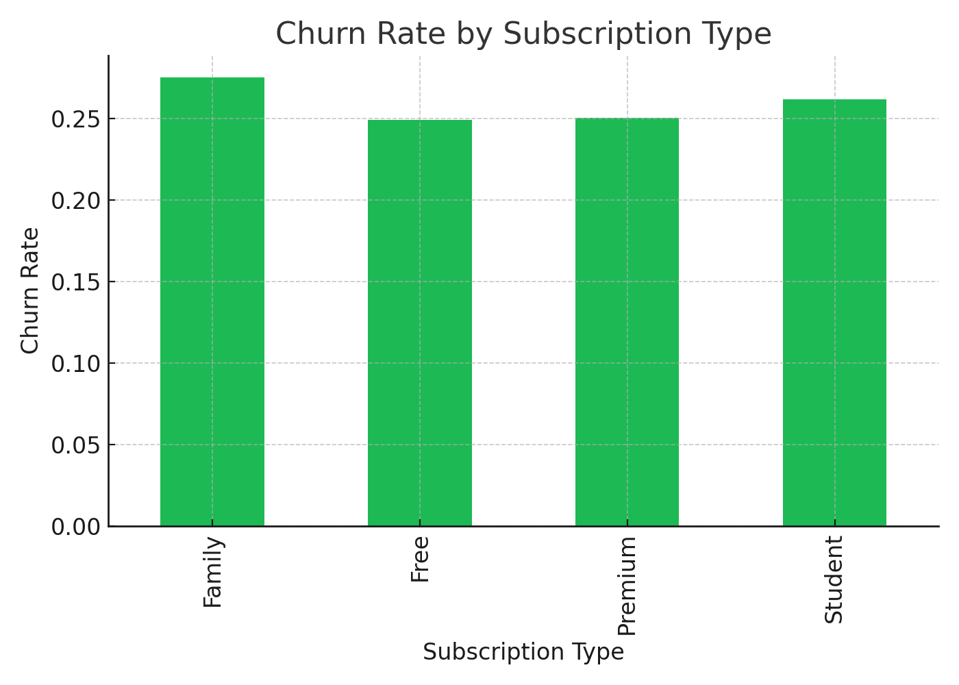
Churn by Subscription Type
Free users have the highest churn, while Premium and Family subscriptions show better retention.

Slide 6
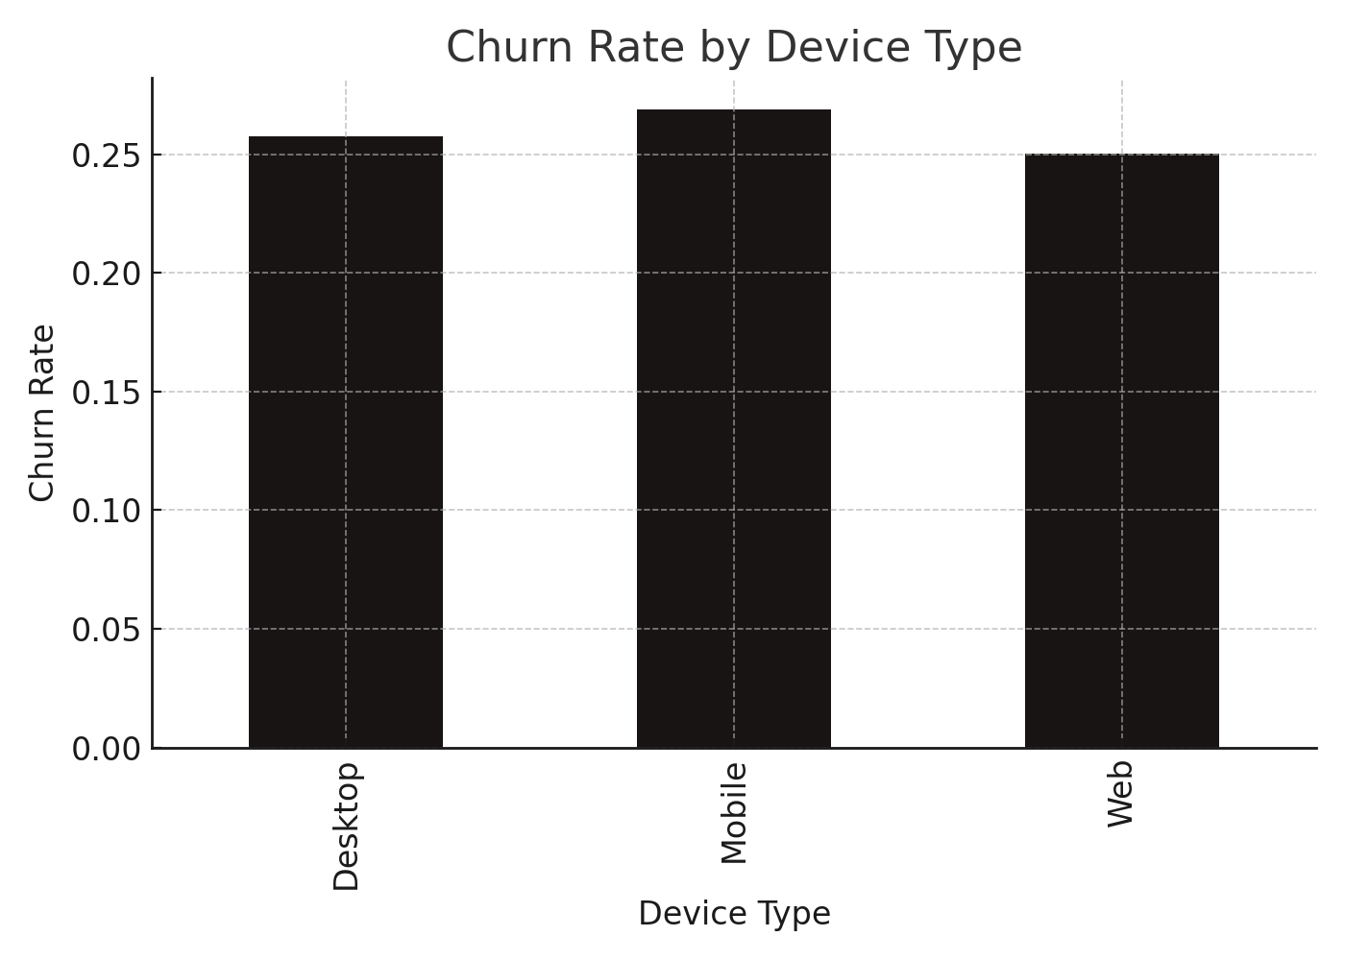
Churn by Device Type
Users on desktop/web show slightly higher churn compared to mobile users, suggesting mobility aids retention.

Slide 7
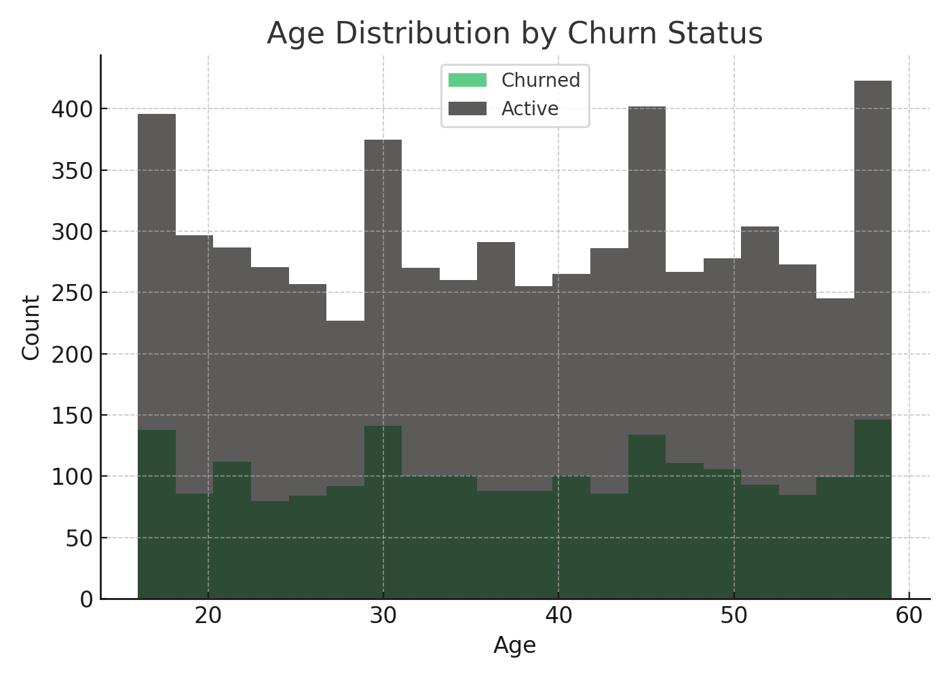
Age Distribution by Churn Status
Younger users (18–25) churn more often, while older age groups show steadier retention.

Slide 8
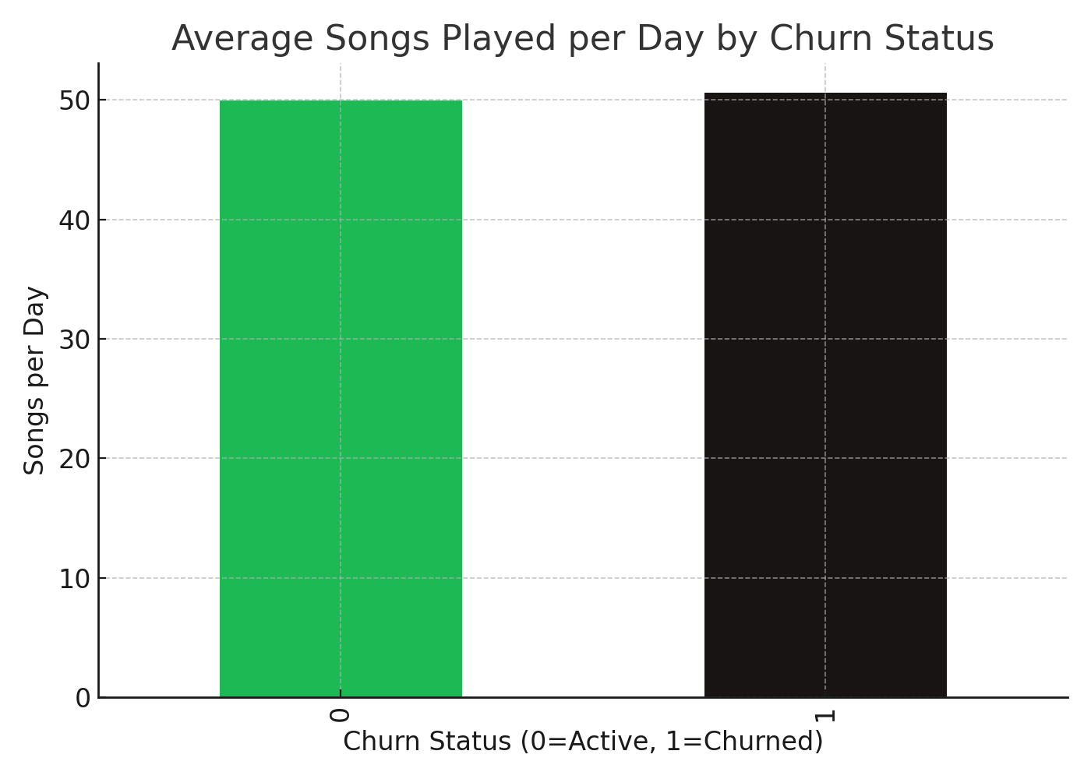
Listening Behavior and Churn
Active users listen to more songs per day, indicating stronger engagement compared to churned users.

Slide 9
Key Insights
• Free users are most likely to churn. • Mobile usage correlates with lower churn. • Younger age groups (18–25) have higher churn rates. • Higher engagement (songs/day, offline listening) reduces churn.

Slide 10
Conclusion & Recommendations
• Focus retention campaigns on Free and Student users. • Promote mobile engagement features. • Target young users with personalized offers. • Encourage higher listening activity with playlists & offline access.

Slide 11
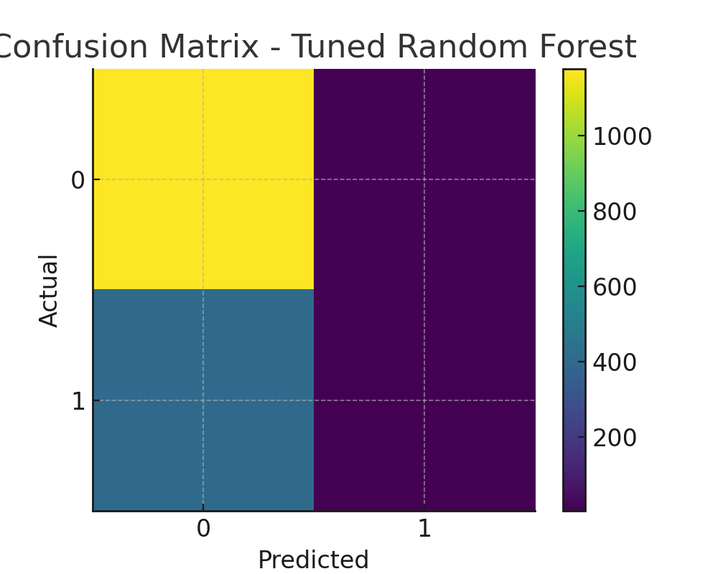
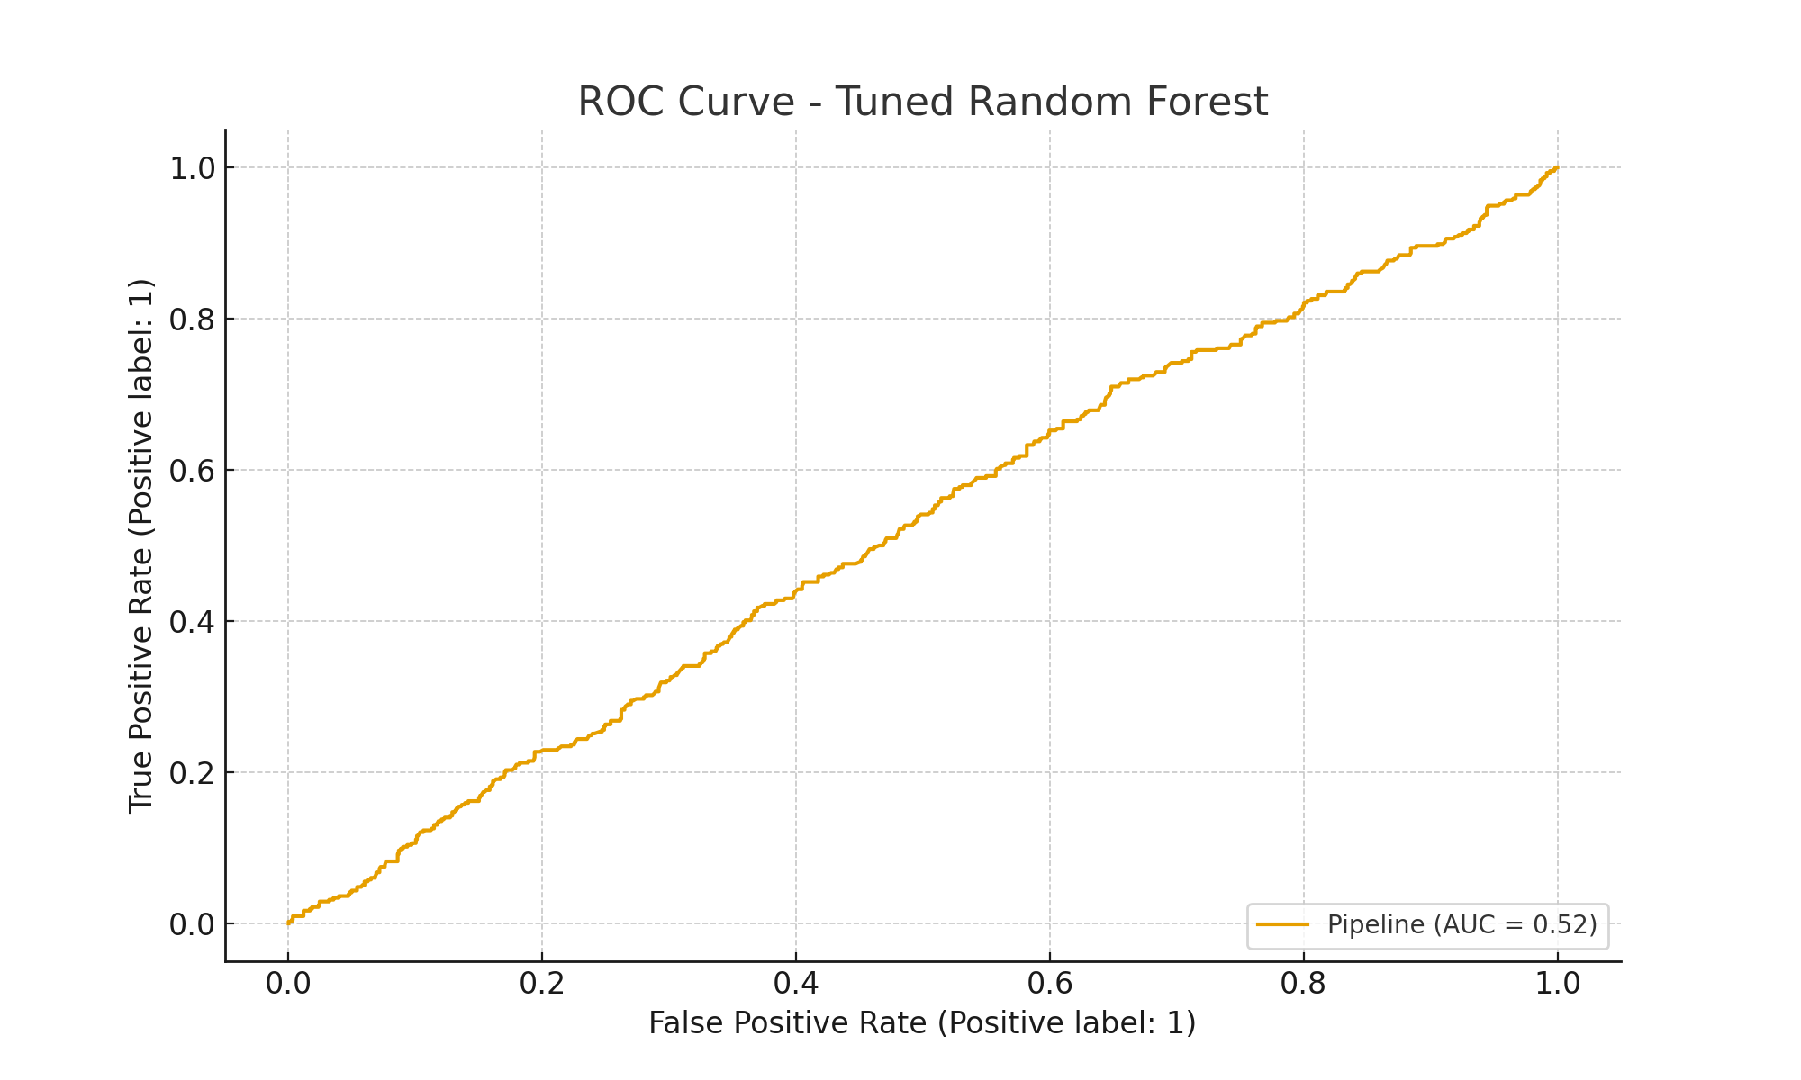
Tuned Random Forest - Test Performance
Tuned RF test metrics: accuracy=0.738, precision=0.308, recall=0.010, f1=0.019, roc_auc=0.522
Best CV f1 (during tuning) ~ 0.017
Best params: {'clf__max_depth': None, 'clf__min_samples_leaf': 1, 'clf__min_samples_split': 3, 'clf__n_estimators': 124}

Slide 12
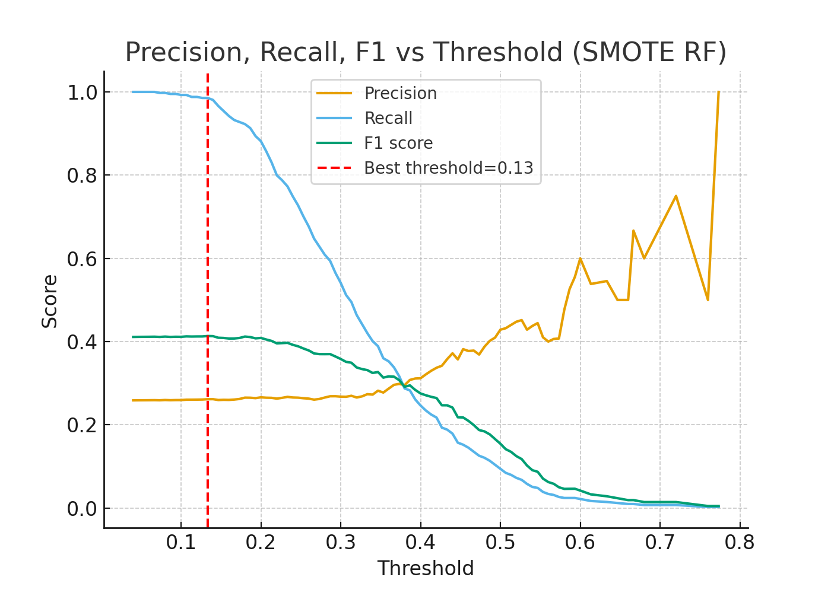
Threshold Tuning (SMOTE RF)
Best threshold: ~0.13
Accuracy: 0.276
Precision: 0.262
Recall: 0.986
F1: 0.413
ROC AUC: 0.532

Slide 13
Project Overview
• Objective: Predict Spotify user churn and identify key risk factors
• Dataset: User demographics, subscription, device, listening behavior, churn status
• Methods: EDA, feature engineering, multiple ML models
• Imbalance Handling: Applied SMOTE oversampling and class weighting
• Threshold Tuning: Improved recall to ~99%, F1 score significantly higher
• Key Insights: Free users, low engagement, and mobile-only users are most likely to churn

Slide 14
Conclusion & Recommendations
• Free-tier users and low engagement listeners are the most at risk of churn
• Random Forest with SMOTE and threshold tuning achieved high recall (~99%)
• Accuracy dropped, but recall is more critical for churn detection
• Business can use this model to flag at-risk users early
• Recommended actions: personalized offers, discounts, and engagement campaigns
• Future work: try advanced models (XGBoost), add recency/session features, and use SHAP for interpretability

